Slide 1
More on Construction and Compactness: Compact Conditional Distributions
Once we have established the topology of a Bnet, we still need to specify the conditional probabilities
How?
From Data
From Experts
To facilitate acquisition, we aim for compact representations for which data/experts can provide accurate assessments
Notes:
Reduce to 8,254

Slide 2
More on Construction and Compactness: Compact Conditional Distributions
From JointPD to
But still, CPT grows exponentially with number of parents
In realistic model of internal medicine with 448 nodes and 906 links 133,931,430 values are required!
And often there are no data/experts for accurate assessment
Notes:
Reduce to 8,254

Slide 3
Effect with multiple non-interacting causes
What do we need to specify?
Malaria
Flu
Cold
Malaria | Flu | Cold | P(Fever=T | ..) | P(Fever=F|..)
T | T | T
T | T | F
T | F | T
T | F | F
F | T | T
F | T | F
F | F | T
F | F | F
Fever
What do you think data/experts could easily tell you?
More difficult to get info to assess more complex conditioning….

Slide 4
Solution: Noisy-OR Distributions
Models multiple non interacting causes
Logic OR with a probabilistic twist.
Logic OR Conditional Prob. Table.
Malaria | Flu | Cold | P(Fever=T | ..) | P(Fever=F|..)
T | T | T
T | T | F
T | F | T
T | F | F
F | T | T
F | T | F
F | F | T
F | F | F

Slide 5
Solution: Noisy-OR Distributions
The Noisy-OR model allows for uncertainty in the ability of each cause to generate the effect (e.g.. one may have a cold without a fever)
Malaria | Flu | Cold | P(Fever=T | ..) | P(Fever=F|..)
T | T | T
T | T | F
T | F | T
T | F | F
F | T | T
F | T | F
F | F | T
F | F | F
Two assumptions
All possible causes a listed
For each of the causes, whatever inhibits it to generate the target effect is independent from the inhibitors of the other causes

Slide 6
Noisy-OR: Derivations
C₁
C_{k}
Effect
For each of the causes, whatever inhibits it to generate the target effect is independent from the inhibitors of the other causes
Independent Probability of failure q_{i} for each cause alone:
P(Effect=F | C_{i} = T, and no other causes) = q_{i}
P(Effect=F | C₁ = T,.. C_{j} = T, C_{j+1} = F,., C_{k} = F)=
P(Effect=T | C₁ = T,.. C_{j} = T, C_{j+1} = F,., C_{k} = F) =

Slide 7
Noisy-OR: Example
Model of internal medicine
133,931,430 → 8,254
P(Fever=F| Cold=T, Flu=F, Malaria=F) = 0.6
P(Fever=F| Cold=F, Flu=T, Malaria=F) = 0.2
P(Fever=F| Cold=F, Flu=F, Malaria=T) = 0.1
P(Effect=F | C₁ = T,.. C_{j} = T, C_{j+1} = F,., C_{k} = F)= ∏^{j}_{i=1} q_{i}
Malaria | Flu | Cold | P(Fever=T | ..) | P(Fever=F|..)
T | T | T |  | 0.1 x 0.2 x 0.6 = 0.012
T | T | F |  | 0.2 x 0.1 = 0.02
T | F | T |  | 0.6 x 0.1=0.06
T | F | F | 0.9 | 0.1
F | T | T |  | 0.2 x 0.6 = 0.12
F | T | F | 0.8 | 0.2
F | F | T | 0.4 | 0.6
F | F | F |  | 1.0
Number of probabilities linear in …..

Slide 8
Bayesian Networks: Sampling Algorithms for Approximate Inference

Slide 9
From Last Class
Inference in Bayesian Networks
In worst case scenario (e.g. fully connected network) exact inference is NP-hard
However space/time complexity is very sensitive to topology
In singly connected graphs (single path from any two nodes), time complexity of exact inference is polynomial in the number of nodes
If things are bad, one can resort to algorithms for approximate inference
This week, we will look at a class of such algorithms known as direct sampling methods

Slide 10
Overview
Sampling algorithms: background
What is sampling
How to do it: generating samples from a distribution
Sampling in Bayesian networks
Forward sampling
Why does sampling work
Two more sampling algorithms
Rejection Sampling
Likelihood Weighting
Case study from the Andes project

Slide 11
Overview
Sampling algorithms: background
What is sampling
How to do it: generating samples from a distribution
Sampling in Bayesian networks
Forward sampling
Why does sampling work
Two more sampling algorithms
Rejection Sampling
Likelihood Weighting
Case study from the Andes project

Slide 12
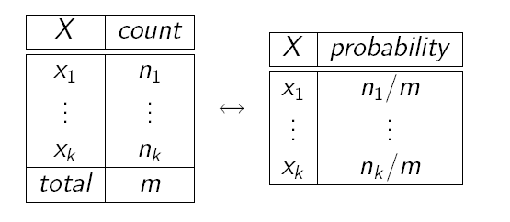
Sampling: What is it?
Idea: Estimate probabilities from sample data (samples) of the (unknown) probabilities distribution
Use frequency of each event in the sample data to approximate its probability
Frequencies are good approximations only if based on large samples
we will see why and what “large” means
How do we get the samples?

Slide 13
We use Sampling
Sampling is a process to obtain samples adequate to estimate an unknown probability
The samples are generated from a probability distribution
P(x₁)
P(x_{n})
We will see how to approximate this process

Slide 14
Sampling
The building block on any sampling algorithm is the generation of samples from a know distribution
We then use these samples to derive estimates of hard-to-compute probabilities

Slide 15
Overview
Sampling algorithms: background
What is sampling
How to do it: generating samples from a distribution
Sampling in Bayesian networks
Forward sampling
Why does sampling work
Two more sampling algorithms
Rejection Sampling
Likelihood Weighting
Case study from the Andes project

Slide 16
Sampling from a distribution
Consider a random variable Lecture with
3 values: <good, bad, soso>
with probabilities 0.7, 0.1 and 0.2 respectively.
A sampler for this distribution is a (randomised) algorithm which outputs values for Lecture (samples) with probability defined by the original distribution:
good with probability 0.7,
bad with probability 0.1
soso with probability 0.2.
If we draw a large number of samples from this sampler, then the relative frequency of each value in the sample will be close to its probability
e.g., frequency of good will be close to 0.7

Slide 17
Sampling: how to do it?
Suppose we have a ‘random number’ generator which outputs numbers in (0, 1] according to a uniform distribution over that interval.
Then we can sample a value for Lecture by seeing which of these intervals the random number falls in:
(0, 0.7], (0.7, 0.8] or (0.8, 1]
Why?

Slide 18
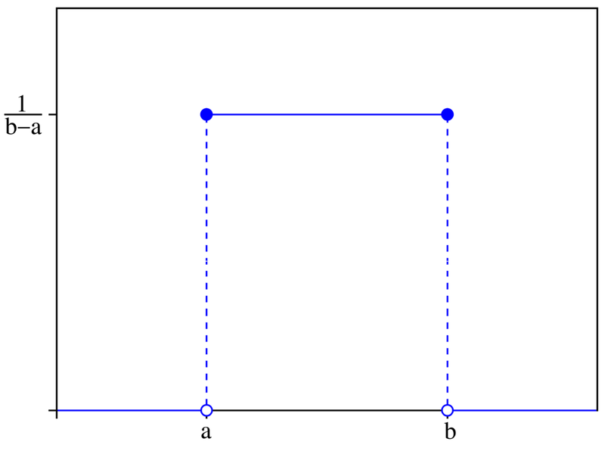
Uniform Distribution and Sampling
A random variable X with continuous values uniformly distributed over interval [a,b] is defined by the following Probability Density Function
When selecting numbers from a uniform distribution over interval [0,1], the probability that each number will fall in a given interval (x1,x2] is
P(x1< x <= x2) = x2 – x1 (length of the interval)
This is exactly what we want for sampling

Slide 19
Uniform Distribution and Sampling
Back to our example on the random variable Lecture with
3 values <good, bad, soso>
with probabilities 0.7, 0.1 and 0.2 respectively.
We can have a sampler for this distribution by:
Using a random number generator that outputs numbers over (0, 1]: it does so according to a uniform distribution
Partition (0,1] into 3 intervals corresponding to the probabilities of the three Lecture values: (0, 0.7], (0.7, 0.8] and (0.8, 1]):
To obtain a sample, generate a random number n and pick the value for Lecture based on which interval n falls into:
P (0 < n ≤ 0.7) = 0.7 = P(Lecture = good)
P (0.7 < n ≤ 0.8) = 0.1 = P(Lecture = bad)
P (0.8 < n ≤ 1) = 0.2 = P(Lecture = soso)

Slide 20
Lecture Example
Random n‏
sample
0.3
good
0.1
good
0.73
bad
0.87
soso
0.2
good
0.5
good
0.9
soso
If we generate enough samples, the frequencies of the three values will get close to their probability

Slide 21
Generating Samples from a Distribution
For a random variable X with
values {x₁,…,x_{k}}
Probability distribution P(X) = {P(x₁),…,P(x_{k})}
Partition the interval (0, 1] into k intervals p_{i} , one for each x_{i} , with length P(x_{i} )
To generate one sample
Randomly generate a value y in (0, 1] (i.e. generate a value from a uniform distribution over (0, 1].
Select the value of the sample based on the interval p_{i} that includes y
From probability theory:

Slide 22
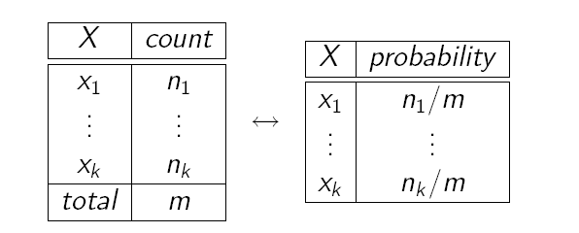
Samples as Probabilities
Count total number of samples m
Count the number n_{i} of samples x_{i}
Generate the frequency of sample x_{i} as n_{i} / m
This frequency is your estimated probability of x_{i}

Slide 23
Overview
Sampling algorithms: background
What is sampling
How to do it: generating samples from a distribution
Sampling in Bayesian networks
Forward sampling
Why does sampling work
Two more sampling algorithms
Rejection Sampling
Likelihood Weighting
Case study from the Andes project

Slide 24
Sampling for Bayesian Networks
OK, but how can we use all this for probabilistic inference in Bayesian networks?
As we said earlier, if we can’t use exact algorithms to update the network, we need to resort to samples and frequencies to compute the probabilities we are interested in
We generate these samples by relying on the mechanism we just described

Slide 25
Sampling for Bayesian Networks (N)
Suppose we have the following BN with two binary variables
A
P(A=1)‏
0.3
A
P(B=1|A)‏
B
1
0
0.7
0.1
It corresponds to the joint probability distribution
P(A,B) =P(B|A)P(A)
To sample from this distribution
we first sample from P(A). Suppose we get A = 0.
In this case, we then sample from P(B|A = 0).
If we had sampled A = 1, then in the second step we would have sampled from P(B|A = 1).

Slide 26
Sampling in Bayesian Networks
A
P(A=1)‏
0.3
B
A
P(B=1|A)‏
1
0
0.7
0.1
How to sample from P(A)?
How to sample from P(B|A = 0)?
How to sample from P(B|A = 1)?

Slide 27
Sampling in Bayesian Networks
A
P(A=1)‏
0.3
A
P(B=1|A)‏
B
1
0
0.7
0.1
How to sample from P(A)? Draw from uniform distribution and
Select A = 1 if n in (0,0.3]
Select A = 0 if n in (0.3, 1]
How to sample from P(B|A = 0)? Draw from uniform distribution and
Select B = 1 if n in (0, 0.1]
Select B = 0 if n in (0.1, 1]
How to sample from P(B|A = 1)? Draw from uniform distribution and
Select B = 1 if n in (0, 0.7]
Select B = 0 if n in (0.7, 1]

Slide 28
Overview
Sampling algorithms: background
What is sampling
How to do it: generating samples from a distribution
Sampling in Bayesian networks
Forward sampling
Why does sampling work
Two more sampling algorithms
Rejection Sampling
Likelihood Weighting
Case study from the Andes project

Slide 29
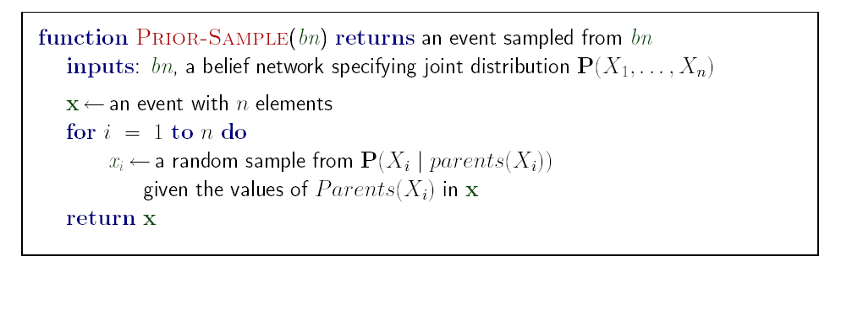
Forward Sampling
In a BN
we can order parents before children (topological order) and
we have CPTs available.
If no variables are instantiated (i.e., there is no evidence), this allows a simple algorithm: forward sampling.
Just sample variables in some fixed topological order, using the previously sampled values of the parents to select the correct distribution to sample from.

Slide 30
Example
Random => 0.4
Sample=>
Cloudy
P(C=T)‏
0.5
C
P(S=T |C)‏
Rain
Sprinkler
T
F
0.1
0.5
C
P(R=T|C)‏
Random => 0.8
Sample=>
T
F
0.8
0.2
Wet Grass
Random => 0.4
Sample=>
S
R
P(W=T|S,R)‏
T
T
0.99
T
F
0.9
F
T
0.9
Random => 0.7
Sample=>
F
F
0.1

Slide 31
Example
Random => 0.4
Sample=> Cloudy=T
Cloudy
P(C=T)‏
0.5
C
P(S=T|C)‏
0.1
0.5
Sprinkler
Rain
T
F
C
P(R=T|C)‏
Random => 0.8
Sample=> Sprinkler =F
T
F
0.8
0.2
Wet Grass
S
R
P(W=T|S,R)‏
Random => 0.4
Sample=> Rain = T
T
T
0.99
T
F
0.9
F
T
0.9
Random => 0.7
Sample=> Wet Grass = T
F
F
0.1

Slide 32
Example
sample #
Cloudy
Sprinkler
Rain
Wet Grass
1
T
F
T
T
2
3
........
n
We generate as many samples as we can afford
Then we can use them to compute the probability of any partially specified event,
e.g. the probability of Rain = T in my Sprinkler network
by computing the frequency of that event in the sample set
So, if we generate 1000 samples from the Sprinkler network, and 511 of then have Rain = T, then the estimated probability of rain is

Slide 33
Why Forward Sampling Works
This algorithm generates samples from the prior joint distribution represented by the network.
Let S_{PS}(x₁,…,x_{n}) be the probability that a specific event (x₁,…,x_{n}) is generated by the algorithm (or sampling probability of the event).
Just by looking at the sampling process, we have
S_{PS}(x₁,…,x_{n}) =
Because each sampling step depends only on the parent value
But this is also the probability of event (x₁,…,x_{n}) according to the BN representation of the JPD
So: S_{PS}(x₁,…,x_{n}) = P (x₁,…,x_{n}) and
S(cloudy, ⌐sprinkler, rain, wet-grass)
= P(cloudy)P(⌐sprinkler|cloudy)P(rain|cloudy)P(wet-grass| ⌐sprinkler, rain) =
= P(cloudy, ⌐sprinkler, rain, wet-grass)
= 0.5 x 0.9 x 0.8 x 0.9 = 0.324
We use lower case names as short for P(Variable = T/F)

Slide 34
Forward Sampling
This algorithm generates samples from the prior joint distribution represented by the network.
Let S_{PS}(x₁,…,x_{n}) be the probability that a specific event (x₁,…,x_{n}) is generated by the algorithm (or sampling probability of the event).
Just by looking at the sampling process, we have
Because each sampling step depends only on the parent value
But this is also the probability of event (x₁,…,x_{n}) according to the BN representation of the JPD
So: S_{PS}(x₁,…,x_{n}) = P (x₁,…,x_{n}) and
S(cloudy, ⌐sprinkler, rain, wet-grass)
= P(cloudy)P(⌐sprinkler|cloudy)P(rain|cloudy)P(wet-grass| ⌐sprinkler, rain) =
= P(cloudy, ⌐sprinkler, rain, wet-grass)
= 0.5 x 0.9 x 0.8 x 0.9 = 0.324

Slide 35
Forward Sampling
Because of this result, we can answer any query on the distribution for X₁,…,X_{n} represented by our Bnet using the samples generated with Prior-Sample(Bnet)‏
Let N be the total number of samples generated, and N_{PS}(x₁,…,x_{n}) be the number of samples generated for event x₁,…,x_{n}
We expect the frequency of a given event to converge to its expected value, according to its sampling probability
That is, event frequency in a sample set generated via forward sampling is a consistent estimate of that event’s probability
Given (cloudy, ⌐sprinkler, rain, wet-grass), with sampling probability 0.324 we expect, for large samples, to see 32% of them to correspond to this event

Slide 36
Forward Sampling
Thus, we can compute the probability of any partially specified event, (x₁,…,x_{m}) with m < n
e.g. the probability of rain in my Sprinkler world
by computing the frequency in the sample of the events that have x₁,…,x_{m} and use that as an estimate of P (x₁,…,x_{m} )‏
P (x₁,…,x_{m} ) = N_{PS}(x₁,…,x_{m})/ N

Slide 37
Overview
Sampling algorithms: background
What is sampling
How to do it: generating samples from a distribution
Sampling in Bayesian networks
Forward sampling
Why does sampling work
Two more sampling algorithms
Rejection Sampling
Likelihood Weighting
Case study from the Andes project

Slide 38
Sampling: why does it work?
Because of the Law of Large Numbers (LLN)
Theorem in probability that describes the long-term stability of a random variable.
Given repeated, independent trials with the same probability p of success in each trial,
the percentage of successes approaches p as the number of trials approaches ∞
Example: tossing a coin a large number of times, where the probability of heads on any toss is p.
Let S_{n} be the number of heads that come up after n tosses.

Slide 39
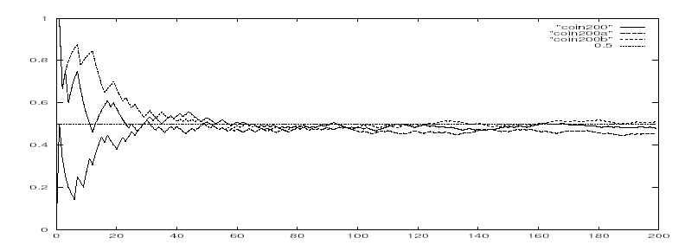
Simulating Coin Tosses
Here’s a graph of S_{n}/n against p for three different sequences of simulated coin tosses, each of length 200.
Remember that P(head) = 0.5

Slide 40
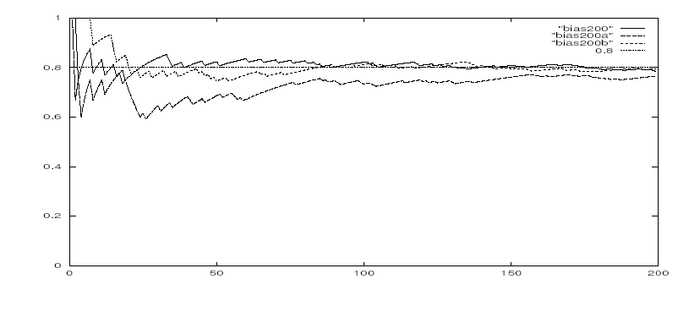
Simulating Tosses with a Bias Coin
Let's change P(head) = 0.8
http://socr.ucla.edu/htmls/SOCR_Experiments.html

Slide 41
Simulating Coin Tosses
http://socr.ucla.edu/htmls/SOCR_Experiments.html
You can run simulations with different values of P(head) and number of samples, and see the graph of of S_{n}/n against p
Select “Coin Toss LLN Experiment” under “Simulations and Experiments”

Slide 42
Sampling: why does it work?
The LLN is important because it "guarantees" stable long-term results for random events.
However, it is important to remember that the LLN only applies (as the name indicates) when a large number of observations are considered.
There is no principle ensuring that a small number of observations will converge to the expected value or that a streak of one value will immediately be "balanced" by the others.
But how many samples are enough?

Slide 43
End here

Slide 44
Hoeffding’s inequality
Suppose p is the true probability and s is the sample average from n independent samples.
p above can be the probability of any event for random variable X = {X₁,…X_{n}} described by a Bayesian network
If you want an infinitely small probability of having an error greater than ε, you need infinitely many samples
But if you settle on something less than infinitely small, let’s say δ, then you just need to set
So you pick
the error ε you can tolerate,
the frequency δ with which you can tolerate it
And solve for n, i.e., the number of samples that can ensure this performance
(1)‏

Slide 45
Hoeffding’s inequality
Examples:
You can tolerate an error greater than 0.1 only in 5% of your cases
Set ε =0.1, δ = 0.05
Equation (1) gives you n > 184
If you can tolerate the same error (0.1) only in 1% of the cases, then you need 265 samples
If you want an error of 0.01 in no more than 5% of the cases, you need 18,445 samples

Slide 46
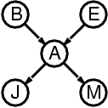
Sampling: What is it?
From existing data?
This is feasible sometime (e.g., to estimate P(A | E) in Alarm network)
Not feasible to estimate complex events, such as
P(e| m ∧ ¬b ∧ ¬j) = P(e ∧ m ∧ ¬b ∧ ¬j) / P(m ∧ ¬b ∧ ¬j)
To estimate P(e ∧ m ∧ ¬b ∧ ¬j), I need a large number of sample events from the Alarm world, to look at the frequency of events with target combination of values < e ∧ m ∧ ¬b ∧ ¬j>
But isn’t P(e| m ∧ ¬b ∧ ¬j) something that the Bnet is supposed to give me?
Yes, because the exact algorithms for Bayesian update work on this network
When they don’t, because the network is too complex, we need to resort to approximations based on frequencies of samples
So, again, how do we get the samples?

Slide 47
Probability Density Function
Probability Density Function f(x)‏ : defines the probability distribution for a random variable with continuous values
Properties:
f(x) is greater than or equal to zero for all values of x
The total area under the graph is 1:
Notes:
Covered this in 2008, but decided to remove in 2009

Slide 48
Cumulative Distribution Function
The probability density function cannot be used to define the probability of a specific value, (e.g., P(X = 2.00023))‏
This does not make sense with an infinite set of values
However, it can be used to define the probability that X falls in a given interval, or Cumulative Distribution Function F(), as follows
That is, the probability that X ≤ x is the area under the curve f(x) between -∞ and x
Notes:
Covered this in 2008, but decided to remove in 2009

Slide 49
Cumulative Distribution for Uniform Distribution
Probability Density Function for uniform distribution over interval [a,b]

Slide 50
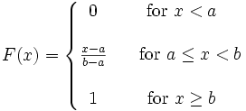
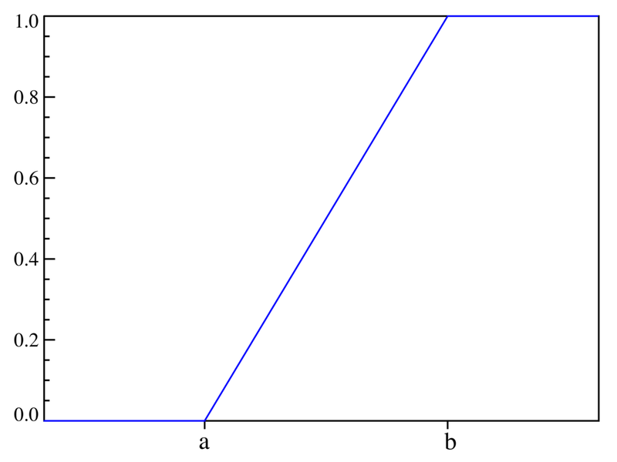
Cumulative Distribution Function
Cumulative Distribution Function for uniform distribution over interval [a,b]
x ≤ a
a < x < b
x ≥ b
Notes:
Covered this in 2008, but decided to remove in 2009

Slide 51
Cumulative Distribution Function
Cumulative Distribution Function for uniform distribution over interval [0,1]
x ≤ 0
0
x
0
0 < x < 1
1
1
x ≥ 1
1
0
1
P(a < X ≤ b] = F(b) – F(a) = b - a
Notes:
Covered this in 2008, but decided to remove in 2009

