Slide 1
Ontologies
and
Knowledge-based Systems

Slide 2
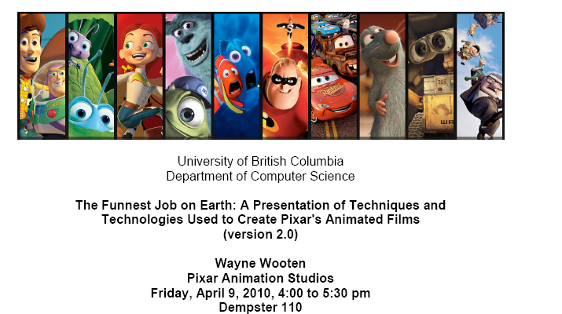
Announcement

Slide 3
Announcement
Next Tuesday we’ll have a discussion-based class
Check whether you can access the paper
Remember to send questions by 9am that morning (to both me and Hajir) and bring printouts to class

Slide 4
Pros of Semantic Networks
Very intuitive representation, easy for humans to understand
Capture inheritance information in a modular way
Efficient computation for property inheritance

Slide 5
Cons
In their basic form, Semantic Networks have limited expressiveness
No negation, no disjunction. Can’t express facts like
a term1-course does not have reading week
a cs-course is taught either in ICICS-CS or DMPS
Can’t express relations among classes, other than SubClassOf
A person has a mother who is a female person
Essentially, can only define classes as conjunctions of properties
A term-2 course is a cs-course, lasts 12 weeks and has final in april

Slide 6
Description Logics
Extensions of Semantic Networks designed to make it easier to describe definitions and properties of classes
Principal inference tasks
Subsumption: checking if one class is a subset of another
Classification : whether an object belongs to a class
by comparing corresponding definitions

Slide 7
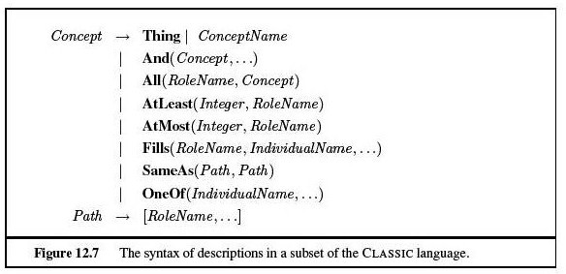
Example From Classic
Role name => Attribute in Semantic nets
ConceptName => Class in Semantic nets
IndividualName => Instance in Sem. nets
Describe the class of men with
at least 3 sons who are unemployed and married to doctors, and
At most 2 daughters who are professors in physics or math departments

Slide 8
Example From Classic
Describe the class of men with
at least 3 sons who are unemployed and married to doctors, and
At most 2 daughters who are professors in physics or math departments
Any Classic sentence can be expressed in first-order logic, but some sentences (like the one above) are much more easily expressed in Classic or equivalent description logics

Slide 9
Description Logics
Subsumption and classification intractable in first-order-logic
Description logics strive to ensure that subsumption testing can be solved in polynomial time in the size of the descriptions
Tradeoff between expressiveness and tractability
Description Logics usually lack full negation and disjunction (expressible in first-order logic)
Classic allows for limited disjunction over explicitly enumerated individuals, (one of) not over full concept descriptions
Tractability achieved in practice (e.g. Classic) but worse-case run time still exponential

Slide 10
Why Do We Care?
Individual-attribute-value representation adopted to distribute machine-interpretable knowledge on the Web
Semantic Web
Beyond HTML pages that are to be understood by humans only
Languages and formalisms based on description logics that allow websites to also include information that can be processed by computer

Slide 11
Overview
Brief Review of Representation and Reasoning from 322
individual-attribute-value representation
semantic networks
primitive versus derived relations
property inheritance
Ontologies and the Semantic Web

Slide 12
Problems With The Web
Billions of diverse documents online -> problems in
Retrieving documents
Extracting relevant data from retrieved documents
Combining information from different sources to achieve a particular goal
INFORMATION OVERLOAD

Slide 13
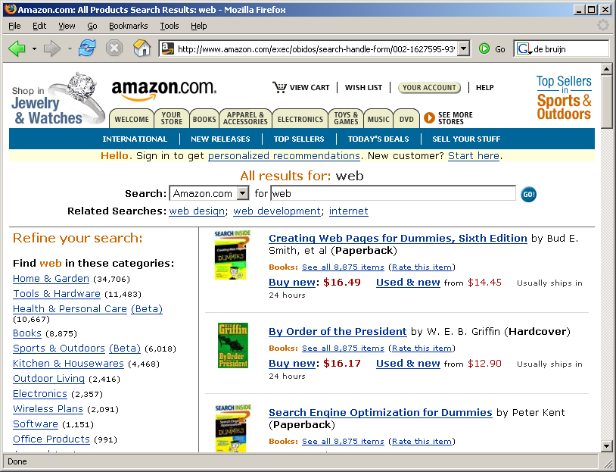
Extracting Data
Which book is about
the web?

Slide 14
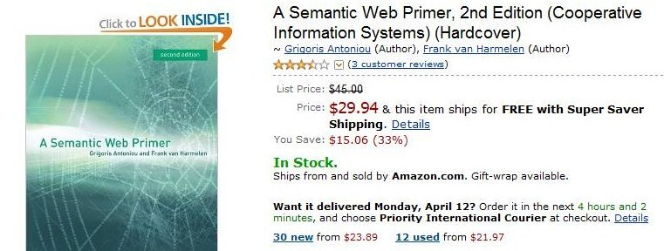
Extracting data
What is the Amazon price of the book: “A semantic web primer”?
Find the cheapest copy of “A semantic web primer”.
Find the cheapest copy taking into account shipping price
With webpages based on basic HTML, the human needs to scout for the information and integrate it
The computer does not understand “price”, “cheaper”, “shipping price”

Slide 15
Mashup sites
Some of the functionalities described earlier are provided by so called “mashup sites”
Sites that integrate and present informations from various sources
E.g., I am Caltrain uses Yahoo Maps, schedules from the California Railway company (Caltrain) and Flickr Photos to help you plan your rail travel in California.
But mashup sites do very ad-hoc computations
various data sources expose their data via Web Services
each with a different API, a different logic, different structure
No standard that regulates and unifies the communication among sites

Slide 16
Handy alternative
Software agents that can roam the web and carry out sophisticated tasks on our behalf.
Different than searching content for keywords and popularity. These agents need to
Infer meaning from content based on metadata and assertions that have already been made.
Automatically classify and integrate information through the help of suitable RRS
This is the vision behind the Semantic Web (aka "Web 3.0.“)

Slide 17
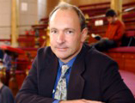
The Semantic Web
Vision for the future of the Web, a "Web of meaning" (i.e. semantics), that was set forth by Tim Berners-Lee. (often referred to as the father of the Web)
"The Semantic Web is not a separate Web but an extension of the current one, in which information is given well-defined meaning, better enabling computers and people to work in cooperation."
- Tim Berners-Lee, James Hendler and Ora Lassila; Scientific American, May 2001

Slide 18
The Semantic Web
A set of technologies (emerging set of standards, markup languages, and related processing tools) that allow publishing on the Web machine-processable data instead of natural language
A Web of meaning on which machine reasoning can become ubiquitous and powerful.
Publish information in terms understandable for a machine
Ask questions in terms understandable for a machine
And: make sure all machines understand your terms!

Slide 19
Semantic Web: Intelligent Data Integration and Processing
Map the various data onto an abstract data representation
make the data independent of its internal representation
Merge the resulting representations
Start making queries on the whole
queries that could not have been done on the individual data sets
We will see a simple example from a tutorial given at 2009 Semantic Technology Conference (San Jose, California, USA, June 15, 2009
http://www.w3.org/2009/Talks/0615-SanJose-tutorial-IH/
(check it out if you want to know more about the topics introduced here)

Slide 20
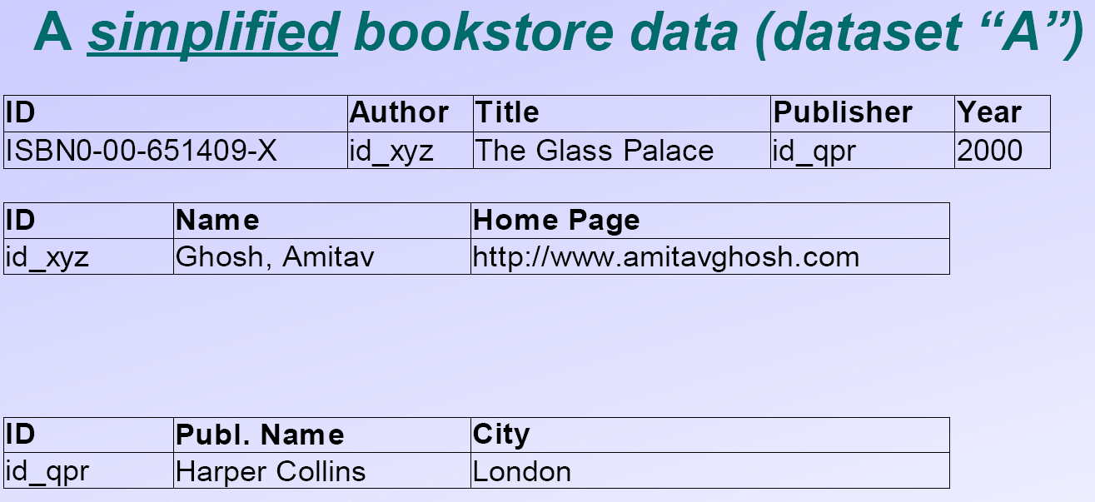
Example

Slide 21
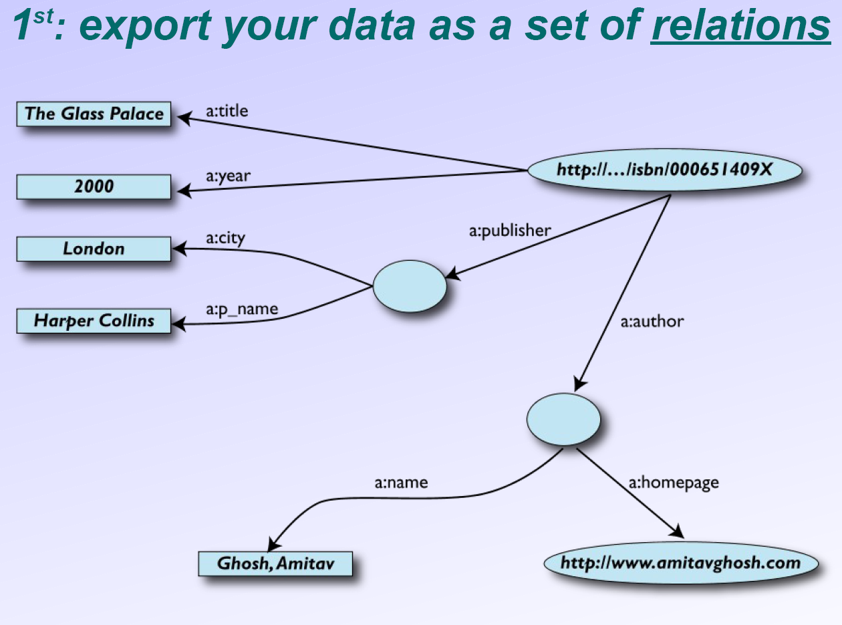
Nodes represents real data (e.g. a webpage) or some literal

Slide 22
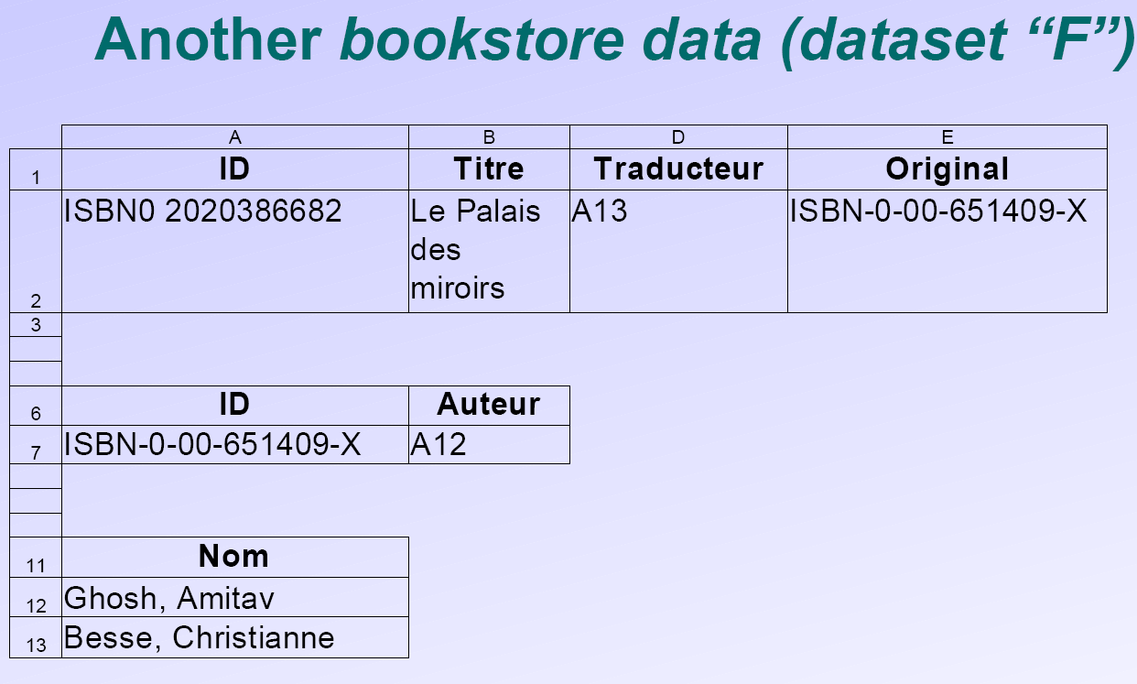

Slide 23
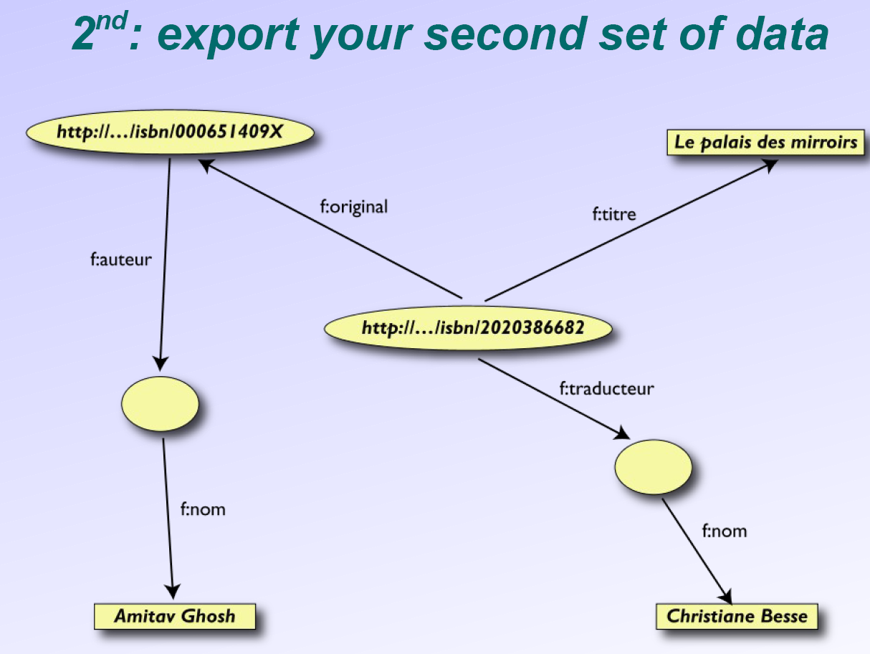

Slide 24
Same object

Slide 25
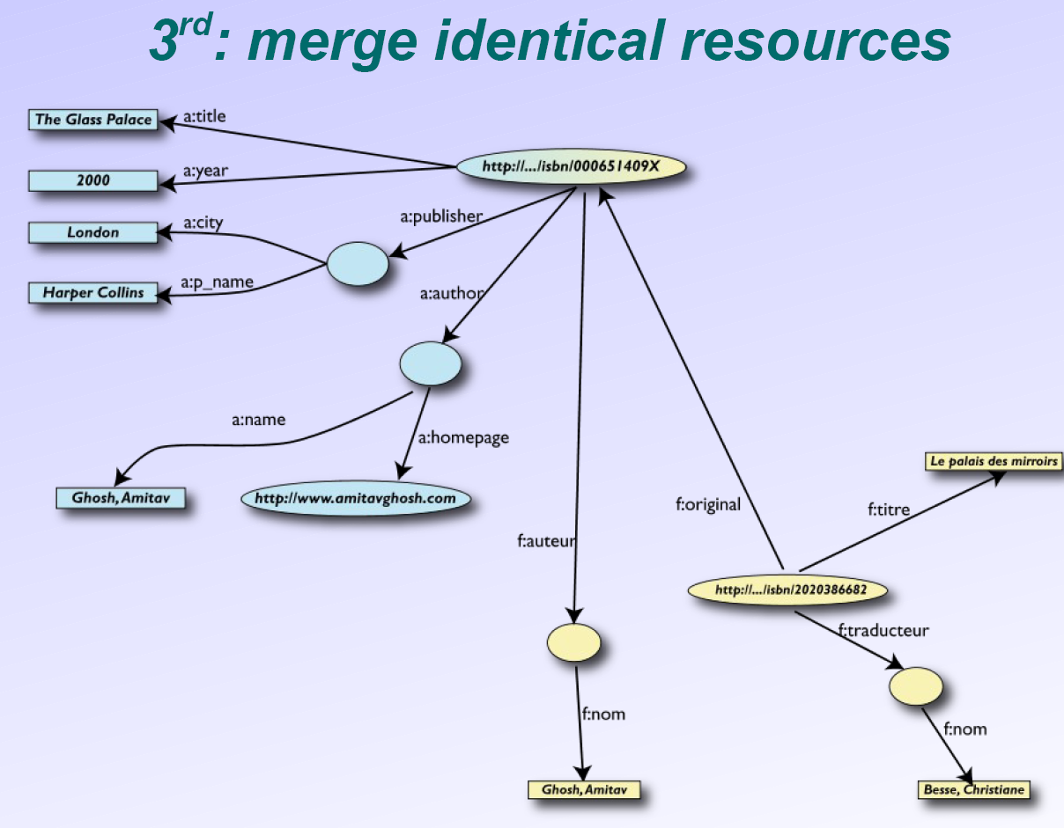
User of dataset “F” can now ask queries like:
• “give me the title of the original”
This information is not in the dataset “F”…
…but can be retrieved by merging with dataset “A”!

Slide 26
Some extra information
• a:author same as f:auteur
• both identify a Person, a term that a community
may have already defined:
identified by his/her name and, say, homepage
can be used as a “category” for certain type of
entities

Slide 27
User of dataset “F” can now query:
give me the home page of the original’s ‘auteur’
although the information is not in datasets “F” or “A”…

Slide 29
It could be even more powerful
We could add extra knowledge to the merged datasets
e.g., a full classification of various types of library data
information on translation techniques
etc.:
This is where more advanced representation and reasoning and technologies (e.g. ontologies, description logics) come into play
• Even more powerful queries can be asked as a result

Slide 30
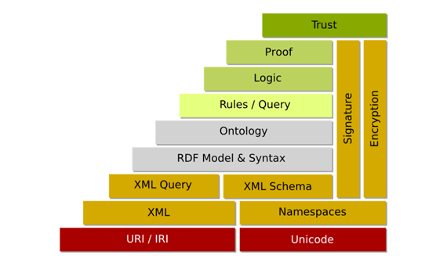
Enabling Technologies: Semantic Web layer cake
We can’t cover all the components (some don’t even exist yet), but we will focus on 3 that are key to this enterprise
: OWL
URI
Building one upon another, these technologies can help realize the full Semantic Web vision

Slide 31
URI
URI: Uniform Resource Identifier is a unique name (e.g. URL) that can be used to identify resources on the Web (individuals, classes, properties)
: OWL
URI

Slide 32
URIs

Slide 33
RDF
RDF: Resource Description Framework is a language to denote individual-property-value triples
: OWL
URI

Slide 34
RDF
An RDF Triple (subject, verb, object) is such that:
subject and verb are URI-s, i.e., resources on the Web;
object is a URI or a literal
here is a complete triple from our example:
RDF is a general model for such triples, implemented in various languages/sintaxes (RDF/XML, Turtle, N3, RXR, …)
The book uses Turtle

Slide 35
Namespaces can be defined to simplify URIs (see textbook)
Triples related to the same “object” can be combined

Slide 36
RDF defines the type and subClassOf properties we have seen in semantic networks -
- <http://www.w3.org/1999/02/22-rdf-syntax-ns#type>
- <http://www.w3.org/2000/01/rdf-schema#subClassOf>
Also allows specifying type/range of properties
Includes rules to implement property inheritance

Slide 37
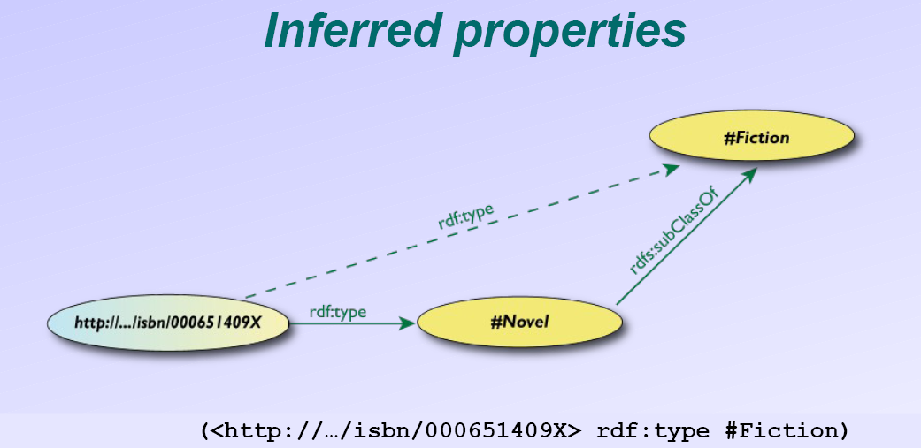
This triple was not in the original RDF data, but can be derived by RDF rules

Slide 39
OWL: Web Ontology Language
A powerful description logic that extends RDF by including, among other things
characterization of properties
construction of classes via set
operations or explicit descriptions
equivalence of individuals, classes,
objects
: OWL
URI

Slide 40
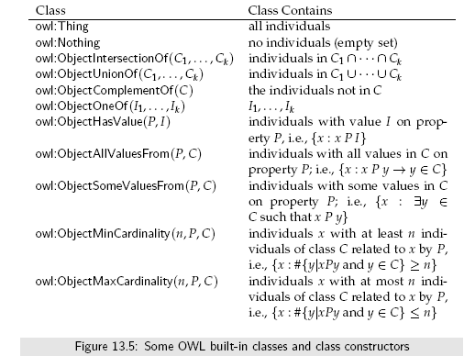
Owl Example

Slide 41
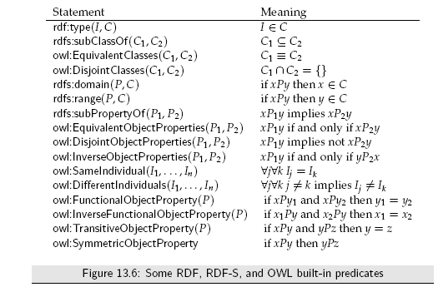
Owl Example

Slide 43
Ontologies
RDF and OWL are languages to define Ontologies
An Ontology in AI is a formal specification of the concepts and relationships used to describe and represent an area of knowledge
What sorts of objects are being modeled
The vocabulary for specifying objects, relations and properties
The meaning or intention of the relations or properties

Slide 44
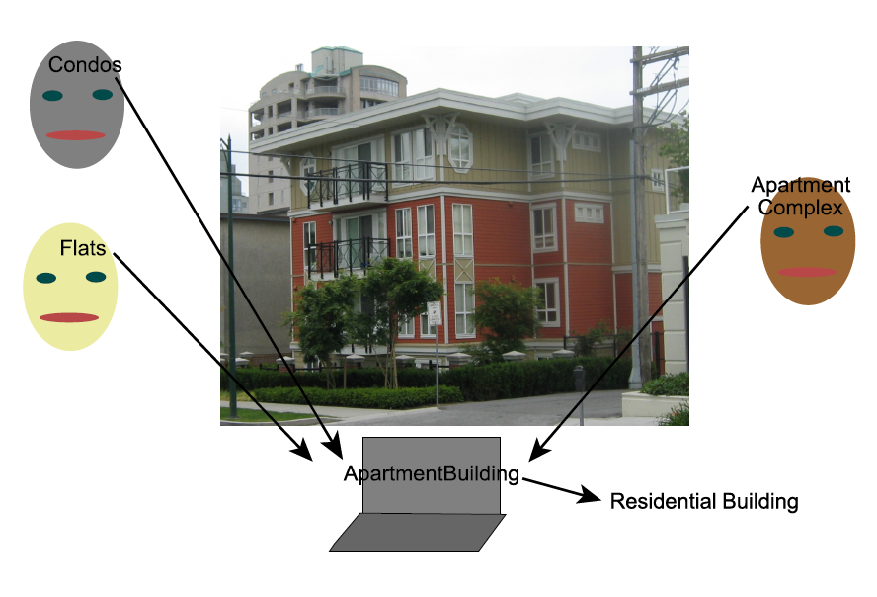
Ontologies
Given a concept, an ontology allows to find the symbol that represents it
Given a symbol, the ontology allows understanding what it
means.

Slide 45
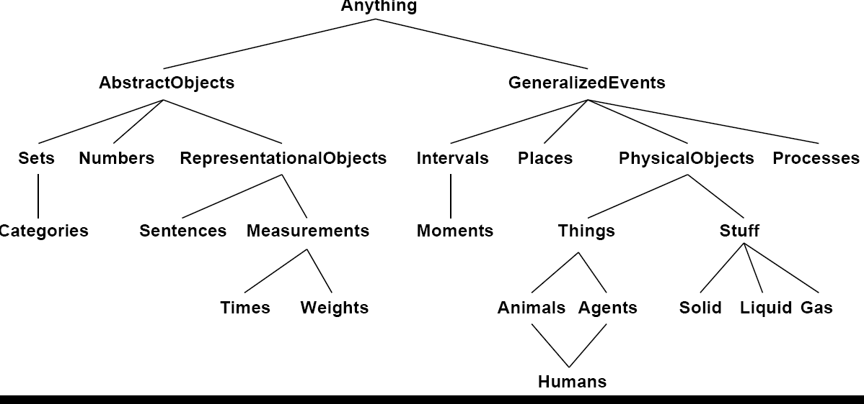
Ontologies
Can be targeted to a specific domain (domain Ontologies)
Or more high-level (Top-Level Ontologies)

Slide 46
Ontologies
Ontologies are published on the web in machine readable form (e.g. using OWL/RDF) and are publicly readable.
Builders of knowledge bases or web sites can adhere to and refer to a published ontology
the same symbol means the same thing across the various web sites that obey the ontology.
if someone wants to refer to some other object or relation, they publish the terminology with its intended interpretation.
Others adopt the new terminology by using it and referring to its source. In this way, ontologies grow.
Separately developed ontologies can have mappings between them published.
Very important that ontologies by shared and reused, because…

Slide 47
…Building new ontologies is hard!
Requires very good understanding of a domain
Large ontologies are often built by a community: people can fundamentally disagree about the appropriate structure
How one divides the world can depend on the application. Different ontologies describe the world in different ways..
To allow KBs based on different ontologies to inter-operate, there must be mapping between different ontologies.

Slide 48
Knowledge Sharing
One ontology typically imports and builds on other ontologies.
Tools for mapping one ontology to another to allow inter-operation of different knowledge bases.
The semantic web promises to allow you to find the right concept in a query if
the information adheres to some ontology
the query adheres to some ontology
these are the same ontology or there is a mapping between them.

Slide 49
Ontologies Examples
eClassOwl: eBusiness ontology for products and services, 75,000 classes and 5,500 properties
National Cancer Institute’s ontology: about 58,000 classes
Open Biomedical Ontologies Foundry: a collection of ontologies, including the Gene Ontology to describe
gene and gene product attributes in any organism or protein sequence
annotation terminology and data (UniProt)
OpenCyc project: a 150,000-concept ontology including
Top-level ontology similar to the one shown earlier
Many specific concepts such as “OLED display”, “iphone” and related classes/superclasses

Slide 50
Impact
Latest Oracle version includes an RDF store (system for storing and managing RDF data) and an OWL inference engine.
YAHOO e GOOGLE use RDF to improve their searches
Semantic Web Case Studies and Use Cases site (http://www.w3.org/2001/sw/sweo/public/UseCases/) reports
28 case studies: systems deployed within an organization, and used within a production environment.
14 use cases: examples where an organization has built a prototype system, but it is not currently being used by business functions.
There is a great and very active user and developer community
See for instance, the site of the Semantic Technology (SemTech) conference (http://semtech2010.semanticuniverse.com/)

Slide 51
However
99% of Web content is still in basic, HTML-like format
Use of sophisticated RDF and OWL not yet widespread, and the full Semantic Web vision not yet realized
Why?
Chichen-and-egg problem
Difficult/time consuming to publish structured data
Because not much structured data is available, applications are not being developed
Because there are not many applications available, it is not worth publishing structured data
Researchers are working on
“bootstrapping” the process by developing methods to automatically structure large amounts of existing data
Tools for facilitate manual Ontology construction

Slide 52
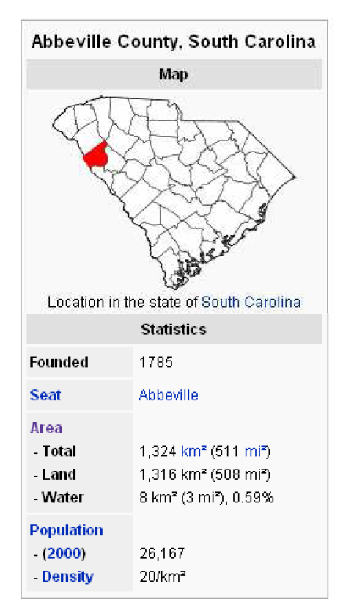
Examples
Dbpedia project: Extract structured data from Wikipedia
Uses existing infoboxes to learn how to extract/classify similar information
2.6 million concepts with ~100 facts per object
Protégé Ontology Editor
support the creation, visualization, and manipulation of ontologies in various representation formats.

