Slide 1
Reinforcement Learning

Slide 2
Overview
Introduction
Q-learning
Exploration Exploitation
Evaluating RL algorithms
On-Policy learning: SARSA
Model-based Q-learning

Slide 3
What Does Q-Learning learn
Does Q-learning gives the agent an optimal policy?

Slide 4
Q values
 | s₀ | s₁ | … | s_{k}
a₀ | Q[s₀,a₀] | Q[s₁,a₀] | …. | Q[s_{k},a₀]
a₁ | Q[s₀,a₁] | Q[s₁,a₁] | … | Q[s_{k},a₁]
… | … | … | …. | …
a_{n} | Q[s₀,a_{n}] | Q[s₁,a_{n}] | …. | Q[s_{k},a_{n}]

Slide 5
Exploration vs. Exploitation
Q-learning does not explicitly tell the agent what to do
just computes a Q-function Q[s,a] that allows the agent to see, for every state, which is the action with the highest expected reward
Given a Q-function, there are two things that the agent can do:
Exploit the knowledge accumulated so far, and chose the action that maximizes Q[s,a] in a given state (greedy behavior)
Explore new actions, hoping to improve its estimate of the optimal Q-function, i.e. *do not chose* the action suggested by the current Q[s,a]

Slide 6
Exploration vs. Exploitation
Q-learning does not explicitly tell the agent what to do
just computes a Q-function Q[s,a] that allows the agent to see, for every state, which is the action with the highest expected reward
Given a Q-function, there are two things that the agent can do:
Exploit the knowledge accumulated so far, and chose the action that maximizes Q[s,a] in a given state (greedy behavior)
Explore new actions, hoping to improve its estimate of the optimal Q-function, i.e. *do not chose* the action suggested by the current Q[s,a]
When to explore and when the exploit?
Never exploring may lead to being stuck in a suboptimal course of actions
Exploring too much is a waste of the knowledge accumulated via experience
Must find the right compromise

Slide 7
Exploration Strategies
Hard to come up with an optimal exploration policy (problem is widely studied in statistical decision theory)
But intuitively, any such strategy should be greedy in the limit of infinite exploration (GLIE), i.e.
Try each action an unbounded number of times, to avoid the possibility of missing an optimal action because of an unusually bad series of outcomes (we discussed this before)
choose the predicted best action when, in the limit, it has found the optimal value function/policy
We will look at two exploration strategies
ε-greedy
soft-max

Slide 8
ε-greedy
Choose a random action with probability ε and choose a best action with probability 1- ε
Eventually converges to an optimal policy because it ensures that the first GLIE condition (try every action an unbounded number of times) is satisfied via the ε random selection
But it is rather slow
It always chooses the non-optimal action with probability ε, while ideally you would want to explore more at the beginning and become greedier as estimates become more accurate
Fix: vary ε overtime

Slide 9
Soft-Max
Takes into account improvement in estimates of expected reward function Q[s,a]
Choose action a in state s with a probability proportional to current estimate of Q[s,a]
τ in the formula above influences how randomly values should be chosen
if τ is high, the exponentials approach 1, the fraction approaches 1/(number of actions), and each action has approximately the same probability of being chosen ( exploration or exploitation?)
as τ → 0, the exponential with the highest Q[s,a] dominates, and the current best action is always chosen (exploration or exploitation?)
As τ goes from 1 to 0, actions with higher Q[s,a] are more likely to be chosen

Slide 10
Overview
Introduction
Q-learning
Exploration vs. Exploitation
Evaluating RL algorithms
On-Policy Learning: SARSA
Model-based Q-learning

Slide 11
Evaluating RL Algorithms
Two possible measures
Quality of the optimal policy
Reward received while looking for the policy
If there is a lot of time for learning before the agent is deployed, then quality of the learned policy is the measure to consider
If the agent has to learn while being deployed, it may not get to the optimal policy for a along time
Reward received while learning is the measure to look at, e.g, plot cumulative reward as a function of number of steps
One algorithm dominates another if its plot is consistently above

Slide 12
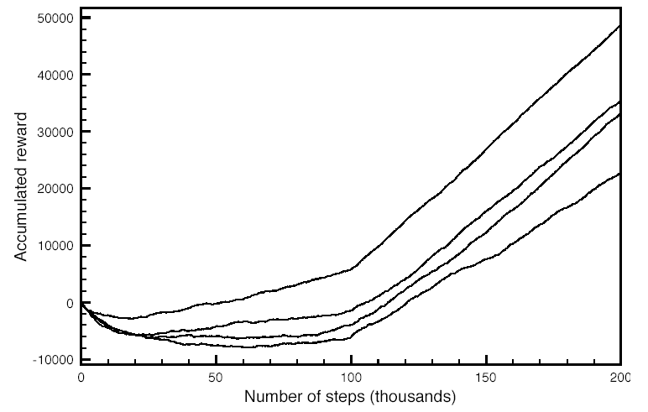
Evaluating RL Algorithms
Plots for example 11.8 in textbook (p. 464), with
Either fixed or variable α
Different initial values for Q[s,a]

Slide 13
Evaluating RL Algorithms
Lots of variability in each algorithm for different runs
for fair comparison, run each algorithm several times and report average behavior
Relevant statistics of the plot
Asymptotic slopes: how good the policy is after the algorithm stabilizes
Plot minimum: how much reward must be sacrificed before starting to gain (cost of learning)
zero-crossing: how long it takes for the algorithm to recuperate its cost of learning

Slide 14
Overview
Introduction
Q-learning
Exploration vs. Exploitation
Evaluating RL algorithms
On-Policy Learning: SARSA
Model-based Q-learning

Slide 15
Learning before vs. during deployment
As we saw earlier, there are two possible modus operandi for our learning agents
act in the environment to learn how it works:
first learn an optimal policy, then use this policy to act (there is a learning phase before deployment)
Learn as you go:
start operating in the environment right away and learn from actions (learning happens during deployment)
If there is time to learn before deployment, the agent should try to do its best to learn as much as possible about the environment
even engage in locally suboptimal behaviors, because this will guarantee reaching an optimal policy in the long run
If learning while “at work”, suboptimal behaviors could be costly

Slide 16
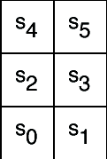
Example
-1
-1
Consider, for instance, our sample grid game:
the optimal policy is to go up in S₀
But if the agent includes some exploration in its policy (e.g. selects 20% of its actions randomly), exploring in S₂ could be dangerous because it may cause hitting the -100 wall
No big deal if the agent is not deployed yet, but not ideal otherwise
+ 10
-1
-100
-1
-1
-1
Q-learning would not detect this problem
It does off-policy learning, i.e., it focuses on the optimal policy
On-policy learning addresses this problem

Slide 17
On-policy learning: SARSA
On-policy learning learns the value of the policy being followed.
e.g., act greedily 80% of the time and act randomly 20% of the time
Better to be aware of the consequences of exploration has it happens, and avoid outcomes that are too costly while acting, rather than looking for the true optimal policy
SARSA
So called because it uses <state, action, reward, state, action> experiences rather than the <state, action, reward, state> used by Q-learning
Instead of looking for the best action at every step, it evaluates the actions suggested by the current policy
Uses this info to revise it

Slide 18
On-policy learning: SARSA
Given an experience <s,a,r,s’,a’>, SARSA updates Q[s,a] as follows
What’s different from Q-learning?

Slide 19
On-policy learning: SARSA
Given an experience <s ,a, r, s’, a’>, SARSA updates Q[s,a] as follows
While Q-learning was using
There is no more MAX operator in the equation, there is instead the Q-value of the action suggested by the policy

Slide 20
On-policy learning: SARSA
Does SARSA remind you of any other algorithm we have seen before?

Slide 21
Policy Iteration
Algorithm
π ← an arbitrary initial policy, U ← A vector of utility values, initially 0
2. Repeat until no change in π
Compute new utilities given π and current U (policy evaluation)
(b) Update π as if utilities were correct (policy improvement)
Expected value of following another action in s
Expected value of following current пi from s
Policy
Improvement
step

Slide 22
-1
-1
+ 10
-1
Q[s,a] | s₀ | s₁ | s₂ | s₃ | s₄ | s₅
upCareful | 0 | 0 | 0 | 0 | 0 | 0
Left | 0 | 0 | 0 | 0 | 0 | 0
Right | 0 | 0 | 0 | 0 | 0 | 0
Up | 0 | 0 | 0 | 0 | 0 | 0
-100
-1
k=1
k=1
-1
-1
Only immediate rewards
are included in the update,
as with Q-learning

Slide 23
-1
-1
+ 10
-1
-100
-1
Q[s,a] | s₀ | s₁ | s₂ | s₃ | s₄ | s₅
upCareful | 0 | -1 | 0 | -1 | 0 | 0
Left | 0 | 0 | 0 | 0 | 10 | 0
Right | 0 | 0 | 0 | 0 | 0 | 0
Up | 0 | 0 | 0 | 0 | 0 | 0
k=1
k=2
-1
-1
SARSA backs up the expected reward of the next action, rather than the max expected reward

Slide 24
Comparing SARSA and Q-learning
For the little 6-states world
Policy learned by Q-learning 80% greedy is to go up in s₀ to reach s₄ quickly and get the big +10 reward
-1
-1
+ 10
-1
-100
-1
-1
-1

Slide 25
Comparing SARSA and Q-learning
Policy learned by SARSA 80% greedy is to go left in s₀
Safer because avoid the chance of getting the -100 reward in s₂
but non-optimal => lower q-values
-1
-1
+ 10
-1
-100
-1
-1
-1

Slide 26
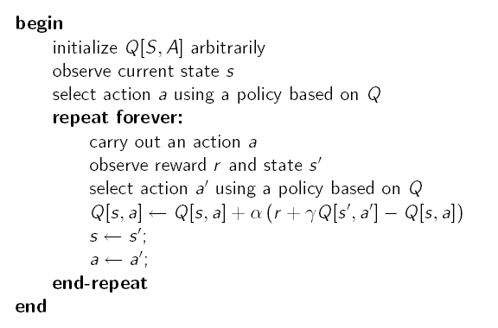
SARSA Algorithm
This could be, for instance any ε-greedy strategy:
Choose random ε times, and max the rest
This could be, for instance any ε-greedy strategy:
- Choose random ε times, and max the rest
If the random step is chosen here, and has a bad negative reward, this will affect the value of Q[s,a].
Next time in s, a’ may no longer be the action selected because of its lowered Q value

Slide 27
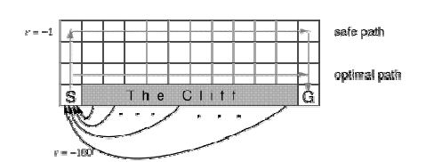
Another Example
Gridworld with:
Deterministic actions up, down, left, right
Start from S and arrive at G
Reward is -1 for all transitions, except those into the region marked “Cliff”
Falling into the cliff causes the agent to be sent back to start: r = -100

Slide 28
Another Example
Because of negative reward for every step taken, the optimal policy over the four standard actions is to take the shortest path along the cliff
But if the agents adopt an ε-greedy action selection strategy with ε=0.1, walking along the cliff is dangerous
The optimal path that considers exploration is to go around as far as possible from the cliff

Slide 29
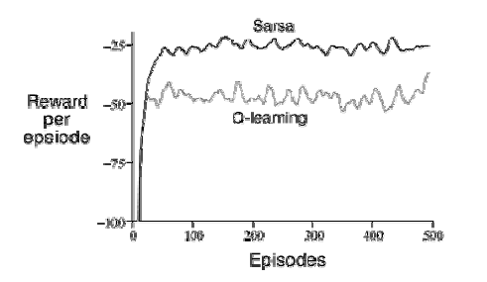
Q-learning vs. SARSA
Q-learning learns the optimal policy, but because it does so without taking exploration into account, it does not do so well while the agent is exploring
It occasionally falls into the cliff, so its reward per episode is not that great
SARSA has better on-line performance (reward per episode), because it learns to stay away from the cliff while exploring
But note that if ε→0, SARSA and Q-learning would asymptotically converge to the optimal policy

Slide 30
Problem with Model-free methods
Q-learning and SARSA are model-free methods
What does this mean?

Slide 31
Problems With Model-free Methods
Q-learning and SARSA are model-free methods
They do not need to learn the transition and/or reward model, they are implicitly taken into account via experiences
Sounds handy, but there is a main disadvantage:
How often does the agent get to update its Q-estimates?

Slide 32
Problems with Model-free Methods
Q-learning and SARSA are model-free methods
They do not need to learn the transition and/or reward model, they are implicitly taken into account via experiences
Sounds handy, but there is a main disadvantage:
How often does the agent get to update its Q-estimates?
Only after a new experience comes in
Great if the agent acts very frequently, not so great if actions are sparse, because it wastes computation time

Slide 33
Model-based methods
Idea
learn the MDP and interleave acting and planning.
After each experience,
update probabilities and the reward,
do some steps of value iteration (asynchronous ) to get better estimates of state utilities U(s) given the current model and reward function
Remember that there is the following link between Q values and utility values

Slide 34
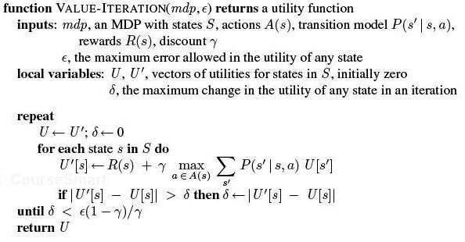
VI algorithm

Slide 35
Asynchronous Value Iteration
The “basic” version of value iteration applies the Bellman update to all states at every iteration
This is in fact not necessary
On each iteration we can apply the update only to a chosen subset of states
Given certain conditions on the value function used to initialize the process, asynchronous value iteration converges to an optimal policy
Main advantage
one can design heuristics that allow the algorithm to concentrate on states that are likely to belong to the optimal policy
Much faster convergence

Slide 36
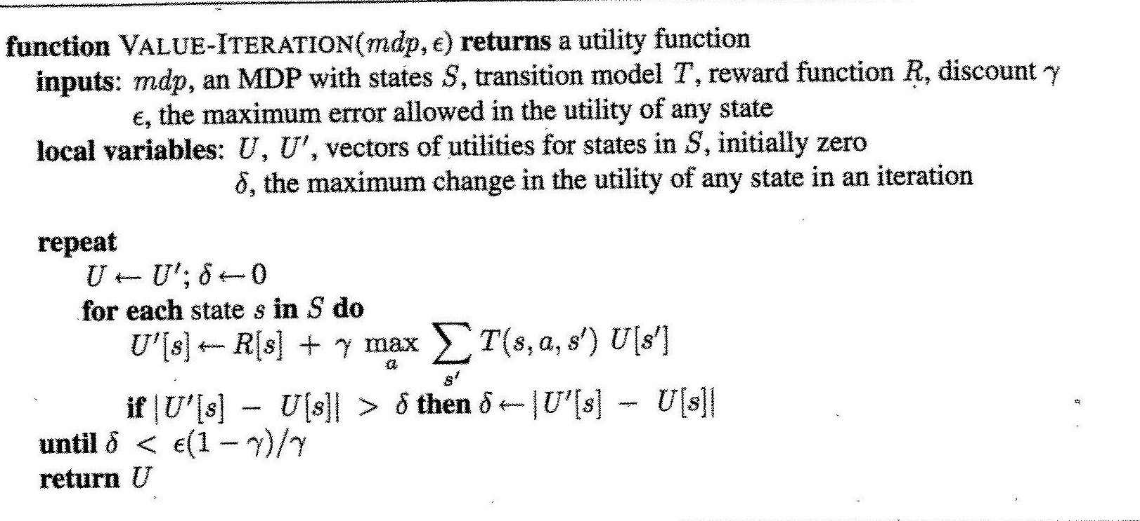
Asynchronous VI algorithm
for some

Slide 37
Model-based RL algorithm
Model Based Reinfortcement Learner
inputs:
S is a set of states, A is a set of actions, γ the discount, c is a prior count
internal state:
real array Q[S,A], R[S,A, S’]
integer array T[S,A, S’]
previous state s
previous action a

Slide 38
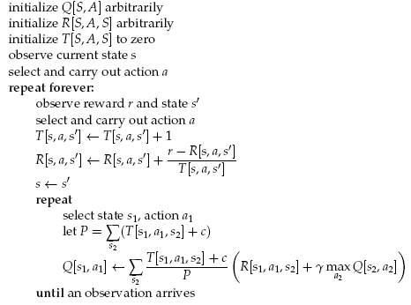
Counts of events when action a performed in s generated s’
TD-based estimate of R(s,a,s’)
Asynchronous value iteration steps
What is this c for?
Why is the reward inside the summation?
Frequency of transition from s₁ to s₂ via a₁
Notes:
Assumes a reward function as general as possible, i.e. depending on all of s,a,s’

Slide 39
Discussion
Which Q values should asyncronous VI update?
At least s in which the action was generated
Then either select states randomly, or
States that are likely to get their Q-values changed because they can reach states with Q-values that have changed the most
How many steps of asynchronous value-iteration to perform?

Slide 40
Discussion
Which states to update?
At least s in which the action was generated
Then either select states randomly, or
States that are likely to get their Q-values changed because they can reach states with Q-values that have changed the most
How many steps of asynchronous value-iteration to perform?
As many as can be done before having to act again

Slide 41
Q-learning vs. Model-based
Is it better to learn a model and a utility function or an action value function with no model?
Still an open-question
Model-based approaches require less data to learn well, but they can be computationally more expensive (time per iteration)
Q-learning takes longer because it does not enforce consistency among Q-values via the model
Especially true when the environment becomes more complex
In games such as chess and backgammon, model-based approaches have been more successful that q-learning methods
Cost/ease of acting needs to be factored in

