Slide 1
CPSC 422 Lecture 2 Review of Bayesian Networks, Representational Issues

Slide 2
Recap: Different Views of AI
Systems that act like humans | Systems that think rationally
“The study of how to make computers do things at which, at the moment, people are better”(Rich and Knight, 1991) | “The study of mental faculties through the use of computational models” (Charniack and McDermott, 1985).
Systems that think like humans | Systems that act rationally
“The automation of activities that we associate with human thinking, such as decision making, problem solving, learning”(Bellman, 1978) | “The branch of computer science that is concerned with the automation of intelligent behavior (Luger and Stubblefield 1993)

Slide 3
Recap: Our View.
AI as Study and Design of Intelligent Agents
An intelligent agent is such that
Its actions are appropriate for its goals and circumstances
It is flexible to changing environments and goals
It learns from experience
It makes appropriate choices given perceptual limitations and limited resources
This definition drops the constraint of cognitive plausibility (“think like a human)
Same as building flying machines by understanding general principles of flying (aerodynamic) vs. by reproducing how birds fly
Normative vs. Descriptive theories of Intelligent Behavior
What is the relation with the “act like a human” view?

Slide 4
Recap: Intelligent Agents
artificial agents that have a physical presence in the world are usually known as Robots
Another class of artificial agents include interface agents, for either stand alone or Web-based applications
intelligent desktop assistants, recommender systems, intelligent tutoring systems
We will focus on these agents in this course

Slide 5
Intelligent Agents in the World
Knowledge Representation
Machine Learning
Reasoning +
Decision Theory
Natural Language
Generation
Natural Language
Understanding
+
Computer Vision
Speech Recognition
+
Physiological Sensing
Mining of Interaction Logs
+
Robotics
+
Human Computer
/Robot
Interaction

Slide 6
Recap: Course Overview
Reasoning under uncertainty:
Bayesian networks: brief review, approximate inference, an application
Probability and Time: algorithms, Hidden Markov Models and Dynamic Bayesian Networks
Decision Making: planning under uncertainty
Markov Decision Processes: Value and Policy Iteration
Partially Observable Markov Decision Processes (POMDP)
Learning
Decision Trees, Neural Networks, Learning Bayesian Networks, Reinforcement Learning
Knowledge Representation and Reasoning
Semantic Nets, Ontologies and the Semantic Web

Slide 7
Lecture 2 Review of Bayesian Networks, Representational Issues

Slide 8
What we will review/learn in this module
What Bayesian networks are, and their advantages with respect to using joint probability distributions for performing probabilistic inference
The semantics of Bayesian network.
A procedure to define the structure of the network that maintains this semantics
How to compare alternative network structures for the same domain, and how to chose a suitable one
How to evaluate indirect conditional dependencies among variables in a network
What is the Noisy-Or distribution and why it is useful in Bayesian networks

Slide 9
Intelligent Agents in the World
Can we assume that
we can reliably
observe everything we
need to
know about the environment ?
Can we assume that our actions
always have well defined effects
on the environment?

Slide 10
Uncertainty
Let action A_{t} = leave for airport t minutes before flight
Will A_{t} get me there on time?
Problems:
partial observability (road state, other drivers' plans, limited traffic reports etc.)
uncertainty in action outcomes (flat tire, etc.)
immense complexity of modeling and predicting traffic
Hence a purely logical approach either
risks falsehood: “A₂₅ will get me there on time”, or
leads to conclusions that are too weak for decision making:
“A₂₅ will get me there on time if there's no accident on the bridge and it doesn't rain and my tires remain intact etc etc.”
(A₁₄₄₀ might reasonably be said to get me there on time but I'd have to stay overnight in the airport …)

Slide 11
Methods for handling uncertainty
Default or non-monotonic logic:
Assume my car does not have a flat tire
Assume A₂₅ works unless contradicted by evidence
Issues: What assumptions are reasonable? How to handle
contradiction?
Rules with “certainty” factors:
A₂₅ |→_{0.3} get there on time
Sprinkler |→ _{0.99} WetGrass
WetGrass |→ _{0.7} Rain
Issues: Problems with combination, e.g., Sprinkler causes
Rain??
Probability
Model agent's degree of belief that:
Given the available evidence, A₂₅ will get me there on time with probability 0.04

Slide 12
Probability
Model agent's degree of belief on events
E.g., Given the available evidence, A₂₅ will get me there on time with probability 0.04
Probabilistic assertions summarize effects of
laziness: failure to enumerate exceptions, qualifications, etc.
E.g. A₂₅ will do if there is no traffic, no constructions, no flat tire….
ignorance: lack of relevant facts, initial conditions, etc.
Subjective probability:
Probabilities relate propositions to agent's own state of knowledge (beliefs)
e.g., P(A₂₅ | no reported accidents) = 0.06
These are not assertions about the world
Probabilities of propositions change with new evidence:
e.g., P(A₂₅ | no reported accidents, 5 a.m.) = 0.15

Slide 13
Probability theory
System of axioms and formal operations for sound reasoning under uncertainty
Basic element: random variable, with a set of possible values (domain)
You must be familiar with the basic concepts of probability theory. See Ch. 13 in textbook and review slides posted in the schedule

Slide 14
Bayesian networks
A simple, graphical notation for conditional independence assertions and hence for compact specification of full joint distributions
Syntax:
a set of nodes, one per variable
a directed, acyclic graph (link ≈ "directly influences")
a conditional probability distribution for each node given its parents:
P (X_{i} | Parents (X_{i}))
In the simplest case, conditional distribution represented as a conditional probability table (CPT) giving the distribution over X_{i} for each combination of parent values

Slide 15
Example
I have an anti-burglair alarm in my house
I have an agreement with two of my neighbors, John and Mary, that they call me if they hear the alarm go off when I am at work
Sometime they call me at work for other reasons
Sometimes the alarm is set off by minor earthquakes.
Variables: Burglary (B), Earthquake (E), Alarm (A), JohnCalls (J), MaryCalls (M)
One possible network topology reflects "causal" knowledge:
A burglary can set the alarm off
An earthquake can set the alarm off
The alarm can cause Mary to call
The alarm can cause John to call

Slide 16
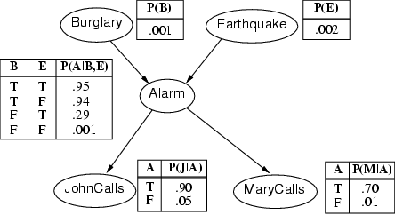
Example contd.

Slide 17
Bayesian Networks - Inference
Update algorithms exploit dependencies to reduce the complexity of probabilistic inference
Diagnostic
Predictive
Intercausal
Mixed
Burglary
Burglary
Earthquake
Earthquake
P(B) = 0.016
P(B) = 1.0
P(E) = 1.0
P(¬E) = 1.0
Alarm
Alarm
Burglary
Alarm
P(B) = 0.003
P(A) = 0.03
JohnCalls
JohnCalls
Alarm
JohnCalls
P(J) = 1.0
P(J) = 0.67
P(A) = 1.0
P(M) = 1.0

Slide 18
Semantics
In a Bayesian network, the full joint distribution is defined as the product of the local conditional distributions:
P(X₁, …,X_{n}) = ∏^{n}_{i= 1} P (X_{i} | Parents(X_{i}))
But, by applying the product rule, we also have
P(X₁, …,X_{n}) = P(X₁,...,X_{n-1}) P(X_{n} | X₁,...,X_{n-1})
= P(X₁,...,X_{n-2}) P(X_{n-1} | X₁,...,X_{n-2}) P(X_{n} | X₁,...,X_{n-1}) = ….
= P(X₁ | X₂)…P(X₁,...,X_{n-2}) P(X_{n-1} | X₁,...,X_{n-2}) P(X_{n} | X₁,.,X_{n-1})
= ∏^{n}_{i= 1} P(X_{i} | X₁, … ,X_{i-1})
Thus ∏^{n}_{i= 1} P(X_{i} | X₁, … ,X_{i-1}) = ∏^{n}_{i= 1} P (X_{i} | Parents(X_{i}))
X_{i} is conditionally independent of the other variables in X₁, … ,X_{i-1} given its
parent nodes
WHY?

Slide 19
Bayesian Networks - Inference
Update algorithms exploit dependencies to reduce the complexity of probabilistic inference
Diagnostic
Predictive
Intercausal
Mixed
Burglary
Burglary
Earthquake
Earthquake
P(B) = 0.016
P(B) = 1.0
P(E) = 1.0
P(¬E) = 1.0
Alarm
Alarm
Burglary
Alarm
P(B) = 0.003
P(A) = 0.03
JohnCalls
JohnCalls
Alarm
JohnCalls
P(J) = 1.0
P(J) = 0.67
P(A) = 1.0
P(M) = 1.0

Slide 20
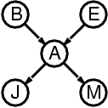
Compactness
Suppose that we have a network with n Boolean variables X_{i}
The CPT for each X_{i} with k parents has 2^{k} rows for the combinations of parent values
Each row requires one number p for X_{i} = true (the number for X_{i} = false is just 1-p)
If each variable has no more than k parents, the complete network requires O(n · 2^{k}) numbers
How does this compare with the numbers that I need to specify the full Join Probability Distribution over these n binary variables?
For burglary net…

Slide 21
Compactness
Suppose that we have a network with n binary variables
A CPT for Boolean X_{i} with k Boolean parents has 2^{k} rows for the combinations of parent values
Each row requires one number p for X_{i} = true (the number for X_{i} = false is just 1-p)
If each variable has no more than k parents, the complete network requires O(n · 2^{k}) numbers
Specifying the full Joint Probability Distribution would require 2^{n} numbers
For burglary net, 1 + 1 + 4 + 2 + 2 = 10
numbers (vs. 2⁵-1 = 31)
For k<< n, this is a substantial improvement,
the numbers required grow linearly with n

Slide 22
Example
e.g., P(j ∧ m ∧ a ∧ ¬b ∧ ¬e)

Slide 23
Example
e.g., P(j ∧ m ∧ a ∧ ¬b ∧ ¬e)
= P (j | a) P (m | a) P (a | ¬b, ¬e) P (¬b) P (¬e)
= 0.90 x 0.70 x 0.01 x 0.999 x 0.998= 0.00063

Slide 24
Constructing Bayesian networks
Need a method such that a series of locally testable assertions of
conditional independence guarantees the required global semantics
Choose an ordering of variables X₁, … ,X_{n}
For i = 1 to n
add X_{i} to the network
select parents from X₁, … ,X_{i-1} such that
P (X_{i} | Parents(X_{i})) = P (X_{i} | X₁, ... X_{i-1})
i.e., X_{i} is conditionally independent of its other predecessors in the ordering, given its parent nodes
This choice of parents guarantees:
P (X₁, … ,X_{n}) = ∏^{n}_{i= 1} P (X_{i} | X₁, … , X_{i-1}) (chain rule)
= ∏^{n}_{i= 1} P (X_{i} | Parents(X_{i})) (by construction)

Slide 25
Example
Suppose we choose to add nodes in the following order: M, J, A, B, E
MaryCalls

Slide 26
Example
Suppose we choose to add nodes in the following order: M, J, A, B, E
Does knowing whether Mary called or not influence our belief on whether John will call?
MaryCalls
JohnCalls

Slide 27
Example
Suppose we choose to add nodes in the following order: M, J, A, B, E
Does knowing whether Mary called or not influence our belief on whether John will call? YES, that is J is conditionally dependent from M
MaryCalls
JohnCalls

Slide 28
Example
Suppose we choose to add nodes in the following order: M, J, A, B, E
Does knowing whether Mary called or not influence our belief on whether John will call? YES, that is J is conditionally dependent from M
MaryCalls
JohnCalls
Alarm

Slide 29
Example
Suppose we choose to add nodes in the following order: M, J, A, B, E
Does knowing whether Mary called or not influence our belief on whether John will call? YES, that is J is conditionally dependent from M
Does knowing whether either or both Mary and John called influence our belief on the alarm state?
MaryCalls
JohnCalls
Alarm

Slide 30
Example
Suppose we choose to add nodes in the following order: M, J, A, B, E
Does knowing whether Mary called or not influence our belief on whether John will call? YES, that is J is conditionally dependent from M
Does knowing whether either or both Mary and John called influence our belief on the alarm state? YES, that is A is conditionally dependent from both J and M
MaryCalls
JohnCalls
Alarm

Slide 31
Example
Suppose we choose to add nodes in the following order: M, J, A, B, E
Does knowing whether Mary called or not influence our belief on whether John will call? YES, that is J is conditionally dependent from M
Does knowing whether either or both Mary and John called influence our belief on the alarm state? YES, that is A is conditionally dependent from both J and M
MaryCalls
JohnCalls
Alarm
Burglary

Slide 32
Example
Suppose we choose to add nodes in the following order: M, J, A, B, E
Does knowing whether Mary called or not influence our belief on whether John will call? YES, that is J is conditionally dependent from M
Does knowing whether either or both Mary and John called influence our belief on the alarm state? YES, that is A is conditionally dependent from both J and M
If I know the state of the alarm, knowing whether john or mary called does not change my belief on burglary => P(B|A,J,M)=P(B|A)
MaryCalls
JohnCalls
Alarm
Burglary

Slide 33
Example
Suppose we choose to add nodes in the following order: M, J, A, B, E
Does knowing whether Mary called or not influence our belief on whether John will call? YES, that is J is conditionally dependent from M
Does knowing whether either or both Mary and John called influence our belief on the alarm state? YES, that is A is conditionally dependent from both J and M
If I know the state of the alarm, knowing whether John or Mary called does not change my belief on burglary => P(B|A,J,M)=P(B|A)
MaryCalls
JohnCalls
Alarm
Burglary
Earthquake

Slide 34
Example
Suppose we choose to add nodes in the following order: M, J, A, B, E
Does knowing whether Mary called or not influence our belief on whether John will call? YES, that is J is conditionally dependent from M
Does knowing whether either or both Mary and John called influence our belief on the alarm state? YES, that is A is conditionally dependent from both J and M
If I know the state of the alarm, knowing whether John or Mary called does not change my belief on burglary => P(B|A,J,M)=P(B|A)
If I know the state of the alarm, knowing whether a burglary happened or not will change my belief on whether there was an earthquake => P(E|B,A,J,M)=P(E|B,A)
MaryCalls
JohnCalls
Alarm
Burglary
Earthquake

Slide 35
Completely Different Topology
Does not represent the causal relationships in the domain, is it still a Bayesian network?
MaryCalls
JohnCalls
Alarm
Burglary
Earthquake

Slide 36
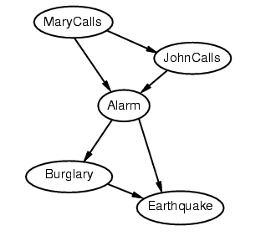
Completely Different Topology
Does not represent the causal relationships in the domain, is it still a Bayesian network?
Of course, there is nothing in the definition of Bayesian networks that requires them to represent causal relations
Is it equivalent to the “causal” version we constructed first?
(that is, does it generate the same probabilities for the same queries?)

Slide 37
Completely Different Topology
Does not represent the causal relationships in the domain, is it still a Bayesian network?
Of course, there is nothing in the definition of Bayesian networks that requires them to represent causal relations
Is it equivalent to the “causal” version we constructed first?

Slide 38
Example contd.
Our two alternative Bnets for the Alarm problem are equivalent as long as they represent the same probability distribution
Burglary
Earthquake
Alarm
MayCalls
JohnCalls
P(B,E,A,M,J) = P (J | A) P (M | A) P (A | B, E) P (B) P (E) =
P (E/B,A)P(B/A)P(A/M,J)P(J/M)P(M)
i.e., they are equivalent if the corresponding CPTs are specified so that they satisfy the equation above

Slide 39
Which Structure is Better?
Burglary
Earthquake
Alarm
MayCalls
JohnCalls

Slide 40
Which Structure is Better?
Burglary
Earthquake
Alarm
MayCalls
JohnCalls
Deciding conditional independence is hard in non-causal directions
(Causal models and conditional independence seem hardwired for humans!)
Non-causal network is less compact: 1 + 2 + 4 + 2 + 4 = 13 numbers needed
Specifing the conditional probabilities may be harder
For instance, we have lost the direct dependencies describing the alarm’s reliability and error rate (info often provided by the maker)

Slide 41
Deciding on Structure
In general, the direction of a direct dependency can always be changed using Bayes rule
Product rule P(a∧b) = P(a | b) P(b) = P(b | a) P(a)
Bayes' rule: P(a | b) = P(b | a) P(a) / P(b)
or in distribution form
P(Y|X) = P(X|Y) P(Y) / P(X) = αP(X|Y) P(Y)
Useful for assessing diagnostic probability from causal probability (or vice-versa):
P(Cause|Effect) = P(Effect|Cause) P(Cause) / P(Effect)

Slide 42
Structure (contd.)
So the two simple Bnets below are equivalent as long as the CPTs are related via Bayes rule
Which structure to chose depends, among other things, on which CPT it is easier to specify
Burglair
Alarm
P(A | B) = P(B | A) P(A) / P(B)
Alarm
Burglar

Slide 43
Stucture (contd.)
CPTs for causal relationships represent knowledge of the mechanims underlying the process of interest.
e.g. how an alarm works, why a disease generates certain symptoms
CPTs for diagnostic relations can be defined only based on past observations.
E.g., let m be meningitis, s be stiff neck:
P(m|s) = P(s|m) P(m) / P(s)
P(s|m) can be defined based on medical knowledge on the workings of meningitis
P(m|s) requires statistics on how often the symptom of stiff neck appears in conjuction with meningities. What is the main problem here?

Slide 44
Stucture (contd.)
Another factor that should be taken into account when deciding on the structure of a Bnet is the types of dependencies that it represents
Let’s review the basics

Slide 45
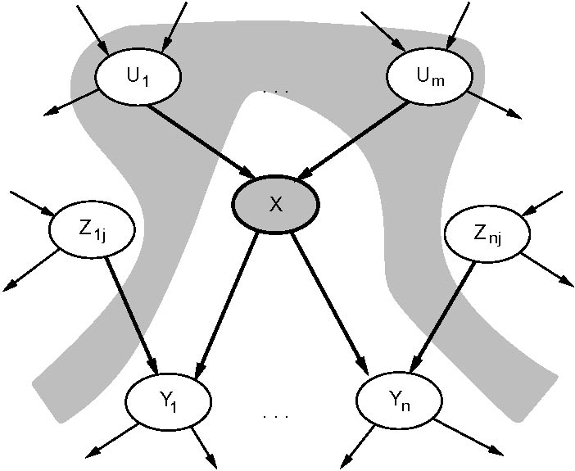
Dependencies in a Bayesian Network
Grey areas in the picture below represent evidence
X
A node X is conditionally independent of its non-descendant nodes (e.g., Z_{ij} in the picture) given its parents. The gray area “blocks” probability propagation

Slide 46
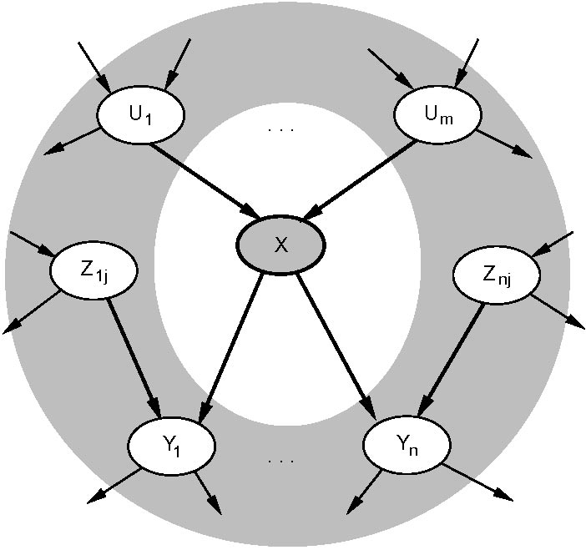
X
A node X is conditionally independent of all other nodes in the network given its Markov blanket (the gray area in the picture). It “blocks” probability propagation
Note that node X is conditionally dependent of non-descendant nodes in its Markov blanket (e.g., its children’s parents, like Z_{1j} ) given their common descendants (e.g., Y_{1j}).
This allows, for instance, explaining away one cause (e.g. X) because of evidence of its effect (e.g., Y₁) and another potential cause (e.g. z_{1j})

Slide 47
D-separation (another way to reason about dependencies in the network)
Or, blocking paths for probability propagation. Three ways in which a path between X to Y can be blocked, given evidence E
Y
E
X
1
Z
Z
2
3
Z
Note that, in 3, X and Y become dependent as soon as there is evidence on Z or on any of its descendants. Why?

Slide 48
What does this means in terms of choosing structure?
That you need to double check the appropriateness of the indirect dependencies/independencies generated by your chosen structures
Example: representing a domain for an intelligent system that acts as a tutor (aka Intelligent Tutoring System)
Topics divided in sub-topics
Student knowledge of a topic depends on student knowledge of its sub-topics
We can never observe student knowledge directly, we can only observe it indirectly via student test answers

Slide 49
Two Ways of Representing Knowledge
Overall Proficiency
Topic 1
Sub-topic 1.1
Sub-topic 1.2
Answer 1
Answer 2
Answer 3
Answer 4
Answer 1
Answer 2
Answer 3
Answer 4
Sub-topic 1.1
Sub-topic 1.2
Topic 1
Overall Proficiency
Which one should I pick?

Slide 50
Two Ways of Representing Knowledge
Overall Proficiency
Change in probability for a given node always propagates to its siblings, because we never get direct evidence on knowledge
Topic 1
Sub-topic 1.1
Sub-topic 1.2
Answer 1
Answer 2
Answer 3
Answer 4
Answer 1
Answer 1
Answer 1
Answer 2
Answer 3
Answer 4
Sub-topic 1.1
Sub-topic 1.2
Change in probability for a given node does not propagate to its siblings, because we never get direct evidence on knowledge
Topic 1
Overall Proficiency
Which one you want to chose depends on the domain you want to represent

Slide 51
Test your understandings of dependencies in a Bnet
Use the AISpace (http://www.aispace.org/mainApplets.shtml) applet for Belief and Decision networks (http://www.aispace.org/bayes/index.shtml)
Load the “conditional independence quiz” network
Go in “Solve” mode and select “Independence Quiz”

Slide 52
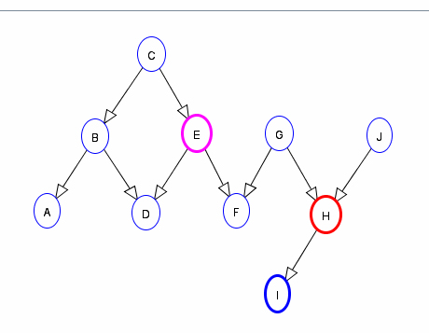
Dependencies in a Bnet
Is H conditionally independent of E given I?

Slide 53
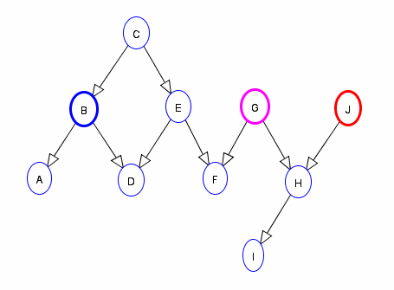
Dependencies in a Bnet
Is J conditionally independent of G given B?

Slide 54
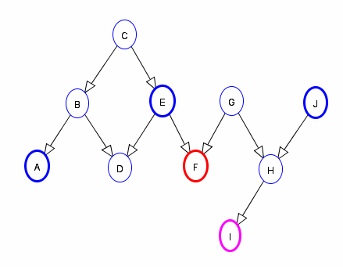
Dependencies in a Bnet
Is F conditionally independent of I given A, E, J?

Slide 55
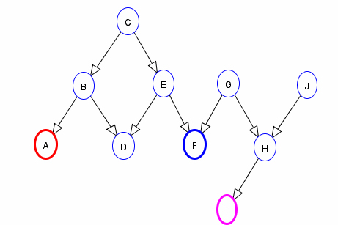
Dependencies in a Bnet
Is A conditionally independent of I given F?

Slide 56
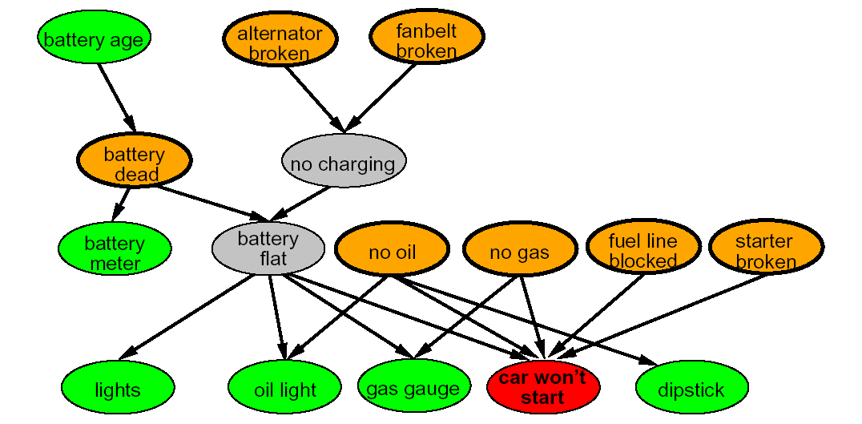
More On Choosing Structure
How to decide which variables to include in my probabilistic model?
Let’s consider a diagnostic problem (e.g. “why my car does not start?”)
Possible causes (orange nodes below) of observations of interest (e.g., “car won’t start”)
Other “observable nodes” that I can test to assess causes (green nodes below)
Useful to add “hidden variables” (grey nodes) that can ensure sparse structure and reduce parameters

Slide 57
Compact Conditional Distributions
CPT grows exponentially with number of parents
Possible solution: canonical distributions that are defined compactly
Example: Noisy-OR distribution
Models multiple non-interacting causes
Logic OR with a probabilistic twist. In Propositional logic, we can define the following rule:
Fever is TRUE if and only if Malaria, Cold or Flue are true
The Noisy-OR model allows for uncertainty in the ability of each cause to generate the effect (i.e. one may have a cold without a fever)
Flu
Cold
Malaria
Two assumptions
All possible causes a listed
For each of the causes, whatever inhibits it to generate the target effect is independent from the inhibitors of the other causes
Fever

Slide 58
Noisy-OR
U₁
U_{k}
LEAK
Effect
Parent nodes U₁ ,…,U_{k} include all causes
but I can always add a “dummy” cause, or leak to cover for left-out causes
For each of the causes, whatever inhibits it to generate the target effect is independent from the inhibitors of the other causes
Independent probability of failure q_{i} for each cause alone: P(⌐Effect| u_{i}) = q_{i}
P(⌐Effect| u₁,.. u_{j} , ⌐ u_{j+1} ,., ⌐ u_{k}) = ∏^{j}_{i=1} P(⌐Effect| u_{i}) = ∏^{j}_{i=1} q_{i}
P(Effect| u₁,.. u_{j} , ⌐ u_{j+1} ,., ⌐ u_{k}) = 1 - ∏^{j}_{i=1} q_{i}

Slide 59
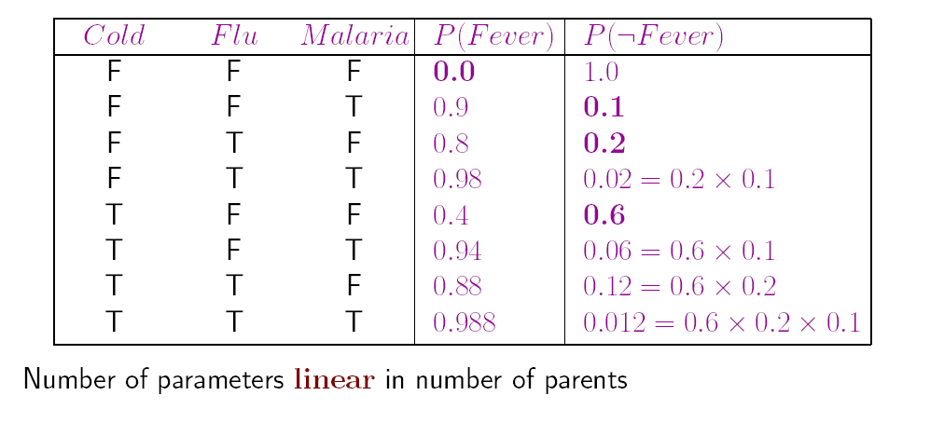
Example
P(⌐fever| cold, ⌐ flu, ⌐ malaria ) = 0.6
P(⌐fever| ⌐ cold, flu, ⌐ malaria ) = 0.2
P(⌐fever| ⌐ cold, ⌐ flu, malaria ) = 0.1
Flu
Cold
Malaria
Fever

Slide 60
In Andes
Andes has simplified version of this OR-based canonical distribution
There is “leak” but no noise, i.e., every cause (rule application) generates the corresponding fact for sure

Slide 61
Example
P(⌐fever| cold, ⌐ flu, ⌐ malaria ) = 0.6
P(⌐fever| ⌐ cold, flu, ⌐ malaria ) = 0.2
P(⌐fever| ⌐ cold, ⌐ flu, malaria ) = 0.1

Slide 62
Example
Note that we did not have a Leak node in this example, for simplicity, but it would have been useful since Fever can definitely be caused by reasons other than the three we had
If we include it, how does the CPT change?
Cold | Flu | Malaria | Leak | P(Fever) | P(⌐Fever)
T | T | T | F
F | T | T | F
T | F | T | F
F | F | T | F
T | T | F | F
T | T | T | F
F | T | T | F
T | F | T | F
T | T | T | T
F | T | T | T
T | F | T | T
F ………… | F ………… | T ………… | T ………… | ………… | …………

Slide 63
Bayesian Networks - Inference
Update algorithms exploit dependencies to reduce the complexity of probabilistic inference
Diagnostic
Predictive
Intercausal
Mixed
Burglary
Burglary
Earthquake
Earthquake
P(B) = 0.016
P(B) = 1.0
P(E) = 1.0
P(¬E) = 1.0
Alarm
Alarm
Burglary
Alarm
P(B) = 0.003
P(A) = 0.03
JohnCalls
JohnCalls
Alarm
JohnCalls
P(J) = 1.0
P(J) = 0.67
P(A) = 1.0
P(M) = 1.0

Slide 64
Variable Elimination Algorithm
Clever way to compute a posterior joint distribution for
the query variables Y [Y_{i},…,Y_{n}]
given specific values e for the evidence variables E [E_{i},…,E_{m}]
by summing out the variables that are not query nor evidence (we call them hidden variables H = [H_{i},….H_{j}])
P(Y|E) = ∑_{H1}..... ∑ _{Hj} P(H_{i} ,…, H_{j}, Y_{i}, ….,Y_{n,,},E_{i},….,E_{m})
You know this from CPSC 322

Slide 65
Variable Elimination in the AI Space Applet
Use the AISpace (http://www.aispace.org/mainApplets.shtml) applet for Belief and Decision networks (http://www.aispace.org/bayes/index.shtml)
Load any of the available network
Go in “Solve” mode
To add evidence to the network, click the “Make Observations” toolbar button, and then the node you want to observe
To make queries, click the “Query” toolbar button, and then the node you want to query
Anser “verbose” in the dialogue box that appears, if you want to see how Variable Elimination Works

Slide 66
Inference in Bayesian Networks
In worst case scenario (e.g. fully connected network) exact inference is NP-hard
However space/time complexity is very sensitive to topology
In singly connected graphs (single path from any two nodes), time complexity of exact inference is polynomial in the number of nodes
If things are bad, one can resort to algorithms for approximate inference
We we’ll look at these next week

Slide 67
Issues in Bayesian Networks
Often creating a suitable structure is doable for domain experts. But…
“Where do the numbers come from?”
From experts
Tedious
Costly
Not always reliable
From data => Machine Learning
There are algorithms to learn both structures and numbers
CPTs easier to learn when all variables are observable: use frequencies
Can be hard to get enough data
We will look into learning Bnets as part of the machine learning portion of the course

Slide 68
Applications
Bayesian networks have been extensively used in real world applications for several domains
Medicine, troubleshooting, Intelligent Interfaces, Intelligent Tutoring systems
We will see an example from Tutoring Systems:
Andes, an Intelligent Learning Environment (ILE) for physics
Discussion-based class of Tu. Jan 19

Slide 69
Next Week
Approximate algorithms for Bnets
I will be away
Giuseppe Carenini will be guest lecturer on Tuesday
Jacek Kisynski will be guest lecturer on Thursday

