Slide 1
Reinforcement Learning

Slide 2
Overview
Introduction
Q-learning
Exploration vs. Exploitation
Evaluating RL algorithms
On-Policy Learning: SARSA

Slide 3
NOTE
For this topic, we will refer to the additional textbook
Artificial Intelligence: Foundations of Computational Agents (P&M). By David Poole and Alan Mackworth.
  Relevant chapter posted on the course schedule page
Simpler, clearer coverage, one minor difference in notation you need to be aware of
  U(s) => V(s)
In the slides, I will use U(s) for consistency with previous lectures

Slide 4
RL: Intro
What should an agent do given:
  Knowledge of
    possible states of the world
    possible actions
  Observations of
    current state of world
    immediate reward / punishment
  Goal: act to maximize accumulated reward, i.e find optimal policy
Like decision-theoretic planning (fully observable), except that agent is not given
  Transition model P(s’|s,a)
  Reward function R(a, s, s’)

Slide 5
Reinforcement
Common way of learning when no one can teach you explicitly
  Do actions until you get some form of feedback from the environments
  See if the feedback is good (reward) or (bad) punishment
  Understand which part of your behaviour caused the feedback
  Repeat until you have learned a strategy of how to act in this world to get the best out of it

Slide 6
Reinforcement
Depending on the problem, reinforcement can come at different points in the sequence of actions
  Just at the end: games like chess where you are simply told “you win!” or “you loose” at some point, no partial reward for intermediate moves
  After some actions: e.g. points scored in tennis
  After every action: moving forward vs. going under when learning to swim
Here we will only consider problems with reward after every action

Slide 7
MDP and RL
Markov decision process
  Set of states S, set of actions A
  Transition probabilities to next states P(s’| s, a′)
  Reward functions R(s,s’,a)
RL is based on MDPs, but
  Transition model is not known
  Reward model is not known
MDP computes an optimal policy
RL learns an optimal policy

Slide 8
Experiences
We assume there is a sequence of experiences:
  state, action, reward, state, action, reward.....
At any time, agent must decide whether to explore vs. exploit. That is, if it has worked out a good course of actions
  Explore a different course, hoping to do better
  Stay with (exploit) the current course, even though there may be better ones around

Slide 9
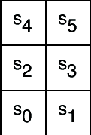
Example
Six possible states <s₀,..,s₅>
4 actions:
  UpCareful: moves one tile up unless there is wall, in which case stays in same tile. Always generates a penalty of -1
  Left: moves one tile left unless there is wall, in which case
    stays in same tile if in s₀ or s₂
    Is sent to s₀ if in s₄
  Right: moves one tile right unless there is wall, in which case stays in same tile
  Up: 0.8 goes up unless there is a wall, 0.1 like Left, 0.1 like Right
+ 10
-1
-100
-1
-1
-1
Reward Model:
  -1 for doing UpCareful
  Negative reward when hitting a wall, as marked on the picture

Slide 10
Example
-1
-1
+ 10
-1
The agent knows about the 6 states and 4 actions
Can perform an action, fully observe its state and the reward it gets
Does not know how the states are configured, nor what the actions do
  no transition model, nor reward model
-100
-1
-1
-1

Slide 11
Search-Based Approaches to RL
Policy Search
  Start with an arbitrary policy
  Try it out in the world (evaluate it)
  Improve it (stochastic local search)
  Repeat from (b) until happy
This is called evolutionary algorithm as the agent is evaluated as a whole, based on how it survives
Problems with evolutionary algorithms
  state space can be huge: with n states and m actions there are m^{n} policies
  use of experiences is wasteful: cannot directly take into account locally good/bad behavior, since policies are evaluated as a whole

Slide 12
Overview
Introduction
Q-learning
Exploration vs. Exploitation
Evaluating RL algorithms
On-Policy Learning: SARSA

Slide 13
Q-learning
Contrary to search-based approaches, Q-learning learns after every action
Learns components of a policy, rather than the policy itself
Q(a,s) = expected value of doing action a in state s and then following the optimal policy
Discounted reward we have seen in MDPs
expected value of following optimal policy л in s’
reward in s
states reachable
from s by doing a
Probability of getting to s’ from s via a

Slide 14
Q values
Q(a,s) are known as Q-values, and are related to the utility of state s as follows

Slide 15
Q values
Q(a,s) are known as Q-values, and are related to the utility of state s as follows
From (1) and (2) we obtain a constraint between the Q value in state a and the Q value of the states reachable from a

Slide 16
Q values
 | s₀ | s₁ | … | s_{k}
a₀ | Q[s₀,a₀] | Q[s₁,a₀] | …. | Q[s_{k},a₀]
a₁ | Q[s₀,a₁] | Q[s₁,a₁] | … | Q[s_{k},a₁]
… | … | … | …. | …
a_{n} | Q[s₀,a_{n}] | Q[s₁,a_{n}] | …. | Q[s_{k},a_{n}]
Once the agent has a complete Q-function, it knows how to act in every state
By learning what to do in each state, rather then the complete policy as in search based methods, learning becomes linear rather than exponential in the number of states
But how to learn the Q-values?

Slide 17
Learning the Q values
We could exploit the relation between Q values in “adjacent” states
Tough, because…..

Slide 18
Learning the Q values
We could exploit the relation between Q values in “adjacent” states
Tough, because we don’t know the transition probabilities P(s’|s,a)
We’ll use a different approach, that relies on the notion on Temporal Difference (TD)

Slide 19
Average Through Time
One of the main elements of Q-learning
Suppose we have a sequence of values (your sample data):
  v₁, v₂, .., v_{k}
And want a running approximation of their expected value
  e.g., given sequence of grades, estimate expected value of next grade
A reasonable estimate is the average of the first k values:

Slide 20
Average Through Time

Slide 21
Temporal Differences
v_{k}-A_{k-1} is called a temporal difference error or TD-error
  it specifies how different the last value v_{k} is from the prediction given by the previous running average A_{k-1}
The new estimate (average) is obtained by updating the previous average by α_{k} times the TD error
It intuitively makes sense
  If the new value v_{k} is higher than the average at k-1, than the old average was too small
    the new average is generated by increasing the old average by a measure proportional to the error
  Do the opposite if the new v_{k} is smaller than the average at k-1

Slide 22
TD property
It can be shown that the formula that updates the running average via the TD-error
converges to the true average of the sequence if
More on this later

Slide 23
Q-learning: General Idea
Learn from the history of interaction with the environment, i.e, a sequence of state-action-rewards
  <s₀, a₀, r₁, s₁, a₁, r₂, s₂, a₂, r₃,.....>
History is seen as sequence of experiences, i.e. tuples
  <s, a, r, s’>
  representing the agent doing action a in state s, receiving reward r and ending up in s’
These experiences are used to establish an explicit constraint over the true value of Q (s,a)

Slide 24
Q-learning: General Idea
But remember
Is an approximation. The real link between Q(s,a) and Q(s’,a’) is

Slide 25
Q-learning: General Idea
Store Q[S, A], for every state S and action A in the world
Start with arbitrary estimates in Q ⁽⁰⁾[S, A],
Update them by using experiences
  Each experience <s, a, r, s’> provides one data point on the actual value of Q[s, a]
current estimated value of Q[s’,a’], where s’ is the state the agent arrives to in the current experience
current value of Q[s,a]
current estimated value of Q[s,a]
This is used in the TD formula
Datapoint derived from <s,a,r,s’>
updated estimated value of Q[s,a]

Slide 26
Q-learning: General Idea
Remember that when we derived the formula for the running average, we set a_{k} = 1/k

Slide 27
Role of α_{k}
α_{k} = 1/k decreases with number of elements in the sequence
  the more elements in the average, the less weight the formula gives to a discrepancy between a new element and the current average
    the new elements is seen as the outlier
  makes sense if all are considered the same: the more elements in the average, the more accurate of an estimate it is
What if the most recent elements in the sequence of observations are more accurate?
  Is this the case in Q-learning?
  Yes, because each new datapoint is built upon the latest experience <s,a,r,s’>, but also on the existing estimate of Q(s’,a).
  This estimate improves as Q-learning proceeds, thus newest datapoints in the TD formula are more reliable than older ones

Slide 28
Fixed vs. Variable α_{k}
One way to weight recent elements more is to fix α , 0< α ≤ 1 rather than decreasing it with k.
Problem: the formula for the TD-error converges to the true average of the sequence if
  True for α = 1/k, but not for fixed α
Compromise
  Still reduce α as the sequence of elements increases, but doing it more slowly than 1/k
  Still converge to the average, but weights more recent observations more
Hard to reach the compromise

Slide 29
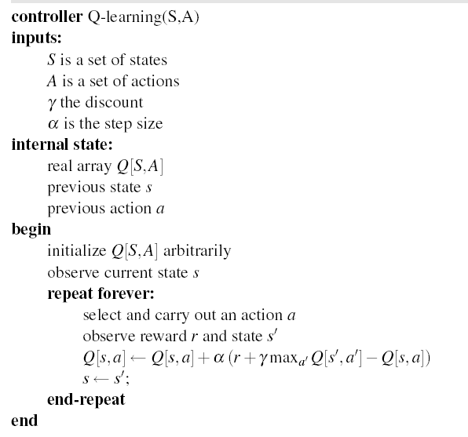
Q-learning: algorithm

Slide 30
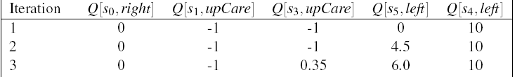
Example (variable α_{k})
Suppose that in the simple world described earlier, the agent has the following sequence of experiences
<s₀, right, 0, s₁, upCareful, -1, s₃, upCareful, -1, s₅, left, 0, s₄, left, 10, s₀>
And repeats it k times (not a good behavior for a Q-learning agent, but good for didactic purposes)
Table shows the first 3 iterations of Q-learning when
  Q[s,a] is initialized to 0 for every a and s
  α_{k}= 1/k, γ= 0.9
  For full demo, see http://www.cs.ubc.ca/~poole/demos/rl/tGame.html

Slide 31
-1
-1
+ 10
-1
Q[s,a] | s₀ | s₁ | s₂ | s₃ | s₄ | s₅
upCareful | 0 | 0 | 0 | 0 | 0 | 0
Left | 0 | 0 | 0 | 0 | 0 | 0
Right | 0 | 0 | 0 | 0 | 0 | 0
Up | 0 | 0 | 0 | 0 | 0 | 0
-100
-1
k=1
k=1
-1
-1
Only immediate rewards
are included in the update
in this first pass

Slide 32
-1
-1
+ 10
-1
Q[s,a] | s₀ | s₁ | s₂ | s₃ | s₄ | s₅
upCareful | 0 | 0 | 0 | 0 | 0 | 0
Left | 0 | 0 | 0 | 0 | 0 | 0
Right | 0 | 0 | 0 | 0 | 0 | 0
Up | 0 | 0 | 0 | 0 | 0 | 0
-100
-1
k=1
k=1
-1
-1
Only immediate rewards
are included in the update

Slide 33
-1
-1
+ 10
-1
Q[s,a] | s₀ | s₁ | s₂ | s₃ | s₄ | s₅
upCareful | 0 | -1 | 0 | -1 | 0 | 0
Left | 0 | 0 | 0 | 0 | 10 | 0
Right | 0 | 0 | 0 | 0 | 0 | 0
Up | 0 | 0 | 0 | 0 | 0 | 0
-100
-1
k=1
k=2
-1
-1
1 step backup from previous positive reward in s4

Slide 34
-1
-1
+ 10
-1
Q[s,a] | s₀ | s₁ | s₂ | s₃ | s₄ | s₅
upCareful | 0 | -1 | 0 | -1 | 0 | 0
Left | 0 | 0 | 0 | 0 | 10 | 0
Right | 0 | 0 | 0 | 0 | 0 | 0
Up | 0 | 0 | 0 | 0 | 0 | 0
-100
-1
k=1
k=2
-1
-1
1 step backup from previous positive reward in s4

Slide 35
-1
-1
+ 10
-1
Q[s,a] | s₀ | s₁ | s₂ | s₃ | s₄ | s₅
upCareful | 0 | -1 | 0 | -1 | 0 | 0
Left | 0 | 0 | 0 | 0 | 10 | 4.5
Right | 0 | 0 | 0 | 0 | 0 | 0
Up | 0 | 0 | 0 | 0 | 0 | 0
-100
-1
k=1
k=3
-1
-1
The effect of the positive reward in s4 is felt two steps earlier at the 3rd iteration

Slide 36
-1
-1
+ 10
-1
Q[s,a] | s₀ | s₁ | s₂ | s₃ | s₄ | s₅
upCareful | 0 | -1 | 0 | -1 | 0 | 0
Left | 0 | 0 | 0 | 0 | 10 | 4.5
Right | 0 | 0 | 0 | 0 | 0 | 0
Up | 0 | 0 | 0 | 0 | 0 | 0
-100
-1
k=1
k=3
-1
-1
The effect of the positive reward in s4 is felt two steps earlier at the 3rd iteration

Slide 37
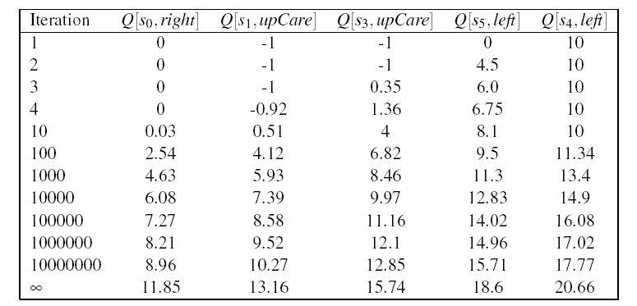
Example (variable α_{k})
As the number of iteration increases, the effect of the positive reward achieved by moving left in s₄ trickles further back in the sequence of steps
Q[s₄,left] starts changing only after the effect of the reward has reached s₀ (i.e. after iteration 10 in the table)
Why 10 and not 6?
Notes:
Because before s0 feels a positive effect, the Q value in s1 need to become positive, otherwise the actions that bring to states with Q = 0 get picked first

Slide 38
Example (Fixed α=1)
First iteration same as before, let’s look at the second
-1
-1
+ 10
-1
Q[s,a] | s₀ | s₁ | s₂ | s₃ | s₄ | s₅
upCareful | 0 | -1 | 0 | -1 | 0 | 0
Left | 0 | 0 | 0 | 0 | 10 | 0
Right | 0 | 0 | 0 | 0 | 0 | 0
Up | 0 | 0 | 0 | 0 | 0 | 0
-100
-1
k=2
-1
-1
New evidence is given much more weight than original estimate
Notes:
Note that each Q(s,a) corresponds to a different TD equation. Thus the value of k in each update depends upon how many times that specific (s,a) pair has been visited. Need a separate K counter for each (s,a) pair

Slide 39
-1
-1
+ 10
-1
Q[s,a] | s₀ | s₁ | s₂ | s₃ | s₄ | s₅
upCareful | 0 | -1 | 0 | -1 | 0 | 0
Left | 0 | 0 | 0 | 0 | 10 | 9
Right | 0 | 0 | 0 | 0 | 0 | 0
Up | 0 | 0 | 0 | 0 | 0 | 0
-100
-1
k=1
k=3
-1
-1
Same here
No change from previous iteration, as all the reward from the step ahead was included there

Slide 40
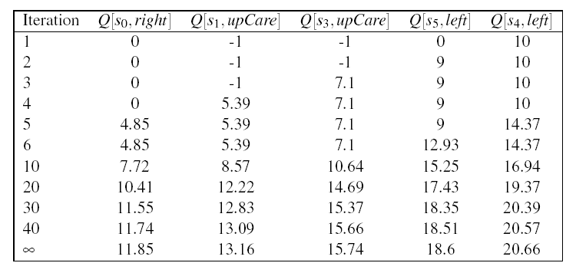
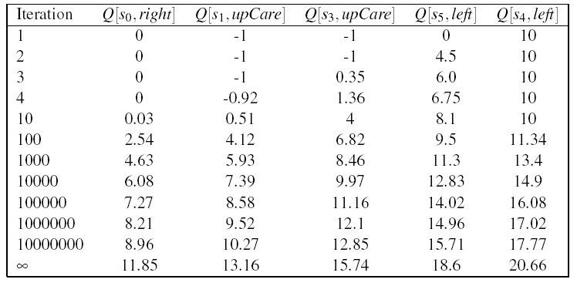
Comparing fixed α (top) and variable α (bottom)
Fixed α generates faster update:
all states see some effect of the
positive reward from <s4, left> by
the 5th iteration
Each update is much larger
Gets very close to final numbers by
iteration 40, while with variable α
still not there by iteration 10⁷
However, remember:
Q-learning with fixed α is not guaranteed to converge

Slide 41
Discussion
In Q-learning,
  Updates involve only s and a that appear in experiences
  The computation of Q(s,a) relies on an approximation of its true link with Q(s’, a’)
    The Q-learning update only considers the s’ observed in the experience
WHY?

Slide 42
Discussion
In Q-learning,
  Updates involve only s and a that appear in experiences
  The computation of Q(s,a) relies on an approximation of its true link with Q(s’, a’)
    The Q-learning update only considers the s’ observed in the experience
WHY?

Slide 43
Discussion
True relation between Q(s.a) and Q(s’a’)
Q-learning approximation based on each individual experience <s, a, r, s’>
Way to get around the missing transition model and reward model
Aren’t we in danger of using data coming from unlikely transition to make incorrect adjustments?

Slide 44
Discussion
True relation between Q(s.a) and Q(s’a’)
Q-learning approximation based on each individual experience <s, a, s’>
Way to get around the missing transition model and reward model
Aren’t we in danger of using data coming from unlikely transition to make incorrect adjustments?
  No, because frequency of updates reflects transition model, P(s’|a,s)
  Unlikely transitions will be observed much less frequently than likely ones, so their related updates will have limited impact in the long term

Slide 45
Discussion
True relation between Q(s.a) and Q(s’a’)
Q-learning approximation based on each individual experience <s, a, s’>
Way to get around the missing transition model and reward model
Aren’t we in danger of using data coming from unlikely transition to make incorrect adjustments?
No, as long as Q-learning tries each action an unbounded number of times
  Frequency of updates reflects transition model, P(s’|a,s)
  Unlikely transitions will be observed much less frequently than likely ones, so their related updates will have limited impact in the long term

Slide 46
Q-learning
Q-learning learns an optimal policy no matter which actions are selected in each state
Q-learning is an off-policy method because it learns an optimal policy no matter which policy the agent is actually following
It is also a model-free method, because it does not need to learn an explicit transition model for the environment in order to find the optimal policy
  The environment provides the connections between neighboring states in the form of observed transitions

