Slide 1
Overview
Full Bayesian Learning
MAP learning
Maximun Likelihood Learning
Learning Bayesian Networks
Fully observable (complete data)
With hidden (unobservable) variables

Slide 2
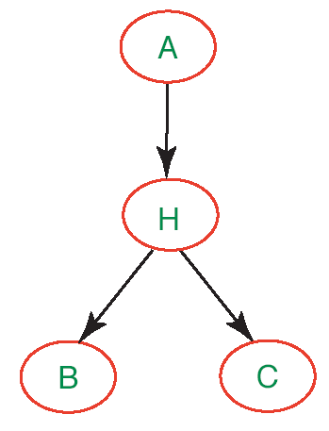
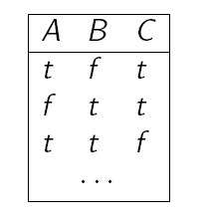
Learning Parameters with Hidden Variables
So far we have assumed that I can collect data on all variables in the network
What if this is not true, i.e. the network has hidden variables?
Clearly I can’t use the frequency approach, because I am missing all the counts involving H

Slide 3
Quick Fix
Get rid of the hidden variables.
It may work in the simple network given earlier, but what about the following one?
Each variable has 3 values (low, moderate, high)
the numbers by the nodes represent how many parameters need to be specified for the CPT of that node
78 probabilities to be specified overall

Slide 4
Not Necessarily a Good Fix
The symptom variables are no longer conditionally independent given their parents
Many more links, and many more probabilities to be specified: 708 overall
Need much more data to properly learn the network

Slide 5
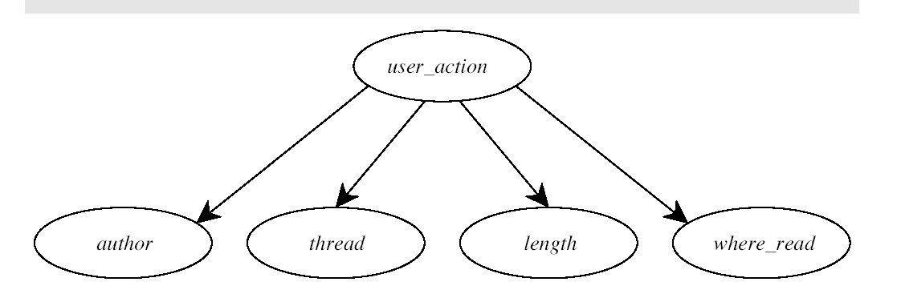
Another Example
We saw how we could use a Naïve Classifier for classifying messages in terms of user reading choice based on labelled data
The data included the classification
can use the frequencies to learn the necessary CPTs

Slide 6
Another Example
But I may want to find groups of users that behave similarly when reading news, without knowing the categories a priori
Type of unsupervised learning known as clustering
I can do that by assuming k user categories and making them the values of an hidden variable C in the Naive classifier
How to computer the parameters?
C

Slide 7
Expectation-Maximization (EM)
If we keep the hidden variables, and want to learn the network parameters from data, we have a form of unsupervised learning
the data do not include information on the true nature of each data point
Expectation-Maximization
general algorithm for learning model parameters from incomplete data
We’ll see how it works on learning parameters for Bnets with discrete, continuous variables

Slide 8
EM: general idea
If we had data for all the variables in the network, we could learn the parameters by using ML (or MAP) models
e.g. frequencies of the relevant events as we saw in previous examples
If we had the parameters in the network, we could estimate the posterior probability of any event, including the hidden variables
e.g., P(H|A,B,C)

Slide 9
EM: General Idea
The algorithm starts from “invented” (e.g., randomly generated) information to solve the learning problem, e.g.,
the network parameters
It then refines this initial guess by cycling through two basic steps
Expectation (E): update the data with predictions generated via the current model
Maximization (M): given the updated data, infer the Maximum Likelihood (or MAP model)
This is the same step that we described when learning parameters for fully observable networks
It can be shown that EM increases the log likelihood of the data at any iteration, and often achieves a local maximum

Slide 10
EM: How if Works on Naive Bayes
We start from our network with hidden variable and incomplete data
?
?
?
?
?
We then make up the missing data.
Suppose that we want C to have three values, [1,2,3] (categories)
What would we need to learn the network parameters?

Slide 11
EM: How if Works on Naive Bayes
We start from our network with hidden variable and incomplete data
?
?
?
?
?
We then make up the missing data.
Suppose that we want C to have three values, [1,2,3] (categories)
What would we need to learn the network parameters?
for P(C) = Count(datapoints with C=i)|Count(all dataponts) ) i=1,2,3
for P(X_{j}|C) = Count(datapoints with X_{j} = val_{k} and C=i)|Counts(data with C=i)
for all values val_{k} of X_{j} and i=1,2,3

Slide 12
EM: Augmenting the Data
We only have Count(all datapoints). We approximate the others with expected counts derived from the model
Expected count is the sum, over all N examples in my dataset, of the probability that each example is in category I
Where
Available from the model

Slide 13
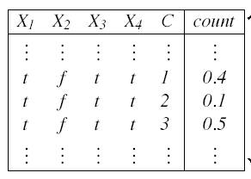
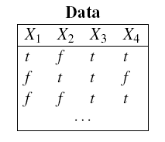
EM: Augmenting the Data
This process is analogous to creating new tuples of data that include values for the hidden variables
For each tuple in the original data (i.e. [t,f,t,t]) below,
expected counts
duplicate it as many times as are the values of C, and add to each new tuple one of the values of C
Get an expected count for each new tuple from the model.

Slide 14
EM: Augmenting the Data
This process is analogous to creating new tuples of data that include values for the hidden variables
For each tuple in the original data (i.e. [t,f,t,t]) below,
expected counts
duplicate it as many times as are the values of C, and add to each new tuple one of the values of C
Get an expected count for each new from the model.

Slide 15
E-Step
And all the probabilities in the expression above are given in the Naive Bayes model
The result of the computation will replace the corresponding expected count in the augmented data
Repeat to update all counts in the table

Slide 16
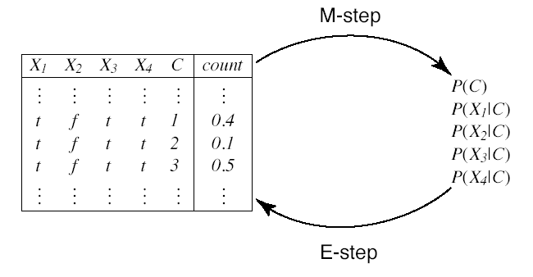
M-Step
Use expected counts to update model parameters via the ML
Augmented data
Probabilities

Slide 17
Repeat
Augmented data
Probabilities

Slide 18
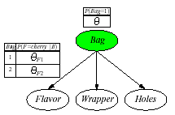
Another Example
Back to the cherry/lime candy world.
Two bags of candies (1 and 2) have been mixed together
Candies are described by 3 features: Flavor and Wrapper as before, plus Hole (whether they have a hole in the middle)
The distribution of candies in each bag is described again by a naive Bayes model, below
θ= P(Bag = 1)
θ_{Fj} = P(Flavor = cherry|Bag = j)
θ_{Wj} = P(Wrapper = red|Bag = j)
θ_{Hj} = P(Hole = yes|Bag = j)
j =1,2

Slide 19
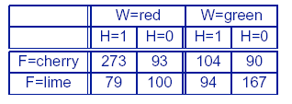
Another Example
Assume that the true parameters are
θ= 0.5;
θ_{F1} = θ_{W1} = θ_{H1} = 0.8;
θ_{F2} = θ_{W2} = θ_{H2} = 0.3;
The following 1000 datapoints have been generated by sampling the true model
We want to re-learn the true parameters using EM

Slide 20
Start Point
This time, we start by directly assigning a guesstimate for the parameters
Usually done randomly; here we select numbers convenient for computation
We’ll work through one cycle of EM to compute θ^{(1).}

Slide 21
E-step
First, we need the expected count of candies from Bag 1,
Sum of the probabilities that each of the N data points comes from bag 1
Be flavor_{j}, wrapper_{j}, hole_{j} the values of the corresponding attributes for the j^{th} datapoint

Slide 22
E-step
This summation can be broken down into the 8 candy groups in the data table.
For instance the sum over the 273 cherry candies with red wrap and hole (first entry in the data table) gives

Slide 23
M-step
If we do compute the sums over the other 7 candy groups we get
At this point, we can perform the M-step to refine θ, by taking the expected frequency of the data points that come from Bag 1

Slide 24
One More Parameter
If we want to do the same for parameter θ_{F1}
E-step: computer the expected count of cherry candies from Bag 1
Can compute the above value from the Naïve model as we did earlier
M-step: refine θ_{F1} by computing the corresponding expected frequencies

Slide 25
Learning Performance
After a complete cycle through all the parameters, we get
For any set of parameters, I can compute the log likelihood as we did in the previous class
It can be shown that the log likelihood increases with each EM iteration, surpassing even the likelihood of the original model after only 3 iterations

Slide 26
EM: Discussion
For more complex Bnets the algorithm is basically the same
In general, I may need to compute the conditional probability parameter for each variable X_{i} given its parents Pa_{i}
θ_{ijk}= P(X_{i} = x_{ij}|Pa_{i =} pa_{ik})
The expected counts are computed by suming over the examples, after having computer for each P(X_{i} = x_{ij},Pa_{i =} pa_{ik}) using any Bnet inference algorithm
The inference can be intractable, in which case there are variations of EM that use sampling algorithms for the E-Step

Slide 27
EM: Discussion
The algorithm is sensitive to “degenerated” local maxima due to extreme configurations
e.g., data with outliers can generate categories that include only 1 outlier each because these models have the highest log likelihoods
Possible solution: re-introduce priors over the learning hypothesis and use the MAP version of EM

