Slide 1
Bayesian Learning and Learning Bayesian Networks

Slide 2
Overview
Full Bayesian Learning
MAP learning
Maximun Likelihood Learning
Learning Bayesian Networks
  Fully observable
  With hidden (unobservable) variables

Slide 3
Full Bayesian Learning
In the learning methods we have seen so far, the idea was always to find the best model that could explain some observations
In contrast, full Bayesian learning sees learning as Bayesian updating of a probability distribution over the hypothesis space, given data
  H is the hypothesis variable
  Possible hypotheses (values of H) h₁…, h_{n}
  P(H) = prior probability distribution over hypotesis space
j_{th} observation d_{j} gives the outcome of random variable D_{j}
  training data d= d₁,..,d_{k}

Slide 4
Full Bayesian Learning
Given the data so far, each hypothesis h_{i} has a posterior probability:
  P(h_{i} |d) = αP(d| h_{i}) P(h_{i}) (Bayes theorem)
  where P(d| h_{i}) is called the likelihood of the data under each hypothesis
Predictions over a new entity X are a weighted average over the prediction of each hypothesis:
  P(X|d) =
  = ∑_{i} P(X, h_{i} |d)
  = ∑_{i} P(X| h_{i},d) P(h_{i} |d)
  = ∑_{i} P(X| h_{i}) P(h_{i} |d)
  ~ ∑_{i} P(X| h_{i}) P(d| h_{i}) P(h_{i})
  The weights are given by the data likelihood and prior of each h
No need to pick one best-guess hypothesis!
The data does not add anything to a prediction given an hp

Slide 5
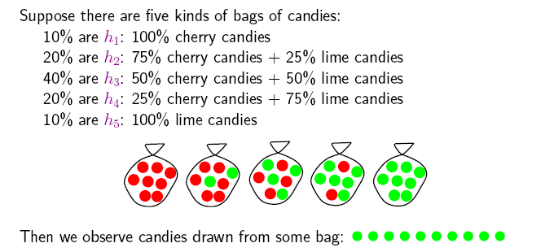
Example
Suppose we have 5 types of candy bags
  10% are 100% cherry candies (h₁₀₀ , P(h₁₀₀ )= 0.1)
  20% are 75% cherry + 25% lime candies (h₇₅ , P(h₇₅ )= 0.2)
  50% are 50% cherry + 50% lime candies (h₅₀ , P(h₅₀ )= 0.4)
  20% are 25% cherry + 75% lime candies (h₂₅ , P(h₂₅ )= 0.2)
  10% are 100% lime candies (h₀ ,P(h₁₀₀ )= 0.1)
The we observe candies drawn from some bag
Let’s call θ the parameter that defines the fraction of cherry candy in a bag, and h_{θ} the corresponding hypothesis
Which of the five kinds of bag has generated my 10 observations? P(h _{θ} |d).
What flavour will the next candy be? Prediction P(X|d)

Slide 6
Example
If we re-wrap each candy and return it to the bag, our 10 observations are independent and identically distributed, i.i.d, so
  P(d| h_{θ}) = ∏_{j} P(d_{j}| h_{θ}) for j=1,..,10
For a given h_{θ} , the value of P(d_{j}| h_{θ}) is
  P(d_{j} = cherry| h_{θ}) = θ; P(d_{j} = lime|h_{θ}) = (1-θ)
And given N observations, of which c are cherry and l = N-c lime
  Binomial distribution: probability of # of successes in a sequence of N independent trials with binary outcome, each of which yields success with probability θ.
For instance, after observing 3 lime candies in a row:
  P([lime, lime, lime| h ₅₀) = 0.5³ because the probability of seeing lime for each observation is 0.5 under this hypotheses

Slide 7
Example
If we re-wrap each candy and return it to the bag, our 10 observations are independent and identically distributed, i.i.d, so
  P(d| h_{θ}) = ∏_{j} P(d_{j}| h_{θ}) for j=1,..,10
For a given h_{θ} , the value of P(d_{j}| h_{θ}) is
  P(d_{j} = cherry| h_{θ}) = θ; P(d_{j} = lime|h_{θ}) = (1-θ)
And given N observations, of which c are cherry and l = N-c lime
  Binomial distribution: probability of # of successes in a sequence of N independent trials with binary outcome, each of which yields success with probability θ.
For instance, after observing 3 lime candies in a row:
  P([lime, lime, lime| h ₅₀) = 0.5³ because the probability of seeing lime for each observation is 0.5 under this hypotheses

Slide 8
Example
If we re-wrap each candy and return it to the bag, our 10 observations are independent and identically distributed, i.i.d, so
  P(d| h_{θ}) =
For a given h_{θ} , the value of P(d_{j}| h_{θ}) is
  P(d_{j} = cherry| h_{θ}) = ; P(d_{j} = lime|h_{θ}) =
And given N observations, of which c are cherry and l = N-c lime
  Binomial distribution: probability of # of successes in a sequence of N independent trials with binary outcome, each of which yields success with probability θ.
For instance, after observing 3 lime candies in a row:
  P([lime, lime, lime| h ₅₀) =

Slide 9
Posterior Probability of H
P(h₁₀₀|d)
P(h₇₅|d)
P(h₅₀|d)
P(h₂₅|d)
P(h₀|d)
P(h_{i} |d) = αP(d| h_{i}) P(h_{i})
Initially, the hp with higher priors dominate (h₅₀ with prior = 0.4)
As data comes in, the true hypothesis (h₀ ) starts dominating, as the probability of seeing this data given the other hypotheses gets increasingly smaller
  After seeing three lime candies in a row, the probability that the bag is the all-lime one starts taking off

Slide 10
Prediction Probability
∑_{i} P(next candy is lime| h_{i}) P(h_{i} |d)
The probability that the next candy is lime increases with the probability that the bag is an all-lime one

Slide 11
Overview
Full Bayesian Learning
MAP learning
Maximun Likelihood Learning
Learning Bayesian Networks
  Fully observable
  With hidden (unobservable) variables

Slide 12
MAP approximation
Full Bayesian learning seems like a very safe bet, but unfortunately it does not work well in practice
  Summing over the hypothesis space is often intractable (e.g., 18,446,744,073,709,551,616 Boolean functions of 6 attributes)
Very common approximation: Maximum a posterior (MAP) learning:
  Instead of doing prediction by considering all possible hypotheses , as in
    P(X|d) = ∑_{i} P(X| h_{i}) P(h_{i} |d)
  Make predictions based on h_{MAP} that maximises P(h_{i} |d)
    I.e., maximize P(d| h_{i}) P(h_{i})
    P(X|d)~ P(X| h_{MAP} )

Slide 13
MAP approximation
Map is a good approximation when P(X |d) ≈ P(X| h_{MAP})
  In our example, h_{MAP} is the all-lime bag after only 3 candies, predicting that the next candy will be lime with p =1
  the bayesian learner gave a prediction of 0.8, safer after seeing only 3 candies
P(h₁₀₀|d)
P(h₇₅|d)
P(h₅₀|d)
P(h₂₅|d)
P(h₀|d)

Slide 14
Bias
As more data arrive, MAP and Bayesian prediction become closer, as MAP’s competing hypotheses become less likely
Often easier to find MAP (optimization problem) than deal with a large summation problem
P(H) plays an important role in both MAP and Full Bayesian Learning
  Defines the learning bias, i.e. which hypotheses are favoured
Used to define a tradeoff between model complexity and its ability to fit the data
  More complex models can explain the data better => higher P(d| h_{i}) danger of overfitting
  But they are less likely a priory because there are more of them than simpler models => lower P(h_{i})
  I.e. common learning bias is to penalize complexity

Slide 15
Overview
Full Bayesian Learning
MAP learning
Maximun Likelihood Learning
Learning Bayesian Networks
  Fully observable
  With hidden (unobservable) variables

Slide 16
Maximum Likelihood (ML)Learning
Further simplification over full Bayesian and MAP learning
  Assume uniform priors over the space of hypotheses
  MAP learning (maximize P(d| h_{i}) P(h_{i})) reduces to maximize P(d| h_{i})
When is ML appropriate?

Slide 17
Maximum Likelihood (ML) Learning
Further simplification over Full Bayesian and MAP learning
  Assume uniform prior over the space of hypotheses
  MAP learning (maximize P(d| h_{i}) P(h_{i})) reduces to maximize P(d| h_{i})
When is ML appropriate?
  Used in statistics as the standard (non-bayesian) statistical learning method by those distrust subjective nature of hypotheses priors
  When the competing hypotheses are indeed equally likely (e.g. have same complexity)
  With very large datasets, for which P(d| h_{i}) tends to overcome the influence of P(h_{i}))

Slide 18
Overview
Full Bayesian Learning
MAP learning
Maximun Likelihood Learning
Learning Bayesian Networks
  Fully observable (complete data)
  With hidden (unobservable) variables

Slide 19
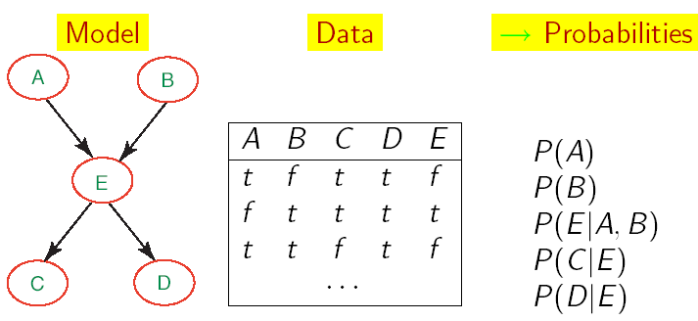
Learning BNets: Complete Data
We will start by applying ML to the simplest type of BNets learning:
  known structure
  Data containing observations for all variables
    All variables are observable, no missing data
The only thing that we need to learn are the network’s parameters

Slide 20
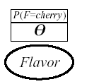
ML learning: example
Back to the candy example:
  New candy manufacturer that does not provide data on the probability of different types of bags, i.e. fraction θ of cherry candy
  Any θ is possible: continuum of hypotheses h_{θ}
  Reasonable to assume that all θ are equally likely (we have no evidence of the contrary): uniform distribution P(h_{θ})
  θ is a parameter for this simple family of models, that we need to learn
Simple network to represent this problem
  Flavor represents the event of drawing a cherry vs. lime candy from the bag
  P(F=cherry), or P(cherry) for brevity, is equivalent to the fraction θ of cherry candies in the bag
We want to infer θ by unwrapping N candies from the bag

Slide 21
ML learning: example (cont’d)
Unwrap N candies, c cherries and l = N-c lime (and return each candy in the bag after observing flavor)
As we saw earlier, this is described by a binomial distribution
  P(d| h _{θ}) = ∏_{j} P(d_{j}| h _{θ}) = θ ^{c} (1- θ) ^{l}
With ML we want to find θ that maximizes this expression, or equivalently its log likelihood (L)
  L(P(d| h _{θ})
  = log (∏_{j} P(d_{j}| h _{θ}))
  = log (θ ^{c} (1- θ) ^{l} )
  = clogθ + l log(1- θ)

Slide 22
ML learning: example (cont’d)
To maximise, we differentiate L(P(d| h _{θ}) with respect to θ and set the result to 0
the proportion of cherries in the bag is equal to the proportion (frequency) of in cherries in the data
Doing the math gives

Slide 23
Frequencies as Priors
So this says that the proportion of cherries in the bag is equal to the proportion (frequency) of in cherries in the data
We have already used frequencies to learn the probabilities of the PoS tagger HMM in the homework
Now we have justified why this approach provides a reasonable estimate of node priors

Slide 24
General ML procedure
Express the likelihood of the data as a function of the parameters to be learned
Take the derivative of the log likelihood with respect of each parameter
Find the parameter value that makes the derivative equal to 0
The last step can be computationally very expensive in real-world learning tasks

Slide 25
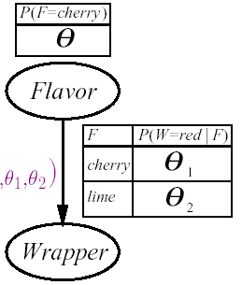
Another example
The manufacturer choses the color of the wrapper probabilistically for each candy based on flavor, following an unknown distribution
  If the flavour is cherry, it chooses a red wrapper with probability θ₁
  If the flavour is lime, it chooses a red wrapper with probability θ₂
The Bayesian network for this problem includes 3 parameters to be learned
  θ θ ₁ θ ₂

Slide 26
Another example
The manufacturer choses the color of the wrapper probabilistically for each candy based on flavor, following an unknown distribution
  If the flavour is cherry, it chooses a red wrapper with probability θ₁
  If the flavour is lime, it chooses a red wrapper with probability θ₂
The Bayesian network for this problem includes 3 parameters to be learned
  θ θ ₁ θ ₂

Slide 27
Another example (cont’d)
P( W=green, F = cherry| h_{θθ1θ2}) = (*)
We unwrap N candies
  c are cherry and l are lime
  r^{c} cherry with red wrapper, g^{c} cherry with green wrapper
  r^{l} lime with red wrapper, g ^{l} lime with green wrapper
  every trial is a combination of wrapper and candy flavor similar to event (*) above, so
P(d| h_{θθ1θ2})
=

Slide 28
Another example (cont’d)
P( W=green, F = cherry| h_{θθ1θ2}) = (*)
= P( W=green|F = cherry, h_{θθ1θ2}) P( F = cherry| h_{θθ1θ2})
= θ (1-θ ₁)
We unwrap N candies
  c are cherry and l are lime
  r_{c} cherry with red wrapper, g_{c} cherry with green wrapper
  r _{l} lime with red wrapper, g _{l} lime with green wrapper
  every trial is a combination of wrapper and candy flavor similar to event (*) above, so
P(d| h_{θθ1θ2})
= ∏_{j} P(d_{j}| h_{θθ1θ2})
  = θ^{c} (1-θ) ^{l} (θ ₁) ^{r}c (1-θ ₁) ^{g}c (θ ₂) ^{r} l (1-θ ₂) ^{g} l

Slide 29
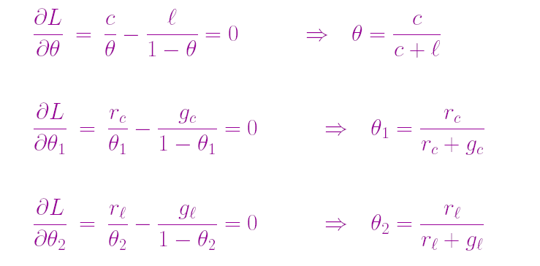
Another example (cont’d)
I want to maximize the log of this expression
  clogθ + l log(1- θ) + r^{c} log θ ₁ + g^{c} log(1- θ ₁) + r^{l} log θ ₂ + g ^{l} log(1- θ ₂)
Take derivative with respect of each of θ, θ ₁ ,θ ₂
  The terms that not containing the derivation variable disappear

Slide 30
Another example (cont’d)
I want to maximize the log of this expression
  clogθ + l log(1- θ) + r^{c} log θ ₁ + g^{c} log(1- θ ₁) + r^{l} log θ ₂ + g ^{l} log(1- θ ₂)
Take derivative with respect of each of θ, θ ₁ ,θ ₂
  The terms not containing the derivation variable disappear

Slide 31
ML parameter learning in Bayes nets
Frequencies again!
This process generalizes to every fully observable Bnet.
With complete data and ML approach:
  Parameters learning decomposes into a separate learning problem for each parameter (CPT), because of the log likelihood step
  Each parameter is given by the frequency of the desired child value given the relevant parents values

Slide 32
Very Popular Application
C
Naïve Bayes models: very simple Bayesian networks for classification
  Class variable (to be predicted) is the root node
  Attribute variables X_{i} (observations) are the leaves
Naïve because it assumes that the attributes are conditionally independent of each other given the class
Deterministic prediction can be obtained by picking the most likely class
Scales up really well: with n boolean attributes we just need…….
X_{i}
X₁
X₂

Slide 33
Very Popular Application
C
Naïve Bayes models: very simple Bayesian networks for classification
  Class variable (to be predicted) is the root node
  Attribute variables X_{i} (observations) are the leaves
Naïve because it assumes that the attributes are conditionally independent of each other given the class
Deterministic prediction can be obtained by picking the most likely class
Scales up really well: with n boolean attributes we just need 2n+1 parameters
X_{i}
X₁
X₂

Slide 34
Example
Naïve Classifier for the newsgroup reading example

Slide 35
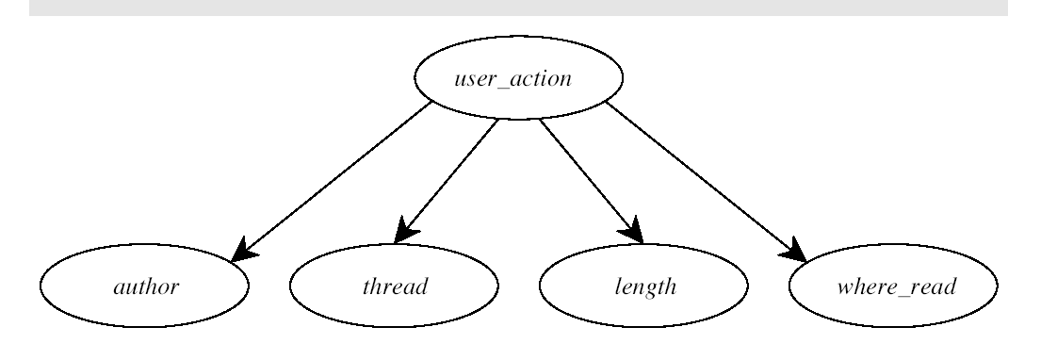
Example
Naïve Classifier for the newsgroup reading example

Slide 36
Problem with ML parameter learning
With small datasets, some of the frequencies may be 0 just because we have not observed the relevant data
Generates very strong incorrect predictions:
  Common fix: initialize the count of every relevant event to 1 before counting the observations

Slide 37
Probability from Experts
As we mentioned in previous lectures, an alternative to learning probabilities from data is to get them from experts
Problems
  Experts may be reluctant to commit to specific probabilities that cannot be refined
  How to represent the confidence in a given estimate
  Getting the experts and their time in the first place
One promising approach is to leverage both sources when they are available
  Get initial estimates from experts
  Refine them with data

Slide 38
Combining Experts and Data
Get the expert to express her belief on event A as the pair
  <n,m>
  i.e. how many observations of A they have seen (or expect to see) in m trials
Combine the pair with actual data
  If A is observed, increment both n and m
  If ⌐A is observed, increment m alone
The absolute values in the pair can be used to express the expert’s level of confidence in her estimate
  Small values (e.g., <2,3>) represent low confidence
  The larger the values, the higher the confidence
WHY?

Slide 39
Combining Experts and Data
Get the expert to express her belief on event A as the pair
  <n,m>
  i.e. how many observations of A they have seen (or expect to see) in m trials
Combine the pair with actual data
  If A is observed, increment both n and m
  If ⌐A is observed, increment m alone
The absolute values in the pair can be used to express the expert’s level of confidence in her estimate
  Small values (e.g., <2,3>) represent low confidence, as they are quickly dominated by data
  The larger the values, the higher the confidence as it takes more and more data to dominate the initial estimate (e.g. <2000, 3000>)

