Slide 1
Learning Neural
Networks (NN)

Slide 2
Department of Computer Science Undergraduate Events
CSSS Movie Night: “Zombieland” & “Iron Man”
Date: Thurs., Mar 11
Time: 6 – 10 pm
Location: DMP 310
Free pop & popcorn for every attendee!
Events next week
Interview Skills Practice Session
Mon., March 15, 12 – 2 pm, Rm 202, ICICS/CS
Transport Canada Info Session
Tues., March 16, 4 – 6 pm, HENN 201
Financial Literacy 101
Wed., March 17, 12 – 1 pm, Angus 426
Townhall Meeting for CS Major/Honours Students
Thurs., March 18, 12:30 – 2 pm, DMP 310
CS Distinguished Lecture Series Featuring Jeff Hawkins
Thurs., March 18, 3:30 – 4:50 pm, DMP 110
Events this week
Drop-In Resume and Cover Letter Editing (20 min. appointments)
Date: Thurs., March 11
Time: 11:30 am – 2:30 pm
Location: Rm 255, ICICS/CS
Townhall Meeting for Combined Majors /Honours, Cogs, BA, B.Comm in CS
Date: Thurs., March 11
Time: 12:30 – 2 pm
Location: DMP 310
Lumch will be provided!
CS Distinguished Lecture Series Featuring David Parkes
Title: Incentive Mechanism Engineering in the Internet Age
Date: Thurs., Mar 11
Time: 3:30 – 4:50 pm
Location: DMP 110

Slide 3
Admin matters
I will have extra office hours tomorrow (Wed March 10)
11am-12pm

Slide 4
Learning Neural Networks (NN)
NN, introduction and basic definitions
Example: NN for the news reading domain
Activation Functions
Perceptron and Feed Forward neural networks (FF NN)
Learning algorithm for FF NN: Back propagation
Applications

Slide 5
Supervised Learning
Supervised Learning => pure inductive inference
Given a set of examples of a function f: pairs (x, f(x))
Find a function h that approximates f.
h is called hypothesis.
H is the space of hypotheses (representations) that we consider

Slide 6
Neural Networks
Computational methods for
representing functions using networks of simple arithmetic computing elements
learning such representations from examples (supervised learning)
Particularly useful for complex functions with continuous-valued outputs and large # of noisy inputs
Inspired by the architecture of the brain:
The simple arithmetic computing elements correspond to neurons
a neural network corresponds to a collection of interconnected neurons

Slide 7
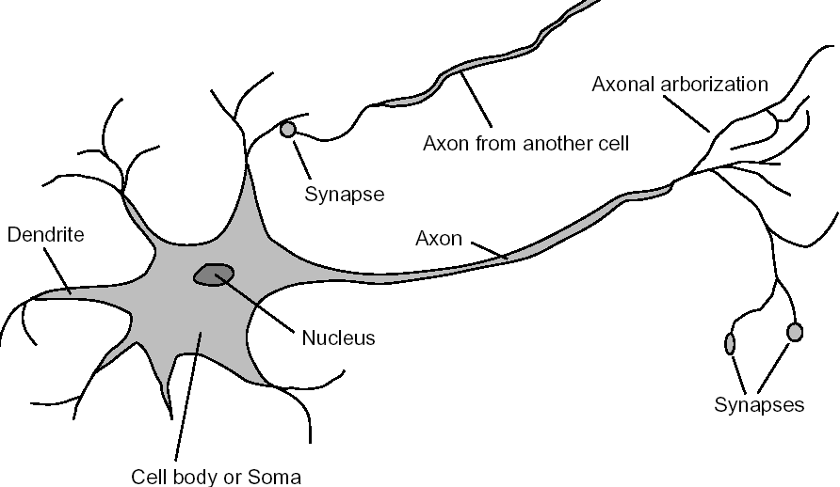
Neurons in the Brain

Slide 8
neuron is also known as nerve cell.
Axons of one neuron connect to dendrites and cell bodies of other neurons, through synapses.
Signals are transmitted from neuron to neuron by complicated electrochemical reactions.
These reactions generate chemical transmitter substances that are released through the synapses, enter the dendrites and raises or lowers the electrical potential of the cell body.
When this potential reaches a given threshold, an electrical pulse of action potential is sent down the axion and passes to other neurons through their synapses, which can be either excitatory or inhibitory.
Strength of connections change in response to patterns of stimulations, and new connections are continuously formed. This seems to be the basic mechanism for learning in the brain

Slide 9
Neural Networks: Basic Components
Artificial neurons, or units
Links that connect the units, each with an associated weight
Each unit has
input links from other units
output links to other units.
activation level, which is a function of its inputs and weights and represents the output of the unit
Input and output units in the network are connected to the environment

Slide 10
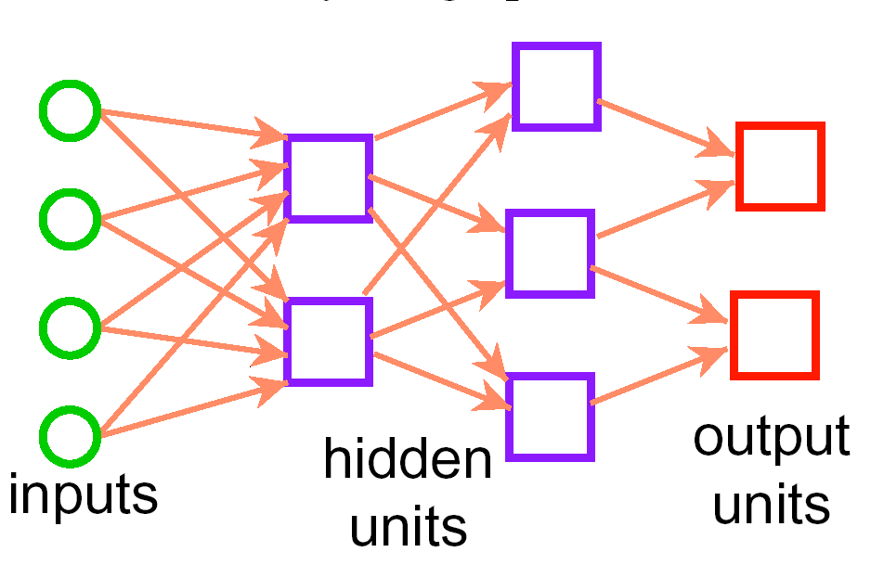
Sample Neural Network

Slide 11
Why Neural Networks?
It seems reasonable to try to build the functionality of the brain via the mechanism of the brain
The brain inspires new ways to think about computation.
Highly parallel, decentralized computation
Graceful degradation as conditions worsen (e.g. novel input, noise)
Neural networks provide a different measure of simplicity as a learning bias.
Functions that correspond to simple NNs are different from those that correspond to simple Decision Tees

Slide 12
Learning Neural Networks (NN)
NN, introduction and basic definitions
Example: NN for the news reading domain
Activation Functions
Perceptron and Feed Forward neural networks (FF NN)
Learning algorithm for FF NN: Back propagation
Applications

Slide 13
Example Classification Data (2)
We want to classify new examples on property Action based
on the examples’ Author, Thread, Length, and Where.

Slide 14
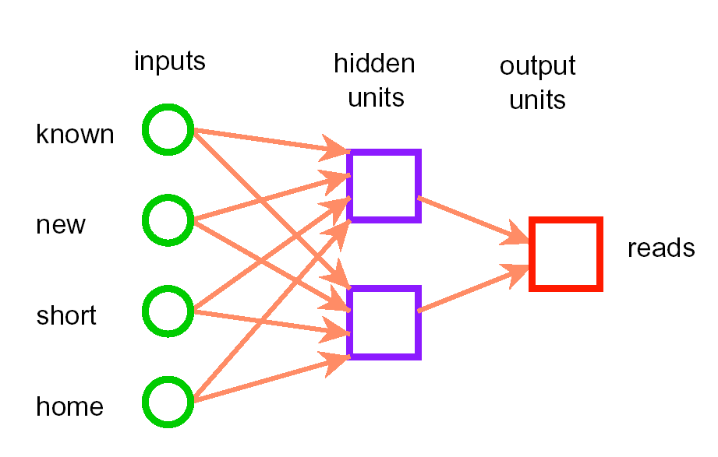
Neural Network for the News Example
w₃
w₄
I₁
w₉
h₁
w₅
w₁
I₂
w₁₀
w₂
w₆
I₃
h₂
w₁₁
w₇
w₀
I₄
w₁₂
w₈

Slide 15
Neural Network for the News Example
The values of the attributes are converted to real numbers
(ex: home = 0; work = 1)
Thirteen parameters w₀,…,w₁₂ are real numbers.
These are the 13 real numbers to be learned. The hypothesis space is thus a 13-dimensional real space.
Each point in this space corresponds to a particular network that predicts a value for reads given known, new, short, and home.
We will see later why we need the hidden units h1 and h2

Slide 16
Neural Network for the News Example
See how the network is learned with the NN applet in AI space
http://www.aispace.org/neural/index.shtml
File -> Load Sample Graph and Data -> Mail Reading
Go to Solve Mode and click on Step to Target Error

Slide 17
Learning Neural Networks (NN)
NN, introduction and basic definitions
Example: NN for the news reading domain
Activation Functions
Perceptron and Feed Forward neural networks (FF NN)
Learning algorithm for FF NN: Back propagation
Applications

Slide 18
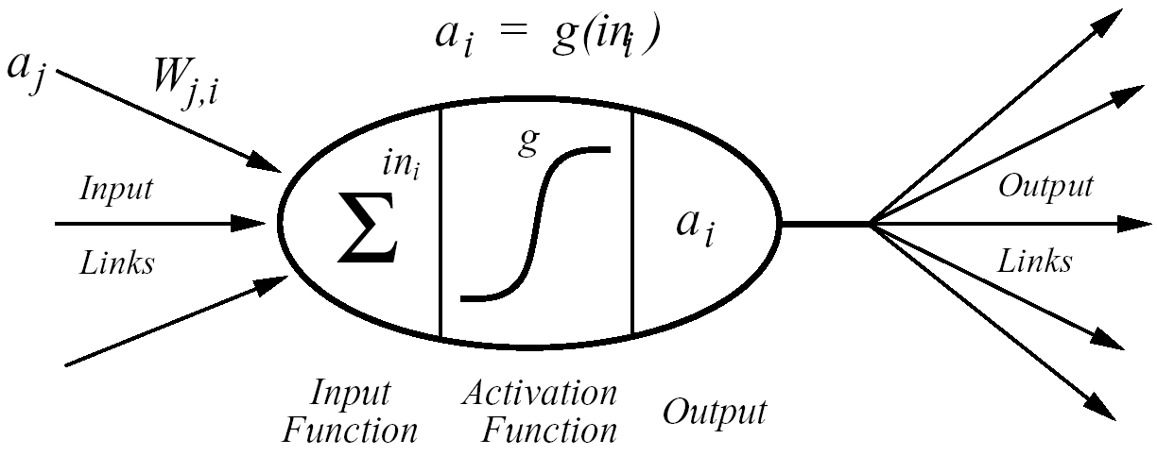
Basic Unit
I_{j} are real-valued inputs.
w_{j} are adjustable real-valued parameters.
f is an activation function.
in is the set of input link values
v is the level of activation or output of the unit
a_{j}
v = f(in) = f(w₀ + w₁*I₁+ w₂*I₂+….+ w_{k}*I_{k} )
I_{j}
w_{j}
f
v

Slide 19
Basic Unit
I_{j} are real-valued inputs.
w_{j} are adjustable real-valued parameters.
f is an activation function.
in is the linear combination of input link values
v is the level of activation or output of the unit
v = f(in) = f(w₀ + w₁*I₁+ w₂*I₂+….+ w_{k}*I_{k} )
I_{j}
w_{j}
f
I₂
v
w₂
I₁
w₁

Slide 20
Activation Functions
Functions from real numbers to real numbers suitable for classification tasks.
Must make a unit “active” (near 1), when it receives the “right” inputs, and inactive (near 0) when it receives the “wrong inputs”.

Slide 21
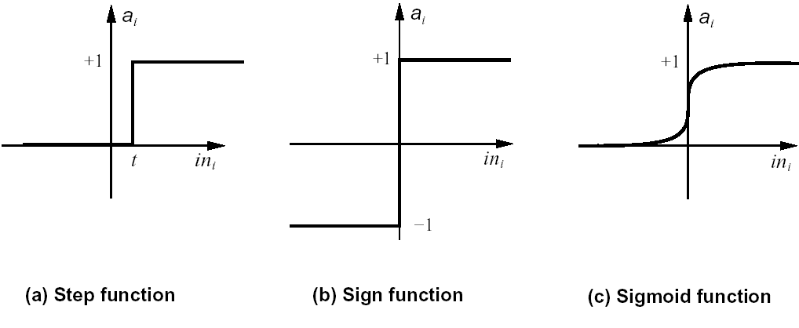
Activation Functions
Commonly used ones: squashed functions of the inputs
f (w₀ + w₁*I₁+ w₂*I₂+….+ w_{k}*I_{k})
Examples:
f(in) = 1 when in > t
= 0 otherwise

Slide 22
Activation Functions
Commonly used ones: squashed linear functions of the inputs
f (w₀ + w₁*I₁+ w₂*I₂+….+ w_{k}*I_{k})
Examples:
f(in) = 1 when in > t
= 0 otherwise

Slide 23
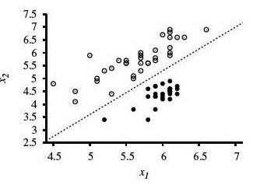
Step Function
If we use a step function, each unit represents a linear classifier with hard threshold
A linear classifier implements a linear decision boundary (aka linear separator) that separates the classes involved in the classification
f(in) = 1 when w₀ + w₁*I₁+ w₂*I₂+….+ w_{k}*I_{k} > 0
= 0 otherwise
w₀ + w₁*I₁+ w₂*I₂+….+ w_{k}*I_{k} > 0 => wI> 0
WI = 0 defines an hyper plane (line in two dimensions, plane in three)
Decision boundary
Assuming a “dummy” input I₀₌ 1

Slide 24
Sample Units for Logic Gates
f = step function
Individual units can represent basic Boolean functions of the inputs
I₁
I₁
w₁ = 1
w₁ = 1
w₁ = -1
t =
t =
I₁
t =
w₂ = 1
w₂ = 1
NOT
I₂
I₂
AND
OR

Slide 25
Sample Units for Logic Gates
f = step function
Individual units can represent basic Boolean functions of the inputs
I₁
I₁
w₁ = 1
w₁ = 1
w₁ = -1
t = 1.5
t = 0.5
I₁
t = -0.5
w₂ = 1
w₂ = 1
NOT
I₂
I₂
AND
OR

Slide 26
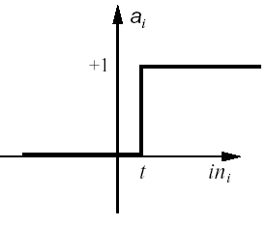
Getting rid of the threshold
Instead of having a unit with threshold t, add a “dummy” input I₀ = 1, with weight w₀, so that I₀ * w₀ = -t .
This way we only have to worry about adjusting weights, not the thresholds.
f = step_{t}
f = step₀
+1
I₀= 1
w₁ = 1
I₁
w₁ = 1
w₀ = -1.5
I₁
t = 1.5
I₂
t = 0
w₂ = 1
AND
I₂
w₂ = 1
AND

Slide 27
Learning Neural Networks (NN)
NN, introduction and basic definitions
Example: NN for the news reading domain
Activation Functions
Perceptron and Feed Forward neural networks (FF NN)
Learning algorithm for FF NN: Back propagation
Applications

Slide 28
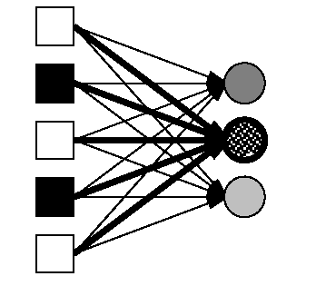
Perceptrons
NN with all the input units directly connected to the outputs
No hidden units
Also called single-layer NN
Note that each output unit is influenced by a different set of weights (i.e. it is independent from the other output units)
We can limit the discussion to single-output perceptrons, with no loss of generality

Slide 29
Perceptron Expressiveness
We saw that they can easily represent AND, OR, NOT (using step as activation function)
Can easily represent even more complex Boolean functions
Boolean Majority function f(x₁,…,x_{n}): T if more than half of its n inputs are T
I_{j}
w_{j}
I₂
w₂
t =
I₁
w₁
j : [1,n]

Slide 30
Perceptron Expressiveness
We saw that they can easily represent AND, OR, NOT (using step as activation function)
Can easily represent even more complex Boolean functions
Boolean Majority function f(x₁,…,x_{n}): T if more than half of its n inputs are T
I_{j}
w_{j}
I₂
w₂
t = n/2
I₁
w₁
w_{j}=1, j : [1,n]

Slide 31
Perceptron Expressiveness
Step Perceptrons can only represent linearly separable functions .
In a step Perceptron:
Output > 0
iff w₀I₀+w₁I₁+…+w_{n} I_{n} > 0 or, equivalently when
Wx > 0 (where W is the weight vector, and x is the input vector)
Wx = 0 defines an hyper plane (line in two dimensions, plane in three)
Thus the Perceptron returns 1 only if the output is on one side of the hyper plane

Slide 32
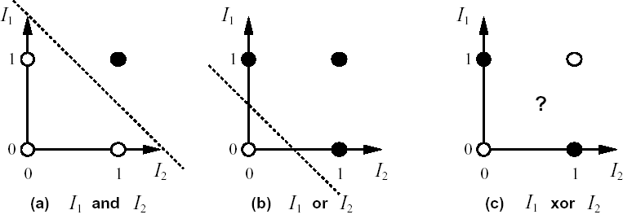
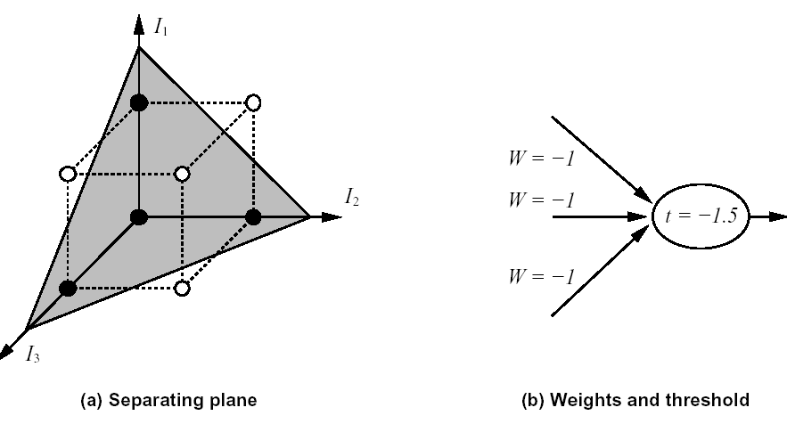
Which functions can they represent?
Linearly
separable
Non-Linearly
separable
Linearly
separable
Linearly
separable
= FALSE
Majority (I₁,I₂,I₃)
= TRUE

Slide 33
Which functions can they represent?
Linearly
separable
Non-Linearly
separable
Linearly
separable
Linearly
separable
= FALSE
Majority (I₁,I₂,I₃)
= TRUE

Slide 34
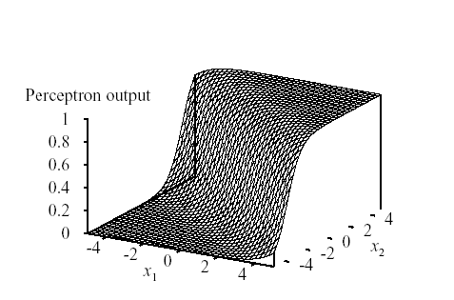
Perceptron Expressiveness
It can be shown that Perceptron with sigmoid activation function has similar limitations in expressiveness
Output of a two-input Perceptron unit with a sigmoid function
Adjusting weights changes the orientation, location and steepness of cliff

Slide 35
Feed Forward NN
We need something more expressive than Perceptrons
A common model are Feed-Forward neural networks
They are directed acyclic graphs.
Each unit is connected only to units in the next layer, there are no links that skip a layer
They are multilayer networks
Like our NN for the news reading dataset

Slide 36
Neural Network for the News Example
w₃
w₄
I₁
w₉
h₁
w₅
w₁
I₂
w₁₀
w₂
w₆
I₃
h₂
w₁₁
w₇
w₀
I₄
w₁₂
w₈

Slide 37
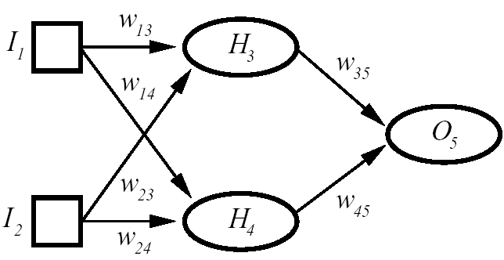
Output of A Feed Forward NN
v₃
v₁
v₅
v₂
v₄
v₅ = f (v₃*w _{3,5}+ v₄*w _{4,5})
Because f is non-linear the output v₅ is a complex non-linear function
Which function, depends on the weights.
= f (f(v₁*w _{1,3}+ v₂*w _{2,3})* w _{3,5} + f (v₁*w _{1,4}+ v₂*w _{2,4})* w _{4,5})

Slide 38
Expressiveness of Feed Forward NN
It can be shown that
FF NN with a single, sufficiently large hidden layer can represent any continuous function with arbitrary accuracy
FF NN with two hidden layers can also represent discontinuous functions
But it is difficult to characterize the expressiveness of any specific network structure
It is also hard, for any given learning task, to decide how many hidden units to add

Slide 39
Expressiveness of Feed Forward NN
Output of a FF NN with four hidden units and sigmoid activation functions
Output of a FF NN with two hidden units and sigmoid activation functions

Slide 40
Learning Neural Networks (NN)
NN, introduction and basic definitions
Example: NN for the news reading domain
Activation Functions
Perceptron and Feed Forward neural networks (FF NN)
Learning algorithm for FF NN: Back propagation
Applications

Slide 41
Learning algorithm: general idea
Start with an initial assignment of weights
Compute the classification error the current network makes on the training set
Change the weights to reduce the error
Repeat from 2 until the error reaches a given value
Essentially the algorithm tries to find the minimum of a measure of prediction error expressed as a function of the weights

Slide 42
Prediction Error
is the predicted output by a neural network with parameter values given by = w₀,…,w_{m} for example e
y_{e} is the observed output for example e.
is the error made by the network on example e
Aim of neural network learning: given a set of examples E, find parameter settings that minimize the sum-of-squares error.

Slide 43
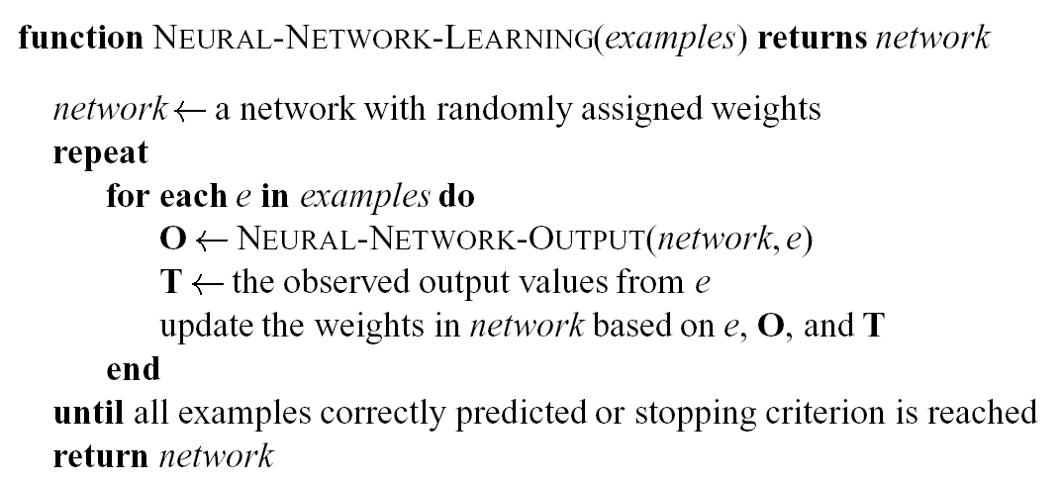
General NN Learning Algorithm
P
O
P
O

Slide 44
General NN Learning Algorithm
One update of all the weights for all the examples is called epoch
It might take many epochs for the network to converge
Main issue: assess the blame for an error and divide it between the contributing weights

Slide 45
Back Propagation Learning
Sensible approach to dividing the contribution of each weight to eliminate an error
Inputs:
A network, including all units and their connections
Stopping Criteria
Learning Rate η
Initial values for the parameters
A set of classified training data
Output: Updated values for the parameters

Slide 46
Backpropagation learning algorithm
Repeat:
evaluate the network on each example given the current parameter settings
determine the derivative of the error function with respect to each parameter
The squared error for a single training example e is
change each parameter in proportion to its derivative
until the stopping criterion is met

Slide 47
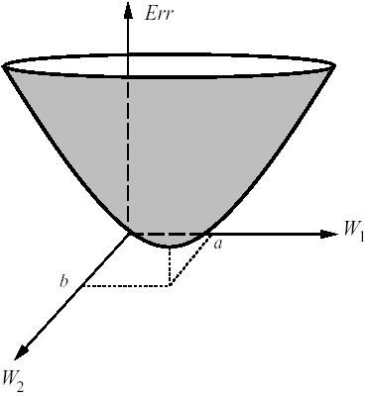
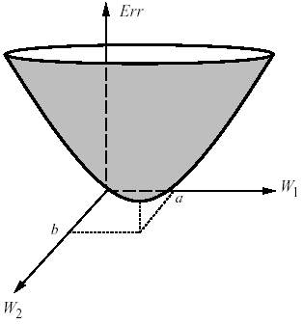
BP as Gradient Descent Search
Backpropagation: gradient descent search toward the minimum of the surface that describes the sum-of-squares errors as a function of all the weights in the network
each set of weights defines a point on the error surface
Given a point on the surface, look at the slope of the surface along the axis formed by each weight
partial derivative of the surface Err with respect to each weight w_{j}

Slide 48
Gradient Descent Search
As we mentioned earlier, we just need to look at the partial derivative of the error term on each example e with respect to each weight w_{j} ,
Alter each weight in an amount proportional to the slope in that direction
η is a constant called the learning rate that determines how fast the algorithm moves toward the minimum of the error function
If η is too large => overshooting => miss the minimum

Slide 49
Weight Update (output layer)
The predicted network value for example e is
w₀
w_{j}
v₀
v_{j}
h₀
h_{j}
where v₀,.,v_{k} are the outputs of the hidden units connected to the output node and w₀,.,w_{k} are the corresponding weights
Partial derivative with respect to weight w_{j} connecting the output v_{j} of hidden unit h_{j} to output node

Slide 50
Weight Update (output layer)
From this result and
each weight w_{j} in the connections between the last hidden layer and the output node is updated as follows
The sigmoid activation function is used because its derivative is easy to compute analytically
f
'
(
x
)
=
f
(
x
)(
1
−
f
(
x
))
chain rule

Slide 51
Weight Update (other layers)
How to apply the same process to update weights in the connections between any other layer?
Need to define a quantity analogous to the error in the output node
Error backpropagation
Idea: Each hidden unit is partially responsible for the error in the output unit
Output error is divided among the connected hidden units by dividing it among them in measure proportional to the strength of the corresponding connection.
This “inherited” error is then used to apply gradient descent to update the weights of the connections to this hidden layer.
What is the bias in this NN learning approach?

Slide 52
Drawback of BackPropagation
How do we know that backpropagation won’t get stuck in local minima?
We don’t
Here is one of the many papers on the subject
On The Problem Of Local Minima In Backpropagatio
(1992)
M. Gori, A. Tesi
IEEE Transaction on Pattern Analysis and Machine Intelligence

Slide 53
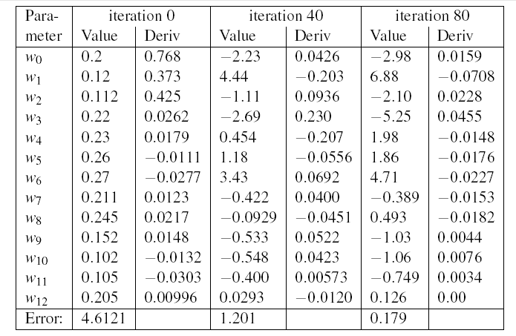
Simulation of NN learning

Slide 54
NN and DT
The functions that are “easy” to represent are different for NN and DT
EX 1: Boolean Majority function
Can be represented by a simple perceptron
Requires a DT with 2^{n} branches
EX 2: Consider representing a conditional: “If c then a else b”:
Simple in a decision tree.
Needs a complicated neural network to represent
(c ∧a) ∨ (not c ∧ b) WHY?

Slide 55
NN and DT
A | B | C | (c ∧a) ∨ (not c ∧ b)
T | T | T
T | T | F
T | F | T
T | F | F
F | T | T
F | T | F
F | F | T
F | F | F

Slide 56
NN and DT
A | B | C | (c ∧a) ∨ (not c ∧ b)
T | T | T | T
T | T | F | T
T | F | T | T
T | F | F | F
F | T | T | F
F | T | F | T
F | F | T | F
F | F | F | F

Slide 57
NN and DT
A
B
C

Slide 58
NN and DT
A
B
C
= TRUE
= FALSE

Slide 59
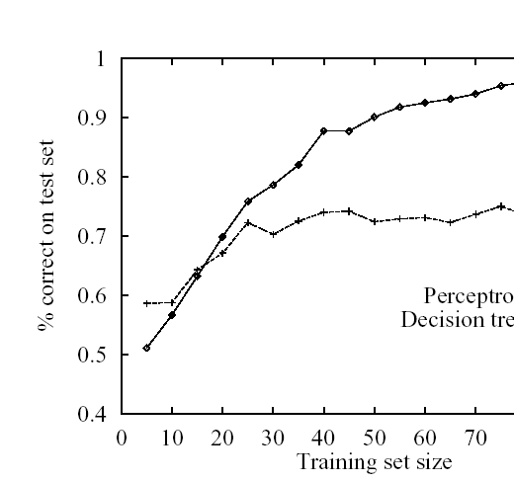
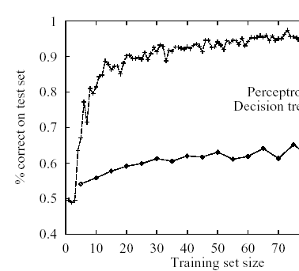
NN and DT
perceptron
decision tree
decision tree
perceptron
Majority function of 11 inputs
Non-linearly separable function

Slide 60
Selecting a NN structure
Too few hidden units may make it impossible to learn the appropriate function, too many might cause overfitting.
Analogous to building the DT with one branch per example
Some algorithms start from large networks:
consider only fully connected networks, so that you need to decide only on the number of layers and units in it.
Mostly trial and error: pick some reasonable structures, do cross-validation and keep the best.
Or start from a fully-connected network, and use information theory over the trained network to see what weights and possibly units can be dropped (optimal brain damage algorithm). Repeat.
Others start from small NN (e.g. tiling):
try single unit , see how it works and add weights and possibly units to deal with examples that are classified incorrectly. Repeat.

Slide 61
Discussion on NN
Well suited for continuous inputs and outputs, unlike DT.
Can represent any function of a set of attributes, but how to design a good topology is still largely unknown.
In the worst-case, the number of epochs is exponential in the number of inputs. In practice, time of convergence is highly variable.
They are very tolerant to noise in the input data
NN are essentially black boxes:
almost impossible to give meaning to weights and hidden units
not possible to explain why a good output is generated
Hard to use prior domain knowledge to design the NN

Slide 62
Applications
NET talk: NN that learns how to pronounce written text
29 input units for letters and punctuation, 80 hidden units, and output units representing the phonetic features of the sound to be produced (e.g., low or high, voiced or unvoiced).
78% level of accuracy (not too good)
training set for Nettalk: 1024 word-text hand-transcribed into the proper phonetic features

Slide 63
Applications
NN to recognize the digits in zip codes on hand addressed envelops.
16 X 16 array of pixels as inputs, three hidden layers with 768, 192 and 30 units, 10 output units for the 10 digits
Trained on 7000 examples, reached 99% accuracy on 2000 test examples
ALVINN: learns how to steer a vehicle on a single lane highway.
30 X 32 array of pixels as inputs, representing image of the road ahead, 5 hidden layers, 30 output units each for a steering direction
Has driven up to 90miles on public highways, as well on dirt roads and bike paths

