Slide 1
Learning: Overview and Decision Trees
Learning: Intro and General concepts
Decision Trees
Basic Concepts
Finding the best DT

Slide 2
Oveview: Learning
Learning is the ability to improve one’s behavior
based on experience.
The range of behaviors is expanded: the agent can do more.
The accuracy on tasks is improved: the agent can do things better.
The speed is improved: the agent can do things faster.

Slide 3
Common Learning Tasks
Supervised classification: given a set of pre-classified training examples, classify a new instance.
Unsupervised classification: find natural classes for examples.
Reinforcement learning: determine what to do based on rewards and punishments.

Slide 4
Representation of Learned Information
Problem/Task
Experience/Data
Induction
Procedure
Internal
representation
Reasoning
Procedure
Background Knowledge/
Bias
Answer/
Performance

Slide 5
Representation of Learned Information
Any of the representation schemes studied in 322 and here can be used to represent the learned info.
Logic-based propositions
Probabilistic schemes
Utility functions
…….
.

Slide 6
Supervised Learning
Supervised Learning => pure inductive inference
Given a set of examples of a function f: pairs (x, f(x))
Find a function h that approximates f.
h is called hypothesis.
H is the space of hypotheses (representations) that we consider: how does one chose?

Slide 7
Learning as Search
Given a representation and a bias, the problem of learning can be reduced to one of search.
Learning is search through the space H of possible hypotheses looking for the hypothesis h that best fits the data, given the bias.
These search spaces are typically prohibitively large for systematic search. Use greedy heuristics.
A learning algorithm is made of a search space, an evaluation function, and a search method.

Slide 8
Bias
The tendency to prefer one hypothesis over another is called a bias.
To have any inductive process make predictions on unseen data, you need a bias.
What constitutes a good bias is an empirical question about which biases work best in practice.

Slide 9
Learning: Overview and Decision Trees
Learning: Intro and General concepts
Supervised Learning
Decision Trees
Basic Concepts
Finding the best DT

Slide 10
Learning Decision Trees
Method for supervised classification (we will assume
attributes with finite discrete values)
Representation is a decision tree.
Bias is towards simple decision trees.
Search through the space of decision trees, from simple decision trees to more complex ones.

Slide 11
Example Classification Data (2)
We want to classify new examples on property Action based
on the examples’ Author, Thread, Length, and Where.

Slide 12
Decision Trees (DT)
The non-leaf nodes are labeled with attributes.
The non-leaf nodes are labeled with attributes.
Arcs out of a node are labeled with
each of the possible values of the
attribute attached to that node
The non-leaf nodes are labeled with attributes.
author
unknown
known
length
thread
short
long
new
old
reads
skips
length
skips
Leaves are labeled with classifications
Leaves are labeled with classifications
long
short
skips
reads

Slide 13
DT as classifiers
To classify an example, filter in down the tree
For each attribute of the example, follow the branch corresponding to that attribute’s value.
When a leaf is reached, the example is classified as the label for that leaf.

Slide 14
DT as a classifier
author
unknown
known
length
thread
short
long
new
old
reads
skips
e4
e6
e2
e3
length
skips
long
short
skips
e1
reads
e5

Slide 15
More than one tree usually fits the data
author
unknown
known
thread
thread
new
old
new
old
length
length
length
length
long
short
long
short
long
where
where
where
where
where
home
work
work
work
home
home
skips
reads
skips
reads
skips
skips
e1
e5
e6
e2
e3
e4

Slide 16
Example Decision Tree (2)
length
long
short
e1, e3, e4, e6
e2, e5
read
skips
But this tree also classifies my examples correctly. Why? What do I need to get a tree that is closer to my true criterion

Slide 17
Searching for a Good Decision Tree
Given some data, which decision tree should be generated?
The space of decision trees is too big for systematic search for the smallest decision tree.

Slide 18
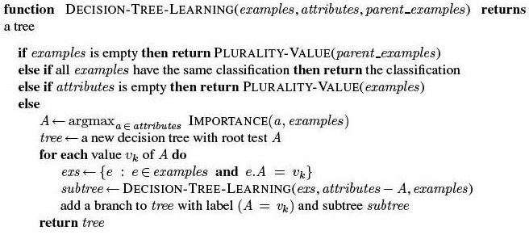
Decision Tree Learning
Plurality Value selects the most common output among a set of examples,
breaking ties randomly

Slide 19
Building a Decision Tree (Newsgroup Read Domain)
e1, e2, e3, e5, e4, e6 author, thread, length, where
author
known
unknown
e1, e5, e4, e6
thread, length, where
e2, e3
thread
thread
new
old
new
old
e1, e5
length,
where
e4, e6
length
reads
skips
skips
e2
e3
long
short
skips
e1
reads
e5

Slide 20
Learning: Overview and Decision Trees
Learning: Intro and General concepts
Decision Trees
Basic Concepts
Finding the best DT

Slide 21
Choosing a good split
Goal: try to minimize the depth of the tree
Split on attributes that move as far as possible toward an exact classification of the examples
Ideal split divides examples in two sets, of all positive and all negative examples
Bad split leaves about the same proportion of positive and negative examples on each side

Slide 22
Choosing a Good Attribute
Good
Not So Good

Slide 23
Information Gain for Attribute Selection
Need a formal measure of how good is the split on a given attribute
One that is often used: Information Gain
From information theory: assume that you are looking for the answer to a question with
v_{i} possible answers,
each answer v_{i} has probability P(v_{i})
The information content of the actual answer is
I(P(v₁),..., P(v_{n})) = ∑_{i} - P(v_{i})log₂ P(v_{i})
(also called entropy of the distribution P(v₁),..., P(v_{n}))

Slide 24
Example
Consider tossing a fair coin. What is the Information Content of the actual outcome?
two possible answers: {head, tail} with P(head) = P(tail) = 1/2
I(1/2, 1/2) = -1/2 log₂ 1/2 - 1/2 log₂ 1/2 = 1 bit (this is how information theory measures information content)
1 bit of information is enough to answer a binary question about which one has no idea (each possible answer is equally likely)
Consider now a “biased” coin that gives heads 99% of the times What is now the Information Content of the toss?
I(1/100, 99/100) = 0.08 bit
Much less, because the answer was much more predictable a priory
As the probability of head goes to 1, the information of the toss goes to 0, because I can predict the answer correctly without tossing at all.

Slide 25
Back to Attribute Selection in DT
For decision tree learning, the question that needs answering is
for a given example, what is the correct classification?
The information content for getting an answer to this question depends of the probability of each possible outcome
For a training set containing p positive examples and n negative examples:
if p = n I need one bit of information
if p = 4 and n = 2 (as in our smaller newsgroup example)
I(2/3, 1/3) = 0.92
The correct DT will give me this much information
The split on a given attribute as I build the tree will give some of it. How much?

Slide 26
Back To Attribute Selection in DT
We can compute how much by comparing how much information I need before and after the split
Given attribute A with v values
A split over it divides the examples E into subsets E₁,..E_{v} based on their value for A
Each E_{i} will have p_{i} positive examples and n_{i} negative ones
If we go down that branch we will need an additional
I(p_{i} / p_{i} + n_{i} , n_{i} / p_{i} + n_{i} )
bits of information to answer the question

Slide 27
Back To Attribute Selection in DT
We can compute how much by comparing how much information I need before and after the split
Given attribute A with v values
A split over it divides the examples E into subsets E₁,..E_{v} based on their value for A
Each E_{i} will have p_{i} positive examples and n_{i} negative ones
If we go down that branch we will need an additional
I(p_{i} / p_{i} + n_{i} , n_{i} / p_{i} + n_{i} )
bits of information to answer the question

Slide 28
Back to Attribute Selection in DT
But I don’t know beforehand which branch will be used to classify an example.
I need to compute the expected (or average) information content of a split
based on the probability that a randomly chosen example from the training set will send me down each branch E_{i}
Information Gain (Gain) from the attribute test:
Chose the attribute with the highest Gain

Slide 29
Example: possible splits
For the initial training set I(4/6, 2/6) = 0.92 bit
Skips 4
author
Read 2
known
unknown
e2, e3
e1, e5, e4, e6
Skips 3
Skips 1
Read 1
Read 1
Reminder(author) = 4/6 * I(1/4, 3/4) + 2/6 * I(1/2, 1/2)
= 2/3*0.811+1/3 =
Gain(author ) = 0.92 – 0.875 = 0.054

Slide 30
Example: possible splits
For the initial training set I(4/6, 2/6) = 0.92 bit
Skips 4
Read 2
length
long
short
e2, e5
e1, e3, e4, e6
Read 0
Skip 2
Skips 4
Read 0
Reminder (length) =
Gain(length)=

Slide 31
Example: possible splits
For the initial training set I(4/6, 2/6) = 0.92 bit
Skips 4
Read 2
length
long
short
e2, e5
e1, e3, e4, e6
Read 0
Skip 2
Skips 4
Read 0
Reminder (length) = 4/6 * I(1, 0) + 2/6 * I(1. 0)=0
Gain(length)=0.92

Slide 32
Drawback of Information Gain
Tends to favor attributes with many different values
Can fit the data better than spitting on attributes with fewer values
Imagine extreme case of using “message id-number” in the newsgroup reading example
Every example may have a different value on this attribute
Splitting on it would give highest information gain, even if it is unlikely that this attribute is relevant for the user’s reading decision
Alternative measures (e.g. gain ratio)

Slide 33
Expressiveness of Decision Trees
They can represent any discrete function, an
consequently any Boolean function
ex: OR
X1 | X2 | OR
1 | 1 | 1
1 | 0 | 1
0 | 1 | 1
0 | 0 | 0

Slide 34
Expressiveness of Decision Trees
They can represent any discrete function, an
consequently any Boolean function
ex: OR
X1 | X2 | OR
1 | 1 | 1
1 | 0 | 1
0 | 1 | 1
0 | 0 | 0
x2
x1
1
1
0
0
1
x1
1
x2
1
0
1
0
1
0
1
0

Slide 35
Expressiveness of Decision Trees
ex: Parity function
X1 | X2 | F(X1,X2)
1 | 1 | 1
1 | 0 | 0
0 | 1 | 0
0 | 0 | 1
x1
x2
1
1
0
0
x2
x1
x1
x2
0
1
0
0
1
1
0
1
0
1
0
1
1
0
1
0

Slide 36
Search Space for Decision Tree Learning
If I want to classify items based on n Boolean attributes
Must search the space of all possible Boolean functions of these n attributes
How many such functions are there? E.g. n = 2
X1 | X2 | F(X1,X2)
1 | 1 | ?
1 | 0 | ?
0 | 1 | ?
0 | 0 | ?
With 6 Boolean attributes, there are 18,446,744,073,709,551,616 such functions

Slide 37
Handling Overfitting
This algorithm gets into trouble over fitting the data.
This occurs with noise and correlations in the training set that are not reflected in the data as a whole.
One technique to handle overfitting: decision tree pruning
Statistical techniques to evaluate when the gain on the attribute selected by the splitting technique is large enough to be relevant
Based on tests for statistical significance (see R&N p. 705-706 if you are interested in knowing more)
Another technique: cross-validation
Use it to discard trees that do not perform well on the test set

Slide 38
Assessing Performance of Learning Algorithm
Collect a large set of examples
Divide into two sets: training set and test set
Use the learning algorithm on the training set to generate an hypothesis h
Measure the percentage of examples in the test set that are correctly classified by h
Repeat with training sets of different size and different randomly selected training sets.

Slide 39
Cross-Validation
We want a large training set, to get more reliable models.
But this implies having a small test set
Not ideal, as it may give good or bad results just by luck
One common solution: k-fold cross validation
Partition the training set into k sets
Run the algorithm k times, each time (fold) using one of the k sets as the test test, and the rest as training set
Report algorithm performance as the average performance (e.g. ac curacy) over the k different folds
Useful to select different candidate algorithms/models
E.g. a DT built using information gain vs. some other measure for splitting
Once the algorithm/model type is selected via cross-validation, return the model trained on all available data

Slide 40
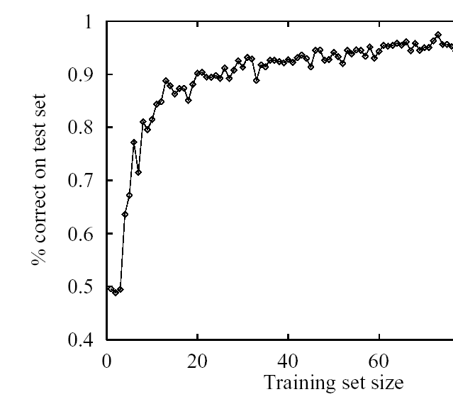
Interesting thing to try
Repeat cross-validation with training sets of different size
Report algorithm performance as a function of training set size: learning curve

Slide 41
Other Issues in DT Learning
Attributes with continuous and integer values (e.g. Cost in $)
Important because many real world applications deal with continuous values
Methods for finding the split point that gives the highest information gain (e.g. Cost > 50$)
Still the most expensive part of using DT in real-world applications
Continue-valued output attribute (e.g. predicted cost in $): Regression Tree
Splitting may stop before classifying all examples
Leaves with unclassified examples use a linear function of a subset of the attributes to classify them via linear regression
Tricky part: decide when to stop splitting and start linear regression

Slide 42
DT Applications (1)
DT are often the first method tried in many areas of industry and commerce, when task involves learning from a data set of examples
Main reason: the output is easy to interpret by humans

Slide 43
DT Applications (1)
BP Gasoil, expert system for designing gas-oil separation systems for offshore oil platform
Design depends on many attributes (e.g., proportion of gas, oil and water, the flow rate, pressure, density, viscosity, temperature )
BP Gasoil 2055 rules learned using a decision tree method applied to a database of existing design
Took 100 person-days instead of the 10- person-years that it would have taken to do it by hand (the largest Expert System in the World in 1986)

Slide 44
DT Applications (1)
Program to teach a flight simulator how to fly a Cessna
Two ways to construct a controller for a complex system
Build a precise model of the dynamics of the system and use formal methods to design a controller.
Learn the correct mapping from state of the system to actions.
Cessna system was built by observing 3 expert pilots perform an assigned flight plan 30 times each.
Every time a pilot took an action by setting one of the control variables such as thrust or flaps, a training example was created.
90.000 examples, each described by 20 state variables and labeled by the action taken.
Resulting decision tree was then converted into C code and inserted into the flight simulator control loop

