Slide 1
Applications of AI: Assistive Technology and Robotics
Pooja Viswanathan

Slide 2
The Aging Population
Older adults commonly use powered wheelchairs for enhanced mobility.
Operation of these devices requires significant cognitive capacity.
Of the 1.5 million nursing home residents, 60-80% have dementia, primarily Alzheimer’s disease (Payne et al. 2002).
These residents lack the cognitive abilities to safely maneuver powered wheelchairs, and are thus not permitted to use them.
This leads to reduced mobility, and, in turn, depression, social isolation, and an increased dependence on caregivers.

Slide 3
Assistive Technology
Several technologies exclude people with disabilities
Wikipedia: “Assistive Technology (AT) is a generic term that includes assistive, adaptive, and rehabilitative devices and the process used in selecting, locating, and using them. AT promotes greater independence for people with disabilities by enabling them to perform tasks that they were formerly unable to accomplish, or had great difficulty accomplishing, by providing enhancements to or changed methods of interacting with the technology needed to accomplish such tasks.”

Slide 4
Solution
Intelligent powered wheelchair for older adults with cognitive impairment that:
Prevents collisions
Infers the user's goal location/activity and provides automated reminders
Provides navigation assistance using prompts that account for the user’s cognitive state

Slide 5
Safety
73-80% of older adults fall or trip after being hit by wheelchair (Corfman, 2001)‏
Even minor collision could startle elderly residents and lead to fall
5-10% of falls could result in fracture (Nevitt, 1989)‏
40% of older adults who sustain a hip fracture die within 6 months due to complications (Jaglal et al., 1996)‏
Need non-contact anti-collision system!!

Slide 6
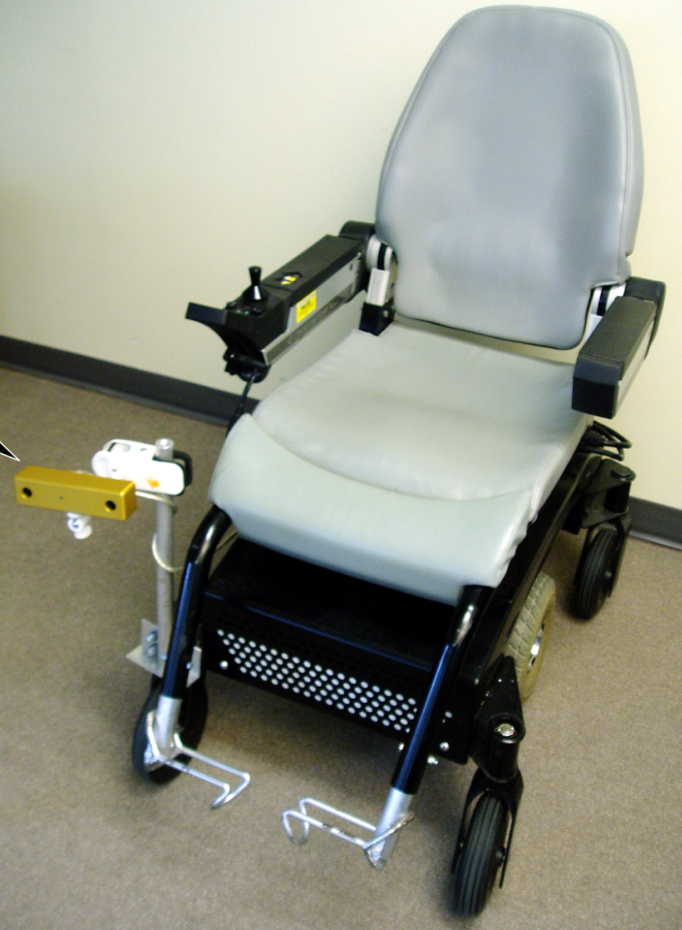
System overview
The system consists of:
Nimble Rocket TM Powered Wheelchair
Bumblebee Stereovision Camera from Point Grey Research
Fujitsu Lifebook P7120 Laptop (under seat)‏

Slide 7
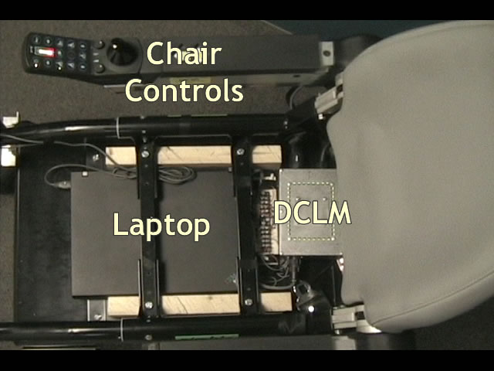
System Overview

Slide 8
Prompting strategy
Fulfill the following (possibly conflicting) goals according to the following order of priority:
Ensure safety (through navigation assistance, medication reminders, etc.)‏
Assist in the effective completion of daily activities
Minimize user frustration (minimize incorrect and excessive prompting)‏
Maximize user independence (minimize caregiver intervention)‏
Maximize user awareness (issue appropriate level of prompts with justification)‏

Slide 9
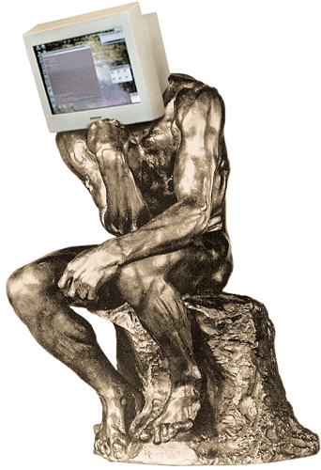
Control Strategy
Autonomous
Manual
Strength:
Weakness:
Strength:
Weakness:
Semi-Autonomous

Slide 10
Control Strategy
Autonomous
Manual
Strength:
No need for user input
Weakness:
User might want some control
Strength:
User has full control
Weakness: Tedious, user might not have ability
Semi-Autonomous
Combines strengths of other 2 systems
How do we determine who has control and when?

Slide 11
Collision Avoidance
Find the distance to objects – stored in depth maps
Use this to create a map of all obstacles in front of the wheelchair – occupancy map

Slide 12
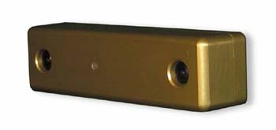
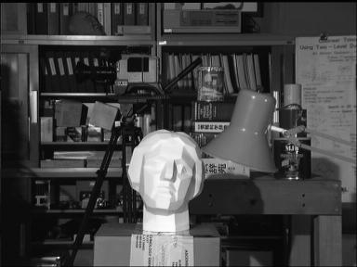
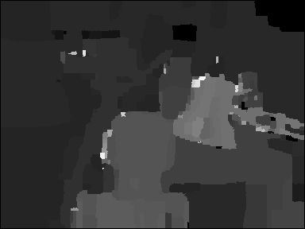
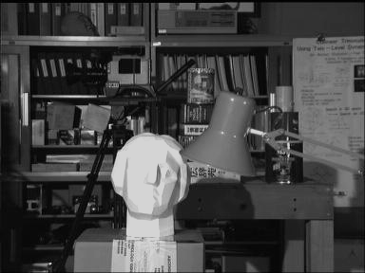
Depth
Stereopsis
Point Grey’s Bumblebee Camera
Left Image
Right Image
Depth Map

Slide 13


Occupancy Grid
_{Depth Map}
_{2D Projection - Occupancy Map}

Slide 14
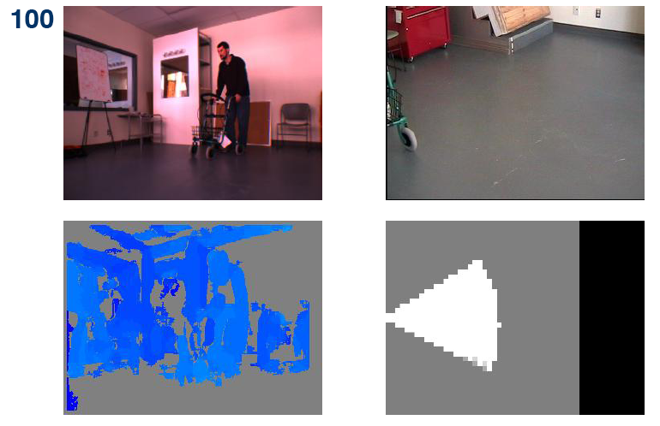
Example OGs

Slide 15
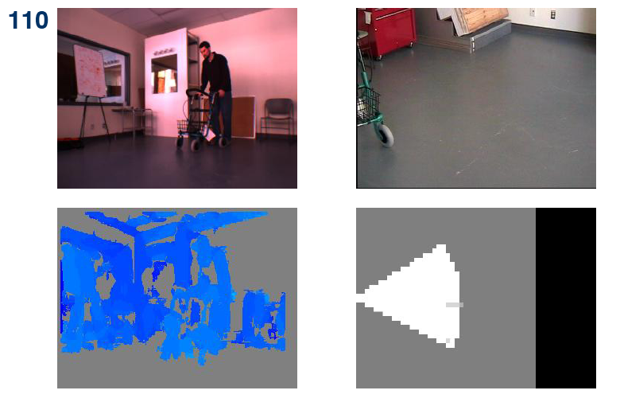
Example OGs

Slide 16
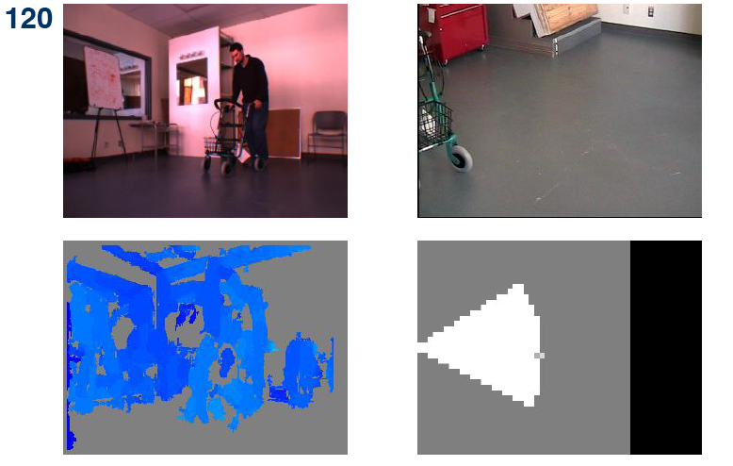
Example OGs

Slide 17
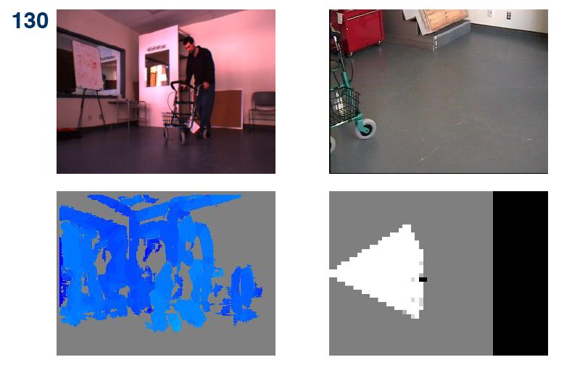
Example OGs

Slide 18
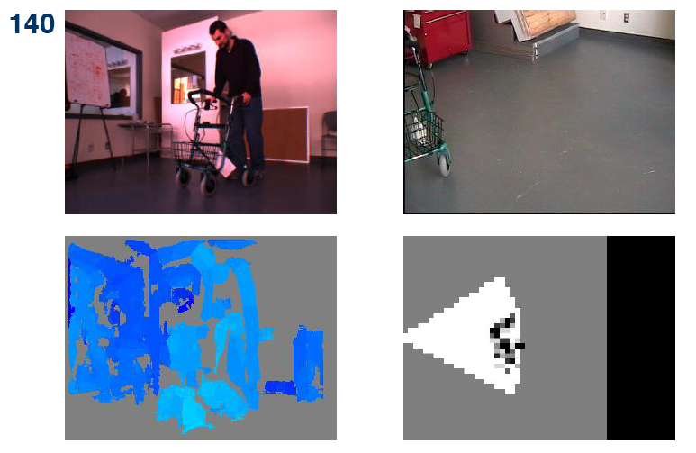
Example OGs

Slide 19
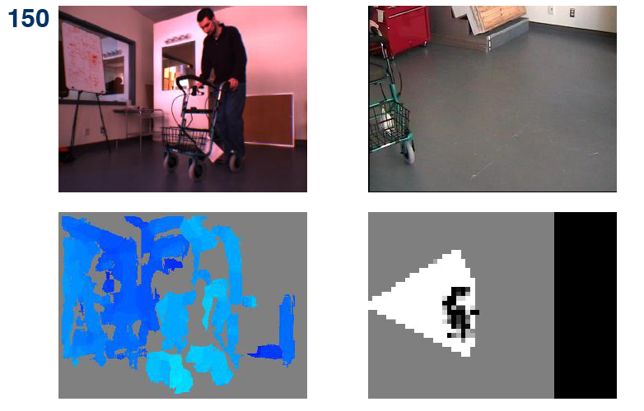
Example OGs

Slide 20
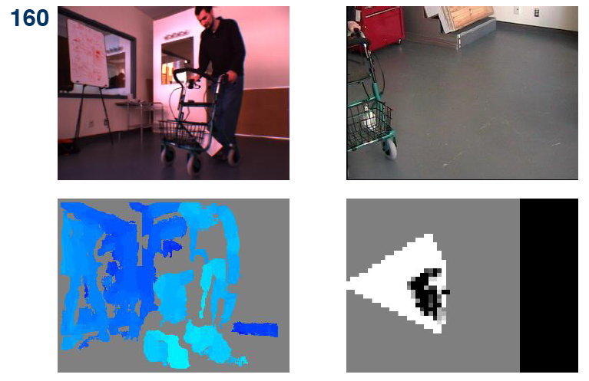
Example OGs

Slide 21
Collision Avoidance
If object detected within a specified distance threshold, wheelchair is stopped
Compute direction around obstacle with greatest amount of free space

Slide 22
Collision Avoidance
Most free space is to the left of the object
      Prompt: “Try turning left”

Slide 23
Demo
Anti-collision demo

Slide 24
Pilot Study
Experiments conducted to test efficacy of anti-collision and prompting system
Conducted within controlled environment

Slide 25
Pilot Study
Trials tested:
  Detection of objects commonly found in LTC facility
  Collision avoidance
  Correct prompt issued

Slide 26
Object Detection
Anti-collision system was tested with the following commonly-found objects:
  A painted white wall with a flat finish
  A light green aluminum 4-wheeled walker
  A silver aluminum walking cane
  A person who was standing still
  A person who was moving

Slide 27
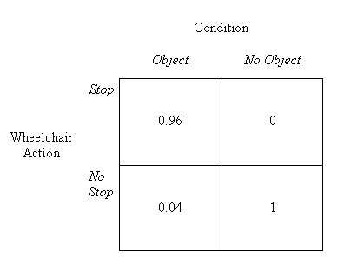
Results
Overall Anti-collision Results
Misses occurred during wall and cane conditions
System performs better on larger and more textured objects

Slide 28
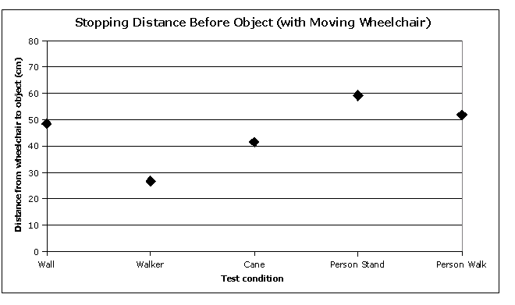
Results
Distance between wheelchair and object when stopped

Slide 29
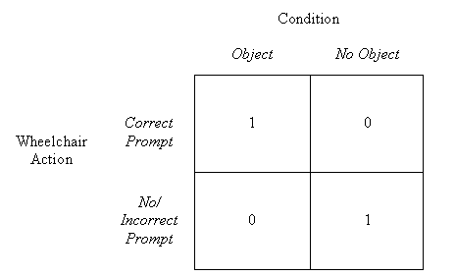
Results
Overall Prompting Results

Slide 30
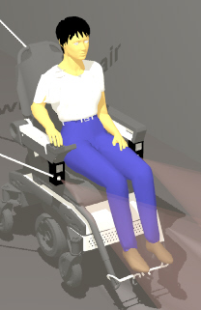
Now what???
I’m hungry…
Example Scenario:
It’s 11:50 a.m. Mary eats lunch at 12:00

Slide 31
Now what???
I’m hungry…
Example Scenario:
It’s lunch time! Let’s go to the dining hall!

Slide 32
Navigation Assistance
To assist in navigation, wheelchair must know three things:
  Where the user wants to go (destination)‏
  Where the destination is located
  Where the chair is located
User destination - learned user schedules and/or from past behaviours
Locations – need maps!!

Slide 33
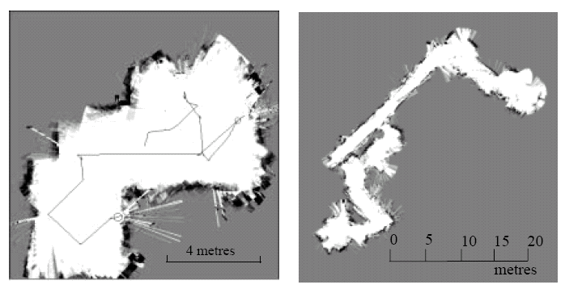
Automated Mapping
Wheelchair automatically builds map of environment using visual landmarks
Wheelchair can then find its current location by matching landmarks in the incoming images with those in the map
Known as SLAM

Slide 34

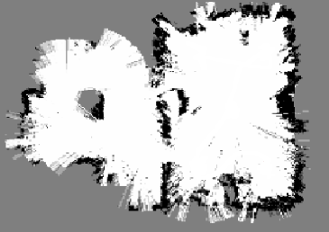



Navigation Assistance
Annotate Map
Bedroom
Lounge
Kitchen
Compute Path
Bedroom
Lounge
Bedroom
Lounge
Kitchen
Kitchen
Issue Prompt
User Model
(responsiveness, awareness etc.)‏
Bedroom
Lounge
Kitchen
This step involves using a POMDP as in Hoey et al. 2006
After a global map is created using visual SLAM, adaptive audio prompts to assist in navigation will be determined as follows:

Slide 35
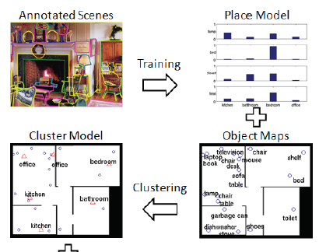
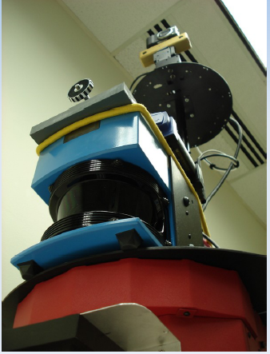
Automated Labeling
Recognition
Curious
George

Slide 36
Planning and Prompting
Remind the user of where he/she needs to be
Plan the shortest (?) path to the destination
Prompt the user as necessary
Avoid obstacles on the way

Slide 37
Planning and Prompting
The MDP (and POMDP) framework is great for task specification and planning
A task is specified via the Reward function
Planning can be done “efficiently” using value or policy iteration (exact and approximate methods)‏
Problems:
  Sensor noise
  Large state, action and observation spaces

Slide 38
Flat vs. Structured POMDPs
Flat – States, Actions, Observations
Structured
  States → State variables
  Actions → Action variables
  Observations → Observation variables
State variables - X = {X₁,…,X_{n}}
State - s = <x₁,…, x_{n}>

Slide 39
Structured POMDPs
Dynamic Bayesian Networks – 2-layered, model dynamic changes
Nodes – Variables
Edges – dependency
CPT – conditional probability table
A_{t-1}
A_{t}
A_{t+1}
Actions
B_{t}
B_{t+1}
B_{t+2}
State
D_{t}
D_{t+1}
D_{t+2}
O_{t}
O_{t+1}
O_{t+2}
Observations

Slide 40
CPT as Decision Diagrams
Decision Diagrams
  Inner nodes – variables
  Edges – values (left = False, right = True)‏
  Leaves hold values
Algebraic Decision Diagrams (ADD)
  Nodes with identical children are removed
  Context specific independence
Decision Diagram
CPT
ADD
X₁
X₃
X’₁
X₁
X₁
F
F
0.5
F
T
0.5
X₃
X₃
.5
X₃
T
F
0.2
.5
.5
.2
.9
.2
.9
T
T
0.9

Slide 41
Point-based Value Iteration
Find a solution for a sub-set of all states
Not all states are necessarily reachable
Generalize the solution to all states
Solution methods include: PERSEUS, PBVI, and HSVI and other similar approaches (FSVI, PEGASUS)‏

Slide 42
Symbolic Perseus
Symbolic Perseus - point-based value iteration algorithm that uses Algebraic Decision Diagrams (ADDs) as the underlying data structure to tackle large factored POMDPs
Flat methods: 10 states at 1998, 200,000 states at 2008
Factored methods: 50,000,000 states
http://www.cs.uwaterloo.ca/~ppoupart/software.html#symbolic-perseus

Slide 43
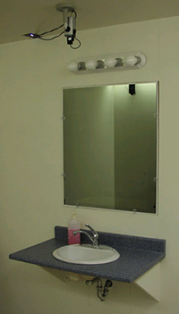
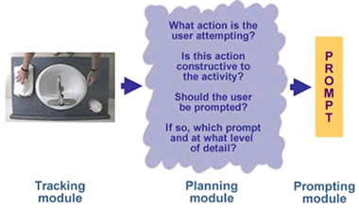
Another Example: COACH

Slide 44
Demos
Trial B
Trial C
Real demo

Slide 45
Issues
Ethics
Liability
Privacy
??

Slide 46
Acknowledgements
A few slides were borrowed from:
Pantelis Elinas, University of Sydney
Alex Mihailidis, University of Toronto
Guy Shani, Microsoft Research

