Slide 1
Learning: Overview and Decision Trees
Learning: Intro and General concepts
Decision Trees
Basic Concepts
Finding the best DT

Slide 2
Agents in the World

Slide 3
Problem Solving/Planning Agent Architecture
Problem/Task
Internal
representation
Reasoning
Procedure
Background Knowledge/
Answer/
Performance

Slide 4
Learning
Learning is the ability to improve one’s behavior
based on experience.
The range of behaviors is expanded: the agent can do more.
The accuracy on tasks is improved: the agent can do things better.
The speed is improved: the agent can do things faster.

Slide 5
Components of the Learning Problem
Task: the behavior or task that’s being improved.
For example: classification, acting in an environment
Data: the experiences that are being used to improve performance in the task.
Measure of improvement: How can the improvement be measured?
For example: increasing accuracy in prediction, new skills that were not present initially, improved speed.

Slide 6
Learning Task
Problem/Task
Experience/Data
Learning Agent
Background Knowledge/
Bias
Answer/
Performance

Slide 7
Learning Agent Architecture
Problem/Task
Experience/Data
Induction
Procedure
Internal
representation
Reasoning
Procedure
Background Knowledge/
Bias
Answer/
Performance

Slide 8
Learning as an Induction Problem
Induction: inferring a representation given a set of examples
EX: {q(a) , p(a)}
{q(b), p(b)} q(x) ← p(x) or
{q(c), p(c)} p(x) ← q(x) or neither?
what if I also observe {q(d)}?

Slide 9
Common Learning Tasks
Supervised classification: given a set of pre-classified training examples, classify a new instance.
Unsupervised classification: find natural classes for examples.
Reinforcement learning: determine what to do based on rewards and punishments.

Slide 10
Common Learning Tasks (1)
Supervised classification: given a set of pre-classified training examples, classify a new instance.
Alan does not drink coffee with sugar
Alan does not drink tea with sugar
Alan drinks diet lemonade
Will Alan drink a diet coke?

Slide 11
Example Classification Data (2): reading newsgroup postings
We want to classify new examples on property Action based
on the examples’ attributes Author, Thread, Length, and Where.

Slide 12
Common Learning Tasks (2)
Unsupervised classification: find natural classes for examples.
e.g. given patterns of users selections of web pages find categorizations of “user types”
e.g. given patterns of interface actions in an Tutoring Systems, (e.g., lots of hints requested, lots of repeated errors…) predict success in learning
Reinforcement learning: determine what to do based on rewards and punishments.
e.g. A butler robot brings Alan coffee and the newspaper and gets a reward. Is it for the coffee or for the newspaper or both?

Slide 13
Common Learning Tasks (3)
Analytic learning: reason faster using experience (knowledge compilation).
Ex:
at(Ag, Y) ← adjacient(X,Y) & move(Ag, X, Y) and at(Ag,X)
+
adjacient(X,Y) <- between(door, X, Y) & unlocked(door)
at(Ag, Y) ← move(Ag, X, Y) & at(Ag,X) &
between(door, X, Y) & unlocked(door)

Slide 14
Feedback
Learning tasks can be characterized by the feedback given
to the learner.
Supervised learning: what has to be learned is specified for each example.
Unsupervised learning: no classifications are given; the learner has to discover categories and regularities in the data.
Reinforcement learning: feedback occurs after a sequence of actions.
+

Slide 15
Representation of Learned Information
Problem/Task
Experience/Data
Induction
Procedure
Internal
representation
Reasoning
Procedure
Background Knowledge/
Bias
Answer/
Performance

Slide 16
Representation of Learned Information
Any of the representation schemes studied in 322 and here can be used to represent the learned info.
Logic-based propositions
Probabilistic schemes
Utility functions
…….
.

Slide 17
Learning: Overview and Decision Trees
Learning: Intro and General concepts
Supervised Learning
Decision Trees
Basic Concepts
Finding the best DT

Slide 18
Supervised Learning
Supervised Learning => pure inductive inference
Given a set of examples of a function f: pairs (x, f(x))
Find a function h that approximates f.
h is called hypothesis.

Slide 19
Supervised Learning
H is the space of hypotheses (representations) that we consider, e.g.
Linear functions only
polynomial functions
Sinusoidal functions (ax+b+c*sin(x))
How does one chose?

Slide 20
Supervised Learning
H is the space of hypotheses (representations) that we consider, e.g.
Linear functions only
polynomial functions
Sinusoidal functions (ax+b+c*sin(x))
How does one chose?
Aim to reduce complexity: simpler representations are easier to learn and use
Aim to get enough expressiveness to learn the true function
E.g. Cannot learn from sinusoidal data with polynomial functions

Slide 21
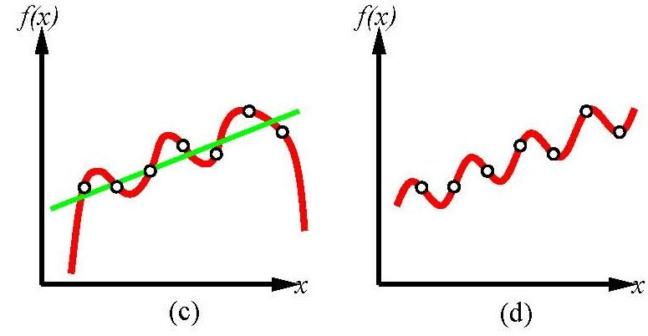
Supervised Learning
Degree-6 polynomial
Sinusoidal function

Slide 22
Supervised Learning
The learning problem is called
Regression if f(x) is number
Classification, if f(x) is one of a finite set of values
Alan does not drink coffee with sugar
Alan does not drink tea with sugar
Alan drinks diet lemonade
Will Alan drink a diet coke?

Slide 23
Measuring Success
The measure of success is not how well the agent performs on the training examples, but how well the agent performs for new examples.
Consider two agents:
P claims the negative examples seen are the only negative examples. Every other instance is positive.
N claims the positive examples seen are the only positive examples. Every other instance is negative.
Both agents correctly classify every training example, but disagree on every other example.

Slide 24
Bias
Should we chose N’s or P’s hypothesis?
The data does not help us with the decision
The tendency to prefer one hypothesis over another is called a bias.
To have any inductive process make predictions on unseen data, you need a bias.
What constitutes a good bias is an empirical question about which biases work best in practice.

Slide 25
Learning as Search
Given a representation and a bias, the problem of learning can be reduced to one of search.
Learning is search through the space of possible representations looking for the representation or representations that best fits the data, given the bias.
These search spaces are typically prohibitively large for systematic search. Use greedy heuristics.
A learning algorithm is made of a search space, an evaluation function, and a search method.

Slide 26
Noise in the Data
Data isn’t perfect:
some of the attributes are assigned the wrong value
the attributes given are inadequate to predict the classification data
E.g., in Alan’s beverage preferences example adding whether it was sunny or cloudy when Alan got the drink
there are examples with missing attributes
e.g. in the beverage example, suppose that what matters to Alan is weather the drink is organic or not, but we don’t have this information for the given examples

Slide 27
Noise in the Data
Overfitting occurs when there are random correlations in the training set, that do not appear in the unseen examples.
Alan does not drink HOT coffee with sugar
Alan does not drink HOT tea with sugar
Alan drinks COLD diet lemonade
Will Alan drink a COLD diet coke?
The system may say “YES” because “hot” appears in both negative examples and
“cold” appears in the positive one, but this is only do to chance. The correct
answer is “NO” because Alan does not like caffeinated beverages

Slide 28
Assessing Performance of Learning Algorithm
Collect a large set of examples
Divide into two sets: training set and test set
Use the learning algorithm on the training set to generate an hypothesis h
Measure the percentage of examples in the test set that are correctly classified by h
Repeat with training sets of different size and different randomly selected training sets.

Slide 29
Cross-Validation
We want a large training set, to get more reliable models.
But this implies having a small test set
Not ideal, as it may give good or bad results just by luck
One common solution: k-fold cross validation
Partition the training set into k sets
Run the algorithm k times, each time (fold) using one of the k sets as the test test, and the rest as training set
Report algorithm performance as the average performance (e.g. ac curacy) over the k different folds
Useful to select different candidate algorithms/models
Once the algorithm/model type is selected via cross-validation, return the model trained on all available data

Slide 30
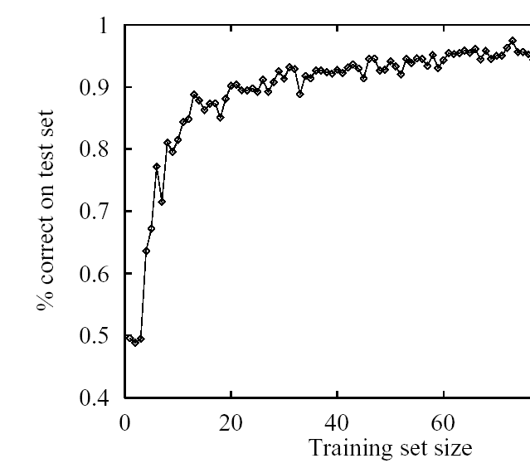
Interesting thing to try
Repeat cross-validation with training sets of different size
Report algorithm performance as a function of training set size: learning curve

Slide 31
Learning: Overview and Decision Trees
Learning: Intro and General concepts
Supervised Learning
Decision Trees
Basic Concepts
Finding the best DT

Slide 32
Learning Decision Trees
Method for supervised classification (we will assume
attributes with finite discrete values)
Representation is a decision tree.
Bias is towards simple decision trees.
Search through the space of decision trees, from simple decision trees to more complex ones.

Slide 33
Example Classification Data (2)
We want to classify new examples on property Action based
on the examples’ Author, Thread, Length, and Where.

Slide 34
Learning task
Inductive inference
Given a set of examples of
f(author,thread, length, where) = {reads,skips}
Find a function h(author,thread, length, where) that approximates f

Slide 35
Decision Trees (DT)
A decision tree is a tree where:
The non-leaf nodes are labeled with attributes.
The arcs out of a node labeled with attribute A are labeled with each of the possible values of the attribute A.
The leaves of the tree are labeled with classifications.

Slide 36
Example Decision Tree (1)
author
unknown
known
length
thread
short
long
new
old
reads
skips
length
skips
long
short
skips
reads

Slide 37
DT as classifiers
To classify an example, filter in down the tree
For each attribute of the example, follow the branch corresponding to that attribute’s value.
When a leaf is reached, the example is classified as the label for that leaf.

Slide 38
DT as classifiers
author
unknown
known
length
thread
short
long
new
old
reads
skips
e4
e6
e2
e3
length
skips
long
short
skips
e1
reads
e5

Slide 39
Equivalent Rule Based Representation
If author is unknown and length is short
then user-action is reads
If author is unknown and length is long
then user-action is skips
If author is known and thread is new and length is short
then user-action is reads
If author is known and thread is new and length is long
then user-action is skips
If author is known and thread is old
then user-action is skips
Suppose this is the true criteria that my user is employing

Slide 40
Trivially Correct Decision Tree next
author
thread
length
l
where

Slide 41
Trivially Correct Decision Tree
PROBLEM?
author
unknown
known
thread
thread
new
old
new
old
length
length
length
length
long
short
long
short
long
where
where
where
where
where
home
work
work
work
home
home
skips
reads
skips
reads
skips
skips
e1
e5
e6
e2
e3
e4

Slide 42
Example Decision Tree (2)
length

Slide 43
Example Decision Tree (2)
length
long
short
e1, e3, e4, e6
e2, e5
read
skips
But this tree also classifies my examples correctly. Why? What do I need to get a tree that is closer to my true criterion

Slide 44
Searching for a Good Decision Tree
Given some data, which decision tree should be generated? Search space is huge (more on this later)
Need a bias to guide the selection of a good tree.
Example, prefer the smallest tree.
Least depth? Fewest nodes? Which trees are the best predictors of unseen data?
How should one go about building a decision tree? The space of decision trees is too big for systematic search for the smallest decision tree.

Slide 45
Searching for a Good Decision Tree
The input is
a target attribute for which we want to build a classification,
a set of examples
a set of attributes.
Stop if all examples have the same classification (good ending).
Plus some other stopping conditions for not so good endings
Otherwise, choose an attribute to split on (greedy, or myopic step)
for each value of this attribute, build a sub-tree for those examples with this attribute value

Slide 46
Building a Decision Tree (Newsgroup Read Domain)
e1, e2, e3, e5, e4, e6 author, thread, length, where
author
known
unknown
e1, e5, e4, e6
thread, length, where
e2, e3
thread
thread
new
old
new
old
e1, e5
length,
where
e4, e6
length
reads
skips
skips
e2
e3
long
short
skips
e1
reads
e5

Slide 47
Decision Tree Learning
function DT-Learning(examples, attributes,default) returns a decision tree
inputs: examples, set of examples.
attributes, set of attributes
default, default value for the target attribute
if examples is empty then return default
else if all examples have the same classification then return the classification
else if attributes is empty then return Something(examples)
else
best ← Choose-Attribute(attributes,examples)
tree ← a new decision tree with root at best
m ← Something (examples))
for each value v_{i} of best do
examples_{i} ←{elements of examples with best = v_{i}}
subtree ← DT-Learning(examples_{i}, attributes - best, m)
add a branch to tree with label v_{i} and subtree subtree
end
return tree

Slide 48
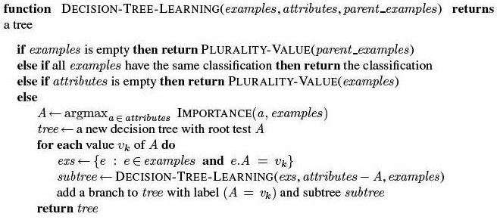
Decision Tree Learning

Slide 49
Decision Tree Learning

Slide 50
Decision Tree Learning

Slide 51
Decision Tree Learning

Slide 52
Building a Decision Tree (Newsgroup Read Domain)
e1, e2, e3, e5, e4, e6 author, thread, length, where
author
known
unknown
e1, e5, e4, e6
thread, length, where
e2, e3
thread
thread
new
old
new
old
e1, e5
length,
where
e4, e6
length
reads
skips
skips
e2
e3
long
short
skips
e1
reads
e5

Slide 53
Decision Tree Learning
Plurality Value selects the most common output among a set of examples,
breaking ties randomly

Slide 54
Building a Decision Tree (Newsgroup Read Domain)
e1, e2, e3, e5, e4, e6 author, thread, length, where
author
known
unknown
e1, e5, e4, e6
thread, length, where
e2, e3
thread
thread
new
old
new
old
e1, e5
length,
where
e4, e6
length
reads
skips
skips
e2
e3
long
short
skips
e1
reads
e5

Slide 55
Building a Decision Tree (2)
e1, e2, e3, e5, e4, e6 author, thread, length, where
length
long
short
e1, e3, e4, e6
e2, e5
read
skips

Slide 56
What to return when classification fails
I.e., the Something(examples) in DT-Learning
Most likely classification: the value of the classification attribute that appears most frequently in examples
A probability distribution over all possible values on the classification attribute
Based on the frequency of each value in examples

