Slide 1
CPSC 503
Computational Linguistics
Lecture 6
Giuseppe Carenini

Slide 2
Feedback on Assignment #1
Assignments are self-assessed
It is like class participation
You have to try answering all the questions
If you do not show that you tried all the questions marks will be deducted
In case this was not clear, we will start deducting marks for this reason starting with assingn#2
Notes on ‘Dementia Detection’ exercises.
if you did not manage to run the code in Assign#1, please team up with someone who did and you can work with her/him on Dementia questions from now on (in Assign #2 and #3).
Assign#2 will be posted today – due Oct 15

Slide 3
Today Sep 29
Markov Models
Part-of-speech tagging

Slide 4
Knowledge-Formalisms Map
(including probabilistic & neural formalisms)
State Machines (and prob. versions)
(Finite State Automata,Finite State Transducers, Markov Models)
Neural Models, Neural Sequence Modeling
Morphology
Machine Learning
Syntax
Rule systems (and prob. versions)
(e.g., (Prob.) Context-Free Grammars)
Neural Tree/Graph processing
Semantics
Logical formalisms (First-Order Logics, Prob. Logics)
Pragmatics
Discourse and Dialogue
AI planners (MDP Markov Decision Processes, Reinforcement learning)
Markov Chains -> n-grams
Markov Models
Hidden Markov Models (HMM)… Conditional Random Fields
Notes:
My Conceptual map - This is the master plan
Markov Models used for part-of-speech and dialog
Syntax is the study of formal relationship between words
How words are clustered into classes (that determine how they group and behave)
How they group with they neighbors into phrases

Slide 5
Example of a Markov Chain
.6
1
a
p
h
.4
.4
1
.3
.6
.3
e
1
t
g
.4
.6
.4
Start
Start

Slide 6
Markov-Chain
.6
1
h
a
.4
p
.4
1
.3
.3
.6
e
1
t
g
.4
.6
.4
t
g
p
a
h
e
Start
Start
Formal description:
t
0
.3
0
.3
.4
0
1
Stochastic Transition matrix A
g
.4
0
.6
0
0
0
p
0
0
1
0
0
0
a
0
0
.4
.6
0
0
h
0
0
0
0
0
1
e
1
0
0
0
0
0
2
Probability of initial states
t
.6
g
.4

Slide 7
Markov Assumptions
Let X=(X₁, .., X_{t}) be a sequence of random variables taking values in some finite set S={s₁, …, s_{n}}, the state space, the Markov properties are:
(a) Limited Horizon:
For all t, P(X_{t+1}|X₁, .., X_{t})=P(X _{t+1} | X_{t})
(b)Time Invariant:
For all t, P(X _{t+1} |X_{t})=P(X₂ | X₁)
i.e., the dependency does not change over time.
Notes:
(b) Means that the matrix does not change
If X possesses these properties, then X is said to be a Markov Chain

Slide 8
Markov-Chain
.6
1
a
p
t
g
p
a
h
e
h
.4
t
0
.3
0
.3
.4
0
.4
g
.4
0
.6
0
0
0
1
.3
.3
.6
p
0
0
1
0
0
0
e
1
t
g
a
0
0
.4
.6
0
0
.4
h
0
0
0
0
0
1
.6
.4
e
1
0
0
0
0
0
Start
Start
Probability of a sequence of states X₁ … X_{T}
t
.6
g
.4
Example:
g
g
g

Slide 9
Count-Ngrams models are Markov chains !
to
Notes:
0 for unseen
This is qualitatively wrong as a prior model because it would never allow n-gram,
While clearly some of the unseen ngrams will appear in other texts

Slide 10
Markov-Chain
.6
1
h
a
.4
p
.4
1
.3
.3
.6
e
1
t
i
Probability of a sequence of states X₁ … X_{T}
.4
.6
.4
Start
Start
Example:

Slide 11
Knowledge-Formalisms Map
(including probabilistic & neural formalisms)
State Machines (and prob. versions)
(Finite State Automata,Finite State Transducers, Markov Models)
Neural Models, Neural Sequence Modeling
Morphology
Machine Learning
Syntax
Rule systems (and prob. versions)
(e.g., (Prob.) Context-Free Grammars)
Neural Tree/Graph processing
Semantics
Logical formalisms (First-Order Logics, Prob. Logics)
Pragmatics
Discourse and Dialogue
AI planners (MDP Markov Decision Processes, Reinforcement learning)
Markov Chains -> n-grams
Markov Models
Hidden Markov Models (HMM)… Conditional Random Fields
Notes:
My Conceptual map - This is the master plan
Markov Models used for part-of-speech and dialog
Syntax is the study of formal relationship between words
How words are clustered into classes (that determine how they group and behave)
How they group with they neighbors into phrases

Slide 12
HMMs (and MEMM and CRFs) intro
They are probabilistic sequence-classifier / sequence-lablers: assign a class/label to each unit in a sequence
Used extensively in NLP
Part of Speech Tagging e.g
Brainpower , not physical plant , is now a firm's chief asset .
NN , RB JJ NN , VBZ RB DT NN POS JJ NN.
Brainpower , not physical plant , is now a firm ‘s chief asset .
Brainpower_NN ,_, not_RB physical_JJ plant_NN ,_, is_VBZ now_RB a_DT firm_NN 's_POS chief_JJ asset_NN ._.
Notes:
-NNP (Proper N sing), RB (Adv), JJ (Adj), NN (N sing. or mass), VBZ (V 3sg pres), DT (Determiner), POS (Possessive ending), . (sentence-final punct

Slide 13



HMMs (and MEMM and CRFs) intro
They are probabilistic sequence-classifier / sequence-lablers: assign a class/label to each unit in a sequence
Identify subsequences...
Partial parsing (identify non-nested NPs VPs..)
The HD box that you ordered from Shaw never arrived .
[NP The HD box] that [NP you] [VP ordered] [PP from] [NP Shaw] [VP never arrived].
Notes:
-NNP (Proper N sing), RB (Adv), JJ (Adj), NN (N sing. or mass), VBZ (V 3sg pres), DT (Determiner), POS (Possessive ending), . (sentence-final punct

Slide 14



HMMs (and MEMM and CRFs) intro
They are probabilistic sequence-classifier / sequence-lablers: assign a class/label to each unit in a sequence
Identify subsequences...
Named entity recognition (identify People, Organizations.... Names)
John Smith left IBM Corp. last summer.
[John Smith PERSON] left [IBM Corp. ORG] last summer.
Notes:
-NNP (Proper N sing), RB (Adv), JJ (Adj), NN (N sing. or mass), VBZ (V 3sg pres), DT (Determiner), POS (Possessive ending), . (sentence-final punct

Slide 15
Hidden Markov Model
(State Emission)
.6
1
a
.1
.5
b
b
.4
s₄
s₃
.4
.5
a
.5
i
.7
.6
.3
b
1
s₁
.1
i
s₂
.9
a
.4
.6
.4
Start
Start

Slide 16
Hidden
Markov Model
.6
1
a
.1
.5
b
s₄
b
.4
.4
s₃
.5
a
i
.5
.7
.3
.6
b
1
s₁
.1
i
s₂
a
.4
.9
.6
.4
Start
Start
Formal Specification as five-tuple
Set of States
Output Alphabet
Initial State Probabilities
State Transition
Probabilities
Symbol Emission
Probabilities
Notes:
Why do they sum up to 1?

Slide 17
Three fundamental questions for HMMs
Finding the probability of an observation sequence
  brute force or Forward/Backward-Algorithms
Finding the most likely state sequence
  Viterbi-Algorithm
Training: find model parameters which best explain the observations
Manning/Schütze, 2000: 325
Notes:
- Given a model μ=(A, B, Π), how do we efficiently compute how likely a certain
observation is, that is, P(O| μ)
- Given the observation sequence O and a model μ, how do we choose a state sequence (X₁, …, X _{T+1})
that best explains the observations?
- Given an observation sequence O, and a space of possible models found by varying
the model parameters μ = (A, B, π), how do we find the model that best explains the observed data?

Slide 18
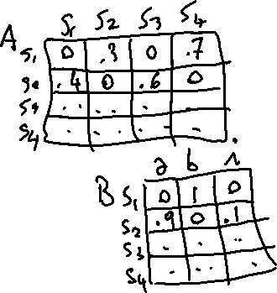

Computing the probability of an observation sequence O= o₁ ... o_{T}
e.g., P(b,i | sample HMM )
X = all sequences of T states
Notes:
Example on sample arc emission HMM? On P(b,i)
This is simply the sum of the probability of the observation occurring according to each possible state sequence.
Direct evaluation of this expression, however, is extremely inefficient.

Slide 19
Computing the probability of an observation sequence O= o₁ ... o_{T}
.6
1
a
.1
.5
e.g., P(b,i | sample HMM )
b
s₄
b
.4
.4
s₃
.5
a
i
.5
X = all sequences of T states
.7
.3
.6
b
1
s₁
.1
i
s₂
a
.4
.9
.6
.4
Start
Start
Notes:
Example on sample arc emission HMM? On P(b,i)
This is simply the sum of the probability of the observation occurring according to each possible state sequence.
Direct evaluation of this expression, however, is extremely inefficient.

Slide 20

Decoding Example
s₁, s₁ = 0 ?
.6
1
a
.1
.5
s₁, s₂ = 1 * .1 * .6 * .3
b
s₄
b
.4
.4
s₃
.5
a
i
.5
……….
.7
.3
.6
b
1
s₁
.1
i
……….
s₂
a
.4
.9
s₁, s₄ = 1 * .5 * .6 * .7
.6
.4
Start
Start
s₂, s₄ = 0?
……….
Complexity☹
……….
Manning/Schütze, 2000: 327

Slide 21
The forward procedure
.6
1
a
.1
.5
b
s₄
b
.4
.4
s₃
.5
a
1. Initialization
.5
i
.7
.6
1
.3
.1
b
s₁
s₂
i
.9
a
.4
.6
.4
2. Induction
Start
Start
3. Total
Complexity☺
Notes:
In order to avoid this complexity, we can use dynamic programming or memoization techniques.
In particular, we use treillis algorithms.
We make a square array of states versus time and compute the probabilities of being at each
state at each time in terms of the probabilities for being in each state at the preceding time.
A treillis can record the probability of all initial subpaths of the HMM that end in a certain state at a certain time.
The probability of longer subpaths can then be worked out in terms of the shorter subpaths.
This algorithm requires 2N²T multiplications (much less than the direct method which takes (2T+1).N^{T+1}

Slide 22

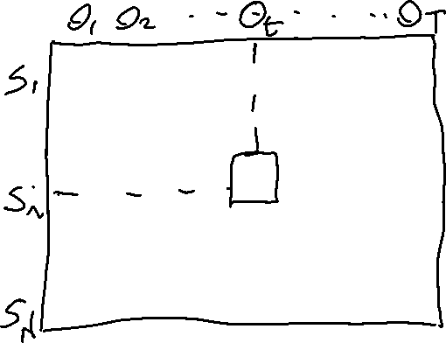



The forward procedure
.6
1
a
.1
.5
b
s₄
b
.4
.4
s₃
.5
a
i
.5
.7
.3
.6
b
1
s₁
.1
i
s₂
a
.4
.9
.6
.4
Start
Start
Notes:
In order to avoid this complexity, we can use dynamic programming or memoization techniques.
In particular, we use treillis algorithms.
We make a square array of states versus time and compute the probabilities of being at each
state at each time in terms of the probabilities for being in each state at the preceding time.
A treillis can record the probability of all initial subpaths of the HMM that end in a certain state at a certain time.
The probability of longer subpaths can then be worked out in terms of the shorter subpaths.
This algorithm requires 2N²T multiplications (much less than the direct method which takes (2T+1).N^{T+1}

Slide 23





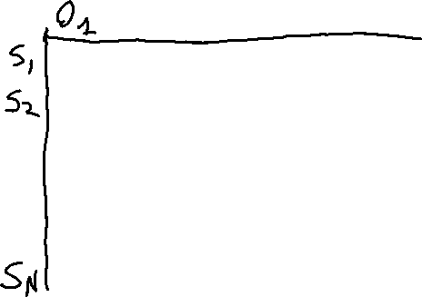




The forward procedure
.6
1
a
.1
.5
1. Initialization
b
s₄
b
.4
.4
s₃
.5
a
i
.5
.7
.3
.6
b
1
s₁
.1
i
s₂
a
.4
.9
.6
.4
Start
Start
Probability of starting in state S_{i} and making observation o₁
Notes:
In order to avoid this complexity, we can use dynamic programming or memoization techniques.
In particular, we use treillis algorithms.
We make a square array of states versus time and compute the probabilities of being at each
state at each time in terms of the probabilities for being in each state at the preceding time.
A treillis can record the probability of all initial subpaths of the HMM that end in a certain state at a certain time.
The probability of longer subpaths can then be worked out in terms of the shorter subpaths.
This algorithm requires 2N²T multiplications (much less than the direct method which takes (2T+1).N^{T+1}

Slide 24
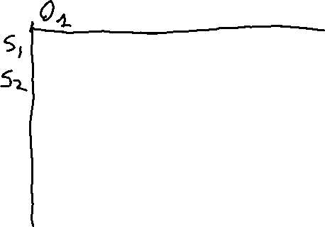



The forward procedure
.6
1
a
.1
.5
1. Initialization
b
s₄
b
.4
.4
s₃
.5
a
i
.5
.7
.3
.6
b
1
s₁
.1
i
s₂
a
.4
.9
.6
.4
Start
Start
Probability of starting in state S_{i} and making observation o₁
Notes:
In order to avoid this complexity, we can use dynamic programming or memoization techniques.
In particular, we use treillis algorithms.
We make a square array of states versus time and compute the probabilities of being at each
state at each time in terms of the probabilities for being in each state at the preceding time.
A treillis can record the probability of all initial subpaths of the HMM that end in a certain state at a certain time.
The probability of longer subpaths can then be worked out in terms of the shorter subpaths.
This algorithm requires 2N²T multiplications (much less than the direct method which takes (2T+1).N^{T+1}

Slide 25
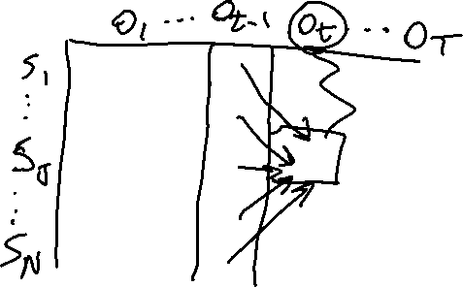




The forward procedure
.6
1
a
.1
.5
b
s₄
b
.4
.4
s₃
.5
a
i
.5
.7
.3
.6
b
1
s₁
.1
i
2. Induction
s₂
a
.4
.9
.6
.4
Start
Start
Notes:
In order to avoid this complexity, we can use dynamic programming or memoization techniques.
In particular, we use treillis algorithms.
We make a square array of states versus time and compute the probabilities of being at each
state at each time in terms of the probabilities for being in each state at the preceding time.
A treillis can record the probability of all initial subpaths of the HMM that end in a certain state at a certain time.
The probability of longer subpaths can then be worked out in terms of the shorter subpaths.
This algorithm requires 2N²T multiplications (much less than the direct method which takes (2T+1).N^{T+1}

Slide 26








The forward procedure
.6
1
a
.1
.5
b
s₄
b
.4
.4
s₃
.5
a
i
.5
.7
.3
.6
b
1
s₁
.1
i
2. Induction
s₂
a
.4
.9
.6
.4
Start
Start
Notes:
In order to avoid this complexity, we can use dynamic programming or memoization techniques.
In particular, we use treillis algorithms.
We make a square array of states versus time and compute the probabilities of being at each
state at each time in terms of the probabilities for being in each state at the preceding time.
A treillis can record the probability of all initial subpaths of the HMM that end in a certain state at a certain time.
The probability of longer subpaths can then be worked out in terms of the shorter subpaths.
This algorithm requires 2N²T multiplications (much less than the direct method which takes (2T+1).N^{T+1}

Slide 27
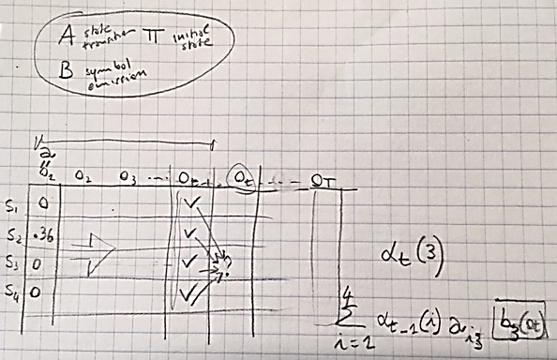


















.6
1
a
.1
.5
b
s₄
b
.4
.4
s₃
.5
a
i
.5
.7
.3
.6
b
1
s₁
.1
i
s₂
a
.4
.9
.6
.4
Start
Start

Slide 28

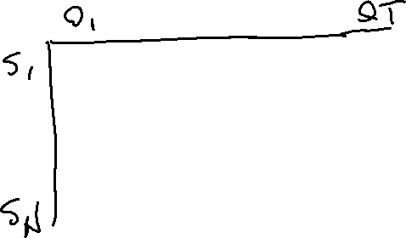

The forward procedure
.6
1
a
.1
.5
b
s₄
b
.4
.4
s₃
.5
a
i
.5
3. Total
.7
.3
.6
b
1
s₁
.1
i
s₂
a
.4
.9
.6
.4
Start
Start
Complexity☺
Notes:
In order to avoid this complexity, we can use dynamic programming or memoization techniques.
In particular, we use treillis algorithms.
We make a square array of states versus time and compute the probabilities of being at each
state at each time in terms of the probabilities for being in each state at the preceding time.
A treillis can record the probability of all initial subpaths of the HMM that end in a certain state at a certain time.
The probability of longer subpaths can then be worked out in terms of the shorter subpaths.
This algorithm requires 2N²T multiplications (much less than the direct method which takes (2T+1).N^{T+1}

Slide 29
Three fundamental questions for HMMs
Finding the probability of an observation sequence
  brute force or Forward Algorithm
If interested in details the next two questions, read
(Sections 8.4, 8.5 3rd Edition)
Decoding: Finding the most likely state sequence
  Viterbi-Algorithm
Training: find model parameters which best explain the observations
Notes:
- Given a model μ=(A, B, Π), how do we efficiently compute how likely a certain
observation is, that is, P(O| μ)
- Given the observation sequence O and a model μ, how do we choose a state sequence (X₁, …, X _{T+1})
that best explains the observations?
- Given an observation sequence O, and a space of possible models found by varying
the model parameters μ = (A, B, π), how do we find the model that best explains the observed data?

Slide 30
State of the art: Decoding for sequence labeling
Linear-Chain Conditional Random Fields:
  Generalization of HMM (undirected models)
  Viterbi can be applied for inference
Neural model (Recurrent NN) - NEXT WEEK
  What are the challenge?
input and output of the network does not have a fixed length.
Solution: activation value of the hidden layer h_{t} depends on the current input x_{t} as well as the activation value of the hidden layer from the previous time step h_{t-1}.
Notes:
Linear-chain CRFs have many of the same applications as conceptually simpler hidden Markov models (HMMs), but relax certain assumptions about the input and output sequence distributions. An HMM can loosely be understood as a CRF with very specific feature functions that use constant probabilities to model state transitions and emissions. Conversely, a CRF can loosely be understood as a generalization of an HMM that makes the constant transition probabilities into arbitrary functions that vary across the positions in the sequence of hidden states, depending on the input sequence.
CRF will discuss in some of the readings - there are packages if you need it in your project
RNN will discuss in some of the reading – good topic for project (at least one student will use this formalism)

Slide 31
Today Sep 28
Markov models: Chains… Hidden Markov Models: definition, three key problems (only one in detail)
Part-of-speech tagging
  What it is, Why we need it…
  Word classes (Tags)
    Distribution
    Tagsets
  How to do it
    Rule-based
    Stochastic

Slide 32
Parts of Speech Tagging: What
Input
Brainpower, not physical plant, is now a firm's chief asset.
Output
Brainpower_NN ,_, not_RB physical_JJ plant_NN ,_, is_VBZ now_RB a_DT firm_NN 's_POS chief_JJ asset_NN ._.
Tag meanings
NNP (Proper N sing), RB (Adv), JJ (Adj), NN (N sing. or mass), VBZ (V 3sg pres), DT (Determiner), POS (Possessive ending), . (sentence-final punct)
Notes:
Penn Treebank part-of-speech tags (including punctuation)

Slide 33
Parts of Speech Tagging: Why?
Part-of-speech (word class, morph. class, syntactic category) gives a significant amount of info about the word and its neighbors
Useful in the following NLP tasks:
As a basis for (Partial) Parsing
Information Retrieval
Word-sense disambiguation
Speech synthesis
……
And as features for many others NLP tasks:
Notes:
Penn Treebank part-of-speech tags (including punctuation)
Quickly finding names or other phrases for information extraction
Select important words from documents (e.g., nouns)
I made her duck
Knowing PoS produce more natural pronunciations Object Content
Kind of recursive….
Class-based n-grams (J&M pag 112 do not work with POS)

Slide 34
Parts of Speech
Eight basic categories
  Noun, verb, pronoun, preposition, adjective, adverb, article, conjunction
These categories are based on:
  morphological properties (affixes they take)
  distributional properties (what other words can occur nearby)
  e.g, green It is so… , both…, The… is
Notes:
Words that function similarly with respect to
the affixes they take
What other words can occur nearby
Only tendency towards semantic coherence
An Adjective is a word that can fill the blank in:
It’s so __________.
A Noun is a word that can be marked as plural.
A Noun is a word that can fill the blank in:
the __________ is
What is green?
It’s so green.
Both greens could work for the walls.
The green is a little too much given the red rug.
Not defined based on semantics

Slide 35
Parts of Speech
Two kinds of category
  Closed class (generally are function words)
    Prepositions, articles, conjunctions, pronouns, determiners, aux, numerals
  Open class
    Nouns (proper/common; mass/count), verbs, adjectives, adverbs (degree, manner,…)
Very short, frequent and important
Objects, actions, events, properties
If you run across an unknown word….??
Notes:
Very short, occur frequently, play important grammatical role
Identify objects events actions and properties of those..
Most languages have Adjectives for color age and value
Adverbs locative/degree/manner/temporal
.. Much more likely it is a member of an open class

Slide 36
PoS Distribution
Parts of speech follow a usual behavior in Language
(unfortunately very frequent)
>2 PoS
Words
~4k
1 PoS
2 PoS
~35k
~4k
…but luckily different tags associated with a word are not equally likely
Notes:
Most words have one part of speech of the rest, most have two
From there it’s about what you’d expect
A small number of words have lots of parts of speech
Unfortunately, the words with lots of parts of speech occur with high frequency
In: adv contrasted with out, prep eg of time ,N the ins and outs
A (det vs. letter) Still ( N apparatus for making liquor, still Adv)
Most nouns can be used as verbs “to oil the pan”

Slide 37
Sets of Parts of Speech:Tagsets
Most commonly used:
  45-tag Penn Treebank,
  61-tag C5,
  146-tag C7
The choice of tagset is based on the application (do you care about distinguishing between “to” as a prep and “to” as a infinitive marker?)
Accurate tagging can be done automatically even with large tagsets
Notes:
There are various standard tagsets to choose from; some have a lot more tags than others
(C5 and C7 in Appendix C of textbook) (most are evolutions of the brown corpus 87-tagset 1982)
The choice of tagset is based on the application
Accurate tagging can be done with even large tagsets

Slide 38
PoS Tagging
Input text
Brainpower, not physical plant, is now a firm's chief asset. …………
Dictionary
word_{i} -> set of tags from Tagset
Tagger selects “best” tag for each word
Output
Brainpower_NN ,_, not_RB physical_JJ plant_NN ,_, is_VBZ now_RB a_DT firm_NN 's_POS chief_JJ asset_NN ._. ……….
Notes:
Def: Part of speech tagging is the process of assigning parts of speech to each word in a sentence… Assume we have
A tagset
A dictionary that gives you the possible set of tags for each entry

Slide 39
Tagger Types
Rule-based ‘95
Stochastic
  HMM tagger ~ >= ’92
  Transformation-based tagger (Brill) ~ >= ’95
  MEMM (Maximum Entropy Markov Models)
  ~ >= ’97 (if interested sec. 9.5 textbook 3rd Ed. )
  ……… and many others
Notes:
Current work, using POS tagging to find phrases

Slide 40
Rule-Based (ENGTWOL ‘95)
A lexicon transducer returns for each word all possible morphological parses
A set of ~3,000 constraints is applied to rule out inappropriate PoS
Step 1: sample I/O
Sample Constraint
“Pavlov had show that salivation….”
Example: Adverbial “that” rule
Given input: “that”
If
(+1 A/ADV/QUANT)
(+2 SENT-LIM)
(NOT -1 SVOC/A)
Then eliminate non-ADV tags
Else eliminate ADV
Pavlov N SG PROPER
had HAVE V PAST SVO
HAVE PCP2 SVO
shown SHOW PCP2 SVOO ……
that ADV
PRON DEM SG
CS
……..
…….
That adv: “it isn’t that odd”
Notes:
PCP2 past participle
That adv: it isn’t that odd
CS = complementaized (conjunction?)
Constraints are used to eliminate tags inconsistent with the context
Simplified version of constraint
If following word is an adj/adv/quant and it is followed by an end of sentence
And the preceding word is not a verb like consider and believe
Which allow adj as object complements like in “I consider that odd”

Slide 41
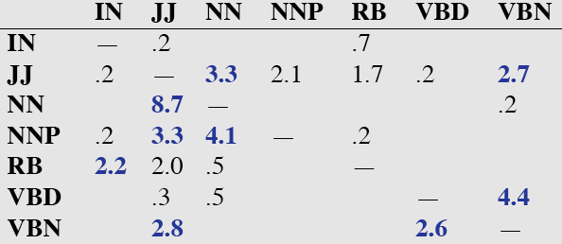

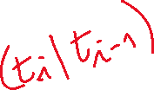




HMM Stochastic Tagging in essence
Tags corresponds to an HMM states
Words correspond to the HMM alphabet symbols
Tagging: given a sequence of words (observations), find the most likely sequence of tags (states)
Notes:
Two reasons: what to do about context words that are ambiguous and, this way, since there are a lot fewer tags than words, counts are high enough to be meaningful.
EM. These taggers will start with a dictionary that lists which tags can be assigned to each word

Slide 42







HMM Stochastic Tagging in essence
Tagging: given a sequence of words (observations), find the most likely sequence of tags (states)
But this is…..!
We need: State transition and symbol emission probabilities
1) From hand-tagged corpus
2) No tagged corpus: parameter estimation (forward/backward aka Baum-Welch)
Notes:
Two reasons: what to do about context words that are ambiguous and, this way, since there are a lot fewer tags than words, counts are high enough to be meaningful.
EM. These taggers will start with a dictionary that lists which tags can be assigned to each word

Slide 43
Evaluating Taggers
Accuracy: percent correct (most current taggers 97%) *test on unseen data!*
Unigram baseline: assign each token to the class it occurred in most frequently in the training set (race -> NN). (91%)
What is causing the errors? Build a confusion matrix…
Notes:
How good is the algorithm?
What’s the maximum performance we have any reason to believe is achievable? (How well can people do?)
How good is good enough?
Is 97% good enough?
Example 1: A speech dialogue system correctly assigns a meaning to a user’s input 97% of the time.
Example 2: An OCR systems correctly determines letters 97% of the time.

Slide 44
Confusion matrix
Precision ?
Recall ?

Slide 45
Error Analysis
Look at a confusion matrix
See what errors are causing problems
  Noun (NN) vs ProperNoun (NNP) vs Adj (JJ)
  Past tense (VBD) vs Past Participle (VBN)

Slide 46
POS tagging state of the art + tools
Stanford Tagger: Maximum entropy cyclic dependency network – Java - 97.24%
  Toutanova and Manning. 2000. Enriching the Knowledge Sources Used in a Maximum Entropy Part-of-Speech Tagger (EMNLP/VLC-2000),
  Toutanova, Klein, Manning, and Singer. 2003. Feature-Rich Part-of-Speech Tagging with a Cyclic Dependency Network. HLT-NAACL 2003,
Semisup Neighbor - Python – 97.50%
  Anders. 2011. Semi-supervised condensed nearest neighbor for part-of-speech tagging. (ACL-HLT).
More….
Notes:
We present a new part-of-speech tagger that
demonstrates the following ideas: (i) explicit use of both preceding and following tag contexts
via a dependency network representation, (ii) broad use of lexical features, including
jointly conditioning on multiple consecutive words, (iii) effective use of priors in conditional
loglinear models, and (iv) fine-grained modeling of unknown word features. Using these ideas together, the resulting tagger gives a 97.24%accuracy on the Penn TreebankWSJ, an error reduction of 4.4% on the best previous single automatically learned tagging result.
The labeled data points are the model. Consequently,
classification time is proportional to the
number of labeled data points. This is of course impractical.
Many algorithms have been proposed to
make memory-based learning more efficient. The
intuition behind many of them is that the set of labeled
data points can be reduced or condensed, since
many labeled data points are more or less redundant.
The algorithms try to extract a subset of the overall
training set that correctly classifies all the discarded
data points through the nearest neighbor rule. Intuitively,
the model finds good representatives of clusters
in the data or discards the data points that are far
from the decision boundaries. Such algorithms are
called training set condensation algorithms.
The need for training set condensation is particularly
important in semi-supervised learning where
we rely on a mixture of labeled and unlabeled data
points. While the number of labeled data points
is typically limited, the number of unlabeled data
points is typically high. In this paper, we introduce
a new semi-supervised learning algorithm that
combines self-training and condensation to produce
small subsets of labeled and unlabeled data points
that are highly relevant for determining good decision boundaries

Slide 47
POS tagging state of the art + tools
Neural Approaches (on several languages)
Barbara Plank, Anders Søgaard, and Yoav Goldberg. Multilingual part-of-speech tagging with bidirectional long short-term memory models and auxiliary loss. ACL 2016.
“state of the art POS tagging “ link on course webpage
Notes:
We present a new part-of-speech tagger that
demonstrates the following ideas: (i) explicit use of both preceding and following tag contexts
via a dependency network representation, (ii) broad use of lexical features, including
jointly conditioning on multiple consecutive words, (iii) effective use of priors in conditional
loglinear models, and (iv) fine-grained modeling of unknown word features. Using these ideas together, the resulting tagger gives a 97.24%accuracy on the Penn TreebankWSJ, an error reduction of 4.4% on the best previous single automatically learned tagging result.
The labeled data points are the model. Consequently,
classification time is proportional to the
number of labeled data points. This is of course impractical.
Many algorithms have been proposed to
make memory-based learning more efficient. The
intuition behind many of them is that the set of labeled
data points can be reduced or condensed, since
many labeled data points are more or less redundant.
The algorithms try to extract a subset of the overall
training set that correctly classifies all the discarded
data points through the nearest neighbor rule. Intuitively,
the model finds good representatives of clusters
in the data or discards the data points that are far
from the decision boundaries. Such algorithms are
called training set condensation algorithms.
The need for training set condensation is particularly
important in semi-supervised learning where
we rely on a mixture of labeled and unlabeled data
points. While the number of labeled data points
is typically limited, the number of unlabeled data
points is typically high. In this paper, we introduce
a new semi-supervised learning algorithm that
combines self-training and condensation to produce
small subsets of labeled and unlabeled data points
that are highly relevant for determining good decision boundaries

Slide 48



TNT: a second order HMM
Notes:
TNT (Brants, 2000)—a second order HMM with suffix trie handling for OOVs. We use
TNT as it was among the best performing taggers evaluated in Horsmann et al. (2015).3

Slide 49
Next ….
Wed: Recurrent Neural networks for Sequence Labeling (J&M 3Ed Chp. 9)
Next Mon: Start Syntax & Context Free Grammars (J&M 3Ed Chp. 10-11)
Solution for Assignment1 Posted
(use them to check your work)
Work on Assignment 2
(will be on Canvas by tonight)

