Slide 1
CPSC 503
Computational Linguistics
Finish Encoder Decoder / Attention/ Transformers /Pragmatics
Lecture 15
Giuseppe Carenini
Slides Sources: Jurafsky & Martin 3rd Ed /
blog https://jalammar.github.io/illustrated-transformer/

Slide 2
Today Nov 2
(Finish) Encoder Decoder
Attention
Transformers
Intro to Pragmatics (time permitting)

Slide 3
Encoder-Decoder
RNN: input sequence is transformed into output sequence in a one-to-one fashion.
Goal: Develop an architecture capable of generating contextually appropriate, arbitrary length, output sequences
Applications:
  Machine translation,
  Summarization,
  Question answering,
  Dialogue modeling.
Notes:
that are capable of generating
contextually appropriate, arbitrary length, output sequences. Encoder-decoder networks
have been applied to a very wide range of applications including machine
translation, summarization, question answering, and dialogue modeling.

Slide 4









Simple recurrent neural network illustrated as a feed-forward network
Most significant change: new set of weights, U
connect the hidden layer from the previous time step to the current hidden layer.
determine how the network should make use of past context in calculating the output for the current input.
$y_{t}=softmax$(V$h_{t}$)
$y_{t}=$f(V$h_{t}$)
$h_{t}=$g(U$h_{t−1}$+W$x_{t}$)
Notes:
Simple recurrent neural network illustrated as a feed-forward network
The most significant change lies in the new set of weights,
U, that connect the hidden layer from the previous time step to the current hidden
layer. These weights determine how the network should make use of past context in
calculating the output for the current input.

Slide 5
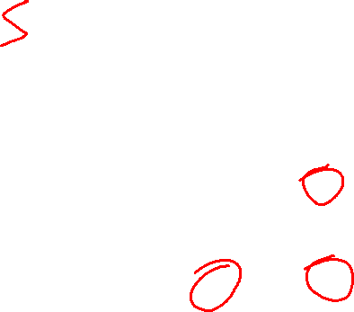
Simple-RNN abstraction
y₁
y₂
y₃
Notes:
In figures such as this, the
various layers of units are copied for each time step to illustrate that they will have
differing values over time. However the weights themselves are shared across the
various time steps. Finally, the fact that the computation at time t requires the value
of the hidden layer from time t-1 mandates an incremental inference algorithm that
proceeds from the start of the sequence to the end as shown in Fig. 9.5.

Slide 6
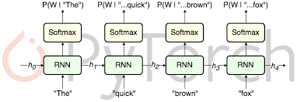
RNN Applications
Language Modeling
Sequence Classification (Sentiment, Topic)
Sequence to Sequence
Notes:
Simple recurrent networks have proven to be an effective approach to language modeling,
sequence labeling tasks such as part-of-speech tagging, as well as sequence
classification tasks such as sentiment analysis and topic classification. And as we’ll
see in Chapter 22, they form the basic building blocks for sequence to sequence
approaches to applications such as summarization and machine translation.

Slide 7


Sentence Completion using an RNN
$y_{t}=softmax$(V$h_{t}$)
$h_{t}=$g($h_{t−1}$+W$x_{t}$)
Trained Neural Language Model can be used to generate novel sequences
Or to complete a given sequence (until end of sentence token <\s> is generated)
Notes:
Given a trained model, we can ask the network to generate novel sequences by first randomly sampling
an appropriate word as the beginning of a sequence. We then condition the
generation of subsequent words on the hidden state from the previous time step as
well as the embedding for the word just generated, again sampling from the distribution
provided by the softmax.
…Note that the goal of the lefthand portion of the network
is to generate a series of hidden states from the given input; there are no outputs
associated with this part of the process until we reach the end of the prefix

Slide 8
Extending (autoregressive) generation to Machine Translation
word generated at each time step is conditioned on word from previous step.
Training data are parallel text e.g., English / French
there lived a hobbit vivait un hobbit
……..
Build an RNN language model on the concatenation of source and target
there lived a hobbit <\s> vivait un hobbit <\s>
……..
Notes:
This technique is called autoregressive generation since the word generated at the
Generation each time step is conditioned on the word generated by the network at the previous
step.

Slide 9


Extending (autoregressive) generation to Machine Translation
Translation as Sentence Completion !

Slide 10


(simple) Encoder Decoder Networks
Limiting design choices
E and D assumed to have the same internal structure (here RNNs)
Final state of the E is the only context available to D
this context is only available to D as its initial hidden state.
Encoder generates a contextualized representation of the input (last state).
Decoder takes that state and autoregressively generates a sequence of outputs
Notes:
Basic RNN-based encoder-decoder architecture. The final hidden state of the encoder RNN
serves as the context for the decoder in its role as h0 in the decoder RNN.

Slide 11














General Encoder Decoder Networks
Abstracting away from these choices
Encoder: accepts an input sequence, x_{1:n} and generates a corresponding sequence of contextualized representations, h_{1:n}
Context vector c: function of h_{1:n} and conveys the essence of the input to the decoder.
Decoder: accepts c as input and generates an arbitrary length sequence of hidden states h_{1:m} from which a corresponding sequence of output states y_{1:m} can be obtained.
h₁
h₂
h_{m}
h₁
h₂
h_{n}
Notes:
, we can say that encoder-decoder networks consist of three components:
Basic architecture for an abstract encoder-decoder network. The context is a
function of the vector of contextualized input representations and may be used by the decoder
in a variety of ways.
Among the major ones are that the encoder and the decoder
are assumed to have the same internal structure (RNNs in this case), that the final
state of the encoder is the only context available to the decoder, and finally that
this context is only available to the decoder as its initial hidden state. Abstracting
away from these choices, we can say that encoder-decoder networks consist of three
components:
1. An encoder that accepts an input sequence, xn
1, and generates a corresponding
sequence of contextualized representations, hn1
.
2. A context vector, c, which is a function of hn1
, and conveys the essence of the
input to the decoder.
3. And a decoder, which accepts c as input and generates an arbitrary length
sequence of hidden states hm1
, from which a corresponding sequence of output
states ym1
, can be obtained.

Slide 12













Stacked architectures are popular choices for Encoders
Stacked Bi-LSTMs
Contextualized representations for each time step: hidden states from top layers from the forward and backward passes
Later in this Class:
Transformers
Notes:
An encoder design makes use
of stacked Bi-LSTMs where the hidden states from top layers from the forward and
backward passes are concatenated as described in Chapter 9 to provide the contextualized
representations for each time step.

Slide 13
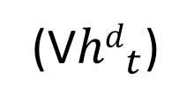
Decoder Basic Design
produce an output sequence an element at a time
Last hidden state of the encoder
z₁
z₂
First hidden state of the decoder
(V${hd}_{t}$)
Notes:
autoregressive generation is used to produce an output sequence,
an element at a time, until an end-of-sequence marker is generated
This incremental
process is guided by the context provided by the encoder as well as any items
generated for earlier states by the decoder.

Slide 14

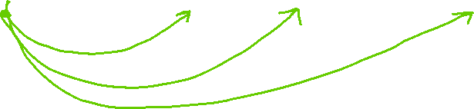
Decoder Design
Enhancement
z₁
z₂
Context available at each step of decoding
Notes:
autoregressive generation is used to produce an output sequence,
an element at a time, until an end-of-sequence marker is generated
This incremental
process is guided by the context provided by the encoder as well as any items
generated for earlier states by the decoder.

Slide 15









Decoder: How output y is chosen
z₁
z₂
Sample soft-max distribution (OK for generating novel output, not OK for e.g. MT or Summ)
Most likely output (doesn’t guarantee individual choices being made make sense together)
For sequence labeling we used Viterbi – here not possible ☹
Notes:
independently choosing the argmax over a sequence is not a reliable way of arriving
at a good output since it doesn’t guarantee that the individual choices being made
make sense together and combine into a coherent whole
With sequence labeling we
addressed this with a CRF-layer over the output token types combined with a Viterbi-style
dynamic programming search. Unfortunately, this approach is not viable here
since the dynamic programming invariant doesn’t hold.

Slide 16











4 most likely “words” decoded from initial state
Feed each of those in decoder and keep most likely 4 sequences of two words
Feed most recent word in decoder and keep most likely 4 sequences of three words …….
When EOS is generated. Stop sequence and reduce Beam by 1
Notes:
Beam decoding with a beam width of 4. At the initial step, the frontier is filled with the best 4
options from the initial state of the decoder. In a breadth-first fashion, each state on the frontier is passed to a
decoder which computes a softmax over the entire vocabulary and attempts to enter each as a new state into the
frontier subject to the constraint that they are better than the worst state already there. As completed sequences
are discovered they are recorded and removed from the frontier and the beam width is reduced by 1.

Slide 17
Today Nov 2
Encoder Decoder
Attention
Transformers
Intro to Pragmatics (time permitting)

Slide 18
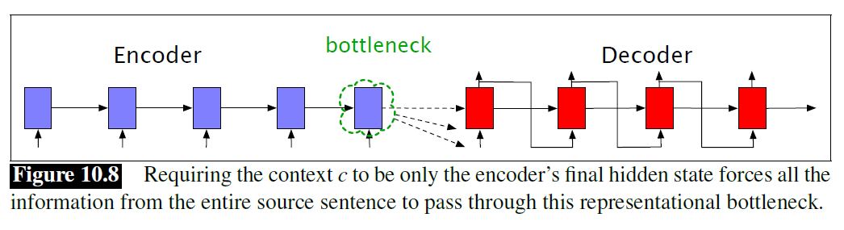






Avoid a representational bottleneck!

Slide 19








Flexible context: Attention
Context vector c: function of h_{1:n} and conveys the essence of the input to the decoder.
Flexible?
Different for each h_{i}
Flexibly combining the h_{j}
h₂
h₁
h_{m}
Fixed –length vector
h₁
h₂
h_{n}
Notes:
we’ll need a mechanism that can take the entire encoder context into account, that dynamically
updates during the course of decoding, and that can be embodied in a fixed-size
attention vector. Taken together, we’ll refer such an approach as an attention mechanism.

Slide 20





Attention (1): dynamically derived context
Replace static context vector with dynamic c_{i}
derived from the encoder hidden states at each point i during decoding
Ideas:
should be a linear combination of those states
should depend on ?
Notes:
Replace the static context vector with one that is dynamically derived from the encoder hidden states at each point during decoding

Slide 21
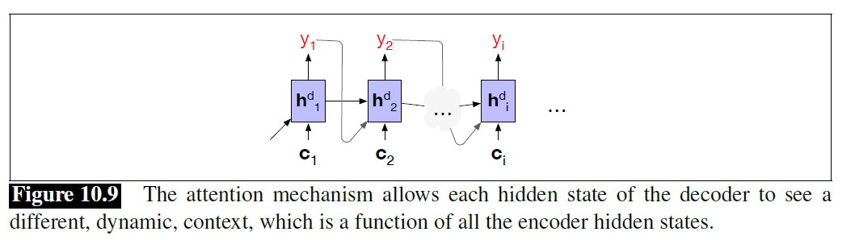

Slide 22









Attention (2): computing c_{i}
Compute a vector of scores that capture the relevance of each encoder hidden state to the decoder state
Just the similarity (dot product)
Then, to give network the ability to learn which aspects of similarity between the decoder and encoder states are important to the current application.
Also allows for h^{d} and h^{e} of different dimensionality
Notes:
The first step in computing ci is to compute a vector of scores that capture the
relevance of each encoder hidden state to the decoder state captured in hdi
For now, let’s assume that this score provides us with a measure of how similar
the decoder hidden state is to each encoder hidden state
When taking the inner (dot) product of a vector with itself, large numbers are perfectly
aligned with large numbers, and small with small. Any other ordering will match a
smaller with a larger, and that will produce smaller products than when they are
aligned.
The weights Ws, which are then trained during normal end-to-end training, give the network the ability to learn which aspects of similarity between the decoder and encoder states are important to the current application. This bilinear model also allows the encoder and decoder to use different dimensional vectors, whereas the simple dot-product attention requires the encoder and decoder hidden states have the same dimensionality.

Slide 23








Attention (3): computing c_{i}
From scores to weights
Create vector of weights by normalizing scores
Goal achieved: compute a fixed-length context vector for the current decoder state by taking a weighted average over all the encoder hidden states.
Notes:
To make use of these scores, we’ll next normalize them with a softmax to create
a vector of weights, ai j, that tells us the proportional relevance of each encoder
hidden state j to the current decoder state, i.
Finally, given the distribution in a, we can compute a fixed-length context vector for
the current decoder state by taking a weighted average over all the encoder hidden
states.

Slide 24




Attention: Summary
Decoder
Encoder
Notes:
To make use of these scores, we’ll next normalize them with a softmax to create
a vector of weights, ai j, that tells us the proportional relevance of each encoder
hidden state j to the current decoder state, i.

Slide 25
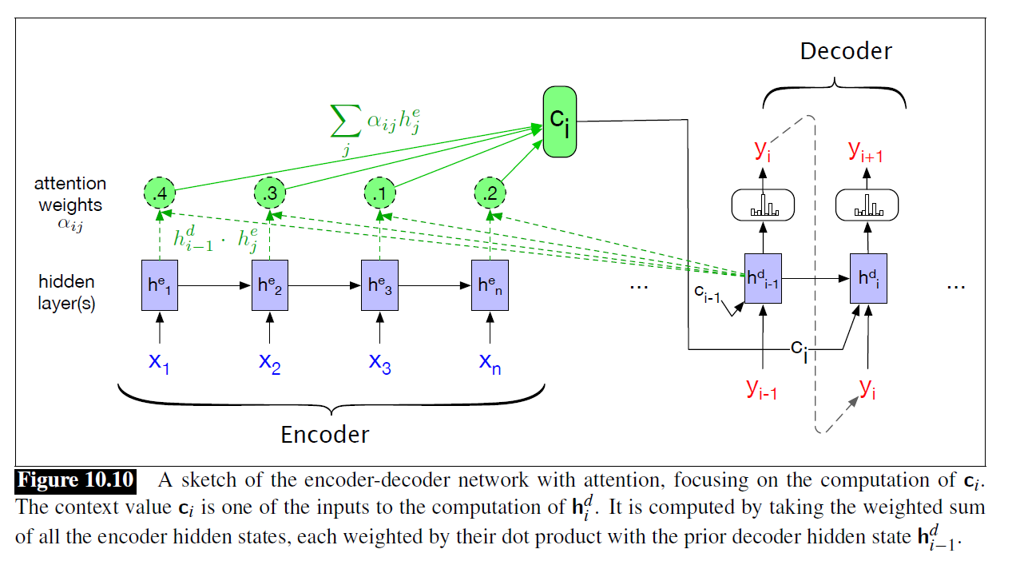
Textbook new figure: let’s parse it

Slide 26





Explain Y. Goldberg different notation

Slide 27































Intro to Encoder-Decoder and Attention (Goldberg’s notation)
Decoder
Encoder

Slide 28
Today Nov 2
Encoder Decoder
Attention
Transformers (self-attention)
Intro to Pragmatics (time permitting)

Slide 29
Transformers (Attention is all you need 2017)
Just an introduction: These are two valuable resources to learn more details on the architecture and implementation
Also Assignment 4 will help you learn more about Transformers
http://nlp.seas.harvard.edu/2018/04/03/attention.html
https://jalammar.github.io/illustrated-transformer/ (slides come from this source)

Slide 30
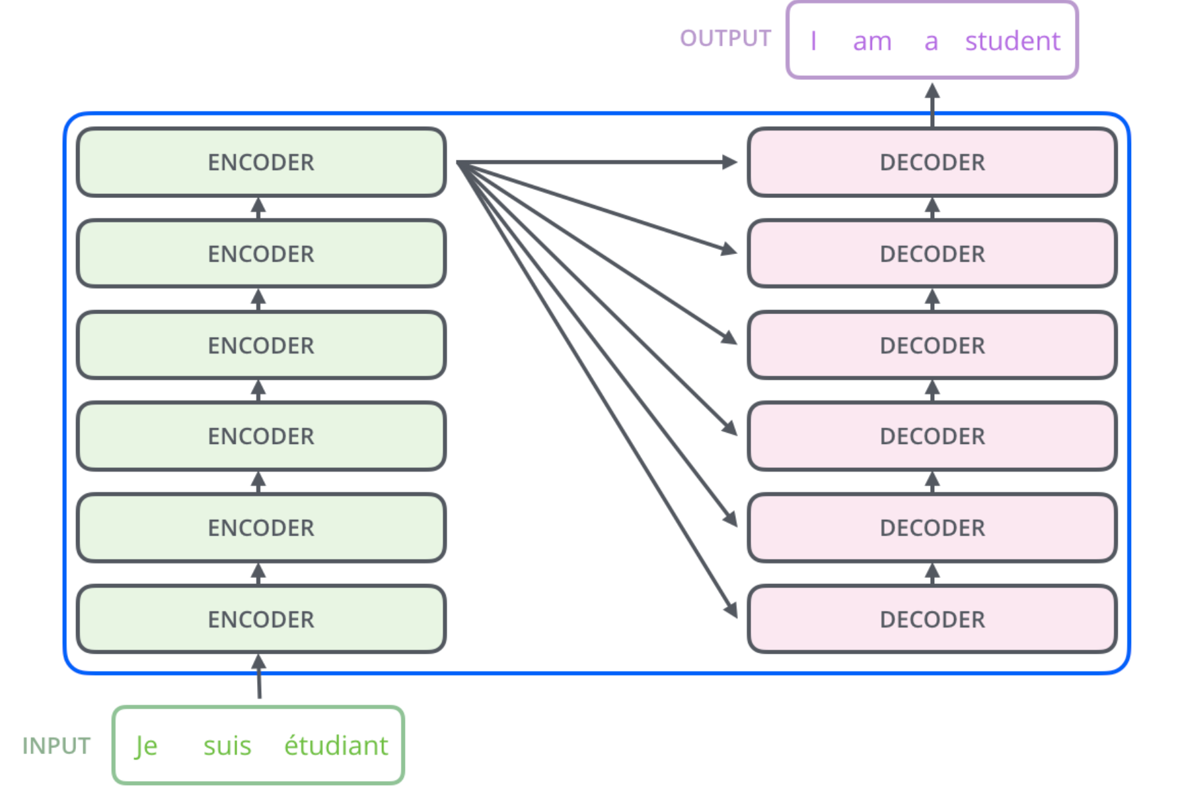
High-level architecture
We will mainly look at the ENCODER(s) part in detail

Slide 31
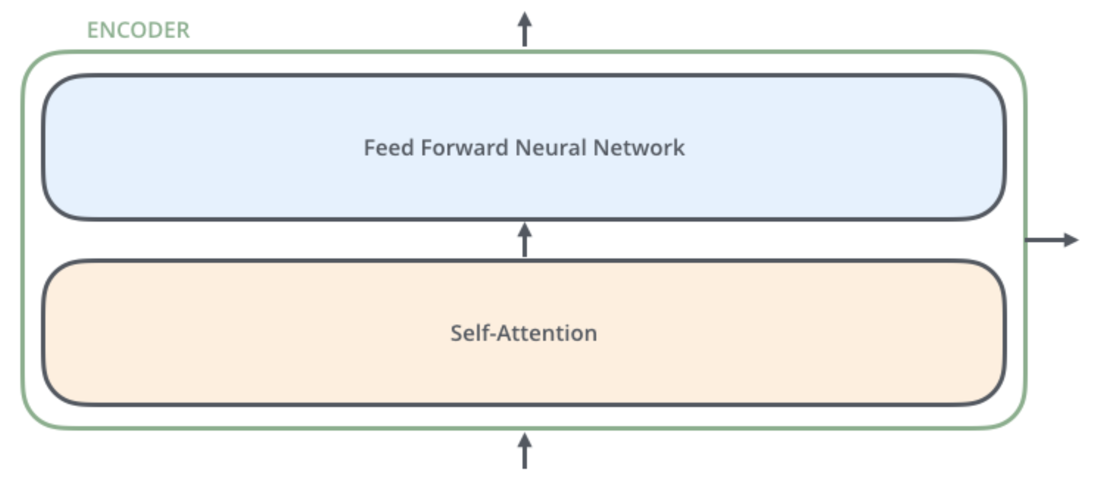
The encoders are all identical in structure (yet they do not share weights). Each one is broken down into two sub-layers
outputs of the self-attention are fed to a feed-forward neural network. The exact same one is independently applied to each position.
helps the encoder look at other words in the input sentence as it encodes a specific word.

Slide 32
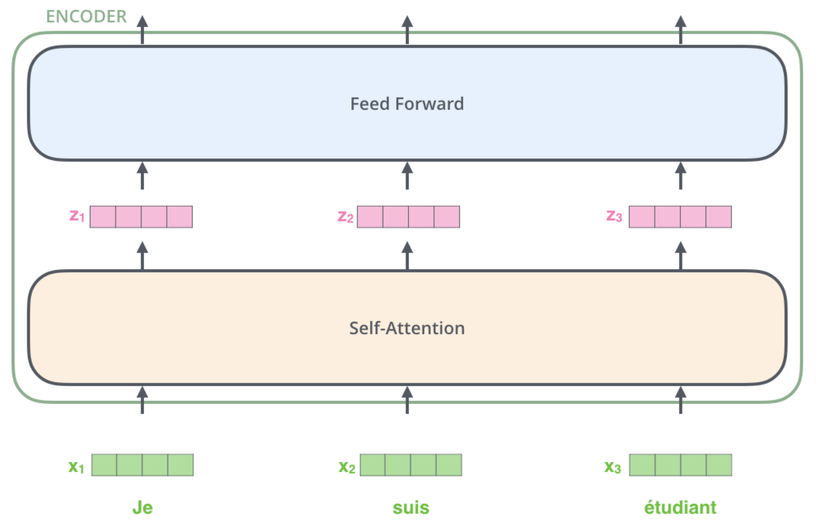
Key property of Transformer: word in each position flows through its own path in the encoder.
There are dependencies between these paths in the self-attention layer.
Feed-forward layer does not have those dependencies => various paths can be executed in parallel !
Word embeddings
Notes:
The size of this list is hyperparameter we can set – basically it would be the length of the longest sentence in our training dataset.
Here we begin to see one key property of the Transformer, which is that the word in each position flows through its own path in the encoder. There are dependencies between these paths in the self-attention layer. The feed-forward layer does not have those dependencies, however, and thus the various paths can be executed in parallel while flowing through the feed-forward layer.

Slide 33
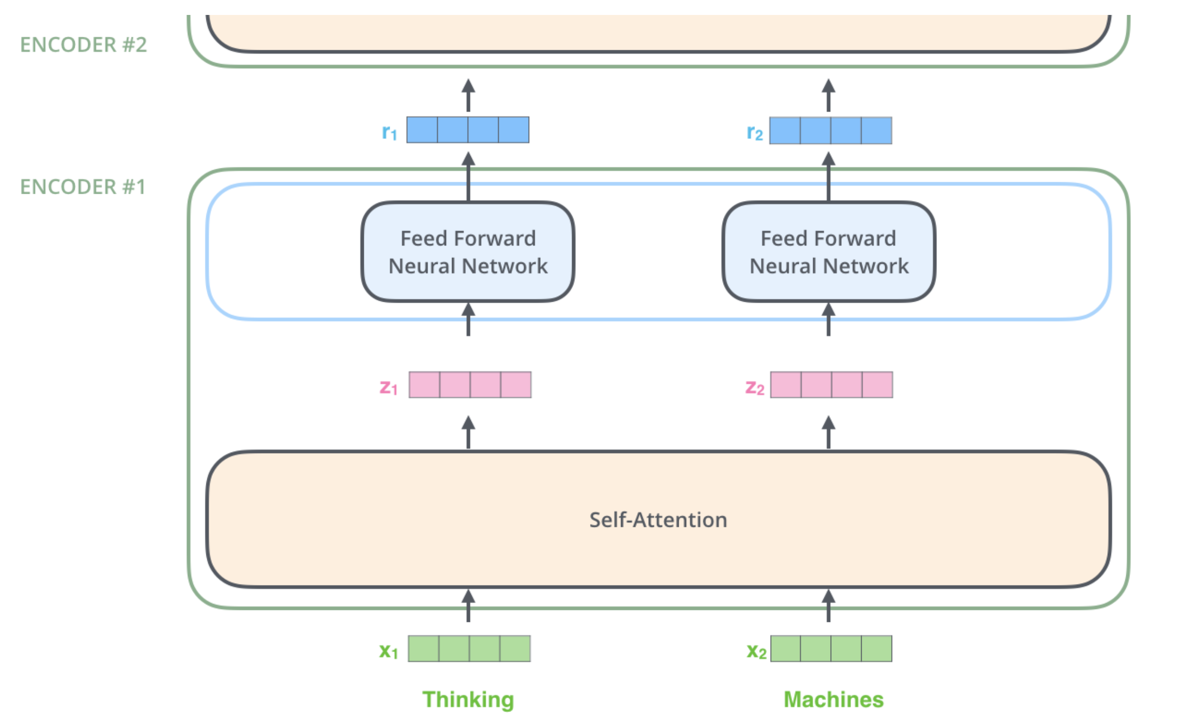


Visually clearer on two words
dependencies in self-attention layer.
No dependencies in Feed-forward layer
Word embeddings

Slide 34
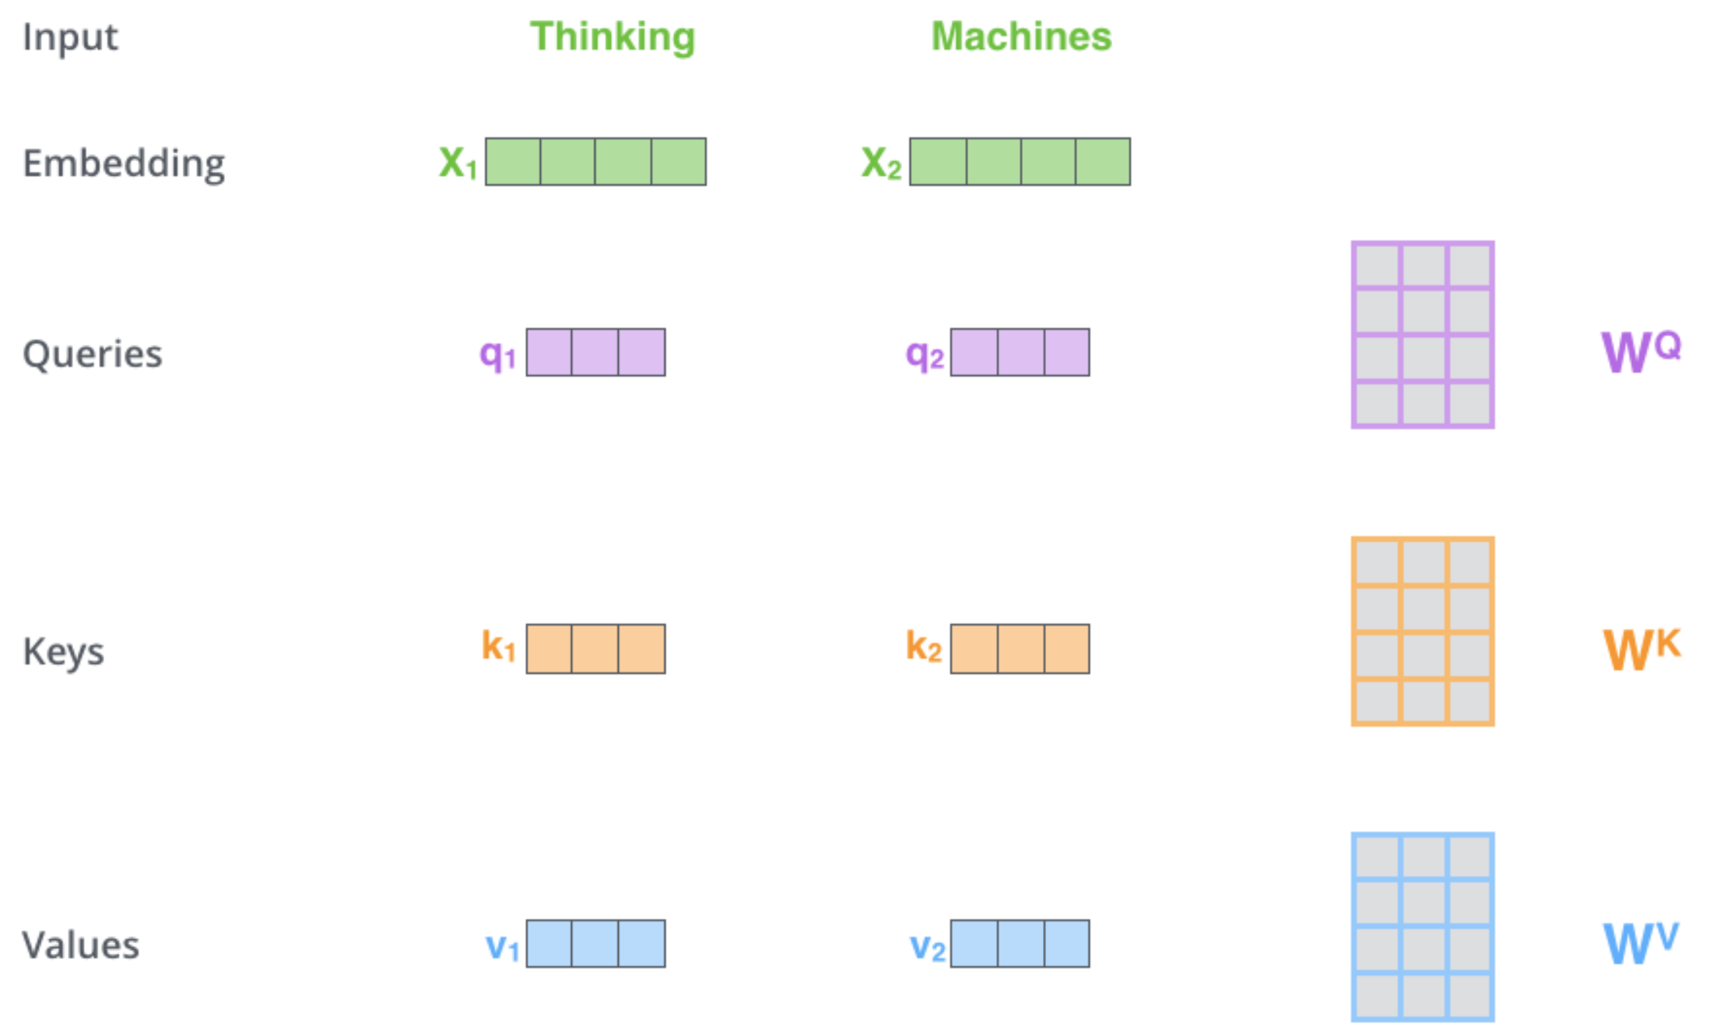
Self-Attention
While processing each word it allows to look at other positions in the input sequence for clues to build a better encoding for this word.
Step1: create three vectors from each of the encoder’s input vectors:
Query, a Key, Value (typically smaller dimension).
by multiplying the embedding by three matrices that we trained during the training process.
Notes:
As the model processes each word (each position in the input sequence), self attention allows it to look at other positions in the input sequence for clues that can help lead to a better encoding for this word.
If you’re familiar with RNNs, think of how maintaining a hidden state allows an RNN to incorporate its representation of previous words/vectors it has processed with the current one it’s processing. Self-attention is the method the Transformer uses to bake the “understanding” of other relevant words into the one we’re currently processing.
The first step in calculating self-attention is to create three vectors from each of the encoder’s input vectors (in this case, the embedding of each word). So for each word, we create a Query vector, a Key vector, and a Value vector. These vectors are created by multiplying the embedding by three matrices that we trained during the training process.
Notice that these new vectors are smaller in dimension than the embedding vector. Their dimensionality is 64, while the embedding and encoder input/output vectors have dimensionality of 512. They don’t HAVE to be smaller, this is an architecture choice to make the computation of multiheaded attention (mostly) constant.

Slide 35

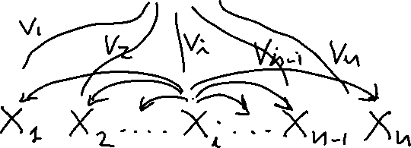
















Why three vectors?
To capture the three different roles that each input embedding plays during the course of the attention process.
As the current focus of attention when being compared to all of the other inputs (query)
In its role as input being compared to the current focus of attention. (key)
finally, as a value used to compute the output for the current focus of attention

Slide 36
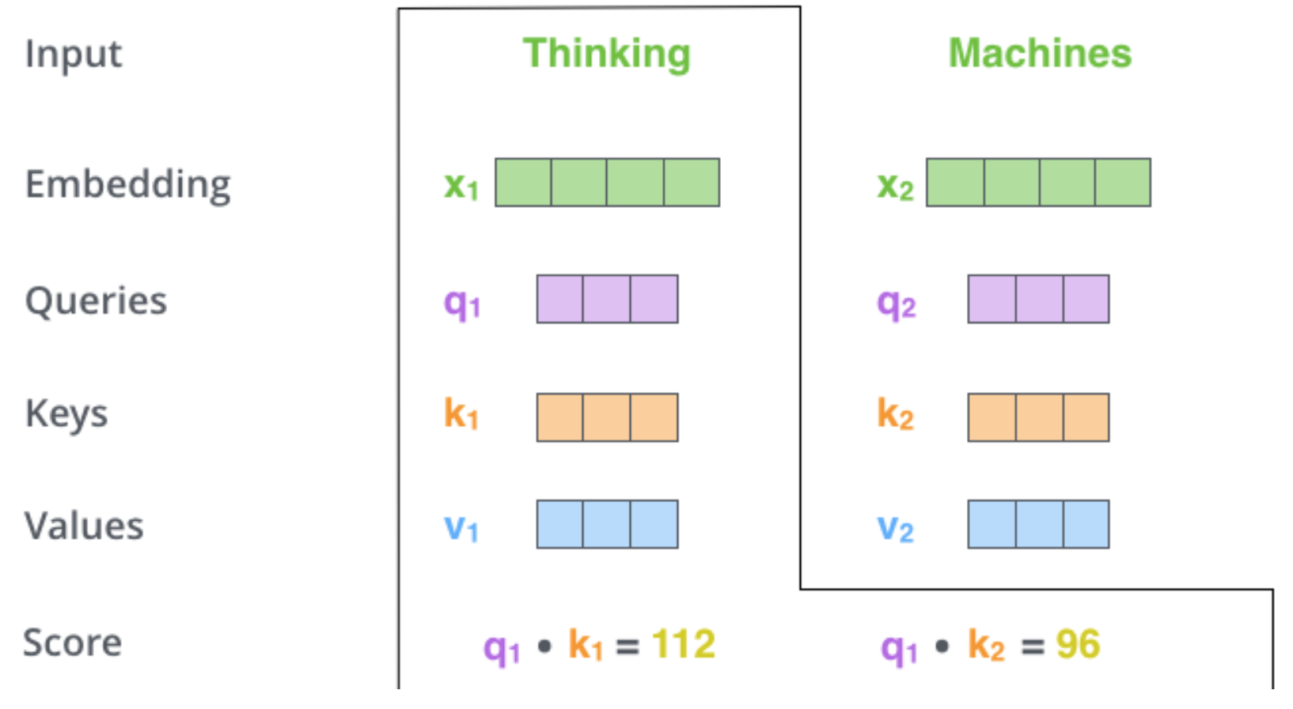
Self-Attention
Processing “Thinking”: x₁
Step 2: calculate a score (like we have seen for regular attention!) how much focus to place on other parts of the input sentence as we encode a word at a certain position.
Take dot product of the query vector with the key vector of the respective word we’re scoring.
E.g., Processing the self-attention for word “Thinking” in position #1, the first score would be the dot product of q1 and k1. The second score would be the dot product of q1 and k2.
Notes:
The second step in calculating self-attention is to calculate a score. Say we’re calculating the self-attention for the first word in this example, “Thinking”. We need to score each word of the input sentence against this word. The score determines how much focus to place on other parts of the input sentence as we encode a word at a certain position.
The score is calculated by taking the dot product of the query vector with the key vector of the respective word we’re scoring. So if we’re processing the self-attention for the word in position #1, the first score would be the dot product of q1 and k1. The second score would be the dot product of q1 and k2.

Slide 37
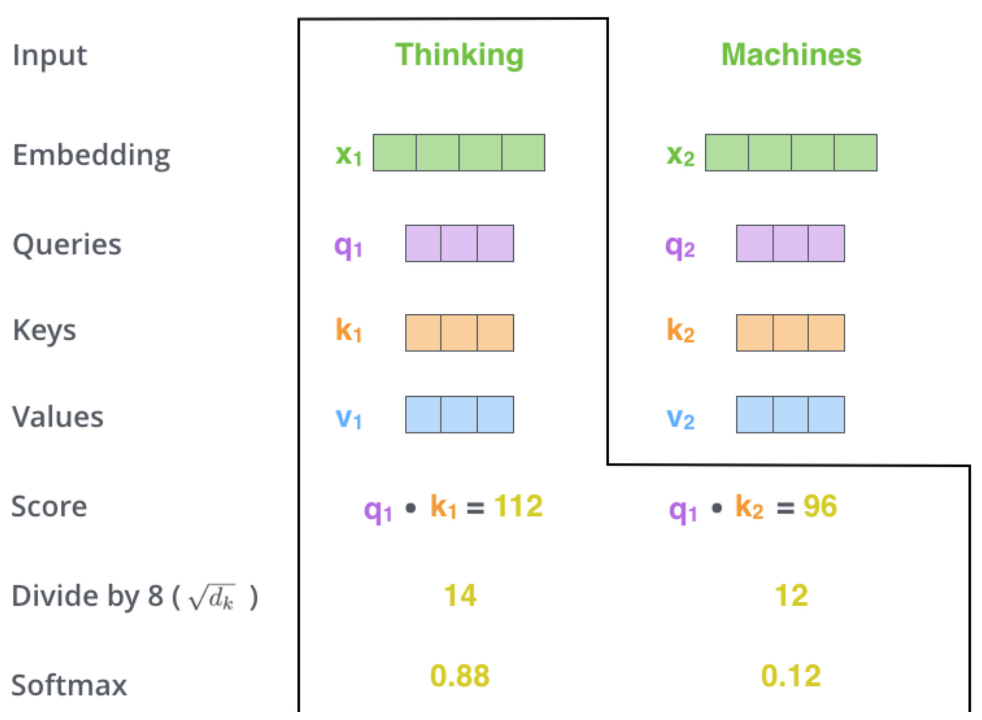




Self Attention
Step 3 divide scores by the square root of the dimension of the key vectors (more stable gradients).
Step 4 pass result through a softmax operation. (all positive and add up to 1)
Intuition: softmax score determines how much each word will be expressed at this position.
Notes:
The third and forth steps are to divide the scores by 8 (the square root of the dimension of the key vectors used in the paper – 64. This leads to having more stable gradients. There could be other possible values here, but this is the default), then pass the result through a softmax operation. Softmax normalizes the scores so they’re all positive and add up to 1
Third step Justification: The result of a dot product can be an arbitrarily large (positive or negative) value.
Exponentiating such large values can lead to numerical issues and to an effective loss
of gradients during training. To avoid this, the dot product needs to be scaled in a
suitable fashion. A scaled dot-product approach divides the result of the dot product
by a factor related to the size of the embeddings before passing them through the
softmax.

Slide 38
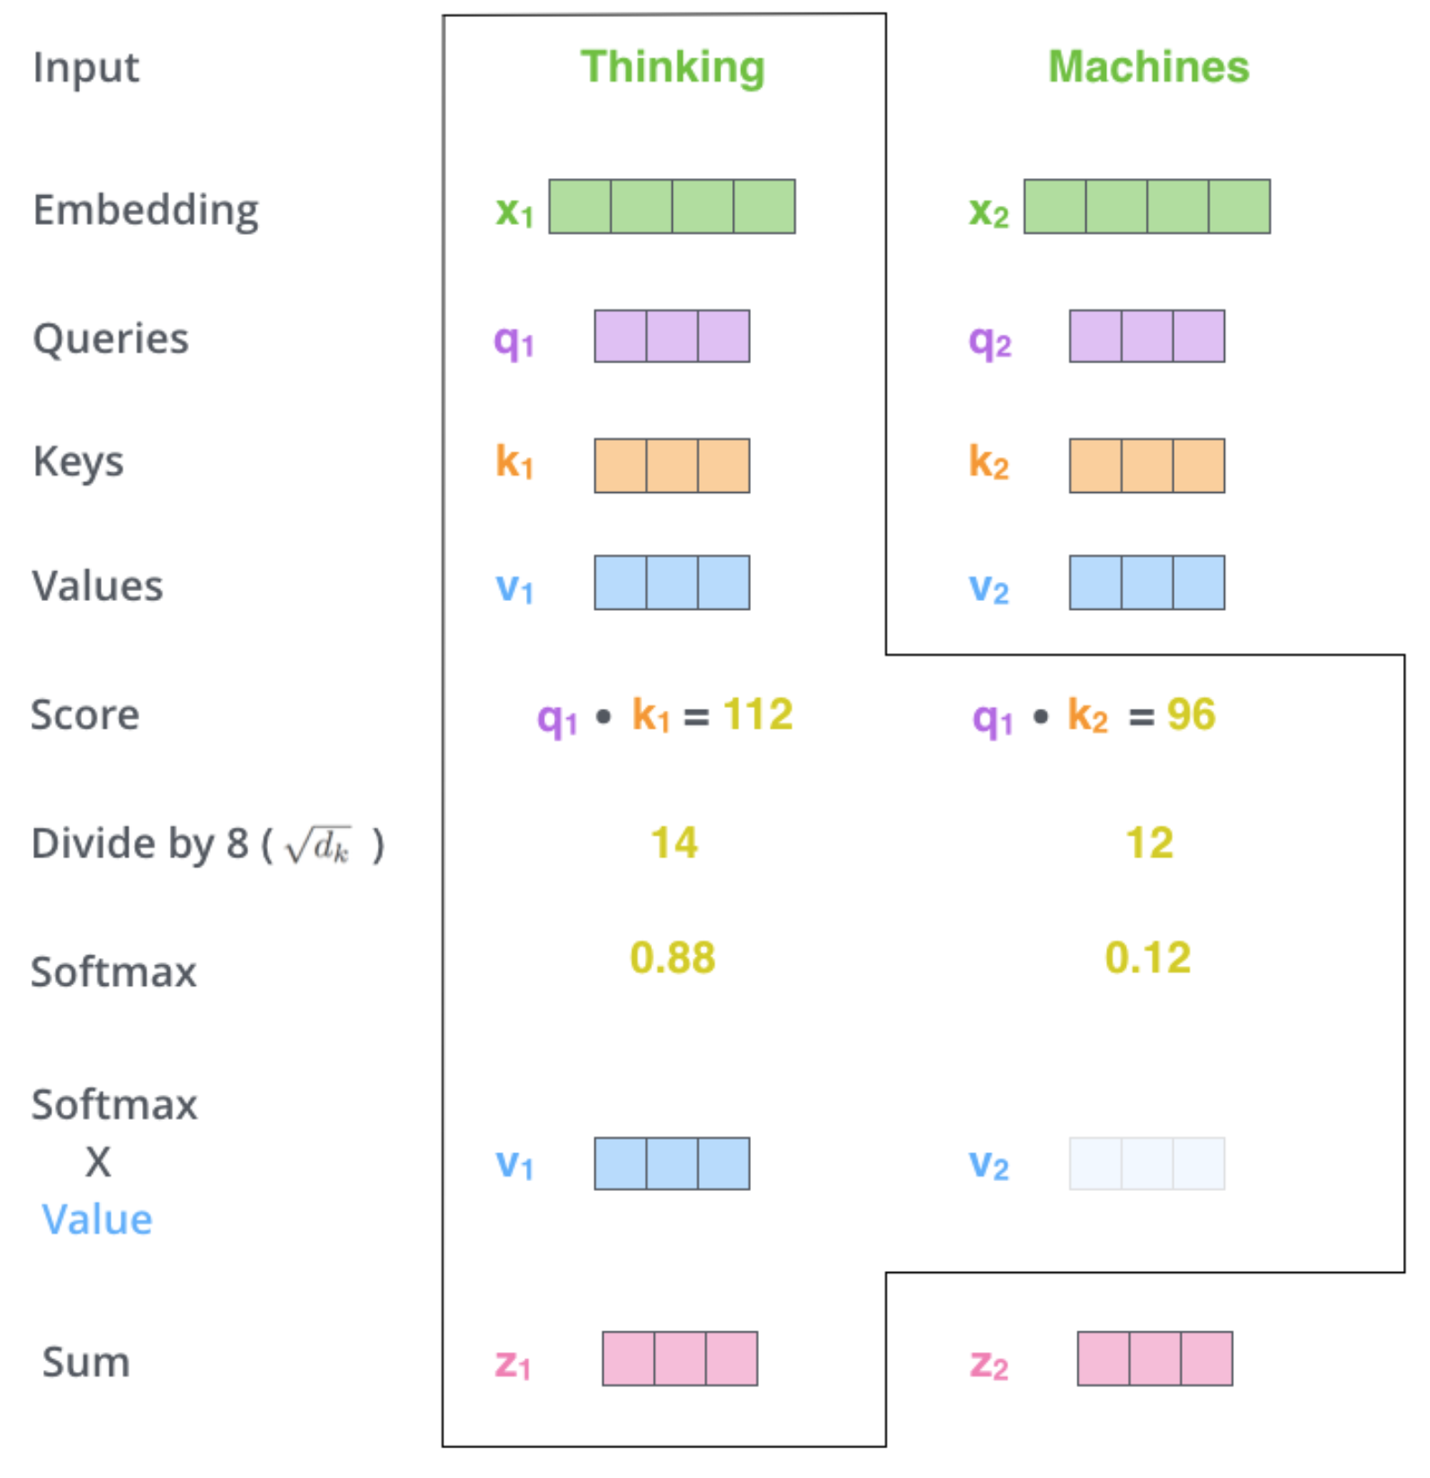
Self Attention
Step6 : sum up the weighted value vectors. This produces the output of the self-attention layer at this position
More details:
What we have seen for a word is done for all words (using matrices)
Need to encode position of words
And improved using a mechanism called “multi-headed” attention
(kind of like multiple filters for CNN)
see https://jalammar.github.io/illustrated-transformer/
Notes:
The third and forth steps are to divide the scores by 8 (the square root of the dimension of the key vectors used in the paper – 64. This leads to having more stable gradients. There could be other possible values here, but this is the default), then pass the result through a softmax operation. Softmax normalizes the scores so they’re all positive and add up to 1

Slide 39
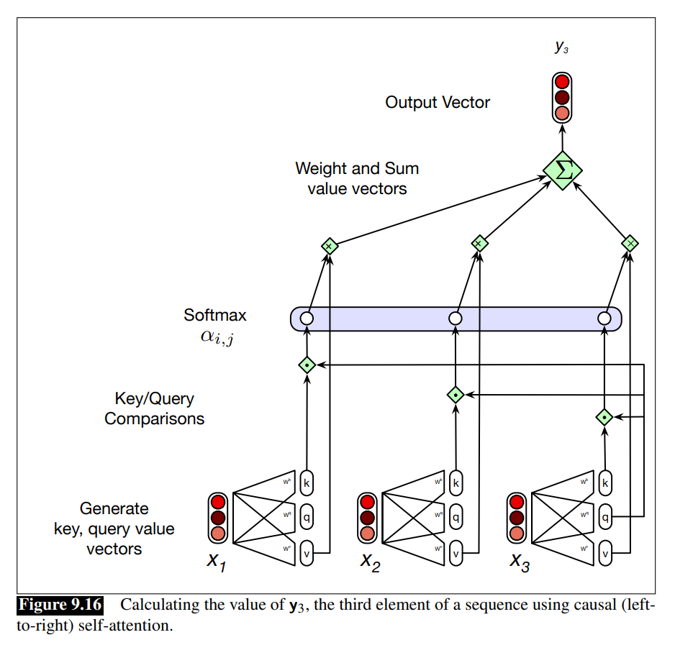
Let’s parse the textbook figure
And learn about causal self-attention

Slide 40
Multihead Attention (9.7.2)
Different words in a sentence can relate to each other in many different ways simultaneously
E.g. distinct syntactic, semantic, and discourse relationships can hold between words in text.
Difficult for a single transformer block to capture all these different parallel relations
Solution: multihead self-attention layers.
  Heads are parallel (independently parametrized) self-attentions layers at the same depth in a model,
  Each head can learn different aspects of the relationships that exist among inputs at the same level of abstraction
Notes:
The different words in a sentence can relate to each other in many different ways simultaneously. For example, distinct syntactic, semantic, and discourse relationships can hold between verbs and their arguments in a sentence. It would be difficult for a single transformer block to learn to capture all of the different kinds of parallel relations among its inputs. Transformers address this issue with multihead selfattention layers. These are sets of self-attention layers, called heads, that reside in multihead self-attention layers parallel layers at the same depth in a model, each with its own set of parameters. Given these distinct sets of parameters, each head can learn different aspects of the relationships that exist among inputs at the same level of abstraction

Slide 41
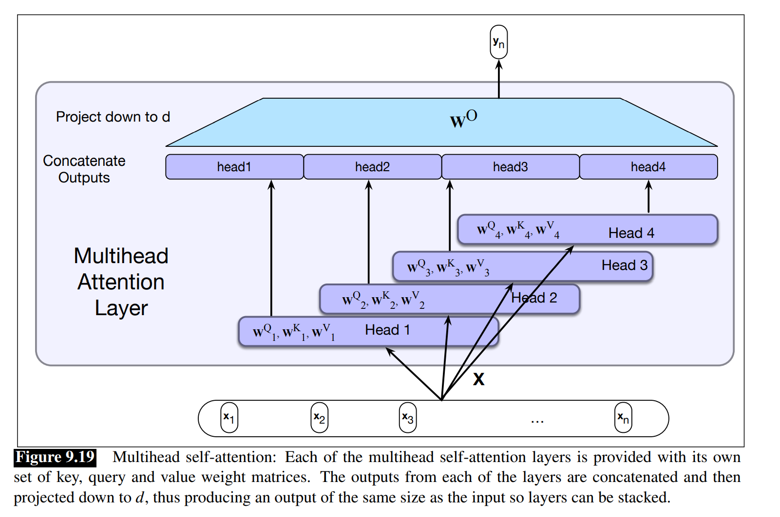

Slide 42
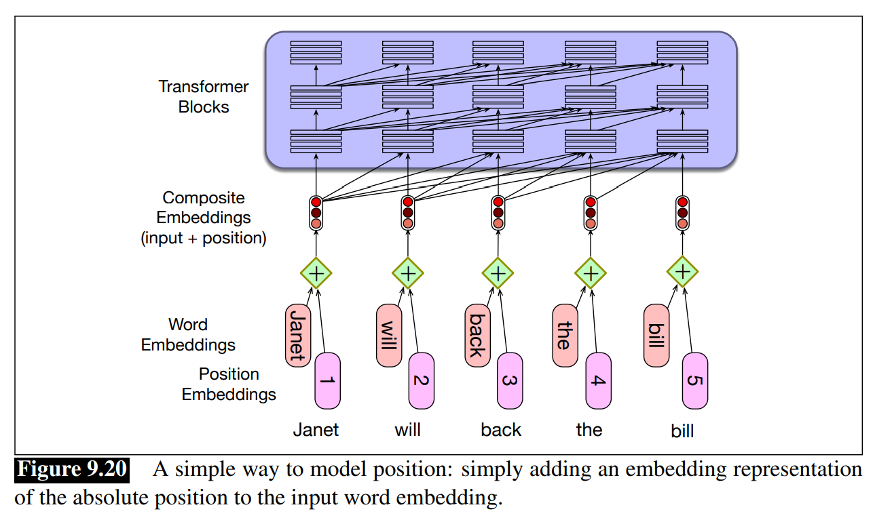
Alternative approach: choose a static function that maps integer inputs to real-valued vectors in a way that captures the inherent relationships among the positions (position 5 is more closely related to position 6 than it is to position 13)
Notes:
How does a transformer model the position of each token in the input sequence? With RNNs, information about the order of the inputs was built into the structure of the model. Unfortunately, the same isn’t true for transformers; the models as we’ve described them so far don’t have any notion of the relative, or absolute, positions of the tokens in the input. This can be seen from the fact that if you scramble the order of the inputs in the attention computation in Fig. 9.16 you get exactly the same answer.
… Where do we get these positional embeddings? The simplest method is to start with randomly initialized embeddings corresponding to each possible input position up to some maximum length. For example, just as we have an embedding for the word fish, we’ll have an embedding for the position 3. As with word embeddings, these positional embeddings are learned along with other parameters during training. To produce an input embedding that captures positional information, we just add the word embedding for each input to its corresponding positional embedding. This new embedding serves as the input for further processing. Fig. 9.20 shows the idea.
A potential problem with the simple absolute position embedding approach is that there will be plenty of training examples for the initial positions in our inputs and correspondingly fewer at the outer length limits. These latter embeddings may be poorly trained and may not generalize well during testing. An alternative approach to positional embeddings is to choose a static function that maps integer inputs to realvalued vectors in a way that captures the inherent relationships among the positions. That is, it captures the fact that position 4 in an input is more closely related to position 5 than it is to position 17. A combination of sine and cosine functions with differing frequencies was used in the original transformer work. Developing better position representations is an ongoing research topic.

Slide 43
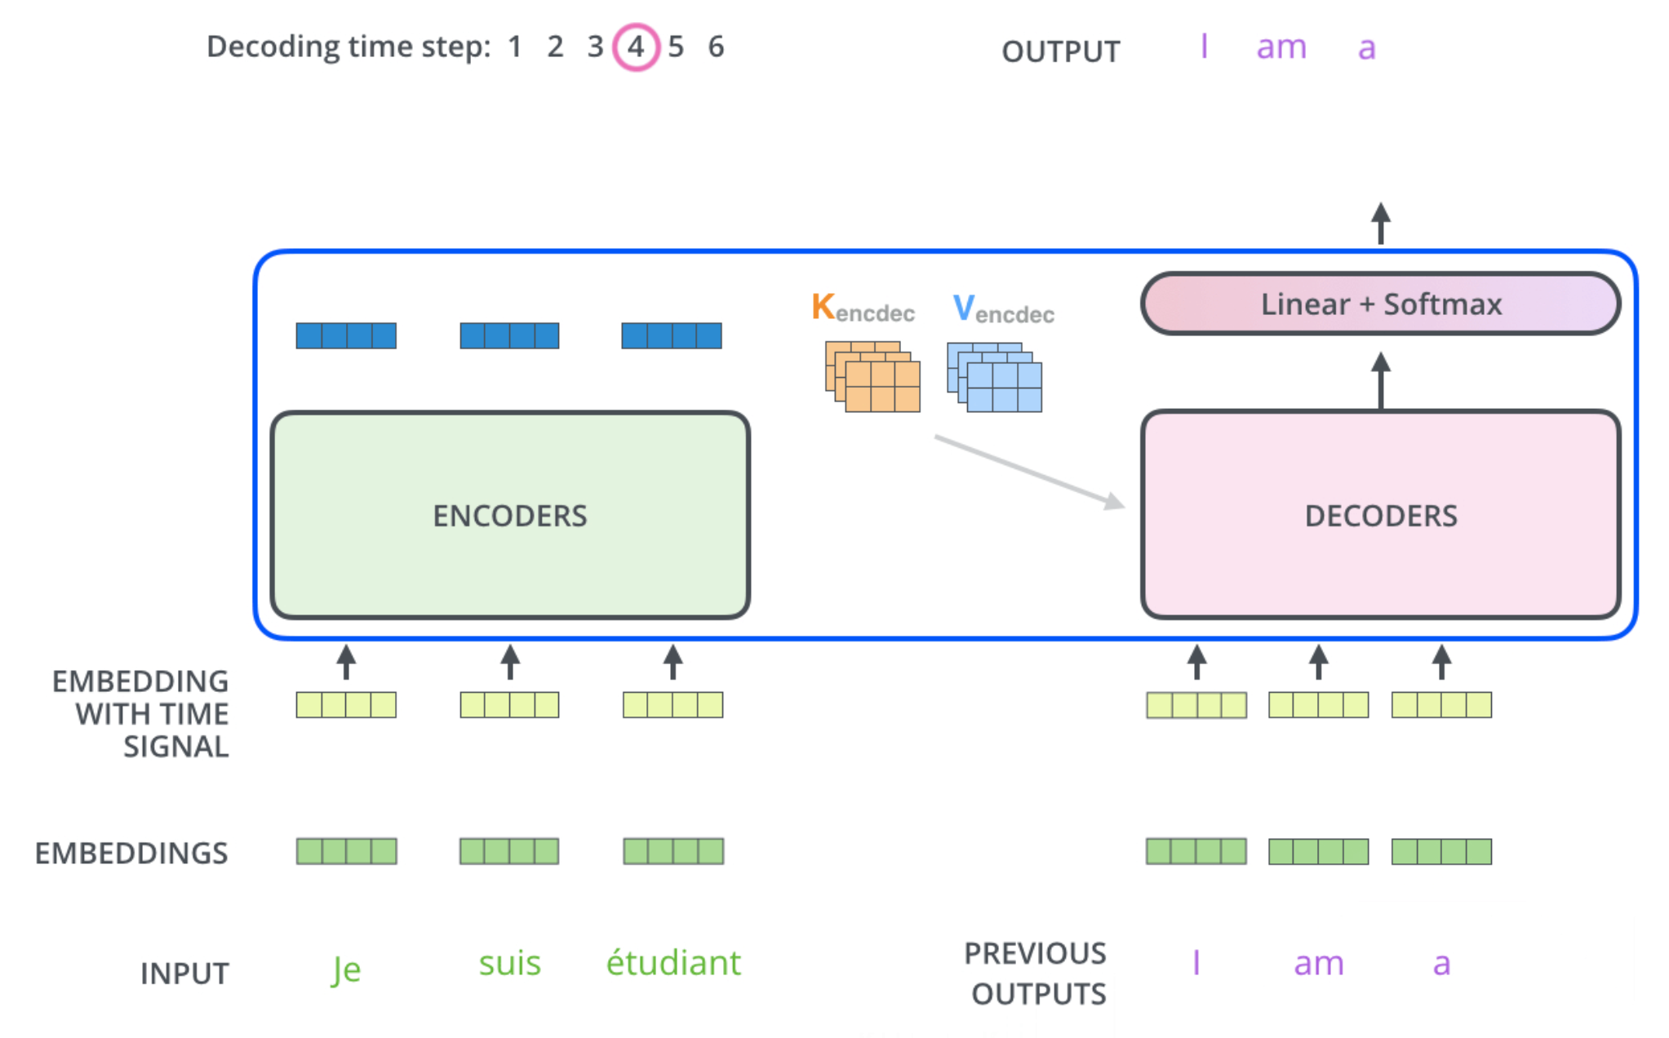
The Decoder Side
Relies on most of the concepts on the encoder side
See animation on https://jalammar.github.io/illustrated-transformer/

Slide 44
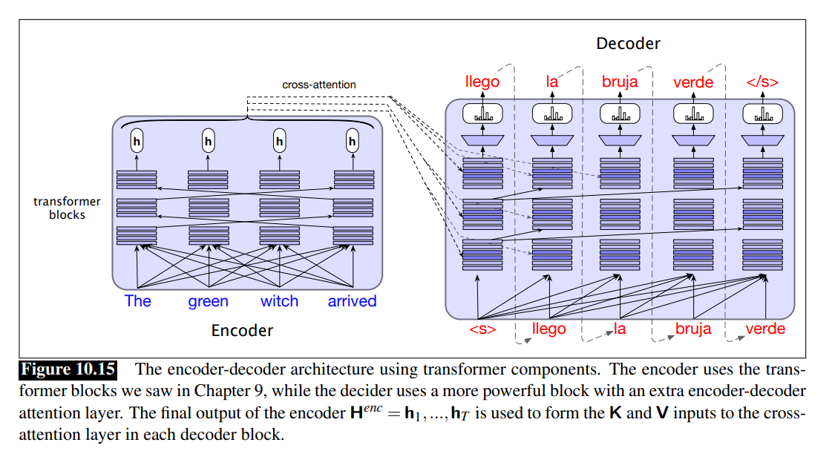



Notes:
The decoder, just like the encoder-decoder RNN, is essentially a conditional language model that attends to the encoder representation and generates the target words one by one, at each timestep conditioning on the source sentence and the previously generated target language words. … The decoder transformer block includes an cross-attention extra layer with a special kind of attention, cross-attention (also sometimes called encoder-decoder attention orsource attention). Cross-attention has the same form as the multi-headed self-attention in a normal transformer block, except that while the queries as usual come from the previous layer of the decoder, the keys and values come from the output of the encoder

Slide 45
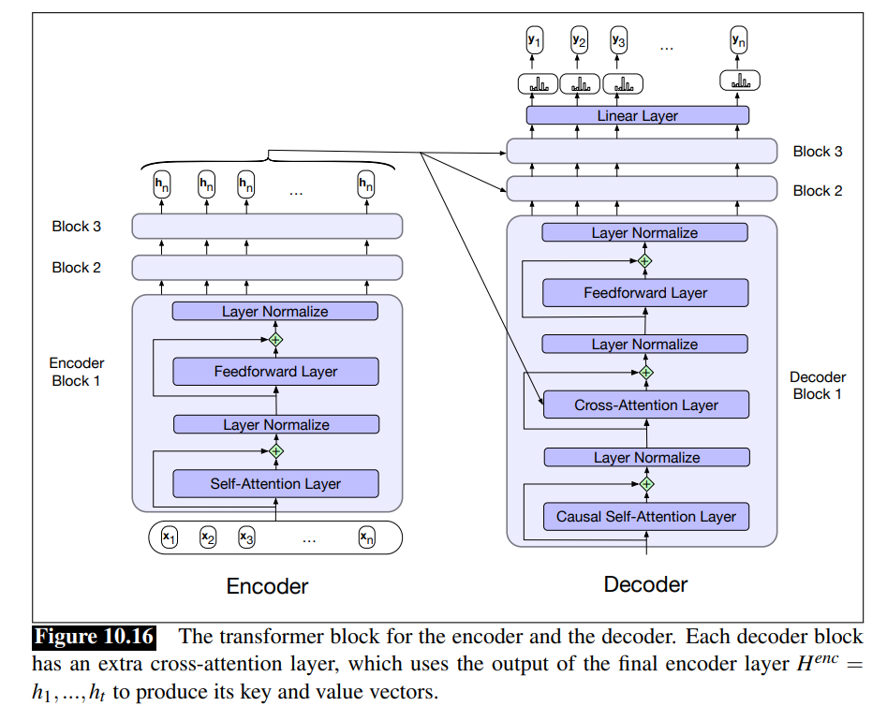
Notes:
The cross attention thus allows the decoder to attend to each of the source language words as projected into the entire encoder final output representations. The other attention layer in each decoder block, the self-attention layer, is the same causal (left-to-right) self-attention that we saw in Chapter 9. The self-attention in the encoder, however, is allowed to look ahead at the entire source language text. In training, just as for RNN encoder-decoders, we use teacher forcing, and train autoregressively, at each time step predicting the next token in the target language, using cross-entropy loss.

Slide 46
Today Nov 2
Encoder Decoder
Attention
Transformers (self-attention)
Intro to Pragmatics (time permitting)

Slide 47
“Semantic” Analysis
Sentence
Meanings of grammatical structures
Syntax-driven and Lexical
Semantic Analysis
Meanings of words
Literal Meaning
I
N
F
E
R
E
N
C
E
Beyond single sentence…. Dialog…Paragraphs
Common-Sense
Domain knowledge
Further
Analysis
Discourse
Structure
User/speaker task, location, (mutual)beliefs, attitudes…
Intended meaning
Context
Pragmatics
Notes:
Pragmatic processing adjusts a meaning in light of the current context
Look at complete dialogues, not individual sentences.
Look at general context (ie, user’s task, location, background)
Part of the meaning of a sentence does not come from the parts of the sentence itself or
the way they are combined. Study of language used in context
It comes from world knowledge or from inferences based on tacit conversational rules
Context: beliefs, attitudes, physical environment, previous discourse/dialog
Even fuzzier than semantics...
Study individual phenomena
No general theories, which may be a plus
Context. Mutual knowledge, physical context
Has Mary left?
Semantic analysis is the process of taking in some linguistic input and assigning a meaning representation to it.
There a lot of different ways to do this that make more or less (or no) use of syntax
We’re going to start with the idea that syntax does matter
The compositional rule-to-rule approach

Slide 48
Semantic Analysis
I am going to SFU on Tue
Meanings of grammatical structures
Sentence
The garbage truck just left
Syntax-driven
Semantic Analysis
Meanings of words
Literal Meaning
I
N
F
E
R
E
N
C
E
Common-Sense
Domain knowledge
Further
Analysis
Discourse
Structure
Intended meaning
Context
Shall we meet on Tue?
What time is it?
Notes:
Can we meet on tue?
I am going to SFU on Tue.
What time is it?
The garbage truck just left.
Context. Mutual knowledge, physical context
Has Mary left?
Semantic analysis is the process of taking in some linguistic input and assigning a meaning representation to it.
There a lot of different ways to do this that make more or less (or no) use of syntax
We’re going to start with the idea that syntax does matter
The compositional rule-to-rule approach
MOTIVATIONs
-for some applications it is enough (e.g., question answering)
- Produce input for further analysis (processing extended discourses and dialogs)

Slide 49
Pragmatics: Example
(i) A: So can you come over here again right now
(ii) B: Well, I have to go to Edinburgh today sir
(iii) A: Hmm. How about this Thursday?
What information can we infer about the context in which this (short and insignificant) exchange occurred ?
we can make a great number of detailed (Pragmatic) inferences about the nature of the context in which it occurred
Notes:
It is not difficult to see that in understanding such an exchange we make a great
number of detailed (Pragmatic) inferences about the nature of the context in which it occured
This will serve to clarify the general nature of the phenomena pragmatics is concerned with

Slide 50
Pragmatics: Conversational Structure
(i) A: So can you come over here again right now
(ii) B: Well, I have to go to Edinburgh today sir
(iii) A: Hmm. How about this Thursday?
Not the end of a conversation (nor the beginning)
Pragmatic knowledge: Strong expectations about the structure of conversations
Pairs e.g., request <-> response
Closing/Opening forms

Slide 51
Pragmatics: Dialog Acts
Not a Y/N info seeking question like “can you run for 1h?”
It is a request for an action
(i) A: So can you come over here again right now?
(ii) B: Well, I have to go to Edinburgh today sir
(iii) A: Hmm. How about this Thursday?
A is requesting B to come at time of speaking,
B implies he can’t (or would rather not)
A repeats the request for some other time.
Pragmatic assumptions relying on:
mutual knowledge (B knows that A knows that B is capable to go there)
co-operation (must be a response… triggers inference)
topical coherence (who should do what on Thur?)
Notes:
The first utterance is not a Y/N question (like “can you run for more than 1 hour)
It would be strikingly uncooperative if B were to say yes (meaning just ‘yes I am able to come’)
B knows that A knows that B is capable to go there

Slide 52
Pragmatics: Specific Act (Request)
(i) A: So can you come over here again right now
(ii) B: Well, I have to go to Edinburgh today sir
(iii) A: Hmm. How about this Thursday?
A wants B to come over
A believes it is possible for B to come over
A believes B is not already there
A believes he is not in a position to order B to…
Pragmatic knowledge: speaker beliefs and intentions underlying the act of requesting
Assumption: A behaving rationally and sincerely
Notes:
In requesting A ….. It is possible for B to come, thinks B is not already there, B was not about to come anyway…

Slide 53
Pragmatics: Deixis
(i) A: So can you come over here again right now
(ii) B: Well, I have to go to Edinburgh today sir
(iii) A: Hmm. How about this Thursday?
A assumes B knows where A is
Neither A nor B are in Edinburgh
The day in which the exchange is taking place is not Thur., nor Wed. (or at least, so A believes)
Pragmatic knowledge: References to space and time wrt space and time of speaking
Notes:
Reference to space and time with respect to space and time of speaking (context)
Come, go, here and now

Slide 54
Project Proposal:
Most on Thur Nov. 4
Rest on Tue Nov.9
Read carefully!
Assignment-4 out tonight
Due Nov 14
Tonight I will send out:
Schedule For Project Proposal Presentations
a G-Forms On your preferences for which paper to present
Project proposal (submit a copy of your slides on Canvas before the class in which wuo will present; Write-up: 1-2 pages single project, 3-4 pages for group project)
Submit your write-up by Nov. 9
Project proposal Presentation (Bring a printout of your slides when you present)
  Approx. 3.5 min presentation + 1.5 min for questions (8 tot. mins if you are in a group of 2)(11 tot. mins if you are in a group of 3)
  For content, follow instructions at course project web page
  Please have your presentation ready on your laptop to minimize transition delays
  We will start at @9:35 (sharp)

Slide 55
Today March 11
Encoder Decoder
Attention
Transformers
Very Brief Intro Pragmatics

Slide 56
Pragmatics: Example
(i) A: So can you please come over here again right now
(ii) B: Well, I have to go to Edinburgh today sir
(iii) A: Hmm. How about this Thursday?
What information can we infer about the context in which this (short and insignificant) exchange occurred ?
we can make a great number of detailed (Pragmatic) inferences about the nature of the context in which it occurred
Notes:
It is not difficult to see that in understanding such an exchange we make a great
number of detailed (Pragmatic) inferences about the nature of the context in which it occured
This will serve to clarify the general nature of the phenomena pragmatics is concerned with

Slide 57
Pragmatics: Conversational Structure
(i) A: So can you please come over here again right now
(ii) B: Well, I have to go to Edinburgh today sir
(iii) A: Hmm. How about this Thursday?
Not the end of a conversation (nor the beginning)
Pragmatic knowledge: Strong expectations about the structure of conversations
Pairs e.g., request <-> response
Closing/Opening forms

Slide 58
Pragmatics: Dialog Acts
Not a Y/N info seeking question like “can you run for 1h?”
It is a request for an action
(i) A: So can you please come over here again right now?
(ii) B: Well, I have to go to Edinburgh today sir
(iii) A: Hmm. How about this Thursday?
A is requesting B to come at time of speaking,
B implies he can’t (or would rather not)
A repeats the request for some other time.
Pragmatic assumptions relying on:
mutual knowledge (B knows that A knows that…)
co-operation (must be a response… triggers inference)
topical coherence (who should do what on Thur?)
Notes:
The first utterance is not a Y/N question (like “can you run for more than 1 hour)
It would be strikingly uncooperative if B were to say yes (meaning just ‘yes I am able to come’)
B knows that A knows that B is capable to go there

Slide 59
Pragmatics: Specific Act (Request)
(i) A: So can you please come over here again right now
(ii) B: Well, I have to go to Edinburgh today sir
(iii) A: Hmm. How about this Thursday?
A wants B to come over
A believes it is possible for B to come over
A believes B is not already there
A believes he is not in a position to order B to…
Pragmatic knowledge: speaker beliefs and intentions underlying the act of requesting
Assumption: A behaving rationally and sincerely
Notes:
In requesting A ….. It is possible for B to come, thinks B is not already there, B was not about to come anyway…

Slide 60
Pragmatics: Deixis
(i) A: So can you please come over here again right now
(ii) B: Well, I have to go to Edinburgh today sir
(iii) A: Hmm. How about this Thursday?
A assumes B knows where A is
Neither A nor B are in Edinburgh
The day in which the exchange is taking place is not Thur., nor Wed. (or at least, so A believes)
Pragmatic knowledge: References to space and time wrt space and time of speaking
Notes:
Reference to space and time with respect to space and time of speaking (context)
Come, go, here and now

Slide 61
Additional Notes (not required)

Slide 62
From Yoav Artzi (these are links)
 | Contextualized word representations |  | Annotated Transformer, Illustrated Transformer, ELMo, BERT, The Illustrated BERT, ELMo, and co.

Slide 63
Transformers
WIKIPEDIA:
However, unlike RNNs, Transformers do not require that the sequence be processed in order. So, if the data in question is natural language, the Transformer does not need to process the beginning of a sentence before it processes the end. Due to this feature, the Transformer allows for much more parallelization than RNNs during training.^{[1]}

Slide 64
The Transformer uses multi-head attention in three different ways:
In "encoder-decoder attention" layers, the queries come from the previous decoder layer,
and the memory keys and values come from the output of the encoder. This allows every
position in the decoder to attend over all positions in the input sequence. This mimics the
typical encoder-decoder attention mechanisms in sequence-to-sequence models such as
[38, 2, 9].
The encoder contains self-attention layers. In a self-attention layer all of the keys, values
and queries come from the same place, in this case, the output of the previous layer in the
encoder. Each position in the encoder can attend to all positions in the previous layer of the
encoder.
Similarly, self-attention layers in the decoder allow each position in the decoder to attend to
all positions in the decoder up to and including that position. We need to prevent leftward
information flow in the decoder to preserve the auto-regressive property. We implement this
inside of scaled dot-product attention by masking out (setting to infinity) all values in the input
of the softmax which correspond to illegal connections. See Figure 2.
At each step the model is auto-regressive
[10], consuming the previously generated symbols as additional input when generating the next.
The autoregressive model specifies that the output variable depends linearly on its own previous values and on a stochastic term (an imperfectly predictable term);
Notes:
The autoregressive model specifies that the output variable depends linearly on its own previous values and on a stochastic term (an imperfectly predictable term);

Slide 65
An attention function can be described as mapping a query and a set of key-value pairs to an output, where the query, keys, values, and output are all vectors. The output is computed as a weighted sum of the values, where the weight assigned to each value is computed by a compatibility function of the query with the corresponding key.

Slide 66
Positional Encodings
In geometry, an affine transformation, affine map^{[1]} or an affinity (from the Latin, affinis, "connected with") is a function between affine spaces which preserves points, straight lines and planes. Also, sets of parallel lines remain parallel after an affine transformation. An affine transformation does not necessarily preserve angles between lines or distances between points, though it does preserve ratios of distances between points lying on a straight line.

Slide 67
Additional resources !
References/Resources to explain transformers in cpsc503. And possible question for assignment
  http://jalammar.github.io/illustrated-transformer/
  Combined with this http://nlp.seas.harvard.edu/2018/04/03/attention.html
Medium article that I read a while back and thought that s a nice intro to the transformer: https://medium.com/@adityathiruvengadam/transformer-architecture-attention-is-all-you-need-aeccd9f50d09
They first start with motivating attention in general and show problems of RNN/CNN architectures, then leading to the transformer. I especially liked some of the visualizations they have. But it is a relatively long read and unfortunately, at some points, it's not super consistent.
I thought it might be still useful.

Slide 68
