Slide 1
CPSC 503
Computational Linguistics
CNNs / Semantic Role Labeling / Encoder-Decoder
Lecture 14
Giuseppe Carenini
Slides Source: Jurafsky & Martin / Y. Goldberg

Slide 2
Today Oct 28
Based on Chp 13 Y. Goldberg book
Convolutional Neural Networks
Semantic Role Labeling
  CNN R. Collobert et al. Natural language processing (almost) from scratch. The Journal of Machine Learning Research, 12:2493–2537, 2011.
  RNN-LSTM J&M 3Ed textbook
Encoder/Decoder
Notes:
History and Terminology Convolution-and-pooling architectures [LeCun and Bengio, 1995]
evolved in the neural networks vision community, where they showed great success as object
detectors—recognizing an object from a predefined category (“cat,” “bicycles”) regardless of its
position in the image [Krizhevsky et al., 2012]. When applied to images, the architecture is using
2D (grid) convolutions. When applied to text, we are mainly concerned with 1D (sequence)
convolutions. Convolutional networks were introduced to the NLP community in the pioneering
work of Collobert et al. [2011] who used them for semantic-role labeling, and later by Kalchbrenner
et al. [2014] and Kim [2014] who used them for sentiment and question-type classification.

Slide 3
(Task Specific)Ngram Detectors: convolutional Neural Networks (CNNs)
A CNN is designed to
  identify indicative local predictors in a large structure
  to combine them to produce a fixed size vector representation of the structure, capturing the local aspects that are most informative for the prediction task at hand.
The CNN architecture will
  identify ngrams that are predictive for the task at hand (e.g., Sentiment analysis)
  without the need to pre-specify an embedding vector for each possible ngram.

Slide 4
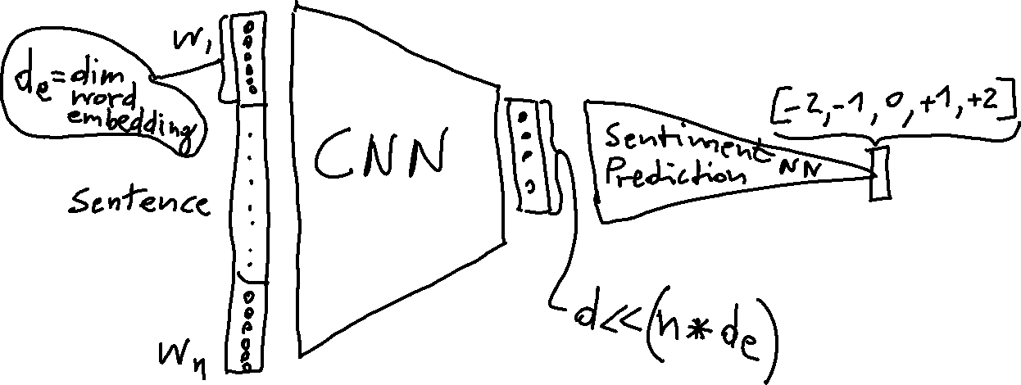
CNN example: Predicting Sentiment of Sentence (on white-board)

Slide 5
CNN: feature-extracting architecture
Not a standalone, useful network on its own,
but meant to be integrated into a larger network, and to be trained to work in tandem with it in order to produce an end result.
CNN layer’s responsibility is to extract meaningful sub-structures that are useful for the overall prediction task at hand.
Initial successes in Vision
When applied to images, the architecture is using 2D (grid) convolutions.
When applied to text (NLP), we are mainly concerned with 1D (sequence) convolutions.
Notes:
It does not constitute a standalone, useful network on its own, but rather is meant to be integrated into a larger network, and to be trained to work in tandem with it in order to produce an end result. e CNN layer’s responsibility is to extract meaningful sub-structures that are useful for the overall prediction task at hand.

Slide 6

CNN 1-D convolution over sentence: filter
k=3
Each word is represented by its embedding (2-dim here for simplicity)
. u -> non-linear function
Scalar value
. u -> non-linear function
……
. u -> non-linear function
……
. ………..
. ………..
dim of u ?
each instantiation of a k-word sliding window over the sentence is multiplied by a vector u and a non-linear function is applied to the result.
This column vector u combined with a non-linear function (also called “filter”) transforms a window of k words into a scalar value.
Notes:
1D convolution+pooling over the sentence “the quick brown fox jumped over the lazy
dog.” is is a narrow convolution (no padding is added to the sentence) with a window size of 3.
Each word is translated to a 2-dim embedding vector (not shown). e embedding vectors are then
concatenated, resulting in 6-dim window representations. Each of the seven windows is transfered
through a 6 3 filter (linear transformation followed by element-wise tanh), resulting in seven 3-
dimensional filtered representations. en, a max-pooling operation is applied, taking the max over
each dimension, resulting in a final 3-dimensional pooled vector.
Average Pooling

Slide 7
CNN: convolution and pooling in NLP
Each column of W is a filter
6
3
l such filters can be applied (l =3 here), resulting in an l dimensional vector (each dimension corresponding to a filter)
Notes:
e main idea behind a convolution and pooling architecture for language tasks is to apply a nonlinear
(learned) function over each instantiation of a k-word sliding window over the sentence.¹
is function (also called “filter”) transforms a window of k words into a scalar value. Several such
filters can be applied, resulting in ` dimensional vector (each dimension corresponding to a filter)
that captures important properties of the words in the window. en, a “pooling” operation is used
to combine the vectors resulting from the different windows into a single `-dimensional vector,
by taking the max or the average value observed in each of the ` dimensions over the different
windows. e intention is to focus on the most important “features” in the sentence, regardless of
their location—each filter extracts a different indicator from the window, and the pooling operation
zooms in on the important indicators. e resulting `-dimensional vector is then fed further
into a network that is used for prediction. e gradients that are propagated back from the network’s
loss during the training process are used to tune the parameters of the filter function to
highlight the aspects of the data that are important for the task the network is trained for. Intuitively,
when the sliding window of size k is run over a sequence, the filter function learns to
identify informative kgram

Slide 8
Multiple filters u_{i}: details

Slide 9
CNN: convolution and pooling in NLP
6
3
A “pooling” operation combine the vectors resulting from the different windows into a single vector, by taking the max or the average value observed in each of the ` dimensions over the different windows.
Notes:
e main idea behind a convolution and pooling architecture for language tasks is to apply a nonlinear
(learned) function over each instantiation of a k-word sliding window over the sentence.¹
is function (also called “filter”) transforms a window of k words into a scalar value. Several such
filters can be applied, resulting in ` dimensional vector (each dimension corresponding to a filter)
that captures important properties of the words in the window. en, a “pooling” operation is used
to combine the vectors resulting from the different windows into a single `-dimensional vector,
by taking the max or the average value observed in each of the ` dimensions over the different
windows. e intention is to focus on the most important “features” in the sentence, regardless of
their location—each filter extracts a different indicator from the window, and the pooling operation
zooms in on the important indicators. The resulting `-dimensional vector is then fed further
into a network that is used for prediction. The gradients that are propagated back from the network’s
loss during the training process are used to tune the parameters of the filter function to
highlight the aspects of the data that are important for the task the network is trained for. Intuitively,
when the sliding window of size k is run over a sequence, the filter function learns to
identify informative kgram

Slide 10


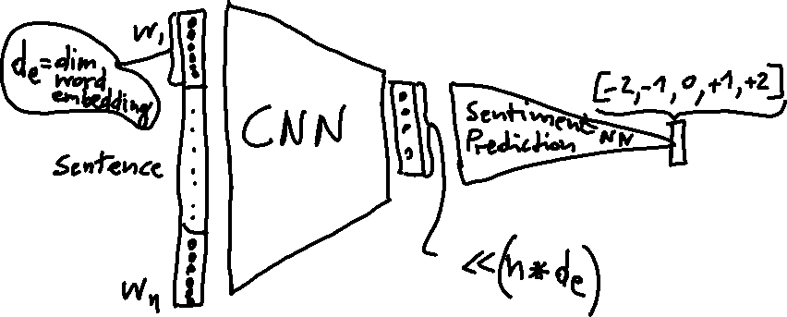
Motivation / Training / Intuitions
Intention is to focus on the most important “features” in the sentence, regardless of their location
Each filter extracts a different indicator from the window
The pooling operation zooms in on the important indicators.
The resulting l -dimensional vector is then fed further into a network that is used for prediction.
Notes:
The intention is to focus on the most important “features” in the sentence, regardless of
their location—each filter extracts a different indicator from the window, and the pooling operation zooms in on the important indicators. e resulting `-dimensional vector is then fed further into a network that is used for prediction. e gradients that are propagated back from the network’s loss during the training process are used to tune the parameters of the filter function to highlight the aspects of the data that are important for the task the network is trained for. Intuitively, when the sliding window of size k is run over a sequence, the filter function learns to identify informative kgram

Slide 11
Motivation / Training / Intuitions
Training: gradients that propagated back from the network’s loss on task
  used to tune the parameters of the filter function to highlight the aspects of the data that are important for the task
Intuitively, when the sliding window of size k is run over a sequence, the filter function learns to identify informative k-gram
Notes:
The intention is to focus on the most important “features” in the sentence, regardless of
their location—each filter extracts a different indicator from the window, and the pooling operation zooms in on the important indicators. e resulting `-dimensional vector is then fed further into a network that is used for prediction. e gradients that are propagated back from the network’s loss during the training process are used to tune the parameters of the filter function to highlight the aspects of the data that are important for the task the network is trained for. Intuitively, when the sliding window of size k is run over a sequence, the filter function learns to identify informative kgram

Slide 12
CNN for capturing k-gram of varying length
Rather than a single convolutional layer, several convolutional layers may be applied in parallel.
We may have four different convolutional layers, each with a different window size in the range 2,3,4,5, capturing k-gram sequences of varying lengths.
The result of each convolutional layer will then be pooled, and the resulting vectors concatenated and fed to further processing [Kim, 2014].
The quick brown fox jumped over the lazy dog
Notes:
Rather than a single convolutional layer, several convolutional layers may be applied in parallel.
For example, we may have four different convolutional layers, each with a different window size in
the range 2–5, capturing k-gram sequences of varying lengths. e result of each convolutional
layer will then be pooled, and the resulting vectors concatenated and fed to further processing
[Kim, 2014].
e convolutional architecture need not be restricted into the linear ordering of a sentence.
For example, Ma et al. [2015] generalize the convolution operation to work over syntactic
dependency trees. ere, each window is around a node in the syntactic tree, and the pooling is
performed over the different nodes. Similarly, Liu et al. [2015] apply a convolutional architecture
on top of dependency paths extracted from dependency trees. Le and Zuidema [2015] propose
performing max pooling over vectors representing the different derivations leading to the same
chart item in a chart parser.

Slide 13



Hierarchical Convolutions
No pooling !
Layer-1 transforms each sequence of k word-vectors into vectors representing k-grams.
Layer-2 combines each k consecutive k-gram-vectors into more abstract vectors
These vectors can be sensitive to gappy-ngrams, potentially capturing patterns such as “not ------- good” or “obvious ------- predictable ----- plot” where ------stands for a short sequence of words
If interested in Strides and Dilation see Y. Goldberg Book pag. 160
Other Advanced topics in CNN: Feature hashing, Param. Tying etc also see Goldberg Chpt 13
Notes:
The 1D convolution approach described so far can be thought of as an ngram detector. A convolution
layer with a window of size k is learning to identify indicative k-grams in the input.
This approach can be extended into a hierarchy of convolutional layers, in which a sequence
of convolution layers are applied one after the other.
the first convolution layer transforms each sequence of k neighboring word-vectors into vectors
representing k-grams. Then, the second convolution layer will combine each k consecutive k-gram-vectors into vectors that
capture a window of k +( k – 1) words, and so on, until the rth convolution will capture k C.r 􀀀 1/.k 􀀀 1/ D r.k 􀀀 1/C1 words.

Slide 14
Less popular today but…
May come back as component in multimodal applications….
Their applications to graph structure GCNs has potential in data2text / text2data
…..

Slide 15
Today Oct 28
Based on Chp 13 Y. Goldberg book
Convolutional Neural Networks
Semantic Role Labeling Chp 19 J&M
  CNN R. Collobert et al. Natural language processing (almost) from scratch. The Journal of Machine Learning Research, 12:2493–2537, 2011.
  RNN-LSTM J&M 3Ed textbook
Encoder/Decoder
Notes:
History and Terminology Convolution-and-pooling architectures [LeCun and Bengio, 1995]
evolved in the neural networks vision community, where they showed great success as object
detectors—recognizing an object from a predefined category (“cat,” “bicycles”) regardless of its
position in the image [Krizhevsky et al., 2012]. When applied to images, the architecture is using
2D (grid) convolutions. When applied to text, we are mainly concerned with 1D (sequence)
convolutions. Convolutional networks were introduced to the NLP community in the pioneering
work of Collobert et al. [2011] who used them for semantic-role labeling, and later by Kalchbrenner
et al. [2014] and Kim [2014] who used them for sentiment and question-type classification.

Slide 16
Summary of Lexical Resources/Thesauri/KnowledgeGraphs
Google Knowledge Graph
Relations among words and their meanings
Freebase
Babel Net
COMET
Wordnet
YAGO
Microsoft Concept Graph
Probase
Concept Net
Internal structure of individual words
PropBank
UMLS - MeSH
VerbNet
FrameNet
Notes:
Human specified… but also learned from data / text

Slide 17
Predicate-Argument Structure
Represent relationships among concepts, events and their participants
“I ate a turkey sandwich for lunch”
∃ w: Isa(w,Eating) ∧ Eater(w,Speaker) ∧ Eaten(w,TurkeySandwich) ∧ MealEaten(w,Lunch)
“Nam does not serve meat”
∃ w: Isa(w,Serving) ∧ Server(w, Nam) ∧ ¬Served(w,Meat)
Notes:
All human languages
a specific relation holds between the concepts expressed by the words or the phrases
Events, actions and relationships can be captured with representations that consist of predicates and arguments.
Languages display a division of labor where some words and constituents function as predicates and some as arguments.
One of the most important roles of the grammar is to help organize this pred-args structure

Slide 18
Semantic/Thematic Roles
  Def. Semantic generalizations over the specific roles that occur with specific verbs.
  I.e. eaters, servers, takers, givers, makers, doers, killers, all have something in common
  We can generalize (or try to) across other roles as well
Notes:
How does language convey meaning?

Slide 19
Thematic Role Examples
fi
fl

Slide 20
Thematic Roles
fi
fi
  Not definitive, not from a single theory!
Notes:
It is controversial whether a finite list of thematic roles exists..

Slide 21
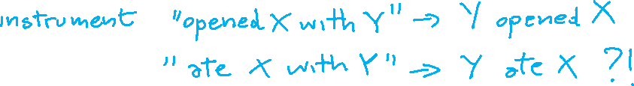
Problem with Thematic Roles
NO agreement on what standard set should be
NO agreement on formal definition
Fragmentation problem: when you try to formally define a role you end up creating more specific sub-roles
Solutions
Generalized semantic roles
Define verb specific semantic roles
Define semantic roles for classes of verbs
Notes:
Instrument
intermediary “opened X with Y” -> “Y opened X”
enabling “ate X with Y” -> ?”Y ate X”?

Slide 22






Generalized Semantic Roles
Very abstract roles are defined heuristically as a set of conditions
The more conditions are satisfied the more likely an argument fulfills that role
Proto-Patient
  Undergoes change of state
  Incremental theme
  Causally affected by another participant
  Stationary relative to movement of another participant
  (does not exist independently of the event, or at all)
Proto-Agent
  Volitional involvement in event or state
  Sentience (and/or perception)
  Causing an event or change of state in another participant
  Movement (relative to position of another participant)
  (exists independently of event named)
Taylor ate the apricot (the apricot is half-eaten the event is half done)
Notes:
OR Thematic roles should be viewed as prototypes, where there may be different degrees of membership
Sentience refers to utilization of sensory organs, the ability to feel or perceive subjectively
Incremental theme
the apricot is the incremental theme in (3) since the progress of the eating event is reflected
in the amount of apricot remaining: when the apricot is half-eaten the event is half done,
when the apricot is two-thirds eaten, the event is two-thirds done, and so on.
(3) Taylor ate the apricot.

Slide 23
Semantic Roles: Resources
Databases containing for each verb its syntactic and thematic argument structures
PropBank: sentences in the Penn Treebank annotated with semantic roles
Roles are verb-sense specific
Arg0 (PROTO-AGENT), Arg1(PROTO-PATIENT), Arg2,…….
(see also VerbNet)
Notes:
From wikipedia (and imprecise)
PropBank differs from FrameNet, the resource to which it is most frequently compared, in two major ways. The first is that it commits to annotating all verbs in its data. The second is that all arguments to a verb must be syntactic constituents.

Slide 24









PropBank Example
Increase “go up incrementally”
  Arg0: causer of increase
  Arg1: thing increasing
  Arg2: amount increase by
  Arg3: start point
  Arg4: end point
Glosses for human reader. Not formally defined
PropBank semantic role labeling would identify common aspects among these three examples
“ Y performance increased by 3% ”
“ Y performance was increased by the new X technique ”
“ The new X technique increased performance of Y”
Notes:
From wikipedia (and imprecise)
PropBank differs from FrameNet, the resource to which it is most frequently compared, in two major ways. The first is that it commits to annotating all verbs in its data. The second is that all arguments to a verb must be syntactic constituents.
Also
The VerbNet project maps PropBank verb types to their corresponding Levin classes. It is a lexical resource that incorporates both semantic and syntactic information about its contents. The lexicon can be viewed and downloaded from http://verbs.colorado.edu/verb-index
VerbNet is part of the SemLink project in development at the University of Colorado.

Slide 25
Semantic Roles: Resources
Move beyond inferences about single verbs
“ IBM hired John as a CEO ”
“ John is the new IBM hire ”
“ IBM signed John for 2M$”
FrameNet: Databases containing frames and their syntactic and semantic argument structures
(book online Version Revised November 1, 2016)
  for English (versions for other languages are under development)
Notes:
10,000 lexical units (defined below), more than 6,100 of which are fully annotated, in more than 825 hierarchically structured semantic frames, exemplified in more than 135,000 annotated sentences
John was HIRED to clean up the file system.
IBM HIRED Gates as chief janitor.
I was RETAINED at $500 an hour.
The A's SIGNED a new third baseman for $30M.

Slide 26

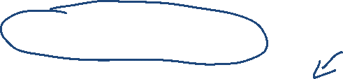
FrameNet Entry
Hiring
Definition: An Employer hires an Employee, promising the Employee a certain Compensation in exchange for the performance of a job. The job may be described either in terms of a Task or a Position in a Field.
Inherits From: Intentionally affect
Lexical Units: commission.n, commission.v, give job.v, hire.n, hire.v, retain.v, sign.v, take on.v
Notes:
Very specific thematic roles!

Slide 27
Semantic Role Labeling: Example
Some roles.. (FrameNet for hiring frame)
Employer
Employee
Task
Position
Compensation
Field
  In 1979 , singer Nancy Wilson HIRED him to open her nightclub act .
  In 1979 , singer Nancy Wilson HIRED him to open her nightclub act .
  Castro has swallowed his doubts and HIRED Valenzuela as a cook in his small restaurant .
  Castro has swallowed his doubts and HIRED Valenzuela as a cook in his small restaurant .
Notes:
Shallow semantic parsing is labeling phrases of a sentence with semantic roles with respect to a target word.
For example, the sentence
“Shaw Publishing offered Mr. Smith a reimbursement last March.”
Is labeled as:
[AGENTShaw Publishing] offered [RECEPIENTMr. Smith] [THEMEa reimbursement] [TIMElast March] .
We work with a number of collaborators, beginning with Dan Gildea in his dissertation work, on automatic semantic parsing. Much of Dan Gildeas's dissertation work was written up here: Daniel Gildea and Daniel Jurafsky. 2002. Automatic Labeling of Semantic Roles. Computational Linguistics 28:3, 245-288. This work also involves close collaboration with the FrameNet and PropBank projects.
Currently, we focus on building joint probabilistic models for simultaneous assignment of labels to all nodes in a syntactic parse tree. These models are able to capture the strong correlations among decisions at different nodes.
CompensationPeripheral
EmployeeCore
EmployerCore
FieldCore
InstrumentPeripheral
MannerPeripheral
MeansPeripheral
PlacePeripheral
PositionCore
PurposeExtra-Thematic
TaskCore
TimePeripheral

Slide 28
Neural Approach (1)
BIO/IOB labeling..

Slide 29
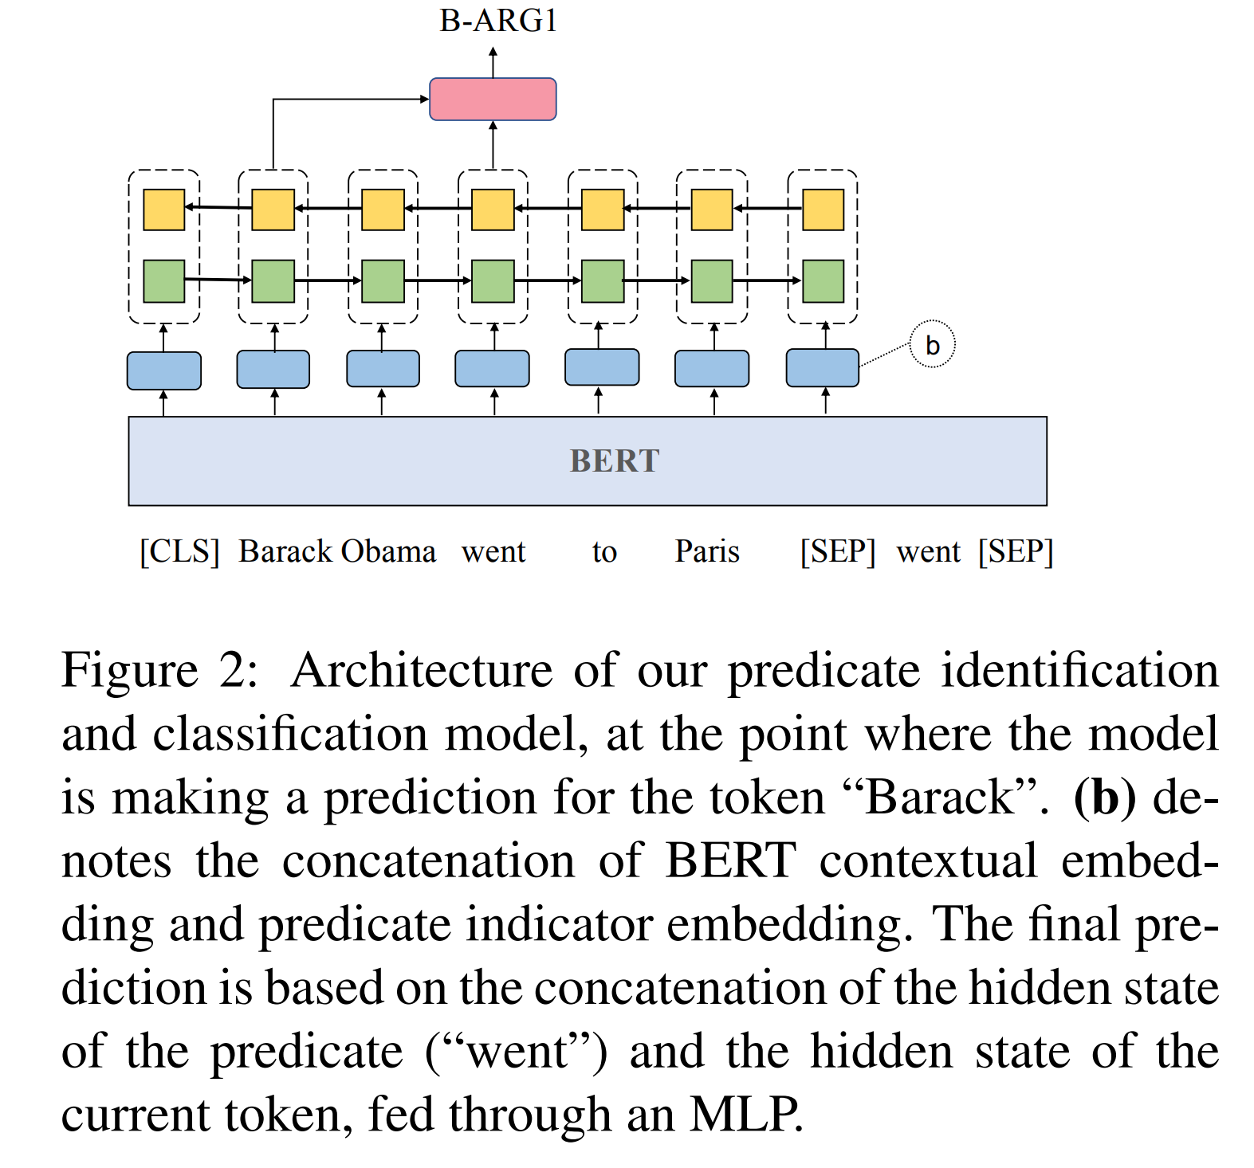






Neural Approach (2)
Notes:
he model architecture is illustrated in Figure 2, at the point in the inference process where it is outputting a tag for the token “Barack”. In order to encode the sentence in a predicate-aware manner, we design the input as [[CLS] sentence [SEP] predicate [SEP]], allowing the representation of the predicate to interact with the entire sentence via appropriate attention mechanisms. The input sequence as described above is fed into the BERT encoder. The contextual representation of the sentence ([CLS] sentence [SEP]) from BERT is then concatenated to predicate indicator embeddings, followed by a one-layer BiLSTM to obtain hidden states G = [g1, g2, ..., gn]. For the final prediction on each token gi , the hidden state of predicate gp is concatenated to the hidden state of the token gi , and then fed into a one-hidden-layer MLP classifier over the label set.
Shi, P. and J. Lin. 2019. Simple BERT
models for relation extraction and
semantic role labeling. ArXiv.

Slide 30
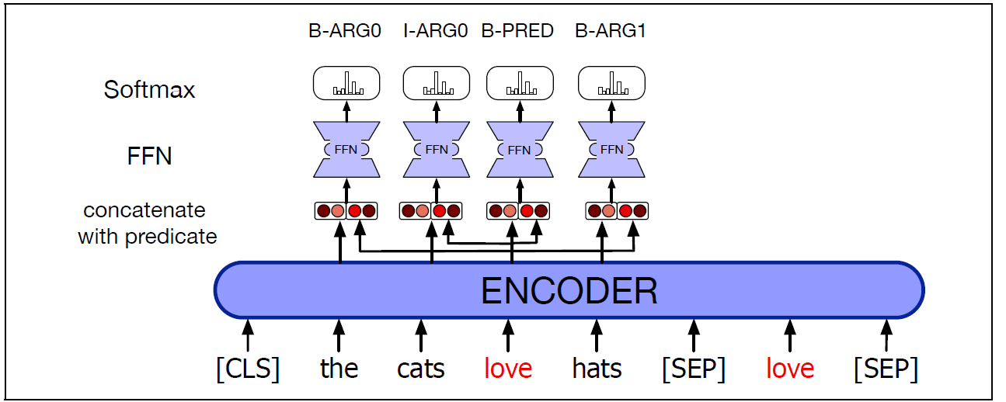
Neural Approach (2)
Notes:
Shi, P. and J. Lin. 2019. Simple BERT
models for relation extraction and
semantic role labeling. ArXiv.

Slide 31
Global approach
Probably skip in class, but check textbook 19.6.2 if something similar needed for your project
Exploit global constraints between tags; e.g., a tag I-ARG0 must follow another I-ARG0 or B-ARG0.
Apply Viterbi decoding to HMM-like (CRF) layer
  start with the simple softmax output (the entire probability distribution over tags for each word)
  Hard IOB constraints can act as the transition probabilities in the Viterbi decoding (Thus the transition from state I-ARG0 to I-ARG1 would have probability 0).
  Alternatively, the training data can be used to learn bigram tag transition probabilities as if doing CRF decoding.
Notes:
However, just as feature-based SRL tagging, this local approach to decoding doesn’t exploit the global constraints between tags; a tag I-ARG0, for example, must follow another I-ARG0 or B-ARG0.
As we saw for POS and NER tagging, there are many ways to take advantage of these global constraints. A CRF layer can be used instead of a softmax layer on top of the bi-LSTM output, and the Viterbi decoding algorithm can be used to decode from the CRF.
An even simpler Viterbi decoding algorithm that may perform equally well and doesn’t require adding CRF complexity to the training process is to start with the simple softmax. The softmax output (the entire probability distribution over tags)
for each word is then treated it as a lattice and we can do Viterbi decoding through the lattice. The hard IOB constraints can act as the transition probabilities in the Viterbi decoding (Thus the transition from state I-ARG0 to I-ARG1 would have probability 0). Alternatively, the training data can be used to learn bigram or trigram tag transition probabilities as if doing HMM decoding. Fig. 18.6 shows a sketch of the algorithm.

Slide 32
Today Oct 28
Based on Chp 13 Y. Goldberg book
Convolutional Neural Networks
Semantic Role Labeling Chp 19 J&M
  CNN R. Collobert et al. Natural language processing (almost) from scratch. The Journal of Machine Learning Research, 12:2493–2537, 2011.
  RNN-LSTM J&M 3Ed textbook
Encoder/Decoder
Notes:
History and Terminology Convolution-and-pooling architectures [LeCun and Bengio, 1995]
evolved in the neural networks vision community, where they showed great success as object
detectors—recognizing an object from a predefined category (“cat,” “bicycles”) regardless of its
position in the image [Krizhevsky et al., 2012]. When applied to images, the architecture is using
2D (grid) convolutions. When applied to text, we are mainly concerned with 1D (sequence)
convolutions. Convolutional networks were introduced to the NLP community in the pioneering
work of Collobert et al. [2011] who used them for semantic-role labeling, and later by Kalchbrenner
et al. [2014] and Kim [2014] who used them for sentiment and question-type classification.

Slide 33
Encoder-Decoder
RNN: input sequence is transformed into output sequence in a one-to-one fashion.
Goal: Develop an architecture capable of generating contextually appropriate, arbitrary length, output sequences
Applications:
  Machine translation,
  Summarization,
  Question answering,
  Dialogue modeling.
Notes:
that are capable of generating
contextually appropriate, arbitrary length, output sequences. Encoder-decoder networks
have been applied to a very wide range of applications including machine
translation, summarization, question answering, and dialogue modeling.

Slide 34









Simple recurrent neural network illustrated as a feed-forward network
Most significant change: new set of weights, U
connect the hidden layer from the previous time step to the current hidden layer.
determine how the network should make use of past context in calculating the output for the current input.
$y_{t}=softmax$(V$h_{t}$)
$y_{t}=$f(V$h_{t}$)
$h_{t}=$g(U$h_{t−1}$+W$x_{t}$)
Notes:
Simple recurrent neural network illustrated as a feed-forward network
The most significant change lies in the new set of weights,
U, that connect the hidden layer from the previous time step to the current hidden
layer. These weights determine how the network should make use of past context in
calculating the output for the current input.

Slide 35
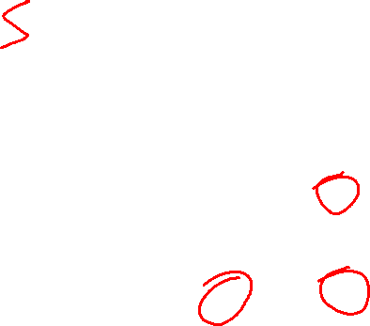
Simple-RNN abstraction
y₁
y₂
y₃
Notes:
In figures such as this, the
various layers of units are copied for each time step to illustrate that they will have
differing values over time. However the weights themselves are shared across the
various time steps. Finally, the fact that the computation at time t requires the value
of the hidden layer from time t-1 mandates an incremental inference algorithm that
proceeds from the start of the sequence to the end as shown in Fig. 9.5.

Slide 36
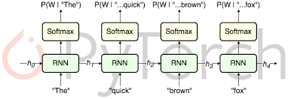
RNN Applications
Language Modeling
Sequence Classification (Sentiment, Topic)
Sequence to Sequence
Notes:
Simple recurrent networks have proven to be an effective approach to language modeling,
sequence labeling tasks such as part-of-speech tagging, as well as sequence
classification tasks such as sentiment analysis and topic classification. And as we’ll
see in Chapter 22, they form the basic building blocks for sequence to sequence
approaches to applications such as summarization and machine translation.

Slide 37


Sentence Completion using an RNN
$y_{t}=softmax$(V$h_{t}$)
$h_{t}=$g($h_{t−1}$+W$x_{t}$)
Trained Neural Language Model can be used to generate novel sequences
Or to complete a given sequence (until end of sentence token <\s> is generated)
Notes:
Given a trained model, we can ask the network to generate novel sequences by first randomly sampling
an appropriate word as the beginning of a sequence. We then condition the
generation of subsequent words on the hidden state from the previous time step as
well as the embedding for the word just generated, again sampling from the distribution
provided by the softmax.
…Note that the goal of the lefthand portion of the network
is to generate a series of hidden states from the given input; there are no outputs
associated with this part of the process until we reach the end of the prefix

Slide 38
Extending (autoregressive) generation to Machine Translation
word generated at each time step is conditioned on word from previous step.
Training data are parallel text e.g., English / French
there lived a hobbit vivait un hobbit
……..
Build an RNN language model on the concatenation of source and target
there lived a hobbit <\s> vivait un hobbit <\s>
……..
Notes:
This technique is called autoregressive generation since the word generated at the
Generation each time step is conditioned on the word generated by the network at the previous
step.

Slide 39


Extending (autoregressive) generation to Machine Translation
Translation as Sentence Completion !

Slide 40


(simple) Encoder Decoder Networks
Limiting design choices
E and D assumed to have the same internal structure (here RNNs)
Final state of the E is the only context available to D
this context is only available to D as its initial hidden state.
Encoder generates a contextualized representation of the input (last state).
Decoder takes that state and autoregressively generates a sequence of outputs
Notes:
Basic RNN-based encoder-decoder architecture. The final hidden state of the encoder RNN
serves as the context for the decoder in its role as h0 in the decoder RNN.

Slide 41














General Encoder Decoder Networks
Abstracting away from these choices
Encoder: accepts an input sequence, x_{1:n} and generates a corresponding sequence of contextualized representations, h_{1:n}
Context vector c: function of h_{1:n} and conveys the essence of the input to the decoder.
Decoder: accepts c as input and generates an arbitrary length sequence of hidden states h_{1:m} from which a corresponding sequence of output states y_{1:m} can be obtained.
h₁
h₂
h_{m}
h₁
h₂
h_{n}
Notes:
, we can say that encoder-decoder networks consist of three components:
Basic architecture for an abstract encoder-decoder network. The context is a
function of the vector of contextualized input representations and may be used by the decoder
in a variety of ways.
Among the major ones are that the encoder and the decoder
are assumed to have the same internal structure (RNNs in this case), that the final
state of the encoder is the only context available to the decoder, and finally that
this context is only available to the decoder as its initial hidden state. Abstracting
away from these choices, we can say that encoder-decoder networks consist of three
components:
1. An encoder that accepts an input sequence, xn
1, and generates a corresponding
sequence of contextualized representations, hn1
.
2. A context vector, c, which is a function of hn1
, and conveys the essence of the
input to the decoder.
3. And a decoder, which accepts c as input and generates an arbitrary length
sequence of hidden states hm1
, from which a corresponding sequence of output
states ym1
, can be obtained.

Slide 42













Stacked architectures are popular choices for Encoders
Stacked Bi-LSTMs
Contextualized representations for each time step: hidden states from top layers from the forward and backward passes
Next Class:
Transformers
Notes:
A widely used encoder design makes use
of stacked Bi-LSTMs where the hidden states from top layers from the forward and
backward passes are concatenated as described in Chapter 9 to provide the contextualized
representations for each time step.

Slide 43


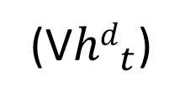

Decoder Basic Design
produce an output sequence an element at a time
Last hidden state of the encoder
z₁
z₂
First hidden state of the decoder
context
(V${hd}_{t}$)
Notes:
autoregressive generation is used to produce an output sequence,
an element at a time, until an end-of-sequence marker is generated
This incremental
process is guided by the context provided by the encoder as well as any items
generated for earlier states by the decoder.

Slide 44

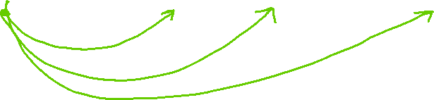
Decoder Design
Enhancement
z₁
z₂
Context available at each step of decoding
Notes:
autoregressive generation is used to produce an output sequence,
an element at a time, until an end-of-sequence marker is generated
This incremental
process is guided by the context provided by the encoder as well as any items
generated for earlier states by the decoder.

Slide 45









Decoder: How output y is chosen
z₁
z₂
Sample soft-max distribution (OK for generating novel output, not OK for e.g. MT or Summ)
Pick Most likely output at each step (doesn’t guarantee individual choices being made make sense together)
For sequence labeling we used Viterbi – here not possible ☹
Notes:
independently choosing the argmax over a sequence is not a reliable way of arriving
at a good output since it doesn’t guarantee that the individual choices being made
make sense together and combine into a coherent whole
With sequence labeling we
addressed this with a CRF-layer over the output token types combined with a Viterbi style
dynamic programming search. Unfortunately, this approach is not viable here
since the dynamic programming invariant doesn’t hold.
Recall from Chapter 8 that for part-of-speech tagging we used dynamic programming
search (the Viterbi algorithm) to address this problem. Unfortunately,
dynamic programming is not applicable to generation problems with long-distance
dependencies between the output decisions. The only method guaranteed to find the
best solution is exhaustive search: computing the probability of every one of the V^T
possible sentences (for some length value T) which is obviously too slow.

Slide 46











4 most likely “words” decoded from initial state
Feed each of those in decoder and keep most likely 4 sequences of two words
Feed most recent word in decoder and keep most likely 4 sequences of three words …….
When EOS is generated. Stop sequence and reduce Beam by 1
Notes:
Beam decoding with a beam width of 4. At the initial step, the frontier is filled with the best 4
options from the initial state of the decoder. In a breadth-first fashion, each state on the frontier is passed to a
decoder which computes a softmax over the entire vocabulary and attempts to enter each as a new state into the
frontier subject to the constraint that they are better than the worst state already there. As completed sequences
are discovered they are recorded and removed from the frontier and the beam width is reduced by 1.
We then prune the k*V hypotheses down to the k best hypotheses, so there are never more than k hypotheses
at the frontier of the search, and never more than k decoders.

Slide 47
Next class Tue: Last Lecture
Will send out another G-Form
On your preferences for which paper to present (still have to finalize the list ! )
Finish Neural Models (J&M Chp. 9 & 10, Goldberg Chp. 17)
  Attention (J&M 10.4)
  Transformers (J&M 9.7, 10.6)
  (If time) Quick Intro to Pragmatics
Assignment-4
Next Thur Nov 4th :
Course Project Proposal !

