Slide 1
CPSC 503
Computational Linguistics
Computational Lexical Semantics
(focus on word embeddings)
Lecture 13
Giuseppe Carenini
Slides Source: Jurafsky & Martin

Slide 2
Another example Neural + Traditional (for NLG)
New Frontiers in Summarization
EMNLP Workshop 2021:
Keynote I - Sashi Narayan (Google)
Learning from Past: Bringing Planning Back to Neural Generators
….. In this talk, I will discuss why we need to bring back planning to neural generation and to make generation systems more grounded, controllable, inspectable and trustworthy. I will present several pieces of evidence supporting this direction exploring existing work in data-to-text and story generation, and in summarization.
Notes:
Keynote I - Sashi Narayan (Google)
Learning from Past: Bringing Planning Back to Neural Generators
Traditional NLG systems in Reiter and Dale’s vision were inherently grounded and controllable, thanks to a planning stage which played a crucial role in ordering and structuring the information, and in grounding the generation of text to the plan. Modern neural generation systems have advanced NLG beyond our imagination, yet some of the most desired properties such as grounding and controllability have been lost and are still to be mastered. In this talk, I will discuss why we need to bring back planning to neural generation and to make generation systems more grounded, controllable, inspectable and trustworthy. I will present several pieces of evidence supporting this direction exploring existing work in data-to-text and story generation, and in summarization.

Slide 3
Bigger Picture
Three well-defined Semantic Tasks
Word Similarity
Word Sense Disambiguation (in Assignment 3)
Semantic Role Labeling
Notes:
Stand-alone with minimal assumptions on what information will be provided by other processes
IR and extremely broad field (not just text)
Today we’ll cover only a specific case in which user’s needs are expressed as words
and documents are expressed in terms of the word they contains

Slide 4
Summary of Lexical Resources/Thesauri/KnowledgeGraphs
Google Knowledge Graph
Relations among words and their meanings
Freebase
Babel Net
COMET
Wordnet
YAGO
Microsoft Concept Graph
Probase
Concept Net
Internal structure of individual words
PropBank
UMLS - MeSH
VerbNet
FrameNet
Notes:
Human specified… but also learned from data / text

Slide 5
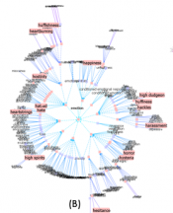
Thesaurus-based Solutions
E.g., similarity: measure distance in graph
(old?) Problems
We don’t have a thesaurus for every language (but see https://babelnet.org/ covers 100s)
We can’t have a thesaurus for every year
  For historical linguistics, we need to compare word meanings in year t to year t+1
Thesauri (used to?) have problems with recall
  Many words and phrases are missing
  Typically cannot compare nouns with verbs, with adjectives
Covers every topics
Contains rich connections
Knows about everything on a topic

Slide 6
Today Oct 26
Main focus: Vector Semantics
Notes:
Stand-alone with minimal assumptions on what information will be provided by other processes
IR and extremely broad field (not just text)
Today we’ll cover only a specific case in which user’s needs are expressed as words
and documents are expressed in terms of the word they contains

Slide 7
Vector Semantics
Introduction
For word similarity and beyond (word embeddings)
Slides Source: Jurafsky & Martin

Slide 8
Why vector models of meaning?
Use these as features to represent words in many NLP tasks
Use these to compute similarity between words
“fast” is similar to “rapid”
“tall” is similar to “height”
Question answering:
Q: “How tall is Mt. Everest?”
Candidate A: “The official height of Mount Everest is 29029 feet”
Extends to sentence/paragraph similarity
Summarization: identify and eliminate redundancy, aggregate similar phrase/sentences
Notes:
Applications
Information extraction, question answering, summarization (identify and eliminate redundancy) , language modeling (by clustering words)… extends to sentence / paragraph similarity … plagiarism detection

Slide 9
Distributional models of meaning
= vector-space models of meaning
= vector semantics
Intuitions: Zellig Harris (1954):
  “oculist and eye-doctor … occur in almost the same environments”
  “If A and B have almost identical environments we say that they are synonyms.”
Firth (1957):
  “You shall know a word by the company it keeps!”

Slide 10
WS: Distributional Methods
Do not have any thesauri for target language
If you have thesaurus, still
  Missing domain-specific (e.g., technical words)
  Poor hyponym knowledge (for V) and nothing for Adj and Adv
  Difficult to compare senses from different hierarchies
Solution: extract similarity from corpora
Basic idea: two words are similar if they appear in similar contexts

Slide 11
Intuition of distributional word similarity
Example: Suppose I asked you what is tesgüino?
    A bottle of tesgüino is on the table
    Everybody likes tesgüino
    Tesgüino makes you drunk
    We make tesgüino out of corn.
From context words humans can guess tesgüino means
  an alcoholic beverage like beer
Intuition for algorithm:
  Two words are similar if they have similar word contexts.

Slide 12
Shared intuition: Vectors Models aka “embeddings”.
Model the meaning of a word by “embedding” in a vector space.
The meaning of a word is a vector of numbers
Four kinds of vector models
Sparse vector representations
  Tf-Idf
  Mutual-information weighted word co-occurrence matrices
Dense vector representations:
  Singular value decomposition (and Latent Semantic Analysis)
  Neural-Network-inspired models (Language Model, skip-grams, CBOW)
  Brown clusters

Slide 13
Vector Semantics
Words and co-occurrence vectors

Slide 14
Co-occurrence Matrices
We represent how often a word occurs in a document
  Term-document matrix
Or how often a word occurs with another
  Term-term matrix
    (or word-word co-occurrence matrix
    or word-context matrix)

Slide 15
Term-document matrix
Each cell: count of word w in a document d:
  Each document is a count vector in ℕ^{v}: a column below
Notes:
Columns are Shakespeare’s works

Slide 16
Similarity in term-document matrices
Two documents are similar if their vectors are similar

Slide 18
The words in a term-document matrix
Each word is a count vector in ℕ^{D}: a row below

Slide 19
The words in a term-document matrix
Two words are similar if their vectors are similar

Slide 20
But raw frequency is not enough….
Frequency is clearly useful; But overly frequent words like the, it, or they are not very informative in describing a doc
A word is really informative in describing a document if it appears a lot in that doc but not in other docs
More formally….

Slide 21
tf-idf: combine two factors
tf: term frequency. frequency count (usually log-transformed):
Idf: inverse document frequency: tf-
Total # of docs in collection
Words like "the" or "good" have very low idf
# of docs that have word i
tf-idf value for word t in document d:

Slide 22











Tf-idf
Notes:
The tf-idf weighting is by far the dominant way of weighting co-occurrence matrices
in information retrieval, but also plays a role in many other aspects of natural language processing. It’s also a great baseline, the simple thing to try first.

Slide 23
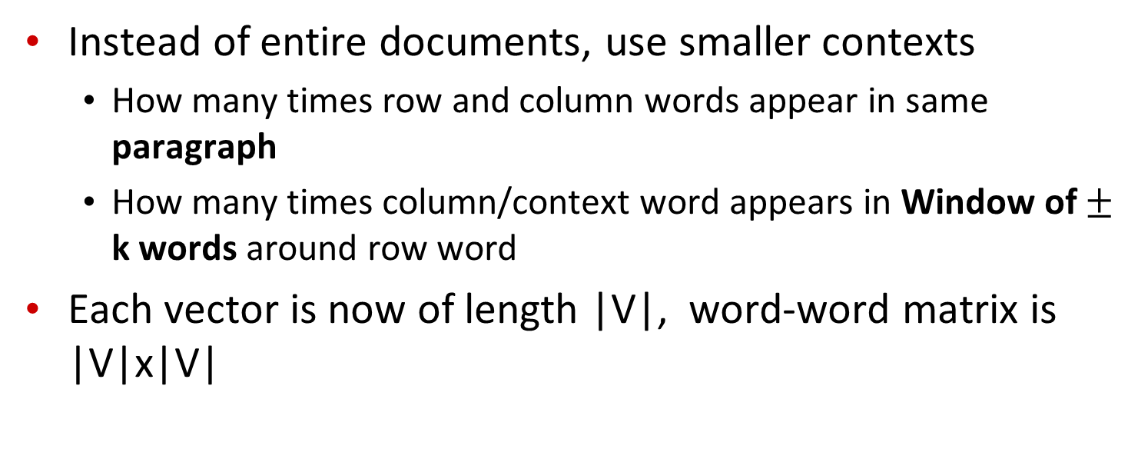

The word-word or word-context matrix
Instead of entire documents, use smaller contexts
  How many times row and column words appear in same paragraph
  How many times column/context word appears in Window of $±$ k words around row word
Each vector is now of length |V|, word-word matrix is |V|x|V|
Notes:
A word is now defined by a vector over counts of context words
Instead of each vector being of length D

Slide 24

Word-Word matrix: Sample contexts $±$ 7 words
…
…
…
Portion of matrix from the Brown corpus
…
…

Slide 26
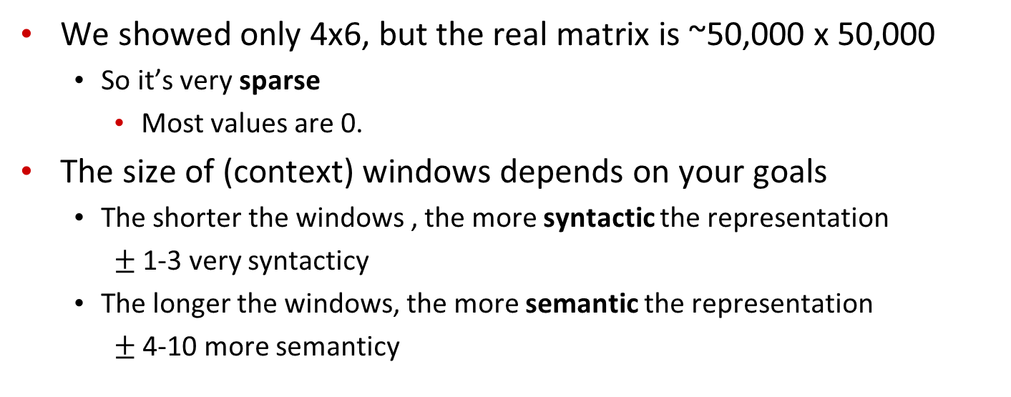
Word-word matrix
We showed only 4x6, but the real matrix is ~50,000 x 50,000
  So it’s very sparse
    Most values are 0.
The size of (context) windows depends on your goals
  The shorter the windows , the more syntactic the representation
    $±$ 1-3 very syntacticy
  The longer the windows, the more semantic the representation
    $±$ 4-10 more semanticy
Notes:
That maybe OK, since there are lots of efficient algorithms for sparse matrices.

Slide 27
Vector Semantics
Positive Pointwise Mutual Information (PPMI)

Slide 28
Problem with raw counts
Raw word frequency is not a great measure of association between words
  It’s very skewed
    “the” and “of” are very frequent, but maybe not the most discriminative
We’d rather have a measure that asks whether a context word is particularly informative about the target word.
  Positive Pointwise Mutual Information (PPMI)

Slide 29
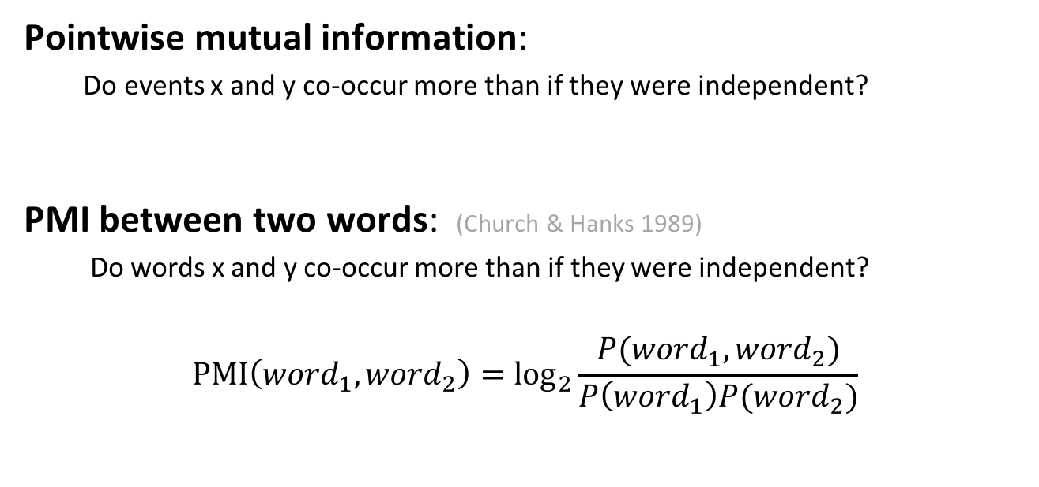
Pointwise Mutual Information
Pointwise mutual information:
  Do events x and y co-occur more than if they were independent?
  PMI between two words: (Church & Hanks 1989)
  Do words x and y co-occur more than if they were independent?
$$\text{PMI}\left({word}_{1}, {word}_{2}\right)={\text{log}}_{2}\frac{P({word}_{1}, {word}_{2})}{P\left({word}_{1}\right)P({word}_{2})}$$
Notes:
Word2 = context word

Slide 30
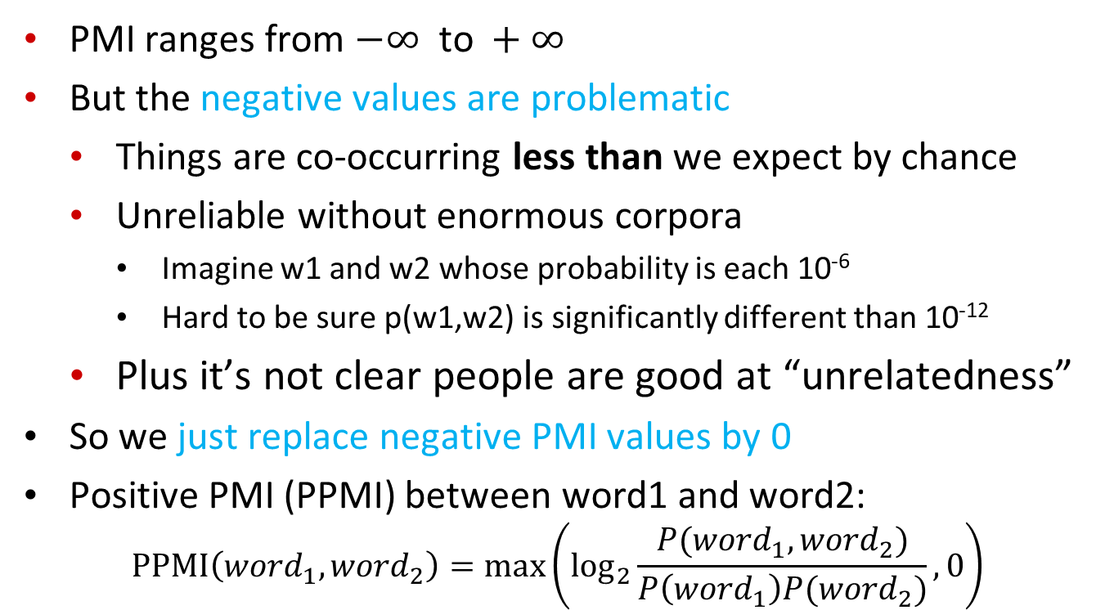
Positive Pointwise Mutual Information
  PMI ranges from $−∞ \text{to} +∞$
  But the negative values are problematic
    Things are co-occurring less than we expect by chance
    Unreliable without enormous corpora
      Imagine w1 and w2 whose probability is each 10⁻⁶
      Hard to be sure p(w1,w2) is significantly different than 10⁻¹²
    Plus it’s not clear people are good at “unrelatedness”
  So we just replace negative PMI values by 0
  Positive PMI (PPMI) between word1 and word2:
$$\text{P}\text{P}\text{MI}\left({word}_{1}, {word}_{2}\right)=\max\left({\text{log}}_{2}\frac{P({word}_{1}, {word}_{2})}{P\left({word}_{1}\right)P({word}_{2})},0\right)$$

Slide 31
Computing PPMI on a term-context matrix
Matrix F with W rows (words) and C columns (contexts)
f_{ij} is # of times c_{j} occurs in window of w_{i}
Notes:
Matrix F with W rows (words) and C columns (contexts)
f_{ij} is # of times w_{i} occurs in context c_{j}
=>
Matrix F with W rows (words) and C columns (contexts)
f_{ij} is # of times w_{i} occurs in context c_{j}

Slide 32
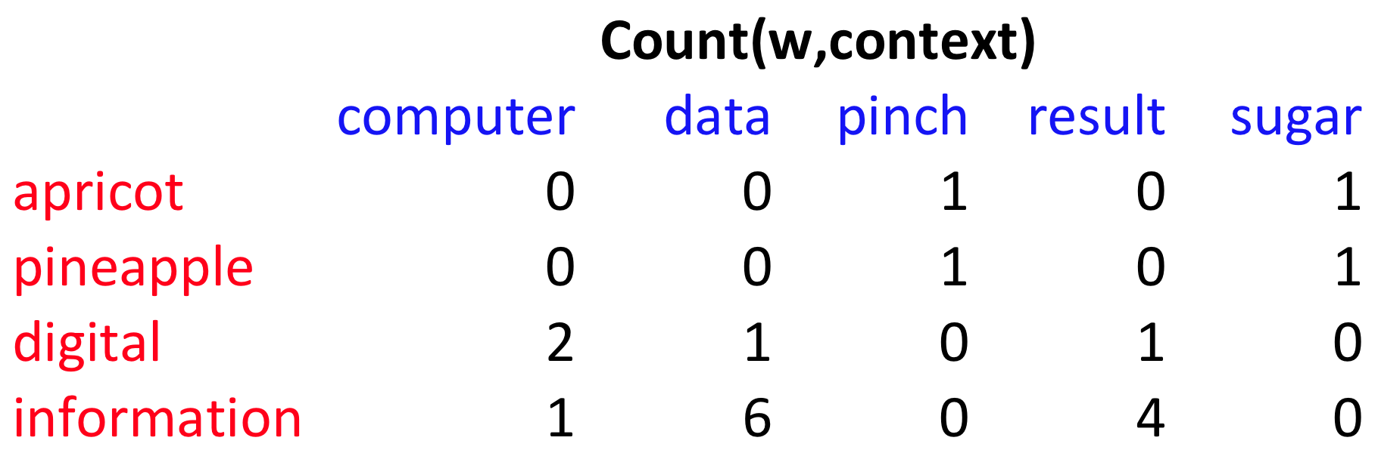
p(w=information,c=data) =
p(w=information) =
p(c=data) =
6/19
= .32
11/19
= .58
7/19
= .37

Slide 33
pmi(information,data) = log₂ (
.32 /
(.37*.58) )
= .58
(.57 using full precision)

Slide 34
Vector Semantics
Measuring similarity: the cosine

Slide 35
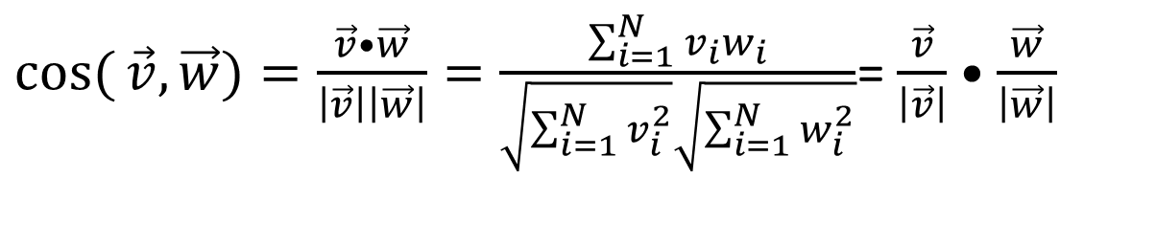
Cosine for computing similarity
(exemplified for PPMI vectors)
Sec. 6.3
Dot product
Unit vectors
$\cos{(}\vec{v},\vec{w})=\frac{\vec{v}•\vec{w}}{\left|\vec{v}\right|\left|\vec{w}\right|}=\frac{\sum_{i=1}^{N}{v_{i}w_{i}}}{\sqrt{\sum_{i=1}^{N}{v_{i}^{2}}}\sqrt{\sum_{i=1}^{N}{w_{i}^{2}}}}$= $\frac{\vec{v}}{\left|\vec{v}\right|}•\frac{\vec{w}}{\left|\vec{w}\right|}$
v_{i} is the PPMI value for word v in context i
w_{i} is the PPMI value for word w in context i.
cos(v,w) is the cosine similarity of v and w

Slide 36
 | large | data | computer
apricot | 1 | 0 | 0
digital | 0 | 1 | 2
information | 1 | 6 | 1
Which pair of words is more similar?
cosine(apricot,information) =
cosine(digital,information) =
cosine(apricot,digital) =

Slide 37
Visualizing cosines
(well, angles)

Slide 38
Clustering vectors to visualize similarity in co-occurrence matrices
Rohde et al. (2006)

Slide 39
Vector Semantics
Dense Vectors

Slide 40
Sparse versus dense vectors
PPMI vectors are
  long (length |V|= 20,000 to 50,000 to …)
  sparse (most elements are zero)
Alternative: learn vectors which are
  short (length 200-1000)
  dense (most elements are non-zero)
Notes:
Why dense vectors?
Short vectors may be easier to use as features in machine learning (less weights to tune)
Dense vectors may generalize better than storing explicit count-based info
They may do better at capturing synonymy:
car and automobile are synonyms; but are distinct dimensions
a word with car as a neighbor and a word with automobile as a neighbor should be similar, but aren't
In practice, they work better

Slide 41
Three methods for getting short dense vectors
Singular Value Decomposition (SVD)
  A special case of this is called LSA – Latent Semantic Analysis
“Neural Language Model”-inspired predictive models
  skip-grams and CBOW
Brown clustering

Slide 42
SVD applied to term-term matrix
(I’m simplifying here by assuming the matrix has rank |V|)
Notes:
The rank of a matrix is defined as (a) the maximum number of linearly independent column vectors in the matrix or (b) the maximum number of linearly independent row vectors in the matrix. Both definitions are equivalent.

Slide 43
Truncated SVD on term-term matrix

Slide 44
Vector Semantics
Embeddings inspired by neural language models: skip-grams and CBOW

Slide 45
Neural Language Models
What function are we trying to learn?
n-gram: a function that takes n-1 words and returns a prob. distribution on the next word
Let’s focus on the simple 2-gram…
Take a word and return a prob. distribution on the next word

Slide 46




NN Input: Represent words as vectors
Represent each word as a different vector with no prior info on their similarity -> 1-of-K coding scheme
How to map that into a “smaller” vector of real numbers? Multiply by matrix E’ with dimension d<<|V|
w is a column vector

Slide 47
NN Output: Probability distribution for next word
Output vector y of dimension |V| that we can then normalize (with soft-max)
A little simplified for the sake of simplicity

Slide 48

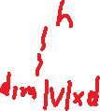





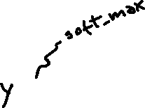

Connecting input and output

Slide 49
Intuition about training
Output vector y of dimension |V| that we can then normalized (with soft-max)

Slide 50

Training Procedure: details
Take as input a very long text
Concatenate all sentences
Iterate through text predicting each word w_{t}
At each word w_{t} the cross-entropy Loss is
$$L=−\log{P(}w_{t}\text{|}w_{t−1}\text{)}$$
Loss if

Slide 51



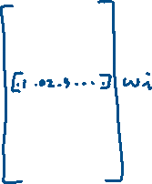


What info is stored in matrix E’ ?
It gives us a dense continuous vector representation for each word
Notes:
New 2019 (also W contains a representation for the words !)
This approach, which was proposed in [79] as a continuous bag-of-words (CBoW) model,20 was found to exhibit an interesting property. That is, the word embedding matrix E learned as a part of this CBoWmodel very well reflects underlying structures of words, and this has become one of the darling models by natural language processing
researchers in recent years. We will discuss further in the next section.
Skip-Gram and Implicit Matrix Factorization In [79], another model, called skipgram,
is proposed. The skip-gram model is built by flipping the continuous bag-ofwords
model. Instead of trying to predict the middle word given 2n surrounding words,
the skip-gram model tries to predict randomly chosen one of the 2n surrounding words
given the middle word. From this description alone, it is quite clear that this skip-gram
model is not going to be great as a language model. However, it turned out that the
word vectors obtained by training a skip-gram model were as good as those obtained by
either a continuous bag-of-words model or any other neural language model. Of course,
it is debatable which criterion be used to determine the goodness of word vectors, but in
many of the existing so-called “intrinsic” evaluations, those obtained from a skip-gram
model have been shown to excel.
The authors of [72] recently showed that training a skip-gram model with negative
sampling (see [79]) is equivalent to factorizing a positive point-wise mutual information
matrix (PPMI) into two lower-dimensional matrices. The left lower-dimensional
matrix corresponds to the input word embedding matrix E in a skip-gram model. In
other words, training a skip-gram model implicitly factorizes a PPMI matrix.
Their work drew a nice connection between the existing works on distributional
word representations from natural language processing, or even computational linguistics
and these more recent neural approaches. I will not go into any further detail in
this course, but I encourage readers to read [72].

Slide 52
Matrix E: Vxd is
a dense continuous vector representation for each word (called word embedding)
When this is learned in slightly different settings (e.g., to predict the probability of a word given x words on the right and x words on the left, aka continuous bag-of-words (CBoW)) => embeddings very well reflects underlying structures of words
Can also be learned in the context of RNNs and other Neural Architectures
This has become a key model for words in NLP
Notes:
New 2019 (also W contains a representation for the words !)
This approach, which was proposed in [79] as a continuous bag-of-words (CBoW) model,20 was found to exhibit an interesting property. That is, the word embedding matrix E learned as a part of this CBoWmodel very well reflects underlying structures of words, and this has become one of the darling models by natural language processing
researchers in recent years. We will discuss further in the next section.
Skip-Gram and Implicit Matrix Factorization In [79], another model, called skipgram,
is proposed. The skip-gram model is built by flipping the continuous bag-ofwords
model. Instead of trying to predict the middle word given 2n surrounding words,
the skip-gram model tries to predict randomly chosen one of the 2n surrounding words
given the middle word. From this description alone, it is quite clear that this skip-gram
model is not going to be great as a language model. However, it turned out that the
word vectors obtained by training a skip-gram model were as good as those obtained by
either a continuous bag-of-words model or any other neural language model. Of course,
it is debatable which criterion be used to determine the goodness of word vectors, but in
many of the existing so-called “intrinsic” evaluations, those obtained from a skip-gram
model have been shown to excel.
The authors of [72] recently showed that training a skip-gram model with negative
sampling (see [79]) is equivalent to factorizing a positive point-wise mutual information
matrix (PPMI) into two lower-dimensional matrices. The left lower-dimensional
matrix corresponds to the input word embedding matrix E in a skip-gram model. In
other words, training a skip-gram model implicitly factorizes a PPMI matrix.
Their work drew a nice connection between the existing works on distributional
word representations from natural language processing, or even computational linguistics
and these more recent neural approaches. I will not go into any further detail in
this course, but I encourage readers to read [72].

Slide 53
Slightly more complex Neural Language Model
(J&M 3Ed draft Chp 7)
3-gram neural model
Training the embeddings !
Different names for the parameters but need to get used to that ;-)
Notes:
A simplified view of a feedforward neural language model moving through a text. At each
timestep t the network takes the 3 context words, converts each to a d-dimensional embeddings, and concatenates
the 3 embeddings together to get the 1Nd unit input layer x for the network. These units are multiplied
by a weight matrix W and bias vector b and then an activation function to produce a hidden layer h, which
is then multiplied by another weight matrix U. (For graphic simplicity we don’t show b in this and future
pictures). Finally, a softmax output layer predicts at each node i the probability that the next word wt will be
vocabulary word Vi. (This picture is simplified because it assumes we just look up in an embedding dictionary
E the d-dimensional embedding vector for each word, precomputed by an algorithm like word2vec.)

Slide 54
Prediction-based models:
An alternative way to get dense vectors
Skip-gram (Mikolov et al. 2013a) CBOW (Mikolov et al. 2013b)
Learn embeddings as part of the process of word prediction.
Train a neural network to predict neighboring words
    Inspired by neural net language models.
    In so doing, learn dense embeddings for the words in the training corpus.
Available online in the word2vec package
  Including sets of pre-trained embeddings
Notes:
word2vec package implements both Skip-gram and CBOW

Slide 55
Skip-grams & CBOW
Distinguish “good” word-context pairs from “bad” ones
  in a context window of 2C words
So for C=2, we are given word w_{t} and this context :

Slide 56
Skip-grams
Neural net to Distinguish “good” word-context pairs from “bad” ones
  in a context window of 2C words
CBOW
Same task but now the context is represented as a single vector (the sum of all the 1-hot vectors for the context words
[Goldberg 10.4.2]

Slide 57
Skip-grams
Neural net to Distinguish “good” word-context pairs from “bad” ones
  in a context window of 2C words
In the following examples you keep the target word and you change the context word! That is what the J&M does now!
Revise this accordingly
CBOW
Also J&M describes maximizing dot product between target and context word as the goal! Revise accordingly
Same task but now the context is represented as a single vector (the sum of all the 1-hot vectors for the context words
[Goldberg 10.4.2]

Slide 58
Skip-Gram Training Data
Training sentence:
... lemon, a tablespoon of apricot jam a pinch ...
c1 c2 t c3 c4
Training data: input/output pairs centering on apricot
Assume a +/- 2 word window

Slide 59
Skip-Gram Training
Training sentence:
... lemon, a tablespoon of apricot jam a pinch ...
c1 c2 t c3 c4
For each positive example, we'll create k negative examples.
Using noise words
  Any random word that isn't t

Slide 60
Skip-Gram Training
Training sentence:
... lemon, a tablespoon of apricot jam a pinch ...
c1 c2 t c3 c4
k=2

Slide 61
Connecting input and output

Slide 62



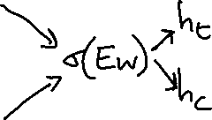




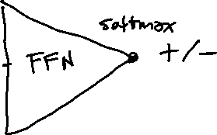

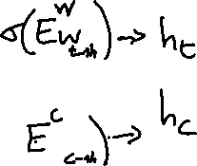




Sketch of skip-Gram Neural Architecture

Slide 63
Choosing noise words
Could pick w according to their unigram frequency P(w)
More common to chosen then according to p_{α}(w)
α= ¾ works well because it gives rare noise words slightly higher probability
To show this, imagine two events p(a)=.99 and p(b) = .01:

Slide 64
Properties of embeddings
Nearest words to some embeddings (Mikolov et al. 2013)
Available online in the word2vec package
  Including sets of pre-trained embeddings

Slide 65
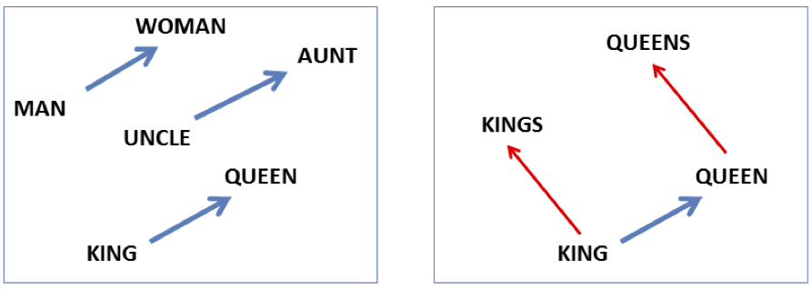

Embeddings (often) capture relational meaning!
vector(‘king’) - vector(‘man’) + vector(‘woman’) $≈$vector(‘queen’)
vector(‘Paris’) - vector(‘France’) + vector(‘Italy’) $≈$ vector(‘Rome’)

Slide 67
For another method to build embeddings see…
Glove: Global Vectors for Word Representation
J. Pennington | R. Socher | C. Manning
Proc. of the 2014 Conference on Empirical Methods in Natural Language Processing (EMNLP)
Best on analogy task like, “a is to b as c is to ?”
The dataset contains 19,544 such questions, divided into a semantic subset and a syntactic subset. The semantic questions are typically analogies about people or places, like “Athens is to Greece as Berlin is to ?”
Notes:
Word analogies. The word analogy task consists of questions like, “a is to b as c is to ?” The dataset contains 19,544 such questions, divided into a semantic subset and a syntactic subset. The semantic questions are typically analogies about people or places, like “Athens is to Greece as Berlin is to ?”. The syntactic questions are typically analogies about verb tenses or forms of adjectives, for example “dance is to dancing as fly is to ?”. To correctly answer the question, the model should uniquely identify the missing term, with only an exact correspondence counted as a correct match. We answer the question “a is to b as c is to ?” by finding the word d whose representation wd is closest to wb − wa + wc according to the cosine similarity
There are many other embedding algorithms, using methods like non-negative
matrix factorization (Fyshe et al., 2015), or by converting sparse PPMI embeddings
to dense vectors by using SVD (Levy and Goldberg, 2014c). The most widely used
embedding model besides word2vec is GloVe (Pennington et al., 2014). The
name stands for Global Vectors, because the model is based on capturing global
corpus statistics. GloVe is based on ratios of probabilities from the word-word cooccurrence
matrix, combining the intuitions of count-based models like PPMI while
also capturing the linear structures used by methods like word2vec.

Slide 68
Next Two Lectures More on Neural approaches
Lecture on Thur ….. CNNs, Semantic Role Labeling… Some Pragmatics..
Lecture On Tue… Encoder-Decoder, Attention… Transformers
Following Thur (Nov 4th): project proposals . Look at project work plan. Presentation 5 mins each (7mins for group projects).
How many group projects? (answ: there are ??)
So Tot. time (5mins x ??) + (7mins x ??) = ??? mins
Notes:
May need to stay past 1:30.? If you need to attend another class you can present first… will try to find another room

Slide 69
Next Two Lectures More on Neural approaches
Lecture on Thur ….. CNNs, Semantic Role Labeling… Some Pragmatics..
Lecture On Tue… Encoder-Decoder, Attention… Transformers
Following Tue (Nov 4th): project proposals . Look at project work plan. Presentation 5 mins each (7mins for group projects).
Fill out form about your course project asap!
https://forms.gle/KFXoAiZXogfrWGvw9
Notes:
May need to stay past 1:30.? If you need to attend another class you can present first… will try to find another room

