Slide 1
CPSC 503
Computational Linguistics
Lecture 12
Giuseppe Carenini

Slide 2
Today Oct 21
Finish Semantic Analysis……
Meaning of words
Relations among words and their meanings (Paradigmatic)
Internal structure of individual words (Syntagmatic)
Notes:
Paradigmatic: the external relational structure among words
Syntagmatic: the internal structure of words that determines how they can be combined with other words

Slide 3


Practical Goals for Semantic Analysis (1)
  Map NL queries into FOPC so that answers can be effectively computed
What African countries are not on the Mediterranean Sea?
Was 2007 the first El Nino year after 2001?
Notes:
We didn’t assume much about the meaning of words when we talked about sentence meanings
Verbs provided a template-like predicate argument structure
Nouns were practically meaningless constants
There has be more to it than that
View assuming that words by themselves do not refer to the world, cannot be
Judged to be true or false…

Slide 4
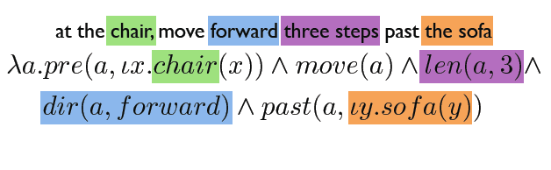

Practical Goal for Semantic Analysis (2)
  Referring to physical objects - Executing instructions
Notes:
Referring to physical objects - Executing instructions

Slide 5
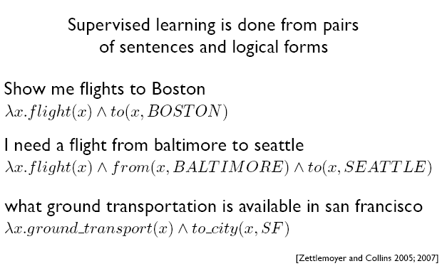
Semantic Parsing (via ML)
Notes:
Lambda calculus • Parsing with Combinatory Categorial Grammars

Slide 6
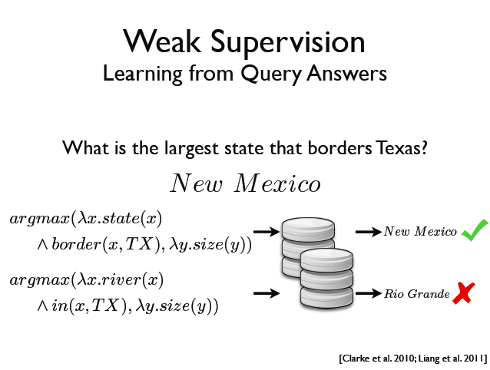

Semantic Parsing (via ML)
Notes:
Lambda calculus • Parsing with Combinatory Categorial Grammars
Liang et al 2011
https://cs.stanford.edu/~pliang/papers/dcs-acl2011.pdf
did not use reinforcement learning
For more advanced recent techniques see
https://zhangyuc.github.io/files/zhang17emnlp.pdf
this one is using RL
https://arxiv.org/abs/1704.07926

Slide 7
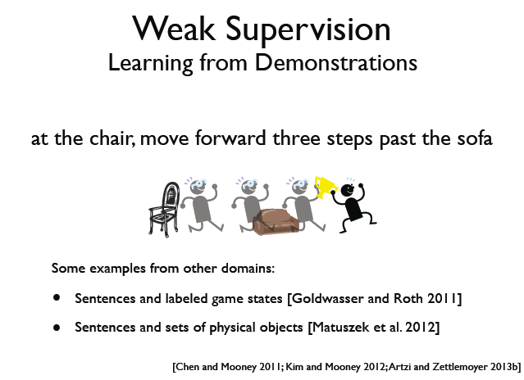
Semantic Parsing (via ML)
Notes:
Lambda calculus • Parsing with Combinatory Categorial Grammars

Slide 8







Neural Semantic Parser
Neural Semantic Parsing with Type Constraints for Semi-Structured Tables
Jayant Krishnamurthy, Pradeep Dasigi, Matt Gardner. EMNLP 2017.
Encoder Decoder Architecture in three classes

Slide 9
References (Project?)
Text Book: Representation and Inference for Natural Language : A First Course in Computational Semantics Patrick Blackburn and Johan Bos, 2005, CSLI (pre-neural)
J. Bos (2011): A Survey of Computational Semantics: Representation, Inference and Knowledge in Wide-Coverage Text Understanding. Language and Linguistics Compass 5(6): 336–366. (pre-neural)
Semantic parsing via Machine Learning: The Cornell Semantic Parsing Framework (Cornell SPF) is an open source research software package. It includes a semantic parsing algorithm, a flexible meaning representation language and learning algorithms. http://yoavartzi.com/amr
The paper in previous slide: Neural Semantic Parsing with Type Constraints for Semi-Structured Tables Jayant Krishnamurthy, Pradeep Dasigi, Matt Gardner. EMNLP 2017. (neural)
Many more papers on Semantic Parsing in more recent conferences ACL, NAACL, EMNLP, …..

Slide 10
Today Oct 21
“Finish” Semantic Analysis
Meaning of words
Relations among words and their meanings (Paradigmatic)
Internal structure of individual words (Syntagmatic)
Notes:
Paradigmatic: the external relational structure among words
Syntagmatic: the internal structure of words that determines how they can be combined with other words

Slide 11
Summary of Lexical Resources ~ 2017 circa
Google Knowledge Graph
Relations among words and their meanings
Freebase
Wordnet
YAGO
Microsoft Concept Graph
Probase
Wikipedia
Internal structure of individual words
PropBank
UMLS - MeSH
VerbNet
FrameNet

Slide 12
Word?
Stem?
  Lemma:
  Orthographic form +
  Phonological form +
  Meaning (sense)
  [Modulo inflectional morphology]
content?
celebration?
bank?
celebrate?
duck?
banks?
  Lexicon: A collection of lemmas/lexemes
Notes:
What’s a word?
Types, tokens, stems, roots, inflected forms, etc... Ugh.
So how many entries for the “string”….
Lexeme a pairing of a particular form (ortographic and phonological) with its meaning
For the purposes of lexical semantics (dictionaries and thesauri) we represent a lexeme by a lemma
Lexicon include compound words and non-compositional phrases
Where do you usually find this kind of information?

Slide 13
Dictionary
  Repositories of information about the meaning of words, but…..
  Most of the definitions are circular… ?? They are descriptions….
  Fortunately, there is still some useful semantic info (Lexical Relations):
  L_{1,}L₂ same O and P, different M
  L_{1,}L₂ “same” M, different O
  L_{1,}L₂ “opposite” M
  L_{1,}L₂ , M₁ subclass of M₂
  _{Etc. ……}
Homonymy
Synonymy
Antonymy
Hyponymy
Notes:
We can use them because some lexemes are grounded in the external word (perception (visual systems), ….)
Red blood
The list of relations presented here is by no means exhaustive
For computational purposes, one approach to defining a sense is to make use
of a similar approach to these dictionary definitions; defining a sense through its
relationship with other senses.

Slide 14
Ontologies: inspiration from Natural Language
(From 422)
:
How do we refer to individuals and relationship in the world in NL e.g., English?
Where do we find definitions for words?
  Most of the definitions are circular? They are descriptions.
  Fortunately, there is still some useful semantic info (Lexical Relations):
  w₁ w₂ same Form and Sound, different Meaning
  w₁ w₂ same Meaning, different Form
  w₁ w₂ “opposite” Meaning
  w₁ w₂ Meaning₁ subclass of Meaning₂
Homonymy
Synonymy
Antonymy
Hyponymy
Notes:
Meaning of words
Relations among words and their meanings (Paradigmatic)
Internal structure of individual words (Syntagmatic)
Repositories of information about the meaning of words, but…..
We can use them because some lexemes are grounded in the external word (perception (visual systems), ….)
Red blood
The list of relations presented here is by no means exhaustive

Slide 15
Homonymy
  Def. Lexemes that have the same Orthographic and Phonological forms but unrelated meanings
  Examples: Bat (wooden stick-like thing) vs. Bat (flying scary mammal thing)
    Plant (…….) vs.
    Plant (………)
Homographs
Homonyms
Homophones
content/content
wood/would
Notes:
Items taking part in such relation: homonyms
Phonological, orthographic or both
POS can help but not always
Found: past of find / found (a city)

Slide 16
Relevance to NLP Tasks
Information retrieval (homonymy):
    QUERY: ‘bat care’
Spelling correction: homophones can lead to real-word spelling errors
Text-to-Speech: homographs (which are not homophones)
……
Notes:
The problematic part of understanding homonymy isn’t with the forms, it’s the meanings.
An intuition with true homonymy is coincidence
It’s a coincidence in English that bat and bat mean what they do.
Nothing particularly important would happen to anything else in English if we used a different word for the little flying mammal things

Slide 17
Polysemy
Def. The case where we have a set of lexemes with the same form and multiple related meanings.
Consider the homonym:
bank → commercial bank₁ vs. river bank₂
Now consider: “A PCFG can be trained using derivation trees from a tree bank annotated by human experts”
Is this a new independent sense of bank?
Notes:
meanings associated with it
Most non-rare words have multiple meanings
The number of meanings is related to its frequency
Verbs tend more to polysemy
Distinguishing polysemy from homonymy isn’t always easy (or necessary)

Slide 18
Polysemy
  Lexeme (new def.):
  Orthographic form + Phonological form +
  Set of related senses
  How many distinct (but related) senses?
  They serve meat…
  He served as Dept. Head…
  She served her time….
Different subcat
Intuition (prison)
  Does AC serve vegetarian food?
  Does AC serve Rome?
  (?)Does AC serve vegetarian food and Rome?
Zeugma
Notes:
What distinct senses does it have?
How are these senses related?
How can they be reliably distinguished?
The answer to these questions can have serious consequences for how well semantic analyzers
Search engines, Generators, and Machine translation systems perform their respective tasks.
ZEUGMA:Combine two separate uses of a lexeme into a single example using a conjunction…
What is the relation among the various senses?

Slide 19
Synonyms
Def. Different lexemes with the same meaning.
Substitutability- if they can be substituted for one another in some environment without changing meaning or acceptability.
Would I be flying on a large/big plane?
?… became kind of a large/big sister to…
? You made a large/big mistake
Notes:
Synonyms clash with polysemous meanings (one sense of big is older)
Collocation: big mistake sounds more natural
There aren’t any…
Maybe not, but people think and act like there are so maybe there are…
PURCHASE / BUY
One test…
Two lexemes are synonyms if they can be successfully substituted for each other in all situations
Too strong!

Slide 20
Hyponymy
Def. Pairings where one lexeme denotes a subclass of the other
  Since dogs are canids
    Dog is a hyponym of canid and
    Canid is a hypernym of dog
  car/vehicle
  doctor/human
  ……
Notes:
A hyponymy relation can be asserted between two lexemes when the meanings of the lexemes entail a subset relation

Slide 21
Lexical Resources
Databases containing all lexical relations among all lexemes
Development:
  Mining info from dictionaries and thesauri
  Handcrafting it from scratch
WordNet: first developed with reasonable coverage and widely used [Fellbaum… 1998]
  for English (versions for other languages have been developed – see MultiWordNet)

Slide 22
WordNet 3.0
POS | Unique Strings | Synsets | Word-Sense Pairs
Noun | 117798 | 82115 | 146312
Verb | 11529 | 13767 | 25047
Adjective | 21479 | 18156 | 30002
Adverb | 4481 | 3621 | 5580
Totals | 155287 | 117659 | 206941
For each lemma/lexeme: all possible senses (no distinction between homonymy and polysemy)
For each sense: a set of synonyms (synset) and a gloss
Notes:
So bass includes fish-sense instrument-sense musical-range-sense
The noun "bass" has 8 senses in WordNet.
1. bass -- (the lowest part of the musical range)
2. bass, bass part -- (the lowest part in polyphonic music)
3. bass, basso -- (an adult male singer with the lowest voice)
4. sea bass, bass -- (the lean flesh of a saltwater fish of the family Serranidae)
5. freshwater bass, bass -- (any of various North American freshwater fish with lean flesh (especially of the genus Micropterus))
6. bass, bass voice, basso -- (the lowest adult male singing voice)
7. bass -- (the member with the lowest range of a family of musical instruments)
8. bass -- (nontechnical name for any of numerous edible marine and freshwater spiny-finned fishes)

Slide 23
WordNet: entry for “table”
The noun "table" has 6 senses in WordNet.
1. table, tabular array -- (a set of data …)
2. table -- (a piece of furniture …)
3. table -- (a piece of furniture with tableware…)
4. mesa, table -- (flat tableland …)
5. table -- (a company of people …)
6. board, table -- (food or meals …)
The verb "table" has 1 sense in WordNet.
1. postpone, prorogue, hold over, put over,
table, shelve, set back, defer, remit, put off –
(hold back to a later time; "let's postpone the exam")
Notes:
Each blue list is a synset

Slide 24

WordNet Relations (between synsets!)
fi
Notes:
Key point: synsets are related not specific words
Adjectives (synonyms, antonyms)

Slide 25
WordNet Hierarchies: “Vancouver”
WordNet: example from ver1.7.1
For the three senses of “Vancouver”
⇒(city, metropolis, urban center)
⇒ (municipality)
⇒ (urban area)
⇒ (geographical area)
⇒ (region)
⇒ (location)
⇒ (entity, physical thing)
⇒ (administrative district, territorial division)
⇒ (district, territory)
⇒ (region)
⇒ (location ⇒ (entity, physical thing)
⇒ (port)
⇒ (geographic point)
⇒ (point)
⇒ (location)
⇒ (entity, physical thing)
Notes:
Now 3.0

Slide 26
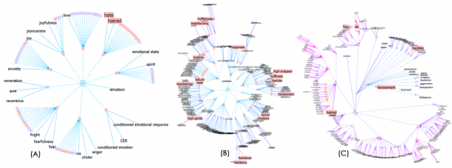
Visualizing Wordnet Relations
C. Collins, “WordNet Explorer: Applying visualization principles to lexical semantics,” University of Toronto, Technical Report kmdi 2007-2, 2007.

Slide 27
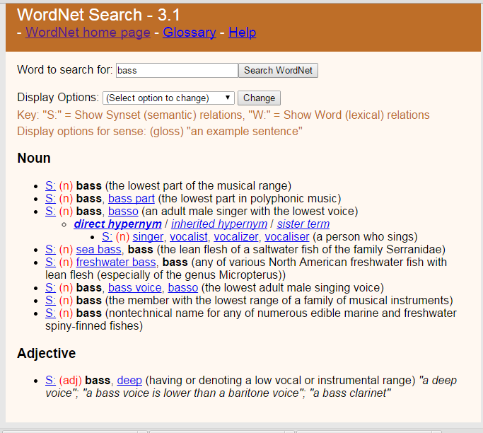
Web interface & API

Slide 28
Wordnet: NLP Tasks
Probabilistic Parsing (PP-attachments): words + word-classes extracted from the hypernym hierarchy increase accuracy from 84% to 88% [Stetina and Nagao, 1997]
… acquire a company for money
… purchase a car for money
… buy a book for a few bucks
Word sense disambiguation
Lexical Chains (topic modeling, summarization)
and many, many others !
More importantly starting point for larger Lexical Resources (aka Ontologies) !
Notes:
If you know the right attachment for “acquire a company for money”,
“purchase a car for money”
Can help you to decide the attachment for “buy books for money”
John assassinated the senator

Slide 29
YAGO2: huge semantic knowledge base
Derived from Wikipedia, WordNet and GeoNames. (started in 2007, paper in www conference)
10⁶ entities (persons, organizations, cities, etc.)
>120* 10⁶ facts about these entities.
YAGO accuracy of 95%. has been manually evaluated.
Anchored in time and space. YAGO attaches a temporal dimension and a spatial dimension to many of its facts and entities.
Notes:
YAGO2s is a huge semantic knowledge base, derived from Wikipedia WordNet and GeoNames. Currently, YAGO2s has knowledge of more than 10 million entities (like persons, organizations, cities, etc.) and contains more than 120 million facts about these entities.
YAGO is special in several ways:
The accuracy of YAGO has been manually evaluated, proving a confirmed accuracy of 95%. Every relation is annotated with its confidence value.
YAGO is an ontology that is anchored in time and space. YAGO attaches a temporal dimension and a spatial dimension to many of its facts and entities.
In addition to a taxonomy, YAGO has thematic domains such as "music" or "science" from WordNet Domains.

Slide 30
Freebase
“Collaboratively constructed database.”
Freebase contains tens of millions of topics, thousands of types, and tens of thousands of properties and over a billion of facts
Automatically extracted from a number of resources including Wikipedia, MusicBrainz, and NNDB
as well as the knowledge contributed by the human volunteers.
Each Freebase entity is assigned a set of human-readable unique keys, which are assembled of a value and a namespace.
All was available for free through the APIs or to download from weekly data dumps
Notes:
Notable Names Database (NNDB) is an online database of biographical details of over 40,000 people of note.
What is Freebase?
Freebase contains tens of millions of topics, thousands of types, and tens of thousands of properties. By comparison, English Wikipedia has over 4 million articles. Each of the topics in Freebase is linked to other related topics and annotated with important properties like movie genres and people's dates of birth. There are over a billion such facts or relations that make up the graph and they're all available for free through the APIs or to download from our weekly data dumps.
Notable Names Database (NNDB) is an online database of biographical details of over 40,000 people of note
MusicBrainz is an open music encyclopedia that collects music metadata and makes it available to the public.

Slide 31
Fast Changing Landscape.....
On 16 December 2015, Google officially announced the Knowledge Graph API, which is meant to be a replacement to the Freebase API.
Freebase.com was officially shut down on 2 May 2016.^{[6]}
Notes:
Freebase was a large collaborative knowledge base consisting of data composed mainly by its community members. It was an online collection of structured data harvested from many sources, including individual, user-submitted wiki contributions.^{[2]} Freebase aimed to create a global resource that allowed people (and machines) to access common information more effectively. It was developed by the American software company Metaweb and ran publicly since March 2007. Metaweb was acquired by Google in a private sale announced 16 July 2010.^{[3]} Google's Knowledge Graph was powered in part by Freebase.^{[4]}
Freebase data was available for commercial and non-commercial use under a Creative Commons Attribution License, and an open API, RDF endpoint, and a database dump was provided for programmers.
On 16 December 2014, Knowledge Graph announced that it would shut down Freebase over the succeeding six months and help with the move of the data from Freebase to Wikidata.^{[5]}
On 16 December 2015, Google officially announced the Knowledge Graph API, which is meant to be a replacement to the Freebase API. Freebase.com was officially shut down on 2 May 2016.^{[6]}

Slide 32
Probase (MS Research) < Sept 2016
Harnessed from billions of web pages and years worth of search logs
Extremely large concept/category space (2.7 million categories).
Probabilistic model for correctness, typicality (e.g., between concept and instance)
Notes:
Knowledge in Probase is harnessed from billions of web pages and years worth of search logs -- these are nothing more than the digitized footprints of human communication.
Probase is unique in two aspects. First, Probase has an extremely large concept/category space (2.7 million categories). As these concepts are automatically acquired from web pages authored by millions of users, it is probably true that they cover most concepts in our mental world (about worldly facts). Second, data in Probase, as knowledge in our mind, is not black or white. Probase quantifies the uncertainty. These serve as the priors and likelihoods that become the foundations of probabilistic reasoning in Probase.
Our mental world contains many concepts about worldly facts, and Probase tries to duplicate them. The core taxonomy of Probase alone contains above 2.7 million concepts. Figure 2 shows their distribution. The Y axis is the number of instances each concept contains(logarithmic scale), and on the X axis are the 2.7 million concepts ordered by their size. In contrast, existing knowledge bases have far fewer concepts (Freebase [3] contains no more than 2,000 concepts, and Cyc [7] has about 120,000 concepts), which fall short of modeling our mental world. As we can see in Figure 2, besides popular concepts such as “cities” and “musicians”, which are included by almost every general purpose taxonomy, Probase has millions of long tail concepts such as “anti-parkinson treatments”, "celebrity wedding dress designers” and “basic watercolor techniques”, which cannot be found in Freebase or Cyc. Besides concepts, Probase also has a large data space (each concept contains a set of instances or sub-concepts), a large attribute space (each concept is described by a set of attributes), and a large relationship space (e.g.,“locatedIn”, "friendOf”, "mayorOf”, as well as relationships that are not easily named, such as the relationship between apple and Newton.)
Another feature of Probase is that it is probabilistic, which means every claim in Probase is associated with some probabilities that model the claim’s correctness, typicality, ambiguity, and other characteristics. The probabilities are derived from evidences found in web data, search log data, and other existing taxonomies. For example, for typicality (between concepts and instances), Probase contains the following probabilities:
P(C=company|I=apple): How likely people will think of the concept “company” when they see the word “apple”.
P(I=steve jobs|C=ceo): How likely “steve jobs” will come into mind when people think about the concept “ceo”.
Probase also has typicality scores for concepts and attributes. Another important score in Probase is the similarity between any
two concepts y1 and y2 (e.g., celebrity and famous politicians). Thus Probase can tell that natural disasters and politicians are very different concepts,endangered species and tropical rainforest plants have certain relationships, while countries and nations are almost the same concepts.
These probabilities serve as priors and likelihoods for Bayesian reasoning on top of Probase. In addition, the probabilistic nature of Probase also enables it to incorporate data of varied quality from heterogeneous sources. Probase regards external data as evthese probabilities serve as priors and likelihoods for Bayesian reasoning on top of Probase.

Slide 33
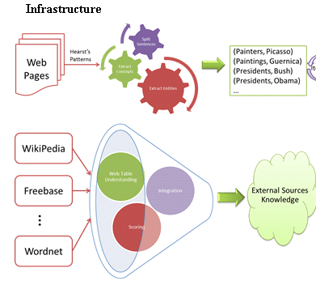

Slide 34
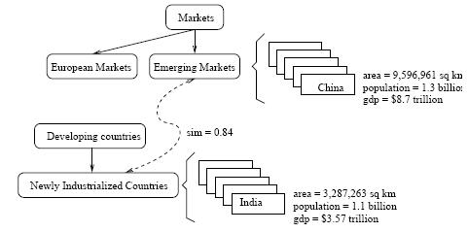
A snippet of Probase's core taxonomy
Notes:
shows what is inside Probase. The knowledgebase consists of concepts (e.g. emerging markets), instances (e.g., China), attributes and values (e.g., China's population is 1.3 billion), and relationships (e.g., emerging markets, as a concept, is closely related to newly industrialized countries), all of which are automatically derived in an unsupervised manner.

Slide 35
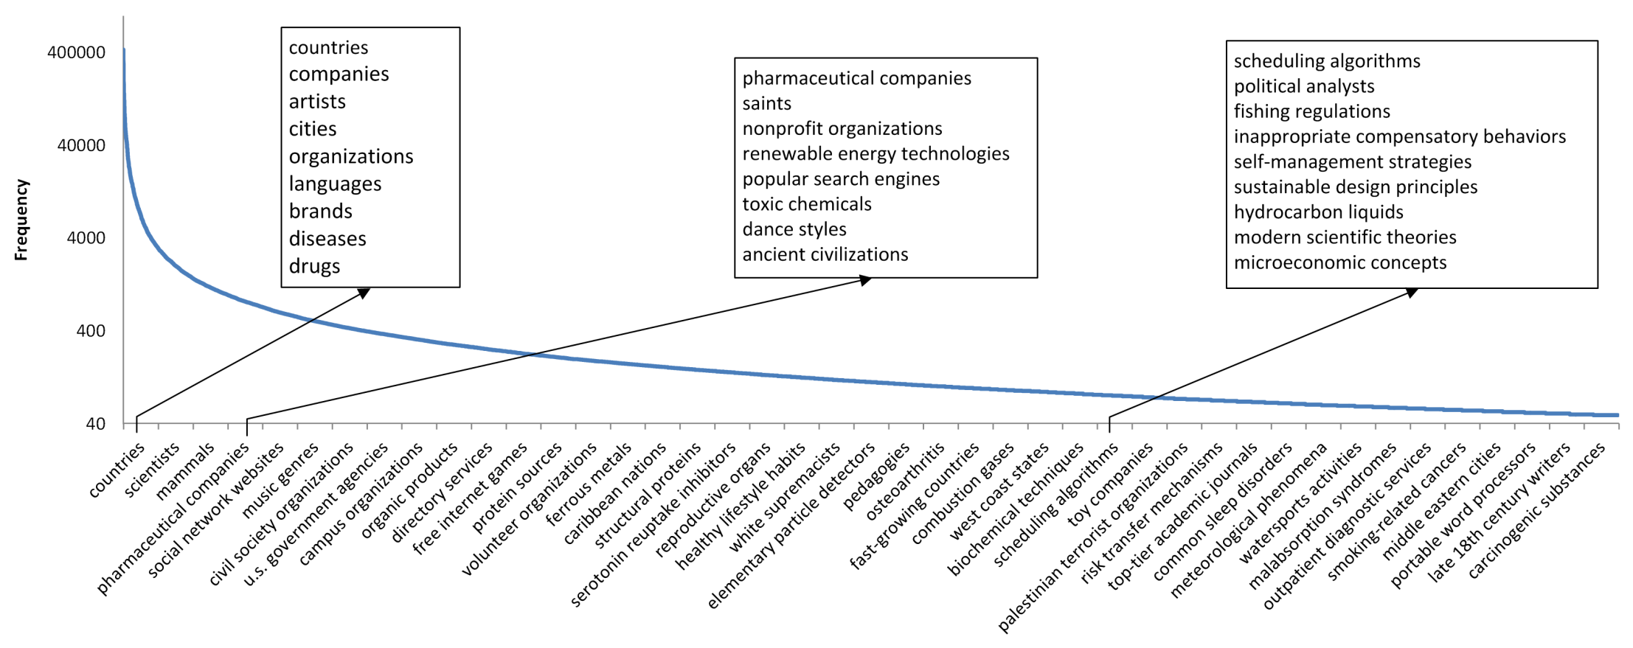
Frequency distribution of the 2.7 million concepts
The Y axis is the number of instances each concept contains(logarithmic scale), and on the X axis are the 2.7 million concepts ordered by their size.
besides popular concepts such as “cities” and “musicians”, which are included by almost every general purpose taxonomy, Probase has millions of long tail concepts such as “anti-parkinson treatments”, "celebrity wedding dress designers” and “basic watercolor techniques”,
Notes:
Figure 2 shows their distribution. The Y axis is the number of instances each concept contains(logarithmic scale), and on the X axis are the 2.7 million concepts ordered by their size. In contrast, existing knowledge bases have far fewer concepts (Freebase [3] contains no more than 2,000 concepts, and Cyc [7] has about 120,000 concepts), which fall short of modeling our mental world. As we can see in Figure 2, besides popular concepts such as “cities” and “musicians”, which are included by almost every general purpose taxonomy, Probase has millions of long tail concepts such as “anti-parkinson treatments”, "celebrity wedding dress designers” and “basic watercolor techniques”, which cannot be found in Freebase or Cyc.

Slide 36
Fast Changing Landscape...
From Probase page......
[Sept. 2016] Please visit our Microsoft Concept Graph release for up-to-date information of this project!

Slide 37
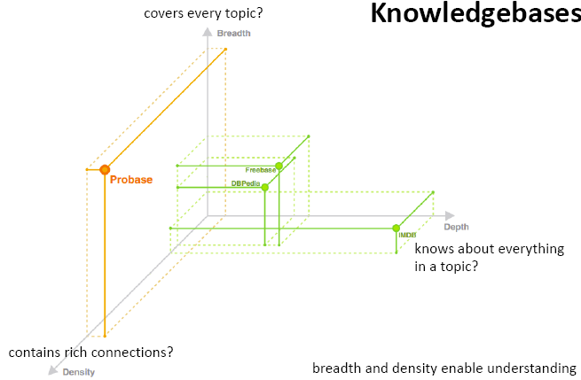
Interesting dimensions to compare Ontologies
(but from Probase so possibly biased)
Notes:
DBpedia is a crowd-sourced community effort to extract structured information from Wikipedia and make this information available on the Web. DBpedia allows you to ask sophisticated queries against Wikipedia, and to link the different data sets on the Web to Wikipedia data. We hope that this work will make it easier for the huge amount of information in Wikipedia to be used in some new interesting ways. Furthermore, it might inspire new mechanisms for navigating, linking, and improving the encyclopedia itself.

Slide 38
Domain Specific Ontologies: UMLS, MeSH
Unified Medical Language System: brings together many health and biomedical vocabularies
Enable interoperability (linking medical terms, drug names)
Develop electronic health records, classification tools
Search engines, data mining
My group has used it in text classification and topic modeling..
Notes:
What is the UMLS?
The UMLS, or Unified Medical Language System, is a set of files and software that brings together many health and biomedical vocabularies and standards to enable interoperability between computer systems.
You can use the UMLS to enhance or develop applications, such as electronic health records, classification tools, dictionaries and language translators.
More About the UMLS
Presentations and Publications
UMLS Reference Manual
UMLS Basics Tutorial
Source Vocabulary Information
UMLS Video Learning Resources
UMLS in Use
One powerful use of the UMLS is linking health information, medical terms, drug names, and billing codes across different computer systems. Some examples of this are:
Linking terms and codes between your doctor, your pharmacy, and your insurance company
Patient care coordination among several departments within a hospital
The UMLS has many other uses, including search engine retrieval, data mining, public health statistics reporting, and terminology research.
More Uses of the UMLS
NLM Applications
UMLS Community
Health Information Technology
Supporting Interoperability
The Three UMLS Tools
The UMLS has three tools, which we call the Knowledge Sources:
Metathesaurus: Terms and codes from many vocabularies, including CPT®, ICD-10-CM, LOINC®, MeSH®, RxNorm, and SNOMED CT®
Semantic Network: Broad categories (semantic types) and their relationships (semantic relations)
SPECIALIST Lexicon and Lexical Tools: Natural language processing tools
We use the Semantic Network and Lexical Tools to produce the Metathesaurus. Metathesaurus production involves:
Processing the terms and codes using the Lexical Tools
Grouping synonymous terms into concepts
Categorizing concepts by semantic types from the Semantic Network
Incorporating relationships and attributes provided by vocabularies
Releasing the data in a common format
Although we integrate these tools for Metathesaurus production, you can access them separately or in any combination according to your needs.

Slide 39
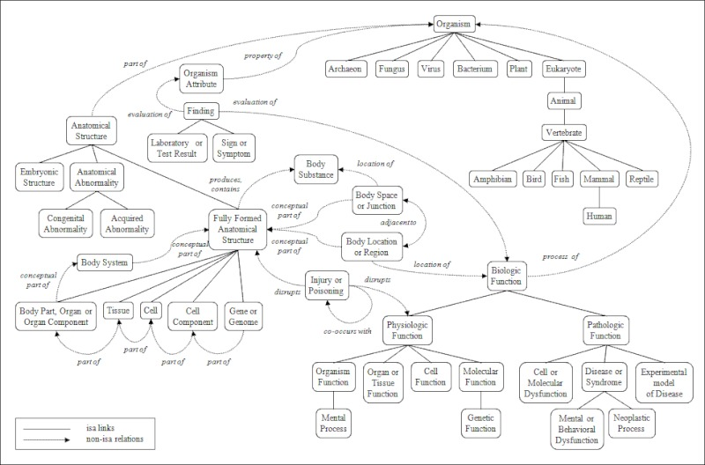
Portion of the UMLS Semantic Net
Notes:
igure 3. A Portion of the UMLS Semantic Network: Relations
The Semantic Network contains 133 semantic types and 54 relationships.

Slide 41

Artificial Intelligence
Volume 296, July 2021, 103471
Using ontologies to enhance human understandability of global post-hoc explanations of black-box models☆
Author links open overlay panelRobertoConfalonieriªTillmanWeyde^{b}Tarek R.Besold^{c}FermínMoscoso del Prado Martín^{d}

Slide 42
Today Oct 21
:
Finish Semantic Analysis
Meaning of words
Relations among words and their meanings (Paradigmatic)
Internal structure of individual words (Syntagmatic)
Notes:
Paradigmatic: the external relational structure among words
Syntagmatic: the internal structure of words that determines how they can be combined with other words

Slide 43
Predicate-Argument Structure
Represent relationships among concepts, events and their participants
“I ate a turkey sandwich for lunch”
∃ w: Isa(w,Eating) ∧ Eater(w,Speaker) ∧ Eaten(w,TurkeySandwich) ∧ MealEaten(w,Lunch)
“Nam does not serve meat”
∃ w: Isa(w,Serving) ∧ Server(w, Nam) ∧ ¬Served(w,Meat)
Notes:
All human languages
a specific relation holds between the concepts expressed by the words or the phrases
Events, actions and relationships can be captured with representations that consist of predicates and arguments.
Languages display a division of labor where some words and constituents function as predicates and some as arguments.
One of the most important roles of the grammar is to help organize this pred-args structure

Slide 44
Semantic/Thematic Roles
  Def. Semantic generalizations over the specific roles that occur with specific verbs.
  I.e. eaters, servers, takers, givers, makers, doers, killers, all have something in common
  We can generalize (or try to) across other roles as well
Notes:
How does language convey meaning?

Slide 45
Thematic Role Examples
fi
fl

Slide 46
Thematic Roles
fi
fi
  Not definitive, not from a single theory!
Notes:
It is controversial whether a finite list of thematic roles exists..

Slide 47
Problem with Thematic Roles
NO agreement on what standard set should be
NO agreement on formal definition
Fragmentation problem: when you try to formally define a role you end up creating more specific sub-roles
Solutions
Generalized semantic roles
Define verb specific semantic roles
Define semantic roles for classes of verbs
Notes:
Instrument
intermediary “opened X with Y” -> “Y opened X”
enabling “ate X with Y” -> ?”Y ate X”?

Slide 48
Generalized Semantic Roles
Very abstract roles are defined heuristically as a set of conditions
The more conditions are satisfied the more likely an argument fulfills that role
Proto-Patient
  Undergoes change of state
  Incremental theme
  Causally affected by another participant
  Stationary relative to movement of another participant
  (does not exist independently of the event, or at all)
Proto-Agent
  Volitional involvement in event or state
  Sentience (and/or perception)
  Causing an event or change of state in another participant
  Movement (relative to position of another participant)
  (exists independently of event named)
Taylor ate the apricot
Notes:
OR Thematic roles should be viewed as prototypes, where there may be different degrees of membership
Sentience refers to utilization of sensory organs, the ability to feel or perceive subjectively
Incremental theme
the apricot is the incremental theme in (3) since the progress of the eating event is reflected
in the amount of apricot remaining: when the apricot is half-eaten the event is half done,
when the apricot is two-thirds eaten, the event is two-thirds done, and so on.
(3) Taylor ate the apricot.

Slide 49
Semantic Roles: Resources
Databases containing for each verb its syntactic and thematic argument structures
PropBank: sentences in the Penn Treebank annotated with semantic roles
Roles are verb-sense specific
Arg0 (PROTO-AGENT), Arg1(PROTO-PATIENT), Arg2,…….
(see also VerbNet)
Notes:
From wikipedia (and imprecise)
PropBank differs from FrameNet, the resource to which it is most frequently compared, in two major ways. The first is that it commits to annotating all verbs in its data. The second is that all arguments to a verb must be syntactic constituents.

Slide 50









PropBank Example
Increase “go up incrementally”
  Arg0: causer of increase
  Arg1: thing increasing
  Arg2: amount increase by
  Arg3: start point
  Arg4: end point
Glosses for human reader. Not formally defined
PropBank semantic role labeling would identify common aspects among these three examples
“ Y performance increased by 3% ”
“ Y performance was increased by the new X technique ”
“ The new X technique increased performance of Y”
Notes:
From wikipedia (and imprecise)
PropBank differs from FrameNet, the resource to which it is most frequently compared, in two major ways. The first is that it commits to annotating all verbs in its data. The second is that all arguments to a verb must be syntactic constituents.
Also
The VerbNet project maps PropBank verb types to their corresponding Levin classes. It is a lexical resource that incorporates both semantic and syntactic information about its contents. The lexicon can be viewed and downloaded from http://verbs.colorado.edu/verb-index
VerbNet is part of the SemLink project in development at the University of Colorado.

Slide 51
Semantic Roles: Resources
Move beyond inferences about single verbs
“ IBM hired John as a CEO ”
“ John is the new IBM hire ”
“ IBM signed John for 2M$”
FrameNet: Databases containing frames and their syntactic and semantic argument structures
(book online Version Revised November 1, 2016)
  for English (versions for other languages are under development)
Notes:
10,000 lexical units (defined below), more than 6,100 of which are fully annotated, in more than 825 hierarchically structured semantic frames, exemplified in more than 135,000 annotated sentences
John was HIRED to clean up the file system.
IBM HIRED Gates as chief janitor.
I was RETAINED at $500 an hour.
The A's SIGNED a new third baseman for $30M.

Slide 52
FrameNet Entry
Hiring
Definition: An Employer hires an Employee, promising the Employee a certain Compensation in exchange for the performance of a job. The job may be described either in terms of a Task or a Position in a Field.
Inherits From: Intentionally affect
Lexical Units: commission.n, commission.v, give job.v, hire.n, hire.v, retain.v, sign.v, take on.v
Notes:
Very specific thematic roles!

Slide 53
FrameNet Annotations
Some roles..
Employer
Employee
Task
Position
np-vpto
  In 1979 , singer Nancy Wilson HIRED him to open her nightclub act .
  ….
np-ppas
  Castro has swallowed his doubts and HIRED Valenzuela as a cook in his small restaurant .
Includes counting: How many times a role was
expressed with a particular syntactic structure…
Notes:
Shallow semantic parsing is labeling phrases of a sentence with semantic roles with respect to a target word.
For example, the sentence
“Shaw Publishing offered Mr. Smith a reimbursement last March.”
Is labeled as:
[AGENTShaw Publishing] offered [RECEPIENTMr. Smith] [THEMEa reimbursement] [TIMElast March] .
We work with a number of collaborators, beginning with Dan Gildea in his dissertation work, on automatic semantic parsing. Much of Dan Gildeas's dissertation work was written up here: Daniel Gildea and Daniel Jurafsky. 2002. Automatic Labeling of Semantic Roles. Computational Linguistics 28:3, 245-288. This work also involves close collaboration with the FrameNet and PropBank projects.
Currently, we focus on building joint probabilistic models for simultaneous assignment of labels to all nodes in a syntactic parse tree. These models are able to capture the strong correlations among decisions at different nodes.
CompensationPeripheral
EmployeeCore
EmployerCore
FieldCore
InstrumentPeripheral
MannerPeripheral
MeansPeripheral
PlacePeripheral
PositionCore
PurposeExtra-Thematic
TaskCore
TimePeripheral

Slide 54
Summary of Lexical Resources ~ 2017 circa
Google Knowledge Graph
Relations among words and their meanings
Freebase
Wordnet
YAGO
Microsoft Concept Graph
Probase
Wikipedia
Internal structure of individual words
PropBank
UMLS - MeSH
VerbNet
FrameNet

Slide 55

BabelNet 5 (2021)
A brand-new interface;
500 languages now covered;
Wikipedia, Wiktionary, Wikidata and GeoNames have been updated thanks to BabelNet live, a continuously-growing resource with daily updates from all the sources that go to make it up;
Better sense inventory thanks to the manual validation of thousands of mappings;
WordNet 2020 integrated;
Improved treatment of Chinese;
4 million new multilingual synsets (from 16 in v4 to 20 million synsets in v5);
1,426 million senses (was 832 million senses in v4, increasing language coverage considerably);
Linkage to BabelPic, VerbAtlas, and many other resources;
Thousands of synsets manually updated with the new domain labels;
Improved domain labels available, including: Education and science, Mathematics and statistics, Navigation and aviation, Geography, geology and places, Culture, anthropology and society, and more.
Notes:
Release of BabelNet 5
Tue Feb 02 2021
To celebrate its tenth anniversary, we are proud to announce the release of a new major version of BabelNet and its API, developed jointly by the Sapienza NLP Group of the Sapienza University of Rome under the supervision of prof. Roberto Navigli and Babelscape, a high-tech multilingual NLP Company providing innovative solutions for multilingual NLP.
BabelNet -- winner of the prominent paper award 2017 from the Artificial Intelligence Journal and the META prize 2015, and covered in media such as The Guardian and Time magazine -- is today’s most far-reaching multilingual resource which, according to need, can be used as an encyclopedic dictionary, or a semantic network or a huge knowledge base/ontology. It has been used by more than 1000 universities and research institutions, enabling multilinguality in several fields of AI and NLP, such as semantic search, Word Sense Disambiguation, Semantic Role Labeling and image tagging.
BabelNet was created by means of the seamless integration and interlinking of the largest multilingual Web encyclopedia - i.e., Wikipedia - with the most popular computational lexicon of English - i.e., WordNet, and other lexical resources such as Wiktionary, OmegaWiki, Wikidata, dozens of wordnets, Wikiquote, GeoNames, and ImageNet. BabelNet provides multilingual synsets, i.e., concepts and named entities lexicalized in many languages, and connected with large amounts of semantic relations.
Version 5.0 comes with the following features:
A brand-new interface;
500 languages now covered;
Wikipedia, Wiktionary, Wikidata and GeoNames have been updated thanks to BabelNet live, a continuously-growing resource with daily updates from all the sources that go to make it up;
Better sense inventory thanks to the manual validation of thousands of mappings;
WordNet 2020 integrated;
Improved treatment of Chinese;
4 million new multilingual synsets (from 16 in v4 to 20 million synsets in v5);
1,426 million senses (was 832 million senses in v4, increasing language coverage considerably);
Linkage to BabelPic, VerbAtlas, and many other resources;
Thousands of synsets manually updated with the new domain labels;
Improved domain labels available, including: Education and science, Mathematics and statistics, Navigation and aviation, Geography, geology and places, Culture, anthropology and society, and more.
More statistics are available at: babelnet.org/statistics.
Kind regards,
The BabelNet group
Release of BabelNet 5
Release of BabelNet 4
BabelNet in The Guardian!
AIJ Prominent Paper Award 2017
BabelNet 3.7 is now out!
BabelNet in TIME magazine!
BabelNet 3.6 is now out!
The Luxembourg BabelNet Workshop!
BabelNet 3.5 is now out!
BabelNet received the prestigious META prize 2015!
Babelfy 1.0 released!
BabelNet API 3.0 final release.
BabelNet 3.0 released!
Please note that, in order to improve yo

Slide 56
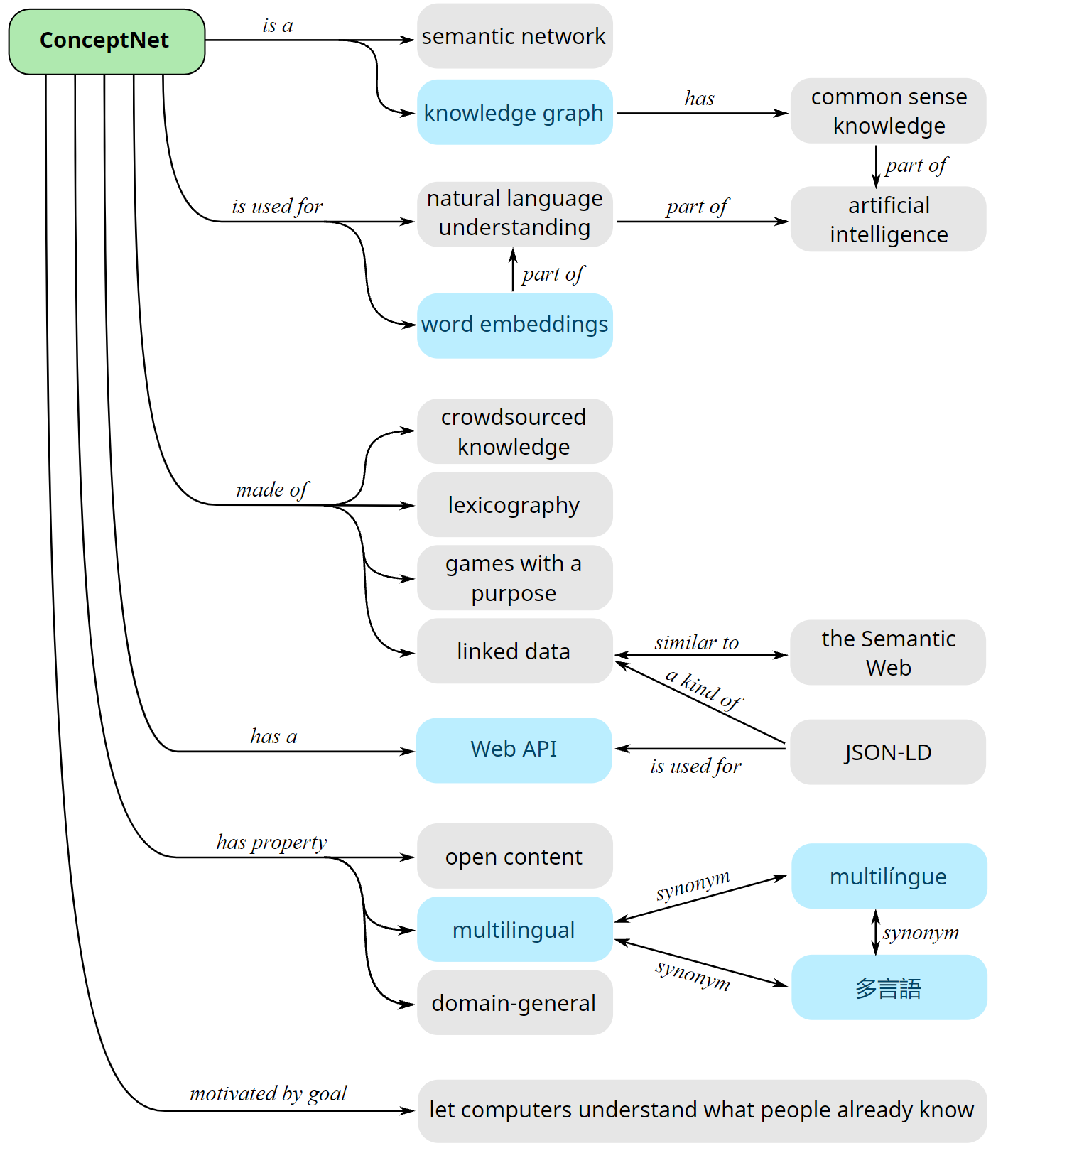
CommonSense Knowledge Graphs
ConceptNet in ConceptNet ;-)
ConceptNet: Robyn Speer, Joshua Chin, and Catherine Havasi.. "ConceptNet 5.5: An Open Multilingual Graph of General Knowledge." In proceedings of AAAI 2017
See Also Atomic
Atomic: An atlas of machine commonsense for if thenreasoning. In AAAI. 2019
Notes:
What is ConceptNet?
ConceptNet is a freely-available semantic network, designed to help computers understand the meanings of words that people use.
ConceptNet originated from the crowdsourcing project Open Mind Common Sense, which was launched in 1999 at the MIT Media Lab. It has since grown to include knowledge from other crowdsourced resources, expert-created resources, and games with a purpose.
Sources of knowledge
Previous versions of ConceptNet were a home-grown crowd-sourced project, where we ran a Web site (Open Mind Common Sense) collecting facts from people who came to the site. The Web of Data is much bigger than that now. Our data comes from many different sources, some of which you can contribute to and improve not just the state of computational knowledge, but of human knowledge.
ConceptNet 5, like previous versions, contains the relational knowledge contributed to Open Mind Common Sense and its sister projects in other languages.
We connect to a subset of DBPedia, which extracts knowledge from the infoboxes on Wikipedia articles.
Much of our knowledge comes from Wiktionary, the free multilingual dictionary. This gives us information about synonyms, antonyms, translations of concepts into hundreds of languages, and multiple labeled word senses for many words.
More dictionary-style knowledge comes from Open Multilingual WordNet.
We imported a high-level ontology from OpenCyc (by Cycorp, formerly hosted at cyc.com).
Some knowledge about people's intuitive word associations comes from "games with a purpose". We have learned facts in English from Verbosity, a word game formerly run by the GWAP project, and in Japanese from the "nadya.jp" game by Nihon Unisys and Dentsu.
If you believe a term should be understood by ConceptNet, the most straightforward way to add it to a future build is to add information about that term to Wiktionary, following their guidelines.
Attributing ConceptNet
To give proper attribution to ConceptNet's data, we suggest this text:
This work includes data from ConceptNet 5, which was compiled by the Commonsense Computing Initiative. ConceptNet 5 is freely available under the Creative Commons Attribution-ShareAlike license (CC BY SA 4.0) from https://conceptnet.io. The included data was created by contributors to Commonsense Computing projects, contributors to Wikimedia projects, Games with a Purpose, Princeton University's WordNet, DBPedia, OpenCyc, and Umbel.A paper you can cite about ConceptNet is:
Robyn Speer, Joshua Chin, and Catherine Havasi. 2017. "ConceptNet 5.5: An Open Multilingual Graph of General Knowledge." In proceedings of AAAI 31.Development
Development of ConceptNet takes place as an open-source project of Luminoso Technologies, Inc. The code that builds and powers ConceptNet is available on GitHub.
ConceptNet originated at the MIT Media Lab, and became part of the Commonsense Computing Initiative, a collaboration between MIT and other labs and companies around the world. This global collaboration helps us collect relational knowledge in many languages. The Commonsense Computing Initiative was founded by Catherine Havasi, now the CEO of Luminoso.
The development of ConceptNet 5 is led by Robyn Speer, a Luminoso co-founder, with contributions from several other people.

Slide 57
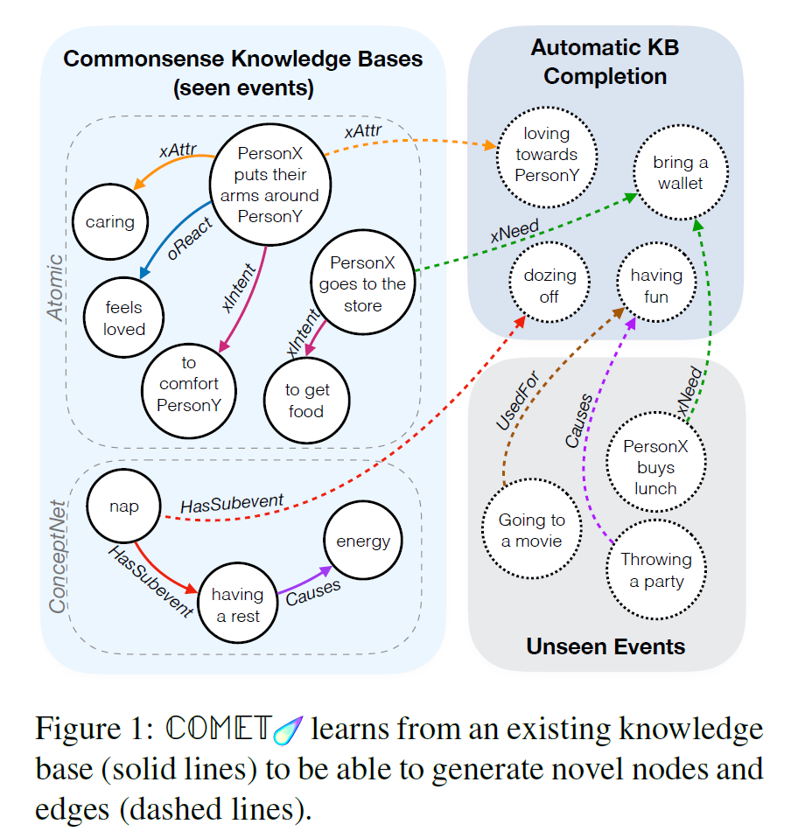

New trend: LM -> CommonSense KB
…….implicit knowledge
from deep pre-trained language models is transferred to generate explicit knowledge in commonsense knowledge graphs
COMET : Commonsense Transformers
for Automatic Knowledge Graph Construction
Antoine Bosselut et al. ACL 2019
New Grad Course: Next Term
532V | 201 2W1 | Topics in Artificial Intelligence: Commonsense Reasoning in Natural Language Processing (NLP COMMONSENSE) Depth Course | MW | 9:00-10:30 | DMP 101 | Vered Shwartz
Notes:
We present the first comprehensive study on automatic knowledge base construction
for two prevalent commonsense knowledge graphs: ATOMIC (Sap et al., 2019) and ConceptNet
(Speer et al., 2017). Contrary to many conventional KBs that store knowledge
with canonical templates, commonsense KBs only store loosely structured open-text descriptions
of knowledge. We posit that an important step toward automatic commonsense
completion is the development of generative models of commonsense knowledge,
and propose COMmonsEnse Transformers (COMET ) that learn to generate rich and
diverse commonsense descriptions in natural language. Despite the challenges of commonsense
modeling, our investigation reveals promising results when implicit knowledge
from deep pre-trained language models is transferred to generate explicit knowledge in
commonsense knowledge graphs. Empirical results demonstrate that COMET is able to
generate novel knowledge that humans rate as high quality, with up to 77.5% (ATOMIC) and
91.7% (ConceptNet) precision at top 1, which approaches human performance for these resources.
Our findings suggest that using generative commonsense models for automatic
commonsense KB completion could soon be a plausible alternative to extractive methods.

Slide 58
Next Time
(Read Chp.6 + Section 19.6 3^{rd)} Ed.
Computational Lexical Semantics
Vector Semantics
Word Similarity
(Maybe) Neural Semantic Role Labeling 20.6.2
Assignment 3: will be posted tomorrow. Parsing, FOL, Ontologies, WSD, Word Similarity
Projects: talk to me at least once before making a final decision on topic and papers

