Slide 1
CPSC 503
Computational Linguistics
Lecture 9
Giuseppe Carenini
Slide Source for Dependency Parsing:
Joakim Nivre, Uppsala Universitet

Slide 2
Constituency vs. Dependency structures
Economic
news had little
effect on financial markets .
p
pred obj pc
nmod
sbj
nmod
nmod
nmod
ROOT Economic
news had little
effect on financial markets .

Slide 3






Big Picture: Syntax & Parsing
Notes:
My Conceptual map - This is the master plan
Markov Models used for part-of-speech and dialog
Syntax is the study of formal relationship between words
How words are clustered into classes (that determine how they group and behave)
How they group with they neighbors into phrases

Slide 4
Key Constituents – with heads
(English)
(Specifier) X (Complement)
Noun Phrases
Verb Phrases
Prepositional Phrases
Adjective Phrases
Sentences
(Det) N (PP)
(Qual) V (NP)
(Deg) P (NP)
(Deg) A (PP)
(NP) V (VP)
(just examples of possible specifiers and complements ! )
Notes:
All group/phrases share the same structure!
Sequence of words surrounding at least one noun
They appear in similar “environments” Before a verb
Substitution for PP location :“there”
Specifiers much more complex in general
There are also Adjuncts: Adjuncts are head modifiers which may be added infinitely. For example, there is no limit on the number of adjectives which may be added to a noun: the big long red gruesome . . . limosine. The same is true of adverbs: Tweeky ran quickly, surreptitiously, . . . and unsuspectingly into Lance's arms.
The adjunct phrase is an X' node which contains an X' node. This allows for infinite recursivity, which distinguishes adjuncts from specifiers and complements.

Slide 5
Today Oct 12
Quick and (not too dirty) approaches to syntax… classification…
  Partial Parsing: Chunking
Heads in Trees
Dependency Grammars / Parsing
Treebank
Final Research Project

Slide 6
Chunking
Classify only basic non-recursive phrases (NP, VP, AP, PP)
  Find non-overlapping chunks
  Assign labels to chunks
Chunk: typically includes headword and pre-head material
[NP The HD box] that [NP you] [VP ordered] [PP from] [NP Shaw] [VP never arrived]
Notes:
(Specifier) head (Complements)

Slide 7
Machine Learning Approach to Chunking
A case of sequential classification
BIO tagging: (B) beginning, (I) internal, (O) outside,
Internal and Beginning for each chunk type => size of tagset (2n + 1) where n is the num of chunk types
Find an annotated corpus
Select feature set
Select and train a classifier
Traditional Approach

Slide 8



Context window approach
Typical features:
  Current / previous / following words
  Current / previous / following POS
  Previous chunks
Notes:
NN noun

Slide 9
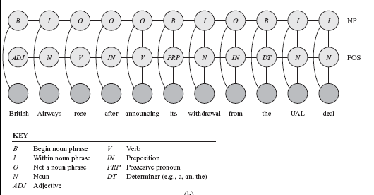
Linear-chain CRFs
Linear-chain CRFs traditional SOTA for sequence labeling (generalization of HMMs)

Slide 10
Coupled linear-chain CRFs
Multi-tasking idea
Linear-chain CRFs can be combined to perform multiple tasks simultaneously
Performs part-of-speech labeling and noun-phrase segmentation

Slide 11
Coupled linear-chain CRFs
Linear-chain CRFs can be combined to perform multiple tasks simultaneously
Performs part-of-speech labeling and noun-phrase segmentation

Slide 12



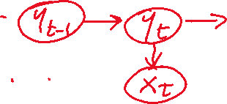



Inference in CRFs (just intuition)
Forward / Backward / Smoothing and Viterbi can be rewritten (not trivial!) using these factors
Then you plug in the factors of the CRFs and all the algorithms work fine with CRFs! ☺

Slide 13
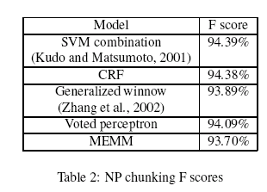
Context window approach and others..
Specific choice of machine learning approach does not seem to matter
F-measure 92-95 range
Common causes of errors:
  POS tagger inaccuracies
  Inconsistencies in training corpus
  Inaccuracies in identifying heads
  Ambiguities involving conjunctions e.g.,
  “Late arrivals and departures are common in winter”
  “Late arrivals and cancellations are common in winter”
NAACL ‘03
Semi-supervised sequential labeling and segmentation using gigaword
scale unlabeled data.
[95.15%]
ACL ‘08
Notes:
The Head is the word in a phrase that is grammatically more important
Jun Suzuki and Hideki Isozaki.. Semi-supervised sequential labeling and segmentation using gigaword
scale unlabeled data. In ACL. 2008
- Shallow parsing using specialized hmms Full text Pdf (239 KB)
Source The Journal of Machine Learning Research archive
Volume 2 , (March 2002) table of contents
SPECIAL ISSUE: Special issue on machine learning approaches to shallow parsing table of contents
Pages: 595 - 613
Year of Publication: 2002
ISSN:1533-7928
Authors Antonio Molina Departament de Sistemes Informàtics i Computació, Universitat Politècnica de València, Camí de Vera s/n, 46020 València (Spain) Ferran Pla Departament de Sistemes Informàtics i Computació, Universitat Politècnica de València, Camí de Vera s/n, 46020 València (Spain)
Publisher MIT Press Cambridge, MA, USA

Slide 14
Neural Approaches (Goldberg book sec. 20.2)

Slide 15
Neural Approaches (Goldberg 20.2)
Multi-tasking ideas
Main vs auxillary task:
Scale the loss
Notes:
20.2.1 TRAINING IN A MULTI-TASK SETUP
e computation graph abstraction makes it very easy to construct such networks and compute
the gradients for them, by computing a separate loss for each available supervision signals, and
then summing the losses into a single loss that is used for computing the gradients. In case we
have several corpora, each with different kind of supervision signal (e.g., we have one corpus for
POS and another for chunking), the preferred training protocol would be to choose a corpus
at random, pass the example through the relevant part of the computation graph, compute the
loss, backpropagate the error, and update the parameters. en, on the next step, again choose a
corpus at random and so on. In practice, this is often achieved by shuffling all the available training
examples and going through them in order. e important part is that we potentially compute
the gradients with respect to a different loss (and using a different sub-network) for each training
example.

Slide 16
Neural Approaches (Goldberg 20.2)
Multi-tasking ideas
Low vs. High level tasks
This approach F-measure . [95.56%]
Semi-supervised sequential labeling and segmentation using gigaword
scale unlabeled data. [95.15%]
Notes:
20.2.1 TRAINING IN A MULTI-TASK SETUP
The computation graph abstraction makes it very easy to construct such networks and compute
the gradients for them, by computing a separate loss for each available supervision signals, and
then summing the losses into a single loss that is used for computing the gradients. In case we
have several corpora, each with different kind of supervision signal (e.g., we have one corpus for
POS and another for chunking), the preferred training protocol would be to choose a corpus
at random, pass the example through the relevant part of the computation graph, compute the
loss, backpropagate the error, and update the parameters. Then, on the next step, again choose a
corpus at random and so on. In practice, this is often achieved by shuffling all the available training
examples and going through them in order. The important part is that we potentially compute
the gradients with respect to a different loss (and using a different sub-network) for each training
example.

Slide 17
Today Oct 12
Quick and (not too dirty) approaches to syntax… classification…
  Partial Parsing: Chunking
Heads in Trees
Dependency Grammars / Parsing
Treebank
Final Research Project

Slide 18
Heads in Constituency Parse Trees
Finding heads in constituency parse trees is a task that arises frequently in many applications.
  Particularly important in statistical parsing
We can visualize this task by annotating the nodes of a parse tree with the heads of each corresponding node.

Slide 19
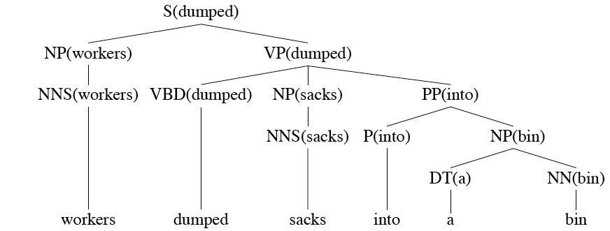














Lexically Decorated Tree

Slide 20
Head Finding in Constituency Parses
The standard way to do head specification/finding is to use a simple set of tree traversal rules specific to each non-terminal in the grammar.

Slide 21
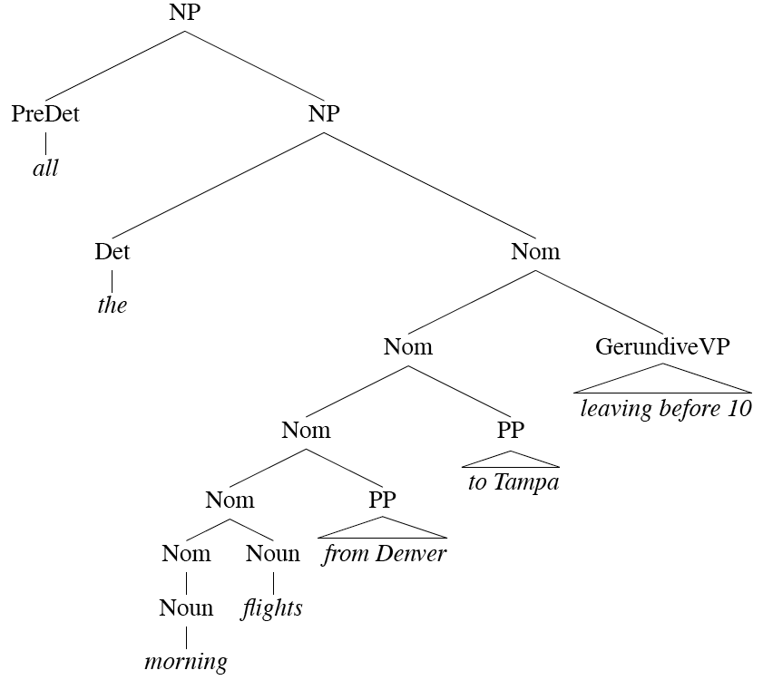
(head percolation rules) e.g., Noun Phrases
Notes:
For each phrase type Simple set of hand-written rules to find the head of such a phrase.
This rules are often called head percolation

Slide 22
Noun Phrases
Notes:
For each phrase type Simple set of hand-written rules to find the head of such a phrase.
This rules are often called head percolation

Slide 23
(head percolation rules) e.g., Noun Phrases
Notes:
For each phrase type Simple set of hand-written rules to find the head of such a phrase.
This rules are often called head percolation

Slide 24
Today Oct 12
Quick and (not too dirty) approaches to syntax… classification…
  Partial Parsing: Chunking
Heads in Trees
Dependency Grammars / Parsing
Treebank
Final Research Project

Slide 25
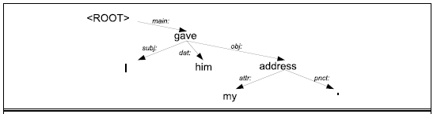
Dependency Grammars
Syntactic structure: binary relations between words
Links:grammatical function or very general semantic relation
Directed labeled arcs from heads to dependents (good approx. of semantic relations)
Abstract away from word-order variations (simpler grammars and deal with languages with relatively free word order)

Slide 26
Dependency Parsing
Parsing can be framed as classification !
Output can play a role in many NLP applications (for text classification, summarization and NLG)
Error analysis / Interpretability of neural systems….

Slide 27
Dependency Grammars
(more verbose)
In CFG-style phrase-structure grammars the main focus is on constituents.
But it turns out you can get a lot done with just binary relations among the words in an utterance.
In a dependency grammar framework, a parse is a tree where
  the nodes stand for the words in an utterance
  The links between the words represent dependency relations between pairs of words.
    Relations may be typed (labeled), or not.

Slide 28
Introduction
Introduction
◮
Syntactic parsing of natural language:
◮
Who does what to whom?
◮
Dependency-based syntactic representations
◮
◮
have a natural way of representing discontinuous constructions,
give a transparent encoding of predicate-argument structure (Semantics),
can be parsed using (simple) data-driven models,
can be parsed efficiently.
◮
◮
p
pred _{adv}
nmod
pc
det
sbj
vg
det
ROOT A hearing is scheduled
on the issue today .
Sorting Out Dependency Parsing
2(38)

Slide 29
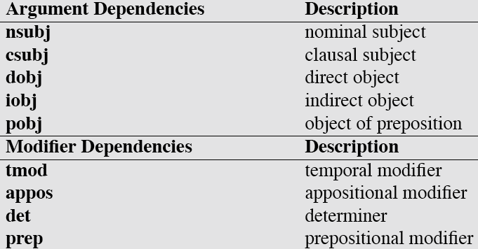
Some Dependency Relations
E.g., Clausal subject:
That he had even asked her made her angry.
See https://universaldependencies.org/
Def. To find an indirect object, ask “to whom/what?” or “for whom/what” the direct object is intended.
Notes:
Clausal subject:
That he had even asked her made her angry. The clause "that he had even asked her" is the subject of this sentence.

Slide 30
Some Dependency Relations (examples)
Notes:
Clausal subject:
That he had even asked her made her angry. The clause "that he had even asked her" is the subject of this sentence.

Slide 31
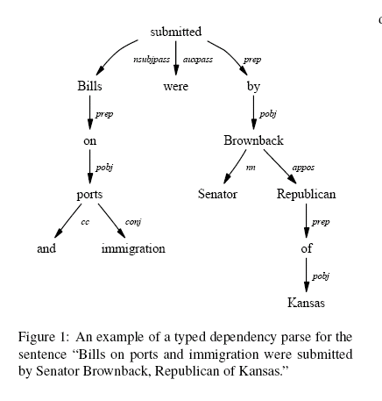
Dependency Parse (ex 1)

Slide 32
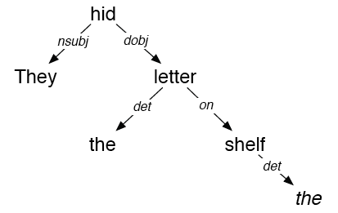
Dependency Parse (ex 2) possibly confusing notation
They hid the letter on the shelf

Slide 33
Dependency Parsing
(see MINIPAR / Stanford demos and more….)
Dependency approach vs. CFG parsing.
  Deals well with free word order languages where the constituent structure is quite fluid
  Parsing is much faster than CFG-based parsers (MaltParser, 2008. Linear time!)
  Dependency structure often captures all the syntactic relations actually needed by later applications
Notes:
The dependency approach has a number of advantages over full phrase-structure parsing.
Deals well with free word order languages where the constituent structure is quite fluid
Parsing is much faster than CFG-bases parsers
Dependency structure often captures the syntactic relations needed by later applications
CFG-based approaches often extract this same information from trees anyway.

Slide 34
Dependency Parsing
There are two modern approaches to dependency parsing (supervised learning from Treebank data)
  Graph / Optimization-based approach: Find Minimum spanning tree that best matches some criteria [McDonald, 2005]
  Greedy Transition-based approach: define and learn a transition system for mapping a sentence to its dependency graph (MaltParser – Java – pointer course webpage)
Notes:
Data-Driven Dependency Parsing
◮ Dependency parsing based on (only) supervised learning from
treebank data (annotated sentences)
◮ Graph-based [Eisner 1996, McDonald et al. 2005a]
◮ Define a space of candidate dependency graphs for a sentence
◮ Learning: Induce a model for scoring an entire dependency
graph for a sentence
◮ Inference: Find the highest-scoring dependency graph, given
the induced model
◮ Transition-based [Yamada and Matsumoto 2003, Nivre et al. 2004]:
◮ Define a transition system (state machine) for mapping a
sentence to its dependency graph
◮ Learning: Induce a model for predicting the next state
transition, given the transition history
◮ Inference: Construct the optimal transition sequence, given the
induced model

Slide 35
Transition-Based Dependency Parsing
Transition-Based
Dependency
Parsing
Sorting Out Dependency Parsing
10(38)

Slide 36

Transition-Based Dependency Parsing
Overview of the Approach
◮
The basic idea:
◮
Define a transition system for dependency parsing
Train a classifier for predicting the next transition
Use the classifier to do parsing as greedy, deterministic search
◮
◮
◮
Advantages:
◮
Efficient parsing (linear time complexity)
Robust disambiguation (discriminative classifiers)
◮
Sorting Out Dependency Parsing
11(38)

Slide 37
Transition-Based Dependency Parsing
Transition System: Configurations
◮
A parser configuration is a triple c = (S , Q , A), where
◮
S = a stack [. . . , wi ]S of partially processed words,
Q = a queue [wj , . . .]Q of remaining input words,
A = a set of arcs (wi , wj , l ).
◮
◮
◮
Initialization:
([w₀ ]_{S} , [w₁ , . . . , w_{n} ]_{Q} , { })
Termination:
([w₀ ]_{S} , [ ]_{Q} , A)
NB: w0 = ROOT
◮
Sorting Out Dependency Parsing
12(38)

Slide 38
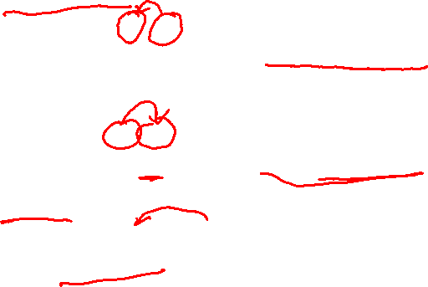
Transition-Based Dependency Parsing
Transition System: Transitions
Assert head dependent relation between word at the top of the stack and word directly beneath it; remove lower word
◮
Left-Arc(l )
([. . . , w_{i} , w_{j} ]_{S}
([. . . , wj ]S ,
Q ,
Q ,
A)
A ∪ {(wj , wi , l )})
[i = 0]
◮
Right-Arc(l )
([. . . , w_{i} , w_{j} ]_{S}
([. . . , w_{i} ]_{S} ,
Assert head dependent relation between second word of the stack and word on top; remove top word
Q ,
Q ,
A)
A ∪ {(wi , wj , l )})
◮
Shift
([. . .]S , [wi , . . .]Q , A)
([. . . , w_{i} ]_{S} , [. . .]_{Q} , A)
NOTE: Very flexible and general technique: other transitions can be specified and added (like reduce); also used in discourse parsing!
Sorting Out Dependency Parsing
13(38)

Slide 39










Transition-Based Dependency Parsing
Deterministic Dep. Parsing (slightly simplified)
◮
Given an oracle o that correctly predicts the next transition
o(c ), parsing is deterministic:
Parse(w₁, . . . , w_{n} )
Process ends when the Queue is empty and the ROOT node is the only element remaining on the Stack.
1
2
3
4
5
c ← ([w0 ]S , [w1 , . . . , wn ]Q , { })
while not ([.. ] Q and [w0 ] S )
t =o(c )
c = t (c )
return G = ({w₀ , w₁ , . . . , w_{n} }, A_{c} )
NB: w0 = ROOT
Sorting Out Dependency Parsing
14(38)
Notes:
The process ends when all the words in the sentence have been consumed and the ROOT node is the only element remaining on the stack.

Slide 40
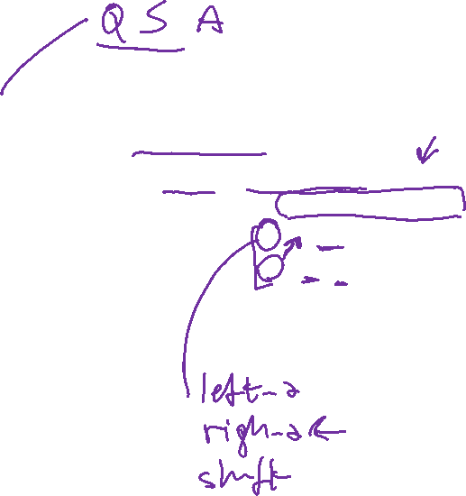
Transition-Based Dependency Parsing
Deterministic Dep. Parsing (slightly simplified)
◮
Given an oracle o that correctly predicts the next transition
o(c ), parsing is deterministic:
Parse(w₁, . . . , w_{n} )
Process ends when the Queue is empty and the ROOT node is the only element remaining on the Stack.
1
2
3
4
5
c ← ([w0 ]S , [w1 , . . . , wn ]Q , { })
while not ([.. ] Q and [w0 ] S )
t =o(c )
c = t (c )
return G = ({w₀ , w₁ , . . . , w_{n} }, A_{c} )
NB: w0 = ROOT
Sorting Out Dependency Parsing
14(38)
Notes:
The process ends when all the words in the sentence have been consumed and the ROOT node is the only element remaining on the stack.

Slide 41
Transition-Based Dependency Parsing
Deterministic Parsing
◮
Given an oracle o that correctly predicts the next transition
o(c ), parsing is deterministic:
Parse(w₁, . . . , w_{n} )
1
2
3
4
5
6
7
8
c ← ([w0 ]S , [w1 , . . . , wn ]Q , { })
while Q_{c} is not empty
c ← Shift(c )
t ← o(c )
while t ∈ {Left-Arc(l ), Right-Arc(l )}
c = t (c )
t = o(c )
return G = ({w₀ , w₁ , . . . , w_{n} }, A_{c} )
Sorting Out Dependency Parsing
14(38)

Slide 42
Transition-Based Dependency Parsing
Example
o(c ) = Shift
[ROOT ]S
[Economic
news
had
little
effect
on
financial
markets
. ]Q
ROOT Economic news had little effect on financial
markets
.
Sorting Out Dependency Parsing
15(38)

Slide 43
Transition-Based Dependency Parsing
Example
o(c ) = Shift
[ROOT
Economic ]S
[news
had
little
effect
on
financial
markets
. ]Q
ROOT
Economic news had little effect on financial
markets
.
Sorting Out Dependency Parsing
15(38)

Slide 44

Transition-Based Dependency Parsing
Example
o(c ) = Left-Arcnmod
[ROOT
Economic
news ]S
[had
little
effect
on
financial
markets
. ]Q
ROOT
Economic
news had little effect on financial
markets
.
Sorting Out Dependency Parsing
15(38)

Slide 45

Transition-Based Dependency Parsing
Example
o(c ) = Shift
[ROOT
news ]S
[had
little
effect
on
financial
markets
. ]Q
nmod
ROOT
Economic news
had little effect on
financial markets
.
Sorting Out Dependency Parsing
15(38)

Slide 46

Transition-Based Dependency Parsing
Example
o(c ) = Left-Arcsbj
[ROOT
news
had ]S
[little
effect
on
financial
markets
. ]Q
nmod
ROOT
Economic news
had little effect on
financial markets
.
Sorting Out Dependency Parsing
15(38)

Slide 47
Transition-Based Dependency Parsing
Example
o(c ) = Shift
[ROOT
had ]S
[little
effect
on
financial
markets
. ]Q
nmod
sbj
ROOT
Economic news had little effect on financial
markets .
Sorting Out Dependency Parsing
15(38)

Slide 48
Transition-Based Dependency Parsing
Example
o(c ) = Shift
[ROOT
had
little ]S
[effect
on
financial
markets
. ]Q
nmod
sbj
ROOT
Economic news had little effect on financial
markets .
Sorting Out Dependency Parsing
15(38)

Slide 49
Transition-Based Dependency Parsing
Example
o(c ) = Left-Arcnmod
[ROOT
had
little effect ]S
[on
financial
markets
. ]Q
nmod
sbj
ROOT
Economic news had little effect on financial
markets .
Sorting Out Dependency Parsing
15(38)

Slide 50
Transition-Based Dependency Parsing
Example
o(c ) = Shift
[ROOT
had
effect ]S
[on
financial markets
. ]Q
nmod
sbj
nmod
ROOT
Economic news had little effect
on financial markets .
Sorting Out Dependency Parsing
15(38)

Slide 51
Transition-Based Dependency Parsing
Example
o(c ) = Shift
[ROOT
had
effect on ]S [financial markets
. ]Q
nmod
sbj
nmod
ROOT
Economic news had
little effect
on financial markets .
Sorting Out Dependency Parsing
15(38)

Slide 52
Transition-Based Dependency Parsing
Example
o(c ) = Shift
[ROOT
had
effect on financial ]S [markets
. ]Q
nmod
sbj
nmod
ROOT
Economic news had
little effect
on financial markets .
Sorting Out Dependency Parsing
15(38)

Slide 53
Transition-Based Dependency Parsing
Example
o(c ) = Left-Arcnmod
[ROOT
had
effect on financial
markets ]S
[. ]Q
nmod
sbj
nmod
ROOT
Economic news had little effect
on financial markets .
Sorting Out Dependency Parsing
15(38)

Slide 54
Transition-Based Dependency Parsing
Example
o(c ) = Right-Arcpc
[ROOT
had
effect
on markets ]S [. ]Q
nmod
sbj
nmod
nmod
ROOT
Economic news had
little effect
on financial markets
.
Sorting Out Dependency Parsing
15(38)

Slide 55
Transition-Based Dependency Parsing
Example
o(c ) = Right-Arcnmod
[ROOT
had
effect on ]S
[. ]Q
pc
nmod
sbj
nmod
nmod
ROOT
Economic news had
little effect
on financial
markets .
Sorting Out Dependency Parsing
15(38)

Slide 56
Transition-Based Dependency Parsing
Example
o(c ) = Right-Arcobj
[ROOT
had
effect ]S
[. ]Q
pc
nmod
sbj
nmod nmod
nmod
ROOT
Economic news had
little effect on
financial
markets .
Sorting Out Dependency Parsing
15(38)

Slide 57
Transition-Based Dependency Parsing
Example
o(c ) = Right-Arcpred
[ROOT
had ]S [. ]Q
obj
pc
nmod
sbj
nmod
nmod
nmod
ROOT
Economic news had little
effect on
financial
markets .
Sorting Out Dependency Parsing
15(38)

Slide 58
Transition-Based Dependency Parsing
Example
o(c ) = Shift
[ROOT ]S
[. ]Q
pred
obj
pc
nmod ^{sbj}
nmod
nmod
nmod
ROOT Economic
news had little
effect on
financial
markets .
Sorting Out Dependency Parsing
15(38)

Slide 59
Transition-Based Dependency Parsing
Example
o(c ) = Right-Arcp
[ROOT
. ]S
[ ]Q
pred
obj
pc
nmod ^{sbj}
nmod
nmod
nmod
ROOT
Economic
news had little
effect on
financial
markets .
Sorting Out Dependency Parsing
15(38)

Slide 60
Transition-Based Dependency Parsing
Example
[ROOT ]S
[ ]Q
p
pred obj pc
nmod ^{sbj} nmod nmod nmod
ROOT Economic
news had little
effect on financial markets .
Sorting Out Dependency Parsing
15(38)

Slide 61

Transition-Based Dependency Parsing
Algorithm Analysis
◮
Given an input sentence of length n, the parser terminates
after exactly 2n transitions (each word is shifted and linked).
The algorithm has some very nice properties
◮
◮
robustness (at least one analysis),
disambiguation (at most one analysis), efficiency (linear time).
◮
◮
◮
Accuracy depends on how well we can approximate the oracle using machine learning.
Sorting Out Dependency Parsing
16(38)

Slide 62
Transition-Based Dependency Parsing
Oracles as Classifiers
◮
Learning problem in transition-based dependency parsing:
◮
Approximate oracle o (c ) by classifier g (c )
◮
History-based feature models:
◮
◮
Parse history c = (S , Q , A) represented by feature vector x(c )
Individual features x_{i} (c ) defined by properties of words in c , for example:
◮
◮
◮
◮
Lexical properties (FORM or LEMMA)
Part-of-speech tags (POSTAG) Morphosyntactic features (FEATS)
Labels in the partially built dependency graph (DEPREL)
Sorting Out Dependency Parsing
18(38)

Slide 63
Transition-Based Dependency Parsing
A
Typical
Feature
Model
j
k
[. . .
wi
w
w
]S
[wm
wm+1 wm+2
. . . ]Q
lj
rj
lk
rk
FORM
LEMMA
POSTAG
FEATS
DEPREL
+
+
+
+
+
+
+
+
+
+
+
+
+
+
+
+
+
Sorting Out Dependency Parsing
19(38)

Slide 64
Transition-Based Dependency Parsing
Training Data
◮
Training instances have the form (x(c ), t ), where
1. x(c ) is a feature vector representation of a configuration c ,
2. t is the correct transition out of c (i.e., o (c ) = t ).
Given a dependency treebank, we can sample the oracle function o as follows:
◮
◮
For each sentence we reconstruct the transition sequence
C_{0,m} = (c₀ , c₁ , . . . , c_{m} ) for the gold standard dependency tree.
For each configuration c_{i} (i < m), we construct a training
instance (x(c_{i} ), t_{i} ), where t_{i} (c_{i} ) = c_{i +1}.
◮
Sorting Out Dependency Parsing
20(38)

Slide 65
Transition-Based Dependency Parsing
Learning Algorithms
Discriminative models for classification:
◮
◮
Support vector machines (SVM) [Kudo and Matsumoto 2002,
Yamada and Matsumoto 2003, Nivre et al. 2006]
Memory-based learning [Nivre et al. 2004, Attardi 2006] Maximum entropy [Cheng et al. 2005, Attardi 2006] Perceptron learning [Ciaramita and Attardi 2007]
◮
◮
◮
◮
State-of-the-art performance:
◮
Deterministic transition-based parsing with SVM classifiers
CoNLL Shared Task 2006 and 2007
[Buchholz and Marsi 2006, Nivre et al. 2007]
◮
Sorting Out Dependency Parsing
21(38)

Slide 66
Transition-Based Dependency Parsing
Summing Up
◮
The approach so far:
◮
Transition systems for constructing dependency graphs
Deterministic linear-time parsing with oracle
Oracles approximated by classifiers trained on treebank data
◮
◮
◮
However:
◮
Limited to projective dependency graphs
What to do with discontinuous constructions?
◮
Sorting Out Dependency Parsing
22(38)

Slide 67
Today Oct 12
Quick and (not too dirty) approaches to syntax… classification…
  Partial Parsing: Chunking
Heads in Trees
Dependency Grammars / Parsing
Treebank
Final Research Project

Slide 68
Treebanks
DEF. corpora in which each sentence has been paired with a parse tree
These are generally created
  Parse collection with parser
  human annotators revise each parse
Requires detailed annotation guidelines
  POS tagset
  instructions for how to deal with particular grammatical constructions.
Notes:
Treebanks are corpora in which each sentence has been paired with a parse tree (presumably the right one).
These are generally created
By first parsing the collection with an automatic parser
And then having human annotators correct each parse as necessary.
This generally requires detailed annotation guidelines that provide a POS tagset, a grammar and instructions for how to deal with particular grammatical constructions.

Slide 69
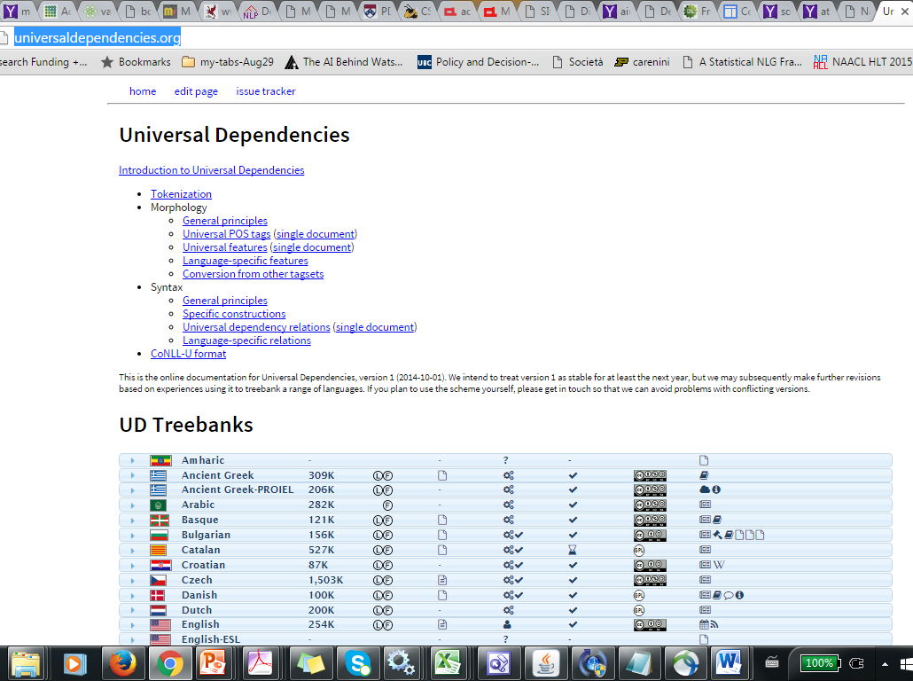
(Dependency) Treebanks
http://universaldependencies.org/

Slide 70
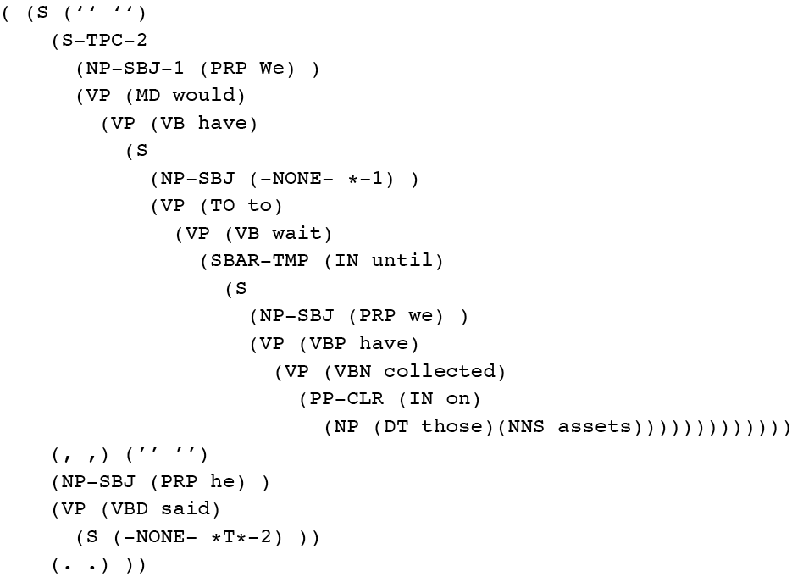

Penn Treebank (Constituency)
Penn TreeBank is a widely used treebank.
  Most well known is the Wall Street Journal section of the Penn TreeBank.
    1 M words from the 1987-1989 Wall Street Journal.
Notes:
Penn Treebank phrases annotated with grammatical function
To make recovery of predicate argument easier

Slide 71
(Constituency) Treebank Grammars
Treebanks implicitly define a grammar.
Simply take the local rules that make up the sub-trees in all the trees in the collection
if decent size corpus, you’ll have a grammar with decent coverage.
Notes:
Treebanks implicitly define a grammar for the language covered in the treebank.
Simply take the local rules that make up the sub-trees in all the trees in the collection and you have a grammar.
Not complete, but if you have decent size corpus, you’ll have a grammar with decent coverage.

Slide 72


(Constituency) Treebank Grammars
Such grammars tend to be very flat due to the fact that they tend to avoid recursion.
  To ease the annotators burden
For example, the Penn Treebank has 4500 different rules for VPs! Among them...
Notes:
Total of 17,500 rules

Slide 73

(Constituency) Treebank Uses
Searching a Treebank. TGrep2
NP < PP or NP << PP
Treebanks (and headfinding) are particularly critical to the development of statistical parsers
  Chapter 12 (3rd Ed.)
Also valuable to Corpus Linguistics
  Investigating the empirical details of various constructions in a given language
NPs immediately dominating a PP
NPs dominating a PP
Notes:
NP immediately dominating a PP
NP dominating a PP

Slide 74
Today Oct 12
Quick and (not too dirty) approaches to syntax… classification…
  Partial Parsing: Chunking
Heads in Trees
Dependency Grammars / Parsing
Treebank
Final Research Project

Slide 75

Final Research Project: Decision
(Group of 2 people is OK)
Select an NLP task / problem or a technique used in NLP that truly interests you
Tasks: summarization of …… , computing similarity between two terms/sentences… topic modeling, opinion mining …(skim through the textbook, final chapters)
Techniques: extensions / variations / combinations of what we discuss in class – Language Models (n-grams or neural), Sequence labelers (e.g., CRFs, RNNs, Transformers), Parsers (e.g., PCFG, Dependency Parsing)…

Slide 76

Final Research Project: possible goals (and hopefully contributions ☺)
Apply a technique which has been used for NLP taskA to a (minimally is OK!) different NLP taskB
Apply a technique to a different dataset or to a different language
Proposing/applying a different evaluation measure
Improve on a proposed solution by using a possibly more effective technique or by combining multiple techniques
Proposing a novel (minimally is OK!) different solution.

Slide 77
Final Research Oriented Project
Make “very small” contribution to open NLP problem
  Identify and Read several papers about it
  Either (try to) improve on the proposed solution (e.g., using more effective technique)
  Or propose new solution
  Or perform a more informative evaluation / error analysis
Write report motivating project discussing results
Present results to class
These can be done in groups (max 2?). Can be combined with project in another course (taught this term) with permission of both profs
Sample of previous projects on course Webpage
Read ahead in the textbook to get a feel for various areas of NLP
Notes:
This will be a research-oriented project.
Critical review of a research project: read 2-3 papers, try to improve on the solution proposed using a more
effective technique, combining multiple techniques. Propose a different solution.
I’ll prepare a list of possible topics / papers.

Slide 78
Sample Projects from previous years that led to publications ☺
…Often with substantial work after course (some MSc thesis)
Tanzila Rahman, An Improve Attention based Architecture for Visual Question Answering 4th Multimodal Learning and Applications (MULA) Workshop 2021 503-2020
Neural RST-based Evaluation of Discourse Coherence Grigorii Guz Peyman Bateni Darius Muglich (AACL-2020 short) 503-2019
Comparing the Intrinsic Performance of Clinical Concept Embeddings by their Field of Medicine, John-Jose Nunez Led to paper in workshop LOUHI@EMNLP 503-2019
Sentiment Analysis with D-Neural Networks. (Bita Najat) Led to paper in the SIGDIAL 2017 conference
Improving discourse parsing by using data generated by another parser. Led to paper in the COLING 2016 conference.
Extractive Summarization and Dialogue Act Modeling on Email Threads: ... (Tatsuro Oya) in 15th Annual SIGdial Meeting on Discourse and Dialogue. 2014.
Evaluating machine learning algorithms for email thread summarization (J. Ulrich) in the 3rd Int'l AAAI Conference on Weblogs and Social Media, San Jose, CA, 2009
Summarization of Evaluative Text: the role of controversiality (J. Cheung) in the Int. Conf. on Natural Language Generation. (INLG 2008), Salt Fork, Ohio, USA, June 12-14, 2008
…Many more samples at the course webpage….
Notes:
Useful Tasks - Applications
Mix of research and deployed techniques/tasks
Extract meaning from fluent speech via automatic acquisition and exploitation of salient words,
phrases and grammar fragment from a corpus
Speech, language and dialog techniques… Evaluated on live customer
Another generation: generate weather reports in multiple languages

Slide 79
(from lecture 1) Final Pedagogical Project
Make “small” contribution to NLP education
  Select an advanced topic that was not covered in class (or was only covered partially/superficially)
  Read/Review several educational materials about it (e.g., textbook chp., tutorials, wikipedia, MOOCs ….)
  Select material for the target students
  Summarize material and prepare a lecture about your topic. Specify Learning Goals.
  Develop an assignment to test the learning goals and work out the solution.
These can be done in groups (max 2?)
List of possible topics (next slide)
Notes:
This will be a research-oriented project.
Critical review of a research project: read 2-3 papers, try to improve on the solution proposed using a more
effective technique, combining multiple techniques. Propose a different solution.
I’ll prepare a list of possible topics / papers.

Slide 80
Pedagogical: list of possible topics
Neural language models (BERT BART GPT etc.)
Neural Sequence labeler (LSTM, GRU, Transformers)
Encode Decoder Architectures (conditioned generation)
Combinatory Categorical Grammar (CCG)
Non-projective Dependency Parsing
Neural Dependency Parsing
LDA for topic modeling
Semantic Parsing…. And many others….

Slide 81
Combine with project in other grad courses?
E.g., InfoVis course…… text analytics
…… other AI grad courses….
Talk to me and prof of other course first

Slide 82

Final Project: what to do + Examples / Ideas
Look at these slides and on the course WebPage
Talk to me at least one before you seriously pursue a specific topic. Book time in office hours…..send me email if my office hour time does not work for you
Proposal due Nov 9

Slide 83

503 Grading: Final Project
~15 Lectures (participation 10%)
3-4 assignments (10% - self assessed)
1 Student Presentations on selected readings (15%)
Readings: Critical summary and Questions(15%)
Project (50%)
  Proposal: 1-2 pages write-up & Presentation (5%)
  Update Presentation (5%)
  Final Presentation and (10%)
  8-10 pages report (30%)
Notes:
The instructor reserves the right to adjust this grading scheme during the term, if necessary
?Assignments hands-on experience with algorithms?

Slide 84
Next class on Thur
Probabilistic CFG
Probabilistic Parsing
Probabilistic Lexicalized CFGs
Assignment-2 due Oct 15

Slide 85
Approaches to Chunking (1): Finite-State Rule-Based (skip)
Set of hand-crafted rules (no recursion!) e.g., NP -> (Det) Noun* Noun
Implemented as FSTs (unionized/determinized/minimized)
F-measure 85-92
To build tree-like structures several FSTs can be combined [Abney ’96]
Notes:
Show NLTK demo

Slide 86
Approaches to Chunking (1): Finite-State Rule-Based (skip)
… several FSTs can be combined
Notes:
What about ambiguity?

