Slide 1

CPSC 503
Computational Linguistics
Lecture 7
Giuseppe Carenini
Source: Jurafsky & Martin 3rd Edition Chp 9 + Y. Goldberg NN methods for NLP

Slide 2
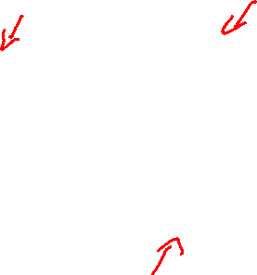
Today Oct 5
Markov Models: N-grams, HMM,…

Slide 3

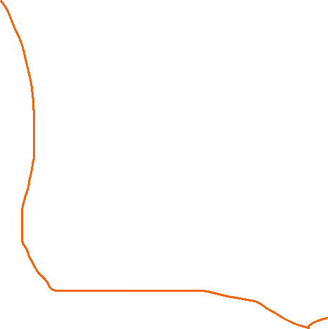



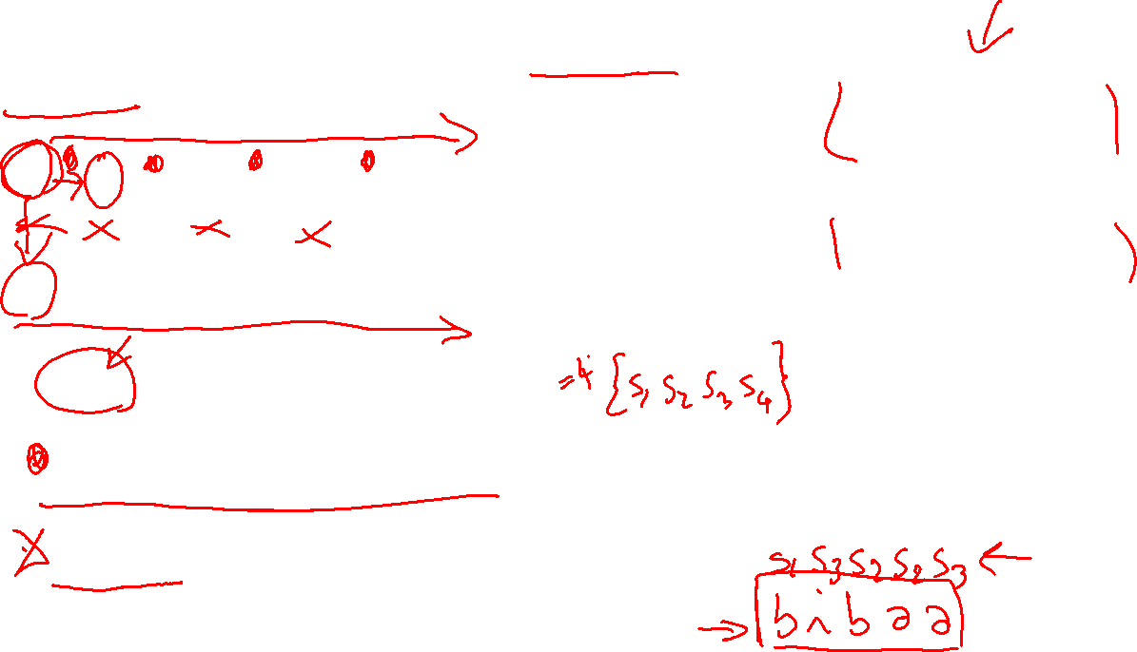

Hidden Markov Model (HMM) as graphical models…
.6
a
.1
1
.5
b
b
.4
s₄
.4
s₃
.5
a
.5
i
.7
.6
.3
|domain(X)| = k
|domain(E)| = h
1
.1
i
b
s₁
s₂
.9
a
.4
.6
.4
Start
Start
Last Thur
P (X₀) specifies initial conditions
P (X_{t+1}|X_{t}) specifies the dynamics
P (E_{t} |S_{t}) specifies the sensor model

Slide 4

Today Oct 5
Intro to RNN: motivation, unrolling, learning
Basic tasks and corresponding architectures
More sophisticated Deep Networks: Stacked and Bidirectional
Managing Context: LSTMs and GRUs

Slide 5
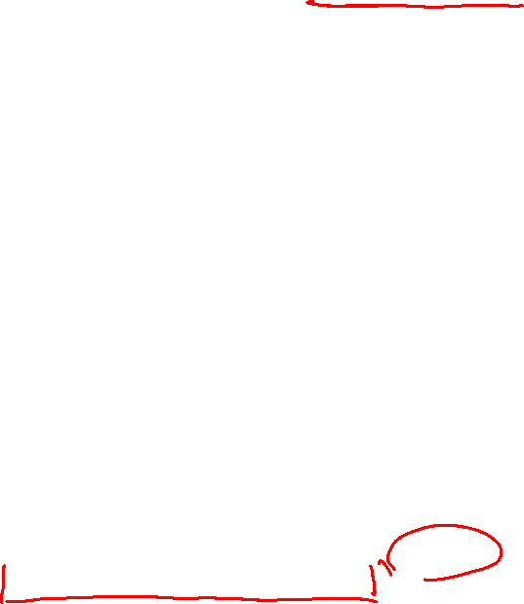

We saw the sliding window Neural Language Model …..
(J&M 3Ed draft Chp 7)
3-gram neural model
Pre-trained embeddings !
Different names for the parameters but need to get used to that ;-)
$$L=−\log{P(}w_{t}\text{|}w_{t−1}\text{)}$$
Notes:
A simplified view of a feedforward neural language model moving through a text. At each
timestep t the network takes the 3 context words, converts each to a d-dimensional embeddings, and concatenates
the 3 embeddings together to get the 1Nd unit input layer x for the network. These units are multiplied
by a weight matrix W and bias vector b and then an activation function to produce a hidden layer h, which
is then multiplied by another weight matrix U. (For graphic simplicity we don’t show b in this and future
pictures). Finally, a softmax output layer predicts at each node i the probability that the next word wt will be
vocabulary word Vi. (This picture is simplified because it assumes we just look up in an embedding dictionary
E the d-dimensional embedding vector for each word, precomputed by an algorithm like word2vec.)

Slide 6
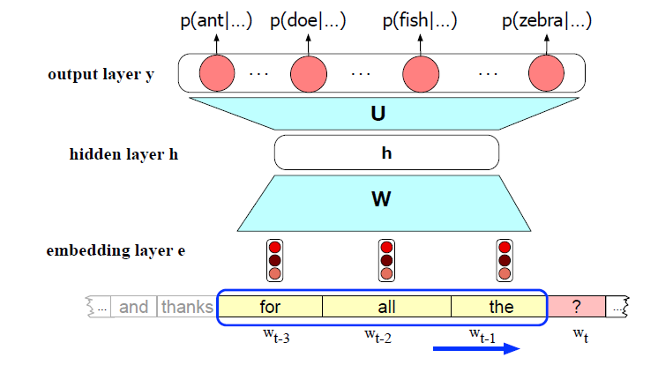
We saw the sliding window Neural Language Model …..
Notes:
Simplified sketch of a feedforward neural language model moving through a
text. At each time step t the network converts N context words, each to a d-dimensional
embedding, and concatenates the N embeddings together to get the Nd 1 unit input vector
x for the network. The output of the network is a probability distribution over the vocabulary
representing the model’s belief with respect to each word being the next possible word.

Slide 7

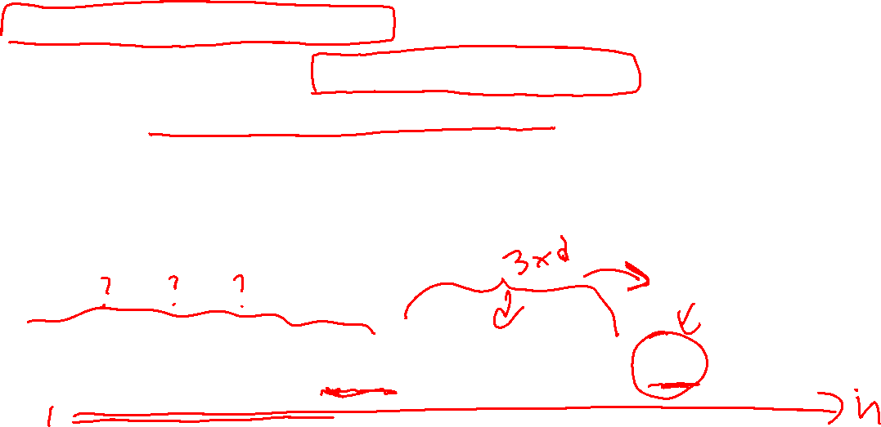
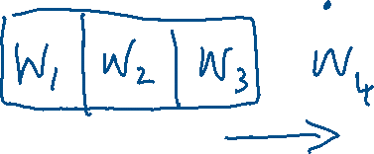

Sequence Processing with Recurrent Networks
Handle variable length input
Addressing limitation of sliding window approach
Anything outside the context has no impact (many tasks require access to arbitrarily distant info)
makes it difficult for networks to learn systematic patterns arising from phenomena like constituency
Notes:
Difficult to learn systematic patterns (see example) ?? For example, in Fig. 9.1 the noun phrase the ground appears in two separate windows:
once, as shown, in the first and second positions in the window, and in the preceding
step where it appears in the second and third positions, thus forcing the network to
learn two separate patterns for what should be a constituent.

Slide 8
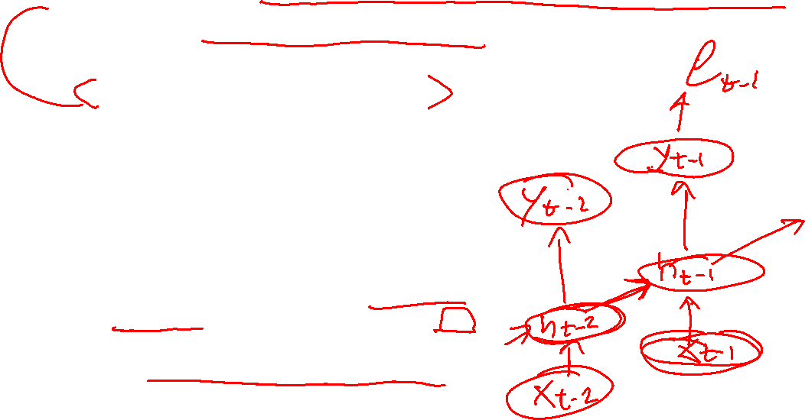
Decoding for sequence labeling
Linear-Chain Conditional Random Fields:
  Generalization of HMM (undirected models) LAST WEEK
  Viterbi can be applied for inference
Neural model (Recurrent NN) (Elman, 1990) –
What are the challenges?
input and output of the network do not have a fixed length.
Solution: activation value of the hidden layer h_{t} depends on the current input x_{t} as well as the activation value of the hidden layer from the previous time step h_{t-1}.
..which provides a form of memory, or context, that encodes earlier processing and informs the decisions to be made at later points in time.
Notes:
Linear-chain CRFs have many of the same applications as conceptually simpler hidden Markov models (HMMs), but relax certain assumptions about the input and output sequence distributions. An HMM can loosely be understood as a CRF with very specific feature functions that use constant probabilities to model state transitions and emissions. Conversely, a CRF can loosely be understood as a generalization of an HMM that makes the constant transition probabilities into arbitrary functions that vary across the positions in the sequence of hidden states, depending on the input sequence.
CRF will discuss in some of the readings - there are packages if you need it in your project
RNN (basis for LSTM, Transformers, Encoder-Decoder) will discuss in some of the reading – good topic for project (at least one student will use this formalism)

Slide 9
Simple recurrent neural network after Elman (Elman, 1990)
The hidden layer includes a recurrent connection as part of its input.
That is, the activation value of the hidden layer depends on the current input as well as the activation value of the hidden layer from the previous time step.
Notes:
Simple recurrent neural network after Elman (Elman, 1990). The hidden layer
includes a recurrent connection as part of its input. That is, the activation value of the hidden
layer depends on the current input as well as the activation value of the hidden layer from the
previous timestep.

Slide 10




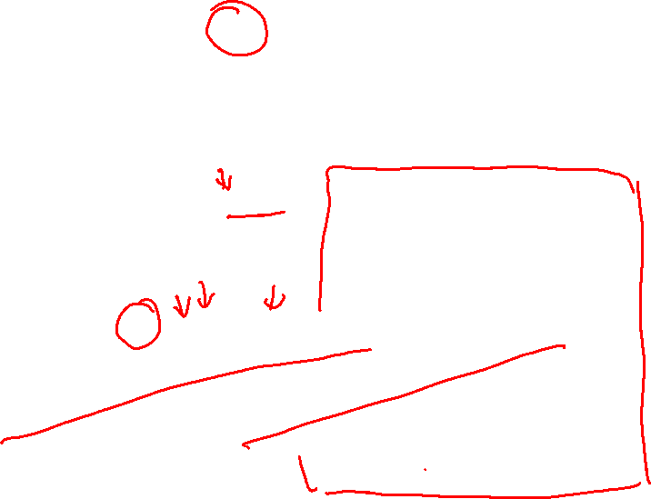





Simple Recurrent Neural Network illustrated as a feed-forward network
Most significant change: new set of weights, U
connect the hidden layer from the previous time step to the current hidden layer.
determine how the network should make use of past context in calculating the output for the current input.
$y_{t}=softmax$(V$h_{t}$)
$y_{t}=$f(V$h_{t}$)
$h_{t}=$g(U$h_{t−1}$+W$x_{t}$)
Notes:
Simple recurrent neural network illustrated as a feed-forward network
The most significant change lies in the new set of weights,
U, that connect the hidden layer from the previous time step to the current hidden
layer. These weights determine how the network should make use of past context in
calculating the output for the current input.

Slide 11
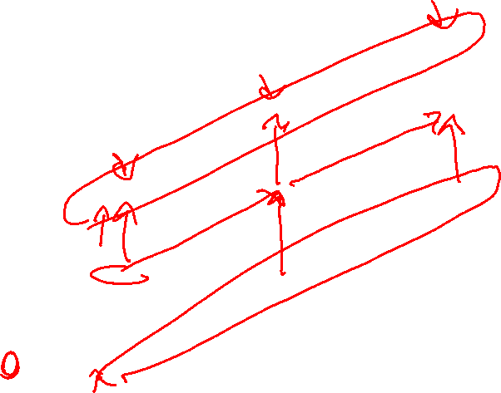
RNN unrolled in time + Inference
Notes:
In figures such as this, the various layers of units are copied for each time step to illustrate that they will have
differing values over time. However the weights themselves are shared across the
various timesteps. Finally, the fact that the computation at time t requires the value
of the hidden layer from time t-1 mandates an incremental inference algorithm that
proceeds from the start of the sequence to the end as shown in Fig. 9.5.

Slide 12
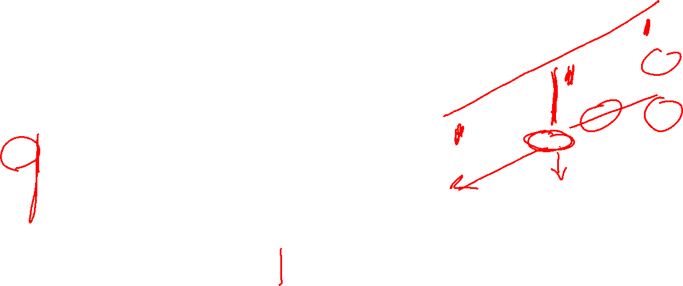




Training an RNN
t_{i} :targets from training data
As for FF/MLP we will use
Loss Function
Backpropagation (Now through time)
Perform forward inference, computing (and saving) h_{t} , y_{t}, and loss at each time step
Process sequence in reverse
  Compute the required error terms gradients as we go
  b) Accumulate gradients for the weights incrementally over the sequence, and then use those accumulated gradients in performing weight updates.
Notes:
Perform forward inference, computing h_{t} , y_{t} , and loss at each step in time, saving the value of the hidden layer at eachstep for use at the next time step.
Figure 9.6 The backpropagation of errors in an SRN. The ti vectors represent the targets for each element
of the sequence from the training data. The red arrows illustrate the flow of backpropagated errors required to
calculate the updates for U, V and W at time 2. The two incoming arrows converging on h2 signal that these
errors need to be summed.
Unfortunately, computing the gradients and updating weights for each item of a
sequence individually would be extremely time-consuming. Instead, much as we did
with mini-batch training in Chapter 7, we will accumulate gradients for the weights
incrementally over the sequence, and then use those accumulated gradients in performing
weight updates.
Isn’t this actually the only sound way of doing it, because you just want a single update for the U W V shared parameters !
9.1.3 Unrolled Networks

Slide 13
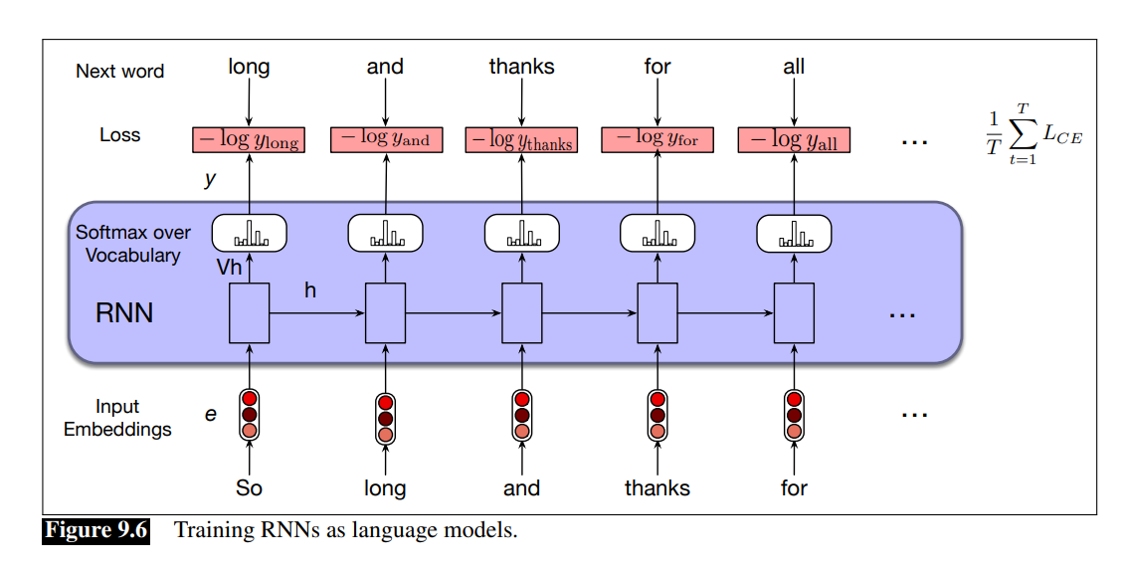
New slide from J&M for training RNNs as LMs

Slide 14
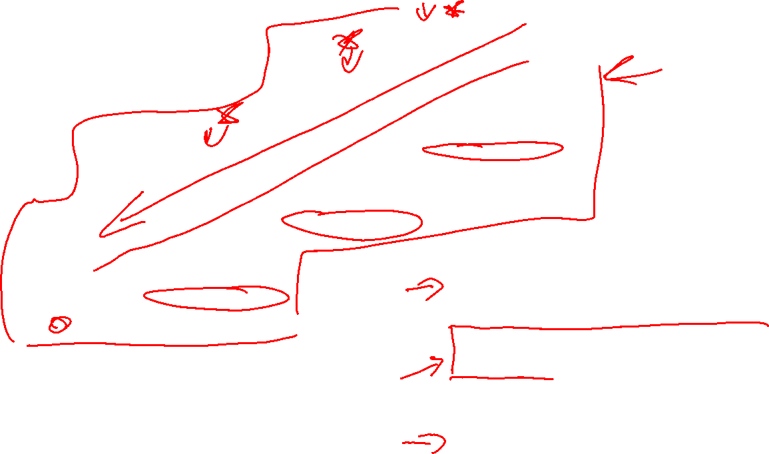
RNN abstraction
y₁
y₂
y₃
Notes:
In figures such as this, the
various layers of units are copied for each time step to illustrate that they will have
differing values over time. However the weights themselves are shared across the
various time steps. Finally, the fact that the computation at time t requires the value
of the hidden layer from time t-1 mandates an incremental inference algorithm that
proceeds from the start of the sequence to the end as shown in Fig. 9.5.

Slide 15

Today Oct 5
Intro to RNN: motivation, unrolling, learning
Basic tasks and corresponding architectures
More sophisticated Deep Networks: Stacked and Bidirectional
Managing Context: LSTMs and GRUs

Slide 16
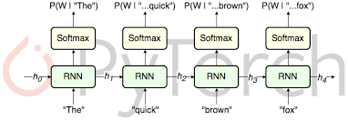
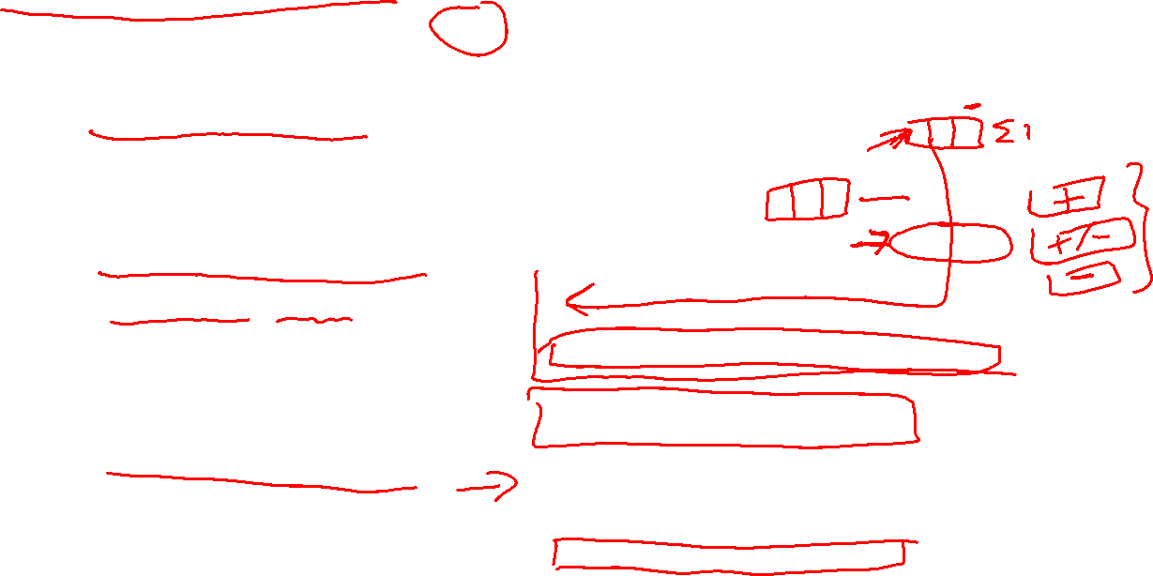
RNN Applications
Language Modeling
Sequence Classification (Sentiment, Topic)
Sequence to Sequence
Notes:
Simple recurrent networks have proven to be an effective approach to language modeling,
sequence labeling tasks such as part-of-speech tagging, as well as sequence
classification tasks such as sentiment analysis and topic classification. And as we’ll
see in Chapter 22, they form the basic building blocks for sequence to sequence
approaches to applications such as summarization and machine translation.

Slide 17


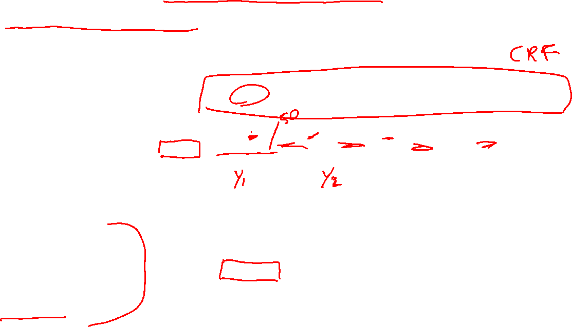
RNN Applications: Sequence Labeling (e.g., POS)
Input: pre-trained embeddings
Output: softmax layer provides a probability distribution over the part-of-speech tags as output at each time step
Choosing max probability label for each item does not necessarily result in optimal (or even very good) tag sequence
Combine with Viterbi for most likely sequence, usually implemented adding CRF layer
Notes:
Part-of-speech tagging as sequence labeling with a simple RNN. Pre-trained
word embeddings serve as inputs and a softmax layer provides a probability distribution over
the part-of-speech tags as output at each time step.
The RNN block is an abstraction that represents
an unrolled simple recurrent network consisting of an input layer, hidden layer, and
output layer at each time step, as well as the sharedU, V andW weight matrices that
comprise the network. The outputs of the network at each time step represent the
distribution over the POS tagset generated by a softmax layer. To generate an actual
tag sequence as output, we can run forward inference over the input sequence and
select the most likely tag from the softmax at each step. Since we’re using a softmax
layer to generate the probability distribution over the output tagset at each timestep,
we’ll rely on the cross entropy loss introduced in Chapter 7 to train the network.
As we saw with applying logistic regression to part-of-speech tagging, choosing the
maximum probability label for each element in a sequence does not necessarily result
in an optimal (or even very good) tag sequence. In the case of IOB tagging, it
doesn’t even guarantee that the resulting sequence will be well-formed. For example,
nothing in approach described in the last section prevents an output sequence
from containing an I following an O, even though such a transition is illegal. Similarly,
when dealing with multiple classes nothing would prevent an I-LOC tag from
following a B-PER tag.
A simple solution to this problem is to use combine the sequence of probability
distributions provided by the softmax outputs with a tag-level language model as we
did with MEMMs in Chapter 8.

Slide 18
Notes:
NOT SURE IS THIS ONE

Slide 19


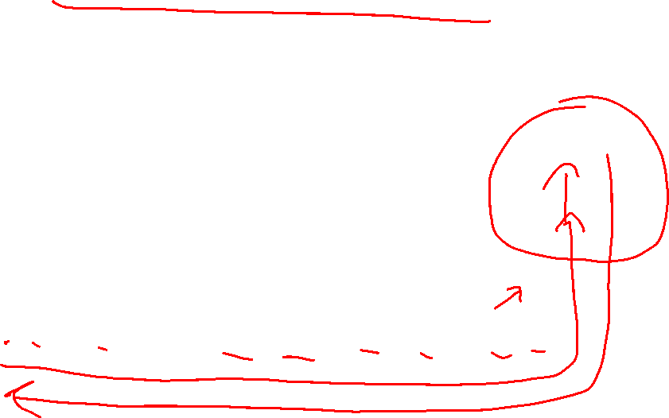
RNN Applications: sequence classification (RNN + FeedForward)
Hidden layer from final state (compressed representation of entire sequence) ->
Input to feed-forward trained to selects correct class
No intermediate outputs for items in the sequence preceding x_{n} => no intermediate losses
Only cross-entropy loss on final classification backpropagated all the way…
Notes:
Using a simple RNN combined with a feedforward network
To apply RNNs in this setting, the hidden layer from the final state of the network
is taken to constitute a compressed representation of the entire sequence. This compressed
sequence representation can then in turn serve as the input to a feed-forward
network trained to select the correct class. Fig. 9.10 illustrates this approach.
Note that in this approach, there are no intermediate outputs for the items in the
sequence preceding the last element, and therefore there are no loss terms associated
with those individual items. Instead, the loss used to train the network weights
is based on the loss from the final classification task. Specifically, we use the output
from the softmax layer from the final classifier along with a cross-entropy loss function
to drive our network training. The loss is backpropagated all the way through
the weights in the feedforward classifier through to its input, and then through to the
three sets of weights in the RNN as described earlier in Section 9.1.2. This combination
of a simple recurrent network with a feedforward classifier is our first example
of a deep neural network.

Slide 20
Today Oct 5
Intro to RNN: motivation, unrolling, learning
Basic tasks and corresponding architectures
More sophisticated Deep Networks: Stacked and Bidirectional
Managing Context: LSTMs and GRUs

Slide 21
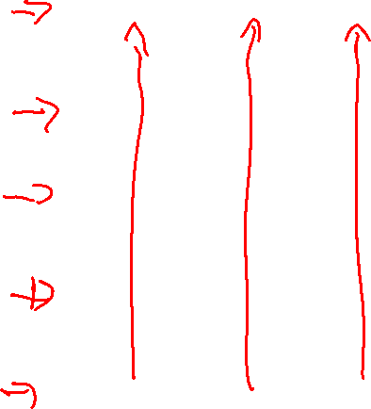
Deep Networks: Stacked RNNs
Using the entire sequence of outputs from one RNN as an input sequence to another one
It has been demonstrated across numerous tasks that stacked RNNs can outperform single-layer networks
Key idea also applied to SOTA Transformers.. BERT… BART….
Notes:
This section introduces two of the more common network architectures used in language
processing with RNNs.
Just as the early stages of the human visual system detects edges that are then used for
finding larger regions and shapes, the initial layers of stacked networks can induce
representations that serve as useful abstractions for further layers—representations
that might prove difficult to induce in a single RNN.
Stacked recurrent networks. The output of a lower level serves as the input to
higher levels with the output of the last network serving as the final output.

Slide 22

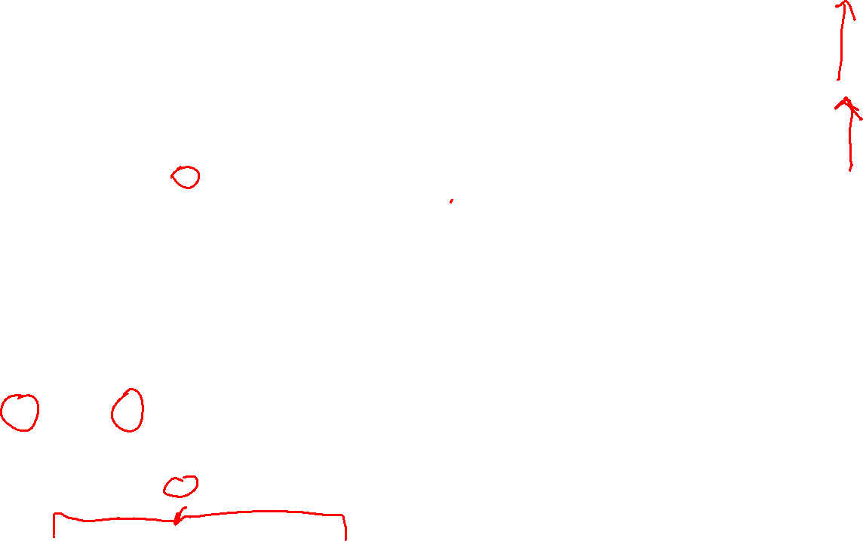




Explain Y. Goldberg different notation

Slide 23
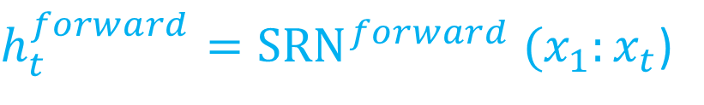
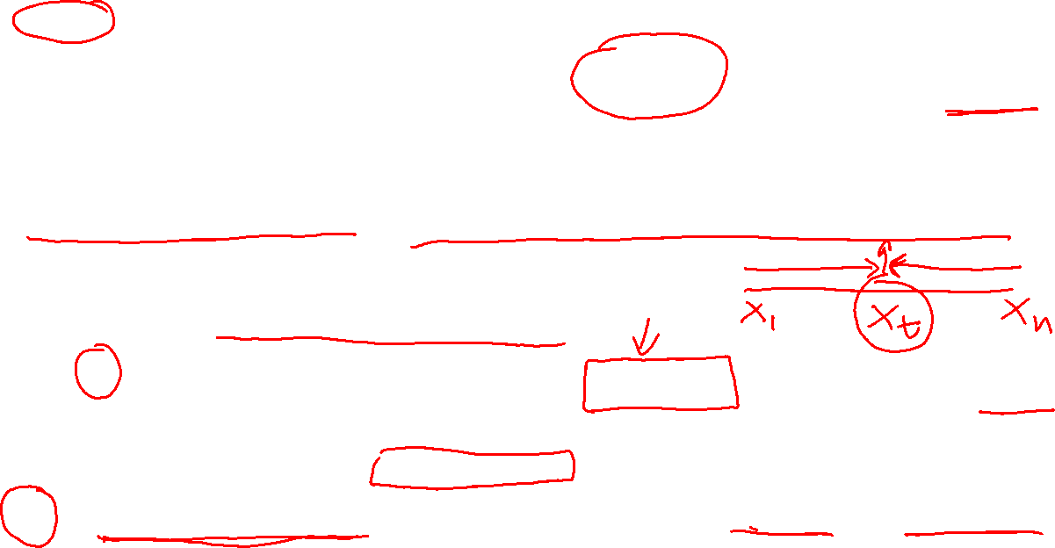
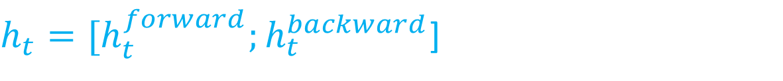
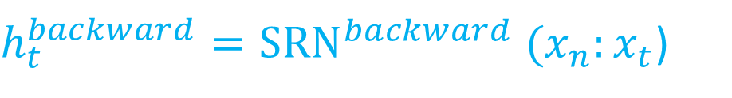
Deep Networks: Bidirectional RNNs
In SimpleRN hidden state at time t, h_{t} represents everything the network knows about the sequence up to that point in the sequence
$h_{t}^{forward}={SRN}^{forward} (x_{1}:x_{t}$)
Result of a function of the inputs up to t
In text-based applications the entire input sequence is available all at once!
Can we take advantage of context to the right?
Train SRN on the input sequence in reverse.
now h_{t} represents information about sequence to the right of the current input.
$h_{t}^{backward}={SRN}^{backward} (x_{n}:x_{t}$)
Outputs of both networks are concatenated
$h_{t}={{[h}_{t}^{forward};h}_{t}^{backward}$]
But also element wise addition or multiplication
Notes:
Simple Recurrent Network
In an simple recurrent network, the hidden state at a given time t represents everything the network knows about the sequence up to that point in the sequence. That
is, the hidden state at time t is the result of a function of the inputs from the start up through time t. We can think of this as the context of the network to the left of the
current time.
Where hf orward t corresponds to the normal hidden state at time t, and represents everything the network has gleaned from the sequence to that point.
Of course, in text-based applications we have access to the entire input sequence all at once.
We might ask whether its helpful to take advantage of the context to the right of the current input as well. One way to recover such information is to train a recurrent network on an input sequence in reverse, using the same kind of network that we’ve been discussing. With this approach, the hidden state at time t
now represents information about the sequence to the right of the current input.
Here, the hidden state hbackward
t represents all the information we have discerned
about the sequence from t to the end of the sequence.

Slide 24

Deep Networks: Bidirectional RNNs
Consists of two independent RNNs
one where the input is processed from the start to the end
the other from the end to the start.
outputs of the two networks are combined to capture both the left and right contexts of an input at each point in time.
Notes:
The second is fed the input sequence in reverse order
A bidirectional RNN. Separate models are trained in the forward and backward directions with the output of each model at each time point concatenated to represent the state
of affairs at that point in time. The box wrapped around the forward and backward network emphasizes the modular nature of this architecture
Putting these networks together results in a bidirectional RNN. A Bi-RNN consists of two independent recurrent networks, one where the input is processed from the start to the end, and the other from the end to the start. We can then combine the outputs of the two networks into a single representation that captures the both the left and right contexts of an input at each point in time.

Slide 25


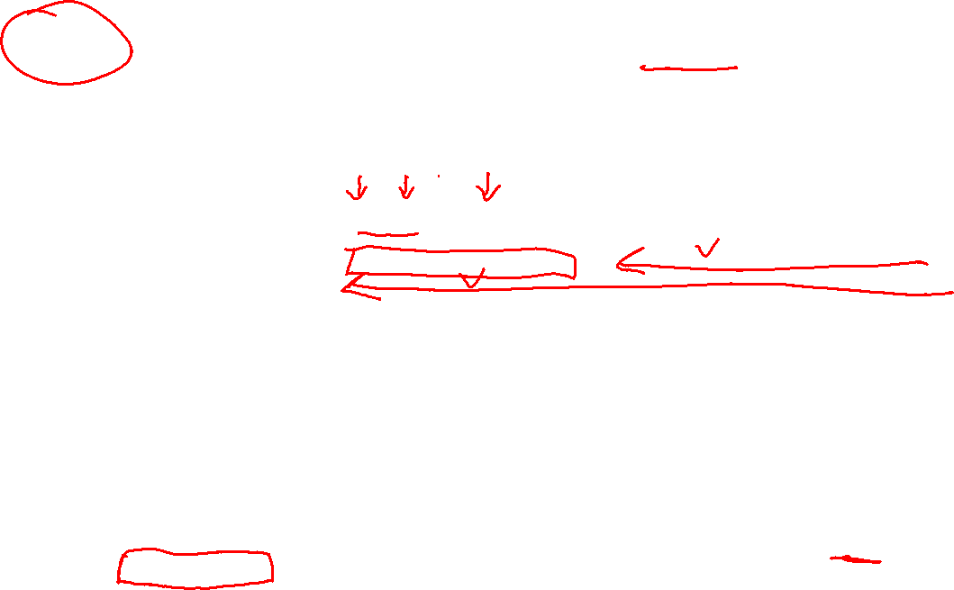



LSTM-minus: Recent paper (NAACL 2018)
What’s Going On in Neural Constituency Parsers? An Analysis,
D.Gaddy, M. Stern, D. Klein, Computer Science ., Univ. of California, Berkeley
Notes:
A number of differences have emerged between modern and classic approaches to constituency parsing in recent years, with structural
components like grammars and feature rich lexicons becoming less central while recurrent neural network representations rise in
popularity. The goal of this work is to analyze the extent to which information provided directly by the model structure in classical systems
is still being captured by neural methods. To this end, we propose a high-performance neural model (92.08 F1 on PTB) that is representative
of recent work and perform a series of investigative experiments. We find that our model implicitly learns to encode much of
the same information that was explicitly provided by grammars and lexicons in the past, indicating that this scaffolding can largely be
subsumed by powerful general-purpose neural machinery.
“Abstractly, our model consists of a single scoring function s(i, j, l) that assigns a real-valued score to every label $l$ for each span(i, j) in an input sentence.
We take the set of available labels to be the collection of all non-terminals and unary chains observed in the training data,
To build up to spans, we first run a bidirectional LSTM over the sequence of word representations for an input sentence
we implement the label scoring function by feeding the span representation through a one layer feedforward network whose output dimensionality equals the number of possible labels
…. Even though our model operates on n-ary trees, we can still employ a CKY-style algorithm for efficient globally optimal inference by introducing an auxiliary empty label
“We find that our model implicitly learns to encode much of the same information that was explicitly provided by grammars and lexicons in the past, indicating that this scaffolding can largely be subsumed by powerful general-purpose neural machinery”

Slide 26
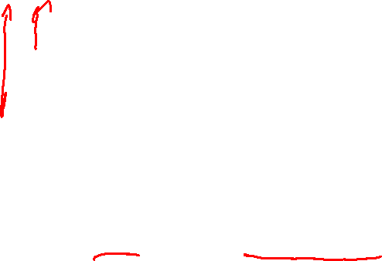
Examples from Goldberg

Slide 27

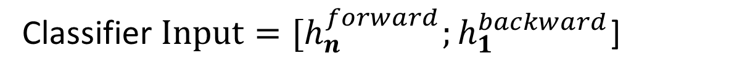
Bidirectional RNNs for Sequence Classification
In SRN, final state naturally reflects more info about the end then the beginning of sequence
Classifier $Input={{[h}_{n}^{forward};h}_{1}^{backward}$]
Bidirectional RNNs provide simple solution !
Notes:
Bidirectional RNNs have also proven to be quite effective for sequence classification. Recall from Fig. 9.10, that for sequence classification we used the final
hidden state of the RNN as the input to a subsequent feedforward classifier. A difficulty with this approach is that the final state naturally reflects more information
about the end of the sentence than its beginning. Bidirectional RNNs provide a simple solution to this problem; as shown in Fig. 9.12, we simply combine the final
hidden states from the forward and backward passes and use that as input for followon processing. Again, concatenation is a common approach to combining the two
outputs but element-wise summation, multiplication or averaging are also used.
Figure 9.12 A bidirectional RNN for sequence classification. The final hidden units from
the forward and backward passes are combined to represent the entire sequence. This combined
representation serves as input to the subsequent classifier.

Slide 28
Bidirectional can be stacked
The two approaches are complementary
You can stack several Bidirectional networks

Slide 29
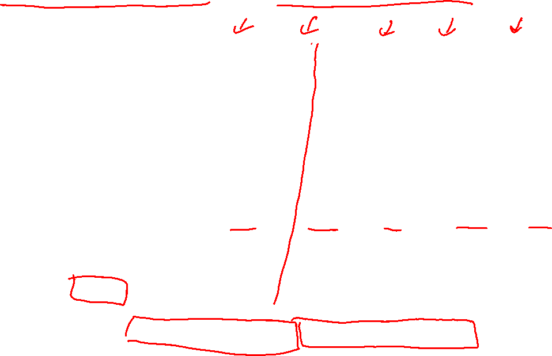
Example of stacked bi-RNN for POS tagging
[Golberg 2017]
Also go beyond word embeddings (which suffer from vocabulary coverage)
Words are made of characters: suffixes prefixes orthographic cues capitalization, hyphens, or digits can provide strong hints.
Encode word using a forward RNN and reverse RNN over its characters!
Notes:
Figure 16.1: Illustration of the RNN tagging architecture. Each word wi is converted into a vector
.wi / which is a concatenation of an embedding vector and the end states of forward- and backward moving
character level RNNs. e word vectors are then fed into a deep biRNN. e output of each
of the outer layer biRNN states is then fed into a predicting network (MLP followed by softmax)
resulting in a tag prediction. Note that each tagging prediction can conditions on the entire input
sentence.
Words are made of characters, and certain suffixes and
prefixes, as well as other orthographic cues such as the presence of capitalization, hyphens, or digits can provide strong hints regarding the word’s ambiguity class.
we will use two character-level RNNs. For a
word w made of characters c1; : : : ; c`, we will map each character into a corresponding embedding
vector ci . e word will then be encoded using a forward RNN and reverse RNN over the
characters. Note that the forward-running RNN focuses on capturing suffixes, the backward-running
RNN focuses on prefixes, and both RNNs can be sensitive to capitalization, hyphens, and even
word length.

Slide 30
Warnings on reading the literature (RNNs) from Goldberg (2017)
Often inferring the exact model form from reading its description in a research paper can be quite challenging
Many aspects of the models are not yet standardized: different researchers use the same terms to refer to slightly different things
  inputs to the RNN can be either one-hot vectors (in which case the embedding matrix is internal to the RNN) or embedded representations
  input sequence can be padded with start-of-sequence and/or end-of-sequence symbols, or not
  while the output of an RNN is usually assumed to be a vector which is expected to be fed to additional layers followed by a softmax for prediction, some papers assume the softmax to be part of the RNN itself
  in multi-layer RNN, the “state vector” can be either the output of the top-most layer, or a concatenation of the outputs from all layers
  when using the encoder-decoder framework, conditioning on the output of the encoder can be interpreted in various different ways (for later in course)
Be aware of these as a reader and as a writer!
As a writer don’t rely solely on figures or natural language text when describing your model, as these are often ambiguous
Notes:
Unfortunately, it is often the case that inferring the exact model form from reading its description
in a research paper can be quite challenging. Many aspects of the models are not yet standardized,
and different researchers use the same terms to refer to slightly different things. To list a few
examples, the inputs to the RNN can be either one-hot vectors (in which case the embedding
matrix is internal to the RNN) or embedded representations; the input sequence can be padded
with start-of-sequence and/or end-of-sequence symbols, or not; while the output of an RNN
is usually assumed to be a vector which is expected to be fed to additional layers followed by a
softmax for prediction (as is the case in the presentation in this tutorial), some papers assume
the softmax to be part of the RNN itself; in multi-layer RNN, the “state vector” can be either
the output of the top-most layer, or a concatenation of the outputs from all layers; when using
the encoder-decoder framework, conditioning on the output of the encoder can be interpreted in
various different ways; and so on. On top of that, the LSTM architecture described in the next section has many small variants, which are all referred to under the common name LSTM. Some
of these choices are made explicit in the papers, other require careful reading, and others still are
not even mentioned, or are hidden behind ambiguous figures or phrasing.
As a reader, be aware of these issues when reading and interpret model descriptions. As a
writer, be aware of these issues as well: either fully specify your model in mathematical notation,
or refer to a different source in which the model is fully specified, if such a source is available.
If using the default implementation from a software package without knowing the details, be
explicit of that fact and specify the software package you use. In any case, don’t rely solely on
figures or natural language text when describing your model, as these are often ambiguous.

Slide 31
Today Oct 5
Intro to RNN: motivation, unrolling, learning
Basic tasks and corresponding architectures
More sophisticated Deep Networks: Stacked and Bidirectional
Managing Context: LSTMs and GRUs

Slide 32
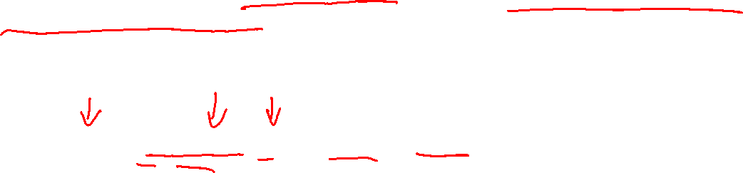
Managing Context in RNNs: LSTMs and GRUs
Information encoded in hidden states tends to be much more influenced by the most recent parts of the input sequence and recent decisions
However, long-distance information is often critical to many language applications
“The flights the airline was cancelling were full.”
Assigning a high probability to was following airline is straightforward
  since it provides a strong local context for the singular agreement.
However, assigning an appropriate probability to were is quite difficult
  not only because the plural flights is quite distant
  but also because the more recent context contains singular constituents.
Notes:
In practice, it is quite difficult to train simple RNNs for tasks that require a network
to make use of information distant from the current point of processing. Despite having
access to the entire preceding sequence, the information encoded in hidden states
tends to be fairly local, more relevant to the most recent parts of the input sequence
and recent decisions. However, it is often the case that long-distance information is
critical to many language applications.
Assigning a high probability to was following airline is straightforward since was
provides a strong local context for the singular agreement. However, assigning an
appropriate probability to were is quite difficult, not only because the plural flights
is quite distant, but also because the more recent context contains singular constituents.
Ideally, a network should be able to retain the distant information about
plural flights until it is needed, all the while processing intermediate parts of the
sequence correctly.
One reason for the inability of SRNs to carry forward critical information is that
the hidden layer in SRNs, and, by extension, the weights that determine the values
in the hidden layer, are being asked to perform two tasks simultaneously: provide
information useful to the decision being made in the current context, and updating
and carrying forward information useful for future decisions.
A second difficulty to successfully training simple recurrent networks arises
from the need to backpropagate training error back in time through the hidden layers.
Recall from Section 9.1.2 that the hidden layer at time t contributes to the loss
at the next time step since it takes part in that calculation. As a result, during the
backward pass of training, the hidden layers are subject to repeated dot products, as
determined by the length of the sequence. A frequent result of this process is that
the gradients are either driven to zero or saturate. Situations that are referred to as
vanishing gradients or exploding gradients, respectively.

Slide 33
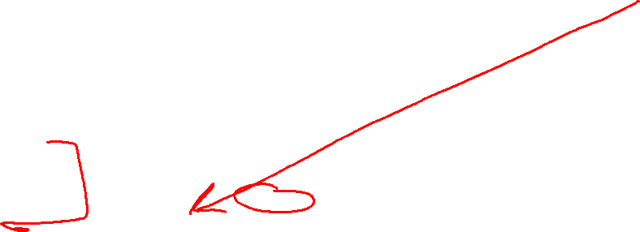
Much more influenced by the most recent parts…
Inability of SRNs to carry forward critical information
Hidden layers h_{i} and weights that determine their the values, are being asked to perform two tasks simultaneously:
  Provide information useful to the decision being made in the current context
  Updating and carrying forward information useful for future decisions.
need to backpropagate training error back in time through the hidden layers results in repeated dot products, determined by the length of the sequence ->
  gradients are often either driven to zero or saturate (vanishing or exploding gradients)
Notes:
Ideally, a network should be able to retain the distant information about
plural flights until it is needed, all the while processing intermediate parts of the
sequence correctly.
One reason for the inability of SRNs to carry forward critical information is that
the hidden layer in SRNs, and, by extension, the weights that determine the values
in the hidden layer, are being asked to perform two tasks simultaneously: provide
information useful to the decision being made in the current context, and updating
and carrying forward information useful for future decisions.
A second difficulty to successfully training simple recurrent networks arises
from the need to backpropagate training error back in time through the hidden layers.
Recall from Section 9.1.2 that the hidden layer at time t contributes to the loss
at the next time step since it takes part in that calculation. As a result, during the
backward pass of training, the hidden layers are subject to repeated dot products, as
determined by the length of the sequence. A frequent result of this process is that
the gradients are either driven to zero or saturate. Situations that are referred to as
vanishing gradients or exploding gradients, respectively.

Slide 34
To enable RNNs to carry forward critical information
More complex network architectures have been designed to explicitly manage the task of maintaining relevant context over time, by enabling the network to
  learn to forget information that is no longer needed
  to remember information required for decisions still to come
Notes:
To address these issues, more complex network architectures have been designed to explicitly manage the task of maintaining relevant context over time, by enabling the network to
learn to forget information that is no longer needed
and to remember information required for decisions still to come.

Slide 35
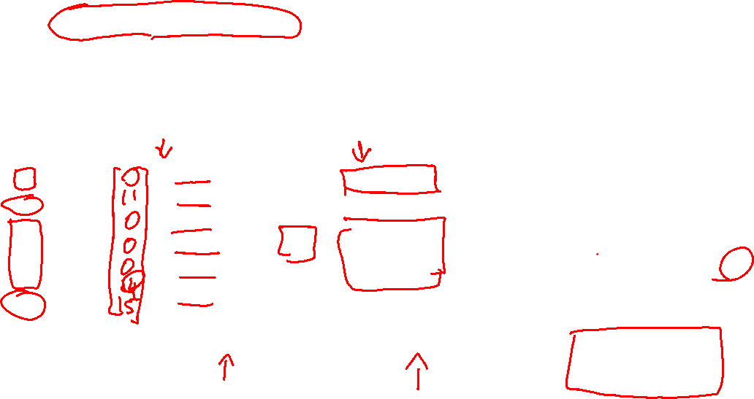

LSTMs and GRUs : Gates
Still need to know about LSTM because they have been generalized to tree in possibly better more effective ways than transformers. Also often they are strong baselines.
If you think of h as a state memory: you read the content h_{t-1} to write new content at h_{t}. In an SRN, at each step of the computation the entire state is read, and the entire state is possibly rewritten
Solution: provide more controlled “memory access” with gates
Gate g specifies what element of x should be copied in memory s’
(1 – g) specifies what should be kept form s!
Hadamard product
Notes:
To address these issues more complex network architectures have been designed
to explicitly manage the task of maintaining contextual information over time. These
approaches treat context as a kind of memory unit that needs to be managed explicitly.
More specifically, the network needs to forget information that is no longer
needed and to remember information as needed for later decisions.
Long short-term memory (LSTM) networks, divide the context management problem
into two sub-problems: removing information no longer needed from the context,
and adding information likely to be needed for later decision making. The key
to the approach is to learn how to manage this context rather than hard-coding a
strategy into the architecture.
LSTMs accomplish this through the use of specialized neural units that make use
of gates that control the flow of information into and out of the units that comprise
the network layers. These gates are implemented through the use of additional sets
of weights that operate sequentially on the context layer.

Slide 36

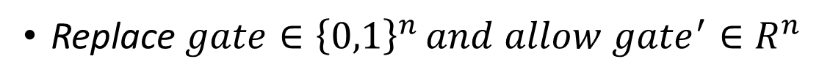




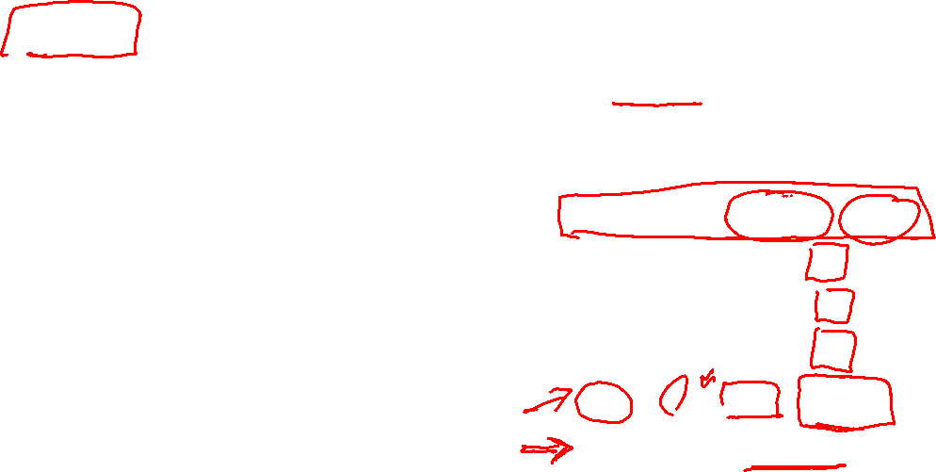







LSTMs and GRUs: learnable gates
These gates serve as building blocks : But they have to be differentiable (learnable)
Replace $gate∈{\left\{0,1\right\}}^{n }and allow {gate}^{′}∈R^{n}$
$which can then pass through a sigmoid function σ(g^{′}$) $∈{\left\{0,1\right\}}^{n }$
As in SRNN, g_{t} computes the info from the
previous hidden state and current inputs.
Solution: split hidden layer into two vectors c and h and have three learnable gates.
forget gate: delete info from the context that is no longer needed.
input/add gate: select info to add to the current context
output gate: decide what info is required for the current hidden state (as opposed to what info needs to be preserved for future decisions)
Input
Forget
Output
1
2
3
Notes:
To address these issues more complex network architectures have been designed
to explicitly manage the task of maintaining contextual information over time. These
approaches treat context as a kind of memory unit that needs to be managed explicitly.
More specifically, the network needs to forget information that is no longer
needed and to remember information as needed for later decisions.
Long short-term memory (LSTM) networks, divide the context management problem
into two sub-problems: removing information no longer needed from the context,
and adding information likely to be needed for later decision making. The key
to the approach is to learn how to manage this context rather than hard-coding a
strategy into the architecture.
LSTMs accomplish this through the use of specialized neural units that make use
of gates that control the flow of information into and out of the units that comprise
the network layers. These gates are implemented through the use of additional sets
of weights that operate sequentially on the context layer.
The gates in an LSTM share a common design pattern; each consists of a feedforward
layer, followed by a sigmoid activation function, followed by a pointwise
multiplication with the layer being gated. The choice of the sigmoid as the activation
function arises from its tendency to push its outputs to either 0 or 1. Combining this
with a pointwise multiplication has an effect similar to that of a binary mask. Values
in the layer being gated that align with values near 1 in the mask are passed through
nearly unchanged; values corresponding to lower values are essentially erased.

Slide 37
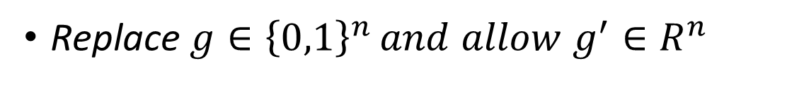
LSTMs and GRUs: learnable gates
These gates serve as building blocks : But they have to be differentiable (learnable)
Replace $g∈{\left\{0,1\right\}}^{n }and allow g^{′}∈R^{n}$
$which can then pass through a sigmoid function σ(g^{′}$) $∈{\left\{0,1\right\}}^{n }$
Solution: split hidden layer into two vectors c and h and have three learnable gates.
Input
g
Forget
Output
Notes:
To address these issues more complex network architectures have been designed
to explicitly manage the task of maintaining contextual information over time. These
approaches treat context as a kind of memory unit that needs to be managed explicitly.
More specifically, the network needs to forget information that is no longer
needed and to remember information as needed for later decisions.
Long short-term memory (LSTM) networks, divide the context management problem
into two sub-problems: removing information no longer needed from the context,
and adding information likely to be needed for later decision making. The key
to the approach is to learn how to manage this context rather than hard-coding a
strategy into the architecture.
LSTMs accomplish this through the use of specialized neural units that make use
of gates that control the flow of information into and out of the units that comprise
the network layers. These gates are implemented through the use of additional sets
of weights that operate sequentially on the context layer.
The gates in an LSTM share a common design pattern; each consists of a feedforward
layer, followed by a sigmoid activation function, followed by a pointwise
multiplication with the layer being gated. The choice of the sigmoid as the activation
function arises from its tendency to push its outputs to either 0 or 1. Combining this
with a pointwise multiplication has an effect similar to that of a binary mask. Values
in the layer being gated that align with values near 1 in the mask are passed through
nearly unchanged; values corresponding to lower values are essentially erased.

Slide 38










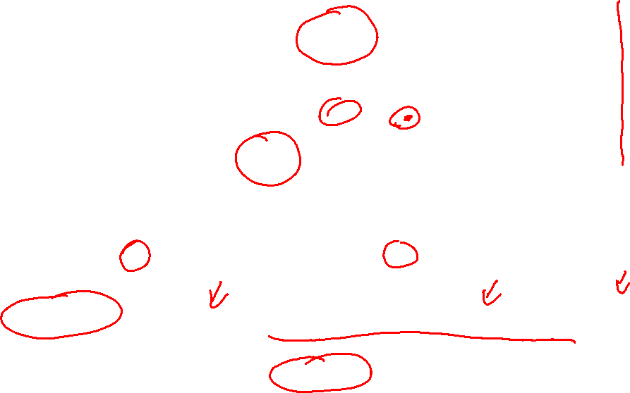







A single LSTM memory unit displayed as a computation graph.
Differences in terminology between J&M and Goldberg
Note j ~ t
C_{t}
z
C_{t-i}
Notes:
To address these issues more complex network architectures have been designed
to explicitly manage the task of maintaining contextual information over time. These
approaches treat context as a kind of memory unit that needs to be managed explicitly.
More specifically, the network needs to forget information that is no longer
needed and to remember information as needed for later decisions.
Long short-term memory (LSTM) networks, divide the context management problem
into two sub-problems: removing information no longer needed from the context,
and adding information likely to be needed for later decision making. The key
to the approach is to learn how to manage this context rather than hard-coding a
strategy into the architecture.
LSTMs accomplish this through the use of specialized neural units that make use
of gates that control the flow of information into and out of the units that comprise
the network layers. These gates are implemented through the use of additional sets
of weights that operate sequentially on the context layer.

Slide 39
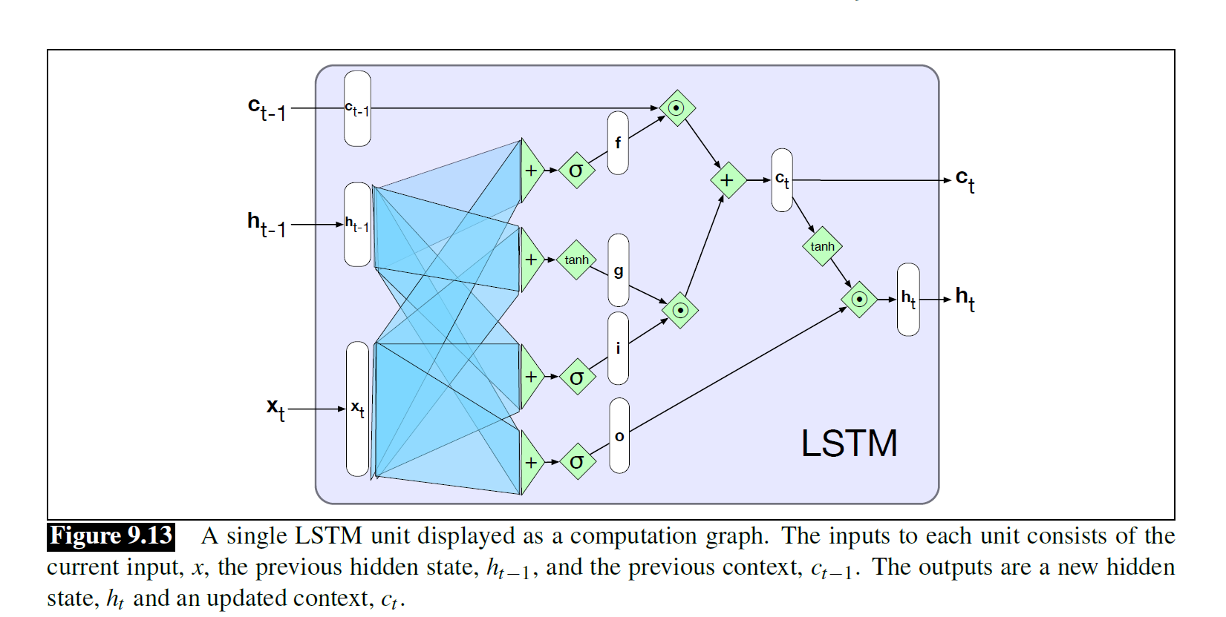





















forget gate: delete info from the context that is no longer needed.
input/add gate: select info to add to the current context
output gate: decide what info is required for the current hidden state (as opposed to what info needs to be preserved for future decisions)
Notes:
Hyperbolic tangent in -1 ; +1
Sigmoid in 0 ; +1

Slide 40









Slide 41




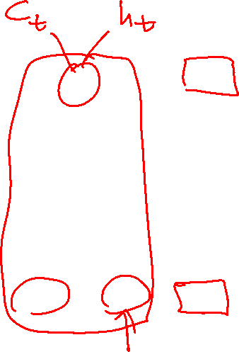
Good News ;-)
The neural units used in LSTMs (and GRUs) are obviously much more complex than basic feed-forward networks.
Fortunately, complexity is largely encapsulated within the basic processing units, allowing us to maintain modularity and to easily experiment with different architectures.
The only additional external complexity over the basic recurrent unit (b) is the presence of the additional context vector input and output c_{t}.
Notes:
9.4.2 Gated Recurrent Units
While relatively easy to deploy, LSTMs introduce a considerable number of parameters
to our networks, and hence carry a much larger training burden. Gated Recurrent
Units (GRUs) try to ease this burden by collapsing the forget and add gates of
LSTMs into a single update gate with a single set of weights.
The neural units used in LSTMs and GRUs are obviously much more complex than
basic feed-forward networks. Fortunately, this complexity is largely encapsulated
within the basic processing units, allowing us to maintain modularity and to easily
experiment with different architectures. To see this, consider Fig. 9.14 which
illustrates the inputs/outputs and weights associated with each kind of unit.
At the far left, (a) is the basic feed-forward unit h = g(Wx+b). A single set of
weights and a single activation function determine its output, and when arranged in
a layer there is no connection between the units in the layer. Next, (b) represents the
unit in an SRN. Now there are two inputs and additional set of weights to go with it.
However, there is still a single activation function and output. When arranged as a
layer the hidden layer from each unit feeds in as an input to the next.
Fortunately, the increased complexity of the LSTM and GRU units is encapsulated
within the units themselves. The only additional external complexity over the
basic recurrent unit (b) is the presence of the additional context vector input and output.
This modularity is key to the power and widespread applicability of LSTM and
GRU units. Specifically, LSTM and GRU units can be substituted into any of the
network architectures described in Section 9.3. And, as with SRNs, multi-layered
networks making use of gated units can be unrolled into deep feed-forward networks
and trained in the usual fashion with backpropagation.

Slide 42
More Warnings on reading the literature (LSTMs) from Goldberg (2017)
The LSTM architecture has many small variants, which are all referred to under the common name LSTM.
Some of these choices are made explicit in the papers, other require careful reading, and others still are not even mentioned, or are hidden behind ambiguous figures or phrasing.
Again Be aware of these as a reader and as a writer!
As a writer don’t rely solely on figures or natural language text when describing your model, as these are often ambiguous
Notes:
On top of that, the LSTM architecture described in the next section has many small variants, which are all referred to under the common name LSTM. Some
of these choices are made explicit in the papers, other require careful reading, and others still are
not even mentioned, or are hidden behind ambiguous figures or phrasing.
As a reader, be aware of these issues when reading and interpret model descriptions. As a
writer, be aware of these issues as well: either fully specify your model in mathematical notation,
or refer to a different source in which the model is fully specified, if such a source is available.
If using the default implementation from a software package without knowing the details, be
explicit of that fact and specify the software package you use. In any case, don’t rely solely on
figures or natural language text when describing your model, as these are often ambiguous.

Slide 43
While the addition of gates allows LSTMs to handle more distant information than RNNs, they don’t completely solve the underlying problem:
passing information through an extended series of recurrent connections leads to information loss and difficulties in training.
Moreover, the inherently sequential nature of recurrent networks makes it hard to do computation in parallel.

Slide 44
Thurs and Next Week
Start Syntax & Context Free Grammars (J&M 3Ed Chp. 12-13)
Keep Working on Assignment 2

