Slide 1
CPSC 503
Computational Linguistics
Lecture 2
Giuseppe Carenini

Slide 2
Today Sept 14
Assignment1, Textbook 3rd Edition on Canvas
Review responses to Initial Survey
Brief check of some background knowledge
English Morphology
FSA and Morphology
Start: Finite State Transducers (FST) and Morphological Parsing/Gen.
Notes:
FSA modelling English morphology can tell you whether a string is or is not an English word
Morphological parsing from the (spelling of a word) to a morpheme and feature sequence

Slide 3
503 Initial Survey (2021-22) avg and sd (#22 responses)
Regular Expressions & Finite State Automata | Finite State Transducers | Hidden-Markov Models | Conditional Probability | Bayes' Rule/Theorem | Entropy | Supervised Classification | Unsupervised Learning (e.g., clustering) | Graphical Models: Bayesian Networks, HMM | Graphical Models: CRFs, LDA topic models
5 | 2.5 | 5 | 8.1 | 7.9 | 5.5 | 6.2 | 6.9 | 5 | 4.5
2.4 | 1.7 | 2.5 | 1.5 | 1.6 | 2.5 | 1.8 | 1.9 | 2.6 | 2.4
Multi-layer Perceptron | RNNs | CNNs | Attention and Transformers
6.7 | 6.3 | 6.2 | 4.5
2.4 | 2.5 | 2.7 | 2.7
Context-Free Grammar | Probabilistic Context-Free Grammar | First-Order Logics | Statistical Relational Models | Dynamic Programming | Search Algorithms | Java | Python | Linguistics | Linear Alg.
4 | 3.4 | 4.9 | 3.0 | 6.8 | 7.5 | 5.7 | 8.5 | 3.1 | 7.7
2.8 | 2.7 | 2.9 | 2.2 | 2.4 | 2.0 | 2.7 | 1.4 | 2.0 | 1.3
Notes:
We will cover everything in red. Which is good because most are below = 5
For the red above 5 we will cover how that framework can be applied to language.
If you are below 5 in any black category (need to make up with assignment 1 and your own readings)
Programming languages you are at lease 6 in one of the two

Slide 4
Pointers to fill in gaps in background knowledge
- ProbInfoTheory Handout on course webpage
- basic concepts in machine learning
http://people.cs.ubc.ca/~poole/aibook/html/ArtInt.html
I am just telling you what is the minimum required (feel free to
explore more! :-)
7.2 only the intro page
7.3.1, 7.3.2, 7.4.1
11.1
11.1.2
- first order logics (please read Chp 17 of textbook 2ndEd up to page 563
3rd edition Chp 14 up to 14.4)
- basic linguistics (pointer to website on the English grammar https://www.ucl.ac.uk/internet-grammar/home.htm

Slide 5
Today Sept 14
Brief check of some background knowledge
English Morphology
FSA and Morphology
Start: Finite State Transducers (FST) and Morphological Parsing/Gen.
Notes:
FSA modelling English morphology can tell you whether a string is or is not an English word
Morphological parsing from the (spelling of a word) to a morpheme and feature sequence

Slide 6



??
b
a
b
a
!
\
b
a
a
a
!
\
Notes:
What is it?
Is it D or ND?
Are ND more powerful?
/baa+!/
NDFSA
- Transition can lead to multiple states
- Explore one alternative at the time

Slide 7
??
    /CPSC50[34]/
/^([Ff]rom\b|[Ss]ubject\b|[Dd]ate\b)/
/[0-9]+(\.[0-9]+){3}/
Notes:
Def. Notation to specify a set of strings
. any character (when used without a \)
Searching and acting on what you find

Slide 8
Fundamental Relations
implement
(generate and recognize)
Regular
Expressions
FSA
describe
model
Linguistic
Phenomena
Notes:
Reg Exp notation to specify a set of strings
Besides implementing regular expression FSA have a wide variety of uses….
Regular expressions can be viewed as a textual way of specifying the structure of finite-state automata.
They both specify regular languages
0 is regular
Each element of alphabet is a regular language
L1 and L2 regular
L1 concatenated with L2 is regular
L1 union L2 is regular
Kleene closure of L1 is regular

Slide 9
RegExp in Practice: Text Searching/Editing
Find me all instances of the determiner “the” in an English text.
  To count them
  To substitute them with something else
You try: /the/
The other cop went to the bank but there were no people there.
/[tT]he/
/\bthe\b/
/\b[tT]he\b/
s/\b([tT]he|[Aa]n?)\b/DET/
Notes:
The process we just went through was based on fixing two kinds of errors
Matching strings that we should not have matched (there, other)
False positives
Not matching things that we should have matched (The)
False negatives
Reducing the error rate for an application often involves two antagonistic efforts:
Increasing accuracy (minimizing false positives)
Increasing coverage (minimizing false negatives).

Slide 10
Annotated Corpora
Example The CoNLL corpora provide chunk structures, which are encoded as flat trees.
The CoNLL 2000 Corpus includes ***phrasal chunks***
The CoNLL 2002 Corpus includes ***named entity chunks***.
http://nltk.googlecode.com/svn/trunk/doc/howto/corpus.html
Notes:
[NP He ] [VP reckons ] [NP the current account deficit ] [VP will narrow ] [PP to ] [NP only # 1.8 billion ] [PP in ] [NP September ]
This data consists of the same partitions of the Wall Street Journal corpus (WSJ) as the widely used data for noun phrase chunking: sections 15-18 as training data (211727 tokens) and section 20 as test data (47377 tokens). The annotation of the data has been derived from the WSJ corpus by a program written by Sabine Buchholz from Tilburg University, The Netherlands.

Slide 11
Formalisms, Models and Algorithms (very brief history of NLP )
… 70s-80s first symbolic models and algorithms for Natural Language
…90s - 00s Probabilistic models HMMs, PCFG and algorithms…machine learning
…10s Neural Models… embeddings, RNNs, Attention
…20s Large Transformer-based Language Models, contextualized embeddings, fine-tuning
Notes:
… to represent the linguistic knowledge….
…

Slide 12
Notes on Machine Learning
6. Sometimes well known symbolic formal systems (models and inference algorithms) support the interpretation of current neural models as well as facilitates the development of new ones
Rational Recurrences. Hao Peng, Roy Schwartz, Sam Thomson and Noah A. Smith EMNLP (Nov) 2018
In this work we show that many neural models are more interpretable than previously thought, by drawing connections to weighted finite state automata (WFSAs). We study several recently proposed RNN architectures and show that one can use WFSAs to characterize their recurrent updates. We call such models rational recurrences (§3).1 Analyzing recurrences in terms of WFSAs provides a new view of existing models and facilitates the development of new ones
So we need to study these symbolic formal systems

Slide 13
Very Recent: Dialog system Combining FST in neural architecture
(point 3 integrating neural models with “traditional” models )
Yiheng Zhou, Yulia Tsvetkov, Alan W Black, and Zhou Yu. 2020. Augmenting non-collaborative dialog systems with explicit semantic and strategic dialog history.
In International Conference on Learning Representations.
Notes:
Augmenting Non-Collaborative Dialog Systems with Explicit Semantic and Strategic Dialog History
Yiheng Zhou, Yulia Tsvetkov, Alan W Black, Zhou Yu
25 Sep 2019 (modified: 11 Mar 2020)ICLR 2020 Conference Blind SubmissionReaders: EveryoneShow BibtexShow Revisions
Original Pdf: pdf
Keywords: dialog systems, history tracking
Abstract: We study non-collaborative dialogs, where two agents have a conflict of interest but must strategically communicate to reach an agreement (e.g., negotiation). This setting poses new challenges for modeling dialog history because the dialog's outcome relies not only on the semantic intent, but also on tactics that convey the intent. We propose to model both semantic and tactic history using finite state transducers (FSTs). Unlike RNN, FSTs can explicitly represent dialog history through all the states traversed, facilitating interpretability of dialog structure. We train FSTs on a set of strategies and tactics used in negotiation dialogs. The trained FSTs show plausible tactic structure and can be generalized to other non-collaborative domains (e.g., persuasion). We evaluate the FSTs by incorporating them in an automated negotiating system that attempts to sell products and a persuasion system that persuades people to donate to a charity. Experiments show that explicitly modeling both semantic and tactic history is an effective way to improve both dialog policy planning and generation performance.

Slide 14
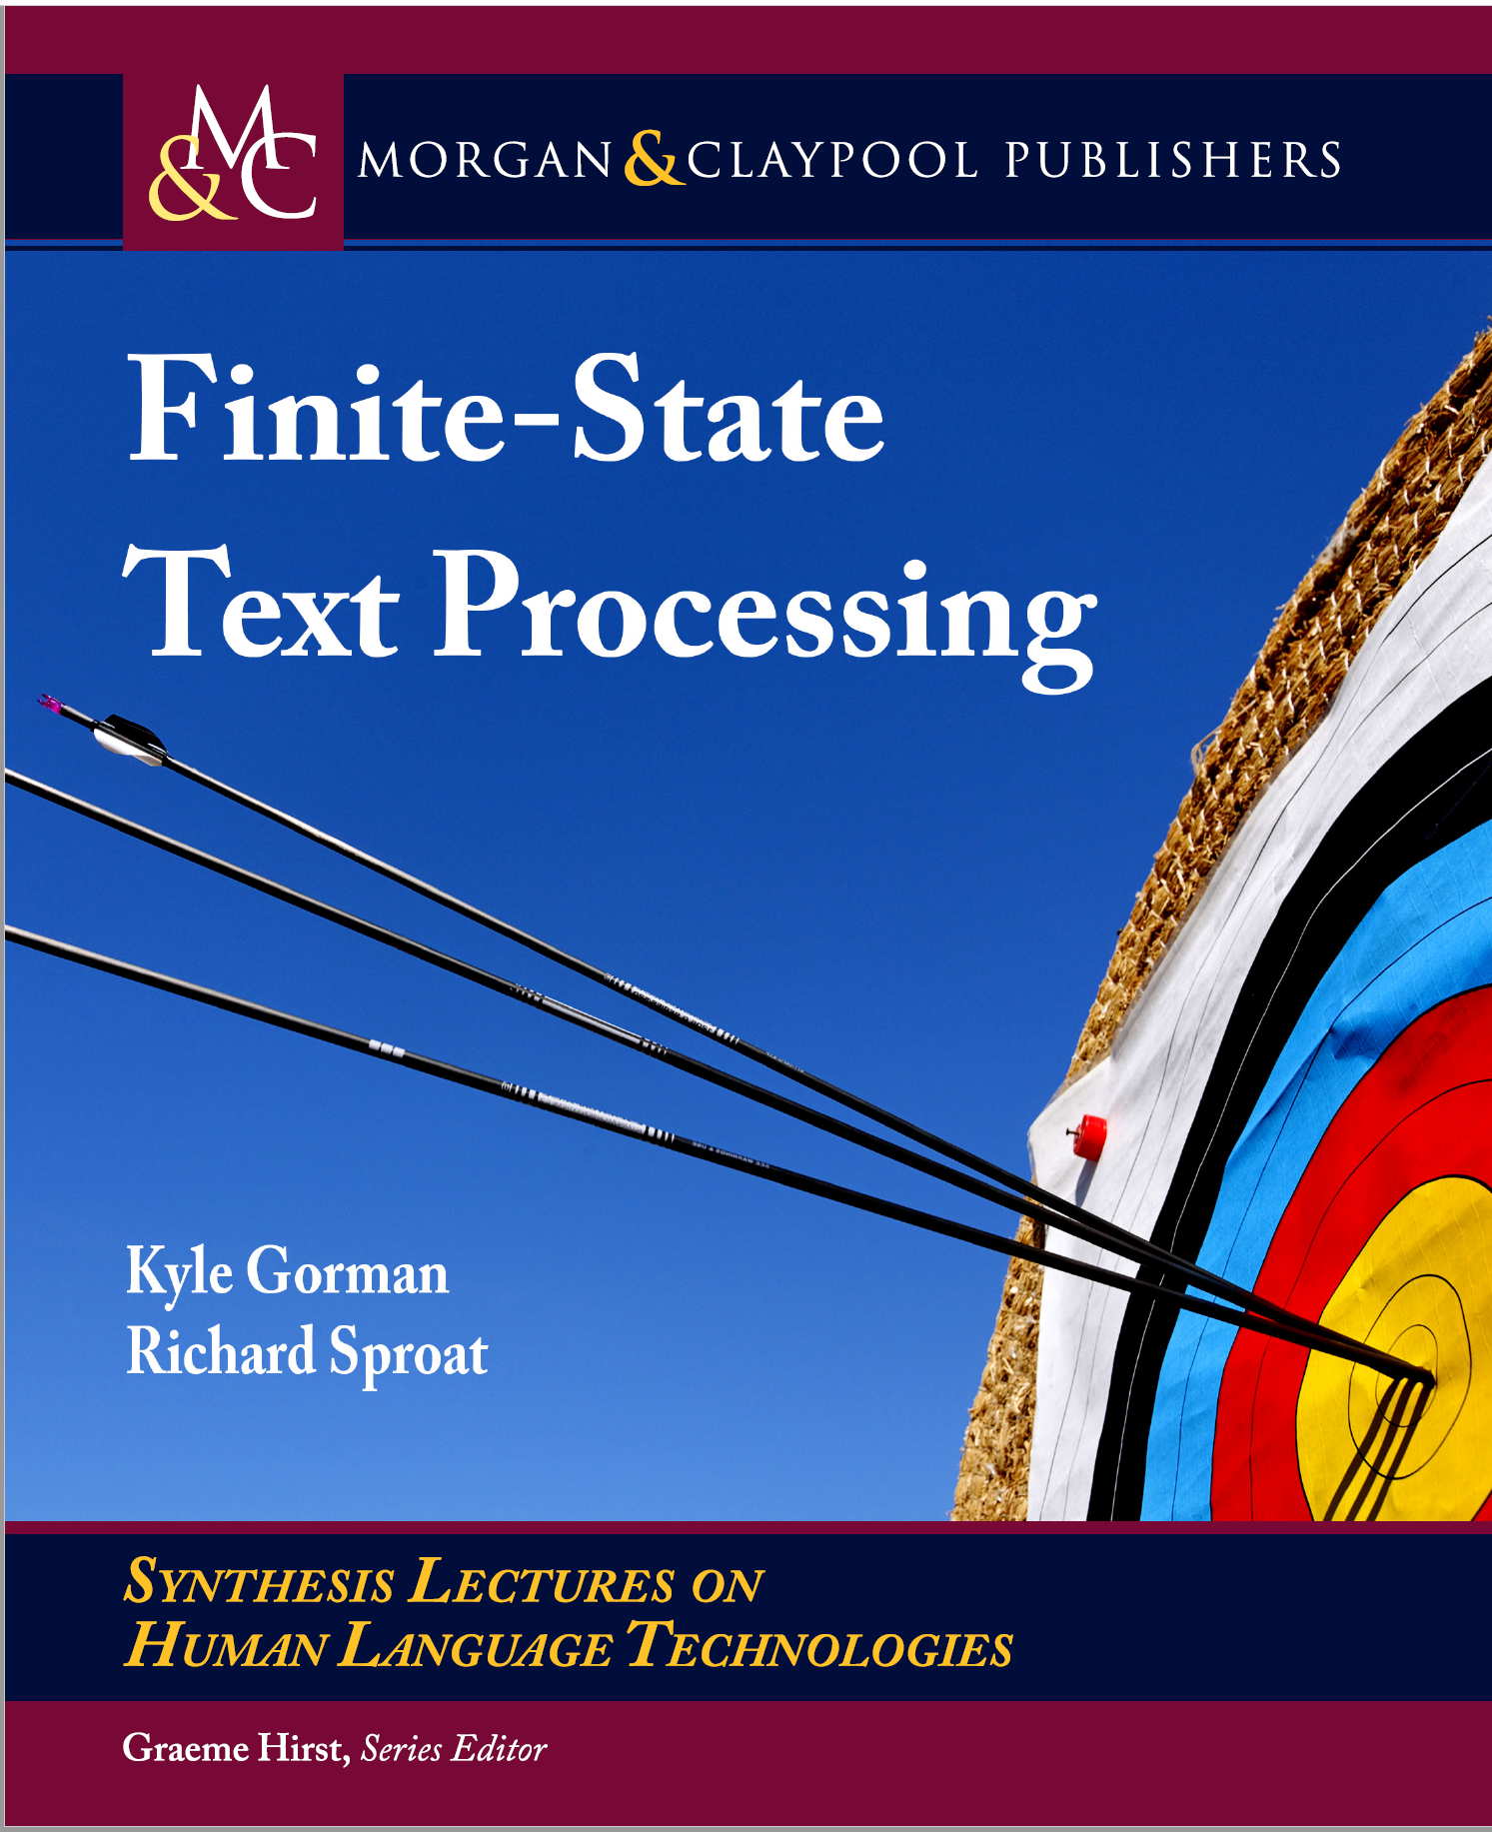
From: Finite-State Text Processing (May 2021)
Kyle Gorman (Graduate Center, City University of New York) ,
Richard Sproat (Google LCC)
In our opinion, finite-state central role in speech and language technologies and are not going away any time soon. At Google, the OpenFst and OpenGrm libraries remain absolutely essential for latency-sensitive applications like voice search, automated captions in YouTube, and the Google Assistant. Many Google engineers and linguists working on speech and language processing specialize in WFST algorithms or grammar development.
While we cannot speak to practices elsewhere in the tech industry, Pusateri et al. (2017) reports that the Apple’s Siri assistant uses finite-state grammars…
Notes:
In our opinion, finite-state methods still play a central role in speech and language technologies and are not going away any time soon. At Google, the OpenFst and OpenGrm libraries remain absolutely essential for latency-sensitive applications like voice search, automated captions in YouTube, and the Google Assistant. Many Google engineers and linguists working on speech and language processing specialize in WFST algorithms or grammar development.
While we cannot speak to practices elsewhere in the tech industry, Pusateri et al. (2017) reports that the Apple’s Siri assistant uses finite-state grammars—hybridized with a neural network— for inverse normalization, i.e., to convert ASR transcripts to a human-readable form. The powerful Kaldi speech recognition toolkit—widely used by academic researchers—uses a WFST decoder, implemented with OpenFst. Other technologies—including modern neural networks— have begun to encroach on the state of the art for speech technologies, and may ultimately render WFSTs obsolete, but such technologies still struggle to compete on latency, particularly for embedded platforms (e.g., mobile devices) lacking the specialized hardware needed to support large neural networks. For instance, at the time of writing the neural network-based text normalization system described by Zhang et al. (2019), which is used to synthesize U.S. English driving directions for Google Maps, nonetheless exceeds the computational capacity of conventional mobile devices.

Slide 15
Knowledge-Formalisms Map
(including probabilistic & neural formalisms)
90s-2000s
2010s
State Machines (and prob. versions)
(Finite State Automata,Finite State Transducers, Markov Models)
Neural Models, Neural Sequence Modeling
Morphology
Machine Learning
Syntax
Rule systems (and prob. versions)
(e.g., (Prob.) Context-Free Grammars)
Semantics
Pragmatics
Discourse and Dialogue
Logical formalisms (First-Order Logics, Prob. Logics, Neural Tree Models)
AI planners (MDP Markov Decision Processes, Reinforcement learning)
Notes:
My Conceptual map - This is the master plan
Markov Models used for part-of-speech and dialog
Syntax is the study of formal relationship between words
How words are clustered into classes (that determine how they group and behave)
How they group with they neighbors into phrases

Slide 16
Today
Morphology
(English)
State Machines (and prob. versions)
(Finite State Automata (Reg. Exp.),Finite State Transducers, Markov Models)
Neural Models, Neural Sequence Modeling
Machine Learning
Syntax
Rule systems (and prob. versions)
(e.g., (Prob.) Context-Free Grammars)
Semantics
Logical formalisms (First-Order Logics, Prob. Logics, Neural Tree Models)
Pragmatics
Discourse and Dialogue
AI planners (MDP Markov Decision Processes, Reinforcement learning)
Notes:
My Conceptual map - This is the master plan
Markov Models used for part-of-speech and dialog
Syntax is the study of formal relationship between words
How words are clustered into classes (that determine how they group and behave)
How they group with they neighbors into phrases

Slide 17
English Morphology
Def. The study of how words are formed from minimal meaning-bearing units (morphemes)
We can usefully divide morphemes into two classes
  Stems: The core meaning bearing units
  Affixes: Bits and pieces that adhere to stems to change their meanings and grammatical functions
  Examples: unhappily, ……………
Notes:
Each one come up with a word and say what the stem is
Un-happy
unbeliveably
Morphology is the study of the ways that words are built up from smaller meaningful units called morphemes

Slide 18
Word Classes
For now word classes: nouns, verbs, adjectives and adverbs.
We’ll go into the gory details later
Word class determines to a large degree the way that stems and affixes combine
Notes:
we have in mind familiar notions like
Right now we’re concerned with word classes because the way that stems and affixes combine is based to a
large degree on the word class of the stem

Slide 19
English Morphology
We can also divide morphology up into two broad classes
  Inflectional
  Derivational

Slide 20
Inflectional Morphology
The resulting word:
  Has the same word class as the original
  Serves a grammatical/semantic purpose different from the original
Notes:
Inflectional morphology concerns the combination of stems and affixes where the resulting word

Slide 21
Nouns, Verbs and Adjectives (English)
Nouns are simple (not really)
  Markers for plural and possessive
Verbs are only slightly more complex
  Markers appropriate to the tense of the verb and to the person
Adjectives
  Markers for comparative and superlative

Slide 22
Regulars and Irregulars
Some words misbehave (refuse to follow the rules)
  Mouse/mice, goose/geese, ox/oxen
  Go/went, fly/flew
Regulars…
  Walk, walks, walking, walked, walked
Irregulars
  Eat, eats, eating, ate, eaten
  Catch, catches, catching, caught, caught
  Cut, cuts, cutting, cut, cut
Notes:
Ok so it gets a little complicated by the fact that

Slide 23
Derivational Morphology
Derivational morphology is the messy stuff that no one ever taught you.
  Changes of word class
  Less Productive ( -ant V -> N only with V of Latin origin!)
Notes:
More complex than inflection for a number of reasons
Less productive (you cannot add and “able” to any verb) many more exception than inflectional
workerwriter

Slide 24
Derivational Examples
Verb/Adj to Noun
-ation | computerize | computerization
-ee | appoint | appointee
-er | kill | killer
-ness | fuzzy | fuzziness

Slide 25
Derivational Examples
Noun/Verb to Adj
-al | Computation | Computational
-able | Embrace | Embraceable
-less | Clue | Clueless
Notes:
- al can also be V-> N

Slide 26
Compute
Many paths are possible…
Start with compute
  Computer -> computerize -> computerization
  Computation -> computational
  Computer -> computerize -> computerizable
  Compute -> computee

Slide 27
Summary
Morphology
(English)
State Machines (and prob. versions)
(Finite State Automata (Reg. Exp.),Finite State Transducers, Markov Models)
Neural Models, Neural Sequence Modeling
Machine Learning
Syntax
Rule systems (and prob. versions)
(e.g., (Prob.) Context-Free Grammars)
Semantics
Logical formalisms (First-Order Logics, Prob. Logics, Neural Tree Models)
Pragmatics
Discourse and Dialogue
AI planners (MDP Markov Decision Processes, Reinforcement learning)
Notes:
My Conceptual map - This is the master plan
Markov Models used for part-of-speech and dialog
Syntax is the study of formal relationship between words
How words are clustered into classes (that determine how they group and behave)
How they group with they neighbors into phrases

Slide 28
FSAs and Morphology
GOAL1: recognize whether a string is an English word
PLAN:
  First we’ll capture the morphotactics (the rules governing the ordering of affixes in a language)
  Then we’ll add in the actual stems
Notes:
Goal: recognize whether a string is an English word
First we’ll capture…
We could list all of them and just perform a linear search
What is the problem with this idea

Slide 29
FSA for Portion of Noun Inflectional Morphology
Notes:
Reg nouns
ending in –s, -z, -sh, -ch, -x -> es (kiss, waltz, bush, rich, box)
ending –y preceded by a consonant change the –y to -i

Slide 30
Adding the Stems
But it does not express that:
Reg nouns ending in –s, -z, -sh, -ch, -x -> es (kiss, waltz, bush, rich, box)
Reg nouns ending –y preceded by a consonant change the –y to -i
Notes:
We expand each arc with the morphemes that make up the set…
The resulting FSA is defined at the level of words
This incorrectly accept foxs we will see later on how to deal with this
SPELLING CHANGES

Slide 31
Small Fragment of V and N Derivational Morphology
[noun_{i}] eg. hospital
[adj_{al}] eg. formal
[adj_{ous}] eg. arduous
[verb_{j}] eg. speculate
[verb_{k}] eg. conserve
Notes:
An FSA for a small portion fragment of English derivational morphology
It gives an idea of its extreme complexity!
(there are exceptions to many of these constraints!)
Some models of English derivation are based on the more complex context-free grammar

Slide 32
GOAL2: Morphological Parsing/Generation (vs. Recognition)
Recognition is usually not quite what we need.
  Usually given a word we need to find: the stem and its class and morphological features (parsing)
  Or we have a stem and its class and morphological features and we want to produce the word (production/generation)
Examples (parsing)
  From “cats” to “cat +N +PL”
  From “lies” to ……
Notes:
lie +N +PL or lie +V +3SG

Slide 33
Computational problems in Morphology
Recognition: recognize whether a string is an English word (FSA)
Parsing/Generation:
stem, class, lexical features
word
….
….
lie +N +PL
e.g.,
lies
lie +V +3SG
Stemming:
stem
word
….
Notes:
buy +V +PAST-PART
This this+Pron+NomObl+3P+Sg I
s be+Verb+Pres+3sg
only only+Adj
Ambiguous stemming:
Organization -> organ / organize

Slide 34
Finite State Transducers
FSA cannot help….
The simple story
  Add another tape
  Add extra symbols to the transitions
  On one tape we read “cats”, on the other we write “cat +N +PL”
Notes:
FST key technology throughout NLP

Slide 35
FSTs
parsing
generation

Slide 36
(Simplified) FST formal definition
(you can skip 3.4.1 unless you want to work on FST)
Q: a finite set of states
I,O: input and an output alphabets (which may include ε)
Σ: a finite alphabet of complex symbols i:o, i∈I and o∈O
Q_{0:} the start state
F: a set of accept/final states (F⊆Q)
A transition relation δ that maps QxΣ -> 2^{Q}
Notes:
The book also mentions relater (you do not need to be concerned about that)
New edition provides a more sophisticated definition. Look at that and at 3.4.1 only if FST used in project.

Slide 37
FST can be used as…
Translators: input one string from I, output another from O (or vice versa)
Recognizers: input a string from IxO
Generator: output a string from IxO
Notes:
The book also mention relater (you do not need to be concerned about the)

Slide 38
Simple Example
c:c
a:a
t:t
+N:ε
+PL:s
+SG: ε
Transitions (as a translator):
c:c means read a c on one tape and write a c on the other (or vice versa)
+N:ε means read a +N symbol on one tape and write nothing on the other (or vice versa)
+PL:s means read +PL and write an s (or vice versa)
Notes:
Or the opposite !
FSTs for the morphology of a natural language may have 10⁵ – 10⁷ states and arcs

Slide 39
Examples (as a translator)
c:c
a:a
t:t
+N:ε
+PL:s
+SG: ε
lexical
parsing
surface
c
a
t
s
lexical
c
a
t
+N
+SG
generation
surface

Slide 40
Slightly More complex Example
l:l
i:i
e:e
+N:ε
+PL:s
q₀
q₁
q₂
q₃
q₄
q₆
q₅
q₇
+V:ε
+3SG:s
Transitions (as a translator):
l:l means read an l on one tape and write an l on the other (or vice versa)
+N:ε means read a +N symbol on one tape and write nothing on the other (or vice versa)
+PL:s means read +PL and write an s (or vice versa)
…
Notes:
Or the opposite !
[Mhori 97] p-subsequential transducers were introduced, which allow emission of up to p final
output strings.

Slide 41
Examples (as a translator)
l:l
i:i
e:e
+N:ε
+PL:s
q₀
q₁
q₂
q₃
q₄
q₆
+V:ε
q₅
q₇
+3SG:s
lexical
parsing
surface
l
i
e
s
lexical
l
i
e
+V
+3SG
generation
surface

Slide 42
Examples
(as a recognizer and a generator)
l:l
i:i
e:e
+N:ε
+PL:s
q₀
q₁
q₂
q₃
q₄
q₆
+V:ε
q₅
q₇
+3SG:s
lexical
l
i
e
+V
+3SG
surface
l
i
e
s
lexical
surface

Slide 43
FST: inflectional morphology of plural
Some regular-nouns
Notes:
X -> X:X
Some irregular-nouns
o:i
lexical:surface
Notes:
Right lexical tape
Left surface tape
Average high school student knows ~60,000 stems!

Slide 44
Examples
lexical
surface
m
i
c
e
lexical
c
a
t
+N
+PL
surface

Slide 45
Computational Morphology: Problems/Challenges
Ambiguity: one word can correspond to multiple structures (more critical in morphologically richer languages)
Spelling changes: may occur when two morphemes are combined
e.g. butterfly + -s -> butterflies
Notes:
Recall that in non-deterministic recognition multiple paths through a machine may lead to an accept state

Slide 46
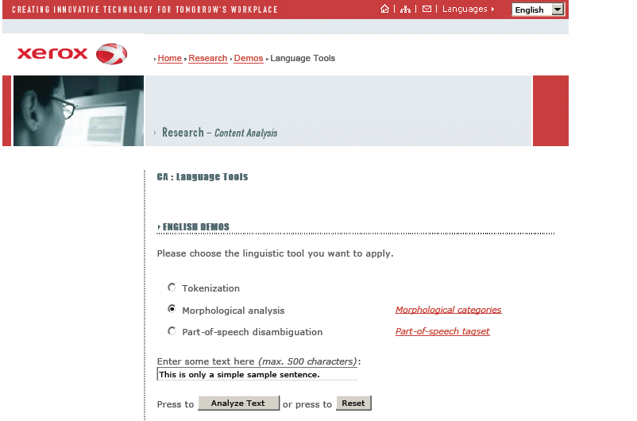
Deal with Morphological Ambiguity
Find all the possible outputs (all paths) and return them all (without choosing)
Then Other processes can look at the neighboring words to choose….
E.g., Part-of-speech tagging
Notes:
How common in English?
Foxes N/V
Barks N/V
For number 2 you need multiple output tapes
For sure more important in morphologically richer languages

Slide 47
(2) Spelling Changes
When morphemes are combined inflectionally the spelling at the boundaries may change
Examples
E-insertion: when –s is added to a word, -e is inserted if word ends in –s, -z, -sh, -ch, -x (e.g., kiss, miss, waltz, bush, watch, rich, box)
Y-replacement: when –s or -ed are added to a word ending with a –y, -y changes to –ie or –i respectively (e.g., butterfly, try)
Notes:
Morpophonemic
Leaves, which is also ambiguous
f-v alternation: wife -> wives, leaf -> leaves

Slide 48
Solution: Multi-Tape Machines
Add intermediate tape
Use the output of one tape machine as the input to the next
Add intermediate symbols
  ^ morpheme boundary
  # word boundary
Notes:
To deal with this we can simply add more tapes and use the output of one tape machine as the input to the next
So to handle irregular spelling changes we’ll add intermediate tapes with intermediate symbols

Slide 49
Multi-Level Tape Machines
FST-1
FST-2
FST-1 translates between the lexical and the intermediate level
FTS-2 handles the spelling changes (due to one rule) to the surface tape
Notes:
Now whenever FST-1 adds a suffix it also adds a ^
To deal with this we can simply add more tapes and use the output of one tape machine as the input to the next
So to handle irregular spelling changes we’ll add intermediate tapes with intermediate symbols
We use one machine to transduce between the lexical and the intermediate level, and another to
handle the spelling changes to the surface tape

Slide 50
FST-1 for inflectional morphology of plural (Lexical <-> Intermediate )
Some
regular-nouns
+PL:^s#
#
#
#
Some irregular-nouns
o:i
+PL:^
ε:s
ε:#
Notes:
^ morpheme boundary symbol
# word boundary symbol

Slide 51





+PL:^s#
#
#
#
o:i
lexical
f
o
x
+N
+PL
intemediate
lexical
m
o
u
s
e
+N
+PL
intemediate

Slide 52
Example
lexical
f
o
x
+N
+PL
intemediate
lexical
m
o
u
s
e
+N
+PL
intemediate
Notes:
It does not do anything if the rule does not apply
A key feature of this machine is that it doesn’t do anything to inputs to which it doesn’t apply.
Meaning that they are written out unchanged to the output tape.

Slide 53
FST-2 for E-insertion
(Intermediate <-> Surface)
E-insertion: when –s is added to a word, -e is inserted if word ends in –s, -z, -sh, -ch, -x
…as in fox^s# <-> foxes
other = any feasible pair that is not on the FST
#: ε
Notes:
other = Any feasible pair that is not in the transducer
Just to show you how complex they are
There is a typo
Try kiss#?

Slide 54



#: ε
intermediate
f
o
x
^
s
#
surface
intermediate
b
o
x
^
i
n
g
#
surface

Slide 55
Examples
intermediate
f
o
x
^
s
#
surface
intermediate
b
o
x
^
i
n
g
#
surface
Notes:
It does not do anything if the rule does not apply
A key feature of this machine is that it doesn’t do anything to inputs to which it doesn’t apply.
Meaning that they are written out unchanged to the output tape.

Slide 56
Where are we?
#

Slide 57
Final Scheme: Part 1

Slide 58
Final Scheme: Part 2

Slide 59
Assignment-1 is out on Canvas (due Sept 23)
Today we did Chp. 3 (2ed) up to 3.10 excluded
(def. of FST: understand the one on slides)
(3.4.1 optional)
For Next Time
Read handout Probability Stats Information theory
Next Lecture:
Start Probabilistic Models for NLP (read Chpt. 5.9 and 4, 4.1 – 4.2 2ndEd; Appendix B, 3, 3.1 3rd Ed)
Noisy Channel – Spelling Checker
Start N-grams

