Slide 1

CPSC 503
Computational Linguistics
Natural Language Processing
Human Language Technology
……
Course Overview- Lecture 1 –
2021-22, Term1
Giuseppe Carenini

Slide 2
Today Sept 9
Overview of the field
Overview of course
  Background knowledge
  Topics
  Activities and Grading
  Administrative Stuff
Introductions (if time left)
Notes:
Introductions?

Slide 3
Natural Language Processing
What is it?
  We’re going to study formalisms, models and algorithms to allow computers to perform useful tasks involving knowledge about human languages.
Notes:
Natural language Processing / Computational Linguistics we’ll use these two term interchangeably
Simply put, computational linguistics is the scientific study of language from a computational perspective.
Computational linguists are interested in providing computational models of various kinds of linguistic phenomena.
These models may be "knowledge-based" ("hand-crafted") or "data-driven" ("statistical" or "empirical").
Work in computational linguistics is in some cases motivated from a scientific perspective in that one is trying to
provide a computational explanation for a particular linguistic or psycholinguistic phenomenon; and in other cases
the motivation may be more purely technological in that one wants to provide a working component of a speech or
natural language system. Indeed, the work of computational linguists is incorporated into many working systems today, including speech recognition systems, text-to-speech synthesizers, automated voice response systems, web search engines, text editors, language instruction materials, to name just a few

Slide 4
Sample Useful Tasks
Any ideas?
Notes:
… involving human languages
In the sense that the computer needs to model some aspects of natural language
Write on board
Little application: spelling checkers, grammar and style checkers

Slide 5
Sample Useful Tasks
Conversational agents: AT&T “How may I help you?” technology
  Apple SIRI…..
Summarization: ”Please summarize my discussion with Sue about 503” “What people say about the new Nikon 5000?”
  Yahoo Paid $30 Million in Cash for the Summly company (2013)
Generation: an automatic commentator of a soccer game (e.g., from output of a vision system)… image captioning….
  ARRIA world leader in NLG- when it floated on London's Alternative Investment Market (AIM) in 2013, it was valued at over £160 million
Notes:
Useful Tasks - Applications
Mix of research and deployed techniques/tasks
Extract meaning from fluent speech via automatic acquisition and exploitation of salient words,
phrases and grammar fragment from a corpus
Speech, language and dialog techniques… Evaluated on live customer
Another generation: generate weather reports in multiple languages
SHOCK: Siri Isn't A Totally Useless Hunk Of Junk From Apple
It turns out Apple's voice-based assistant software, Siri, isn't completely useless.
Siri, which Apple used heavily to market the iPhone 4S, has been regularly trashed by the tech press, and normal people, since it was released.
And when I first got the iPhone, I too, was let down by Siri. The crazy lady didn't even know where I lived! She thought I was in New York, Texas, not New York, New York. She's since fixed that problem and can now tell me the weather in New York, New York when I ask.
However, after a month using Siri, I can say that it's not a complete and utter hunk of junk. It's actually useful, but it's definitely not for normal people, and Apple's decision to market Siri as much as it did is a little suspect.
I ride my bike to and from work, so having a hands free option to send and receive text messages is great. If I get a text, I can squeeze on the mic of Apple's Ear Pods and say, "Read me my unread messages." Siri reads the message and gives me an opportunity to reply to the message.
Or, if I'm riding my bike and I remember something, like, buying toothpaste, I can say, "Remind me to buy toothpaste when I get home," and Siri will set up a reminder.
On Wednesday night, I was riding home and passed a bar that had the Giants-Tigers game on. I asked Siri, "What's the score of the game?" She told me, "5-0." I was stunned since Justin Verlander was supposed to be untouchable. I asked what inning, she told me the fifth.
Siri also works well if I'm driving. I can ask her for directions some place and she'll get them. Or, I can have her send or receive text messages.
That said, Siri can be very fickle. She can take a long time to come up with an answer. She can just conk out and deliver no results. She can rattle of a long list of options when you ask for directions, which is not all that helpful.
And, I personally don't think Siri is simple technology that a normal person would immediately feel comfortable using. Right now, Siri is a nice thing to have, but if it went away tomorrow, I wouldn't be all that upset. The way Apple pitched it, as a must have, revolutionary technology was a mistake. That's why people hated it. Apple over promised and under delivered.
Read more: http://www.businessinsider.com/siri-review-2012-10#ixzz2HJdHCJWR

Slide 6
Sample Useful Tasks (cont’)
Web-based question answering : “Was 1991 an El Nino year? ….Was it the first one after 1982?” “Why was it so intense?”
IBM Watson Jeopardy (now medicine! See next slides)
Document Classification: spam detection, news filtering
Information Extraction ……
…not in 503 ☹ but possible topics for a project ☺
Speech: speech recognition and transcription, text to speech synthesis
Machine Translation
Notes:
https://www.ibm.com/watson/ show this… trust and transparency…. Small datasets….
Everybody does NLP nowdays….. Facebook… amazon… Microsoft…
Speech can be added to most of the above…
Named entities are phrases that contain the names of persons, organizations, locations, times and quantities. Example:
[ORG U.N. ] official [PER Ekeus ] heads for [LOC Baghdad ]
Named Entity Recognition (NER) is a subtask of Information Extraction.

Slide 7


Watson : analyzes natural language questions and content well enough and fast enough to compete and win against champion players at Jeopardy!
NLP systems performing useful NLP tasks are very complicated involving many algorithms (some non-NLP) and many of datasets
When someone tells you that they have solved NLP or even just a subtask of NLP be always skeptical
Transferring results form a game to useful / general solutions is extremely difficult
Source:
IBM
Notes:
The correct Jeopardy! response would be "What is Ritalin?“
This is no easy task for a computer, given the need to perform over an enormously broad domain,
with consistently high precision and amazingly accurate confidence estimations in the correctness of its answers.
Watson’s performance on Jeopardy! is just the opening salvo for a research mission built on decades of
experience in deep Content Analysis, Natural Language Processing, Information Retrieval, Machine Learning and Artificial Intelligence.
Rich natural language questions covering a broad range of general knowledge. It is widely recognized as an entertaining game requiring smart, knowledgeable and quick players.
Computer systems that can directly and accurately answer questions over a broad domain of human knowledge have been envisioned by scientists and writers since the advent of computers themselves. Open domain question answering holds tremendous promise for facilitating informed decision making over vast volumes of natural language content. Applications in business intelligence, healthcare, customer support, enterprise knowledge management, social computing, science and government would all benefit from deep language processing. The DeepQA project is aimed at exploring how advancing and integrating Natural Language Processing (NLP), Information Retrieval (IR), Machine Learning (ML), massively parallel computation and Knowledge Representation and Reasoning (KR&R) can advance open-domain automatic Question Answering. One proof-point in this challenge is to develop a computer system that can successfully compete against top human players at the Jeopardy! quiz show (www.jeopardy.com). Attaining champion-level performance in Jeopardy! requires a computer system to rapidly and accurately answer rich open-domain questions, and to assess its own confidence in a category or question. The system must deliver high degrees of precision and confidence over a very broad range of knowledge and natural language content within a very short 3-second response time. The need for speed and high precision demands a massively parallel computing platform capable of generating, evaluating and combing thousands of hypotheses and their associated evidence. In this talk I will introduce the audience to the Jeopardy! Challenge and the techniques used to tackle it.

Slide 8
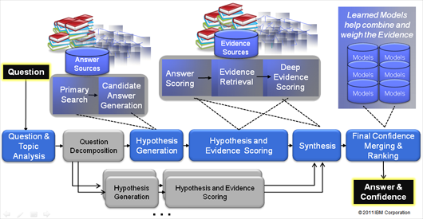
Watson : analyzes natural language questions and content well enough and fast enough to compete and win against champion players at Jeopardy!
“This Drug has been shown to relieve the symptoms of ADD with relatively few side effects."
1000s of algorithms and KBs
3 secs
Massive parallelism
Source:
IBM
Notes:
The correct Jeopardy! response would be "What is Ritalin?“
This is no easy task for a computer, given the need to perform over an enormously broad domain,
with consistently high precision and amazingly accurate confidence estimations in the correctness of its answers.
Watson’s performance on Jeopardy! is just the opening salvo for a research mission built on decades of
experience in deep Content Analysis, Natural Language Processing, Information Retrieval, Machine Learning and Artificial Intelligence.
Rich natural language questions covering a broad range of general knowledge. It is widely recognized as an entertaining game requiring smart, knowledgeable and quick players.
Computer systems that can directly and accurately answer questions over a broad domain of human knowledge have been envisioned by scientists and writers since the advent of computers themselves. Open domain question answering holds tremendous promise for facilitating informed decision making over vast volumes of natural language content. Applications in business intelligence, healthcare, customer support, enterprise knowledge management, social computing, science and government would all benefit from deep language processing. The DeepQA project is aimed at exploring how advancing and integrating Natural Language Processing (NLP), Information Retrieval (IR), Machine Learning (ML), massively parallel computation and Knowledge Representation and Reasoning (KR&R) can advance open-domain automatic Question Answering. One proof-point in this challenge is to develop a computer system that can successfully compete against top human players at the Jeopardy! quiz show (www.jeopardy.com). Attaining champion-level performance in Jeopardy! requires a computer system to rapidly and accurately answer rich open-domain questions, and to assess its own confidence in a category or question. The system must deliver high degrees of precision and confidence over a very broad range of knowledge and natural language content within a very short 3-second response time. The need for speed and high precision demands a massively parallel computing platform capable of generating, evaluating and combing thousands of hypotheses and their associated evidence. In this talk I will introduce the audience to the Jeopardy! Challenge and the techniques used to tackle it.

Slide 9
Not just NLP…
Parsing (PCFGs)
Shallow parsing (NP segmentation with CRFs)
Entity and relation Detection (NER with CRFs)
Logical Form Generation and Matching
Logical Temporal and Spatial Reasoning
Leveraging many databases, taxonomies, and ontologies (help only 25% of questions)
Confidence… Probabilities (Bnets to rank)
Strategy for playing Jeopardy…statistical models of players and games, game-theoretic analyses … .. and application of reinforcement-learning (Buzz-in - Bets)
Notes:
parsing, question classification, question decomposition, automatic source acquisition and evaluation, entity and relation detection, logical form generation, and knowledge representation and reasoning.
These challenges drove the construction of statistical models of players and games, game-theoretic analyses of particular game scenarios and strategies, and the development and application of reinforcement-learning techniques for Watson to learn its strategy for playing Jeopardy.
Dbpedia
Leveraging many loosely formed ontologies
Also databases, taxonomies, and ontologies, such as dbPedia, WordNet, and the Yago⁸ ontology.
a is a crowd-sourced community effort to extract structured information from Wikipedia and make this information available on the Web.
- The authors of Watson report that using Freebase, a large knowledge base about several domains, can at best help with only 25% of the questions, forcing Watson to rely on textual sources alone for
the remaining questions.
The workhorse of strategic decisions is the buzz-in decision, which is required for every non–Daily Double clue on the board. This is where DeepQA’s ability to accurately estimate its confidence in its answer is critical, and Watson considers this confidence along with other game-state factors in making the final determination whether to buzz. Another strategic decision, Final Jeopardy wagering, generally receives the most attention and analysis from those interested in game strategy, and there exists a growing catalogue of heuristics such as “Clavin’s Rule” or the “Two-Thirds Rule” (Dupee 1998) as well as identification of those critical score boundaries at which particular strategies may be used (by no means does this make it easy or rote; despite this attention, we have found evidence that contestants still occasionally make irrational Final Jeopardy bets). Daily Double betting turns out to be less studied but just as challenging since the player must consider opponents’ scores and predict the likelihood of getting the question correct just as in Final Jeopardy. After a Daily Double, however, the game is not over, so evaluation of a wager requires forecasting the effect it will have on the distant, final outcome of the game.
These challenges drove the construction of statistical models of players and games, game-theoretic analyses of particular game scenarios and strategies, and the development and application of reinforcement-learning techniques for Watson to learn its strategy for playing Jeopardy. Fortunately, moderate amounts of historical data are available to serve as training data for learning techniques. Even so, it requires extremely careful modeling and game-theoretic evaluation as the game of Jeopardy has incomplete information and uncertainty to model, critical score boundaries to recognize, and savvy, competitive players to account for. It is a game where one faulty strategic choice can lose the entire match.

Slide 10
From silly project to $1 billion investment
2005-6 “IT’S a silly project to work on, it’s too gimmicky, it’s not a real computer-science test, and we probably can’t do it anyway.” These were reportedly the first reactions of the team of IBM researchers challenged to build a computer system capable of winning “Jeopardy!
………after 8-9 years…
On January 9th 2014, with much fanfare, the computing giant announced plans to invest $1 billion in a new division, IBM Watson Group. By the end of the year, the division expects to have a staff of 2,000 plus an army of external app developers …..Mike Rhodin, who will run the new division, calls it “one of the most significant innovations in the history of our company.” Ginni Rometty, IBM’s boss since early 2012, has reportedly predicted that it will be a $10 billion a year business within a decade.
Notes:
“IT’S a silly project to work on, it’s too gimmicky, it’s not a real computer-science test, and we probably can’t do it anyway.” These were reportedly the first reactions of the team of IBM researchers challenged to build a computer system capable of winning “Jeopardy!
……
On January 9th, with much fanfare, the computing giant announced plans to invest $1 billion in a new division, IBM Watson Group. By the end of the year, the division expects to have a staff of 2,000 plus an army of external app developers working within its “open Watson ecosystem”. It also unveiled a raft of new projects under development, on top of the handful already revealed in health care, financial services and retailing with firms such as WellPoint and the Cleveland Clinic. Mike Rhodin, who will run the new division, calls it “one of the most significant innovations in the history of our company.” Ginni Rometty, IBM’s boss since early 2012, has reportedly predicted that it will be a $10 billion a year business within a decade.

Slide 11
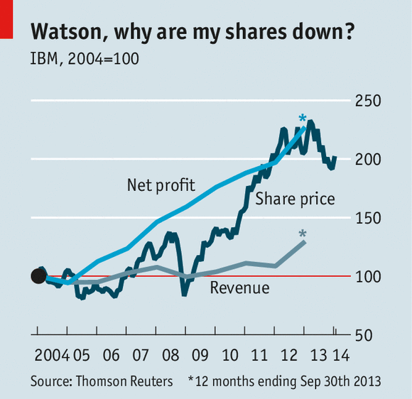
More complex questions in the future…
Or something like: “Should Europe reduce its energy dependency from Russia and what would it take?”

Slide 12
DEBATER (IBM most recent)

Slide 13
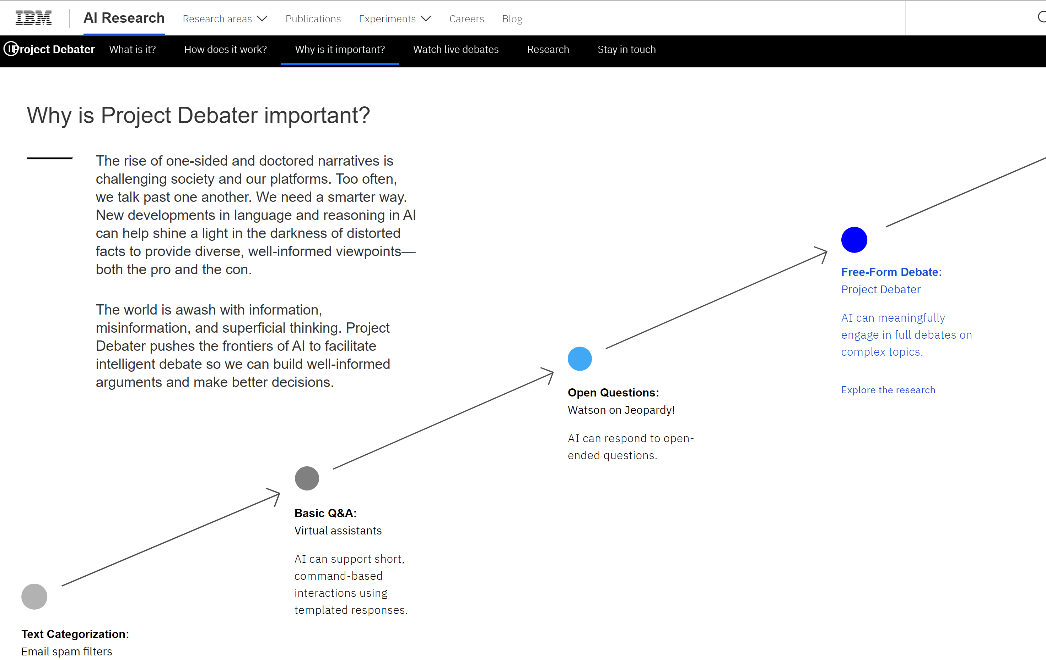
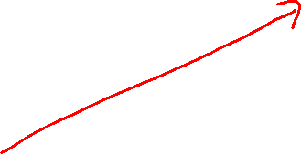




Notes:
Expert Stance Graphs for Computational Argumentation
Orith Toledo-Ronen et al.
ArgMining @ ACL, 2016
Wordnet
including the output of
the ESG syntactic parser (McCord, 1990; McCord
et al., 2012), the TagMe Wikifier (Ferragina and
Scaiella, 2010), named entities recognized with
the Stanford NER (Finkel et al., 2005) and multiword
expressions in WordNet.
First, we train a linear
SVM2 on the PPMI vectors of the words

Slide 14
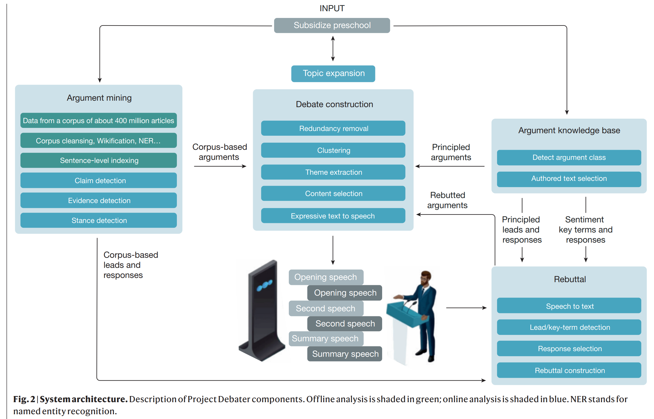

IBM Debater Architecture

Slide 15
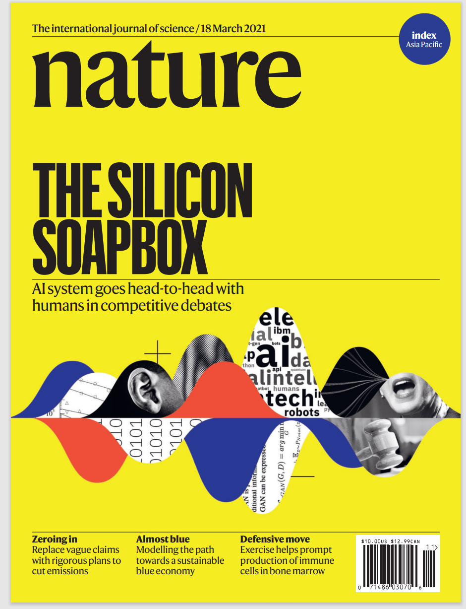

https://www.ibm.com/blogs/research/2021/03/project-debater-api/
https://www.research.ibm.com/artificial-intelligence/project-debater/

Slide 16
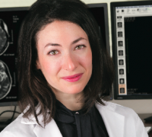


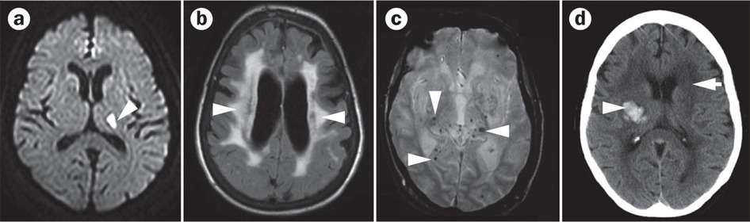
Team in 2016-17 a MSc (Weirui worked in 2018-19) then two postdocs … ongoing….
Example from my own research: Predicting Cerebral Small Vessel Disease
T. Field
The Neurologist
Small Vessel Disease contributes to stroke and dementia
G. Murray
The Speech Expert
Can only be detected with costly MRI
V. Masrani
The Grad Student
Notes:
I am involved in a new project to predict a common brain disease that contributes to strokes and dementia
This disease can only be detected by costly MRI
Cerebral Small Vessel Disease is a common neurodegenerative condition that contributes to 20% of ischemic stroke, more than half of intracerebral hemorrhage and almost half of dementias
Clinical MRI scans will be rated for white matter hyperintensities of presumed vascular origin using the Fazekas scale. Microbleeds will be ascertained using the BOMBS scale, enlarged perivascular spaces using the Edinburgh score and lacunes confirmed using international consensus criteria. Rating scales for the variables above will be converted to dichotomous point scores and summed to create a modified score summarizing total brain burden of cerebral small vessel disease (SVD score).

Slide 17
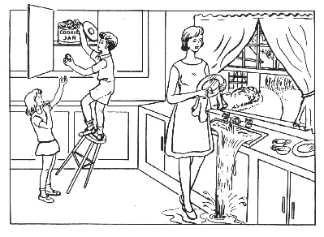
Our Goal
Standard Test “Cookie Theft”
Predict Small Vessel Disease from how a person describes the “Cookie Theft” picture
E.g., what words they use , speech features
Previous NLP work: can predict Alzheimer
“there's a child climbing up getting cookies out of a cookie jar it's a boy and the girl is standing on the and his er stool is tipping over under him and his the girl is standing on the floor with her hand help up for a cookie you remember i lived in america so i use cookie”
We have improve performance for Alzheimer and apply techniques to Small Vessel Disease
Notes:
Our goal is to predict Small Vessel Disease from how a person describes the “Cookie Theft” picture
Previous work has shown this to work for predicting Alzheimer
We will improve performance on Alsheimer and extend techniques to Small Vessel Disease
Participants will undergo voice recordings describing the “Cookie Theft Picture” from the NIH Stroke Scale. Recordings will be transcribed and using tools like the Syntactic Complexity Analyzer (Lu’s L2), the Stanford parser and the Keyplex textual analysis program, a large number of linguistic features will be extracted. These will include lexical features (part-of-speech, word types and frequencies), syntactic complexity, grammaticality, fluency, vocabulary richness, and acoustic features (see (Fraser et al. 2015) for a recent study on predicting Alzheimer, which considered 370 features).
These features will be used to “train” machine learning classifiers to assign transcripts to the CSVD versus the healthy controls. Expanding on previous work, we will apply more sophisticated machine learning algorithms and experiment with domain adaptation. First, instead of simply applying state-of-the-art machine learning techniques (e.g., Support Vector Machines) with default parameters (as was done in previous works on Alzheimer), we will explore the benefits of automated hyper-parameter tuning (Thornton et al., 2012) on CSVD detection. Secondly, we will investigate if larger datasets which were collected to predict other cerebral diseases from transcriptions and recordings of speech samples can be leveraged via domain adaptation for predicting CSVD.

Slide 18
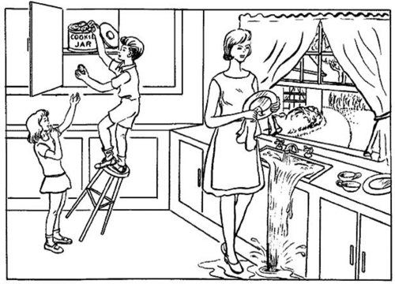
DementiaBank dataset
484 patients
Patients are asked to describe “everything you see going on in this photo”
Answers are transcribed including stutters, false starts, meta comments and filled pauses (“um”, “ah”)
For each patient we have the diagnosis Alzheimer?
“Cookie Theft” Photo
Notes:
- Interviews are randomized to be iid

Slide 19
Supervised Learning
We can formulate this as supervised learning:
Avg. sentence length | Mention Mother | Lexical diversity | …
6 | 0 | 0.4
10 | 1 | 0.2
6 | 0 | 0.3
9 | 1 | 0.9
9 | 0 | 0.95
Alzheimer?
1
1
0
0
0
Input for an object (patient) is a set of features (of the Cookie Theft descriptions).
Output is a desired class label (whether patient has Alzheimer or not).
Goal of supervised learning:
  Use data to write a program mapping from features to labels.
  Program predicts whether patient has Alzheimer (even with new Cookie Theft descriptions).

Slide 20
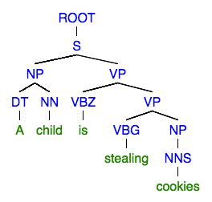
Features of Cookie Theft’s description
136 in total (from Fraser 2015)
Part-of-speech:
  Used Stanford tagger
  Eg. Number of nouns, number of verbs, noun-to-verb ratio, counts of filler words, etc
Syntactic complexity:
  Used Stanford Parser
  Height of parse tree, average sentence length, mean length of clauses, etc
Grammatical constituents:
  Tags from Penn Treebank tagset
  Rate, proportion, frequency of
  NP->DT_NN, VP->VBG_NP, etc,
A parse tree for “a child is stealing cookies”
Notes:
- Interviews are randomized to be iid

Slide 21
Features of Cookie Theft’s description
Psycholinguistics features:
  Age-of-acquisition, frequency, familiarity, imageability, concreteness scores
  Scores came from MRC Psycholinguistic database
Vocabulary richness:
  Number of different metrics used to assess lexical diversity
  Type-token ratio, moving-average type-token ratio, Brunet’s index, and Honore ́’s statistic.
Information content:
  Cookie-theft test related keywords
  eg. “Kitchen”, “mother”, “washing”, “sink”, “stealing”
Repetitiveness:
  Cosine similarity between utterances
Notes:
- Interviews are randomized to be iid

Slide 23
This task will be a running example in some assignments (if we get the new version sufficiently stable)

Slide 24
Natural Language Processing
What is it?
  We’re going to study formalisms, models and algorithms to allow computers to perform useful tasks involving knowledge about human languages.
Notes:
Natural language Processing / Computational Linguistics we’ll use these two term interchangeably
Simply put, computational linguistics is the scientific study of language from a computational perspective.
Computational linguists are interested in providing computational models of various kinds of linguistic phenomena.
These models may be "knowledge-based" ("hand-crafted") or "data-driven" ("statistical" or "empirical").
Work in computational linguistics is in some cases motivated from a scientific perspective in that one is trying to
provide a computational explanation for a particular linguistic or psycholinguistic phenomenon; and in other cases
the motivation may be more purely technological in that one wants to provide a working component of a speech or
natural language system. Indeed, the work of computational linguists is incorporated into many working systems today, including speech recognition systems, text-to-speech synthesizers, automated voice response systems, web search engines, text editors, language instruction materials, to name just a few

Slide 25
Knowledge about Language
Any ideas?

Slide 26
Knowledge about Language
Phonetics and Phonology (sounds)
Morphology (structure of words)
Syntax (structure of sentences)
Semantics (meaning)
Pragmatics (language use)
Discourse and Dialogue (units larger than single utterance)
Notes:
Linguistics part of Comp. Ling. !
Phonetics studies the physical nature of speech sounds: their articulation, acoustic properties and perceptual characteristics
Phonology: what is the inventory of basic sounds (phonemes) in the language and what combinations are possible

Slide 27
Morphology
Def. The study of how words are formed from minimal meaning-bearing units (morphemes)
Examples:
Plural: cat-s, fox-es, fish
Tense: walk-s, walk-ed
Nominalization: kill-er, fuzz-iness
Compounding: book-case,over-load,wash-cloth
Notes:
Inflectional and derivational
Tense: the category that encodes the time of an event with reference to the moment of speaking
Others? Compounding: happy hour(Adj+N), bookcase (N+N), overload (Prep+N), washcloth (V+N)
Adjectives derived from nouns and verbs computation-al, manage-able
Act act-ive act-ive-ate re- act-ive-ate
Free (boy) and bound (-s) morphemes
We can usefully divide morphemes into two classes
Stems: The core meaning bearing units
Affixes: Bits and pieces that adhere to stems to change their meanings and grammatical functions
Inflectional morphology: The resulting word
Has the same word class as the original
Serves a grammatical/semantic purpose different from the original
Derivational morphology is the messy stuff that no one ever taught you.
Changes of word class
Less Productive ( -ant V -> N only with V of Latin origin!)

Slide 28
Syntax
Def. The study of how sentences are formed by grouping and ordering words
Based on: Substitution / Movement / Coordination Tests
Example:
Ming and Sue prefer morning flights
* Ming Sue flights morning and prefer
Notes:
Sentence formation how symbols of the language can be grouped and ordered together
Part of speech: whether a word is a noun, verb or an adjective
Based on Meaning/Inflection/Distribution
Constituency: groups of words behave as a single unit or
Based on:
<Substitution Test (they, it, do so)>
<Movement Test>
<Coordination Test>
Words/phrases order (English SVO)

Slide 29
Semantics
Def. The study of the meaning of words, intermediate constituents and sentences
Examples:
Words: “purchase” vs. “buy”, “hot” vs. “cold”
Sentences: “Mary has a new car”
? “Mary ‘s car is old” ?
…Symbolic structure that corresponds to objects and relations in some world being represented
Notes:
How the meaning of a phrase is related to the meaning of its parts
What sorts of meaning structures and meaning relations obtain in natural language
Semantic relations among words
Link linguistic inputs to a non-linguistic representation of the world
First-Order Logics
Symbol structures that corresponds to objects and relations among objects in some world being represented
…Representation for a particular state of affairs in some world

Slide 30
Pragmatics
(including Discourse and Dialogue)
Def1. The study of the meaning of a sentence that comes from context-of-use
Examples:
“Yesterday, she did much better”
“The judge denied the prisoner’s request because he was cautious/dangerous”
“Can you pass me the salt?
Def2. The study of how language is used to achieve goals (e.g., convince someone to quit smoking)
Notes:
Part of the meaning of a sentence does not come from the parts of the sentence itself or
the way they are combined. Study of language used in context
It comes from world knowledge or from inferences based on tacit conversational rules
Context: beliefs, attitudes, physical environment, previous discourse/dialog
Belief
(1)
Physical environment: We are watching someone performing an action
Previous Discourse”Mary has been trying this exercise for a week.”
(2)
According to previous discourse could be either the judge or the prisoner
(3)
It is never interpreted as a Y/N question

Slide 31
Natural Language Processing
What is it?
  We’re going to study formalisms, models and algorithms to allow computers to perform useful tasks involving knowledge about human languages.
Notes:
Natural language Processing / Computational Linguistics we’ll use these two term interchangeably
Simply put, computational linguistics is the scientific study of language from a computational perspective.
Computational linguists are interested in providing computational models of various kinds of linguistic phenomena.
These models may be "knowledge-based" ("hand-crafted") or "data-driven" ("statistical" or "empirical").
Work in computational linguistics is in some cases motivated from a scientific perspective in that one is trying to
provide a computational explanation for a particular linguistic or psycholinguistic phenomenon; and in other cases
the motivation may be more purely technological in that one wants to provide a working component of a speech or
natural language system. Indeed, the work of computational linguists is incorporated into many working systems today, including speech recognition systems, text-to-speech synthesizers, automated voice response systems, web search engines, text editors, language instruction materials, to name just a few

Slide 32
Formalisms, Models and Algorithms (very brief history of NLP )
… 70s-80s first symbolic models and algorithms for Natural Language
…90s - 00s Probabilistic models HMMs, PCFG and algorithms…machine learning
…10s Neural Models… embeddings, RNNs, Attention
…20s Large Transformer-based Language Models, contextualized embeddings, fine-tuning
Notes:
… to represent the linguistic knowledge….
…

Slide 33
Formalisms, Models and Algorithms
Formalisms allow us to create/learn models of the various kinds of linguistic and non-linguistic knowledge (explicitly vs implicitly)
Algorithms are then used to manipulate representations to create the structures that are needed
Model
Input structure
Output structure
Algorithm
Notes:
… to represent the linguistic knowledge….
…

Slide 34
Simple Example
Formalism : Finite State Transducer (FST)
Model : Morphology of Plural
  Reg-nouns (cat, dog, fox…): plural -s
  Irreg-nouns (goose, mouse,…): plural (geese, mice,…)
  Spelling rules: e.g., fox+s -> foxes
Algorithms: Morphological Parsing and Generation (of plural)
Model
cat
cat +SG
foxes
fox +PL
mice
Algorithm
mouse +PL
goose
goose +SG
Notes:
… to represent the linguistic knowledge….
Takes as input a noun and returns singular form of the noun and whether it was in singular or plural form
Takes the singular form and a morpho-feature for number (sing. Or pl.) and return the corresponding word
Possible application? If you want to search in a text for
We will se how this can be dome efficiently for all word types (not only nouns) and all possible inflections (not just plural)
Key Concept #2: Parsing taking some input and producing some structure for it

Slide 35
From: Finite-State Text Processing
Kyle Gorman, Richard Sproat
May 2021
In our opinion, finite-state methods still play a central role in speech and language technologies and are not going away any time soon. At Google, the OpenFst and OpenGrm libraries remain absolutely essential for latency-sensitive applications like voice search, automated captions in YouTube, and the Google Assistant. Many Google engineers and linguists working on speech and language processing specialize in WFST algorithms or grammar development.
While we cannot speak to practices elsewhere in the tech industry, Pusateri et al. (2017) reports that the Apple’s Siri assistant uses finite-state grammars—hybridized with a neural network— for inverse normalization, i.e., to convert ASR transcripts to a human-readable form. The powerful Kaldi speech recognition toolkit—widely used by academic researchers—uses a WFST decoder, implemented with OpenFst. Other technologies—including modern neural networks— have begun to encroach on the state of the art for speech technologies, and may ultimately render
WFSTs obsolete, but such technologies still struggle to compete on latency, particularly for embedded platforms (e.g., mobile devices) lacking the specialized hardware needed to support large neural networks. For instance, at the time of writing the neural network-based text normalization system described by Zhang et al. (2019), which is used to synthesize U.S. English driving directions for Google Maps, nonetheless exceeds the computational capacity of conventional mobile devices.

Slide 36
Knowledge-Formalisms Map
(no ambiguity / no uncertainty)
Up to the 90s
State Machines
(FiniteStateAutomata,
FiniteStateTransducers)
Morphology
Syntax
Rule systems
(e.g., Context-Free Grammars)
Semantics
Pragmatics
Discourse and Dialogue
Logical formalisms
(First-Order Logics)
AI planners
Notes:
My Conceptual map
Formal models that consists of states, transitions among states and input/output representations
Non probabilistic no uncertainty
We will go back to this throughout the course

Slide 37
Algorithms
Up to the 90s
Transducers: take one kind of structure as input and output another.
Morphological
Structure
Syntactic
Structure
… …
Text
parsing
generation
State-space search with dynamic programming
Need to deal with ambiguity.
Notes:
Many of the algorithms that we’ll study will turn out to be transducers;
algorithms that take one kind of structure as input and output another.
Take one kind of structure (including language) …. Output another (including language)
States represent pairings of partially processed inputs with partially constructed answers
Goals are exhausted inputs paired with complete answers that satisfy some criteria.
As with most interesting problems the spaces are normally too large to exhaustively explore
Don’t do the same work over and over.
Avoid this by building and making use of solutions to sub-problems that must be invariant across all parts of the space.

Slide 38
Ambiguity
What is it? When for some input there are multiple alternative interpretations
Example:
“I made her duck”
How many interpretations ?
  duck : verb (…., ….) / noun (bird, cotton fabric)
  her : dative pronoun/ possessive adjective
  make : create / cook
  make : transitive (single direct obj.) / ditransitive (two objs) / cause (direct obj. + verb)
Notes:
Duck is also semantically ambiguous
Find the most likely interpretation in the given context
Noun
S: (n) duck (small wild or domesticated web-footed broad-billed swimming bird usually having a depressed body and short legs)
S: (n) duck, duck's egg ((cricket) a score of nothing by a batsman)
S: (n) duck (flesh of a duck (domestic or wild))
S: (n) duck (a heavy cotton fabric of plain weave; used for clothing and tents)
Verb
S: (v) duck (to move (the head or body) quickly downwards or away) "Before he could duck, another stone struck him"
S: (v) duck (submerge or plunge suddenly)
S: (v) dip, douse, duck (dip into a liquid) "He dipped into the pool"
S: (v) hedge, fudge, evade, put off, circumvent, parry, elude, skirt, dodge, duck, sidestep (avoid or try to avoid fulfilling, answering, or performing (duties, questions, or issues)) "He dodged the issue"; "she skirted the problem"; "They tend to evade their responsibilities"; "he evaded the questions skillfully"

Slide 39
Some Key Disambiguation Tasks
Part-of-speech
tagging
  duck : verb / noun
  make : create / cook
  her : dative pronoun / possessive adjective
  make : transitive (single direct obj.) / ditransitive (two objs) / cause (direct obj. + verb)
Word Sense
Disambiguation
Syntactic
Disambiguation
Notes:
Duck is also semantically ambiguous
N (bird vs. cotton fabric)
V (plunge under water, lower the head or body suddently)
Find the most likely interpretation in the given context

Slide 40

Sequence Labeling Task (POS Tagging)
Input
Brainpower, not physical plant, is now a firm's chief asset.
Output
Brainpower_NN ,_, not_RB physical_JJ plant_NN ,_, is_VBZ now_RB a_DT firm_NN 's_POS chief_JJ asset_NN ._.
Tag meanings
NNP (Proper N sing), RB (Adv), JJ (Adj), NN (N sing. or mass), VBZ (V 3sg pres), DT (Determiner), POS (Possessive ending), . (sentence-final punct)
Notes:
Penn Treebank part-of-speech tags (including punctuation)

Slide 41

Semantic Role Labeling: Example
Some roles.. (FrameNet for hiring frame)
Employer
Employee
Task
Position
  In 1979 , singer Nancy Wilson HIRED him to open her nightclub act .
  In 1979 , singer Nancy Wilson HIRED him to open her nightclub act .
  Castro has swallowed his doubts and HIRED Valenzuela as a cook in his small restaurant .
  Castro has swallowed his doubts and HIRED Valenzuela as a cook in his small restaurant .
Notes:
Shallow semantic parsing is labeling phrases of a sentence with semantic roles with respect to a target word.
For example, the sentence
“Shaw Publishing offered Mr. Smith a reimbursement last March.”
Is labeled as:
[AGENTShaw Publishing] offered [RECEPIENTMr. Smith] [THEMEa reimbursement] [TIMElast March] .
We work with a number of collaborators, beginning with Dan Gildea in his dissertation work, on automatic semantic parsing. Much of Dan Gildeas's dissertation work was written up here: Daniel Gildea and Daniel Jurafsky. 2002. Automatic Labeling of Semantic Roles. Computational Linguistics 28:3, 245-288. This work also involves close collaboration with the FrameNet and PropBank projects.
Currently, we focus on building joint probabilistic models for simultaneous assignment of labels to all nodes in a syntactic parse tree. These models are able to capture the strong correlations among decisions at different nodes.
CompensationPeripheral
EmployeeCore
EmployerCore
FieldCore
InstrumentPeripheral
MannerPeripheral
MeansPeripheral
PlacePeripheral
PositionCore
PurposeExtra-Thematic
TaskCore
TimePeripheral

Slide 42
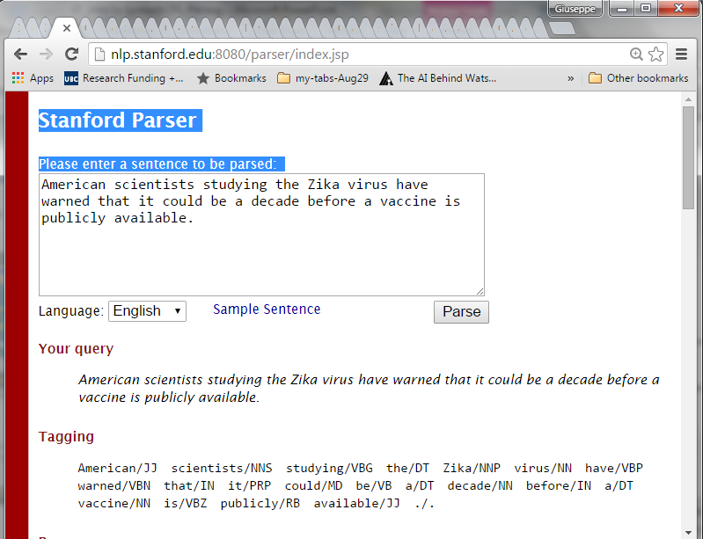
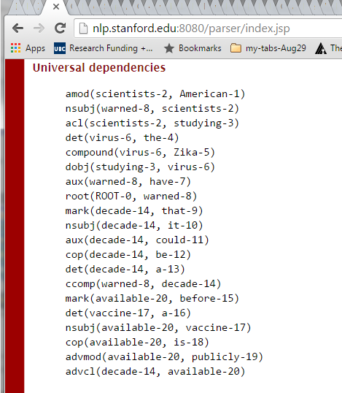
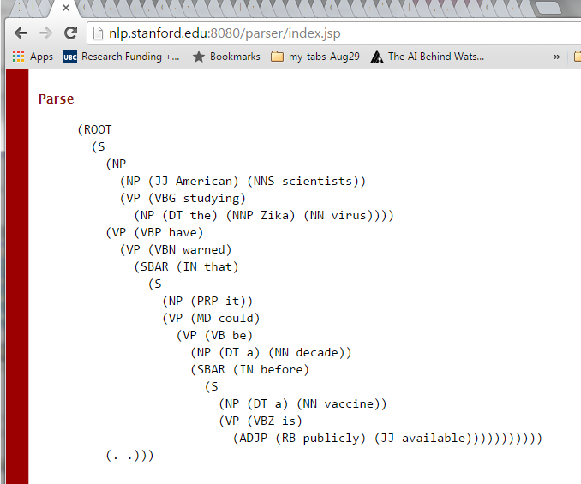

Notes:
Amazing speed
Groupings are meaningful (they can help semantic representation: objects events and their relationships)
Two types of structure: constituency vs. dependency

Slide 43
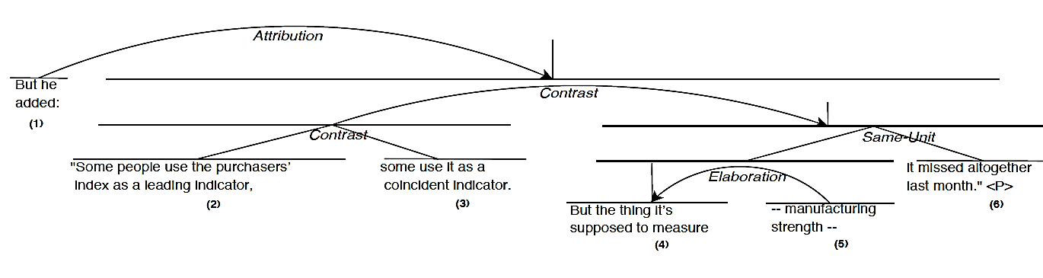
Parsing: Syntax and Discourse
CKY algorithm: used in parsing

Slide 44
Implications of ambiguity
Need probabilistic formalisms/models and corresponding algorithms (e.g., Markov Models and Viterbi algorithm, Recurrent Neural Networks and Forward Computation)
Need machine learning techniques to learn such models:
  Supervised (e.g., Logistic Regression, Deep Learning)
  Unsupervised (e.g., Expectation Maximization, Graph-based methods)
Notes:
So that probabilities can be assigned to possible alternative interpretations
(learn them)
Finding the best state sequence
Viterbi-Algorithm

Slide 45
Knowledge-Formalisms Map
(including probabilistic formalisms)
State Machines (and prob. versions)
(Finite State Automata,Finite State Transducers, Markov Models)
Neural Models, Neural Sequence Modeling
Morphology
Machine Learning
Syntax
When/How to introduce probabilistic graphical models ?
Rule systems (and prob. versions)
(e.g., (Prob.) Context-Free Grammars)
Semantics
Pragmatics
Discourse and Dialogue
Logical formalisms (First-Order Logics, Prob. Logics)
When/How to introduce graph-based methods ?
AI planners (MDP Markov Decision Processes)
Notes:
My Conceptual map - This is the master plan
Markov Models used for part-of-speech and dialog
Syntax is the study of formal relationship between words
How words are clustered into classes (that determine how they group and behave)
How they group with they neighbors into phrases

Slide 46
Knowledge-Formalisms Map
(including probabilistic & neural formalisms)
90s-2000s
2010s
State Machines (and prob. versions)
(Finite State Automata,Finite State Transducers, Markov Models)
Neural Models, Neural Sequence Modeling
Morphology
Machine Learning
Syntax
Rule systems (and prob. versions)
(e.g., (Prob.) Context-Free Grammars)
Semantics
Pragmatics
Discourse and Dialogue
Logical formalisms (First-Order Logics, Prob. Logics, Neural Tree Models)
AI planners (MDP Markov Decision Processes, Reinforcement learning)
Notes:
My Conceptual map - This is the master plan
Markov Models used for part-of-speech and dialog
Syntax is the study of formal relationship between words
How words are clustered into classes (that determine how they group and behave)
How they group with they neighbors into phrases

Slide 47

Most recent neural approaches (Understanding - NLU)
(still problematic)
After 2018…
Neural Language Models (LM) / contextualized embeddings (e.g., BERT, GPT3)
Implicitly learn about morphology, syntax, word meaning…..
Using LM to represent text
Fine-tuning a LM for the task e.g., text classification.
Capture spurious correlations in the training data,
Often right for the wrong reason
Brittle when tested on out of domain examples
Not interpretable
Combine with structures symbolic knowledge to support common sense reasoning
Techniques to Improve interpretability
Notes:
Capture sputious correlations in the training data, often Right for the wrong reason and brittle when tested on out of domain examples
Combine symbolic knowledge with neural approaches

Slide 48
Is Supervised Syntactic Parsing Beneficial for Language Understanding Tasks? An Empirical Investigation
Goran Glavaˇs
University of Mannheim
Data and Web Science Group
Ivan Vuli´c
University of Cambridge
Language Technology Lab
EACL 2021
The key results, obtained through intermediate parsing training (IPT) based on a state-of-theart-level dependency parser, indicate that explicit syntax, at least in our extensive experiments, provides negligible impact on LU tasks.

Slide 49
Most recent neural approaches (Generation - NLG)
(still problematic)
After 2018…
Neural Language models (LM) / contextualized embeddings (e.g., BERT, GPT3)
Implicitly learn about morphology, syntax, word meaning…..
Using LM to generate text
No underlying logical argument
No long-distance consistency
Content is not anchored to any intentions (just hallucination)
Text planning: start from communicative goals and select and structure content to achieve those
Notes:
Capture sputious correlations in the training data, often Right for the wrong reason and brittle when tested on out of domain examples
Combine symbolic knowledge with neural approaches

Slide 50
Notes on Machine Learning: Neural vs Traditional
(7 points overall – some can be outdated 2021)
If you have plenty of training data. Neural models typically offer state of the art performances
Often you can do better by also injecting
  Surface features (e.g. from syntactic tree)
  Domain knowledge
Often you can do better by integrating neural models with “traditional” models (e.g. Conditional random Fields)
In some applications you may want to trade-off accuracy for transparency & interpretability (neural are poor on this)
Sometimes you just do not have much data… semi-supervised can be an option
BUT
So we need to study these structures
So we need to study these models
Explore this in readings + projects
Notes:
Neural language models of the form presented here do have some limitations: predicting
the probability of a word in context is much more expensive than using a traditional
language model, and working with large vocabulary sizes and training corpora can become prohibitive.
However, they do make better use of the data, and can get very competitive perplexities
even with relatively small training set sizes.
When applied in the context of a machine-translation system, neural language models do
not always improve the translation quality over traditional Kneser-Ney smoothed language models.
However, translation quality does improve when the probabilities from a traditional language
model and a neural one are interpolated. It seems that the models complement each other: the
neural language models generalize better to unseen events, but sometimes this generalization can
hurt the performance, and the rigidity of the traditional models is preferred. As an example, consider
the opposite of the colors example above: a model is asked to assign a probability to the
sentence red horse. A traditional model will assign it a very low score, as it likely observed such
⁸Such skip-grams were explored also for non-neural language models; see Pelemans et al. [2016] and the references therein.

Slide 51
Example of point 3 for Language Models - do better by integrating neural models with “traditional” models
(Goldberg 2017)
When applied in the context of a machine-translation system, neural language models do not always improve the translation quality over traditional Kneser-Ney smoothed language models. However, translation quality does improve when the probabilities from a traditional language model and a neural one are interpolated. It seems that the models complement each other: the neural language models generalize better to unseen events, but sometimes this generalization can hurt the performance, and the rigidity of the traditional models is preferred. As an example, consider the opposite of the colors example above: a model is asked to assign a probability to the sentence red horse. A traditional model will assign it a very low score, as it likely observed suchan event only a few times, if at all. On the other hand, a neural language model may have seen brown horse, black horse, and white horse, and also learned independently that black, white, brown, and red can appear in similar contexts. Such a model will assign a much higher probability to the
event red horse, which is undesired.
Notes:
Neural language models of the form presented here do have some limitations: predicting
the probability of a word in context is much more expensive than using a traditional
language model, and working with large vocabulary sizes and training corpora can become prohibitive.
However, they do make better use of the data, and can get very competitive perplexities
even with relatively small training set sizes.
When applied in the context of a machine-translation system, neural language models do
not always improve the translation quality over traditional Kneser-Ney smoothed language models.
However, translation quality does improve when the probabilities from a traditional language
model and a neural one are interpolated. It seems that the models complement each other: the
neural language models generalize better to unseen events, but sometimes this generalization can
hurt the performance, and the rigidity of the traditional models is preferred. As an example, consider
the opposite of the colors example above: a model is asked to assign a probability to the
sentence red horse. A traditional model will assign it a very low score, as it likely observed such
⁸Such skip-grams were explored also for non-neural language models; see Pelemans et al. [2016] and the references therein.

Slide 52
Example of point 3 for Pragmatics
Speech Act Modeling of Written Asynchronous Conversations: A Neural CRF Approach
Shafiq Joty, and Tasnim Mohiuddin. In Computational Linguistics (Special Issue on Language in Social Media, Exploiting discourse and other contextual information) : 2018.
CRF are probabilistic graphical models !

Slide 53
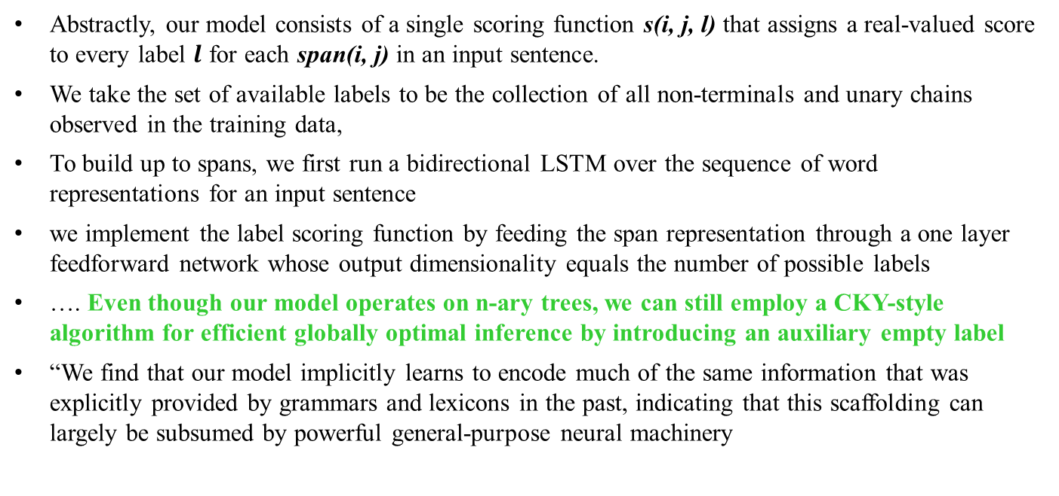
Example of 3 (NAACL 2018)
What’s Going On in Neural Constituency Parsers? An Analysis,
David Gaddy, Mitchell Stern, and Dan Klein, Computer Science Division, University of California, Berkeley
Abstractly, our model consists of a single scoring function s(i, j, l) that assigns a real-valued score to every label $l$ for each span(i, j) in an input sentence.
We take the set of available labels to be the collection of all non-terminals and unary chains observed in the training data,
To build up to spans, we first run a bidirectional LSTM over the sequence of word representations for an input sentence
we implement the label scoring function by feeding the span representation through a one layer feedforward network whose output dimensionality equals the number of possible labels
…. Even though our model operates on n-ary trees, we can still employ a CKY-style algorithm for efficient globally optimal inference by introducing an auxiliary empty label
“We find that our model implicitly learns to encode much of the same information that was explicitly provided by grammars and lexicons in the past, indicating that this scaffolding can largely be subsumed by powerful general-purpose neural machinery
Notes:
A number of differences have emerged between
modern and classic approaches to constituency
parsing in recent years, with structural
components like grammars and featurerich
lexicons becoming less central while recurrent
neural network representations rise in
popularity. The goal of this work is to analyze
the extent to which information provided
directly by the model structure in classical systems
is still being captured by neural methods.
To this end, we propose a high-performance
neural model (92.08 F1 on PTB) that is representative
of recent work and perform a series
of investigative experiments. We find that
our model implicitly learns to encode much of
the same information that was explicitly provided
by grammars and lexicons in the past,
indicating that this scaffolding can largely be
subsumed by powerful general-purpose neural
machinery.

Slide 54
Example of point 4 (trade-off accuracy vs. interpretability) for NLG
Learning Neural Templates for Text Generation. Sam Wiseman, Stuart Shieber and Alexander Rush EMNLP (Nov) 2018
While neural, encoder-decoder models have had significant empirical success in text generation, there remain several unaddressed problems with this style of generation. Encoder decoder models are largely (a) uninterpretable, and (b) difficult to control in terms of their phrasing or content. This work proposes a neural generation system using a hidden semimarkov model (HSMM) decoder, which learns latent, discrete templates jointly with learning to generate. We show that this model learns useful templates, and that these templates make generation both more interpretable and controllable. Furthermore, we show that this approach scales to real data sets and achieves strong performance nearing that of encoder decoder text generation models.

Slide 55
Notes on Machine Learning
Multi-task learning ….
Transfer Learning …..
So we need to study these structures
So we need to study these models
Explore this in readings + projects

Slide 56
Notes on Machine Learning
6. Sometimes well known symbolic formal systems (models and inference algorithms) support the interpretation of current neural models as well as facilitates the development of new ones
Rational Recurrences. Hao Peng, Roy Schwartz, Sam Thomson and Noah A. Smith EMNLP (Nov) 2018
In this work we show that many neural models are more interpretable than previously thought, by drawing connections to weighted finite state automata (WFSAs). We study several recently proposed RNN architectures and show that one can use WFSAs to characterize their recurrent updates. We call such models rational recurrences (§3).1 Analyzing recurrences in terms of WFSAs provides a new view of existing models and facilitates the development of new ones
So we need to study these symbolic formal systems

Slide 57
Notes on Machine Learning
7. Tentative….Sometimes you care more about efficiency of learning and/or efficiency of prediction
Language models
Neural language models of the form presented here do have some limitations: predicting the probability of a word in context is much more expensive than using a traditional language model, and working with large vocabulary sizes and training corpora can become prohibitive.
However, they do make better use of the data, and can get very competitive perplexities even with relatively small training set sizes.
(Neural Network Methods for Natural Language Processing, Yoav Goldberg, 2017)
- See also note on WFST and latency slide 35
Notes:
Other technologies—including modern neural networks— have begun to encroach on the state of the art for speech technologies, and may ultimately render
WFSTs obsolete, but such technologies still struggle to compete on latency, particularly for embedded platforms (e.g., mobile devices) lacking the specialized hardware needed to support large neural networks. For instance, at the time of writing the neural network-based text normalization system described by Zhang et al. (2019), which is used to synthesize U.S. English driving directions for Google Maps, nonetheless exceeds the computational capacity of conventional mobile devices.

Slide 58
Very recent: 2020 TACL
(point 3 integrating neural models with “traditional” models )
Unsupervised Discourse Constituency Parsing Using Viterbi EM (Noriki Nishida, Hideki Nakayama)
..we introduce an unsupervised discourse constituency parsing algorithm. We use Viterbi EM with a margin-based criterion to train a neural span-based discourse parser in an unsupervised manner. We also propose initialization methods for Viterbi training of discourse constituents based on our prior knowledge of text structures. Experimental results demonstrate that our unsupervised parser achieves comparable or even superior performance to fully supervised parsers. ….
Notes:
Unsupervised Discourse Constituency Parsing Using Viterbi EM
Noriki Nishida, Hideki Nakayama
Abstract
In this paper, we introduce an unsupervised discourse constituency parsing algorithm. We use Viterbi EM with a margin-based criterion to train a span-based discourse parser in an unsupervised manner. We also propose initialization methods for Viterbi training of discourse constituents based on our prior knowledge of text structures. Experimental results demonstrate that our unsupervised parser achieves comparable or even superior performance to fully supervised parsers. We also investigate discourse constituents that are learned by our method.

Slide 59
Very Recent: Dialog system Combining FST in neural architecture
(point 3 integrating neural models with “traditional” models )
Yiheng Zhou, Yulia Tsvetkov, Alan W Black, and Zhou Yu. 2020. Augmenting non-collaborative dialog systems with explicit semantic and strategic dialog history.
In International Conference on Learning Representations.
Notes:
Augmenting Non-Collaborative Dialog Systems with Explicit Semantic and Strategic Dialog History
Yiheng Zhou, Yulia Tsvetkov, Alan W Black, Zhou Yu
25 Sep 2019 (modified: 11 Mar 2020)ICLR 2020 Conference Blind SubmissionReaders: EveryoneShow BibtexShow Revisions
Original Pdf: pdf
Keywords: dialog systems, history tracking
Abstract: We study non-collaborative dialogs, where two agents have a conflict of interest but must strategically communicate to reach an agreement (e.g., negotiation). This setting poses new challenges for modeling dialog history because the dialog's outcome relies not only on the semantic intent, but also on tactics that convey the intent. We propose to model both semantic and tactic history using finite state transducers (FSTs). Unlike RNN, FSTs can explicitly represent dialog history through all the states traversed, facilitating interpretability of dialog structure. We train FSTs on a set of strategies and tactics used in negotiation dialogs. The trained FSTs show plausible tactic structure and can be generalized to other non-collaborative domains (e.g., persuasion). We evaluate the FSTs by incorporating them in an automated negotiating system that attempts to sell products and a persuasion system that persuades people to donate to a charity. Experiments show that explicitly modeling both semantic and tactic history is an effective way to improve both dialog policy planning and generation performance.

Slide 60
2020. Domain-
Independent extraction of scientific concepts from research articles.
Arthur Brack, Jennifer D’Souza, Anett Hoppe, S¨oren Auer, and Ralph Ewerth. 2020.
In Advances in Information Retrieval, pages 251–266. Springer International Publishing.
Their domain independent model leverages sci-BERT (Beltagy et al., 2019) encodings and a supervised neural network to label concepts. The model consists of a token embedding layer which uses a concatenation of BERT embeddings and a character level convolutional neural net (CNN) based embedding. These are then encoded using bidirectional long short-term memory (LSTM) followed by a multi-layer perceptron. Finally these encodings are decoded using a conditional random field (CRF) decoder.

Slide 61
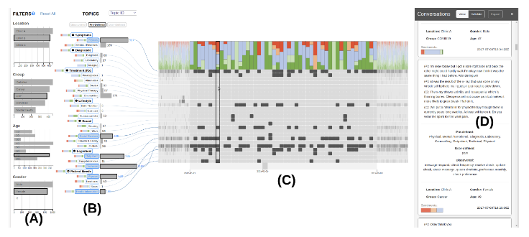
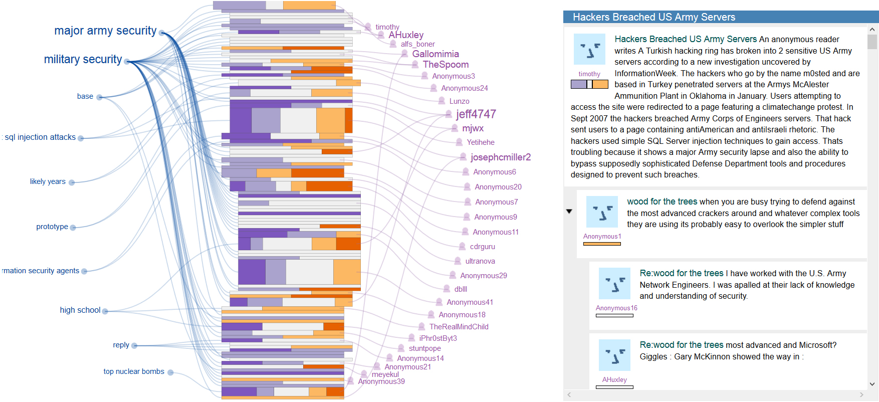
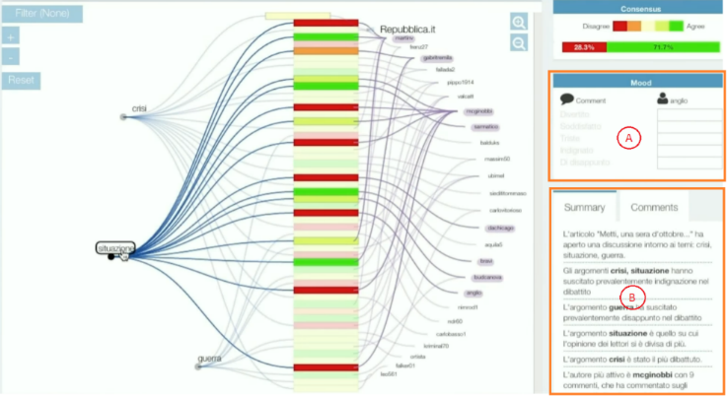
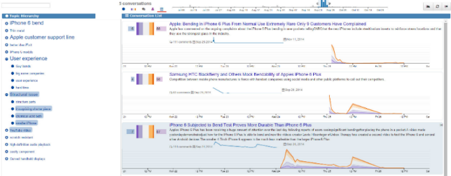
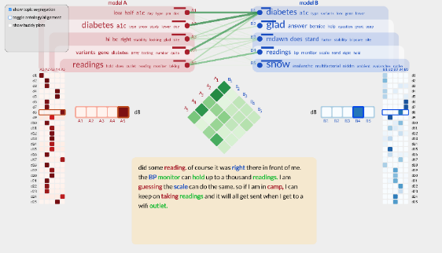
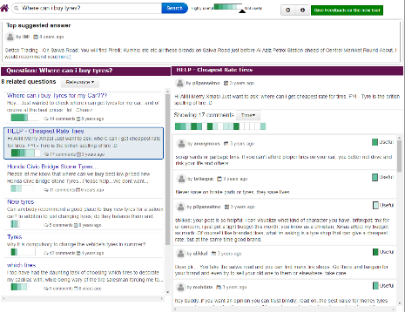
NLP often integrated with InfoVis: Text Analytics
Get / Provide better Education and Healthcare
Stay more informed and participate in daily debates on news
Make more informed purchases / Build better products
Find better answers to their questions
  SENSEI: News Comments
Forums / Reviews in e-commenrce
Doctor patient conversations
Qatar Living: Community Question Answering
Discussions in online courses (MOOCS)
Online Health Communities
ConVis, MultiConVis, Octvis, ConViscope

Slide 62
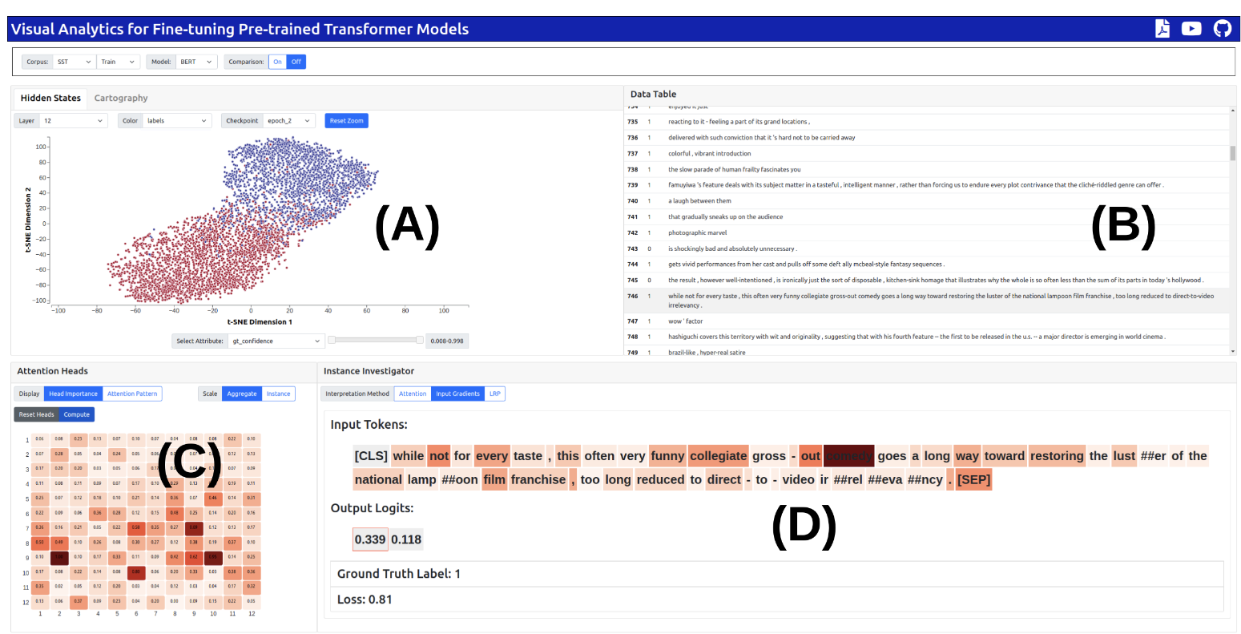
Infovis Key to interpretability of neural models

Slide 63
Why NLP Feasible/Useful Now?
Some trends
  Human-computer communication is increasingly becoming the bottleneck of many applications (Decision-support systems, Robots, Videogames): Conversational agents may address this problem
  The Web! An enormous amount of knowledge is now available in machine readable form as natural language text…. Need to extract/ organize this knowledge so that can be queried, summarized
  And more and more text has been annotated (for syntax, semantics, pragmatics)….. user tags, hashtags
Notes:
Can be exploited for learning our models and algorithms
Can be the input of an infinite number of applications:
Robots, decision-systems, videogames…

Slide 64
Today Sept 9
Overview of the field
Overview of course
  Background knowledge
  Topics
  Activities and Grading
  Administrative Stuff
Introductions
Notes:
Introductions?

Slide 65

503-2021-22-T1 Team
Myself
TA Linzi Xing - PhD student: expert in
  Topic Modeling.
  Neural Topic Segmentation
  (Tree) Transformers
  Neural Text Similarity
MSc UofColorado Boulder 2018

Slide 66
Background
Knowledge
https://docs.google.com/forms/d/e/1FAIpQLSfwVVp-62SKhmQCMf-FOawfCkZ1HZRFP_STt3enPVH1pKb6Rg/viewform?usp=pp_url
Fill out Google Form
https://forms.gle/VS7HsXv7tPgXePrU9
Regular Expressions and Finite State Automata (D and ND)
Basic concepts in probability and information theory:
  Conditional probability
  Bayes’ rule
  Cond. Independence
  Entropy
First Order Logics
Basic supervised Machine Learning
Basic Linear Algebra
Programming! (Java/Python)
Assignment-1 !
Notes:
A language with powerful text processing primitives

Slide 67
Pointers to fill in gaps in background knowledge
- ProbInfoTheory Handout on course webpage
- basic concepts in machine learning (see on Canvas)
http://people.cs.ubc.ca/~poole/aibook/html/ArtInt.html
I am just telling you what is the minimum required (feel free to
explore more! :-)
7.2 only the intro page
7.3.1, 7.3.2, 7.4.1
11.1
11.1.2
- first order logics (please read Chp 17 of textbook up to page 563)
- basic linguistics (pointer on course web page Interactive tutorials
on the English grammar http://www.ucalgary.ca/UofC/eduweb/grammar/)
does not seem to work anymore ☹
Try this https://www.ucl.ac.uk/internet-grammar/home.htm

Slide 68
Course Topics
We’ll be intermingling discussions of:
  Linguistic topics (Knowledge about Language)
    E.g., Semantics
  Computational techniques (Formalisms, Models and algorithms)
    E.g., Prob. Context-free grammars, specific grammars and parsing, Learning word Encodings, seq2seq Neural Models.
  Applications (Useful Tasks)
    E.g., Summarization
No Speech, no machine translation ☹
Notes:
Remember what semantics was?

Slide 69
Just English?
The examples in this class are for the most part all English.
  Only because it happens to be what we share.
Projects on other languages are welcome.

Slide 70
Activities and (tentative) Grading
Readings:
  Speech and Language Processing by Jurafsky and Martin, Prentice-Hall Most Chapters from NEW 3rd EDITION available online !
~15 Lectures (participation 10%)
3-4 assignments (10% - self assessed)
X? Student Presentations on selected readings (15%)
Readings: Critical summary and Questions(15%)
Project (50%)
  Proposal: 1-2 pages write-up & Presentation (5%)
  Update Presentation (5%)
  Final Presentation and (10%)
  8-10 pages report (30%)
Notes:
The instructor reserves the right to adjust this grading scheme during the term, if necessary
?Assignments hands-on experience with algorithms?

Slide 71
Final Research Oriented Project
Make “small” contribution to open NLP problem
  Read several papers about it
  Either improve on the proposed solution (e.g., using more effective technique)
  Or propose new solution
  Or perform a more informative evaluation / error analysis
Write report discussing results
Present results to class
These can be done in groups (max 2?).
Sample of previous projects on course Webpage
Read ahead in the textbook to get a feel for various areas of NLP
Notes:
This will be a research-oriented project.
Critical review of a research project: read 2-3 papers, try to improve on the solution proposed using a more
effective technique, combining multiple techniques. Propose a different solution.
I’ll prepare a list of possible topics / papers.

Slide 72
Sample Projects from previous years that led to publications ☺
Tanzila Rahman, Shih-Han Chou, Leonid Sigal, Giuseppe Carenini: An Improved Attention for Visual Question Answering. CVPR Workshop 2021
Neural RST-based Evaluation of Discourse Coherence Grigorii Guz Peyman Bateni Darius Muglich AACL/IJCNLP 2020
Comparing the Intrinsic Performance of Clinical Concept Embeddings by their Field of Medicine, John-Jose Nunez Led to paper in workshop LOUHI@EMNLP 2019
Sentiment Analysis with D-Neural Networks. (Bita Najat) Led to paper in the SIGDIAL 2017 conference
Improving discourse parsing by using data generated by another parser. Led to paper in the COLING 2016 conference.
Extractive Summarization and Dialogue Act Modeling on Email Threads: ... (Tatsuro Oya) in 15th Annual SIGdial Meeting on Discourse and Dialogue. 2014.
Evaluating machine learning algorithms for email thread summarization (J. Ulrich) in the 3rd Int'l AAAI Conference on Weblogs and Social Media, San Jose, CA, 2009
Summarization of Evaluative Text: the role of controversiality (J. Cheung) in the Int. Conf. on Natural Language Generation. (INLG 2008), Salt Fork, Ohio, USA, June 12-14, 2008
Many more samples at the course webpage….
Notes:
Useful Tasks - Applications
Mix of research and deployed techniques/tasks
Extract meaning from fluent speech via automatic acquisition and exploitation of salient words,
phrases and grammar fragment from a corpus
Speech, language and dialog techniques… Evaluated on live customer
Another generation: generate weather reports in multiple languages

Slide 73
Final Pedagogical Project
Make “small” contribution to NLP education
  Select an advanced topic that was not covered in class (or was only covered partially/superficially)
  Read/View several educational materials about it (e.g., textbook chp., tutorials, wikipedia, MOOCs ….)
  Select material for the target students
  Summarize material and prepare a lecture about your topic. Specify Learning Goals.
  Develop an assignment to test the learning goals and work out the solution.
These can be done in groups (max 2?)
List of possible topics (coming soon)
Notes:
This will be a research-oriented project.
Critical review of a research project: read 2-3 papers, try to improve on the solution proposed using a more
effective technique, combining multiple techniques. Propose a different solution.
I’ll prepare a list of possible topics / papers.

Slide 74
Communication: UBC Canvas
Announcements
Link on course Web page
Links to Form to assess your current relevant knowledge
Assignments posted there
Questions about assignments
Questions about readings
…..
Notes:
… you cannot wait until the next class

Slide 75
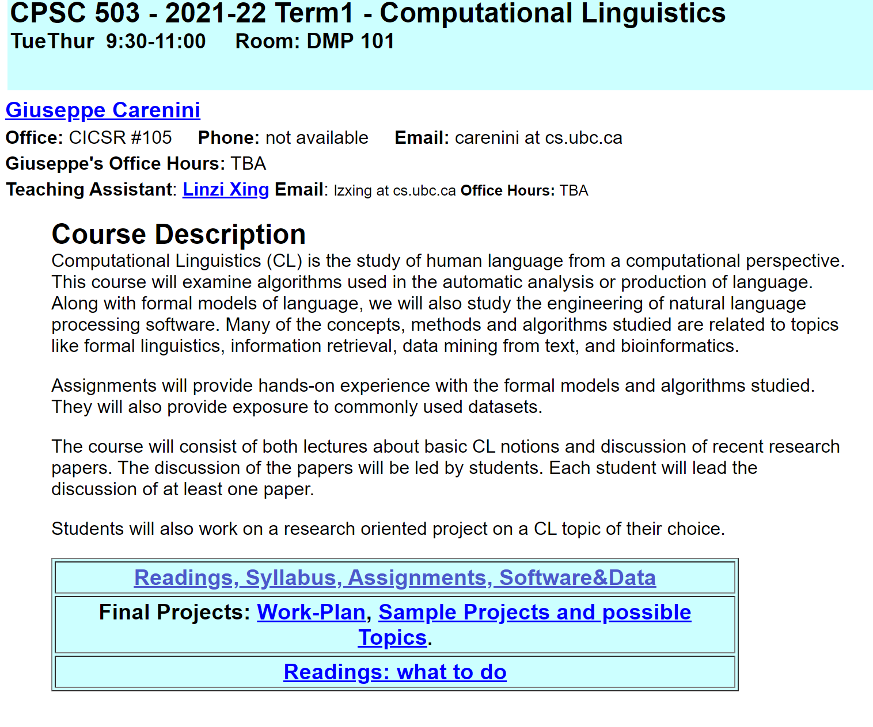
Course Web Page
The course web page (under construction!) can be found on Canvas and also at my homepage and at .
http://www.cs.ubc.ca/~carenini/TEACHING/CPSC503-21-22-T1/503-21-22-T1.html
It will include the syllabus, lecture notes, assignments, additional resources, instructions for projects and readings etc.
You should check it often for new stuff.

Slide 76
Today Sept 9
Overview of the field
Overview of course
  Background knowledge
  Topics
  Activities and Grading
  Administrative Stuff
Introductions (if time left)
Notes:
Introductions?

Slide 77
Introductions
Your Name
Previous experience in NLP?
Why are you interested in NLP?
Are you thinking of NLP as your main research area? If not, what else do you want to specialize in….
Anything else…………

Slide 78
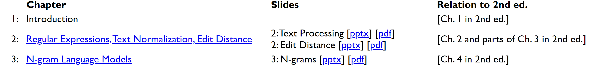






For Next Time
https://forms.gle/VS7HsXv7tPgXePrU9
Fill out Google form.
Assignment 1 will be out by this Tue, due Sept 23

Slide 80
Dementia in class 1 (text classification neural vs surface, use of meta features eg age and domain specific like info unit
Data2text
Text2text
Text2data
Text2infovis
Infovis2text

Slide 81


