Slide 1
CPSC 503
Computational Linguistics
Lecture 10
Giuseppe Carenini

Slide 2
Big Picture: Syntax & Parsing (2013-2014 circa)
Notes:
Shift-reduce constituency parser
As of version 3.4 in 2014, the parser includes the code necessary to run a shift reduce parser, a much faster constituent parser with competitive accuracy. Neural-network dependency parser
In version 3.5.0 (October 2014) we released a high-performance dependency parser powered by a neural network. The parser outputs typed dependency parses for English and Chinese. The models for this parser are included in the general Stanford Parser models package.

Slide 3
Today Feb 12
Probabilistic (PCFG)
Statistical Parsing
  CKY
  Neural Constituency Parsing
  Neural Dependency Parsing
Notes:
Shift-reduce constituency parser
As of version 3.4 in 2014, the parser includes the code necessary to run a shift reduce parser, a much faster constituent parser with competitive accuracy. Models for this parser are linked below.
Neural-network dependency parser
In version 3.5.0 (October 2014) we released a high-performance dependency parser powered by a neural network. The parser outputs typed dependency parses for English and Chinese. The models for this parser are included in the general Stanford Parser models package.

Slide 4
Start Probabilistic CFGs
Formal Definition
Assigning prob. to parse trees and to sentences
Acquiring prob.

Slide 5
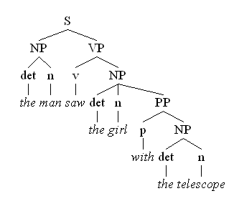
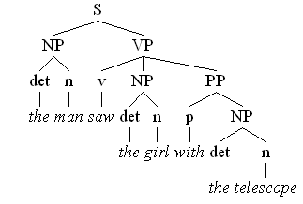
Syntactic Ambiguity….. PP attachment
“the man saw the girl with the telescope”
The man has the telescope
The girl has the telescope
Notes:
I saw the planet with the telescope...

Slide 6
Structural Ambiguity: coordination
Coordination “new students and profs”
Notes:
What are other kinds of ambiguity?
VP -> V NP ; NP -> NP PP
VP -> V NP PP
Attachment non-PP “I saw Mary passing by cs2”
Coordination “new student and profs”
NP-bracketing “French language teacher”
In combinatorial mathematics, the Catalan numbers form a sequence of natural numbers that occur in various counting problems, often involving recursively defined objects.
Catalan numbers (2n)! / (n+1)! n!

Slide 7
Structural Ambiguity: NP-bracketing
NP-bracketing “French language teacher”
Notes:
What are other kinds of ambiguity?
VP -> V NP ; NP -> NP PP
VP -> V NP PP
Attachment non-PP “I saw Mary passing by cs2”
Coordination “new student and profs”
NP-bracketing “French language teacher”
In combinatorial mathematics, the Catalan numbers form a sequence of natural numbers that occur in various counting problems, often involving recursively defined objects.
Catalan numbers (2n)! / (n+1)! n!

Slide 8
Approx. # of parses ?
The famous Chinese deep-space cosmologists and astrophysicists saw a new spiral galaxy with the wide mirror telescope in Hawaii on the night of Jan 21st at 2:34 AM.
Catalan of 5 = 14
Tot= 5 x 2 x 2 x 2 x 14 = 560

Slide 9
Probabilistic CFGs (PCFGs)
Each grammar rule is augmented with a conditional probability
The expansions for a given non-terminal sum to 1
VP -> Verb .55
VP -> Verb NP .40
VP -> Verb NP NP .05
Formal Def: 5-tuple (N, ∑, P, S,D)
Notes:
P(A->beta|A)
D is a function assigning probabilities to each production/rule in P

Slide 10
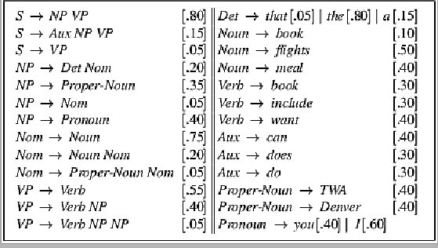
Sample PCFG

Slide 11
PCFGs are used to….
Estimate Prob. of parse tree
Estimate Prob. to sentences
Language model!
Notes:
The probability of a derivation (tree) is just the product of the probabilities of the rules in the derivation.
Product because rule applications are independent (because CFG)
integrate them with n-grams
The probability of a word sequence (sentence) is the probability of its tree in the unambiguous case.
It’s the sum of the probabilities of the trees in the ambiguous case.

Slide 12
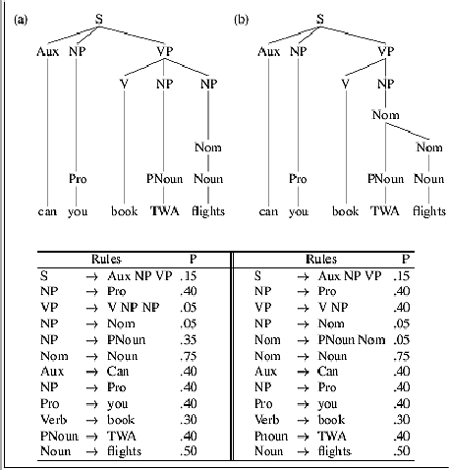
Example
For another complete example see textbook pag. 248-9

Slide 13
Acquiring Grammars and Probabilities
Manually parsed text corpora (e.g., PennTreebank)
Grammar: read it off the parse trees
Ex: if an NP contains an ART, ADJ, and NOUN then we create the rule NP -> ART ADJ NOUN.
Probabilities:
Ex: if the NP -> ART ADJ NOUN rule is used 50 times and all NP rules are used 5000 times, then the rule’s probability is …
Notes:
We can create a PCFG automatically by exploiting manually parsed text corpora, such as the Penn Treebank. We can read off them grammar found in the treebank.
Probabilities: can be assigned by counting how often each item is found in the treebank
Ex: if the NP -> ART ADJ NOUN rule is used 50 times and all NP rules are used 5000 times, then the rule’s probability is 50/5000 = .01

Slide 15
Today Feb 12
Probabilistic (PCFG)
Statistical Parsing
  CKY
  Neural Constituency Parsing
  Neural Dependency Parsing

Slide 16
Probabilistic CFGs
Assigning prob. to parse trees and to sentences
  parse with prob.
  acquiring prob.
Probabilistic Lexicalized CFGs
  Non-terminals more specific/general
  More sophisticated conditioning factors

Slide 17
Probabilistic Parsing:
  Slight modification to dynamic programming approach
  (Restricted) Task is to find the max probability tree for an input
Notes:
We will look at a solution to a restricted version of the general problem of finding all
possible parses of a sentence and their corresponding probabilities

Slide 18
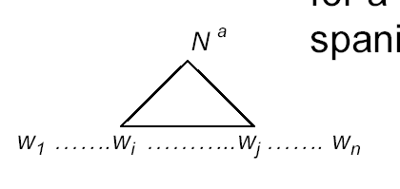
Probabilistic CKY Algorithm
Ney, 1991 Collins, 1999
CKY/CYK (Cocke-Younger-Kasami) algorithm
  A bottom-up parser using dynamic programming
  Assume the PCFG is in Chomsky normal form (CNF)
Definitions
  w₁… w_{n} an input string composed of n words
  w_{ij} a string of words from word i to word j
  µ[i, j, A] : a table entry holds the maximum probability for a constituent with non-terminal A spanning words w_{i}…w_{j}
A
Notes:
First described by Ney, but the version we are seeing here is adapted from Collins

Slide 19
CKY: Base Case
Fill out the table entries by induction: Base case
  Consider the input strings of length one (i.e., each individual word w_{i}) P(A → w_{i})
  Since the grammar is in CNF: A *⇒ w_{i} iff A → w_{i}
  So µ[i, i, A] = P(A → w_{i})
“Can₁ you₂ book₃ TWA₄ flights₅ ?”
Aux
Noun
1
.4
……
.5
5
1
5

Slide 20
CKY: Recursive Case
Recursive case
  For strings of words of length = 2,
  A *⇒ w_{ij} iff there is at least one rule A → BC
  where B derives the first k words (between i and i+k-1 ) and C derives the remaining ones (between i+k and j)
A
  µ[i, j, A] = µ [i, i +k-1, B] *
  µ [i+k, j, C ] *
  P(A → BC)
B
C
i
i+k-1
i+k
j
  (for each non-terminal)Choose the max among all possibilities
Notes:
Compute the probability by multiplying together the probabilities of these two pieces (note that they have been calculated in the recursion)
2<= k <= j – i - 1

Slide 21



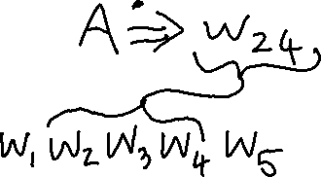




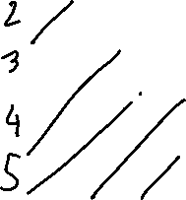
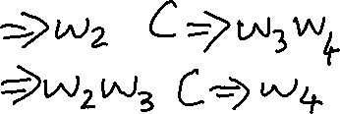






Slide 22
CKY: Termination
  The max prob parse will be µ [ ]
“Can₁ you₂ book₃ TWA₄ flight₅ ?”
5
S
1
1.7x10⁻⁶
5
Notes:
Any other filler for this matrix?
1,3 and 1,4 and 3,5 !

Slide 23
Un-supervised PCFG Learning
Take a large collection of text and parse it
If sentences were unambiguous: count rules in each parse and then normalize
But most sentences are ambiguous: weight each partial count by the prob. of the parse tree it appears in (?!)
Notes:
What if you don’t have a treebank (and can’t get one)

Slide 24
Non-supervised PCFG Learning
Start with equal rule probs and keep revising them iteratively
Parse the sentences
Compute probs of each parse
Use probs to weight the counts
Re-estimate the rule probs
Inside-Outside algorithm
(generalization of forward-backward algorithm)
Notes:
What if you don’t have a treebank (and can’t get one)
Grammar Induction: even more challenging – learn rules and probabilities.

Slide 25
Problems with PCFGs
Most current PCFG models are not vanilla PCFGs
  Usually augmented in some way
Vanilla PCFGs assume independence of non-terminal expansions
But statistical analysis shows this is not a valid assumption
  Structural and lexical dependencies
Notes:
Probabilities for NP expansions do not depend on context.

Slide 26
Structural Dependencies: Problem
E.g. Syntactic subject (vs. object) of a sentence tends to be a pronoun because
  Subject tends to realize the topic of a sentence
  Topic is usually old information (expressed in previous sentences)
  Pronouns are usually used to refer to old information
  Mary bought a new book for her trip. She didn’t like the first chapter. So she decided to watch a movie.
  In Switchboard corpus:
Notes:
I do not get good estimates for the pro
Parent annotation technique
91% of subjects in declarative sentences are pronouns
66% of direct objects are lexical (nonpronominal)
(i.e., only 34% are pronouns)
Subject tends to realize the topic of a sentence
Topic is usually old information
Pronouns are usually used to refer to old information
So subject tends to be a pronoun

Slide 27
How would you address this problem?

Slide 28
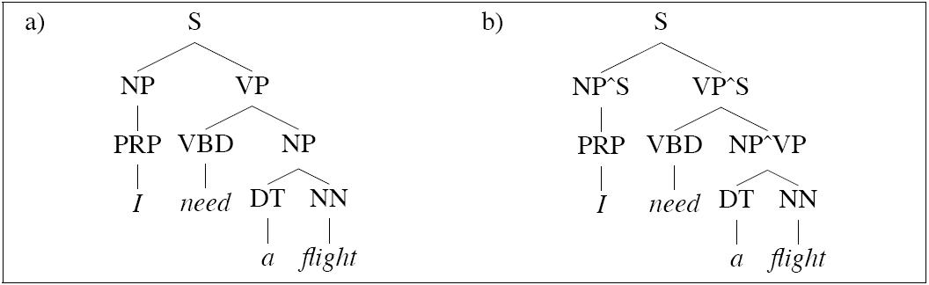
Structural Dependencies: Solution
Split non-terminal. E.g., NPsubject and NPobject
Parent Annotation:
Hand-write rules for more complex struct. dependencies
Splitting problems?
  Automatic/Optimal split – Split and Merge algorithm [Petrov et al. 2006- COLING/ACL]
Notes:
I do not get good estimates for the pro
Parent annotation technique
Splitting problems
- Increase size of the grammar -> reduces amount of training data for each rule -> leads to overfitting

Slide 29
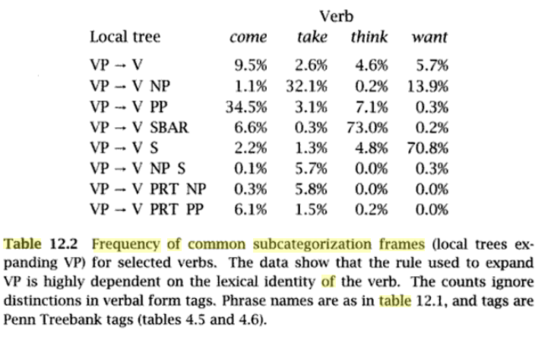
Lexical Dependencies: Problem
SBAR = subordinate clause
Notes:
The verb send subcategorises for a destination, which could be a PP headed by “into”
SBAR stands for Subordinate Clause

Slide 30
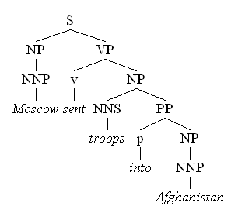
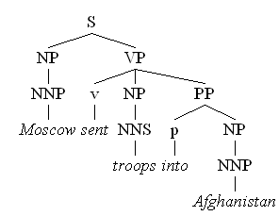
Lexical Dependencies: Problem
Two parse trees for the sentence
“Moscow sent troops into Afghanistan”
(b)
(a)
VP-attachment
NP-attachment
Typically NP-attachment more frequent than VP-attachment
Notes:
The verb send subcategorises for a destination, which could be a PP headed by “into”

Slide 31
Attribute grammar for Lexicalized PCFG : each non-terminal is annotated with its lexical head… many more rules!
(Collins 1999)
We used to have rules like
  VP -> V NP PP
Now we have much more specific rules like
  VP(dumped)-> V(dumped) NP(sacks) PP(into)
Notes:
Each non-terminal is annotated with a single word which is its lexical head
A CFG with a lot more rules!
We used to have rule r
VP -> V NP PP P(r|VP)
That’s the count of this rule divided by the number of VPs in a treebank

Slide 32
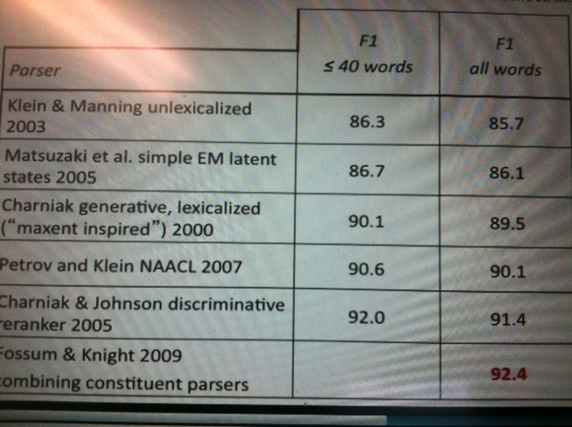
PCFG Parsing State of the art 2010…
  From C. Manning (Stanford NLP)
Notes:
Combining lexicalized and unlexicalized
O lexicalized
* unlexicalized

Slide 33
Today Feb 12
Probabilistic (PCFG)
Statistical Parsing
  CKY
  Neural Constituency Parsing
  Neural Dependency Parsing

Slide 34
Big Picture: Syntax & Parsing (2016)
Notes:
Shift-reduce constituency parser
As of version 3.4 in 2014, the parser includes the code necessary to run a shift reduce parser, a much faster constituent parser with competitive accuracy.
Neural-network dependency parser
In version 3.5.0 (October 2014) we released a high-performance dependency parser powered by a neural network. The parser outputs typed dependency parses for English and Chinese. The models for this parser are included in the general Stanford Parser models package.

Slide 35
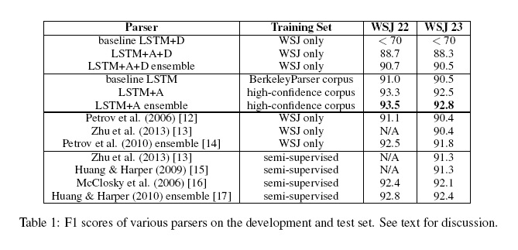
Grammar as a Foreign Language
Computation and Language [cs.CL] Published 24 Dec 2014
Updated 9 Jun 2015
O. Vinyals, L. Kaiser, T. Koo, S. Petrov, I. Sutskever, G. Hinton Google
Fast and Accurate Shift-Reduce Constituent Parsing by Muhua Zhu, Yue Zhang, Wenliang Chen, Min Zhang and Jingbo Zhu (ACL - 2013)

Slide 36


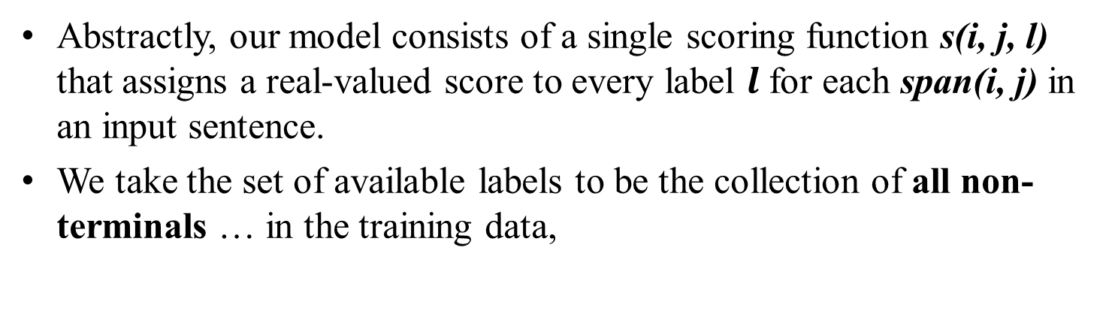


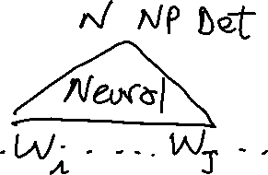

Very recent paper (NAACL 2018)
What’s Going On in Neural Constituency Parsers? An Analysis,
D.Gaddy, M. Stern, D. Klein, Computer Science ., Univ. of California, Berkeley
Abstractly, our model consists of a single scoring function s(i, j, l) that assigns a real-valued score to every label $l$ for each span(i, j) in an input sentence.
We take the set of available labels to be the collection of all non-terminals … in the training data,
You know the terminology and the methods !
You should be able to understand most of this !
Notes:
A number of differences have emerged between modern and classic approaches to constituency parsing in recent years, with structural
components like grammars and feature rich lexicons becoming less central while recurrent neural network representations rise in
popularity. The goal of this work is to analyze the extent to which information provided directly by the model structure in classical systems
is still being captured by neural methods. To this end, we propose a high-performance neural model (92.08 F1 on PTB) that is representative
of recent work and perform a series of investigative experiments. We find that our model implicitly learns to encode much of
the same information that was explicitly provided by grammars and lexicons in the past, indicating that this scaffolding can largely be
subsumed by powerful general-purpose neural machinery.
“Abstractly, our model consists of a single scoring function s(i, j, l) that assigns a real-valued score to every label $l$ for each span(i, j) in an input sentence.
We take the set of available labels to be the collection of all non-terminals and unary chains observed in the training data,
To build up to spans, we first run a bidirectional LSTM over the sequence of word representations for an input sentence
we implement the label scoring function by feeding the span representation through a one layer feedforward network whose output dimensionality equals the number of possible labels
…. Even though our model operates on n-ary trees, we can still employ a CKY-style algorithm for efficient globally optimal inference by introducing an auxiliary empty label
“We find that our model implicitly learns to encode much of the same information that was explicitly provided by grammars and lexicons in the past, indicating that this scaffolding can largely be subsumed by powerful general-purpose neural machinery”

Slide 37



Very recent paper (NAACL 2018)
To build up to spans, we first run a bidirectional LSTM over the sequence of word representations for an input sentence
You know the terminology and the methods !
You should be able to understand most of this !
Notes:
A number of differences have emerged between modern and classic approaches to constituency parsing in recent years, with structural
components like grammars and feature rich lexicons becoming less central while recurrent neural network representations rise in
popularity. The goal of this work is to analyze the extent to which information provided directly by the model structure in classical systems
is still being captured by neural methods. To this end, we propose a high-performance neural model (92.08 F1 on PTB) that is representative
of recent work and perform a series of investigative experiments. We find that our model implicitly learns to encode much of
the same information that was explicitly provided by grammars and lexicons in the past, indicating that this scaffolding can largely be
subsumed by powerful general-purpose neural machinery.
“Abstractly, our model consists of a single scoring function s(i, j, l) that assigns a real-valued score to every label $l$ for each span(i, j) in an input sentence.
We take the set of available labels to be the collection of all non-terminals and unary chains observed in the training data,
To build up to spans, we first run a bidirectional LSTM over the sequence of word representations for an input sentence
we implement the label scoring function by feeding the span representation through a one layer feedforward network whose output dimensionality equals the number of possible labels
…. Even though our model operates on n-ary trees, we can still employ a CKY-style algorithm for efficient globally optimal inference by introducing an auxiliary empty label
“We find that our model implicitly learns to encode much of the same information that was explicitly provided by grammars and lexicons in the past, indicating that this scaffolding can largely be subsumed by powerful general-purpose neural machinery”

Slide 38

Very recent paper (NAACL 2018)
we implement the label scoring function by feeding the span representation through a one layer feedforward network whose output dimensionality equals the number of possible labels
…. we can still employ a CKY-style algorithm for efficient globally optimal inference …..
“We find that our model implicitly learns to encode much of the same information that was explicitly provided by grammars and lexicons in the past, indicating that this scaffolding can largely be subsumed by powerful general-purpose neural machinery
Also this one does (92.08 F1 on PTB)
You know the terminology and the methods !
You should be able to understand most of this !
Notes:
A number of differences have emerged between modern and classic approaches to constituency parsing in recent years, with structural
components like grammars and feature rich lexicons becoming less central while recurrent neural network representations rise in
popularity. The goal of this work is to analyze the extent to which information provided directly by the model structure in classical systems
is still being captured by neural methods. To this end, we propose a high-performance neural model (92.08 F1 on PTB) that is representative
of recent work and perform a series of investigative experiments. We find that our model implicitly learns to encode much of
the same information that was explicitly provided by grammars and lexicons in the past, indicating that this scaffolding can largely be
subsumed by powerful general-purpose neural machinery.
“Abstractly, our model consists of a single scoring function s(i, j, l) that assigns a real-valued score to every label $l$ for each span(i, j) in an input sentence.
We take the set of available labels to be the collection of all non-terminals and unary chains observed in the training data,
To build up to spans, we first run a bidirectional LSTM over the sequence of word representations for an input sentence
we implement the label scoring function by feeding the span representation through a one layer feedforward network whose output dimensionality equals the number of possible labels
…. Even though our model operates on n-ary trees, we can still employ a CKY-style algorithm for efficient globally optimal inference by introducing an auxiliary empty label
“We find that our model implicitly learns to encode much of the same information that was explicitly provided by grammars and lexicons in the past, indicating that this scaffolding can largely be subsumed by powerful general-purpose neural machinery”

Slide 39
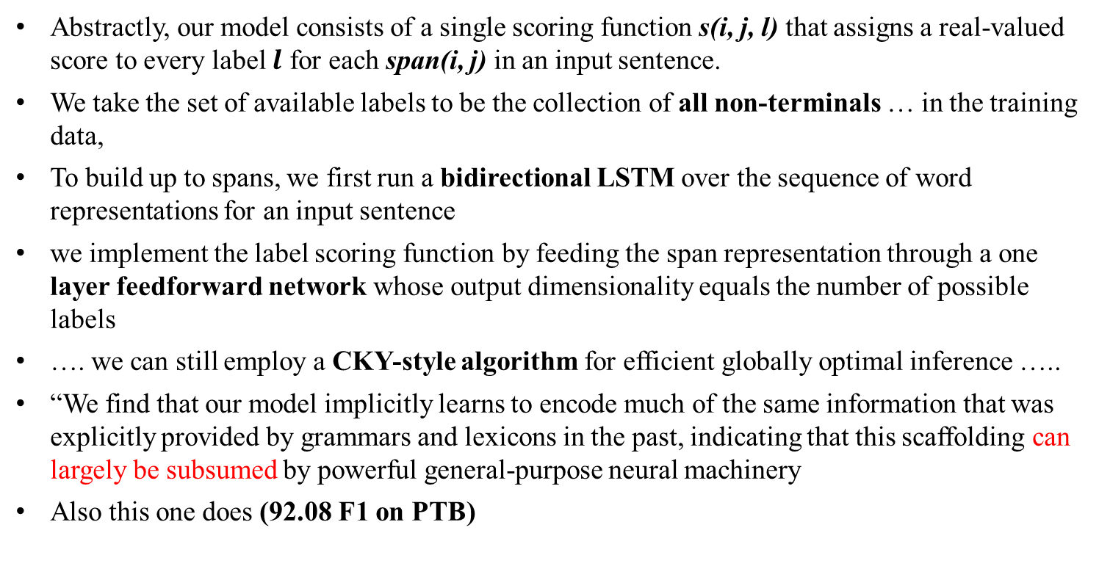
Very recent paper (NAACL 2018)
What’s Going On in Neural Constituency Parsers? An Analysis,
D.Gaddy, M. Stern, D. Klein, Computer Science ., Univ. of California, Berkeley
Abstractly, our model consists of a single scoring function s(i, j, l) that assigns a real-valued score to every label $l$ for each span(i, j) in an input sentence.
We take the set of available labels to be the collection of all non-terminals … in the training data,
To build up to spans, we first run a bidirectional LSTM over the sequence of word representations for an input sentence
we implement the label scoring function by feeding the span representation through a one layer feedforward network whose output dimensionality equals the number of possible labels
…. we can still employ a CKY-style algorithm for efficient globally optimal inference …..
“We find that our model implicitly learns to encode much of the same information that was explicitly provided by grammars and lexicons in the past, indicating that this scaffolding can largely be subsumed by powerful general-purpose neural machinery
Also this one does (92.08 F1 on PTB)
You know the terminology and the methods !
You should be able to understand most of this !
Notes:
A number of differences have emerged between modern and classic approaches to constituency parsing in recent years, with structural
components like grammars and feature rich lexicons becoming less central while recurrent neural network representations rise in
popularity. The goal of this work is to analyze the extent to which information provided directly by the model structure in classical systems
is still being captured by neural methods. To this end, we propose a high-performance neural model (92.08 F1 on PTB) that is representative
of recent work and perform a series of investigative experiments. We find that our model implicitly learns to encode much of
the same information that was explicitly provided by grammars and lexicons in the past, indicating that this scaffolding can largely be
subsumed by powerful general-purpose neural machinery.
“Abstractly, our model consists of a single scoring function s(i, j, l) that assigns a real-valued score to every label $l$ for each span(i, j) in an input sentence.
We take the set of available labels to be the collection of all non-terminals and unary chains observed in the training data,
To build up to spans, we first run a bidirectional LSTM over the sequence of word representations for an input sentence
we implement the label scoring function by feeding the span representation through a one layer feedforward network whose output dimensionality equals the number of possible labels
…. Even though our model operates on n-ary trees, we can still employ a CKY-style algorithm for efficient globally optimal inference by introducing an auxiliary empty label
“We find that our model implicitly learns to encode much of the same information that was explicitly provided by grammars and lexicons in the past, indicating that this scaffolding can largely be subsumed by powerful general-purpose neural machinery”

Slide 40
Very recent paper (NAACL 2018)
What’s Going On in Neural Constituency Parsers? An Analysis,
D.Gaddy, M. Stern, D. Klein, Computer Science ., Univ. of California, Berkeley
Notes:
A number of differences have emerged between modern and classic approaches to constituency parsing in recent years, with structural
components like grammars and feature rich lexicons becoming less central while recurrent neural network representations rise in
popularity. The goal of this work is to analyze the extent to which information provided directly by the model structure in classical systems
is still being captured by neural methods. To this end, we propose a high-performance neural model (92.08 F1 on PTB) that is representative
of recent work and perform a series of investigative experiments. We find that our model implicitly learns to encode much of
the same information that was explicitly provided by grammars and lexicons in the past, indicating that this scaffolding can largely be
subsumed by powerful general-purpose neural machinery.
“Abstractly, our model consists of a single scoring function s(i, j, l) that assigns a real-valued score to every label $l$ for each span(i, j) in an input sentence.
We take the set of available labels to be the collection of all non-terminals and unary chains observed in the training data,
To build up to spans, we first run a bidirectional LSTM over the sequence of word representations for an input sentence
we implement the label scoring function by feeding the span representation through a one layer feedforward network whose output dimensionality equals the number of possible labels
…. Even though our model operates on n-ary trees, we can still employ a CKY-style algorithm for efficient globally optimal inference by introducing an auxiliary empty label
“We find that our model implicitly learns to encode much of the same information that was explicitly provided by grammars and lexicons in the past, indicating that this scaffolding can largely be subsumed by powerful general-purpose neural machinery”

Slide 41
Beyond NLP……. Planning…..
CKY/PCFG Beyond syntax……. Discourse Parsing….. And Dialog
CKY for Probabilistic Discourse parsing: Paper(s?) in Reading
Conversation Trees: A Grammar Model for Topic Structure in Forums, Annie Louis and Shay B. Cohen, EMNLP 2015. [corpus]
Li, N., Cushing, W., Kambhampati, S., & Yoon, S. (2012). Learning probabilistic hierarchical task networks as probabilistic context-free grammars to capture user preferences. ACM Transactions on Intelligent Systems and Technology. (CMU+Arizona State)
Notes:
Probabilistic Context-Free Grammars (PCFG) and Probabilistic Linear Context-Free Rewriting Systems (PLCFRS). In the PCFG model, a non-terminal spans a contiguous sequence of posts. In the PLCFRS model, non-terminals are allowed to span discontinuous segments of posts.

Slide 42

Big Picture: Syntax & Parsing (2016…)
The classifier is a simple MLP/FF neural network
The element of the stack / queue are vectors learned by RNNs
Notes:
Neural-network dependency parser
In version 3.5.0 (October 2014) we released a high-performance dependency parser powered by a neural network. The parser outputs typed dependency parses for English and Chinese. The models for this parser are included in the general Stanford Parser models package.

Slide 43

Transition-Based Dependency Parsing
But parsing algorithm is the same…..
Deterministic Dep. Parsing (slightly simplified)
◮
Given an oracle o that correctly predicts the next transition
o(c ), parsing is deterministic:
Parse(w₁, . . . , w_{n} )
1
2
3
4
5
c ← ([w0 ]S , [w1 , . . . , wn ]Q , { })
while Q_{c} is not empty
t = o(c )
c = t (c )
return G = ({w₀ , w₁ , . . . , w_{n} }, A_{c} )
NB: w0 = ROOT
Sorting Out Dependency Parsing
14(38)

Slide 44
(note buffer-> queue)
Transition is selected greedily
ScoreLeftArc ScoreRightArc ScoreShift
MPL is fed the top 3 words in stack and first word in buffer
Simple and Accurate Dependency Parsing Using Bidirectional LSTM Feature Representations TACL 2016

Slide 45
Simple and Accurate Dependency Parsing
Using Bidirectional LSTM Feature Representations TACL 2016
(note buffer-> queue)

Slide 46
Simple and Accurate Dependency Parsing
Using Bidirectional LSTM Feature Representations TACL 2016
Notes:
Main Results Table 1 lists the test-set accuracies of our best parsing models, compared to other state-ofthe-
art parsers from the literature. It is clear that our parsers are very competitive, despite using very simple parsing architectures and
minimal feature extractors. When not using external embeddings, the first-order graph-based parser with 2 features outperforms all other systems that are not using external resources, including the third-order TurboParser. The greedy transition based parser
with 4 features also matches or outperforms most other parsers, including the beam-based transition parser with heavily engineered features of Zhang and Nivre (2011) and the Stack-LSTM parser of Dyer et al. (2015), as well as the same parser when trained using a dynamic oracle (Ballesteros et al.,
2016). Moving from the simple (4 features) to the extended (11 features) feature set leads to some
gains in accuracy for both English and Chinese.
Interestingly, when adding external word embeddings the accuracy of the graph-based parser degrades.
We are not sure why this happens, and leave the exploration of effective semi-supervised parsing
with the graph-based model for future work. The greedy parser does manage to benefit from the external embeddings, and using them we also see gains
from moving from the simple to the extended feature set. Both feature sets result in very competitive re-sults, with the extended feature set yielding the best
reported results for Chinese, and ranked second for English, after the heavily-tuned beam-based parser of Weiss et al. (2015).

Slide 47
Next Week
You need to have some initial ideas about your project topic. Check Slides from last week. Look at the course Webpage
Some Semantics
  Assuming you know First Order Logics (FOL)
  Read Chp. 16.4 3rd
  ?Read Chp. 18.1-2 2nd ( but slides in class should be sufficient if you do not have access to 2nd Ed)?
Assignment-2 due today !

Slide 48
The end

Slide 49
Removed too complicated, given time available
Given the time

Slide 50
Lexical Dependencies: Solution
Add lexical dependencies to the scheme…
  Infiltrate the influence of particular words into the probabilities in the derivation
  i.e. Condition on the actual words in the right way
All the words?
(a)
  P(VP -> V NP PP | VP = “sent troops into Afg.”)
  P(VP -> V NP | VP = “sent troops into Afg.”)
(b)
Notes:
No only the key ones

Slide 51
More specific rules
We used to have rule r
  VP -> V NP PP P(r|VP)
    That’s the count of this rule divided by the number of VPs in a treebank
Now we have rule r
  VP(h(VP))-> V(h(VP)) NP(h(NP)) PP(h(PP))
  P(r|VP, h(VP), h(NP), h(PP))
Sample sentence:
“Workers dumped sacks into the bin”
  VP(dumped)-> V(dumped) NP(sacks) PP(into)
  P(r|VP, dumped is the verb, sacks is the head of the NP, into is the head of the PP)
Notes:
Also associate the head tag e.g.,
NP(sacks,NNS) where NNS is noun, plural

Slide 52
Example (right)
(Collins 1999)
Attribute grammar: each non-terminal is annotated with its lexical head… many more rules!
Notes:
Each non-terminal is annotated with a single word which is its lexical head
A CFG with a lot more rules!

Slide 53
Example (wrong)

Slide 54
Problem with more specific rules
Rule:
  VP(dumped)-> V(dumped) NP(sacks) PP(into)
  P(r|VP, dumped is the verb, sacks is the head of the NP, into is the head of the PP)
Count of times this rule appears in corpus divided by timed VP(dumped) is decomposed
Not likely to have significant counts in any treebank!
Notes:
Count of times this rule appears in corpus divided by timed VP(dumped) is decomposed

Slide 55
Usual trick: Assume Independence
When stuck, exploit independence and collect the statistics you can… We’ll capture two aspects:
  Verb subcategorization
    Particular verbs have affinities for particular VP expansions
  Affinities between heads
    Some NP PP heads fit better with some VP heads than others

Slide 56
Subcategorization
Condition particular VP rules only on their head… so
  r: VP(h(VP))-> V(h(VP)) NP(h(NP)) PP(h(PP))
  P(r|VP, h(VP), h(NP), h(PP))
  Becomes
  P(r | VP, h(VP)) x ……
  e.g., P(r | VP, dumped)
  What’s the count?
  How many times was this rule used with dumped, divided by the number of VPs that dumped appears in total
Notes:
First step
Now we have rule r
VP(h(VP))-> V(h(VP)) NP(h(NP)) PP(h(PP))
P(r|VP, h(VP), h(NP), h(PP))

Slide 57
Affinities between heads
  r: VP -> V NP PP ; P(r|VP, h(VP), h(NP), h(PP))
  Becomes
  P(r | VP, h(VP)) x
  P(h(NP) | NP, h(VP))) x P(h(PP) | PP, h(VP)))
  E.g. P(r | VP,dumped) x
  P(sacks | NP, dumped)) x P(into | PP, dumped))
count the places where dumped is the head of a constituent that has a PP daughter with into as its head and normalize
Notes:
Normalize = divide by the count of the places where dumped is the head of a constituent that has a PP daughter

Slide 58
Example (right)
  P(VP -> V NP PP | VP, dumped) =.67
  P(into | PP, dumped)=.22
Notes:
The issue here is the attachment of the PP. So the affinities we care about are the ones between:
dumped and into
vs. sacks and into.
So count the places where dumped is the head of a constituent that has a PP daughter with into as its head and normalize
Vs. the situation where sacks is a constituent with into as the head of a PP daughter

Slide 59
Example (wrong)
  P(VP -> V NP | VP, dumped)=..
P(into | PP, sacks)=..
Notes:
Prob “dumped” without destination
Prob of “sacks” modified by into (the sacks into the bin stinks)

Slide 60
Probabilistic Parsing:
  (Restricted) Task is to find the max probability tree for an input
Notes:
We will look at a solution to a restricted version of the general problem of finding all
possible parses of a sentence and their corresponding probabilities

Slide 61
Probabilistic CKY Algorithm
Ney, 1991 Collins, 1999
CYK (Cocke-Kasami-Younger) algorithm
  A bottom-up parser using dynamic programming
  Assume the PCFG is in Chomsky normal form (CNF)
Definitions
  w₁… w_{n} an input string composed of n words
  w_{ij} a string of words from word i to word j
  µ[i, j, A] : a table entry holds the maximum probability for a constituent with non-terminal A spanning words w_{i}…w_{j}
A
Notes:
First described by Ney, but the version we are seeing here is adapted from Collins

Slide 62
CKY: Base Case
Fill out the table entries by induction: Base case
  Consider the input strings of length one (i.e., each individual word w_{i})
  Since the grammar is in CNF: A *⇒ w_{i} iff A → w_{i}
  So µ[i, i, A] = P(A → w_{i})
“Can₁ you₂ book₃ TWA₄ flights₅ ?”
Aux
Noun
1
.4
……
.5
5
1
5

Slide 63
CKY: Recursive Case
Recursive case
  For strings of words of length = 2,
  A *⇒ w_{ij} iff there is at least one rule A → BC
  where B derives the first k words (between i and i+k-1 ) and C derives the remaining ones (between i+k and j)
A
  µ[i, j, A] = µ [i, i+k-1, B] *
  µ [i+k, j, C ] *
  P(A → BC)
B
C
i
i+k-1
i+k
j
  (for each non-terminal) Choose the max among all possibilities
Notes:
Compute the probability by multiplying together the probabilities of these two pieces (note that they have been calculated in the recursion)
2<= k <= j – i - 1

Slide 64
Lecture Overview
Recap Probabilistic Context Free Grammars (PCFG)
CKY parsing for PCFG (only key steps)
PCFG in practice: Modeling Structural and Lexical Dependencies

Slide 65
Problems with PCFGs
Most current PCFG models are not vanilla PCFGs
  Usually augmented in some way
Vanilla PCFGs assume independence of non-terminal expansions
But statistical analysis shows this is not a valid assumption
  Structural and lexical dependencies
Notes:
Probabilities for NP expansions do not depend on context.

Slide 66
Structural Dependencies: Problem
E.g. Syntactic subject of a sentence tends to be a pronoun
  Subject tends to realize “old information”
  Mary bought a new book for her trip. She didn’t like the first chapter. So she decided to watch a movie.
  In Switchboard corpus:
Notes:
I do not get good estimates for the pro
Parent annotation technique
91% of subjects in declarative sentences are pronouns
66% of direct objects are lexical (nonpronominal)
(i.e., only 34% are pronouns)
Subject tends to realize the topic of a sentence
Topic is usually old information
Pronouns are usually used to refer to old information
So subject tends to be a pronoun

Slide 67
Structural Dependencies: Solution
Split non-terminal. E.g., NPsubject and NPobject
Parent Annotation:
Hand-write rules for more complex struct. dependencies
Splitting problems?
  Automatic/Optimal split – Split and Merge algorithm [Petrov et al. 2006- COLING/ACL]
Notes:
I do not get good estimates for the pro
Parent annotation technique
Splitting problems
- Increase size of the grammar -> reduces amount of training data for each rule -> leads to overfitting

Slide 68
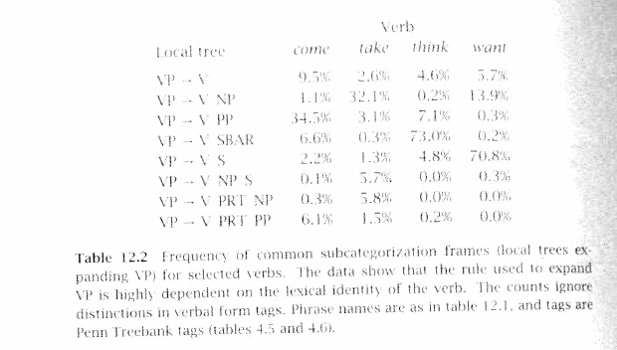
Lexical Dependencies: Problem
(b)
Notes:
The verb send subcategorises for a destination, which could be a PP headed by “into”

Slide 69
Lexical Dependencies: Problem
Two parse trees for the sentence
“Moscow sent troops into Afghanistan”
(b)
(a)
VP-attachment
NP-attachment
Typically NP-attachment more frequent than VP-attachment
Notes:
The verb send subcategorises for a destination, which could be a PP headed by “into”

Slide 70
Use only the Heads
To do that we’re going to make use of the notion of the head of a phrase
  The head of an NP is its noun
  The head of a VP is its verb
  The head of a PP is its preposition
Notes:
(but for other phrases can be more complicated and somewhat controversial)
Should the complementizer TO or the verb be the head of an infinite VP?
Most linguistic theories of syntax of syntax generally include a component that defines heads.

Slide 71
More specific rules
We used to have rule r
  VP -> V NP PP P(r|VP)
    That’s the count of this rule divided by the number of VPs in a treebank
Now we have rule r
  VP(h(VP))-> V(h(VP)) NP PP
  P(r | VP, h(VP)) e.g., P(r | VP, sent)
  What’s the count?
  How many times was this rule used with sent, divided by the number of VPs that sent appears in total
Notes:
Also associate the head tag e.g.,
NP(sacks,NNS) where NNS is noun, plural

Slide 72
NLP application: Practical Goal for FOL
  Map NL queries into FOPC so that answers can be effectively computed
What African countries are not on the Mediterranean Sea?
Was 2007 the first El Nino year after 2001?
Notes:
We didn’t assume much about the meaning of words when we talked about sentence meanings
Verbs provided a template-like predicate argument structure
Nouns were practically meaningless constants
There has be more to it than that
View assuming that words by themselves do not refer to the world, cannot be
Judged to be true or false…

Slide 73
Heads
To do that we’re going to make use of the notion of the head of a phrase
  The head of an NP is its noun
  The head of a VP is its verb
  The head of a PP is its preposition
Notes:
(but for other phrases can be more complicated and somewhat controversial)
Should the complementizer TO or the verb be the head of an infinite VP?
Most linguistic theories of syntax of syntax generally include a component that defines heads.

Slide 74
More specific rules
We used to have rule r
  VP -> V NP PP P(r|VP)
    That’s the count of this rule divided by the number of VPs in a treebank
Now we have rule r
  VP(h(VP))-> V(h(VP)) NP(h(NP)) PP(h(PP))
  P(r|VP, h(VP), h(NP), h(PP))
Sample sentence:
“Workers dumped sacks into the bin”
  VP(dumped)-> V(dumped) NP(sacks) PP(into)
  P(r|VP, dumped is the verb, sacks is the head of the NP, into is the head of the PP)
Notes:
Also associate the head tag e.g.,
NP(sacks,NNS) where NNS is noun, plural

Slide 75
Example (right)
(Collins 1999)
Attribute grammar: each non-terminal is annotated with its lexical head… many more rules!
Notes:
Each non-terminal is annotated with a single word which is its lexical head
A CFG with a lot more rules!

Slide 76
Example (wrong)

Slide 77
Problem with more specific rules
Rule:
  VP(dumped)-> V(dumped) NP(sacks) PP(into)
  P(r|VP, dumped is the verb, sacks is the head of the NP, into is the head of the PP)
Not likely to have significant counts in any treebank!
Notes:
Count of times this rule appears in corpus divided by timed VP(dumped) is decomposed

Slide 78
Usual trick: Assume Independence
When stuck, exploit independence and collect the statistics you can…
We’ll focus on capturing two aspects:
  Verb subcategorization
    Particular verbs have affinities for particular VP expansions
  Phrase-heads affinities for their predicates (i.e., verbs)
    Some NP, PP heads fit better with some verbs than others

Slide 79
Subcategorization
Condition particular VP rules only on their head… so
  r: VP(h(VP))-> V(h(VP)) NP(h(NP)) PP(h(PP))
  P(r|VP, h(VP), h(NP), h(PP))
  Becomes
  P(r | VP, h(VP)) x ……
  e.g., P(r | VP, dumped)
  What’s the count?
  How many times was VP-> V NP PP used with dumped, divided by the number of VPs that dumped appears in total
Notes:
First step
Now we have rule r
VP(h(VP))-> V(h(VP)) NP(h(NP)) PP(h(PP))
P(r|VP, h(VP), h(NP), h(PP))

Slide 80
Phrase/heads affinities for their Predicates
  r: VP -> V NP PP ; P(r|VP, h(VP), h(NP), h(PP))
  Becomes
  P(r | VP, h(VP)) x
  P(h(NP) | NP, h(VP))) x P(h(PP) | PP, h(VP)))
  E.g. P(r | VP,dumped) x
  P(sacks | NP, dumped)) x P(into | PP, dumped))
count the places where dumped is the head of a constituent that has a PP daughter with into as its head and normalize
Notes:
Normalize = divide by the count of the places where dumped is the head of a constituent that has a PP daughter

