Slide 1
CPSC 503
Computational Linguistics
Lecture 5
Giuseppe Carenini

Slide 2
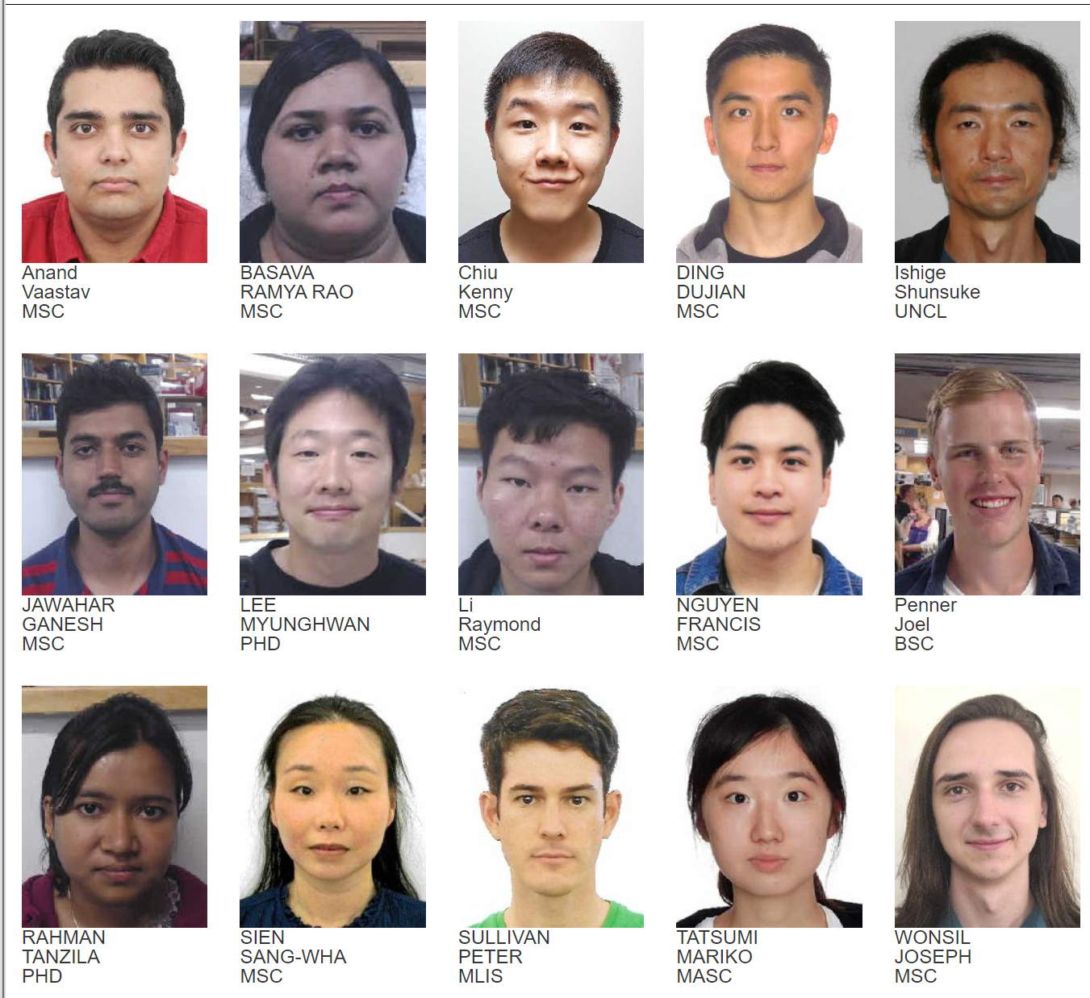
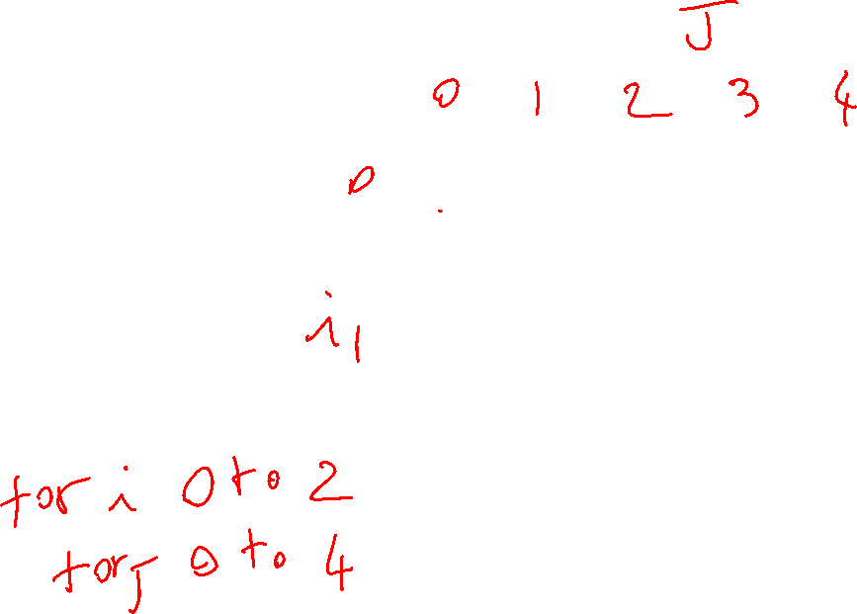
Introductions
Your Name
Previous experience in NLP?
Why are you interested in NLP?
Are you thinking of NLP as your main research area?
If not, what else do you want to specialize in….
Anything else…………

Slide 3
Today Jan 27
Neural Language Models
Markov Models (time permitting)

Slide 4
Background…….
………
- basic concepts in machine learning
http://people.cs.ubc.ca/~poole/aibook/html/ArtInt.html
7.2 only the intro page
7.3.1, 7.3.2, 7.4.1
11.1
11.1.2
Artificial Intelligence, Poole & Mackworth (UBC, Vancouver, Canada)
Copyright © 2010, David Poole and Alan Mackworth

Slide 5
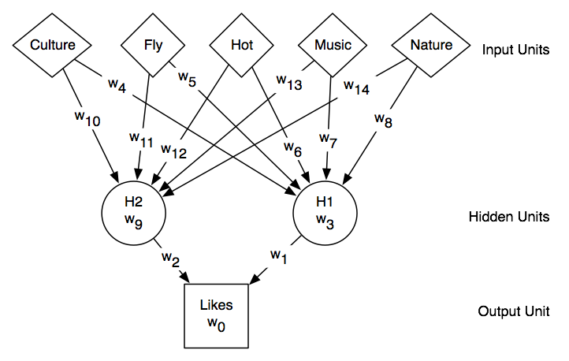
Neural nets
Specify Function: Input Unit(s) -> Output Unit(s)
Example:
Input Units: features of a City (it has/n’t Culture, you can/cannot Fly to it, etc.)
Output Unit: whether user would Like to visit that City
Notes:
The value of a unit is computed by applying “non linear” activation function to a linear combination of its input units.
In matrix notation

Slide 6

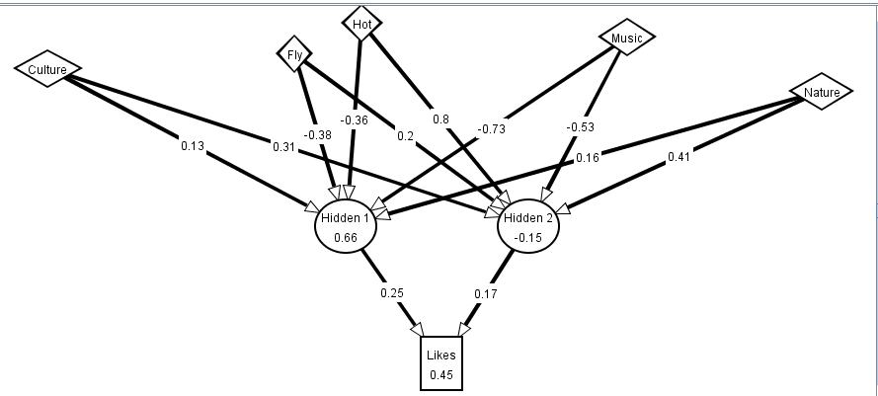
Neural Nets in one slide
Notes:
The value of a unit is computed by applying “non linear” activation function to a linear combination of its input units.
In matrix notation……
Show AI space demo for training

Slide 7
Common activation functions

Slide 9




Notation in Goldberg + justification

Slide 10
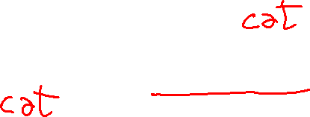
Neural Language Models
What function are we trying to learn?
n-gram: a function that takes n-1 words and returns a prob. distribution on the next word
Let’s focus on the simple 2-gram…
Take a word and return a prob. distribution on the next word

Slide 11



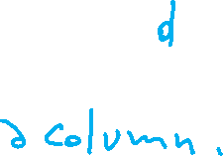
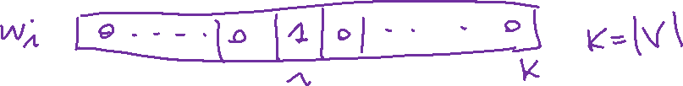

NN Input: Represent words as vectors
Represent each word as a different vector with no prior info on their similarity -> 1-of-K coding scheme
How to map that into a “smaller” vector of real numbers? Multiply by matrix E’ with dimension d<<|V|
w is a column vector

Slide 12
NN Output: Probability distribution for next word
Output vector y of dimension |V| that we can then normalize (with soft-max)
A little simplified for the sake of simplicity

Slide 13
Connecting input and output

Slide 14
Intuition about training
Output vector y of dimension |V| that we can then normalized (with soft-max)

Slide 15

Training Procedure: details
Take as input a very long text
Concatenate all sentences
Iterate through text predicting each word w_{t}
At each word w_{t} the cross-entropy Loss is
$$L=−\log{P(}w_{t}\text{|}w_{t−1}\text{)}$$
Loss if

Slide 16





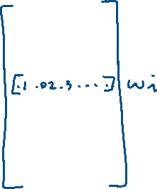


What info is stored in matrix E’ ?
It gives us a dense continuous vector representation for each word
Notes:
New 2019 (also W contains a representation for the words !)
This approach, which was proposed in [79] as a continuous bag-of-words (CBoW) model,20 was found to exhibit an interesting property. That is, the word embedding matrix E learned as a part of this CBoWmodel very well reflects underlying structures of words, and this has become one of the darling models by natural language processing
researchers in recent years. We will discuss further in the next section.
Skip-Gram and Implicit Matrix Factorization In [79], another model, called skipgram,
is proposed. The skip-gram model is built by flipping the continuous bag-ofwords
model. Instead of trying to predict the middle word given 2n surrounding words,
the skip-gram model tries to predict randomly chosen one of the 2n surrounding words
given the middle word. From this description alone, it is quite clear that this skip-gram
model is not going to be great as a language model. However, it turned out that the
word vectors obtained by training a skip-gram model were as good as those obtained by
either a continuous bag-of-words model or any other neural language model. Of course,
it is debatable which criterion be used to determine the goodness of word vectors, but in
many of the existing so-called “intrinsic” evaluations, those obtained from a skip-gram
model have been shown to excel.
The authors of [72] recently showed that training a skip-gram model with negative
sampling (see [79]) is equivalent to factorizing a positive point-wise mutual information
matrix (PPMI) into two lower-dimensional matrices. The left lower-dimensional
matrix corresponds to the input word embedding matrix E in a skip-gram model. In
other words, training a skip-gram model implicitly factorizes a PPMI matrix.
Their work drew a nice connection between the existing works on distributional
word representations from natural language processing, or even computational linguistics
and these more recent neural approaches. I will not go into any further detail in
this course, but I encourage readers to read [72].

Slide 17
Embeddings (E)
Dense continuous vector representation for each word (called word embedding)
Can be learned in slightly different settings (e.g., to predict the probability of a word given x words on the right and x words on the left, aka continuous bag-of-words (CBoW))
Embeddings very well reflects underlying structures of words
This has become a key model for words in NLP (more later in the course)
Notes:
New 2019 (also W contains a representation for the words !)
This approach, which was proposed in [79] as a continuous bag-of-words (CBoW) model,20 was found to exhibit an interesting property. That is, the word embedding matrix E learned as a part of this CBoWmodel very well reflects underlying structures of words, and this has become one of the darling models by natural language processing
researchers in recent years. We will discuss further in the next section.
Skip-Gram and Implicit Matrix Factorization In [79], another model, called skipgram,
is proposed. The skip-gram model is built by flipping the continuous bag-ofwords
model. Instead of trying to predict the middle word given 2n surrounding words,
the skip-gram model tries to predict randomly chosen one of the 2n surrounding words
given the middle word. From this description alone, it is quite clear that this skip-gram
model is not going to be great as a language model. However, it turned out that the
word vectors obtained by training a skip-gram model were as good as those obtained by
either a continuous bag-of-words model or any other neural language model. Of course,
it is debatable which criterion be used to determine the goodness of word vectors, but in
many of the existing so-called “intrinsic” evaluations, those obtained from a skip-gram
model have been shown to excel.
The authors of [72] recently showed that training a skip-gram model with negative
sampling (see [79]) is equivalent to factorizing a positive point-wise mutual information
matrix (PPMI) into two lower-dimensional matrices. The left lower-dimensional
matrix corresponds to the input word embedding matrix E in a skip-gram model. In
other words, training a skip-gram model implicitly factorizes a PPMI matrix.
Their work drew a nice connection between the existing works on distributional
word representations from natural language processing, or even computational linguistics
and these more recent neural approaches. I will not go into any further detail in
this course, but I encourage readers to read [72].

Slide 18
Slightly more complex Neural Language Model
(J&M 3Ed draft Chp 7)
3-gram neural model
Pre-trained embeddings !
Different names for the parameters but need to get used to that ;-)
Notes:
A simplified view of a feedforward neural language model moving through a text. At each
timestep t the network takes the 3 context words, converts each to a d-dimensional embeddings, and concatenates
the 3 embeddings together to get the 1Nd unit input layer x for the network. These units are multiplied
by a weight matrix W and bias vector b and then an activation function to produce a hidden layer h, which
is then multiplied by another weight matrix U. (For graphic simplicity we don’t show b in this and future
pictures). Finally, a softmax output layer predicts at each node i the probability that the next word wt will be
vocabulary word Vi. (This picture is simplified because it assumes we just look up in an embedding dictionary
E the d-dimensional embedding vector for each word, precomputed by an algorithm like word2vec.)

Slide 19
Embeddings are also trained

Slide 20
Preliminary comparison “traditional” vs. “neural”
Slightly more accurate even with relatively small training set sizes
Generalize better to different corpora
Easier to extend vocabulary (memory) linear increase of number of parameters, but output soft-max computation suffers
Easier increase n length of context (G pag 109)
Harder to train
It seems that in some extrinsic task the two models complement each other… (G pag 111)
G= Neural Network Methods for Natural Language Processing, Yoav Goldberg, 2017
Notes:
Output soft-max computation dominates the runtime

Slide 21
ELMo (Embedding Language Model)
Deep contextualized word representations
Matthew E. Peters, Mark Neumann, Mohit Iyyer, Matt Gardner, Christopher Clark, Kenton Lee, Luke Zettlemoyer
(Submitted on 15 Feb 2018 (v1), last revised 22 Mar 2018 (this version, v2))
We introduce a new type of deep contextualized word representation that models both (1) complex characteristics of word use (e.g., syntax and semantics), and (2) how these uses vary across linguistic contexts (i.e., to model polysemy). Our word vectors are learned functions of the internal states of a deep bidirectional language model (biLM), which is pre-trained on a large text corpus. We show that these representations can be easily added to existing models and significantly improve the state of the art across six challenging NLP problems, including question answering, textual entailment and sentiment analysis. We also present an analysis showing that exposing the deep internals of the pre-trained network is crucial, allowing downstream models to mix different types of semi-supervision signals.
Comments: | NAACL 2018. Originally posted to openreview 27 Oct 2017. v2 updated for NAACL camera ready
https://allennlp.org/elmo

Slide 22
Today Jan 27
Finish Language Model evaluation
Neural Language Models
Markov Models

Slide 23
Example of a Markov Chain
.6
1
a
p
h
.4
.4
1
.3
.6
.3
e
1
t
i
.4
.6
.4
Start
Start

Slide 24
Markov-Chain
.6
1
h
a
.4
p
.4
1
.3
.3
.6
e
1
t
i
.4
.6
.4
t
i
p
a
h
e
Start
Start
Formal description:
t
0
.3
0
.3
.4
0
1
Stochastic Transition matrix A
i
.4
0
.6
0
0
0
p
0
0
1
0
0
0
a
0
0
.4
.6
0
0
h
0
0
0
0
0
1
e
1
0
0
0
0
0
2
Probability of initial states
t
.6
i
.4

Slide 25
Markov Assumptions
Let X=(X₁, .., X_{t}) be a sequence of random variables taking values in some finite set S={s₁, …, s_{n}}, the state space, the Markov properties are:
(a) Limited Horizon:
For all t, P(X_{t+1}|X₁, .., X_{t})=P(X _{t+1} | X_{t})
(b)Time Invariant:
For all t, P(X _{t+1} |X_{t})=P(X₂ | X₁)
i.e., the dependency does not change over time.
Notes:
(b) Means that the matrix does not change
If X possesses these properties, then X is said to be a Markov Chain

Slide 26
Markov-Chain
t
i
p
a
h
e
t
0
.3
0
.3
.4
0
i
.4
0
.6
0
0
0
p
0
0
1
0
0
0
a
0
0
.4
.6
0
0
h
0
0
0
0
0
1
Probability of a sequence of states X₁ … X_{T}
e
1
0
0
0
0
0
t
.6
i
.4
Example:

Slide 27
Count-Ngrams models are Markov chains !
to
Notes:
0 for unseen
This is qualitatively wrong as a prior model because it would never allow n-gram,
While clearly some of the unseen ngrams will appear in other texts

Slide 28
Markov-Chain
.6
1
h
a
.4
p
.4
1
.3
.3
.6
e
1
t
i
Probability of a sequence of states X₁ … X_{T}
.4
.6
.4
Start
Start
Example:

Slide 29
Knowledge-Formalisms Map
(including probabilistic & neural formalisms)
State Machines (and prob. versions)
(Finite State Automata,Finite State Transducers, Markov Models)
Neural Models, Neural Sequence Modeling
Morphology
Machine Learning
Syntax
Rule systems (and prob. versions)
(e.g., (Prob.) Context-Free Grammars)
Neural Tree/Graph processing
Semantics
Logical formalisms (First-Order Logics, Prob. Logics)
Pragmatics
Discourse and Dialogue
AI planners (MDP Markov Decision Processes, Reinforcement learning)
Markov Chains -> n-grams
Markov Models
Hidden Markov Models (HMM)… Conditional Random Fields
Notes:
My Conceptual map - This is the master plan
Markov Models used for part-of-speech and dialog
Syntax is the study of formal relationship between words
How words are clustered into classes (that determine how they group and behave)
How they group with they neighbors into phrases

Slide 30
HMMs (and MEMM and CRFs) intro
They are probabilistic sequence-classifier / sequence-lablers: assign a class/label to each unit in a sequence
Can be applied to many NLP tasks
Part of Speech Tagging e.g Brainpower_NN ,_, not_RB physical_JJ plant_NN ,_, is_VBZ now_RB a_DT firm_NN 's_POS chief_JJ asset_NN ._.
Partial parsing
[NP The HD box] that [NP you] [VP ordered] [PP from] [NP Shaw] [VP never arrived].
Named entity recognition
[John Smith PERSON] left [IBM Corp. ORG] last summer.
Notes:
-NNP (Proper N sing), RB (Adv), JJ (Adj), NN (N sing. or mass), VBZ (V 3sg pres), DT (Determiner), POS (Possessive ending), . (sentence-final punct

Slide 31
Hidden Markov Model
(State Emission)
.6
1
a
.1
.5
b
b
.4
s₄
s₃
.4
.5
a
.5
i
.7
.6
.3
b
1
s₁
.1
i
s₂
.9
a
.4
.6
.4
Start
Start

Slide 32
Hidden
Markov Model
.6
1
a
.1
.5
b
s₄
b
.4
.4
s₃
.5
a
i
.5
.7
.3
.6
b
1
s₁
.1
i
s₂
a
.4
.9
.6
.4
Start
Start
Formal Specification as five-tuple
Set of States
Output Alphabet
Initial State Probabilities
State Transition
Probabilities
Symbol Emission
Probabilities
Notes:
Why do they sum up to 1?

Slide 33
Three fundamental questions for HMMs (and CRFs)
Decoding:
Finding the probability of an observation sequence
  brute force or Forward/Backward-Algorithms
Finding the most likely state sequence
  Viterbi-Algorithm
Training: find model parameters which best explain the observations
Manning/Schütze, 2000: 325
Notes:
- Given a model μ=(A, B, Π), how do we efficiently compute how likely a certain
observation is, that is, P(O| μ)
- Given the observation sequence O and a model μ, how do we choose a state sequence (X₁, …, X _{T+1})
that best explains the observations?
- Given an observation sequence O, and a space of possible models found by varying
the model parameters μ = (A, B, π), how do we find the model that best explains the observed data?

Slide 34
Look at course syllabus in class
Point out links
Look at schedule
…..

Slide 35
Next Time
Details on Answering the three fundamental questions for HMMs (and for similar graphical Models)
Part of Speech Tagging
Assignment2 out
Next Week
Recurrent Neural Networks for Sequence Labeling
Start Syntax & Context Free Grammars

