Slide 1
CPSC 503
Computational Linguistics
Computational Lexical Semantics
(focus on word embeddings)
Lecture 13
Giuseppe Carenini
Slides Source: Jurafsky & Martin

Slide 2
Bigger Picture
Three well-defined Semantic Tasks
Word Similarity
Word Sense Disambiguation (in Assignment 3 and readings)
Semantic Role Labeling
Notes:
Stand-alone with minimal assumptions on what information will be provided by other processes
IR and extremely broad field (not just text)
Today we’ll cover only a specific case in which user’s needs are expressed as words
and documents are expressed in terms of the word they contains

Slide 3
Summary of Lexical Resources/Thesauri
Google Knowledge Graph
Relations among words and their meanings
Freebase
Wordnet
YAGO
Microsoft Concept Graph
Probase
Internal structure of individual words
PropBank
UMLS - MeSH
VerbNet
FrameNet
Notes:
Human specified… but also learned from data / text

Slide 4
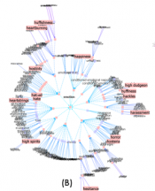
Thesaurus-based Solutions
E.g., similarity: measure distance in graph
(old?) Problems
We don’t have a thesaurus for every language (but see https://babelnet.org/ covers 100s)
We can’t have a thesaurus for every year
  For historical linguistics, we need to compare word meanings in year t to year t+1
Thesauri (used to?) have problems with recall
  Many words and phrases are missing
  Typically cannot compare nouns with verbs, with adjectives
Covers every topics
Contains rich connections
Knows about everything on a topic

Slide 5
Today Feb 25
Main focus: Vector Semantics
Notes:
Stand-alone with minimal assumptions on what information will be provided by other processes
IR and extremely broad field (not just text)
Today we’ll cover only a specific case in which user’s needs are expressed as words
and documents are expressed in terms of the word they contains

Slide 6
Vector Semantics
Introduction
For word similarity and beyond (word embeddings)
Slides Source: Jurafsky & Martin

Slide 7
Why vector models of meaning?
Use these as features to represent words in many NLP tasks
Use these to compute similarity between words
“fast” is similar to “rapid”
“tall” is similar to “height”
Question answering:
Q: “How tall is Mt. Everest?”
Candidate A: “The official height of Mount Everest is 29029 feet”
Extends to sentence/paragraph similarity
Summarization: identify and eliminate redundancy, aggregate similar phrase/sentences
Notes:
Applications
Information extraction, question answering, summarization (identify and eliminate redundancy) , language modeling (by clustering words)… extends to sentence / paragraph similarity … plagiarism detection

Slide 8
Distributional models of meaning
= vector-space models of meaning
= vector semantics
Intuitions: Zellig Harris (1954):
  “oculist and eye-doctor … occur in almost the same environments”
  “If A and B have almost identical environments we say that they are synonyms.”
Firth (1957):
  “You shall know a word by the company it keeps!”

Slide 9
WS: Distributional Methods
Do not have any thesauri for target language
If you have thesaurus, still
  Missing domain-specific (e.g., technical words)
  Poor hyponym knowledge (for V) and nothing for Adj and Adv
  Difficult to compare senses from different hierarchies
Solution: extract similarity from corpora
Basic idea: two words are similar if they appear in similar contexts

Slide 10
Intuition of distributional word similarity
Example: Suppose I asked you what is tesgüino?
    A bottle of tesgüino is on the table
    Everybody likes tesgüino
    Tesgüino makes you drunk
    We make tesgüino out of corn.
From context words humans can guess tesgüino means
  an alcoholic beverage like beer
Intuition for algorithm:
  Two words are similar if they have similar word contexts.

Slide 11
Shared intuition: Vectors Models aka “embeddings”.
Model the meaning of a word by “embedding” in a vector space.
The meaning of a word is a vector of numbers
Four kinds of vector models
Sparse vector representations
  Tf-Idf
  Mutual-information weighted word co-occurrence matrices
Dense vector representations:
  Singular value decomposition (and Latent Semantic Analysis)
  Neural-Network-inspired models (Language Model, skip-grams, CBOW)
  Brown clusters

Slide 12
Vector Semantics
Words and co-occurrence vectors

Slide 13
Co-occurrence Matrices
We represent how often a word occurs in a document
  Term-document matrix
Or how often a word occurs with another
  Term-term matrix
    (or word-word co-occurrence matrix
    or word-context matrix)

Slide 14
Term-document matrix
Each cell: count of word w in a document d:
  Each document is a count vector in ℕ^{v}: a column below
Notes:
Columns are Shakespeare’s works

Slide 15
Similarity in term-document matrices
Two documents are similar if their vectors are similar

Slide 17
The words in a term-document matrix
Each word is a count vector in ℕ^{D}: a row below

Slide 18
The words in a term-document matrix
Two words are similar if their vectors are similar

Slide 19
But raw frequency is not enough….
Frequency is clearly useful; But overly frequent words like the, it, or they are not very informative in describing a doc
A word is really informative in describing a document if it appears a lot in that doc but not in other docs
More formally….

Slide 20
tf-idf: combine two factors
tf: term frequency. frequency count (usually log-transformed):
Idf: inverse document frequency: tf-
Total # of docs in collection
Words like "the" or "good" have very low idf
# of docs that have word i
tf-idf value for word t in document d:

Slide 21
Tf-idf
Notes:
The tf-idf weighting is by far the dominant way of weighting co-occurrence matrices
in information retrieval, but also plays a role in many other aspects of natural language processing. It’s also a great baseline, the simple thing to try first.

Slide 22
Summary: tf-idf
Compare two words using tf-idf cosine to see if they are similar
Compare two documents
  Take the centroid of vectors of all the words in the document
  Centroid document vector is:

Slide 23
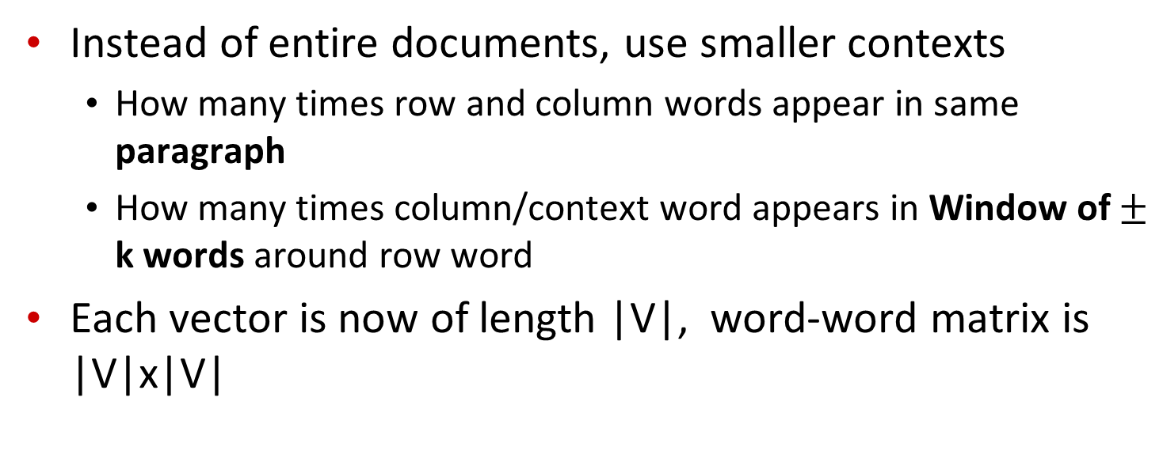
The word-word or word-context matrix
Instead of entire documents, use smaller contexts
  How many times row and column words appear in same paragraph
  How many times column/context word appears in Window of $±$ k words around row word
Each vector is now of length |V|, word-word matrix is |V|x|V|
Notes:
A word is now defined by a vector over counts of context words
Instead of each vector being of length D

Slide 24
But raw frequency is a bad representation
Frequency is clearly useful; if sugar appears a lot near apricot, that's useful information.
But overly frequent words like the, it, or they are not very informative about the context
Need a function that resolves this frequency paradox!

Slide 25

Word-Word matrix: Sample contexts $±$ 7 words
…
…
…
Portion of matrix from the Brown corpus
…
…

Slide 27
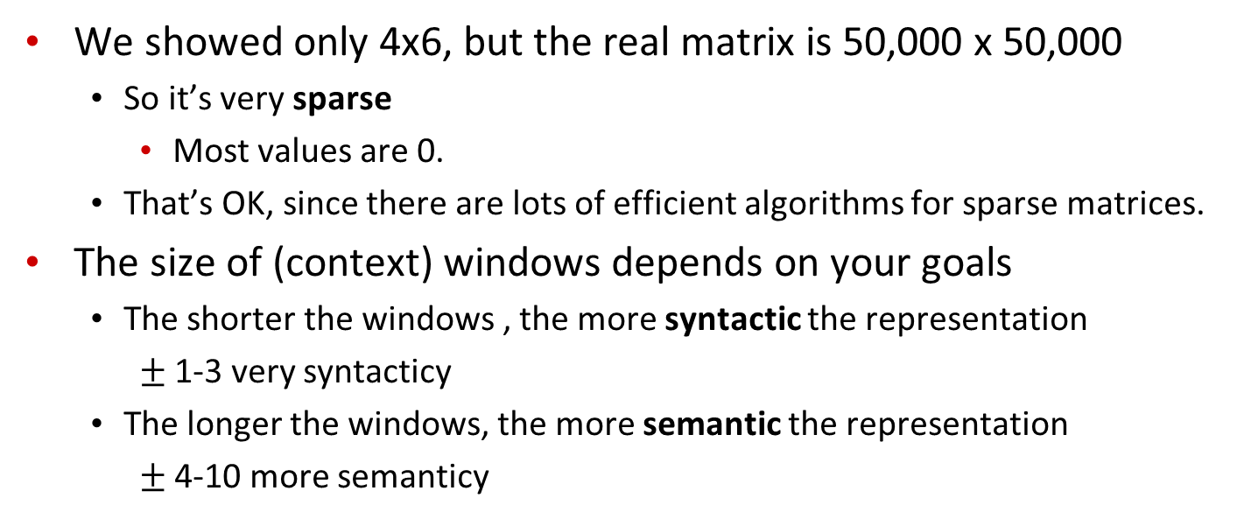
Word-word matrix
We showed only 4x6, but the real matrix is 50,000 x 50,000
  So it’s very sparse
    Most values are 0.
  That’s OK, since there are lots of efficient algorithms for sparse matrices.
The size of (context) windows depends on your goals
  The shorter the windows , the more syntactic the representation
    $±$ 1-3 very syntacticy
  The longer the windows, the more semantic the representation
    $±$ 4-10 more semanticy

Slide 28
Vector Semantics
Positive Pointwise Mutual Information (PPMI)

Slide 29
Problem with raw counts
Raw word frequency is not a great measure of association between words
  It’s very skewed
    “the” and “of” are very frequent, but maybe not the most discriminative
We’d rather have a measure that asks whether a context word is particularly informative about the target word.
  Positive Pointwise Mutual Information (PPMI)

Slide 30
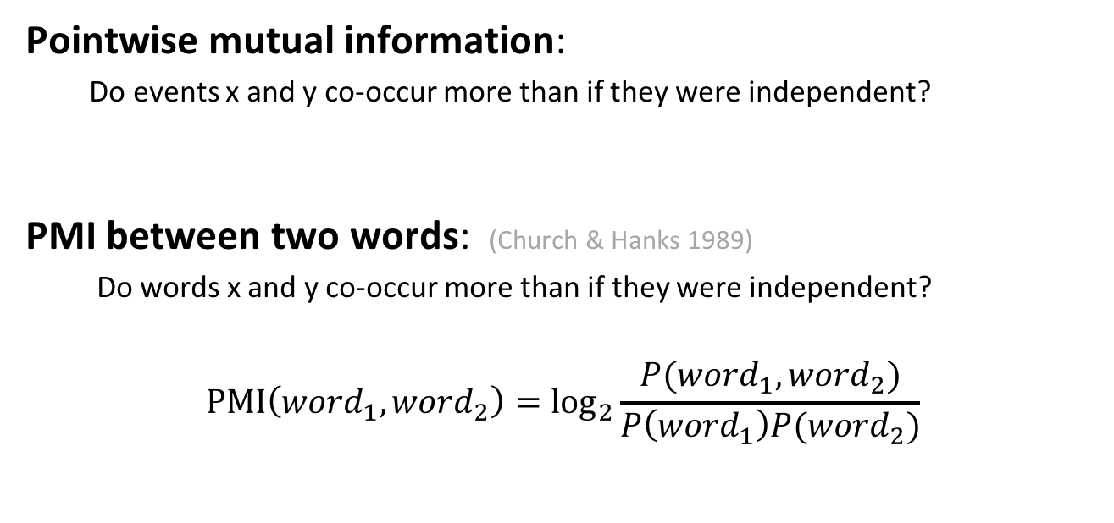
Pointwise Mutual Information
Pointwise mutual information:
  Do events x and y co-occur more than if they were independent?
  PMI between two words: (Church & Hanks 1989)
  Do words x and y co-occur more than if they were independent?
$$\text{PMI}\left({word}_{1}, {word}_{2}\right)={\text{log}}_{2}\frac{P({word}_{1}, {word}_{2})}{P\left({word}_{1}\right)P({word}_{2})}$$
Notes:
Word2 = context word

Slide 31
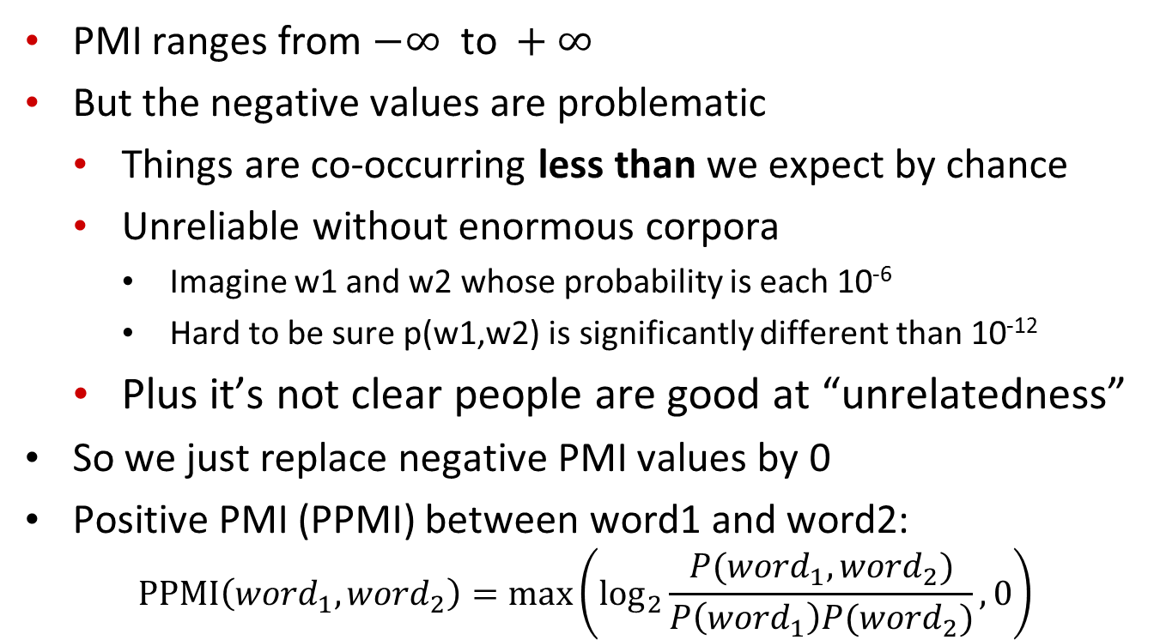
Positive Pointwise Mutual Information
  PMI ranges from $−∞ \text{to} +∞$
  But the negative values are problematic
    Things are co-occurring less than we expect by chance
    Unreliable without enormous corpora
      Imagine w1 and w2 whose probability is each 10⁻⁶
      Hard to be sure p(w1,w2) is significantly different than 10⁻¹²
    Plus it’s not clear people are good at “unrelatedness”
  So we just replace negative PMI values by 0
  Positive PMI (PPMI) between word1 and word2:
$$\text{P}\text{P}\text{MI}\left({word}_{1}, {word}_{2}\right)=\max\left({\text{log}}_{2}\frac{P({word}_{1}, {word}_{2})}{P\left({word}_{1}\right)P({word}_{2})},0\right)$$

Slide 32
Computing PPMI on a term-context matrix
Matrix F with W rows (words) and C columns (contexts)
f_{ij} is # of times c_{j} occurs in window of w_{i}
Notes:
Matrix F with W rows (words) and C columns (contexts)
f_{ij} is # of times w_{i} occurs in context c_{j}
=>
Matrix F with W rows (words) and C columns (contexts)
f_{ij} is # of times w_{i} occurs in context c_{j}

Slide 33
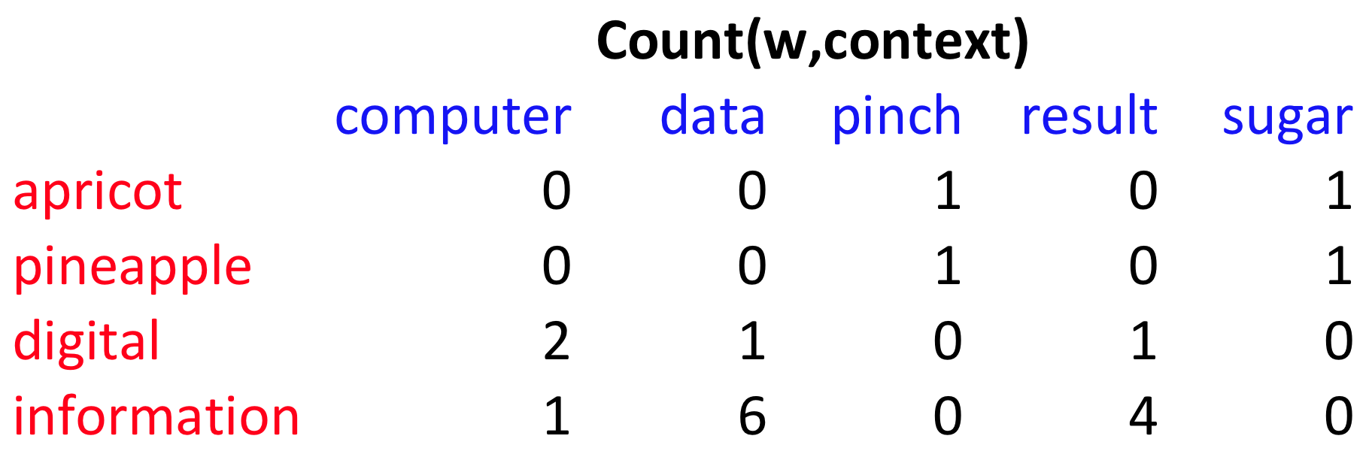
p(w=information,c=data) =
p(w=information) =
p(c=data) =
6/19
= .32
11/19
= .58
7/19
= .37

Slide 34
pmi(information,data) = log₂ (
.32 /
(.37*.58) )
= .58
(.57 using full precision)

Slide 35
Vector Semantics
Measuring similarity: the cosine

Slide 36
Measuring similarity
Given 2 target words v and w
We’ll need a way to measure their similarity.
Most measure of vectors similarity are based on the:
Dot product or inner product from linear algebra
  High when two vectors have large values in same dimensions.
  Low (in fact 0) for orthogonal vectors with zeros in complementary distribution

Slide 37
Problem with dot product
Dot product is longer if the vector is longer. Vector length:
Vectors are longer if they have higher values in each dimension
That means more frequent words will have higher dot products
That’s bad: we don’t want a similarity metric to be sensitive to word frequency

Slide 38
Cosine for computing similarity
Sec. 6.3
v_{i} is the count for word v in context i
w_{i} is the count for word w in context i.
Cos(v,w) is the cosine similarity of v and w
Notes:
See Law of Cosines (Cosine Rule) wikipedia page

Slide 39
 | large | data | computer
apricot | 1 | 0 | 0
digital | 0 | 1 | 2
information | 1 | 6 | 1
Which pair of words is more similar?
cosine(apricot,information) =
cosine(digital,information) =
cosine(apricot,digital) =

Slide 40
Reminders from linear algebra
vector length

Slide 41
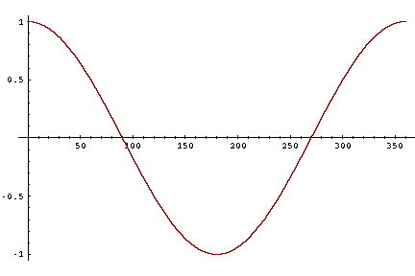
Cosine as a similarity metric
-1: vectors point in opposite directions
+1: vectors point in same directions
0: vectors are orthogonal
Frequency is non-negative, so cosine range 0-1

Slide 42
Visualizing cosines
(well, angles)

Slide 43
An alternative to tf-idf
Ask whether a context word is particularly informative about the target word.
  Positive Pointwise Mutual Information (PPMI)

Slide 44
Solution: cosine
Just divide the dot product by the length of the two vectors!
This turns out to be the cosine of the angle between them!

Slide 45
Cosine for computing similarity
Sec. 6.3
Dot product
v_{i} is the PPMI value for word v in context i
w_{i} is the PPMI value for word w in context i.
Cos(v,w) is the cosine similarity of v and w

Slide 46
Cosine for computing similarity
Sec. 6.3
Dot product
Unit vectors
v_{i} is the PPMI value for word v in context i
w_{i} is the PPMI value for word w in context i.
Cos(v,w) is the cosine similarity of v and w

Slide 47
Clustering vectors to visualize similarity in co-occurrence matrices
Rohde et al. (2006)

Slide 48
Vector Semantics
Dense Vectors

Slide 49
Sparse versus dense vectors
PPMI vectors are
  long (length |V|= 20,000 to 50,000)
  sparse (most elements are zero)
Alternative: learn vectors which are
  short (length 200-1000)
  dense (most elements are non-zero)

Slide 50
Sparse versus dense vectors
Why dense vectors?
  Short vectors may be easier to use as features in machine learning (less weights to tune)
  Dense vectors may generalize better than storing explicit count-based info
  They may do better at capturing synonymy:
    car and automobile are synonyms; but are distinct dimensions
      a word with car as a neighbor and a word with automobile as a neighbor should be similar, but aren't
  In practice, they work better
Notes:
car and automobile are synonyms; but are represented as distinct dimensions; this fails to capture similarity between a word with car as a neighbor and a word with automobile as a neighbor

Slide 51
Three methods for getting short dense vectors
Singular Value Decomposition (SVD)
  A special case of this is called LSA – Latent Semantic Analysis
“Neural Language Model”-inspired predictive models
  skip-grams and CBOW
Brown clustering

Slide 52
Vector Semantics
Embeddings inspired by neural language models: skip-grams and CBOW

Slide 53
Neural Language Models
What function are we trying to learn?
n-gram: a function that takes n-1 words and returns a prob. distribution on the next word
Let’s focus on the simple 2-gram…
Take a word and return a prob. distribution on the next word

Slide 54
NN Input: Represent words as vectors
Represent each word as a different vector with no prior info on their similarity -> 1-of-K coding scheme
How to map that into a “smaller” vector of real numbers? Multiply by matrix E’ with dimension d<<|V|

Slide 55
NN Output: Probability distribution for next word
Output vector y of dimension |V| that we can then normalize (with soft-max)
A little simplified for the sake of simplicity

Slide 56
Connecting input and output

Slide 57
Intuition about training
Output vector y of dimension |V| that we can then normalized (with soft-max)

Slide 58

Training Procedure: details
Take as input a very long text
Concatenate all sentences
Iterate through text predicting each word w_{t}
At each word w_{t} the cross-entropy Loss is
$$L=−\log{P(}w_{t}\text{|}w_{t−1}\text{)}$$
Loss if

Slide 59
What info is stored in matrix E = E’ ^{T} ?
It gives us a dense continuous vector representation for each word (called word embedding)
When this is learned in slightly different settings (e.g., to predict the probability of a word given x words on the right and x words on the left, aka continuous bag-of-words (CBoW)) => embeddings very well reflects underlying structures of words
Can also be learned in the context of RNNs
This has become a key model for words in NLP
Notes:
New 2019 (also W contains a representation for the words !)
This approach, which was proposed in [79] as a continuous bag-of-words (CBoW) model,20 was found to exhibit an interesting property. That is, the word embedding matrix E learned as a part of this CBoWmodel very well reflects underlying structures of words, and this has become one of the darling models by natural language processing
researchers in recent years. We will discuss further in the next section.
Skip-Gram and Implicit Matrix Factorization In [79], another model, called skipgram,
is proposed. The skip-gram model is built by flipping the continuous bag-ofwords
model. Instead of trying to predict the middle word given 2n surrounding words,
the skip-gram model tries to predict randomly chosen one of the 2n surrounding words
given the middle word. From this description alone, it is quite clear that this skip-gram
model is not going to be great as a language model. However, it turned out that the
word vectors obtained by training a skip-gram model were as good as those obtained by
either a continuous bag-of-words model or any other neural language model. Of course,
it is debatable which criterion be used to determine the goodness of word vectors, but in
many of the existing so-called “intrinsic” evaluations, those obtained from a skip-gram
model have been shown to excel.
The authors of [72] recently showed that training a skip-gram model with negative
sampling (see [79]) is equivalent to factorizing a positive point-wise mutual information
matrix (PPMI) into two lower-dimensional matrices. The left lower-dimensional
matrix corresponds to the input word embedding matrix E in a skip-gram model. In
other words, training a skip-gram model implicitly factorizes a PPMI matrix.
Their work drew a nice connection between the existing works on distributional
word representations from natural language processing, or even computational linguistics
and these more recent neural approaches. I will not go into any further detail in
this course, but I encourage readers to read [72].

Slide 60
Slightly more complex Neural Language Model
(J&M 3Ed draft Chp 7)
3-gram neural model
Training the embeddings !
Different names for the parameters but need to get used to that ;-)
Notes:
A simplified view of a feedforward neural language model moving through a text. At each
timestep t the network takes the 3 context words, converts each to a d-dimensional embeddings, and concatenates
the 3 embeddings together to get the 1Nd unit input layer x for the network. These units are multiplied
by a weight matrix W and bias vector b and then an activation function to produce a hidden layer h, which
is then multiplied by another weight matrix U. (For graphic simplicity we don’t show b in this and future
pictures). Finally, a softmax output layer predicts at each node i the probability that the next word wt will be
vocabulary word Vi. (This picture is simplified because it assumes we just look up in an embedding dictionary
E the d-dimensional embedding vector for each word, precomputed by an algorithm like word2vec.)

Slide 61
Prediction-based models:
An alternative way to get dense vectors
Skip-gram (Mikolov et al. 2013a) CBOW (Mikolov et al. 2013b)
Learn embeddings as part of the process of word prediction.
Train a neural network to predict neighboring words
    Inspired by neural net language models.
    In so doing, learn dense embeddings for the words in the training corpus.
Available online in the word2vec package
  Including sets of pre-trained embeddings!
Notes:
word2vec package implements both Skip-gram and CBOW

Slide 62
Skip-grams & CBOW
Distinguish “good” word-context pairs from “bad” ones
  in a context window of 2C words
So for C=1, we are given word w_{t} and this context :

Slide 63
Skip-grams
Neural net to Distinguish “good” word-context pairs from “bad” ones
  in a context window of 2C words
CBOW
Same task but now the context is represented as a single vector (the sum of all the 1-hot vectors for the context words
[Goldberg 10.4.2]

Slide 64
Skip-Gram Training Data
Training sentence:
... lemon, a tablespoon of apricot jam a pinch ...
c1 c2 t c3 c4
Training data: input/output pairs centering on apricot
Asssume a +/- 2 word window

Slide 65
Skip-Gram Training
Training sentence:
... lemon, a tablespoon of apricot jam a pinch ...
c1 c2 t c3 c4
For each positive example, we'll create k negative examples.
Using noise words
  Any random word that isn't t

Slide 66
Skip-Gram Training
Training sentence:
... lemon, a tablespoon of apricot jam a pinch ...
c1 c2 t c3 c4
k=2

Slide 67
Choosing noise words
Could pick w according to their unigram frequency P(w)
More common to chosen then according to p_{α}(w)
α= ¾ works well because it gives rare noise words slightly higher probability
To show this, imagine two events p(a)=.99 and p(b) = .01:

Slide 68
Properties of embeddings
Nearest words to some embeddings (Mikolov et al. 2013)

Slide 69
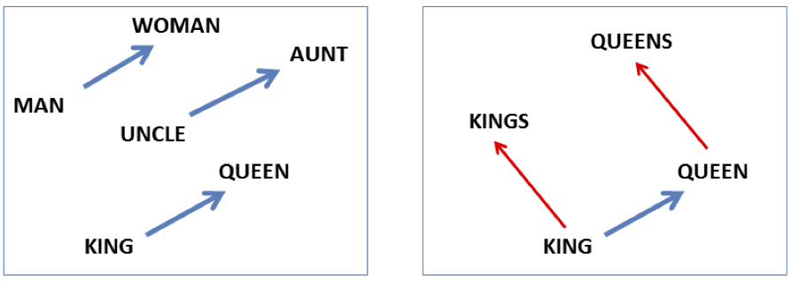

Embeddings (often) capture relational meaning!
vector(‘king’) - vector(‘man’) + vector(‘woman’) $≈$vector(‘queen’)
vector(‘Paris’) - vector(‘France’) + vector(‘Italy’) $≈$ vector(‘Rome’)

Slide 71
For another method to build embeddings see…
Glove: Global Vectors for Word Representation
J. Pennington | R. Socher | C. Manning
Proc. of the 2014 Conference on Empirical Methods in Natural Language Processing (EMNLP)
Best on analogy task like, “a is to b as c is to ?”
The dataset contains 19,544 such questions, divided into a semantic subset and a syntactic subset. The semantic questions are typically analogies about people or places, like “Athens is to Greece as Berlin is to ?”
Notes:
Word analogies. The word analogy task consists of questions like, “a is to b as c is to ?” The dataset contains 19,544 such questions, divided into a semantic subset and a syntactic subset. The semantic questions are typically analogies about people or places, like “Athens is to Greece as Berlin is to ?”. The syntactic questions are typically analogies about verb tenses or forms of adjectives, for example “dance is to dancing as fly is to ?”. To correctly answer the question, the model should uniquely identify the missing term, with only an exact correspondence counted as a correct match. We answer the question “a is to b as c is to ?” by finding the word d whose representation wd is closest to wb − wa + wc according to the cosine similarity
There are many other embedding algorithms, using methods like non-negative
matrix factorization (Fyshe et al., 2015), or by converting sparse PPMI embeddings
to dense vectors by using SVD (Levy and Goldberg, 2014c). The most widelyused
embedding model besides word2vec is GloVe (Pennington et al., 2014). The
name stands for Global Vectors, because the model is based on capturing global
corpus statistics. GloVe is based on ratios of probabilities from the word-word cooccurrence
matrix, combining the intuitions of count-based models like PPMI while
also capturing the linear structures used by methods like word2vec.

Slide 72
Next Time
One more lecture on Wed ….. CNNs, Semantic Role Labeling… Some Pragmatics..
Next Mon: project proposals . Look at project work plan. 4-5 mins each. May need to stay past 3:30. If you need to attend another class you can present first… will try to find another room
How many group projects?

Slide 73
Sparse versus dense vectors
Why dense vectors?
  Short vectors may be easier to use as features in machine learning (less weights to tune)
  Dense vectors may generalize better than storing explicit counts
  They may do better at capturing synonymy:
    car and automobile are synonyms; but are distinct dimensions
      a word with car as a neighbor and a word with automobile as a neighbor should be similar, but aren't
  In practice, they work better

Slide 74


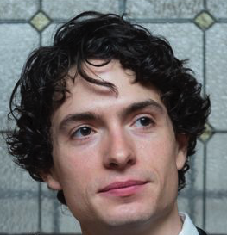


Dense embeddings you can download!
Word2vec (Mikolov et al.)
https://code.google.com/archive/p/word2vec/
Fasttext http://www.fasttext.cc/
Glove (Pennington, Socher, Manning)
http://nlp.stanford.edu/projects/glove/

Slide 75
Word2vec
Popular embedding method
Very fast to train
Code available on the web
Idea: predict rather than count

Slide 76
Word2vec
  Instead of counting how often each word w occurs near "apricot"
  Train a classifier on a binary prediction task:
    Is w likely to show up near "apricot"?
  We don’t actually care about this task
    But we'll take the learned classifier weights as the word embeddings

Slide 77
Brilliant insight: Use running text as implicitly supervised training data!
A word s near apricot
  Acts as gold ‘correct answer’ to the question
  “Is word w likely to show up near apricot?”
No need for hand-labeled supervision
The idea comes from neural language modeling
  Bengio et al. (2003)
  Collobert et al. (2011)

Slide 78
Word2Vec: Skip-Gram Task
Word2vec provides a variety of options. Let's do
  "skip-gram with negative sampling" (SGNS)

Slide 79
Skip-gram algorithm
Treat the target word and a neighboring context word as positive examples.
Randomly sample other words in the lexicon to get negative samples
Use logistic regression to train a classifier to distinguish those two cases
Use the weights as the embeddings

Slide 80
Skip-Gram Training Data
Training sentence:
... lemon, a tablespoon of apricot jam a pinch ...
c1 c2 target c3 c4
Asssume context words are those in +/- 2 word window

Slide 81
Skip-Gram Goal
Given a tuple (t,c) = target, context
  (apricot, jam)
  (apricot, aardvark)
Return probability that c is a real context word:
P(+|t,c)
P(−|t,c) = 1−P(+|t,c)

Slide 82
How to compute p(+|t,c)?
Intuition:
  Words are likely to appear near similar words
  Model similarity with dot-product!
  Similarity(t,c) ∝ t ∙ c
Problem:
  Dot product is not a probability!
    (Neither is cosine)

Slide 83
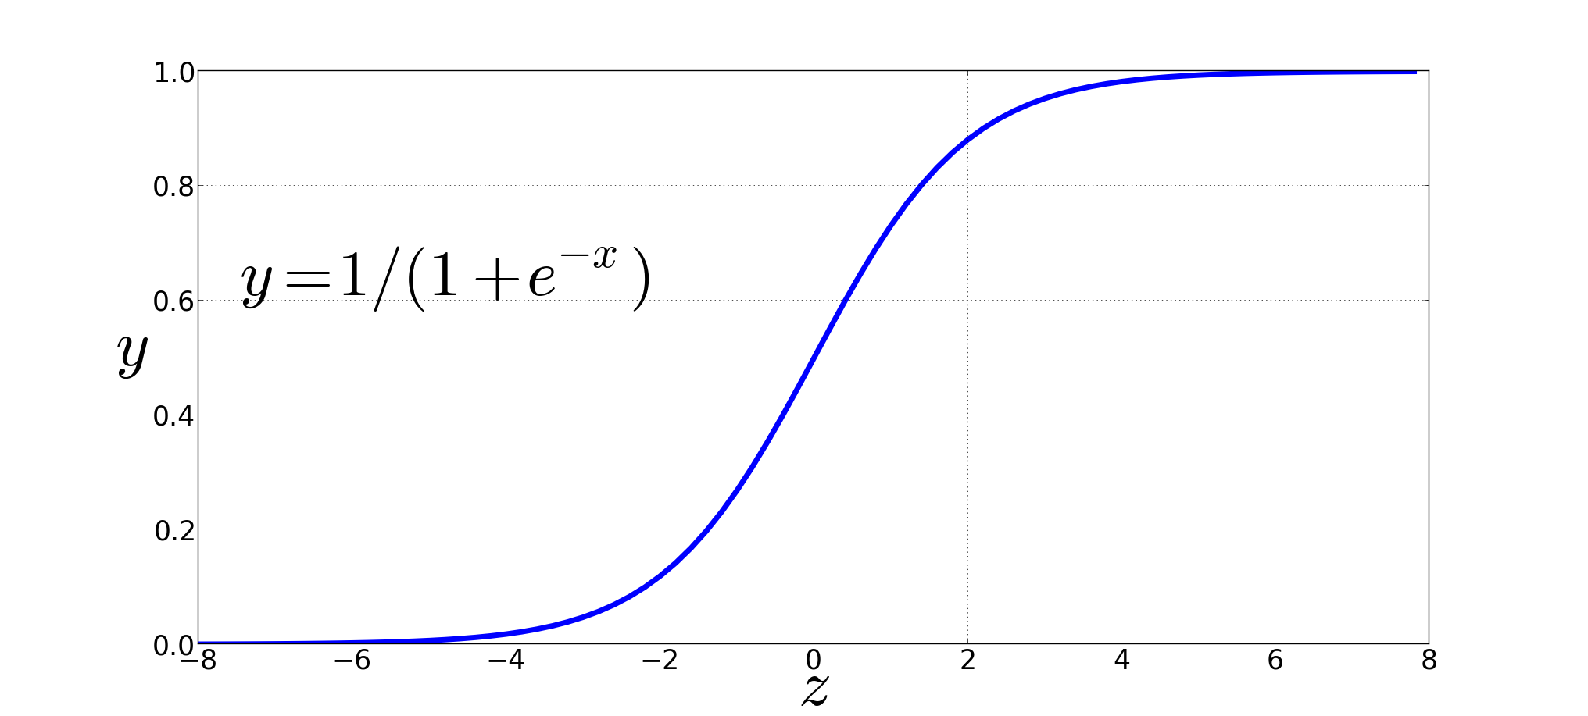
Turning dot product into a probability
The sigmoid lies between 0 and 1:

Slide 84
Turning dot product into a probability

Slide 85
For all the context words:
Assume all context words are independent

Slide 86
Setup
Let's represent words as vectors of some length (say 300), randomly initialized.
So we start with 300 * V random parameters
Over the entire training set, we’d like to adjust those word vectors such that we
  Maximize the similarity of the target word, context word pairs (t,c) drawn from the positive data
  Minimize the similarity of the (t,c) pairs drawn from the negative data.

Slide 87
Learning the classifier
Iterative process.
We’ll start with 0 or random weights
Then adjust the word weights to
  make the positive pairs more likely
  and the negative pairs less likely
over the entire training set:

Slide 88
Objective Criteria
We want to maximize…
Maximize the + label for the pairs from the positive training data, and the – label for the pairs sample from the negative data.

Slide 89
Focusing on one target word t:

Slide 91
Train using gradient descent
Actually learns two separate embedding matrices W and C
Can use W and throw away C, or merge them somehow

Slide 92
Summary: How to learn word2vec (skip-gram) embeddings
Start with V random 300-dimensional vectors as initial embeddings
Use logistic regression, the second most basic classifier used in machine learning after naïve bayes
  Take a corpus and take pairs of words that co-occur as positive examples
  Take pairs of words that don't co-occur as negative examples
  Train the classifier to distinguish these by slowly adjusting all the embeddings to improve the classifier performance
  Throw away the classifier code and keep the embeddings.

Slide 93
Evaluating embeddings
Compare to human scores on word similarity-type tasks:
WordSim-353 (Finkelstein et al., 2002)
SimLex-999 (Hill et al., 2015)
Stanford Contextual Word Similarity (SCWS) dataset (Huang et al., 2012)
TOEFL dataset: Levied is closest in meaning to: imposed, believed, requested, correlated

Slide 94
Properties of embeddings
Similarity depends on window size C
C = ±2 The nearest words to Hogwarts:
  Sunnydale
  Evernight
C = ±5 The nearest words to Hogwarts:
  Dumbledore
  Malfoy
  halfblood

Slide 95

Analogy: Embeddings capture relational meaning!
vector(‘king’) - vector(‘man’) + vector(‘woman’) $≈$vector(‘queen’)
vector(‘Paris’) - vector(‘France’) + vector(‘Italy’) $≈$ vector(‘Rome’)

Slide 96
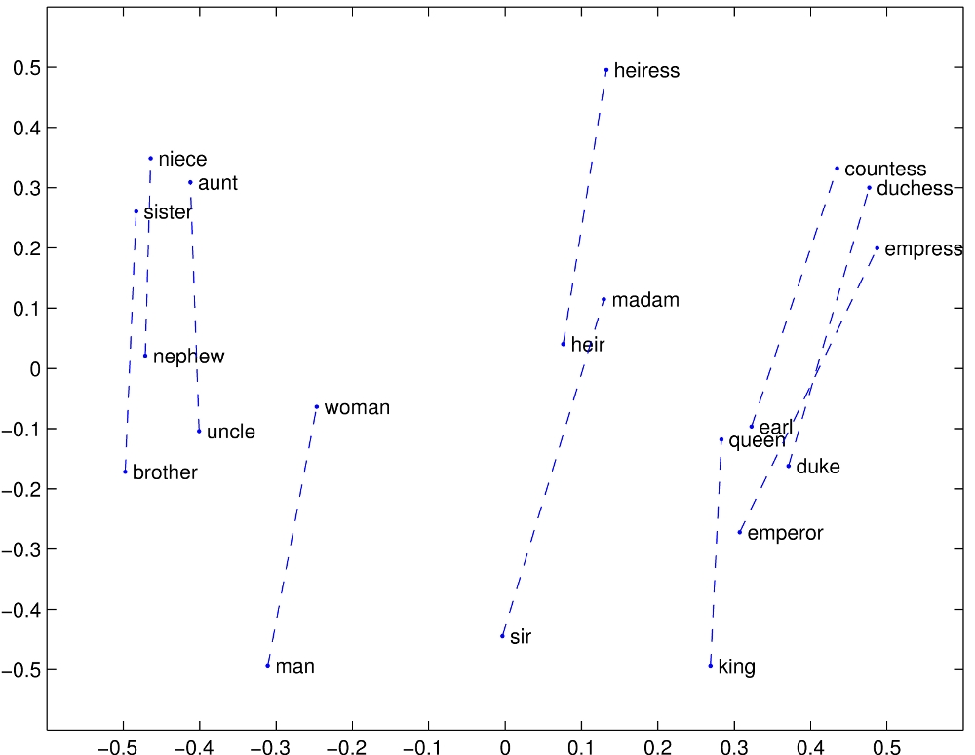

Slide 97
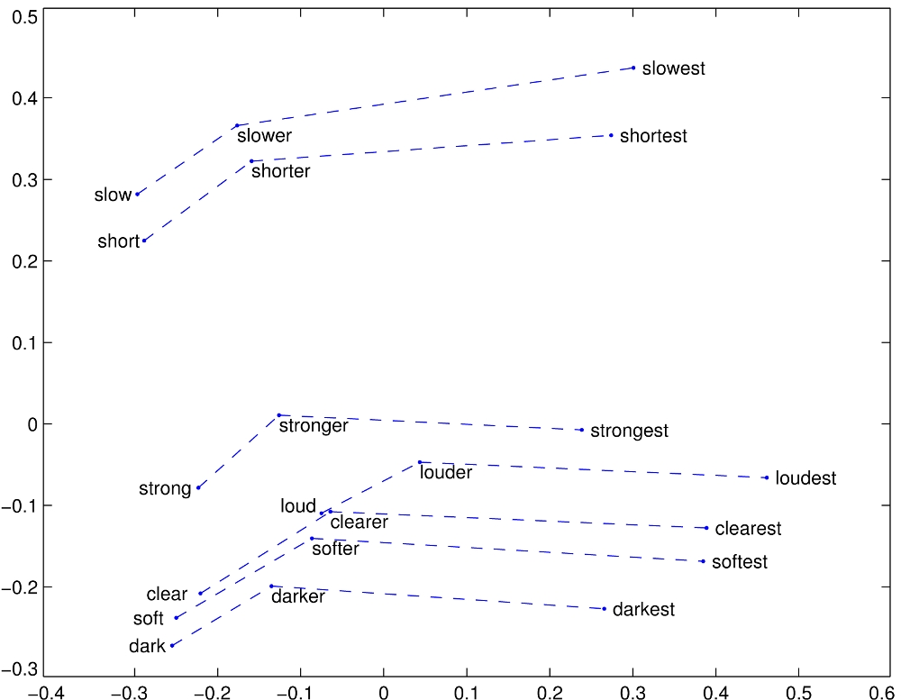

Slide 98

Embeddings can help study word history!
Train embeddings on old books to study changes in word meaning!!
Will Hamilton

Slide 99




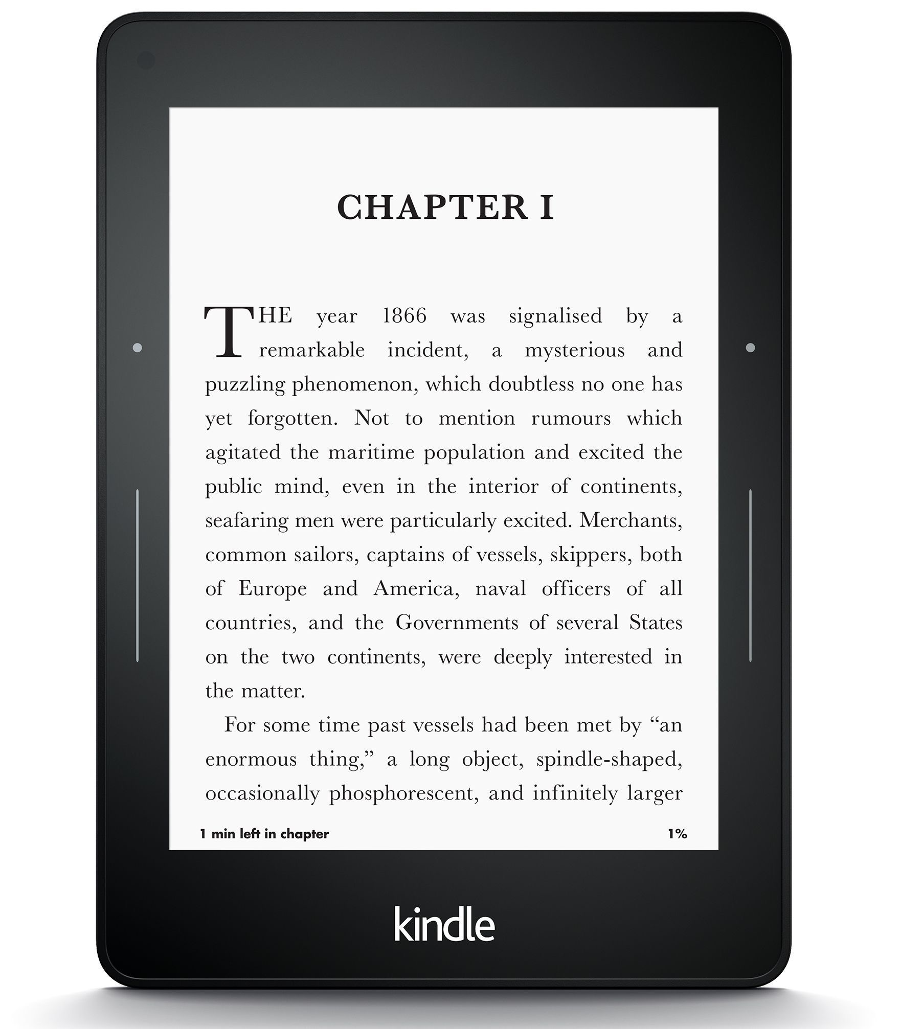
Diachronic word embeddings for studying language change!
Word vectors for 1920
Word vectors 1990
“dog” 1990 word vector
“dog” 1920 word vector
vs.
1900
1950
2000
￼
￼

Slide 100
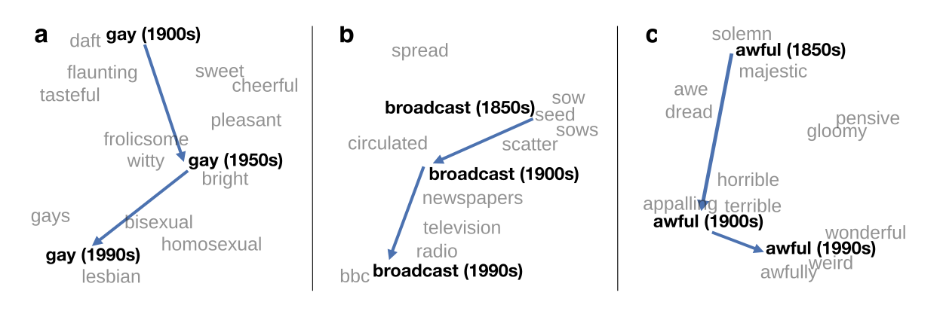
Visualizing changes
Project 300 dimensions down into 2
~30 million books, 1850-1990, Google Books data

Slide 101
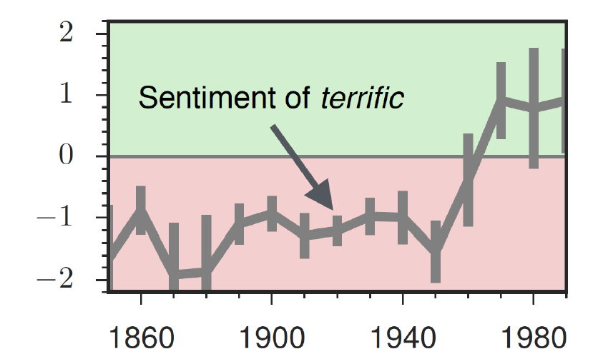
The evolution of sentiment words
Negative words change faster than positive words

Slide 102
Embeddings and bias

Slide 103
Embeddings reflect cultural bias
Bolukbasi, Tolga, Kai-Wei Chang, James Y. Zou, Venkatesh Saligrama, and Adam T. Kalai. "Man is to computer programmer as woman is to homemaker? debiasing word embeddings." In Advances in Neural Information Processing Systems, pp. 4349-4357. 2016.
Ask “Paris : France :: Tokyo : x”
  x = Japan
Ask “father : doctor :: mother : x”
  x = nurse
Ask “man : computer programmer :: woman : x”
  x = homemaker

Slide 104
Embeddings reflect cultural bias
Caliskan, Aylin, Joanna J. Bruson and Arvind Narayanan. 2017. Semantics derived automatically from language corpora contain human-like biases. Science 356:6334, 183-186.
Implicit Association test (Greenwald et al 1998): How associated are
  concepts (flowers, insects) & attributes (pleasantness, unpleasantness)?
  Studied by measuring timing latencies for categorization.
Psychological findings on US participants:
  African-American names are associated with unpleasant words (more than European-American names)
  Male names associated more with math, female names with arts
  Old people's names with unpleasant words, young people with pleasant words.
Caliskan et al. replication with embeddings:
  African-American names (Leroy, Shaniqua) had a higher GloVe cosine with unpleasant words (abuse, stink, ugly)
  European American names (Brad, Greg, Courtney) had a higher cosine with pleasant words (love, peace, miracle)
Embeddings reflect and replicate all sorts of pernicious biases.

Slide 105
Directions
Debiasing algorithms for embeddings
  Bolukbasi, Tolga, Chang, Kai-Wei, Zou, James Y., Saligrama, Venkatesh, and Kalai, Adam T. (2016). Man is to computer programmer as woman is to homemaker? debiasing word embeddings. In Advances in Neural Infor- mation Processing Systems, pp. 4349–4357.
Use embeddings as a historical tool to study bias

Slide 106
Embeddings as a window onto history
Garg, Nikhil, Schiebinger, Londa, Jurafsky, Dan, and Zou, James (2018). Word embeddings quantify 100 years of gender and ethnic stereotypes. Proceedings of the National Academy of Sciences, 115(16), E3635–E3644
Use the Hamilton historical embeddings
The cosine similarity of embeddings for decade X for occupations (like teacher) to male vs female names
  Is correlated with the actual percentage of women teachers in decade X

Slide 107
History of biased framings of women
Garg, Nikhil, Schiebinger, Londa, Jurafsky, Dan, and Zou, James (2018). Word embeddings quantify 100 years of gender and ethnic stereotypes. Proceedings of the National Academy of Sciences, 115(16), E3635–E3644
Embeddings for competence adjectives are biased toward men
  Smart, wise, brilliant, intelligent, resourceful, thoughtful, logical, etc.
This bias is slowly decreasing

Slide 108
Embeddings reflect ethnic stereotypes over time
Garg, Nikhil, Schiebinger, Londa, Jurafsky, Dan, and Zou, James (2018). Word embeddings quantify 100 years of gender and ethnic stereotypes. Proceedings of the National Academy of Sciences, 115(16), E3635–E3644
Princeton trilogy experiments
Attitudes toward ethnic groups (1933, 1951, 1969) scores for adjectives
    industrious, superstitious, nationalistic, etc
Cosine of Chinese name embeddings with those adjective embeddings correlates with human ratings.

Slide 109
Change in linguistic framing 1910-1990
Garg, Nikhil, Schiebinger, Londa, Jurafsky, Dan, and Zou, James (2018). Word embeddings quantify 100 years of gender and ethnic stereotypes. Proceedings of the National Academy of Sciences, 115(16), E3635–E3644
Change in association of Chinese names with adjectives framed as "othering" (barbaric, monstrous, bizarre)

Slide 110
Changes in framing: adjectives associated with Chinese
Garg, Nikhil, Schiebinger, Londa, Jurafsky, Dan, and Zou, James (2018). Word embeddings quantify 100 years of gender and ethnic stereotypes. Proceedings of the National Academy of Sciences, 115(16), E3635–E3644

Slide 111
Conclusion
Concepts or word senses
  Have a complex many-to-many association with words (homonymy, multiple senses)
  Have relations with each other
    Synonymy, Antonymy, Superordinate
  But are hard to define formally (necessary & sufficient conditions)
Embeddings = vector models of meaning
  More fine-grained than just a string or index
  Especially good at modeling similarity/analogy
    Just download them and use cosines!!
  Can use sparse models (tf-idf) or dense models (word2vec, GLoVE)
  Useful in practice but know they encode cultural stereotypes

Slide 113
Vector Semantics
Brown clustering

Slide 114
Brown clustering
An agglomerative clustering algorithm that clusters words based on which words precede or follow them
These word clusters can be turned into a kind of vector
We’ll give a very brief sketch here.

Slide 115
Brown clustering algorithm
Each word is initially assigned to its own cluster.
We now consider consider merging each pair of clusters. Highest quality merge is chosen.
  Quality = merges two words that have similar probabilities of preceding and following words
  (More technically quality = smallest decrease in the likelihood of the corpus according to a class-based language model)
Clustering proceeds until all words are in one big cluster.

Slide 116
Brown Clusters as vectors
By tracing the order in which clusters are merged, the model builds a binary tree from bottom to top.
Each word represented by binary string = path from root to leaf
Each intermediate node is a cluster
Chairman is 0010, “months” = 01, and verbs = 1

Slide 117
Brown cluster examples

Slide 118
Class-based language model
Suppose each word was in some class c_{i:}

Slide 119
Vector Semantics
Evaluating similarity

Slide 120
Evaluating similarity
Extrinsic (task-based, end-to-end) Evaluation:
  Question Answering
  Spell Checking
  Essay grading
Intrinsic Evaluation:
  Correlation between algorithm and human word similarity ratings
    Wordsim353: 353 noun pairs rated 0-10. sim(plane,car)=5.77
  Taking TOEFL multiple-choice vocabulary tests
    Levied is closest in meaning to:
    imposed, believed, requested, correlated

Slide 121
Summary
Distributional (vector) models of meaning
  Sparse (PPMI-weighted word-word co-occurrence matrices)
  Dense:
    Word-word SVD 50-2000 dimensions
    Skip-grams and CBOW
    Brown clusters 5-20 binary dimensions.

Slide 122
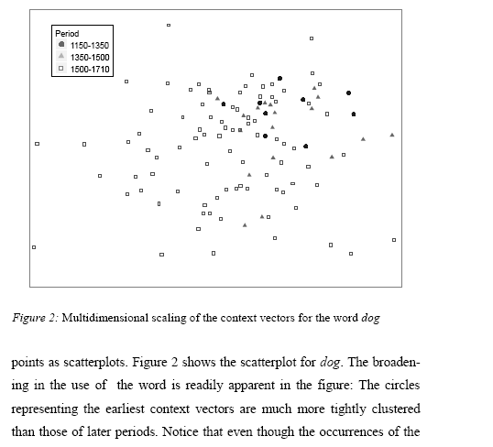
Word similarity for historical linguistics: semantic change over time
Sagi, Kaufmann Clark 2013
Notes:
Once the vector space for word types is obtained from the training corpus, new vectors can be derived for any multi-word unit of text (e.g. paragraphs, queries, or documents), regardless of whether it occurs in the original training corpus or not, as the normalized sum of the vectors associated with the words it contains.12 In this way, for each occurrence of a target word type w under investigation, we calculated a context vector from the 15 items preceding and the 15 items following that occurrence.13 Context vectors were first used in Word Sense Discrimination by Schütze (1998). Similarly to that application, we assume that these “second-order” vectors represent the aggregate meaning or topic of the segment they are associated with, and thus, following the reasoning behind LSA, are indicative of the meaning with which the target word is being used on that particular occurrence.

Slide 123
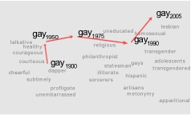
Word similarity for historical linguistics: semantic change over time
Sagi, Kaufmann Clark 2013
Kulkarni, Al-Rfou, Perozzi, Skiena 2015
Notes:
Once the vector space for word types is obtained from the training corpus, new vectors can be derived for any multi-word unit of text (e.g. paragraphs, queries, or documents), regardless of whether it occurs in the original training corpus or not, as the normalized sum of the vectors associated with the words it contains.12 In this way, for each occurrence of a target word type w under investigation, we calculated a context vector from the 15 items preceding and the 15 items following that occurrence.13 Context vectors were first used in Word Sense Discrimination by Schütze (1998). Similarly to that application, we assume that these “second-order” vectors represent the aggregate meaning or topic of the segment they are associated with, and thus, following the reasoning behind LSA, are indicative of the meaning with which the target word is being used on that particular occurrence.

Slide 124
2 kinds of co-occurrence between 2 words
(Schütze and Pedersen, 1993)
First-order co-occurrence (syntagmatic association):
  They are typically nearby each other.
  wrote is a first-order associate of book or poem.
Second-order co-occurrence (paradigmatic association):
  They have similar neighbors.
  wrote is a second- order associate of words like said or remarked.

Slide 125
Weighting PMI
PMI is biased toward infrequent events
  Very rare words have very high PMI values
Two solutions:
  Give rare words slightly higher probabilities
  Use add-one smoothing (which has a similar effect)

Slide 126
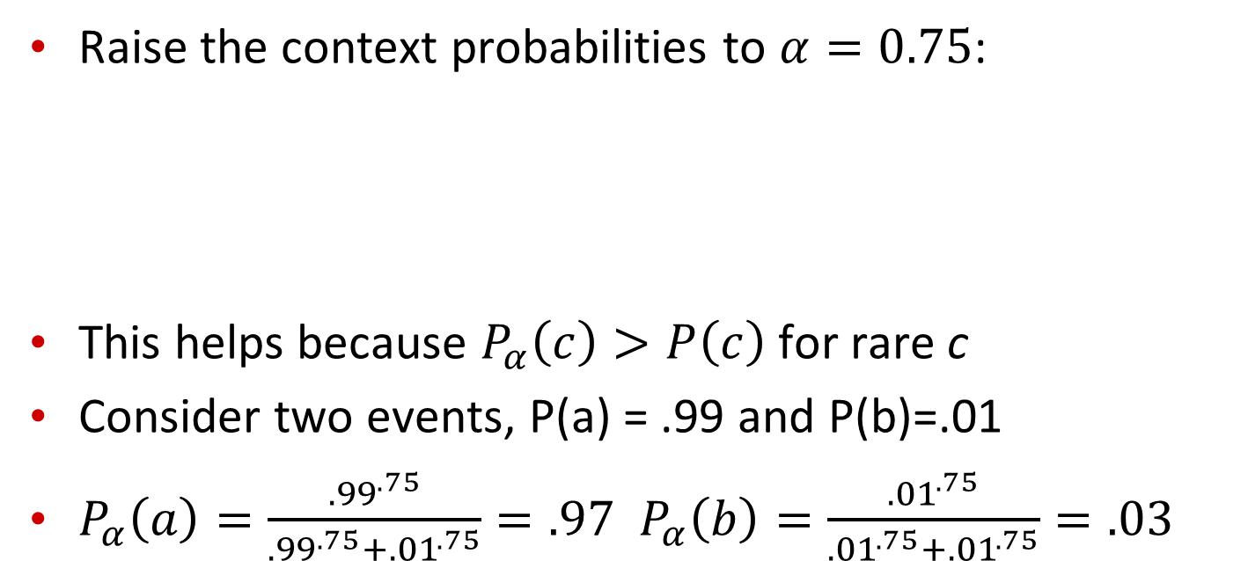
Weighting PMI: Giving rare context words slightly higher probability
Raise the context probabilities to $α=0.75$:
This helps because $P_{α}\left(c\right)>P\left(c\right)$ for rare c
Consider two events, P(a) = .99 and P(b)=.01
$P_{α}\left(a\right)=\frac{{.99}^{.75}}{{.99}^{.75}+{.01}^{.75}}=.97$ $P_{α}\left(b\right)=\frac{{.01}^{.75}}{{.01}^{.75}+{.01}^{.75}}=.03$

Slide 127
Use Laplace (add-1) smoothing

Slide 129
PPMI versus add-2 smoothed PPMI

Slide 130
Cosine as a similarity metric
-1: vectors point in opposite directions
+1: vectors point in same directions
0: vectors are orthogonal
Raw frequency or PPMI are non-negative, so cosine range 0-1

Slide 131



 | large | data | computer
apricot | 2 | 0 | 0
digital | 0 | 1 | 2
information | 1 | 6 | 1
Which pair of words is more similar?
cosine(apricot,information) =
cosine(digital,information) =
cosine(apricot,digital) =
$$2+0+0$$
$$= \frac{2}{\sqrt{2}\sqrt{38}}= .23$$
$$\sqrt{2+0+0 }$$

Slide 132
Visualizing vectors and angles
 | large | data
apricot | 2 | 0
digital | 0 | 1
information | 1 | 6

Slide 133
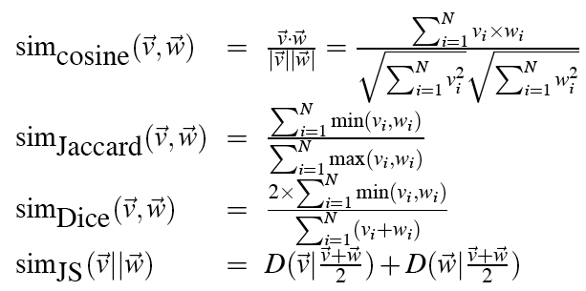
Other possible similarity measures

Slide 134
Vector Semantics
Evaluation, using syntax, alternatives to PPMI

Slide 135
Evaluating similarity
(the same as for thesaurus-based)
Intrinsic Evaluation:
  Correlation between algorithm and human word similarity ratings
Extrinsic (task-based, end-to-end) Evaluation:
  Spelling error detection, WSD, essay grading
  Taking TOEFL multiple-choice vocabulary tests
Levied is closest in meaning to which of these:
  imposed, believed, requested, correlated

Slide 136
Using syntax to define a word’s context
Zellig Harris (1968)
  “The meaning of entities, and the meaning of grammatical relations among them, is related to the restriction of combinations of these entities relative to other entities”
Two words are similar if they have similar syntactic contexts
Duty and responsibility have similar syntactic distribution:
Modified by adjectives | additional, administrative, assumed, collective, congressional, constitutional …
Objects of verbs | assert, assign, assume, attend to, avoid, become, breach..

Slide 137
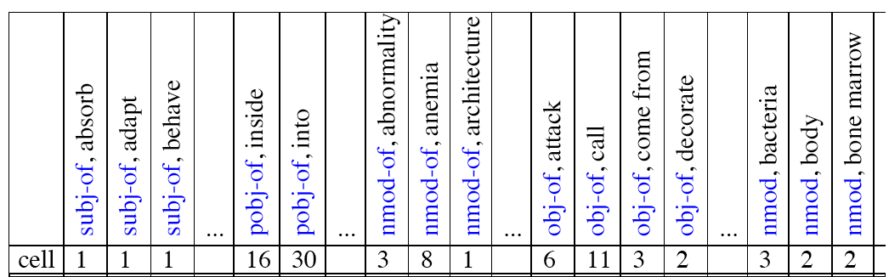
Co-occurrence vectors based on syntactic dependencies
Dekang Lin, 1998 “Automatic Retrieval and Clustering of Similar Words”
Each dimension: a context word in one of R grammatical relations
  Subject-of- “absorb”
Instead of a vector of |V| features, a vector of R|V|
Example: counts for the word cell :

Slide 138
Syntactic dependencies for dimensions
Alternative (Padó and Lapata 2007):
  Instead of having a |V| x R|V| matrix
  Have a |V| x |V| matrix
  But the co-occurrence counts aren’t just counts of words in a window
  But counts of words that occur in one of R dependencies (subject, object, etc).
  So M(“cell”,”absorb”) = count(subj(cell,absorb)) + count(obj(cell,absorb)) + count(pobj(cell,absorb)), etc.

Slide 139
PMI applied to dependency relations
Hindle, Don. 1990. Noun Classification from Predicate-Argument Structure. ACL
Object of “drink” | Count | PMI
it | 3 | 1.3
anything | 3 | 5.2
wine | 2 | 9.3
tea | 2 | 11.8
liquid | 2 | 10.5
Object of “drink” | Count | PMI
tea | 2 | 11.8
liquid | 2 | 10.5
wine | 2 | 9.3
anything | 3 | 5.2
it | 3 | 1.3
“Drink it” more common than “drink wine”
But “wine” is a better “drinkable” thing than “it”

Slide 140
Alternative to PPMI for measuring association
tf-idf (that’s a hyphen not a minus sign)
The combination of two factors
  Term frequency (Luhn 1957): frequency of the word (can be logged)
  Inverse document frequency (IDF) (Sparck Jones 1972)
    N is the total number of documents
    df_{i} = “document frequency of word i”
    = # of documents with word I
  w_{ij} = word i in document j
  w_{ij}=tf_{ij} idf_{i}

Slide 141
tf-idf not generally used for word-word similarity
But is by far the most common weighting when we are considering the relationship of words to documents

Slide 142
Singular Value Decomposition
Any rectangular w x c matrix X equals the product of 3 matrices:
W: rows corresponding to original but m columns represents a dimension in a new latent space, such that
  M column vectors are orthogonal to each other
  Columns are ordered by the amount of variance in the dataset each new dimension accounts for
S: diagonal m x m matrix of singular values expressing the importance of each dimension.
C: columns corresponding to original but m rows corresponding to singular values

Slide 143
Singular Value Decomposition
Landuaer and Dumais 1997

Slide 144
SVD applied to term-document matrix:
Latent Semantic Analysis
Deerwester et al (1988)
If instead of keeping all m dimensions, we just keep the top k singular values. Let’s say 300.
The result is a least-squares approximation to the original X
But instead of multiplying, we’ll just make use of W.
Each row of W:
  A k-dimensional vector
  Representing word W
/
k
/
k
/
k
k
/

Slide 145
LSA more details
300 dimensions are commonly used
The cells are commonly weighted by a product of two weights
  Local weight: Log term frequency
  Global weight: either idf or an entropy measure

Slide 146
Let’s return to PPMI word-word matrices
Can we apply to SVD to them?

Slide 147
SVD applied to term-term matrix
(I’m simplifying here by assuming the matrix has rank |V|)

Slide 148
Truncated SVD on term-term matrix

