Slide 1
Combining Extractive Summarization and DA Recognition
(Combined Method)
Tatsuro Oya
Notes:
My project is about combining extractive summarization and DA recognition

Slide 2
Extractive Summarization + DA Recognition
Locate important sentences in email and model dialogue acts simultaneously.
2

Slide 3
Outline
Introduction
Algorithm
Corpus
Evaluation
Conclusion
3
Notes:
Here is the outline for my presentation
Fist I will talk about brief introduction
Then …..

Slide 4
Example of Extractive Summarization
Hello Education and Outreach Colleagues,
I was talking to a friend today -- an amateur web developer and professional disability rights advocate -- who complained that the W3C guidelines are overly technical for her needs.
She wants a plain language version of the guidelines.
As she is fairly technologically savvy, she expressed frustration at having to work so hard to understand what must be done to make accessible web pages.
To illustrate her point, she read me the Quick Tip card description of Image map.
I agree with her, the tone is definitely geeky.
How about we create a user-friendly version of the Web Content guidelines? Maybe a primer.
Alan
Email Subject: Non-geek version of guidelines
Locate important sentences.
4
Notes:
This is an example of extractive summarization of email
We locate important sentences in this type of document.

Slide 5
Example of Dialogue Act Modeling
From: Brian To: Mike
I propose to cancel this week telecom and schedule another for 12 Mar.
I would like to get moving on comments on the TAG architecture document.
Jan, are you still up for reviewing?
Can we aim to get other comments in by the end of this week?
Detect dialogue acts for each sentence. ↓
[Suggestion]
[Statement]
[Question]
[Question]
5
Notes:
Next, this is an example of dialogue act modeling
For each sentence, we detect its dialogue act such as suggestion, statement, and question.

Slide 6
Assumption
Modeling both simultaneously improves the accuracies of both labeling tasks.
Extractive Summary
Dialog Acts
Relation
6
Notes:
In our work, we assume that there is a relationship between extractive summary and dialogue acts.
Based on this assumption, we can guess that modeling both as the same time improves the accuracies of both labeling tasks.

Slide 7
Fragment Quotation Graph
Create fragment quotation graphs for each email thread.
E1
b
>a
E2
c
>b
>>a
Create graphs using characteristic of “>”
to capture conversation structure.
c
a
b
d
f
E3
d
e
>b
E4
>d
f
>e
g
e
g
Email Conversation Example
(Fragments are represented as letters.)
Fragment Quotation Graph
7
Notes:
First, since we are working on email domain, we create fragment quotation graph for each email thread.
FQG is already explained in detail in one of the assigned papers.
In a simple term, the graph is created using characteristic of quotation markers to capture conversation structure at the finer granularity.
From this email configuration, we can create this FQG.

Slide 8
Sequential Labeling
In FQG, all paths capture the adjacency relations between fragments.
So, we train and test on these paths.
4 paths in total
c
a
b
d
f
e
g
8
Notes:
In the fragment quotation graph structure,
all paths capture the adjacency relations between email fragments.
So, we train and test on every path.

Slide 9
DCRF
Supervised Dynamic CRF to train our model.
A generalization of CRF which allows us to represent complex interaction between labels.
Xt-2
Xt-1
Xt
Xt+1
Xt+2
This chain is modeling
Extractive Summaries.
Yt-2
Yt-1
Yt
Yt+1
Yt+2
This chain is modeling
Dialogue Acts.
Zt-2
Zt-1
Zt
Zt+1
Zt+2
Observation nodes corresponding to sentence features.
t-2 t-1 t t+1 t+2
9
Notes:
We use Dynamic Conditional Random Field (DCRF) for labeling tasks.
It is a generalization of linear-chain CRFs which allows us to represent complex interaction between labels.
Our DCRF uses this graph structure.
one chain (top nodes X’s) modeling extractive summary
and the other (middle nodes Y’s) modeling dialogue acts.
Nodes at the bottom are observation nodes corresponds to each sentence.

Slide 10
Features
Extractive Summarization:
Length
Relative position
Thread Name overlaps
Subject Name overlaps
Clue Word Score
Contains “?”
Contains CC
Participation Dominance
DA Recognition:
Top 5 Most Frequent Unigrams
Top 5 Most Frequent Bigrams
All these features are based on the previous works in this subject.
Rambow et al. (2004)
Carvalho et al. (2006)
Carenini et al. (2008)
10
Notes:
Most of them are based on the papers written by:
Rambow et al. (2004) ---------- Summarizing Email Threads
Cohen et al. (2004) ------------- Improving “Email Speech Acts” Analysis via N-gram Selection
Giuseppe et al. (2008)----------Summarizing Spoken and Written Conversations

Slide 11
BC3 Corpus
Consists of 39 email threads with an average of 5 emails per thread.
Provides extractive summaries, all of which were annotated by three annotators.
We use sentences that are selected by more than one annotator as the gold standard summary.
Each sentence is annotated for one of the following 5 dialog acts.
S (Statement)
Su (Suggestion)
Q (Question)
R (Reply)
M (Miscellaneous)
11

Slide 12
BC3 Corpus
There are 1300 distinct sentences in the 39 email threads. Out of these, we use 34 threads for our train set and 5 threads for our test set.
Test Data
Training Data
12
Notes:
After removing quoted sentences and redundant information such as addresses of senders, there are 1300 distinct sentences in the 39 email threads. Out of these, we use 34 threads for our train set and 5 threads for our test set. The detailed content of the corpus is summarized in Table 5

Slide 13
Our Baseline
For comparison, we implement the followings, respectively:
← Modeling extractive summaries
← Extractive Summarization Features
Linear-chain CRF for Extractive Summarization
← Modeling Dialogue Acts
← Dialogue Act Features
Linear-chain CRF for Dialog Act Modeling
Notes:
For comparison, we implement linear-chain CRF for extractive summary and dialogue act respectively. When classifying extractive summary using linear-chain CRF, we only use a feature set for extractive summarization. Similarly, when modeling dialogue act, we only use dialogue act feature set. For all experiments, we train and test five times on the same training and test dataset and calculate the average of them.

Slide 14
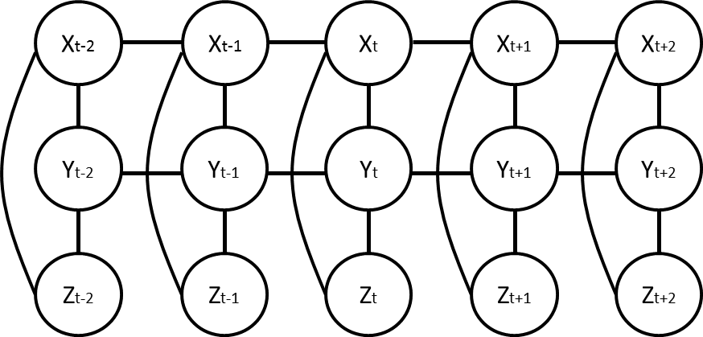
Evaluation Metrics
Extractive Summarization:
F-measure to compare the result.
Dialogue Act Modeling:
Accuracy to compare the result.
Report effective features.
compare
14

Slide 15
Comparison of extractive summarization performances
For all experiments, we train and test 5 times on the same training and test dataset and calculate the average of them.
3% improvement in F-measure.
8 % improvement in recall.
 | DCRF | CRF
F-measure | 0.49 | 0.46
Precision | 0.53 | 0.54
Recall | 0.46 | 0.38
15
Notes:
For extractive summarization task, our approach improves F-measure by 3%.
Especially, it shows 8 % improvement in recall.

Slide 16
Comparison of dialogue act modeling performances
Overall accuracy improves by 3% on average.
But…
Because of the small labeled dataset, we observe low accuracies for some dialogue acts (e.g., Su and R).
 | DCRF | CRF
Overall Accuracy | 0.81 | 0.78
S Accuracy | 0.93 | 0.90
M Accuracy | 0.57 | 0.57
Su Accuracy | 0.0 | 0.2
R Accuracy | 0.09 | 0.0
Q Accuracy | 0.83 | 0.83
16
Notes:
For dialogue act modeling task, overall accuracy improves by 3% on average.
However, because of the small labeled dataset, we get low accuracies for some dialogue acts (e.g., Su and R).

Slide 17
Measuring effectiveness of Extractive Summarization Features
Divide extractive summarization features into four categories based on similarity and report the most effective feature set.
structural feature set
Length feature.
Relative Position feature
overlap feature set
Thread Name Overlaps feature
Subject Name Overlaps feature
Simplified CWS features feature
sentence feature set
Question feature.
email feature set
CC feature
Participation Dominance feature
17
Notes:
we divide extractive summarization features into four categories based on similarity and report the most effective feature set.
Then, for each category, we train and test DCRF on the same dataset as previous section using dialogue act features and the features that belong to the category.

Slide 18
Effective Features
In email domain, the same words are used repeatedly.
This characteristic helps model both labeling tasks.
18
Notes:
The results are summarized here.
It can be seen that the most effective features are overlap features in both extractive summarization and dialogue act modeling tasks.
In email domain, the same words are used repeatedly.
This character helps model both tasks.

Slide 19
Conclusion and Future Work
Conclusion
A new approach that performs DA modeling and extractive summarization jointly in a single DCRF
Pros:
Our approach outperforms the linear-chain CRF in both tasks.
Discovered Overlap Feature Set are the most effective in our model.
Cons:
Observed Low accuracies for some dialogue acts (e.g., Su and R) due to small dataset.
Future Work
Extend our approach to semi-supervised learning.
19

Slide 20
Questions?
20

Slide 21
Dialogue Act Tags
The dialogue act tagset consists of 5 general tags and 12 specific tags. For our experiment, we only use 5 tagset.
Tag | Description | Relative Frequency
S | Statement | 0.738
R | Reply | 0.0523
Q | Question | 0.0792
Su | Suggestion | 0.0562
M | Miscellaneous | 0.0746
21

Slide 22
BC3 Corpus Content
 | Total Dataset (Relative Freq.) | Train Set | Test Set
Num. of All Threads | 39 (100%) | 34 | 5
Num. of All Sentences | 1300 (100%) | 1121 | 179
Num. of Extractive Summary Sentences | 521 (40%) | 458 | 63
Num. of Statement Sentences | 959 (73.8%) | 827 | 132
Num. of Question Sentences | 103 (7.9%) | 91 | 12
Num. of Reply Sentences | 68 (5.2%) | 57 | 11
Num. of Suggestion Sentences | 73 (5.6%) | 68 | 5
Num. of Miscellaneous Sentences | 97 (7.5%) | 78 | 19
22

