Slide 1
Semi-supervised Dialogue Act Recognition
Maryam Tavafi

Slide 2
Motivation
Detecting the human social intentions in spoken conversations
Dialogue summarization
Collaborative task learning agents
Dialogue systems
...

Slide 3
Method for Semi-supervised DA modeling
SVM-hmm with bootstrapping
The features for the classification are:
Unigrams in the sentence
Speaker of the sentence
Relative position of the sentence in the post
Length of the sentence, in terms of the number of its words

Slide 4
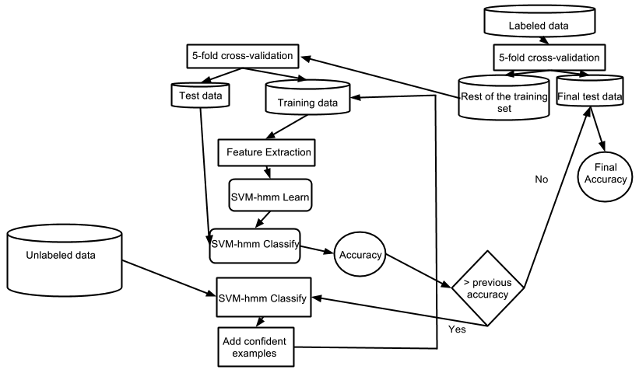
Framework

Slide 5
SVM-hmm
SVM-hmm classification is based on Viterbi algorithm
  Viterbi score of a sequence

Slide 6
Confident Score
Rank all the sequences based on Viterbi score and choose top X sequences
Rank all the sequences based on the Viterbi score normalized by the length of the sequence and choose top X sequences
Sort sequences by their length. Group them into 5 groups, and rank them in each group based on Viterbi score. Choose X sequences from the first group, X-Y from the second, X-2*Y from the third, and so on. (X and Y are the parameters)

Slide 7
Corpora-Asynchronous Conversations
Email
  Labeled dataset: BC3
  Unlabeled dataset: W3C
  Tagset: 12 DAs
Forum
  Labeled dataset: CNET
  Unlabeled dataset: BC3 Blog
  Tagset: 11 DAs

Slide 8
Corpora-Synchronous Conversations
Meeting
  MRDA
  Tagset: 11 DAs
Phone
  SWBD
  Tagset: 16 DAs

Slide 9
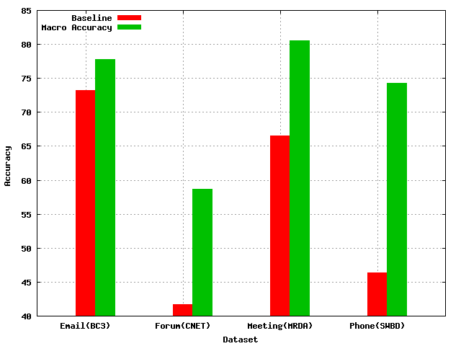
Results
Supervised with SVM-hmm (Baseline is majority class)

Slide 10
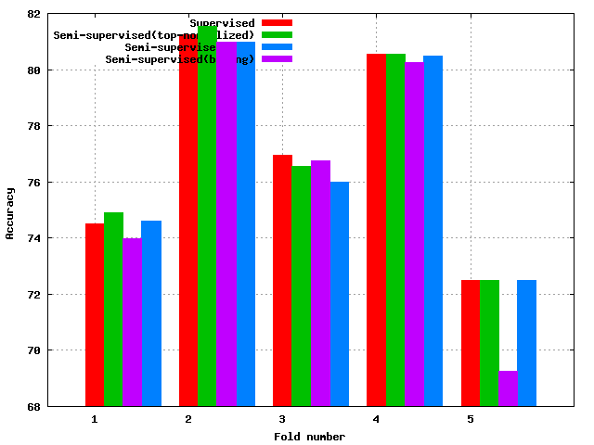
Results
Semi-supervised on Email (comparison of choosing top examples)

Slide 11
Results
SWBD
  no significant improvement
  small dataset
MRDA
  small improvement using bining approach
CNET
  no significant improvement
  thread structure of the unlabeled data was not available

Slide 12
Lessons learned
Email conversations benefit the most from adding unlabeled data
When using Viterbi score as a confidence score for SVM-hmm, we should consider the length difference between sequences
  normalize the score by the length

Slide 13
Evaluation
Showed SVM-hmm performs well for DA modeling on different domains
Bootstrapping performed better on the email dataset
  We need large unlabeled dataset for DA modeling

Slide 14
Future Work
Other semi-supervised techniques
Parameter for confident score
Additional features
  Bigrams, trigrams, POS tags, prosodic features for meeting and phone

Slide 15

Questions?

