Slide 1
NAMED ENTITY RECOGNITION
WITH
RANDOM FORESTS AND
BAYESIAN OPTIMIZATION
Presenters: Arni, Sanjana

Slide 2
Named Entity Recognition
Subtask of Information Extraction
Identify known entity names – person, places, organization etc
Identify the boundaries of the NE and identify its types
Example:
  Input - Pope Benedict , the leader of the Catholic church wants to retire in Rome.
  Output - [PER Pope Benedict XVI], the leader of [ORG the Catholic church] wants to retire in [LOC Rome].
Notes:
Information extraction is the process of extracting some structured information from unstructured text.

Slide 3
Proposed Technique –
Random Forests
Random Forest
  Ensemble of trained decision trees
  Bootstrapping– Randomly sample the labelled training data
Bayesian optimization (New!)
  To set hyperparameter values
Notes:
NER is a sequence labelling task and techniques like HMM, MEMM, CRFs look more suitable for this task. But decision trees take less computation time and enables to use enormous feature set.

Slide 4
Dataset
Using Reuters corpus available in NLTK instead
  Contains 10,788 news documents totalling 1.3 million words
  We use 5000 sentences, about 10% of total data.
  We use the NLTK NER tagger as gold standard [noisy!]

Slide 5
Features
We extracted 11 features from our corpus.
Orthographical:
  Capitalization, word length, digits, dashes, …
Contextual:
  Part of speech tags
Gazetteer lists:
  Unambiguous NEs from training
  Locations, names, corporate names

Slide 6
Unbalanced data
Highly unbalanced data
  Most words are not named entities (i.e. in class 0)
Risk of a strong bias towards class 0.
Solution:
  Undersample 0-class in training data.
  Use all data from other classes.
  Creates extra bootstrapping parameter B.

Slide 7
Random forest
We use 10-fold cross validation to evaluate our model’s performance
Metrics
  Precision & recall
  F-measure
  Accuracy is uninformative
How to choose hyper-parameter values?
  # of trees, max depth, # of features, B
  Answer: Bayesian optimization

Slide 8
Bayesian optimization
Grid search optimization is too expensive!
Bayesian optimization greatly reduces number of model evaluations:
  Assume Gaussian process prior
  Updates a GP posterior on each iteration
Different heuristics for picking points:
  We optimize Expected Improvement
We use Spearmint B.O. package by Snoek et al.

Slide 9
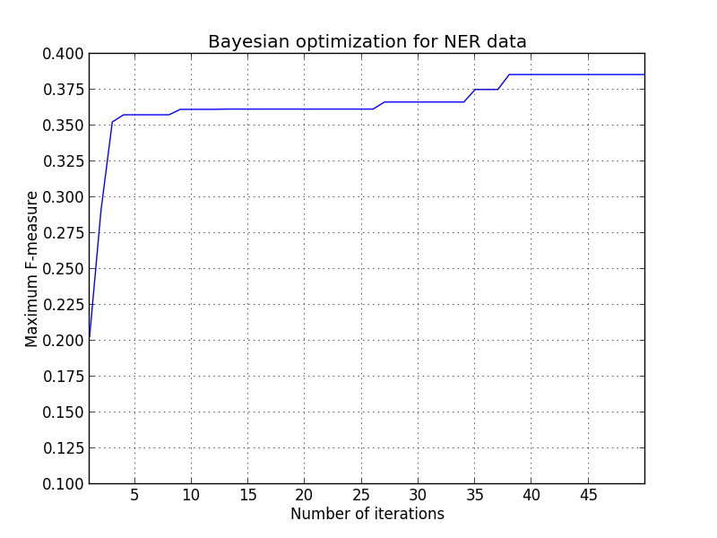
Experiments and results
Optimal values:
B = 0.093408…
#features = 8
max_depth = 7

Slide 10
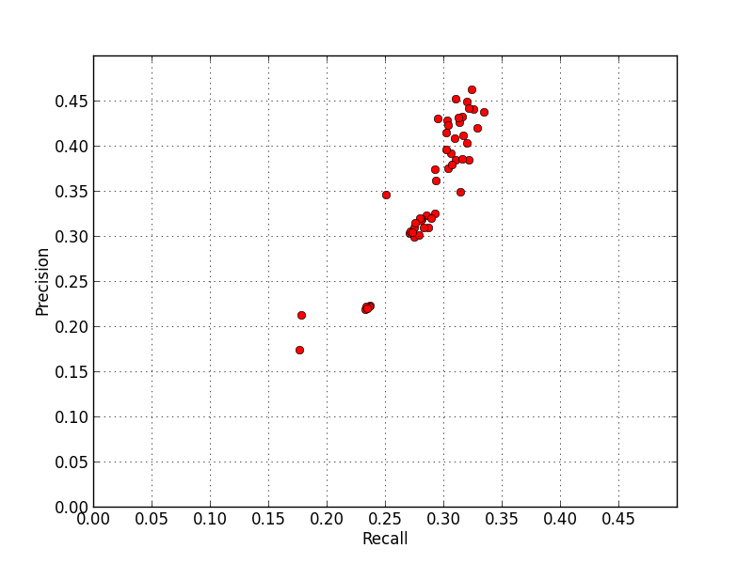
Experiments and results
Precision-recall curve for each iteration of Bayesian optimization
Unexpected proportional relationship!

Slide 11

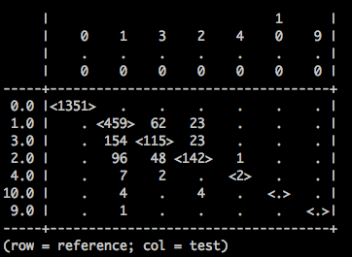
Experiments and results
Random forest with optimal hyper-parameters
Sample confusion matrix

Slide 12
Conclusions
Random forests are a feasible model for doing NER
Bayesian optimization is a powerful way of optimizing hyper-parameters
This work could benefit from:
  Better NER tags in training data
  More features (i.e. n-grams)
  More data for training – now using 160,000 words

Slide 13
Thank you!

