Slide 1
CPSC 503
Computational Linguistics
Lecture 8
Giuseppe Carenini

Slide 2
Knowledge-Formalisms Map
State Machines (and prob. versions)
(Finite State Automata,Finite State Transducers, Markov Models)
Morphology
Syntax
Rule systems (and prob. versions)
(e.g., (Prob.) Context-Free Grammars)
Semantics
Pragmatics
Discourse and Dialogue
Logical formalisms
(First-Order Logics)
AI planners
Notes:
Last time Big transition state machines (Regular languages) → CFGgrammars (CF languages)
Parsing two approaches TD vs. BU (combine them with left corners)
Still inefficient for 3 reasons

Slide 3
Today Sept 30
Partial Parsing: Chunking
Dependency Grammars / Parsing
Treebank
Start PCFG

Slide 4
Chunking
Classify only basic non-recursive phrases (NP, VP, AP, PP)
  Find non-overlapping chunks
  Assign labels to chunks
Chunk: typically includes headword and pre-head material
[NP The HD box] that [NP you] [VP ordered] [PP from] [NP Shaw] [VP never arrived]
Notes:
(Specifier) head (Complements)

Slide 5
Machine Learning Approache to Chunking
A case of sequential classification
IOB tagging: (I) internal, (O) outside, (B) beginning
Internal and Beginning for each chunk type => size of tagset (2n + 1) where n is the num of chunk types
Find an annotated corpus
Select feature set
Select and train a classifier

Slide 6
Context window approach
Typical features:
  Current / previous / following words
  Current / previous / following POS
  Previous chunks
Notes:
NN noun

Slide 7
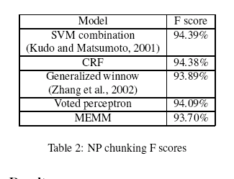
Context window approach and others..
Specific choice of machine learning approach does not seem to matter
F-measure 92-94 range
Common causes of errors:
  POS tagger inaccuracies
  Inconsistencies in training corpus
  Inaccuracies in identifying heads
  Ambiguities involving conjunctions (e.g., “late arrivals and cancellations/departures are common in winter” )
NAACL ‘03
Notes:
- The Head is the word in a phrase that is grammatically more important
- Shallow parsing using specialized hmms Full text Pdf (239 KB)
Source The Journal of Machine Learning Research archive
Volume 2 , (March 2002) table of contents
SPECIAL ISSUE: Special issue on machine learning approaches to shallow parsing table of contents
Pages: 595 - 613
Year of Publication: 2002
ISSN:1533-7928
Authors Antonio Molina Departament de Sistemes Informàtics i Computació, Universitat Politècnica de València, Camí de Vera s/n, 46020 València (Spain) Ferran Pla Departament de Sistemes Informàtics i Computació, Universitat Politècnica de València, Camí de Vera s/n, 46020 València (Spain)
Publisher MIT Press Cambridge, MA, USA

Slide 8
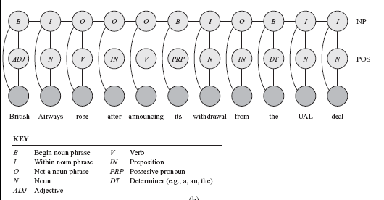
Coupled linear-chain CRFs
Linear-chain CRFs can be combined to perform multiple tasks simultaneously
Performs part-of-speech labeling and noun-phrase segmentation

Slide 9
Today Sept 30
Partial Parsing: Chunking
Dependency Grammars / Parsing
Treebank
Start PCFG

Slide 10
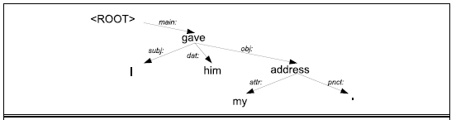
Dependency Grammars
Syntactic structure: binary relations between words
Links: grammatical function or very general semantic relation
Abstract away from word-order variations (simpler grammars)
Useful features in many NLP applications (for classification, summarization and NLG)

Slide 11
Dependency Grammars
(more verbose)
In CFG-style phrase-structure grammars the main focus is on constituents.
But it turns out you can get a lot done with just binary relations among the words in an utterance.
In a dependency grammar framework, a parse is a tree where
  the nodes stand for the words in an utterance
  The links between the words represent dependency relations between pairs of words.
    Relations may be typed (labeled), or not.

Slide 12
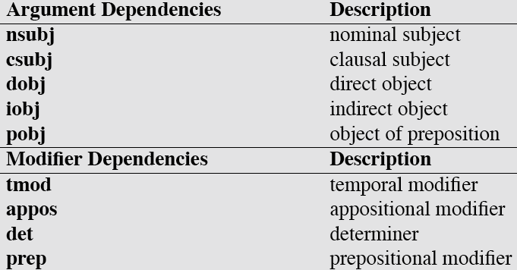
Dependency Relations
Show grammar primer
Notes:
Clausal subject:
That he had even asked her made her angry. The clause "that he had even asked her" is the subject of this sentence.

Slide 13
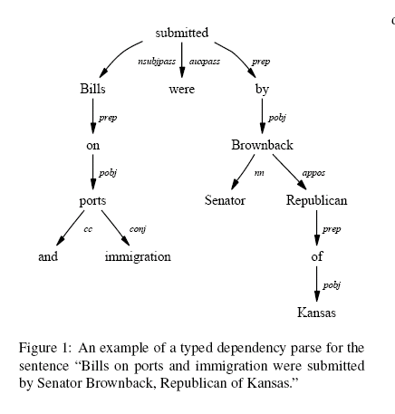
Dependency Parse (ex 1)

Slide 14
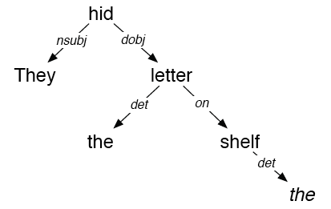
Dependency Parse (ex 2)
They hid the letter on the shelf

Slide 15
Dependency Parsing
(see MINIPAR / Stanford demos and more….)
Dependency approach vs. CFG parsing.
  Deals well with free word order languages where the constituent structure is quite fluid
  Parsing is much faster than CFG-based parsers (MaltParser, 2008. Linear time!)
  Dependency structure often captures all the syntactic relations actually needed by later applications
Notes:
The dependency approach has a number of advantages over full phrase-structure parsing.
Deals well with free word order languages where the constituent structure is quite fluid
Parsing is much faster than CFG-bases parsers
Dependency structure often captures the syntactic relations needed by later applications
CFG-based approaches often extract this same information from trees anyway.

Slide 16
Dependency Parsing
There are two modern approaches to dependency parsing (supervised learning from Treebank data)
  Graph / Optimization-based approach: Find Minimum spanning tree that best matches some criteria [McDonald, 2005]
  Greedy Transition-based approach: define and learn a transition system for mapping a sentence to its dependency graph (MaltParser – Java – pointer course webpage)
Notes:
Data-Driven Dependency Parsing
◮ Dependency parsing based on (only) supervised learning from
treebank data (annotated sentences)
◮ Graph-based [Eisner 1996, McDonald et al. 2005a]
◮ Define a space of candidate dependency graphs for a sentence
◮ Learning: Induce a model for scoring an entire dependency
graph for a sentence
◮ Inference: Find the highest-scoring dependency graph, given
the induced model
◮ Transition-based [Yamada and Matsumoto 2003, Nivre et al. 2004]:
◮ Define a transition system (state machine) for mapping a
sentence to its dependency graph
◮ Learning: Induce a model for predicting the next state
transition, given the transition history
◮ Inference: Construct the optimal transition sequence, given the
induced model

Slide 17
Today Sept 30
Partial Parsing: Chunking
Dependency Grammars / Parsing
Treebank
Start PCFG

Slide 18
Treebanks
DEF. corpora in which each sentence has been paired with a parse tree
These are generally created
  Parse collection with parser
  human annotators revise each parse
Requires detailed annotation guidelines
  POS tagset
  Grammar
  instructions for how to deal with particular grammatical constructions.
Notes:
Treebanks are corpora in which each sentence has been paired with a parse tree (presumably the right one).
These are generally created
By first parsing the collection with an automatic parser
And then having human annotators correct each parse as necessary.
This generally requires detailed annotation guidelines that provide a POS tagset, a grammar and instructions for how to deal with particular grammatical constructions.

Slide 19
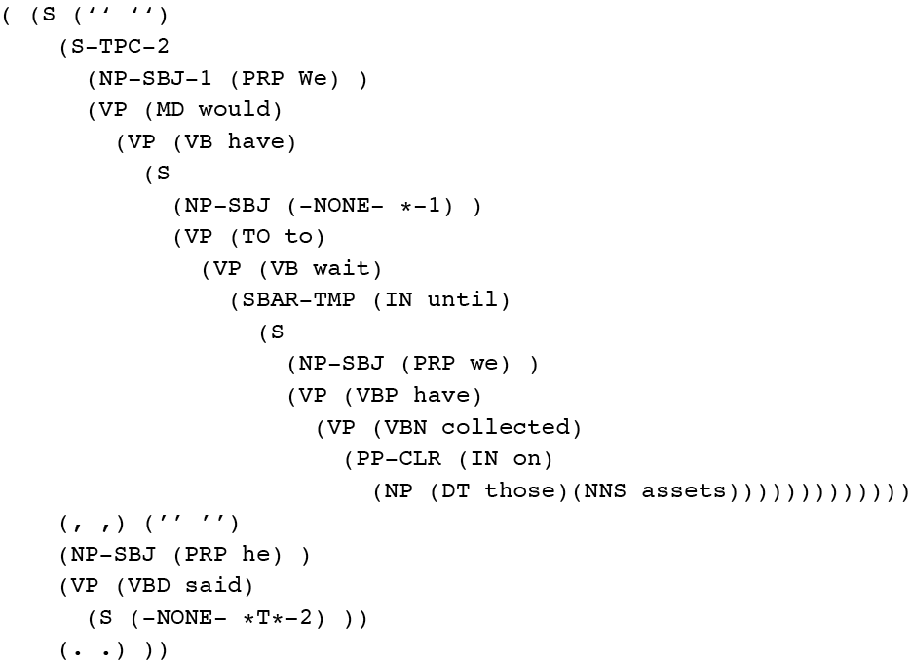
Penn Treebank
Penn TreeBank is a widely used treebank.
  Most well known is the Wall Street Journal section of the Penn TreeBank.
    1 M words from the 1987-1989 Wall Street Journal.
Notes:
Penn Treebank phrases annotated with grammatical function
To make recovery of predicate argument easier

Slide 20
Treebank Grammars
Treebanks implicitly define a grammar.
Simply take the local rules that make up the sub-trees in all the trees in the collection
if decent size corpus, you’ll have a grammar with decent coverage.
Notes:
Treebanks implicitly define a grammar for the language covered in the treebank.
Simply take the local rules that make up the sub-trees in all the trees in the collection and you have a grammar.
Not complete, but if you have decent size corpus, you’ll have a grammar with decent coverage.

Slide 21


Treebank Grammars
Such grammars tend to be very flat due to the fact that they tend to avoid recursion.
  To ease the annotators burden
For example, the Penn Treebank has 4500 different rules for VPs! Among them...
Notes:
Total of 17,500 rules

Slide 22
Heads in Trees
Finding heads in treebank trees is a task that arises frequently in many applications.
  Particularly important in statistical parsing
We can visualize this task by annotating the nodes of a parse tree with the heads of each corresponding node.

Slide 23
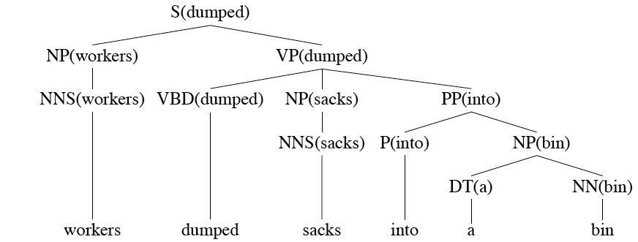
Lexically Decorated Tree

Slide 24
Head Finding
The standard way to do head finding is to use a simple set of tree traversal rules specific to each non-terminal in the grammar.

Slide 25
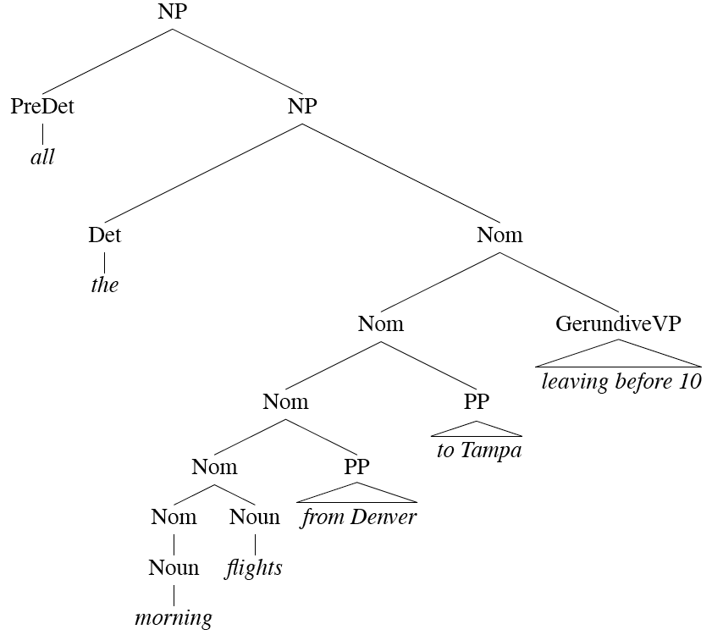
Noun Phrases
Notes:
For each phrase type Simple set of hand-written rules to find the head of such a phrase.
This rules are often called head percolation

Slide 26
Noun Phrases
Notes:
For each phrase type Simple set of hand-written rules to find the head of such a phrase.
This rules are often called head percolation

Slide 27
Treebank Uses
Searching a Treebank. TGrep2
NP < PP or NP << PP
Treebanks (and headfinding) are particularly critical to the development of statistical parsers
  Chapter 14
Also valuable to Corpus Linguistics
  Investigating the empirical details of various constructions in a given language
Notes:
NP immediately dominating a PP
NP dominating a PP

Slide 28
Today Sept 30
Partial Parsing: Chunking
Dependency Grammars / Parsing
Treebank
Start PCFG

Slide 29
Start Probabilistic CFGs
Formal Definition
Assigning prob. to parse trees and to sentences
Acquiring prob.

Slide 30
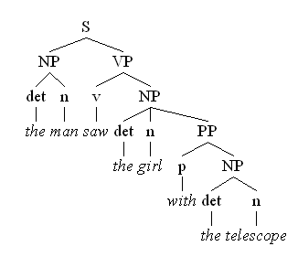
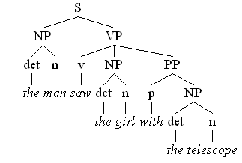
Syntactic Ambiguity…..
“the man saw the girl with the telescope”
The man has the telescope
The girl has the telescope
Notes:
I saw the planet with the telescope...

Slide 31
Structural Ambiguity (Ex. 3)
Coordination “new student and profs”
Notes:
What are other kinds of ambiguity?
VP -> V NP ; NP -> NP PP
VP -> V NP PP
Attachment non-PP “I saw Mary passing by cs2”
Coordination “new student and profs”
NP-bracketing “French language teacher”
In combinatorial mathematics, the Catalan numbers form a sequence of natural numbers that occur in various counting problems, often involving recursively defined objects.
Catalan numbers (2n)! / (n+1)! n!

Slide 32
Structural Ambiguity (Ex. 4)
NP-bracketing “French language teacher”
Notes:
What are other kinds of ambiguity?
VP -> V NP ; NP -> NP PP
VP -> V NP PP
Attachment non-PP “I saw Mary passing by cs2”
Coordination “new student and profs”
NP-bracketing “French language teacher”
In combinatorial mathematics, the Catalan numbers form a sequence of natural numbers that occur in various counting problems, often involving recursively defined objects.
Catalan numbers (2n)! / (n+1)! n!

Slide 33
Probabilistic CFGs (PCFGs)
Each grammar rule is augmented with a conditional probability
The expansions for a given non-terminal sum to 1
VP -> Verb .55
VP -> Verb NP .40
VP -> Verb NP NP .05
Formal Def: 5-tuple (N, ∑, P, S,D)
Notes:
P(A->beta|A)
D is a function assigning probabilities to each production/rule in P

Slide 34
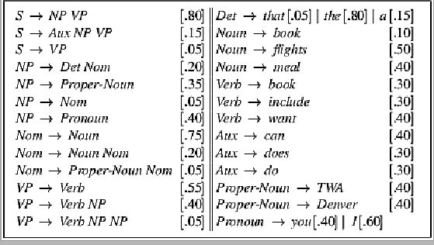
Sample PCFG

Slide 35
PCFGs are used to….
Estimate Prob. of parse tree
Estimate Prob. to sentences
Notes:
The probability of a derivation (tree) is just the product of the probabilities of the rules in the derivation.
Product because rule applications are independent (because CFG)
integrate them with n-grams
The probability of a word sequence (sentence) is the probability of its tree in the unambiguous case.
It’s the sum of the probabilities of the trees in the ambiguous case.

Slide 36
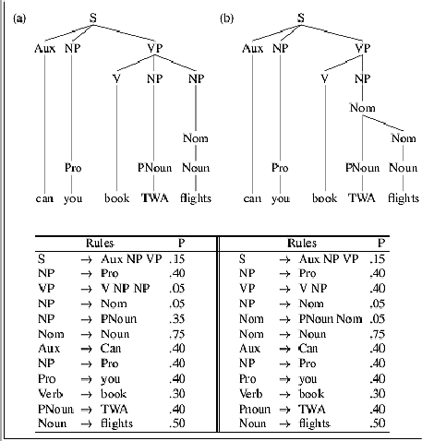
Example

Slide 37
Acquiring Grammars and Probabilities
Manually parsed text corpora (e.g., PennTreebank)
Grammar: read it off the parse trees
Ex: if an NP contains an ART, ADJ, and NOUN then we create the rule NP -> ART ADJ NOUN.
Probabilities:
Ex: if the NP -> ART ADJ NOUN rule is used 50 times and all NP rules are used 5000 times, then the rule’s probability is …
Notes:
We can create a PCFG automatically by exploiting manually parsed text corpora, such as the Penn Treebank. We can read off them grammar found in the treebank.
Probabilities: can be assigned by counting how often each item is found in the treebank
Ex: if the NP -> ART ADJ NOUN rule is used 50 times and all NP rules are used 5000 times, then the rule’s probability is 50/5000 = .01

Slide 39
Final Research Project: Decision
(Group of 2 people is OK)
Select an NLP task / problem or a technique used in NLP that truly interests you
Tasks: summarization of …… , computing similarity between two terms/sentences… topic modeling, opinion mining (skim through the textbook, final chapters)
Techniques: extensions / variations / combinations of what we see in class – Max Entropy Classifiers or MM, Dirichlet Multinomial Distributions, Conditional Random Fields,

Slide 40
Final Research Project: goals (and hopefully contributions ☺)
Apply a technique which has been used for nlp taskA to a different nlp taskB.
Apply a technique to a different dataset or to a different language
Proposing a different evaluation measure
Improve on a proposed solution by using a possibly more effective technique or by combining multiple techniques
Proposing a novel (minimally is OK!) different solution.

Slide 41
Final Pedagogical Project
Make “small” contribution to NLP education
  Select an advanced topic that was not covered in class
  Examine several educational materials about it (e.g., textbook chp., online lectures, tutorials, wikipedia, … ….)
  Select readings for the students possibly including research papers
  Summarize those readings and prepare a lecture about your topic
  Develop an assignment to test the learning goals and work out the solution.
These can also be done in groups (max 2)

Slide 42
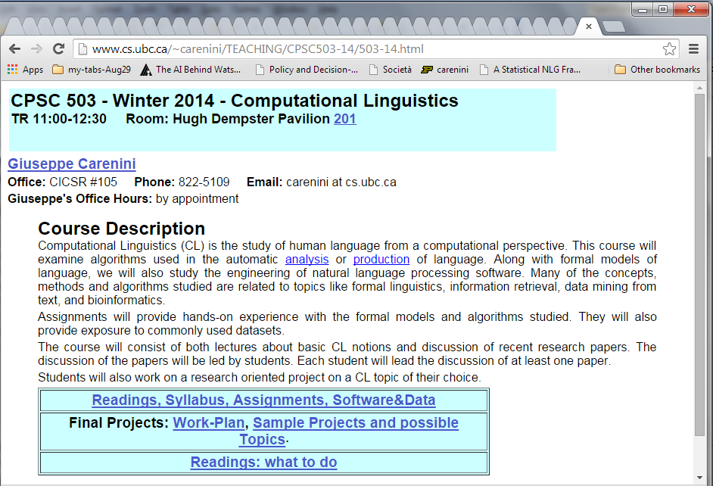
Final Project: what to do + Examples / Ideas
Look on the course WebPage
Proposal due Oct 21

Slide 43
Reminder: Activities and (tentative) Grading
~15 Lectures (participation 10%)
3-4 assignments (15%)
X? Student Presentations on selected readings (10%)
Readings: Critical summary and Questions(10%)
Project (55%)
  Proposal: 1-2 pages write-up & Presentation (5%)
  Update Presentation (5%)
  Final Presentation and 8-10 pages report (45%)
Notes:
The instructor reserves the right to adjust this grading scheme during the term, if necessary
?Assignments hands-on experience with algorithms?

Slide 44
Next Time
Probabilistic Parsing
Probabilistic Lexicalized CFGs
Assignment-2 due next Tue

Slide 45
Probabilistic CFGs
Assigning prob. to parse trees and to sentences
  parse with prob.
  acquiring prob.
Probabilistic Lexicalized CFGs
  Non-terminals more specific/general
  More sophisticated conditioning factors

Slide 46
Approaches to Chunking (1): Finite-State Rule-Based (skip)
Set of hand-crafted rules (no recursion!) e.g., NP -> (Det) Noun* Noun
Implemented as FSTs (unionized/determinized/minimized)
F-measure 85-92
To build tree-like structures several FSTs can be combined [Abney ’96]
Notes:
Show NLTK demo

Slide 47
Approaches to Chunking (1): Finite-State Rule-Based (skip)
… several FSTs can be combined
Notes:
What about ambiguity?

