Slide 1
CPSC 503
Computational Linguistics
Natural Language Processing
Human Language Technology
……
Course Overview- Lecture 1 – 2014 Giuseppe Carenini

Slide 2
Today Sep 4
Overview of the field
Overview of course
  Background knowledge
  Topics
  Activities and Grading
  Administrative Stuff
Introductions (if time left)
Notes:
Introductions?

Slide 3
Natural Language Processing
What is it?
  We’re going to study formalisms, models and algorithms to allow computers to perform useful tasks involving knowledge about human languages.
Notes:
Natural language Processing / Computational Linguistics we’ll use these two term interchangeably
Simply put, computational linguistics is the scientific study of language from a computational perspective.
Computational linguists are interested in providing computational models of various kinds of linguistic phenomena.
These models may be "knowledge-based" ("hand-crafted") or "data-driven" ("statistical" or "empirical").
Work in computational linguistics is in some cases motivated from a scientific perspective in that one is trying to
provide a computational explanation for a particular linguistic or psycholinguistic phenomenon; and in other cases
the motivation may be more purely technological in that one wants to provide a working component of a speech or
natural language system. Indeed, the work of computational linguists is incorporated into many working systems today, including speech recognition systems, text-to-speech synthesizers, automated voice response systems, web search engines, text editors, language instruction materials, to name just a few

Slide 4
Sample Useful Tasks
Any ideas?
Notes:
… involving human languages
In the sense that the computer needs to model some aspects of natural language
Write on board
Little application: spelling checkers, grammar and style checkers

Slide 5
Sample Useful Tasks
Conversational agents: AT&T “How may I help you?” technology
  Apple SIRI
Summarization: ”Please summarize my discussion with Sue about 503” “What people say about the new Nikon 5000?”
  Yahoo Paid $30 Million in Cash for the Summly company (2013)
Generation: an automatic commentator of a soccer game (e.g., from output of a vision system)
  ARRIA world leader in NLG
Notes:
Useful Tasks - Applications
Mix of research and deployed techniques/tasks
Extract meaning from fluent speech via automatic acquisition and exploitation of salient words,
phrases and grammar fragment from a corpus
Speech, language and dialog techniques… Evaluated on live customer
Another generation: generate weather reports in multiple languages
SHOCK: Siri Isn't A Totally Useless Hunk Of Junk From Apple
It turns out Apple's voice-based assistant software, Siri, isn't completely useless.
Siri, which Apple used heavily to market the iPhone 4S, has been regularly trashed by the tech press, and normal people, since it was released.
And when I first got the iPhone, I too, was let down by Siri. The crazy lady didn't even know where I lived! She thought I was in New York, Texas, not New York, New York. She's since fixed that problem and can now tell me the weather in New York, New York when I ask.
However, after a month using Siri, I can say that it's not a complete and utter hunk of junk. It's actually useful, but it's definitely not for normal people, and Apple's decision to market Siri as much as it did is a little suspect.
I ride my bike to and from work, so having a hands free option to send and receive text messages is great. If I get a text, I can squeeze on the mic of Apple's Ear Pods and say, "Read me my unread messages." Siri reads the message and gives me an opportunity to reply to the message.
Or, if I'm riding my bike and I remember something, like, buying toothpaste, I can say, "Remind me to buy toothpaste when I get home," and Siri will set up a reminder.
On Wednesday night, I was riding home and passed a bar that had the Giants-Tigers game on. I asked Siri, "What's the score of the game?" She told me, "5-0." I was stunned since Justin Verlander was supposed to be untouchable. I asked what inning, she told me the fifth.
Siri also works well if I'm driving. I can ask her for directions some place and she'll get them. Or, I can have her send or receive text messages.
That said, Siri can be very fickle. She can take a long time to come up with an answer. She can just conk out and deliver no results. She can rattle of a long list of options when you ask for directions, which is not all that helpful.
And, I personally don't think Siri is simple technology that a normal person would immediately feel comfortable using. Right now, Siri is a nice thing to have, but if it went away tomorrow, I wouldn't be all that upset. The way Apple pitched it, as a must have, revolutionary technology was a mistake. That's why people hated it. Apple over promised and under delivered.
Read more: http://www.businessinsider.com/siri-review-2012-10#ixzz2HJdHCJWR

Slide 6
Sample Useful Tasks (cont’)
Web-based question answering : “Was 1991 an El Nino year? ….Was it the first one after 1982?” “Why was it so intense?”
IBM Watson Jeopardy (now medicine! See next slides)
Document Classification: spam detection, news filtering
…not in 503 ☹ but possible topics for a project ☺
Speech: speech recognition and transcription, text to speech synthesis
Machine Translation
Notes:
Speech can be added to most of the above…
Named entities are phrases that contain the names of persons, organizations, locations, times and quantities. Example:
[ORG U.N. ] official [PER Ekeus ] heads for [LOC Baghdad ]
Named Entity Recognition (NER) is a subtask of Information Extraction.

Slide 7
From silly project to $1 billion investment
2005-6 “IT’S a silly project to work on, it’s too gimmicky, it’s not a real computer-science test, and we probably can’t do it anyway.” These were reportedly the first reactions of the team of IBM researchers challenged to build a computer system capable of winning “Jeopardy!
………after 8-9 years…
On January 9th 2014, with much fanfare, the computing giant announced plans to invest $1 billion in a new division, IBM Watson Group. By the end of the year, the division expects to have a staff of 2,000 plus an army of external app developers …..Mike Rhodin, who will run the new division, calls it “one of the most significant innovations in the history of our company.” Ginni Rometty, IBM’s boss since early 2012, has reportedly predicted that it will be a $10 billion a year business within a decade.
Notes:
“IT’S a silly project to work on, it’s too gimmicky, it’s not a real computer-science test, and we probably can’t do it anyway.” These were reportedly the first reactions of the team of IBM researchers challenged to build a computer system capable of winning “Jeopardy!
……
On January 9th, with much fanfare, the computing giant announced plans to invest $1 billion in a new division, IBM Watson Group. By the end of the year, the division expects to have a staff of 2,000 plus an army of external app developers working within its “open Watson ecosystem”. It also unveiled a raft of new projects under development, on top of the handful already revealed in health care, financial services and retailing with firms such as WellPoint and the Cleveland Clinic. Mike Rhodin, who will run the new division, calls it “one of the most significant innovations in the history of our company.” Ginni Rometty, IBM’s boss since early 2012, has reportedly predicted that it will be a $10 billion a year business within a decade.

Slide 8
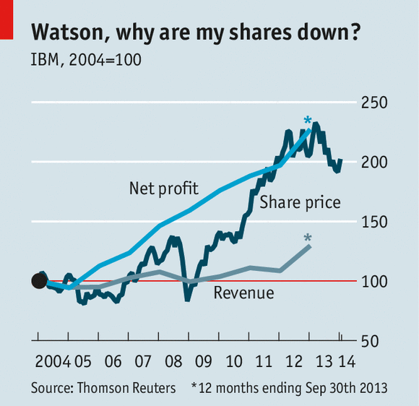
More complex questions in the future…
Or something I read yesterday: “Should Europe reduce its energy dependency from Russia and what would it take?”

Slide 9
Natural Language Processing
What is it?
  We’re going to study formalisms, models and algorithms to allow computers to perform useful tasks involving knowledge about human languages.
Notes:
Natural language Processing / Computational Linguistics we’ll use these two term interchangeably
Simply put, computational linguistics is the scientific study of language from a computational perspective.
Computational linguists are interested in providing computational models of various kinds of linguistic phenomena.
These models may be "knowledge-based" ("hand-crafted") or "data-driven" ("statistical" or "empirical").
Work in computational linguistics is in some cases motivated from a scientific perspective in that one is trying to
provide a computational explanation for a particular linguistic or psycholinguistic phenomenon; and in other cases
the motivation may be more purely technological in that one wants to provide a working component of a speech or
natural language system. Indeed, the work of computational linguists is incorporated into many working systems today, including speech recognition systems, text-to-speech synthesizers, automated voice response systems, web search engines, text editors, language instruction materials, to name just a few

Slide 10
Knowledge about Language
Any ideas?

Slide 11
Knowledge about Language
Phonetics and Phonology (sounds)
Morphology (structure of words)
Syntax (structure of sentences)
Semantics (meaning)
Pragmatics (language use)
Discourse and Dialogue (units larger than single utterance)
Notes:
Linguistics part of Comp. Ling. !
Phonetics studies the physical nature of speech sounds: their articulation, acoustic properties and perceptual characteristics
Phonology: what is the inventory of basic sounds (phonemes) in the language and what combinations are possible

Slide 12
Morphology
Def. The study of how words are formed from minimal meaning-bearing units (morphemes)
Examples:
Plural: cat-s, fox-es, fish
Tense: walk-s, walk-ed
Nominalization: kill-er, fuzz-iness
Compounding: book-case,over-load,wash-cloth
Notes:
Inflectional and derivational
Tense: the category that encodes the time of an event with reference to the moment of speaking
Others? Compounding: happy hour(Adj+N), bookcase (N+N), overload (Prep+N), washcloth (V+N)
Adjectives derived from nouns and verbs computation-al, manage-able
Act act-ive act-ive-ate re- act-ive-ate
Free (boy) and bound (-s) morphemes
We can usefully divide morphemes into two classes
Stems: The core meaning bearing units
Affixes: Bits and pieces that adhere to stems to change their meanings and grammatical functions
Inflectional morphology: The resulting word
Has the same word class as the original
Serves a grammatical/semantic purpose different from the original
Derivational morphology is the messy stuff that no one ever taught you.
Changes of word class
Less Productive ( -ant V -> N only with V of Latin origin!)

Slide 13
Syntax
Def. The study of how sentences are formed by grouping and ordering words
Based on: Substitution / Movement / Coordination Tests
Example:
Ming and Sue prefer morning flights
* Ming Sue flights morning and prefer
Notes:
Sentence formation how symbols of the language can be grouped and ordered together
Part of speech: whether a word is a noun, verb or an adjective
Based on Meaning/Inflection/Distribution
Constituency: groups of words behave as a single unit or
Based on:
<Substitution Test (they, it, do so)>
<Movement Test>
<Coordination Test>
Words/phrases order (English SVO)

Slide 14
Semantics
Def. The study of the meaning of words, intermediate constituents and sentences
Examples:
Words: “purchase” vs. “buy”, “hot” vs. “cold”
Sentences: “Mary has a new car”
? “Mary ‘s car is old” ?
…Symbolic structure that corresponds to objects and relations in some world being represented
Notes:
How the meaning of a phrase is related to the meaning of its parts
What sorts of meaning structures and meaning relations obtain in natural language
Semantic relations among words
Link linguistic inputs to a non-linguistic representation of the world
First-Order Logics
Symbol structures that corresponds to objects and relations among objects in some world being represented
…Representation for a particular state of affairs in some world

Slide 15
Pragmatics
(including Discourse and Dialogue)
Def1. The study of the meaning of a sentence that comes from context-of-use
Examples:
“Yesterday, she did much better”
“The judge denied the prisoner’s request because he was cautious/dangerous”
“Can you pass me the salt?
Def2. The study of how language is used to achieve goals (e.g., convince someone to quit smoking)
Notes:
Part of the meaning of a sentence does not come from the parts of the sentence itself or
the way they are combined. Study of language used in context
It comes from world knowledge or from inferences based on tacit conversational rules
Context: beliefs, attitudes, physical environment, previous discourse/dialog
Belief
(1)
Physical environment: We are watching someone performing an action
Previous Discourse”Mary has been trying this exercise for a week.”
(2)
According to previous discourse could be either the judge or the prisoner
(3)
It is never interpreted as a Y/N question

Slide 16
Natural Language Processing
What is it?
  We’re going to study formalisms, models and algorithms to allow computers to perform useful tasks involving knowledge about human languages.
Notes:
Natural language Processing / Computational Linguistics we’ll use these two term interchangeably
Simply put, computational linguistics is the scientific study of language from a computational perspective.
Computational linguists are interested in providing computational models of various kinds of linguistic phenomena.
These models may be "knowledge-based" ("hand-crafted") or "data-driven" ("statistical" or "empirical").
Work in computational linguistics is in some cases motivated from a scientific perspective in that one is trying to
provide a computational explanation for a particular linguistic or psycholinguistic phenomenon; and in other cases
the motivation may be more purely technological in that one wants to provide a working component of a speech or
natural language system. Indeed, the work of computational linguists is incorporated into many working systems today, including speech recognition systems, text-to-speech synthesizers, automated voice response systems, web search engines, text editors, language instruction materials, to name just a few

Slide 17
Formalisms, Models and Algorithms
Formalisms allow us to create models of the various kinds of linguistic and non-linguistic knowledge.
Algorithms are then used to manipulate representations to create the structures that are needed
Model
Input structure
Output structure
Algorithm
Notes:
… to represent the linguistic knowledge….
…

Slide 18
Simple Example
Formalism : Finite State Transducer (FST)
Model : Morphology of Plural
  Reg-nouns (cat, dog, fox…): plural -s
  Irreg-nouns (goose, mouse,…): plural (geese, mice,…)
  Spelling rules: e.g., fox+s -> foxes
Algorithms: Morphological Parsing and Generation (of plural)
Model
cat
cat +SG
foxes
fox +PL
mice
Algorithm
mouse +PL
goose
goose +SG
Notes:
… to represent the linguistic knowledge….
Takes as input a noun and returns singular form of the noun and whether it was in singular or plural form
Takes the singular form and a morpho-feature for number (sing. Or pl.) and return the corresponding word
Possible application? If you want to search in a text for
We will se how this can be dome efficiently for all word types (not only nouns) and all possible inflections (not just plural)
Key Concept #2: Parsing taking some input and producing some structure for it

Slide 19
Knowledge-Formalisms Map
(no ambiguity / no uncertainty)
State Machines
(FiniteStateAutomata,
FiniteStateTransducers)
Morphology
Syntax
Rule systems
(e.g., Context-Free Grammars)
Semantics
Pragmatics
Discourse and Dialogue
Logical formalisms
(First-Order Logics)
AI planners
Notes:
My Conceptual map
Formal models that consists of states, transitions among states and input/output representations
Non probabilistic no uncertainty
We will go back to this throughout the course

Slide 20
Algorithms
Transducers: take one kind of structure as input and output another.
Morphological
Structure
Syntactic
Structure
… …
Text
parsing
generation
State-space search with dynamic programming
Need to deal with ambiguity.
Notes:
Many of the algorithms that we’ll study will turn out to be transducers;
algorithms that take one kind of structure as input and output another.
Take one kind of structure (including language) …. Output another (including language)
States represent pairings of partially processed inputs with partially constructed answers
Goals are exhausted inputs paired with complete answers that satisfy some criteria.
As with most interesting problems the spaces are normally too large to exhaustively explore
Don’t do the same work over and over.
Avoid this by building and making use of solutions to sub-problems that must be invariant across all parts of the space.

Slide 21
Ambiguity
What is it? When for some input there are multiple alternative interpretations
Example:
“I made her duck”
How many interpretations ?
  duck : verb (…., ….) / noun (bird, cotton fabric)
  her : dative pronoun/ possessive adjective
  make : create / cook
  make : transitive (single direct obj.) / ditransitive (two objs) / cause (direct obj. + verb)
Notes:
Duck is also semantically ambiguous
Find the most likely interpretation in the given context
Noun
S: (n) duck (small wild or domesticated web-footed broad-billed swimming bird usually having a depressed body and short legs)
S: (n) duck, duck's egg ((cricket) a score of nothing by a batsman)
S: (n) duck (flesh of a duck (domestic or wild))
S: (n) duck (a heavy cotton fabric of plain weave; used for clothing and tents)
Verb
S: (v) duck (to move (the head or body) quickly downwards or away) "Before he could duck, another stone struck him"
S: (v) duck (submerge or plunge suddenly)
S: (v) dip, douse, duck (dip into a liquid) "He dipped into the pool"
S: (v) hedge, fudge, evade, put off, circumvent, parry, elude, skirt, dodge, duck, sidestep (avoid or try to avoid fulfilling, answering, or performing (duties, questions, or issues)) "He dodged the issue"; "she skirted the problem"; "They tend to evade their responsibilities"; "he evaded the questions skillfully"

Slide 22
Some Key Disambiguation Tasks
Part-of-speech
tagging
  duck : verb / noun
  make : create / cook
  her : dative pronoun / possessive adjective
  make : transitive (single direct obj.) / ditransitive (two objs) / cause (direct obj. + verb)
Word Sense
Disambiguation
Syntactic
Disambiguation
Notes:
Duck is also semantically ambiguous
N (bird vs. cotton fabric)
V (plunge under water, lower the head or body suddently)
Find the most likely interpretation in the given context

Slide 23
Sequence Labeling Task (POS Tagging)
Input
Brainpower, not physical plant, is now a firm's chief asset.
Output
Brainpower_NN ,_, not_RB physical_JJ plant_NN ,_, is_VBZ now_RB a_DT firm_NN 's_POS chief_JJ asset_NN ._.
Tag meanings
NNP (Proper N sing), RB (Adv), JJ (Adj), NN (N sing. or mass), VBZ (V 3sg pres), DT (Determiner), POS (Possessive ending), . (sentence-final punct)
Notes:
Penn Treebank part-of-speech tags (including punctuation)

Slide 24
Semantic Role Labeling: Example
Some roles.. (FrameNet for hiring frame)
Employer
Employee
Task
Position
  In 1979 , singer Nancy Wilson HIRED him to open her nightclub act .
  Castro has swallowed his doubts and HIRED Valenzuela as a cook in his small restaurant .
Notes:
Shallow semantic parsing is labeling phrases of a sentence with semantic roles with respect to a target word.
For example, the sentence
“Shaw Publishing offered Mr. Smith a reimbursement last March.”
Is labeled as:
[AGENTShaw Publishing] offered [RECEPIENTMr. Smith] [THEMEa reimbursement] [TIMElast March] .
We work with a number of collaborators, beginning with Dan Gildea in his dissertation work, on automatic semantic parsing. Much of Dan Gildeas's dissertation work was written up here: Daniel Gildea and Daniel Jurafsky. 2002. Automatic Labeling of Semantic Roles. Computational Linguistics 28:3, 245-288. This work also involves close collaboration with the FrameNet and PropBank projects.
Currently, we focus on building joint probabilistic models for simultaneous assignment of labels to all nodes in a syntactic parse tree. These models are able to capture the strong correlations among decisions at different nodes.
CompensationPeripheral
EmployeeCore
EmployerCore
FieldCore
InstrumentPeripheral
MannerPeripheral
MeansPeripheral
PlacePeripheral
PositionCore
PurposeExtra-Thematic
TaskCore
TimePeripheral

Slide 25
Implications of ambiguity
Need probabilistic formalisms/models and corresponding algorithms (e.g., Markov Models and Viterbi algorithm)
Need machine learning techniques to learn such models:
  Supervised (e.g., Logistic Regression)
  Unsupervised (e.g., Expectation Maximization)
Notes:
So that probabilities can be assigned to possible alternative interpretations
(learn them)
Finding the best state sequence
Viterbi-Algorithm

Slide 26
Knowledge-Formalisms Map
(including probabilistic formalisms)
State Machines (and prob. versions)
(Finite State Automata,Finite State Transducers, Markov Models)
Morphology
Machine Learning
Syntax
Rule systems (and prob. versions)
(e.g., (Prob.) Context-Free Grammars)
Semantics
Pragmatics
Discourse and Dialogue
Logical formalisms (First-Order Logics, Prob. Logics)
AI planners (MDP Markov Decision Processes)
Notes:
My Conceptual map - This is the master plan
Markov Models used for part-of-speech and dialog
Syntax is the study of formal relationship between words
How words are clustered into classes (that determine how they group and behave)
How they group with they neighbors into phrases

Slide 27
Why NLP Feasible/Useful Now?
Some trends
  Human-computer communication is increasingly becoming the bottleneck of many applications (Decision-support systems, Robots, Videogames): Conversational agents may address this problem
  The Web! An enormous amount of knowledge is now available in machine readable form as natural language text…. And more and more has been annotated (for syntax, semantics, pragmatics)….. user tags, hashtags
Notes:
Can be exploited for learning our models and algorithms
Can be the input of an infinite number of applications:
Robots, decision-systems, videogames…

Slide 28
Today Sep 4
Overview of the field
Overview of course
  Background knowledge
  Topics
  Activities and Grading
  Administrative Stuff
Introductions
Notes:
Introductions?

Slide 29
Background Knowledge
Questionnaire
(Google Form)
Regular Expressions and Finite State Automata (D and ND)
Basic concepts in probability and information theory:
  Conditional probability
  Bayes’ rule
  Independence
  Entropy
First Order Logics
Basic supervised Machine Learning
Basic Linear Algebra
Programming! (Java/Python)
Assignment-1 !
Notes:
A language with powerful text processing primitives

Slide 30
Course Topics
We’ll be intermingling discussions of:
  Linguistic topics (Knowledge about Language)
    E.g., Semantics
  Computational techniques (Formalisms, Models and algorithms)
    E.g., Prob. Context-free grammars, specific grammars and parsing
  Applications (Useful Tasks)
    E.g., Summarization
No Speech, no machine translation ☹
Notes:
Remember what semantics was?

Slide 31
Just English?
The examples in this class are for the most part all English.
  Only because it happens to be what we share.
Projects on other languages are welcome.

Slide 32
Activities and (tentative) Grading
Readings:
  Speech and Language Processing by Jurafsky and Martin, Prentice-Hall (second Edition)
~15 Lectures (participation 10%)
3-4 assignments (15%)
X? Student Presentations on selected readings (10%)
Readings: Critical summary and Questions(10%)
Project (55%)
  Proposal: 1-2 pages write-up & Presentation (5%)
  Update Presentation (5%)
  Final Presentation and 8-10 pages report (45%)
Notes:
The instructor reserves the right to adjust this grading scheme during the term, if necessary
?Assignments hands-on experience with algorithms?

Slide 33
Final Research Oriented Project
Make “small” contribution to open NLP problem
  Read several papers about it
  Either improve on the proposed solution (e.g., using more effective technique)
  Or propose new solution
  Or perform a more informative evaluation
Write report discussing results
Present results to class
These can be done in groups (max 2?).
Sample of previous projects on course Webpage
Read ahead in the book to get a feel for various areas of NLP
Notes:
This will be a research-oriented project.
Critical review of a research project: read 2-3 papers, try to improve on the solution proposed using a more
effective technique, combining multiple techniques. Propose a different solution.
I’ll prepare a list of possible topics / papers.

Slide 34
Sample Projects from previous years that led to publications ☺
Extractive Summarization and Dialogue Act Modeling on Email Threads: ... (Tatsuro Oya)
in 15th Annual SIGdial Meeting on Discourse and Dialogue. 2014.
Evaluating machine learning algorithms for email thread summarization (J. Ulrich)
in the 3rd Int'l AAAI Conference on Weblogs and Social Media, San Jose, CA, 2009
Summarization of Evaluative Text: the role of controversiality (J. Cheung)
in the Int. Conf. on Natural Language Generation. (INLG 2008), Salt Fork, Ohio, USA, June 12-14, 2008
Many more samples at the course webpage….
Notes:
Useful Tasks - Applications
Mix of research and deployed techniques/tasks
Extract meaning from fluent speech via automatic acquisition and exploitation of salient words,
phrases and grammar fragment from a corpus
Speech, language and dialog techniques… Evaluated on live customer
Another generation: generate weather reports in multiple languages

Slide 35
Final Pedagogical Project
Make “small” contribution to NLP education
  Select an advanced topic that was not covered in class
  Read/View several educational materials about it (e.g., textbook chp., tutorials, wikipedia, MOOCs ….)
  Select material for the students
  Summarize material and prepare a lecture about your topic
  Develop an assignment to test the learning goals and work out the solution.
These can be done in groups (max 2?)
List of possible topics (coming soon)
Notes:
This will be a research-oriented project.
Critical review of a research project: read 2-3 papers, try to improve on the solution proposed using a more
effective technique, combining multiple techniques. Propose a different solution.
I’ll prepare a list of possible topics / papers.

Slide 36
Communication: UBC Connect
Link on course Web page
Assignments posted there
Questions about assignments
Questions about readings
….
Notes:
… you cannot wait until the next class

Slide 37
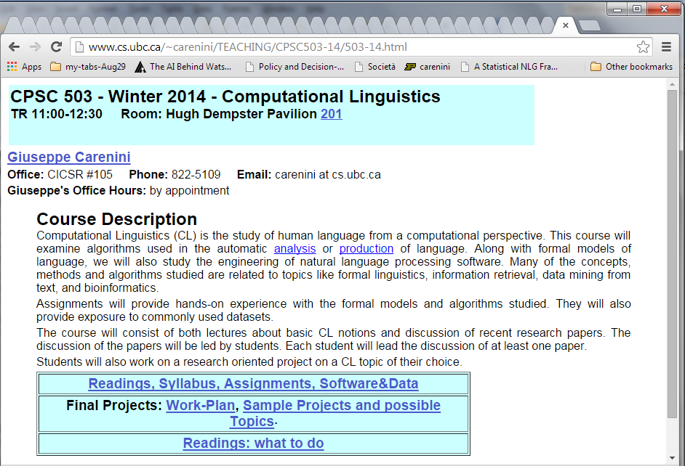
Course Web Page
The course web page can be found at my homepage and.
http://people.cs.ubc.ca/~carenini/TEACHING/CPSC503-14/503-14.html
It has (will have) the syllabus, lecture notes, assignments, announcements, etc.
You should check it often for new stuff.

Slide 38
Today Sep 4
Overview of the field
Overview of course
  Background knowledge
  Topics
  Activities and Grading
  Administrative Stuff
Introductions (if time left)
Notes:
Introductions?

Slide 39
Introductions
Your Name
Previous experience in NLP?
Why are you interested in NLP?
Are you thinking of NLP as your main research area? If not, what else do you want to specialize in….
Anything else…………

Slide 40
For Next Time
Read Chapter 1 (including 1.6 brief history ) and 2 of textbook
Chapter 2 is background knowledge.
We will start Chapter 3
Assignment 1 will be out by this Tue due Sept 18

Slide 41


