Slide 1
Introduction to
Artificial Intelligence (AI)
Computer Science cpsc502, Lecture 9
Oct, 11, 2011
Slide credit Approx. Inference : S. Thrun, P, Norvig, D. Klein
Notes:
Lecture 9

Slide 2
Today Oct 11
  Bayesian Networks Approx. Inference
  Temporal Probabilistic Models
    Markov Chains
    Hidden Markov Models

Slide 3
R&Rsys we'll cover in this course
Environment
Deterministic
Stochastic
Problem
Arc Consistency
SLS
Constraint Satisfaction
Vars +
Constraints
Search
Static
Belief Nets
Var. Elimination
Query
Logics
Approx. Inference
Search
Temporal. Inference
Sequential
Decision Nets
STRIPS
Var. Elimination
Planning
Search
Markov Processes
Representation
Value Iteration
Reasoning
Technique
Notes:
R&R Sys Representation and reasoning Systems
Each cell is a R&R system
STRIPS actions prec
The SCSP extends the classical CSP by
including both decision variables, that an agent can set, and stochastic
variables that follow a probability distribution and can model uncer-
tain events beyond the agent’s control. So far, two approaches to solving
SCSPs have been proposed; backtracking-based procedures that extend
standard methods from CSPs, and scenario-based methods that solve
SCSPs by reducing them to a sequence of CSPs.onditions and effects Stanford Research Institute Problem Solver

Slide 4
Approximate Inference
Basic idea:
  Draw N samples from a sampling distribution S
  Compute an approximate probability
  Show this converges to the true probability P
Why sample?
  Inference: getting a sample is faster than computing the right answer (e.g. with variable elimination)

Slide 5




Prior Sampling
+c | 0.5
-c | 0.5
Cloudy
Cloudy
+c | +s | 0.1
 | -s | 0.9
-c | +s | 0.5
 | -s | 0.5
+c | +r | 0.8
 | -r | 0.2
-c | +r | 0.2
 | -r | 0.8
Sprinkler
Sprinkler
Rain
Rain
WetGrass
WetGrass
Samples:
+s | +r | +w | 0.99
 |  | -w | 0.01
 | -r | +w | 0.90
 |  | -w | 0.10
-s | +r | +w | 0.90
 |  | -w | 0.10
 | -r | +w | 0.01
 |  | -w | 0.99
+c, -s, +r, +w
-c, +s, -r, +w
…

Slide 6
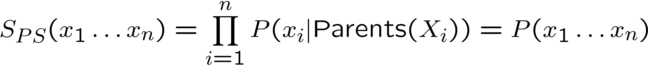
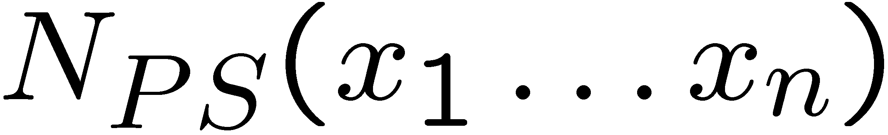
Prior Sampling
This process generates samples with probability:
…i.e. the BN’s joint probability
Let the number of samples of an event be
Then
I.e., the sampling procedure is consistent

Slide 7
Example
We’ll get a bunch of samples from the BN:
  +c, -s, +r, +w
  +c, +s, +r, +w
  -c, +s, +r, -w
  +c, -s, +r, +w
  -c, -s, -r, +w
If we want to know P(W)
  We have counts <+w:4, -w:1>
  Normalize to get P(W) = <+w:0.8, -w:0.2>
  This will get closer to the true distribution with more samples
  Can estimate anything else, too
  What about P(C| +w)? P(C| +r, +w)? P(C| -r, -w)?
  what’s the drawback? Can use fewer samples ?
Cloudy
C
Sprinkler
S
Rain
R
WetGrass
W

Slide 8
Rejection Sampling
Let’s say we want P(C)
  No point keeping all samples around
  Just tally counts of C as we go
Let’s say we want P(C| +s)
  Same thing: tally C outcomes, but ignore (reject) samples which don’t have S=+s
  This is called rejection sampling
  It is also consistent for conditional probabilities (i.e., correct in the limit)
Cloudy
C
Sprinkler
S
Rain
R
WetGrass
W
  +c, -s, +r, +w
  +c, +s, +r, +w
  -c, +s, +r, -w
  +c, -s, +r, +w
  -c, -s, -r, +w
Notes:
He biggest problem with rejection sampling is that it end up rejecting so many samples!
The number of samples consistent with the evidence e drops exponentially as the number of
Evidence variables grows – unusable for complex problems

Slide 9
Likelihood Weighting
Problem with rejection sampling:
  If evidence is unlikely, you reject a lot of samples
  You don’t exploit your evidence as you sample
  Consider P(B|+a)
Idea: fix evidence variables and sample the rest
Problem: sample distribution not consistent!
Solution: weight by probability of evidence given parents
  -b, -a
  -b, -a
  -b, -a
  -b, -a
  +b, +a
Burglary
Alarm
  -b +a
  -b, +a
  -b, +a
  -b, +a
  +b, +a
Burglary
Alarm

Slide 10



Likelihood Weighting
+c | 0.5
-c | 0.5
Cloudy
Cloudy
+c | +s | 0.1
 | -s | 0.9
-c | +s | 0.5
 | -s | 0.5
+c | +r | 0.8
 | -r | 0.2
-c | +r | 0.2
 | -r | 0.8
Sprinkler
Sprinkler
Rain
Rain
WetGrass
Samples:
WetGrass
+s | +r | +w | 0.99
 |  | -w | 0.01
 | -r | +w | 0.90
 |  | -w | 0.10
-s | +r | +w | 0.90
 |  | -w | 0.10
 | -r | +w | 0.01
 |  | -w | 0.99
+c, +s, +r, +w
…

Slide 11
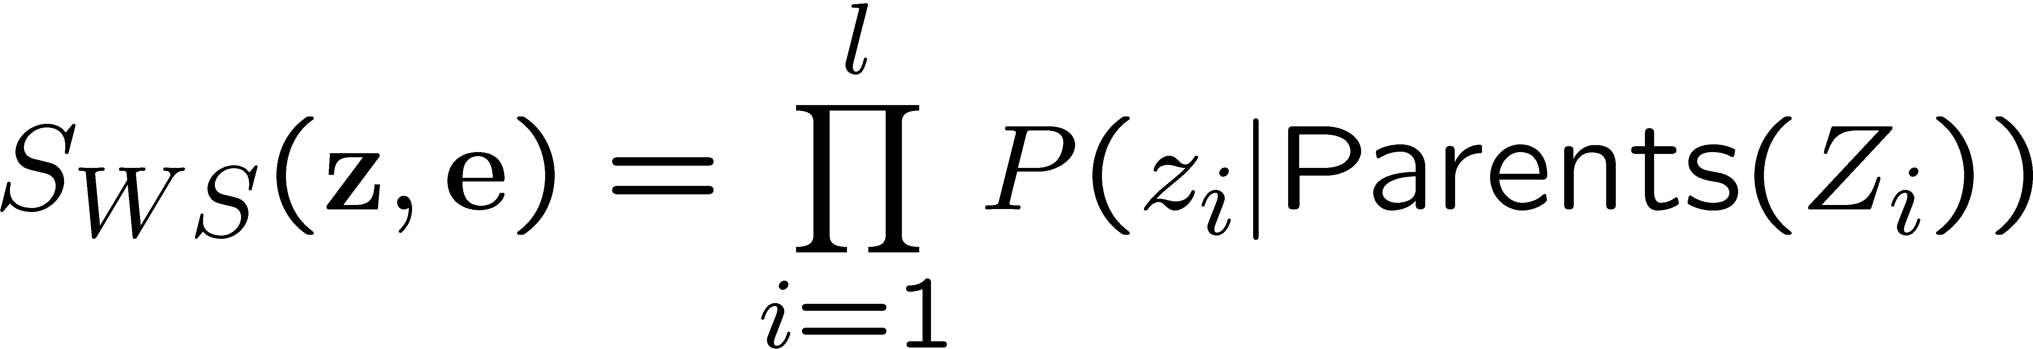
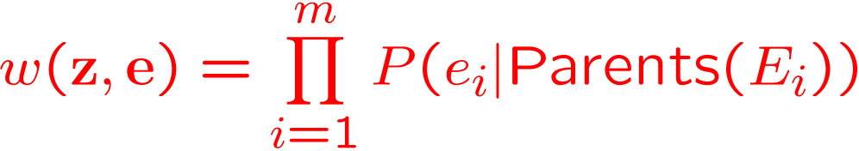
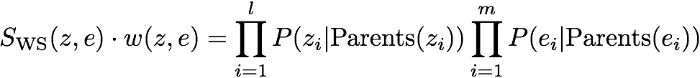

Likelihood Weighting
Sampling distribution if z sampled and e fixed evidence
Now, samples have weights
Together, weighted sampling distribution is consistent
Cloudy
C
S
R
W

Slide 12
Likelihood Weighting
Likelihood weighting is good
  We have taken evidence into account as we generate the sample
  E.g. here, W’s value will get picked based on the evidence values of S, R
  More of our samples will reflect the state of the world suggested by the evidence
Likelihood weighting doesn’t solve all our problems
  Evidence influences the choice of downstream variables, but not upstream ones (C isn’t more likely to get a value matching the evidence)
We would like to consider evidence when we sample every variable
Cloudy
C
S
Rain
R
W
Notes:
Because LW keeps using all the samples that it generates, it is much more efficient that Rejection Sampling
But performance still degrades when number of evidence variables increase
The more evidence variables, the more samples will have small weight
If one does not generate enough samples, the weighted estimate will be dominated by the small fraction of sample with substantial weight
One possible approach is to sample some of the variables, while using exact inference to generate the posterior probability for others

Slide 13
Markov Chain Monte Carlo
Idea: instead of sampling from scratch, create samples that are each like the last one.
Procedure: resample one variable at a time, conditioned on all the rest, but keep evidence fixed. E.g., for P(b|+c):
Properties: Now samples are not independent (in fact they’re nearly identical), but sample averages are still consistent estimators! And can be computed efficiently
What’s the point: both upstream and downstream variables condition on evidence.
+b
+a
+c
-b
+a
+c
-b
-a
+c
Notes:
To flip a var in a fully instantiated BN you only need to multiply the prob of the var given its parents times the probs of all its children given their parents. Number of multiplication required is equal to the number of children

Slide 14
Today Oct 11
  Bayesian Networks Approx. Inference
  Temporal Probabilistic Models
    Markov Chains
    Hidden Markov Models

Slide 15
Modelling static Environments
  So far we have used Bnets to perform inference in static environments
  For instance, the system keeps collecting evidence to diagnose the cause of a fault in a system (e.g., a car).
  The environment (values of the evidence, the true cause) does not change as new evidence is gathered
  What does change?
The system’s beliefs over possible causes
Notes:
So far we have only studied probabilistically models (Bnets) of static world
what changes is my belief over the possible causes.

Slide 16
Modeling Evolving Environments: Dynamic Bnets
Often we need to make inferences about evolving environments.
Represent the state of the world at each specific point in time via a series of snapshots, or time slices,
SolveProblem _{t-1}
SolveProblem_{t}
Knows-Subtraction _{t-1}
Knows-Subtraction _{t}
Morale _{t-1}
Morale _{t}
Tutoring system tracing student knowledge and morale
Notes:
16
DBN are an extension of Bayesian networks devised for reasoning under uncertainty in dynamic environments
This assumes discrete time; step size depends on problem
Notation: Xa:b = Xa , Xa+1,…, Xb-1 , Xb

Slide 17
Dynamic Bayesian Networks (DBN)‏
DBN are an extension of Bayesian networks devised for reasoning under uncertainty in dynamic environments
Knows-Sub₁
Knows-Sub₂
Knows-Sub₃
Knows-Add₁
Knows-Add₂
Knows-Add₃
Morale₁
Morale₂
Morale₃
Face
Obs₁
Face
Obs₂
Face
Obs₃
Add-Test₁
Add-Test₂
Add-Test₃
Sub-Test₁
Add-Test₂
Sub-Test₃
Notes:
17

Slide 18
Today Oct 11
  Bayesian Networks Approx. Inference
  Temporal Probabilistic Models
    Markov Chains
    Hidden Markov Models

Slide 19
Simplest Possible DBN
One random variable for each time slice: let’s assume S_{t} represents the state at time t. with domain {s₁ …s_{n} }
Each random variable depends only on the previous one
Thus
Intuitively S_{t} conveys all of the information about the history that can affect the future states.
“The future is independent of the past given the present.”
Notes:
P (S_{t+1}| S₀,…,S_{t}) = P (S_{t+1}|S₀)

Slide 20

Simplest Possible DBN (cont’)
  How many CPTs do we need to specify?
  Stationary process assumption: the mechanism that regulates how state variables change overtime is stationary, that is it can be described by a single transition model
  P(S_{t}|S_{t-1})
Notes:
20

Slide 21
Stationary Markov Chain (SMC)
A stationary Markov Chain : for all t >0
P (S_{t+1}| S₀,…,S_{t}) = P (S_{t+1}|S_{t}) and
P (S_{t +1}|S_{t}) is the same
We only need to specify P (S₀) and P (S_{t +1} |S_{t})
Simple Model, easy to specify
Often the natural model
The network can extend indefinitely
Variations of SMC are at the core of most Natural Language Processing (NLP) applications!
Notes:
21

Slide 22
Stationary Markov-Chain: Example
Domain of variable S_{i} is {t , q, p, a, h, e}
We only need to specify…
t
.6
P (S₀)
q
.4
p
0
Probability of initial state
a
0
h
0
e
0
Stochastic Transition Matrix
P (S_{t+1}|S_{t})
t
q
p
a
h
e
t
0
.3
0
.3
.4
0
q
.4
0
.6
0
0
0
p
0
0
1
0
0
0
a
0
0
.4
.6
0
0
h
0
0
0
0
0
1
e
1
0
0
0
0
0

Slide 23
Markov-Chain: Inference
Probability of a sequence of states S₀ … S_{T}
P (S_{t+1}|S_{t})
P (S₀)
t
q
p
a
h
e
t
0
.3
0
.3
.4
0
t
.6
q
.4
0
.6
0
0
0
Example:
q
.4
p
0
0
1
0
0
0
p
0
a
0
a
0
0
.4
.6
0
0
h
0
h
0
0
0
0
0
1
e
0
e
1
0
0
0
0
0

Slide 24
Key problems in NLP
“Book me a room near UBC”
Assign a probability to a sentence
  Part-of-speech tagging
  Word-sense disambiguation,
  Probabilistic Parsing
Predict the next word
  Speech recognition
  Hand-writing recognition
  Augmentative communication for the disabled
Summarization, Machine Translation….....
Impossible to estimate ☹
Notes:
Room in a bldg.
Room space
Room scope / opportunity
He is rooming with my friend

Slide 25
Impossible to estimate!
Assuming 10⁵ words in Dictionary and average sentence contains 10 words …….
Google language repository (22 Sept. 2006) contained “only”: 95,119,665,584 sentences
Most sentences will not appear or appear only once ☹
Notes:
Most sentences/sequences will not appear or appear only once ☹
At least your corpus should be >> than your sample space

Slide 26
What can we do?
Make a strong simplifying assumption!
Sentences are generated by a Markov Chain
P(The big red dog barks)=
P(The|<S>) *
Notes:
Most sentences/sequences will not appear or appear only once ☹
Standard Solution: decompose in a set of probabilities that are easier to estimate
So the probability of a sequence is

Slide 27
Estimates for Bigrams
Silly language repositories with only two sentences:
“<S>The big red dog barks against the big pink dog”
“<S>The big pink dog is much smaller”
Notes:
N-pairs in a corpus is equal to the N-words in the corpus

Slide 28
Today Oct 11
  Bayesian Networks Approx. Inference
  Temporal Probabilistic Models
    Markov Chains
    (Intro) Hidden Markov Models

Slide 29
How can we minimally extend Markov Chains?
  Maintaining the Markov and stationary assumption
  A useful situation to model is the one in which:
  the reasoning system does not have access to the states
  but can make observations that give some information about the current state
Notes:
29

Slide 30
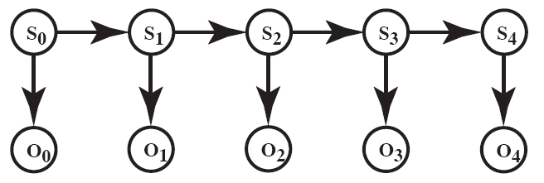
Hidden Markov Model
A Hidden Markov Model (HMM) starts with a Markov chain, and adds a noisy observation about the state at each time step:
|domain(S)| = k
|domain(O)| = h
P (S₀) specifies initial conditions
P (S_{t+1}|S_{t}) specifies the dynamics
P (O_{t} |S_{t}) specifies the sensor model

Slide 31
Example: Localization for “Pushed around” Robot
Localization (where am I?) is a fundamental problem in robotics
Suppose a robot is in a circular corridor with 16 locations
There are four doors at positions: 2, 4, 7, 11
The Robot initially doesn’t know where it is
The Robot is pushed around. After a push it can stay in the same location, move left or right.
The Robot has Noisy sensor telling whether it is in front of a door
Notes:
Simultaneous localization and mapping (SLAM) is a technique used by robots and autonomous vehicles to build up a map within an unknown environment while at the same time keeping track of their current position. This is not as straightforward as it might sound due to inherent uncertainties in discerning the robot's relative movement from its various sensors.
If at the next iteration of map building the measured distance and direction travelled has a slight inaccuracy, then any features being added to the map will contain corresponding errors. If unchecked, these positional errors build cumulatively, grossly distorting the map and therefore the robot's ability to know its precise location. There are various techniques to compensate for this such as recognising features that it has come across previously and re-skewing recent parts of the map to make sure the two instances of that feature become one. Some of the statistical techniques used in SLAM include Kalman filters, particle filters (aka. Monte Carlo methods) and scan matching of range data.

Slide 32
This scenario can be represented as…
Example Stochastic Dynamics: when pushed, it stays in the same location p=0.2, moves left or right with equal probability
P(Loc_{t + 1} | Loc _{t})
P(Loc₁)
Notes:
How many values for Loc _{i}?

Slide 33
This scenario can be represented as…
Example of Noisy sensor telling whether it is in front of a door.
If it is in front of a door P(O _{t} = T) = .8
If not in front of a door P(O _{t} = T) = .1
P(O _{t} | Loc _{t})
Notes:
How many values for Loc _{i}?

Slide 34
Useful inference in HMMs
  Localization: Robot starts at an unknown location and it is pushed around t times. It wants to determine where it is
In general (Filtering): compute the posterior distribution over the current state given all evidence to date
P(X_{t} | o_{0:t} ) or P(X_{t} | e_{0:t} )
Notes:
34

Slide 35
Other HMM Inferences (next time)
  Smoothing (posterior distribution over a past state given all evidence to date)
  P(X_{k} | e_{0:t} ) for 1 ≤ k < t
  Most Likely Sequence (given the evidence seen so far)
  argmax_{x0:t} P(X_{0:t} | e_{0:t} )

Slide 36
Also Do exercise 6.E (parts on importance sampling and particle filtering are optional) http://www.aispace.org/exercises.shtml
TODO for this Thurs
Work on Assignment2
Study the Handout (on approx. inference)
Available outside my office after 1pm

Slide 37
Example : Robot Localization
Suppose a robot wants to determine its location based on its actions and its sensor readings
Three actions: goRight, goLeft, Stay
This can be represented by an augmented HMM
Notes:
(Note: in this example the robot is not choosing its actions)

Slide 38
Robot Localization Sensor and Dynamics Model
Sample Sensor Model (assume same as for pushed around)
Sample Stochastic Dynamics:
P(Loc_{t + 1} | Action_{t} , Loc _{t})
P(Loc_{t + 1} = L | Action _{t} = goRight , Loc _{t} = L) = 0.1
P(Loc_{t + 1} = L+1 | Action _{t} = goRight , Loc _{t} = L) = 0.8
P(Loc_{t + 1} = L + 2 | Action _{t} = goRight , Loc _{t} = L) = 0.074
P(Loc_{t + 1} = L’ | Action _{t} = goRight , Loc _{t} = L) = 0.002 for all other locations L’
All location arithmetic is modulo 16
The action goLeft works the same but to the left

Slide 39
Dynamics Model More Details
Sample Stochastic Dynamics:
P(Loc_{t + 1} | Action, Loc _{t})
P(Loc_{t + 1} = L | Action _{t} = goRight , Loc _{t} = L) = 0.1
P(Loc_{t + 1} = L+1 | Action _{t} = goRight , Loc _{t} = L) = 0.8
P(Loc_{t + 1} = L + 2 | Action _{t} = goRight , Loc _{t} = L) = 0.074
P(Loc_{t + 1} = L’ | Action _{t} = goRight , Loc _{t} = L) = 0.002 for all other locations L’

Slide 40
Robot Localization additional sensor
Additional Light Sensor: there is light coming through an opening at location 10
P (L_{t} | Loc_{t})
Info from the two sensors is combined :“Sensor Fusion”

Slide 41
The Robot starts at an unknown location and must determine where it is
The model appears to be too ambiguous
  Sensors are too noisy
  Dynamics are too stochastic to infer anything
But inference actually works pretty well.
Let’s check:
http://www.cs.ubc.ca/spider/poole/demos/localization/localization.html
You can use standard Bnet inference. However you typically take advantage of the fact that time moves forward (not in 322)

Slide 42
Sample scenario to explore in demo
Keep making observations without moving. What happens?
Then keep moving without making observations. What happens?
Assume you are at a certain position alternate moves and observations
….

Slide 43
HMMs have many other applications….
Natural Language Processing: e.g., Speech Recognition
States: phoneme \ word
Observations: acoustic signal \ phoneme
Bioinformatics: Gene Finding
States: coding / non-coding region
Observations: DNA Sequences
For these problems the critical inference is:
find the most likely sequence of states given a sequence of observations
Notes:
ahone is a speech sound

Slide 44
NEED to explain Filtering
Because it will be used in POMDPs

Slide 45
Markov Models
Simplest Possible Dynamic Bnet
Markov Chains
Add noisy Observations about the state at time t
Hidden Markov Model
Add Actions and Values (Rewards)
Markov Decision Processes (MDPs)

Slide 46
Answering Query under Uncertainty
Probability Theory
Dynamic Bayesian Network
Static Belief Network & Variable Elimination
Hidden Markov Models
Student Tracing in tutoring Systems
Monitoring
(e.g credit cards)
BioInformatics
Markov Chains
Natural Language Processing
Diagnostic Systems (e.g., medicine)
Email spam filters

Slide 47
Lecture Overview
Recap
Temporal Probabilistic Models
Start Markov Models
  Markov Chain
  Markov Chains in Natural Language Processing

Slide 48
Sampling a discrete probability distribution

Slide 49
Answering Query under Uncertainty
Probability Theory
Dynamic Bayesian Network
Static Belief Network & Variable Elimination
Hidden Markov Models
Student Tracing in tutoring Systems
Monitoring
(e.g credit cards)
BioInformatics
Markov Chains
Natural Language Processing
Diagnostic Systems (e.g., medicine)
Email spam filters

Slide 50
Answering Queries under Uncertainty
Probability Theory
Dynamic Bayesian Network
Static Belief Network & Variable Elimination
Hidden Markov Models
Student Tracing in tutoring Systems
Monitoring
(e.g credit cards)
BioInformatics
Robotics
Markov Chains
Natural Language Processing
Diagnostic Systems (e.g., medicine)
Email spam filters

Slide 51
Stationary Markov Chain (SMC)
A stationary Markov Chain : for all t >0
P (S_{t+1}| S₀,…,S_{t}) = and
P (S_{t +1}|
We only need to specify and
Simple Model, easy to specify
Often the natural model
The network can extend indefinitely
Variations of SMC are at the core of most Natural Language Processing (NLP) applications!
Notes:
51

