Slide 1
Introduction to
Artificial Intelligence (AI)
Computer Science cpsc502, Lecture 5
Sep, 22, 2011
Notes:
Lecture 5

Slide 2
Today Sept 22
Finish Stochastic Local Search (SLS)
Planning
STRIPS
Heuristics
STRIPS -> CSP

Slide 3
Population Based SLS
Often we have more memory than the one required for current node (+ best so far + tabu list)
Key Idea: maintain a population of k individuals
At every stage, update your population.
Whenever one individual is a solution, report it.
Notes:
Nothing more then running k random restarts in parallel instead then in sequence…
More memory but same power!
There's not really any reason to use this method (why not?), but it provides a framework for talking about what follows...
Like k restarts, but uses k times the minimum number of steps.

Slide 4
Population Based SLS: Beam Search
Non Stochastic
Start with k individuals, and choose the k best out of all of the neighbors.
Useful information is passed among the k parallel search thread
Troublesome case: If one individual generates several good neighbors and the other k-1 all generate bad successors….
Notes:
Quickly abandon unfruitful searches…
When k=1, it is hill climbing.
When k=∞, it is breadth-first search.
The value of k lets us limit space and parallelism.

Slide 5
Population Based SLS: Stochastic Beam Search
Non Stochastic Beam Search may suffer from lack of diversity among the k individual (just a more expensive hill climbing)
Stochastic version alleviates this problem:
Selects the k individuals at random
But probability of selection proportional to their value (according to scoring function)

Slide 6
Stochastic Beam Search: Advantages
It maintains diversity in the population.
Biological metaphor (asexual reproduction):
each individual generates “mutated” copies of itself (its neighbors)
The scoring function value reflects the fitness of the individual
the higher the fitness the more likely the individual will survive (i.e., the neighbor will be in the next generation)

Slide 7
Population Based SLS: Genetic Algorithms
Start with k randomly generated individuals (population)
An individual is represented as a string over a finite alphabet (often a string of 0s and 1s)
A successor is generated by combining two parent individuals (loosely analogous to how DNA is spliced in sexual reproduction)
Evaluation/Scoring function (fitness function). Higher values for better individuals.
Produce the next generation of individuals by selection, crossover, and mutation

Slide 8
Genetic algorithms: Example
Representation and fitness function
State: string over finite alphabet
Fitness function: higher value better states
Notes:
Fitness function: number of non-attacking pairs of queens (min = 0, max = 8 × 7/2 = 28)

Slide 9
Genetic algorithms: Example
Selection: common strategy, probability of being chosen for reproduction is directly proportional to fitness score
24/(24+23+20+11) = 31%
23/(24+23+20+11) = 29% etc

Slide 10
Genetic algorithms: Example
Reproduction: cross-over and mutation
Notes:
When the two parent states are quite different the cross-over can produce a state that is long away from either parents
At the beginning when population is diverse takes big steps (like simulated annealing with high temperature

Slide 11
Genetic Algorithms: Conclusions
Their performance is very sensitive to the choice of state representation and fitness function
Extremely slow (not surprising as they are inspired by evolution!)
But relatively simple example of biologically inspired AI approaches
Notes:
Swarm intelligence (SI) is the collective behaviour of decentralized, self-organized systems, natural or artificial. The concept is employed in work on artificial intelligence. The expression was introduced by Gerardo Beni and Jing Wang in 1989, in the context of cellular robotic systems.^{[1]}
SI systems are typically made up of a population of simple agents or boids interacting locally with one another and with their environment. The inspiration often comes from nature, especially biological systems. The agents follow very simple rules, and although there is no centralized control structure dictating how individual agents should behave, local, and to a certain degree random, interactions between such agents lead to the emergence of "intelligent" global behavior, unknown to the individual agents. Natural examples of SI include ant colonies, bird flocking, animal herding, bacterial growth, and fish schooling.

Slide 12
Today Sept 22
Finish Stochastic Local Search (SLS)
Planning
STRIPS – Forward Planning
Heuristics
STRIPS -> CSP

Slide 13
R&Rsys we'll cover in this course
Environment
Deterministic
Stochastic
Problem
Arc Consistency
SLS
Constraint Satisfaction
Vars +
Constraints
Search
Static
Belief Nets
Var. Elimination
Query
Logics
Approx. Inference
Search
Temporal. Inference
Sequential
Decision Nets
STRIPS
Var. Elimination
Planning
Search
Markov Processes
Representation
Value Iteration
Reasoning
Technique
Notes:
R&R Sys Representation and reasoning Systems
Each cell is a R&R system
STRIPS actions prec
The SCSP extends the classical CSP by
including both decision variables, that an agent can set, and stochastic
variables that follow a probability distribution and can model uncer-
tain events beyond the agent’s control. So far, two approaches to solving
SCSPs have been proposed; backtracking-based procedures that extend
standard methods from CSPs, and scenario-based methods that solve
SCSPs by reducing them to a sequence of CSPs.onditions and effects Stanford Research Institute Problem Solver

Slide 14
Standard Search vs. Specific R&R systems
Constraint Satisfaction (Problems):
State: assignments of values to a subset of the variables
Successor function: assign values to a “free” variable
Goal test: set of constraints
Solution: possible world that satisfies the constraints
Heuristic function: none (all solutions at the same distance from start)
Planning :
State
Successor function
Goal test
Solution
Heuristic function
Inference
State
Successor function
Goal test
Solution
Heuristic function
Notes:
Allows useful general-purpose algorithms with more power than standard search algorithms

Slide 15
Planning as Search: State and Goal
How to select and organize a sequence of actions to achieve a given goal…
State: Agent is in a possible world (full assignments to a set of variables/features)
Goal: Agent wants to be in a possible world were some variables are given specific values

Slide 16
Planning as Search: Successor function and Solution
Actions : take the agent from one state to another
Solution: sequence of actions that when performed will take the agent from the current state to a goal state

Slide 17
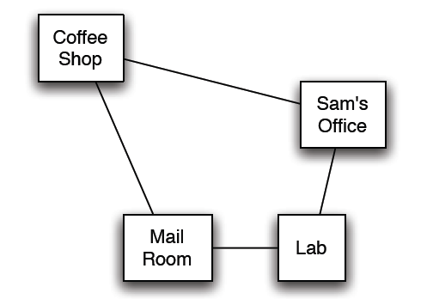
Delivery Robot Example (textbook)
Consider a delivery robot named Rob, who must navigate the following environment, can deliver coffee and mail to Sam
For another example see Practice Exercise 8.C:
“Commuting to UBC”

Slide 18
Delivery Robot Example: States
The state is defined by the following variables/features:
RLoc - Rob's location
domain: coffee shop (cs), Sam's office (off ), mail room (mr ),
or laboratory (lab)
RHC - Rob has coffee True/False.
SWC - Sam wants coffee
MW - Mail is waiting
RHM - Rob has mail
Example state:
Number of states:

Slide 19
Delivery Robot Example: Actions
The robot’s actions are:
Move - Rob's move action
move clockwise (mc ), move anti-clockwise (mac ) not move (nm )
PUC - Rob picks up coffee
must be at the coffee shop
DelC - Rob delivers coffee
must be at the office, and must have coffee
PUM - Rob picks up mail
must be in the mail room, and mail must be waiting
DelM - Rob delivers mail
must be at the office and have mail

Slide 20
STanford Research Institute Problem Solver (STRIPS) action representation
The key to sophisticated planning is modeling actions
In STRIPS, an action has two parts:
1. Preconditions: a set of assignments to features that must be
satisfied in order for the action to be legal
2. Effects: a set of assignments to features that are caused by
the action
Notes:
a logical test about

Slide 21
STRIPS actions: Example
STRIPS representation of the action pick up coffee, PUC :
preconditions Loc = cs and RHC = F
effects RHC = T
STRIPS representation of the action deliver coffee, DelC :
preconditions Loc = and RHC =
effects RHC = and SWC =
Note in this domain Sam doesn't have to want coffee for Rob to deliver it; one way or another, Sam doesn't want coffee after delivery.

Slide 22
STRIPS actions: MC and MAC
STRIPS representation of the action MoveClockwise ?

Slide 23
STRIPS Actions (cont’)
The STRIPS assumption:
all variables not explicitly changed by an action stay unchanged
So if the feature/variable V has value v after the action a has been performed, what can we conclude about a and/or the state of the world immediately preceding the execution of a?
Notes:
If the feature V has value v after the action a has been
performed, what can we conclude about a and/or the state of the world?
either V = v was true in the state of the world immediately preceding execution of action a, or the action sets V = v, or both.

Slide 24
STRIPS Actions (cont’)
The STRIPS assumption:
all features/variables not explicitly changed by an action stay unchanged
So if the feature V has value v_{i} in state S_{i} , after action a has been performed,
what can we conclude about a and/or the state of the world S_{i-1}, immediately preceding the execution of a?
S_{i-1}
S_{i}
a
V = v_{i}

Slide 25
Forward Planning
To find a plan, a solution: search in the state-space graph.
The states are the possible worlds
The arcs correspond to the actions: The arcs from a state s represent all of the actions that are legal in state s. (What actions are legal?)
A plan is a path from the state representing the initial state to a state that satisfies the goal.

Slide 26
Example state-space graph: first level
Start state

Slide 27
Example state-space graph
Start state

Slide 28
Standard Search vs. Specific R&R systems
Constraint Satisfaction (Problems):
State: assignments of values to a subset of the variables
Successor function: assign values to a “free” variable
Goal test: set of constraints
Solution: possible world that satisfies the constraints
Heuristic function: none (all solutions at the same distance from start)
Planning :
State
Successor function
Goal test
Solution
Heuristic function
Inference
State
Successor function
Goal test
Solution
Heuristic function
Notes:
Allows useful general-purpose algorithms with more power than standard search algorithms

Slide 29
Standard Search vs. Specific R&R systems
Constraint Satisfaction (Problems):
State: assignments of values to a subset of the variables
Successor function: assign values to a “free” variable
Goal test: set of constraints
Solution: possible world that satisfies the constraints
Heuristic function: none (all solutions at the same distance from start)
Planning :
State: full assignment of values to features
Successor function: states reachable by applying valid actions
Goal test: partial assignment of values to features
Solution: a sequence of actions
Heuristic function: ? ?
Inference
State
Successor function
Goal test
Solution
Heuristic function

Slide 30
Heuristics for Forward Planning
Recall general method for creating admissible heuristics
Relax the original problem
One example: ignore preconditions; makes problem trivial
Another example: ignore delete lists
Assumptions for simplicity:
All features are binary: T / F
Goals and preconditions can only be assignments to T
Every action has add list and delete list
Add list: features that are made true by the action
Delete list: features that are made false by the action
Compute heuristic values: solve relaxed problem without delete lists!
Planning is P-SPACE hard (that’s really hard, includes NP-hard)
Without delete lists: often very fast

Slide 31
Heuristics for Forward Planning
Heuristic function: estimate of the distance form a state to the goal
In planning this is the……………….
Two simplifications in the representation:
All features are binary: T / F
Goals and preconditions can only be assignments to T
And a Def. a subgoal is a particular assignment in the goal e.g., if the goal is <A=T, B=T, C=T> then….
Notes:
Two simplifications. To let you know about the basic issues involved in developing heuristics
For planning while keeping the explanation manageable
Goals and preconditions can only be positive literals.
(Many problems are written with this convention. For problems that aren’t replace every negative literal in a goal or a precond. With a new positive one. From R&N 2010)
So a negative effect can only
make it harder to achieve a goal (or a precondition to an action that achieves the goal). Therefore,
eliminating all negative effects only makes a problem easier.
Identify relaxed version of the problem (remove some restrictions)
Solution cost for a subproblem
Solution for the problem is the sum of solutions for subproblems

Slide 32
Heuristics for Forward Planning: Any ideas?
Notes:
Because of a) and b) heuristic is inaccurate
Because of c heuristics is inadmissible
Identify relaxed version of the problem (remove some restrictions)
Solution cost for a subproblem
“cannot be achieved at all)
Inadmissible and (inaccurate for two reasons)
Precondition removal

Slide 33
Heuristics for Forward Planning (cont’)
What kind of simplifications of the actions would justify our proposal for h?
We have removed all …………….
We have removed all …………….
We assume no action can achieve…………………..
Notes:
Because of a) and b) heuristic is inaccurate
Because of c heuristics is inadmissible
Identify relaxed version of the problem (remove some restrictions)
Solution cost for a subproblem
“cannot be achieved at all)
Inadmissible and (inaccurate for two reasons)
Precondition removal

Slide 34
Heuristics for Forward Planning: empty-delete-list
We only relax the problem according to (…….)
i.e., we remove all the effects that make a variable F
Action a effects (B=F, C=T)
But then how do we compute the heuristic?
………………………………………….
This is often fast enough to be worthwhile
empty-delete-list heuristics with forward planning is currently considered a very successful strategy
Notes:
Good heuristics make forward planning feasible in practice
Do not need to worry about negative interactions between subplans
We need to actually run the planner on the simplified problem
(remember the 1,2,3,4,problem for the 8-puzzle)

Slide 35
Empty-delete in practice

Slide 36
Today Sept 22
Finish Stochastic Local Search (SLS)
Planning
STRIPS – Forward Planning
Heuristics
STRIPS -> CSP

Slide 37
R&Rsys we'll cover in this course
Environment
Deterministic
Stochastic
Problem
Arc Consistency
SLS
Constraint Satisfaction
Vars +
Constraints
Search
Static
Belief Nets
Var. Elimination
Query
Logics
Approx. Inference
Search
Temporal. Inference
Sequential
Decision Nets
STRIPS
Var. Elimination
Planning
Search
Markov Processes
Representation
Value Iteration
Reasoning
Technique
Notes:
R&R Sys Representation and reasoning Systems
Each cell is a R&R system
STRIPS actions prec
The SCSP extends the classical CSP by
including both decision variables, that an agent can set, and stochastic
variables that follow a probability distribution and can model uncer-
tain events beyond the agent’s control. So far, two approaches to solving
SCSPs have been proposed; backtracking-based procedures that extend
standard methods from CSPs, and scenario-based methods that solve
SCSPs by reducing them to a sequence of CSPs.onditions and effects Stanford Research Institute Problem Solver

Slide 38
Planning as a CSP
An alternative approach to planning is to set up a planning problem as a CSP!
We simply reformulate a STRIPS model as a set of variables and constraints
Once this is done we can even express additional aspects of our problem (as additional constraints)
e.g., see Practice Exercise UBC commuting “careAboutEnvironment” constraint
Notes:
We don't have to worry about searching forwards
Particularly effective in domains for which we can get a reliable estimate of k
STanford Research Institute Problem Solver

Slide 39
Planning as a CSP: Variables
We need to “unroll the plan” for a fixed number of steps: this is called the horizon
To do this with a horizon of k:
construct a CSP variable for each STRIPS variable at each time step from 0 to k
construct a boolean CSP variable for each STRIPS action at each time step from 0 to k - 1.
Notes:
We don't have to worry about searching forwards
Particularly effective in domains for which we can get a reliable estimate of k

Slide 40
CSP Planning: Robot Example
Variables for actions ….
action (non) occurring at that step
Notes:
Do you see why CSP planning doesn't have to search forwards?

Slide 41
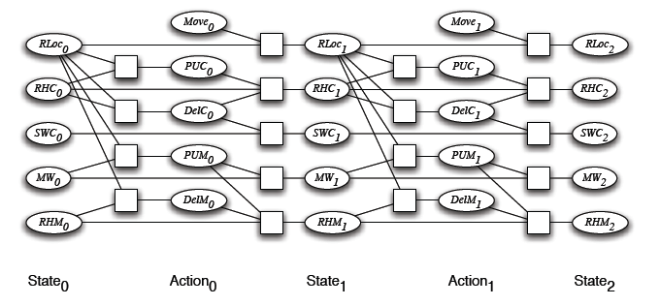
CSP Planning: Initial and Goal Constraints
initial state constraints constrain the state variables at time 0
goal constraints constrain the state variables at time k

Slide 42
CSP Planning: Prec. Constraints
As usual, we have to express the preconditions and effects of actions:
precondition constraints
hold between state variables at time t and action variables at time t
specify when actions may be taken
RLoc₀ | RHC₀ | PUC₀
cs | T | F
cs | F | T
cs | F | F
mr | * | F
lab | * | F
off | * | F
PUC₀

Slide 43
CSP Planning: Effect Constraints
effect constraints
between state variables at time t, action variables at time t and state variables at time t + 1
explain how a state variable at time t + 1 is affected by the action(s) taken at time t and by its own value at time t
RHC_{i} | DelC_{i} | PUC_{i} | RHC_{i+1}
T | T | T | T
T | T | F | F
T | F | T | T
… | … | … | …
… | … | … | …
Notes:
this includes both causal and frame axioms
basically, it goes back to the feature-centric representation the
book discusses before STRIPS
of course, solving the problem this way doesn't mean we can't
encode the problem using STRIPS

Slide 44
CSP Planning: Constraints Contd.
Other constraints we may want are action constraints:
specify which actions cannot occur simultaneously
these are sometimes called mutual exclusion (mutex) constraints
E.g., in the Robot domain
DelM and DelC can occur in any sequence (or simultaneously)
But we could change that…
DelM_{i} | DelC_{i}
Notes:
when the order between several actions doesn't matter, this is a good thing
T F
F T
F F
note that without these constraints, there's nothing to stop the planner from deciding to take several actions simultaneously

Slide 45
CSP Planning: Constraints Contd.
Other constraints we may want are state constraints
hold between variables at the same time step
they can capture physical constraints of the system (robot cannot hold coffee and mail)
they can encode maintenance goals
RHC_{i} | RHM_{i}
Notes:
Charge 100% 80% ….
Distance recharger 1 2 3 4 5
Charge – 20% distance >= 0

Slide 46
CSP Planning: Solving the problem
Map STRIPS Representation for horizon:
Run arc consistency, search, stochastic local search!
Plan: all actions with assignment T
In order to find a plan, we expand our constraint network one layer at the time, until a solution is found
Notes:
But remember that this representation is done for a fixed number of steps (the horizon)

Slide 47
CSP Planning: Solving the problem
Map STRIPS Representation for horizon 1, 2, 3, …, until solution found
Run arc consistency, search, stochastic local search!
K = 0
Is State₀ a goal?
If yes, DONE!
If no,

Slide 48
CSP Planning: Solving the problem
Map STRIPS Representation for horizon k =1
Run arc consistency, search, stochastic local search!
K = 1
Is State₁ a goal
If yes, DONE!
If no,

Slide 49
CSP Planning: Solving the problem
Map STRIPS Representation for horizon k = 2
Run arc consistency, search, stochastic local search!
K = 2: Is State₂ a goal
If yes, DONE!
If no….continue

Slide 50
Solve planning as CSP: pseudo code

Slide 51
State of the art planner
A similar process is implemented (more efficiently) in the Graphplan planner
In general, Planning graphs are an efficient way to create a representation of a planning problem that can be used to
Achieve better heuristic estimates
Directly construct plans
Notes:
But remember that this representation is done for a fixed number of steps (the horizon)
See automated planning book pag. 167

Slide 52
State of the art
Annual planning competitions
Best technique has varied over time
Currently: mostly forward state-space
Largely due to good heuristics (relaxed prob.)
Heuristics for atomic (state search) problem Can only come from outside analysis of domain
Heuristics for factored (planning) problem Can be domain-independent

Slide 53
Do exercise 8.A, B, C http://www.aispace.org/exercises.shtml Please, look at solutions only after you have tried hard to solve them!
TODO for next Tue
Read Chp 5 of textbook (Logics) up to 5.3.3 included
Start working on assignment-1 !

Slide 54
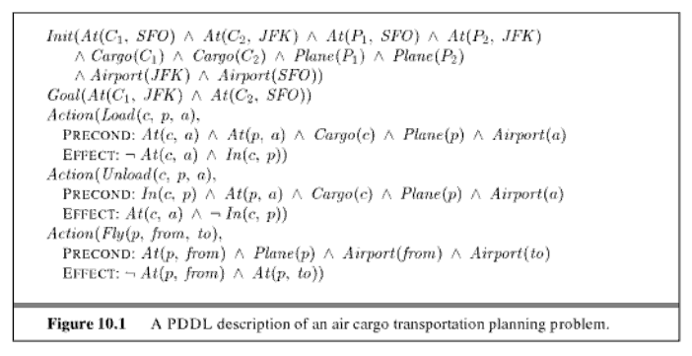
Expressiveness of the language
Notes:
Planning Domain definition Language
Courtesy Sebastian Thrun P. Norvig

Slide 55
STRIPS to CSP applet
Allows you:
to specify a planning problem in STRIPS
to map it into a CSP for a given horizon
the CSP translation is automatically loaded into the CSP applet where it can be solved
Practice exercise using STRIPS to CSP will be posted next week (maybe a couple ☺)

Slide 56
Sampling a discrete probability distribution

