Slide 1
Introduction to
Artificial Intelligence (AI)
Computer Science cpsc502, Lecture 4
Sep, 20, 2011
Notes:
Lecture 4

Slide 2
Systematically solving CSPs: Summary
Build Constraint Network
Apply Arc Consistency
  One domain is empty →
  Each domain has a single value →
  Some domains have more than one value →
Apply Depth-First Search with Pruning
Split the problem in a number of disjoint cases
  Apply Arc Consistency to each case
Notes:
Otherwise, split a domain & apply arc consistency to each case.
Spiltting in half the variable with the smallest domain usually works best (who know why)
ACC: Show with Cispace, first “scheduling problem”, and then crossword 1 for splitting. What makes sense is to split the node with 6 vars to the right, show that it gets to an empty solution, backtrack, and do more s0plitting on the var with 2 values on the top-left. Done. WENT WELL

Slide 3
Limitations of Systematic Approaches
Many CSPs (scheduling, DNA computing, more later) are simply too big for systematic approaches
If you have 10⁵ vars with dom(var_{i}) = 10⁴
Systematic Search
Constraint Network
but if solutions are densely distributed…….
Notes:
AC (d)3 * (n)2

Slide 4
Today Sept 20
Stochastic Local Search (SLS)
Local Search & Constrained Optimization
SLS
SLS variants
Comparing SLS

Slide 5
Local Search: General Method
  Remember , for CSP a solution is a possible world
  Start from a possible world
  Generate some neighbors ( “similar” possible worlds)
  Move from the current node to a neighbor, selected according to a particular strategy
  Example: A,B,C same domain {1,2,3}
Notes:
A useful method in practice for some consistency and optimization problems is local search
move from one node to another according to a function that scores how good each neighbor is
according to a function that scores how good each neighbor is

Slide 6
Local Search: Selecting Neighbors
How do we determine the neighbors?
Usually this is simple: some small incremental change to the variable assignment
  assignments that differ in one variable's value, by (for instance) a value difference of +1
  assignments that differ in one variable's value
  assignments that differ in two variables' values, etc.
  Example: A,B,C same domain {1,2,3}

Slide 7
Selecting the best neighbor
  Example: A,B,C same domain {1,2,3} , (A=B, A>1, C≠3)
A common component of the scoring function (heuristic) => select the neighbor that results in the ……
- the min conflicts heuristics
Notes:
For example, if the goal is to find the highest point on a surface, the scoring function might be the height at the current point.

Slide 8
Queens in Chess
Positions a queen can attack

Slide 9
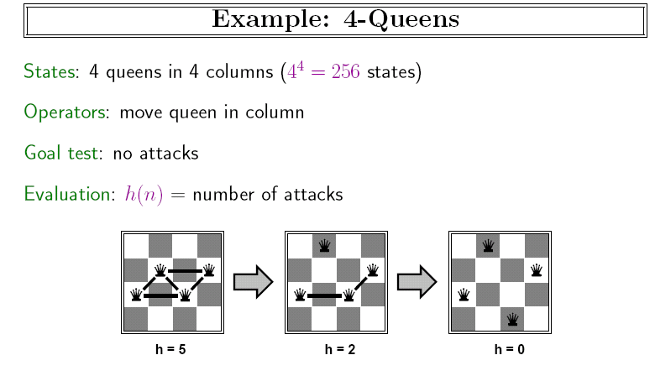
Example: n-queens
Put n queens on an n × n board with no two queens on the same row, column, or diagonal (i.e attacking each other)

Slide 10
n-queens, Why?
Why this problem?
Lots of research in the 90’ on local search for CSP was generated by the observation that the run-time of local search on n-queens problems is independent of problem size!
Notes:
It consists of an initial
search phase that starts during problem generation and a final search phase that removes conflicts During
the initial search function Initial Search an initial permutation of the row positions of the queens is
Generated
A random permutation of n queens would generate approximately .5n
collisions Since this number of collisions is very high the algorithm performance can be improved
signicantly if collisions in the initial permutation are minimized
During the final search procedure Final Search two queens are
chosen for conflict minimization If a swap (the row) of two queens reduces the number of collisions then two queens
are swapped Otherwise no action is taken The final search is repeated until all collisions are eliminated
The number of collisions on a diagonal line can be computed in constant time using a characterization
of diagonal lines

Slide 11
Constrained Optimization Problems
So far we have assumed that we just want to find a possible world that satisfies all the constraints.
But sometimes solutions may have different values / costs
We want to find the optimal solution that
  maximizes the value or
  minimizes the cost
Notes:
It consists of an initial
search phase that starts during problem generation and a final search phase that removes conflicts During
the initial search function Initial Search an initial permutation of the row positions of the queens is
Generated
A random permutation of n queens would generate approximately .5n
collisions Since this number of collisions is very high the algorithm performance can be improved
signicantly if collisions in the initial permutation are minimized
During the final search procedure Final Search two queens are
chosen for conflict minimization If a swap (the row) of two queens reduces the number of collisions then two queens
are swapped Otherwise no action is taken The final search is repeated until all collisions are eliminated
The number of collisions on a diagonal line can be computed in constant time using a characterization
of diagonal lines

Slide 12
Constrained Optimization Example
  Example: A,B,C same domain {1,2,3} , (A=B, A>1, C≠3)
  Value = (C+A) so we want a solution that maximize that
The scoring function we’d like to maximize might be:
f(n) = (C + A) - #-of-conflicts
Hill Climbing means selecting the neighbor which best improves a (value-based) scoring function.
Greedy Descent means selecting the neighbor which minimizes a (cost-based) scoring function.
Notes:
For example, if the goal is to find the highest point on a surface, the scoring function might be the height at the current point.

Slide 13
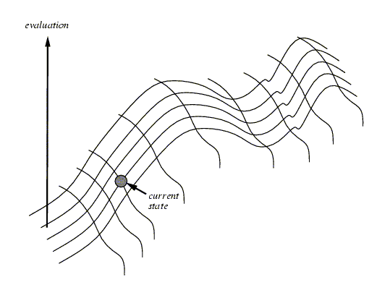
Hill Climbing
NOTE: Everything that will be said for Hill Climbing is also true for Greedy Descent
Notes:
One of the most obvious heuristics is to select the value that results in the minimum # of conflicts with the other variables - the min conflicts heuristics
Ex, in case of eight queen, it is the number of attacking queens.
Min conflict is surprising effective and can solve the million-queens problem in less than 50 steps. It has also been used to schedule the hubble telecope, reducing the time taken to schedule a week of observations from three weeks to around 10’

Slide 14
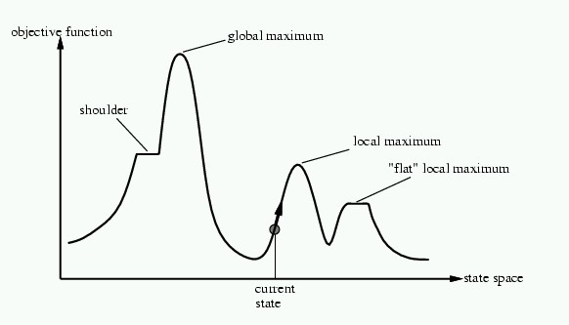
Problems with Hill Climbing
Local Maxima.
Plateau - Shoulders
(Plateau)
Notes:
No way to move from a plateau, could escape from a shoulder
With a randomly gerenated 8-queen initial state steepest ascent hill climbing gets stuck 86% of the times. Takes 4 steps on average to suceed and 3 to get stuck –good since there are 17 million states

Slide 15
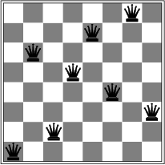
Corresponding problem for GreedyDescent
Local minimum example: 8-queens problem
A local minimum with h = 1

Slide 16
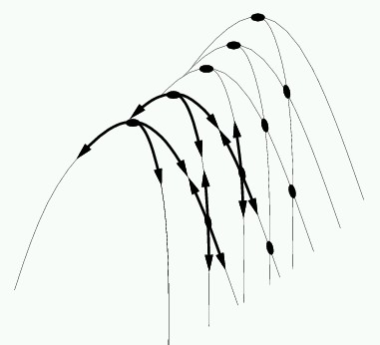
Even more Problems in higher dimensions
E.g., Ridges – sequence of local maxima not directly connected to each other
From each local maximum you can only
go downhill

Slide 17
Today Sept 20
Stochastic Local Search (SLS)
Local Search & Constrained Optimization
SLS
SLS variants
Comparing SLS

Slide 18
Stochastic Local Search
GOAL: We want our local search
  to be guided by the scoring function
  Not to get stuck in local maxima/minima, plateaus etc.
SOLUTION: We can alternate
  Hill-climbing steps
  Random steps: move to a random neighbor.
  Random restart: reassign random values to all variables.
Notes:
NOTE again: Everything that will be said for Hill Climbing is also true for Gradient Descent (max -> min)
Consider two methods to find a maximum value:
Hill climbing, starting from some position, keep moving uphill & report maximum value found
Pick values at random & report maximum value found
Which do you expect to work better to find a maximum?
hill climbing is good for finding local maxima
selecting random nodes is good for finding/exploring new parts of the search space
A mix of the two techniques can work even better

Slide 19
Two extremes versions
Stochastic local search typically involves both kinds of randomization, but for illustration let’s consider
hill climbing with random steps
hill climbing with random restart
Two 1-dimensional search spaces; step right or left:

Slide 20
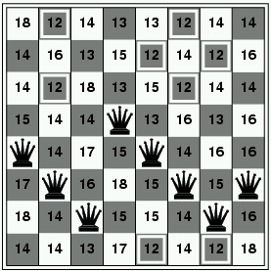
Random Steps (Walk)
Let’s assume that neighbors are generated as
  assignments that differ in one variable's value
How many neighbors there are given n variables with domains with d values?
One strategy to add randomness to the selection variable-value pair. Sometimes choose the pair
According to the scoring function
A random one
E.G in 8-queen
How many neighbors?
……..
Notes:
You may choose between a one or two stage heuristic.
In a one stage heuristic the variable and value are chosen together.
The pair that minimize the number of conflicts
In the two stage heuristic the variable is chosen first and then the
value. The variable with the greatest number of conflicts in it's
edges is chosen and then the value which resolves the highest number
of conflicts is chosen from this variable's set of values.

Slide 21
Random Steps (Walk): two-step
Another strategy: select a variable first, then a value:
  Sometimes select variable:
    that participates in the largest number of conflicts.
    at random, any variable that participates in some conflict.
    at random
  Sometimes choose value
    That minimizes # of conflicts
    at random
0
2
2
3
3
2
Aispace
2 a: Greedy Descent with Min-Conflict Heuristic
3
Notes:
Sometimes choose the variable which participates in the largest number of conflicts.
Sometimes choose, at random, any variable that participates in some conflict.
Sometimes choose a random variable.
Sometimes choose the best value for the chosen variable.
Sometimes choose a random value for the chosen variable.

Slide 22
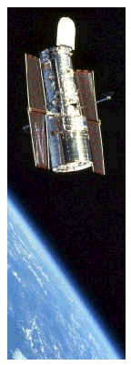
Successful application of SLS
Scheduling of Hubble Space Telescope: reducing time to schedule 3 weeks of observations:
from one week to around 10 sec.
Notes:
Generate feasible schedule that are not too suboptimal
Soft constraints
e.g., Minimize light from moon / sun
SPIKE treats schedule construction as a constrained optimization problem and uses a heuristic
repair-based scheduling search technique called multistart stochastic repair. This
technique consists of the following steps:
1. Trial assignment: make a trial assignment (“initial guess”) of activities to times, based
on heuristics to be discussed further below. Such a schedule will generally have temporal
or other constraint violations, as well as resource capacity overloads;
2. Repair: apply heuristic repair techniques to try to eliminate constraint violations, until
either a pre-established level of effort has been expended or there are no conflicts left;
3. Deconflict: eliminate conflicts by removing any activities with constraint violations, or
by relaxing constraints, until a feasible schedule remains.

Slide 23
(Stochastic) Local search advantage: Online setting
When the problem can change (particularly important in scheduling)
E.g., schedule for airline: thousands of flights and thousands of personnel assignment
  Storm can render the schedule infeasible
Goal: Repair with minimum number of changes
This can be easily done with a local search starting form the current schedule
Other techniques usually:
  require more time
  might find solution requiring many more changes

Slide 24
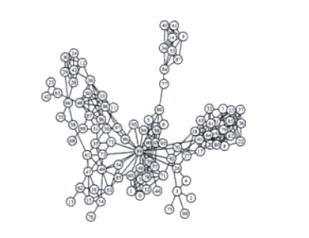
CSPs: Radio link frequency assignment
Assigning frequencies to a set of radio links defined between pairs of sites in order to avoid interferences.
Constraints on frequency depend on position of the links and on physical environment .
Source: INRIA
Sample Constraint network

Slide 25
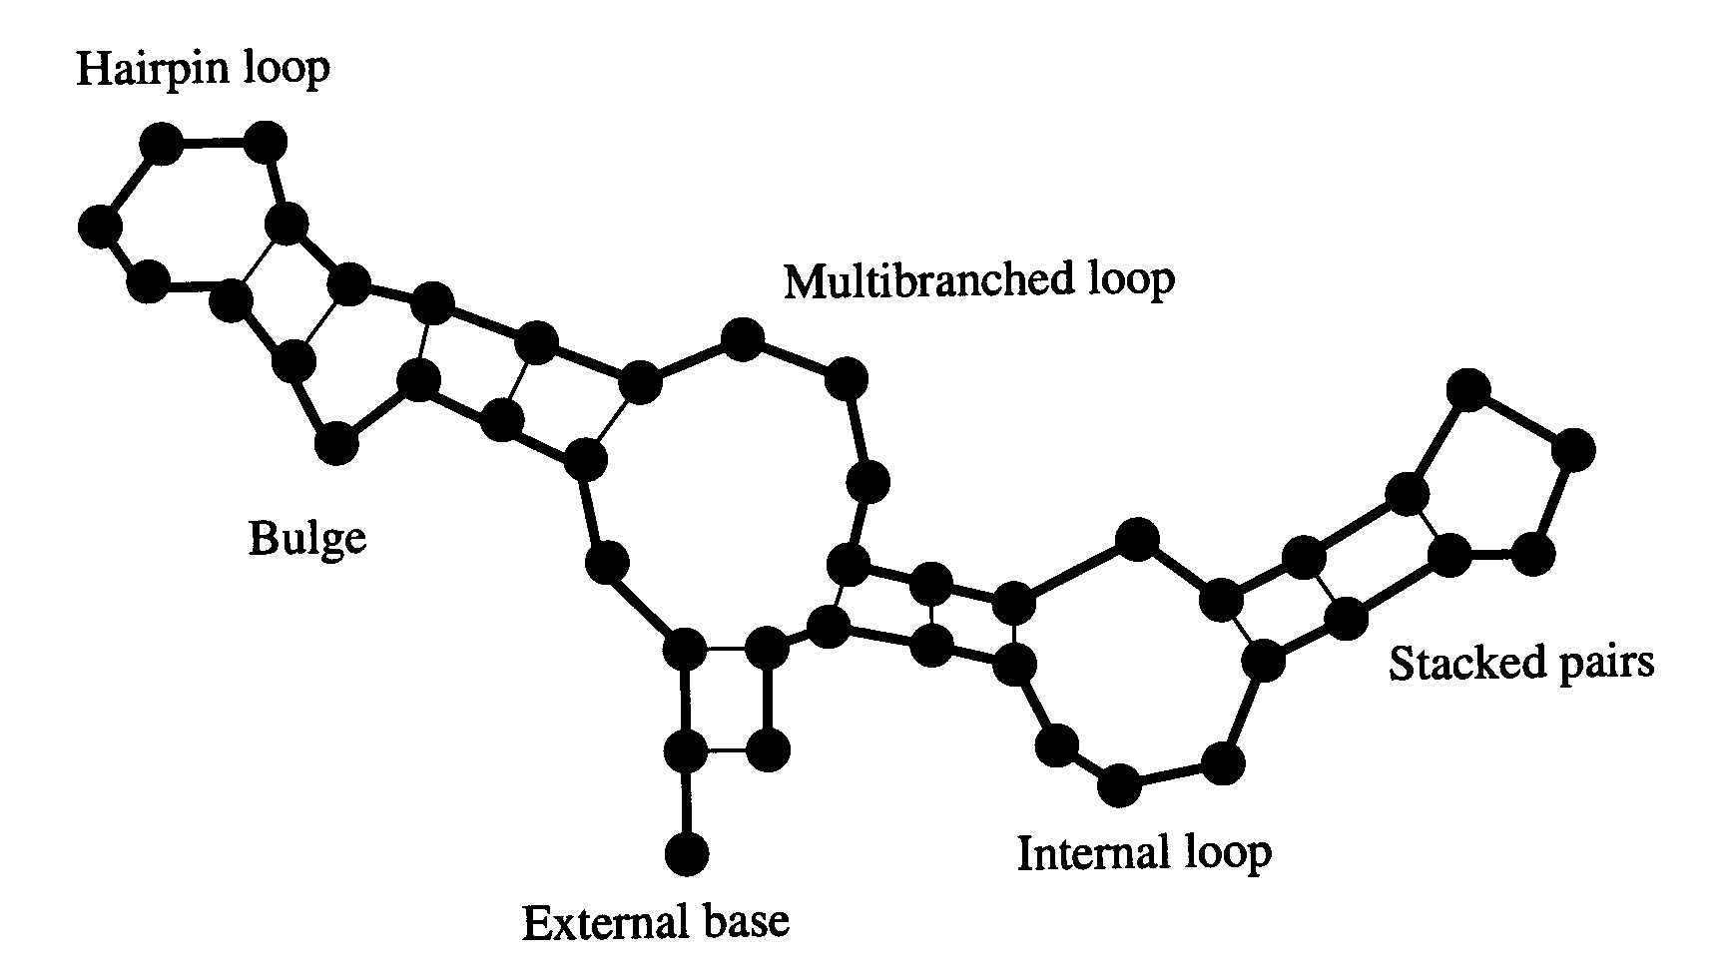
Example: SLS for RNA secondary structure design
RNA strand made up of four bases: cytosine (C), guanine (G), adenine (A), and uracil (U)
2D/3D structure RNA strand folds into
is important for its function
Predicting structure for a
strand is “easy”: O(n³)
But what if we want a strand that folds
into a certain structure?
  Local search over strands
    Search for one that folds
    into the right structure
  Evaluation function for a strand
    Run O(n³) prediction algorithm
    Evaluate how different the result is
    from our target structure
    Only defined implicitly, but can be
    evaluated by running the prediction algorithm
RNA strand
GUCCCAUAGGAUGUCCCAUAGGA
Easy
Hard
Secondary structure
  Best algorithm to date: Local search algorithm RNA-SSD developed at UBC
  [Andronescu, Fejes, Hutter, Condon, and Hoos, Journal of Molecular Biology, 2004]

Slide 26
SLS:Limitations
Typically no guarantee they will find a solution even if one exists
Not able to show that no solution exists

Slide 27
Today Sept 20
Stochastic Local Search (SLS)
Local Search & Constrained Optimization
SLS
SLS variants
Comparing SLS

Slide 28
Tabu lists
To avoid search to
  Immediately going back to previously visited candidate
  To prevent cycling
Maintain a tabu list of the k last nodes visited.
  Don't visit a poss. world that is already on the tabu list.
Cost of this method depends on k
Notes:
SLS algorithms can get stuck in plateaus
To prevent cycling we can maintain a tabu list of the k last nodes visited.
Don't visit a node that is already on the tabu list.
If k=1, we don't allow the search to visit the same assignment twice in a row.
This method can be expensive if k is large.

Slide 29
Simulated Annealing
Key idea: Change the degree of randomness….
Annealing: a metallurgical process where metals are hardened by being slowly cooled.
  Analogy: start with a high ``temperature'': a high tendency to take random steps
  Over time, cool down: more likely to follow the scoring function
Temperature reduces over time, according to an annealing schedule
Notes:
High temperature -> random movements
Low temperature -> little randomness
Zero temperature -> hill climbing
It is an art to set a good annealing schedule!

Slide 30
Simulated Annealing: algorithm
Here's how it works (for maximizing):
  You are in node n. Pick a variable at random and a new value at random. You generate n'
  If it is an improvement i.e., , adopt it.
  If it isn't an improvement, adopt it probabilistically depending on the difference and a temperature parameter, T.
    we move to n' with probability e^{(h(n')-h(n))/T}
Notes:
On textbook for minimizing!

Slide 31
  If it isn't an improvement, adopt it probabilistically depending on the difference and a temperature parameter, T.
    we move to n' with probability e^{(h(n')-h(n))/T}

Slide 32
Properties of simulated annealing search
One can prove: If T decreases slowly enough, then simulated annealing search will find a global optimum with probability approaching 1
Widely used in VLSI layout, airline scheduling, etc.
Notes:
Often the most difficult step in the annealing process is the development of an
appropriate cooling schedule. To ensure the success of the optimization, the
temperature (control parameter) must be controlled so that it is large enough to move off
a local minimum, but small enough not to move off a global minimum. Due to the wide
variety and complicated nature of most combinational optimization problems, the
suitable cooling schedule will be unique for each problem. Ideally, the temperature
should be lowered slow enough to ensure that a good minimum is achieved, but also
quick enough so that computational time is minimized.

Slide 33
Population Based SLS
Often we have more memory than the one required for current node (+ best so far + tabu list)
Key Idea: maintain a population of k individuals
At every stage, update your population.
Whenever one individual is a solution, report it.
Notes:
Nothing more then running k random restarts in parallel instead then in sequence…
More memory but same power!
There's not really any reason to use this method (why not?), but it provides a framework for talking about what follows...
Like k restarts, but uses k times the minimum number of steps.

Slide 34
Population Based SLS: Beam Search
Non Stochastic
Start with k individuals, and choose the k best out of all of the neighbors.
Useful information is passed among the k parallel search thread
Troublesome case: If one individual generates several good neighbors and the other k-1 all generate bad successors….
Notes:
Quickly abandon unfruitful searches…
When k=1, it is hill climbing.
When k=∞, it is breadth-first search.
The value of k lets us limit space and parallelism.

Slide 35
Population Based SLS: Stochastic Beam Search
Non Stochastic Beam Search may suffer from lack of diversity among the k individual (just a more expensive hill climbing)
Stochastic version alleviates this problem:
  Selects the k individuals at random
  But probability of selection proportional to their value (according to scoring function)

Slide 36
Stochastic Beam Search: Advantages
  It maintains diversity in the population.
  Biological metaphor (asexual reproduction):
    each individual generates “mutated” copies of itself (its neighbors)
    The scoring function value reflects the fitness of the individual
    the higher the fitness the more likely the individual will survive (i.e., the neighbor will be in the next generation)

Slide 37
Population Based SLS: Genetic Algorithms
Start with k randomly generated individuals (population)
An individual is represented as a string over a finite alphabet (often a string of 0s and 1s)
A successor is generated by combining two parent individuals (loosely analogous to how DNA is spliced in sexual reproduction)
Evaluation/Scoring function (fitness function). Higher values for better individuals.
Produce the next generation of individuals by selection, crossover, and mutation

Slide 38
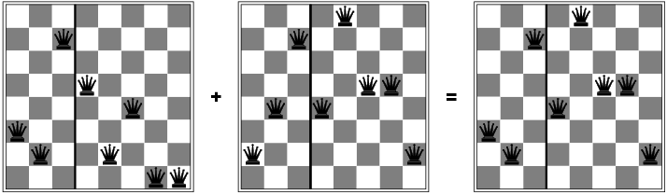
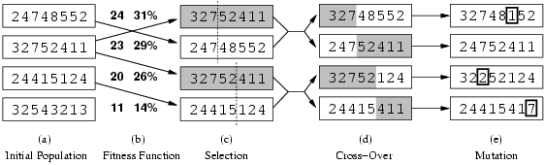
Genetic algorithms: Example
Representation and fitness function
State: string over finite alphabet
Fitness function: higher value better states
Notes:
Fitness function: number of non-attacking pairs of queens (min = 0, max = 8 × 7/2 = 28)

Slide 39
Genetic algorithms: Example
Selection: common strategy, probability of being chosen for reproduction is directly proportional to fitness score
24/(24+23+20+11) = 31%
23/(24+23+20+11) = 29% etc

Slide 40
Genetic algorithms: Example
Reproduction: cross-over and mutation
Notes:
When the two parent states are quite different the cross-over can produce a state that is long away from either parents
At the beginning when population is diverse takes big steps (like simulated annealing with high temperature

Slide 41
Genetic Algorithms: Conclusions
Their performance is very sensitive to the choice of state representation and fitness function
Extremely slow (not surprising as they are inspired by evolution!)

Slide 42
Today Sept 20
Stochastic Local Search (SLS)
Local Search & Constrained Optimization
SLS
SLS variants
Comparing SLS

Slide 43
Comparing Stochastic Algorithms: Challenge
Summary statistics, such as mean run time, median run time, and mode run time don't tell the whole story
  What is the running time for the runs for which an algorithm never finishes (infinite? stopping time?)
% of solved runs
100%
0
10
20
30
…..
runtime / steps
Notes:
Summary stats for each algorithm are not effective…

Slide 44
First attempt….
How can you compare three algorithms when
  one solves the problem 30% of the time very quickly but doesn't halt for the other 70% of the cases
  one solves 60% of the cases reasonably quickly but doesn't solve the rest
  one solves the problem in 100% of the cases, but slowly?
% of solved runs
100%
Mean runtime / steps
of solved runs

Slide 45

Runtime Distributions are even more informative
Plots runtime (or number of steps) and the proportion (or number) of the runs that are solved within that runtime.
  log scale on the x axis is commonly used
Notes:
Scheduling 1 problem
How many states (toy problem)
200 runs 1000 steps
Random sampling
Do it again different result

Slide 46
Runtime Distributions
% of solved runs
100%
time t
Which one would you use if you could only wait
t = t₁ ?
t = t₂ ?
t = t₃ ?

Slide 47
Stochastic Local Search
Key Idea: combine greedily improving moves with randomization
As well as improving steps we can allow a “small probability” of:
  Random steps: move to a random neighbor.
  Random restart: reassign random values to all variables.
Always keep best solution found so far
Stop when
  Solution is found (in vanilla CSP pw that satisfies all C)
  Run out of time (return best solution so far)
Notes:
Key Idea: combine hill climbing (advantage: finds local maximum) with randomization (advantage: doesn't get stuck).
Limitations
Typically no guarantee they will find a solution even if one exists
Not able to show that no solution exists

Slide 48
CSPs summary
Find a single variable assignment that satisfies all of our constraints (atemporal)
Systematic Search approach
  Constraint network support
    inference e.g., Arc Consistency (can tell you if solution does not exist)
    Decomposition (loop, more AC)
  Heuristic Search (degree, min-remaining)
(Stochastic) Local Search (search space …..?)
  Huge search spaces and highly connected constraint network but solutions densely distributed
  No guarantee to find a solution (if one exists).
  Unable to show that no solution exists
Notes:
Diversification vs Intensification
I Goal-directed and randomised components of SLS strategy
need to be balanced carefully.
I Intensification: aims to greedily increase solution quality or
probability, e.g., by exploiting the evalution function.
I Diversification: aim to prevent search stagnation by preventing
search process from getting trapped in confined regions.
Examples:
I Iterative Improvement (II): intensification strategy.
I Uninformed Random Walk (URW): diversification strategy.
Balanced combination of intensification and diversification
mechanisms forms the basis for advanced SLS methods.

Slide 49
R&Rsys we'll cover in this course
Environment
Deterministic
Stochastic
Problem
Arc Consistency
SLS
Constraint Satisfaction
Vars +
Constraints
Search
Static
Belief Nets
Var. Elimination
Query
Logics
Approx. Inference
Search
Temporal. Inference
Sequential
Decision Nets
STRIPS
Var. Elimination
Planning
Search
Markov Processes
Representation
Value Iteration
Reasoning
Technique
Notes:
R&R Sys Representation and reasoning Systems
Each cell is a R&R system
STRIPS actions prec
The SCSP extends the classical CSP by
including both decision variables, that an agent can set, and stochastic
variables that follow a probability distribution and can model uncer-
tain events beyond the agent’s control. So far, two approaches to solving
SCSPs have been proposed; backtracking-based procedures that extend
standard methods from CSPs, and scenario-based methods that solve
SCSPs by reducing them to a sequence of CSPs.onditions and effects Stanford Research Institute Problem Solver

Slide 50
Do exercise 4.C http://www.aispace.org/exercises.shtml
Please, look at solutions only after you have tried hard to solve them!
TODO for this Thur
Read Chp 8 of textbook (Planning with Certainty)

Slide 51
Arc Consistency Algorithm: Complexity
Let’s determine Worst-case complexity of this procedure (compare with DFS )
  let the max size of a variable domain be d
  let the number of variables be n
  The max number of binary constraints is…….
How many times the same arc can be inserted in the ToDoArc list?
How many steps are involved in checking the consistency of an arc?
Notes:
Every time a domain value of its “left var” is removed
Some special cases are faster
e.g., if the constraint graph is a tree, arc consistency is O(ed)
I DO NOT THINK SO
It is linear in the number of variables n (not quadratic as the general case) check with David and Kevin

Slide 52
Sampling a discrete probability distribution

Slide 53
What are we going to look at in AIspace
When selecting a variable first followed by a value:
  Sometimes select variable:
    that participates in the largest number of conflicts.
    at random, any variable that participates in some conflict.
    at random
  Sometimes choose value
    That minimizes # of conflicts
    at random
AIspace terminology
Random sampling
Random walk
Greedy Descent
Greedy Descent Min conflict
Greedy Descent with random walk
Greedy Descent with random restart
…..
Notes:
Sometimes choose the variable which participates in the largest number of conflicts.
Sometimes choose, at random, any variable that participates in some conflict.
Sometimes choose a random variable.
Sometimes choose the best value for the chosen variable.
Sometimes choose a random value for the chosen variable.
Random Sampling
At each step this algorithm randomly creates a new solution. For each variable a new value is randomly chosen.
Random Walk
At each step this algorithm randomly chooses a new solution from the set of neighbouring solutions. The set of neighbouring solutions is defined in this applet as the solutions where a single variable has a different value.
Options: You may choose between a one or two stage heuristic. In the first case, the variable and value are chosen together; in the second case, the variable is chosen first and then the value.
Greedy Descent
At each step this algorithm chooses a value which improves the graph.
Options: You may choose between a one or two stage heuristic. In a one stage heuristic the variable and value are chosen together. In the two stage heuristic the variable is chosen first and then the value. The variable with the greatest number of conflicts in its edges is chosen and then the value which resolves the highest number of conflicts is chosen from this variable's set of values.
Greedy Descent with the Min Conflict Heuristic
The Min Conflict Heuristic is one of the first heuristics used for constraint satisfaction problems. (Minton et Al, 1992). It chooses a variable randomly from the set of variables with conflicts (red edges). The value which results in the fewest conflicts is chosen from the possible assignments for this variable. This heuristic is almost identical to Greedy Descent with Random Walk with a two stage heuristic choosing any red node 100% and best value 100%. The only difference is the MCH may return to the previous assignment.
Greedy Descent with Random Walk
At each step this algorithm probabilistically decides whether or not to take a greedy step (change to the best neighbour) or to take a random walk (change to any neighbour)
Options: You may choose between a one or two stage heuristic. In the first case, the variable and value are chosen together; in the second case, the variable is chosen first and then the value. To increase the random walk percentage increase the "random ..." values.
Greedy Descent with Random Restart
This algorithm proceeds like the Greedy Descent algorithm but resets the variables to a new random solution at regular intervals.
Options: Reset Graph specifies the number of steps between random resets of the graph.
Greedy Descent with all Options

