Slide 1
Introduction to
Artificial Intelligence (AI)
Computer Science cpsc502, Lecture 3
Sep, 15, 2011
Notes:
Lecture 3

Slide 2
Today Sept 15
Finish Search
Constraint Satisfaction Problems
….
….
Office Hours
My office hours – Thurs 11-12
Shafiq’s office hours
Notes:
Introductions?

Slide 3
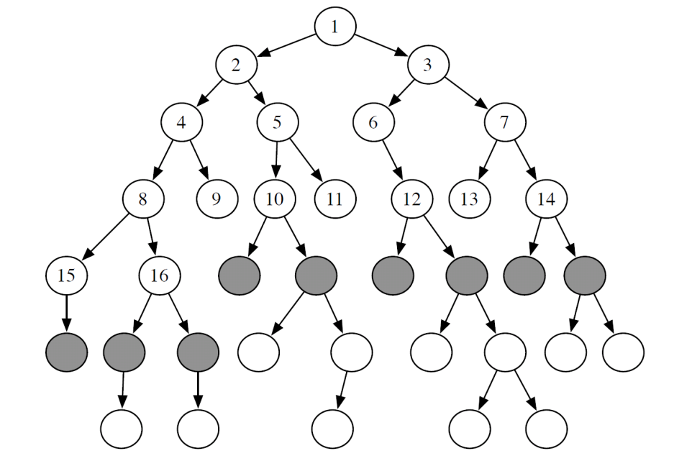
Clarification: state space graph vs search tree
k
d
a
kb
kc
b
z
kbk
kbz
kch
kck
k
c
h
kchz
kbkb
kbkc
kbza
kbzd
kckb
State space
graph.
(For most problems,
we are not explicitly
given the whole graph)
kckc
Search tree.
Nodes in this tree correspond to paths in the state space graph
Notes:
For most problems, we can never actually build the whole graph

Slide 4
Cycle Checking
You can prune a path that ends in a node already on the path. This pruning cannot remove an optimal solution.
The time is linear in path length.
Notes:
Using depth-first methods, with the graph explicitly stored, this can be done in constant time.??

Slide 5
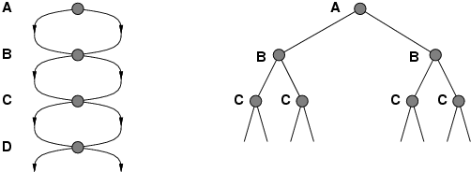
Repeated States / Multiple Paths
Failure to detect repeated states can turn a linear problem into an exponential one!
E.g. state space with 2 actions from each state to next
2^{d} possible paths through the state graph => exponentially larger search tree!

Slide 6
Pruning Cycles
Repeated States
Notes:
CYCLES
You can prune a path that ends in a node already on the path. This pruning cannot remove an optimal solution.
The time is linear in path length.
REPEATED STATES
Failure to detect repeated states can turn a linear problem into an exponential one!
(if the new path is longer – more costly). You can prune a path to node n that you have already found a path to
Problem: what if a subsequent path to n is shorter than the first path to n ?
You can remove all paths from the frontier that use the longer path. (as these can’t be optimal) OR
You can change the initial segment of the paths on the frontier to use the shorter path. Can be computationally costly

Slide 7
R&Rsys we'll cover in this course
Environment
Deterministic
Stochastic
Problem
Arc Consistency
Constraint Satisfaction
Vars +
Constraints
Search
Static
Belief Nets
Var. Elimination
Query
Logics
Approx. Inference
Search
Temporal. Inference
Sequential
Decision Nets
STRIPS
Var. Elimination
Planning
Search
Markov Processes
Representation
Value Iteration
Reasoning
Technique
Notes:
R&R Sys Representation and reasoning Systems
Each cell is a R&R system
STRIPS actions prec
The SCSP extends the classical CSP by
including both decision variables, that an agent can set, and stochastic
variables that follow a probability distribution and can model uncer-
tain events beyond the agent’s control. So far, two approaches to solving
SCSPs have been proposed; backtracking-based procedures that extend
standard methods from CSPs, and scenario-based methods that solve
SCSPs by reducing them to a sequence of CSPs.onditions and effects Stanford Research Institute Problem Solver

Slide 8
Standard Search vs. Specific R&R systems
Constraint Satisfaction (Problems):
  State (and start state)
  Successor function
  Goal test
  Solution
Planning :
  State
  Successor function
  Goal test
  Solution
Inference
  State
  Successor function
  Goal test
  Solution
Notes:
Allows useful general-purpose algorithms with more power than standard search algorithms

Slide 9
Today Sept 15
Finish Search
Constraint Satisfaction Problems
  Variables/Features
  Constraints
  CSPs
  Generate-and-Test
  Search
  Consistency
  Arc Consistency
….

Slide 10
Variables/Features, domains and Possible Worlds
Variables / features
  we denote variables using capital letters
  each variable V has a domain dom(V) of possible values
Variables can be of several main kinds:
  Boolean: |dom(V)| = 2
  Finite: the domain contains a finite number of values
  Infinite but Discrete: the domain is countably infinite
  Continuous: e.g., real numbers between 0 and 1
  Possible world: a complete assignment of values to a set of variables
Notes:
Countably infinite
Reduce infinite by simply bounding the the values of all variables
Continuous domains – operation research – linear programming

Slide 11
Possible Worlds
Mars Explorer Example
Weather
Temperature
LocX LocY
Product of cardinality of each domain
… always exponential in the number of variables

Slide 12
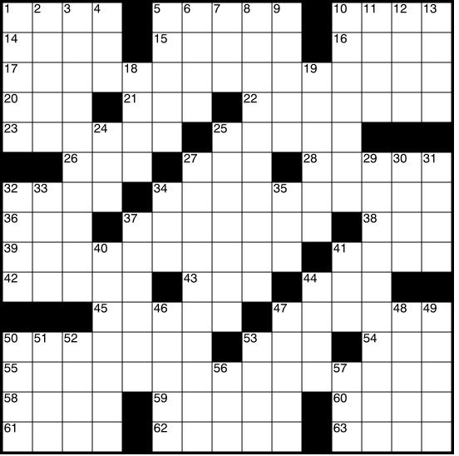
Examples
Crossword Puzzle:
  variables are words that have to be filled in
  domains are valid English words of required length
  possible worlds: all ways of assigning words
Number of English words?
Number of words of length k ?
So, how many possible worlds?
Notes:
~150,000
Variables are the places where word can go e.g. (1 across, 3 down)
Domains are words of the appropriate length (for 1 across in this example – length equals 6)
Constraints letter should be the same at the intersection

Slide 13
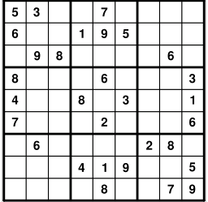
More Examples
Crossword 2:
  variables are cells (individual squares)
  domains are letters of the alphabet
  possible worlds: all ways of assigning letters to cells
So, how many possible worlds?
Sudoku:
  variables are empty cells
  domains are numbers between 1 and 9
  possible worlds: all ways of assigning numbers to cells
So, how many possible worlds?

Slide 14
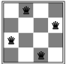
More examples
n-Queens problem
  variable: location of a queen on a chess board
    there are n of them in total, hence the name
  domains: grid coordinates
  possible worlds: locations of all queens
Notes:
the number of ways that k things can be 'chosen' from a set of n things. Hence, is often read as "n choose k" and called the choose function of n and k
Task1 start-time
Task1 end-time
Task1 location

Slide 15
More examples
Scheduling Problem:
  variables are different tasks that need to be scheduled (e.g., course in a university; job in a machine shop)
  domains are the different combinations of times and locations for each task (e.g., time/room for course; time/machine for job)
  possible worlds: time/location assignments for each task
Notes:
the number of ways that k things can be 'chosen' from a set of n things. Hence, is often read as "n choose k" and called the choose function of n and k
Task1 start-time
Task1 end-time
Task1 location

Slide 16
Scheduling possible world
how many possible worlds?

Slide 17
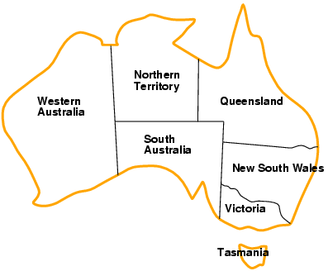
More examples….
Map Coloring Problem
  variable: regions on the map
  domains: possible colors
  possible worlds: color assignments for each region
how many possible worlds?
Notes:
Task1 start-time
Task1 end-time
Task1 location

Slide 18
Constraints
Constraints are restrictions on the values that one or more variables can take
  Unary constraint: restriction involving a single variable
  k-ary constraint: restriction involving the domains of k different variables
    it turns out that k-ary constraints can always be represented as binary constraints, so we'll mainly only talk about this case
  Constraints can be specified by
    giving a function that returns true when given values for each variable which satisfy the constraint
    giving a list of valid domain values for each variable participating in the constraint
Notes:
Unary constraint: restriction involving a single variable
of course, we could also achieve the same thing by using a smaller domain in the first place
k-ary constraints can always be represented as binary constraints
http://ai.uwaterloo.ca/~vanbeek/Publications/ai02.pdf
In the dual transformation, the constraints of the original formulation become variables
in the new representation. We refer to these variables, which represent the original
constraints, as the dual variables, and the variables in the original CSP as the ordinary
variables. The domain of each dual variable is exactly the set of tuples that are in the
original constraint relation. There is a binary constraint, called a dual constraint, between
two dual variables iff the two original constraints share some variables. A dual
constraint prohibits pairs of tuples that do not agree on the shared variables.
In the hidden transformation, the set of variables consists of all the ordinary variables
in the original formulation with their original domains plus all the dual variables
as defined by the dual transformation. There is a binary constraint, called a hidden
constraint, between a dual variable and each of the ordinary variables in the constraint
represented by the dual variable. A hidden constraint enforces the condition that a
value of the ordinary variable must be the same as the value assigned to it by the tuple
that is the value of the dual variable.

Slide 19
Example: Map-Coloring
Variables WA, NT, Q, NSW, V, SA, T
Domains D_{i} = {red,green,blue}
Constraints: adjacent regions must have different colors
e.g., WA ≠
or, (WA,NT) in {(red,green),(red,blue),(green,red), (green,blue),(blue,red),(blue,green)}

Slide 20
Constraints (cont.)
A possible world satisfies a set of constraints if the set of variables involved in each constraint take values that are consistent with that constraint
A,B,C domains [1 .. 10]
A= 1 , B = 2, C = 10
Constraint set1 {A = B, C>B}
Constraint set2 {A ≠ B, C>B}

Slide 21
Examples
Crossword Puzzle:
  variables are words that have to be filled in
  domains are valid English words
  constraints: words have the same letters at points where they intersect
Crossword 2:
  variables are cells (individual squares)
  domains are letters of the alphabet
  constraints: sequences of letters form valid English words

Slide 22
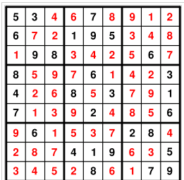
Examples
Sudoku:
  variables are cells
  domains are numbers between 1 and 9
  constraints: rows, columns, boxes contain all different numbers

Slide 23
More examples
n-Queens problem
  variable: location of a queen on a chess board
    there are n of them in total, hence the name
  domains: grid coordinates
  constraints: no queen can attack another
Scheduling Problem:
  variables are different tasks that need to be scheduled (e.g., course in a university; job in a machine shop)
  domains are the different combinations of times and locations for each task (e.g., time/room for course; time/machine for job)
  constraints:
    tasks can't be scheduled in the same location at the same time;
    certain tasks can be scheduled only in certain locations;
    some tasks must come earlier than others; etc.

Slide 24
Constraint Satisfaction Problems: definitions
Definition (Constraint Satisfaction Problem)
A constraint satisfaction problem consists of
  a set of variables
  a domain for each variable
  a set of constraints
A possible world
Definition (model / solution)
A model of a CSP is an assignment of values to variables that satisfies all of the constraints.
Notes:
A possible world satisfies a set of constraints if the set of variables involved in each constraint take
values that are consistent with that constraint

Slide 25
Example: Map-Coloring
Variables WA, NT, Q, NSW, V, SA, T
Domains D_{i} = {red,green,blue}
Constraints: adjacent regions must have different colors
e.g., WA ≠ NT, or
(WA,NT) in {(red,green),(red,blue),(green,red), (green,blue),(blue,red),(blue,green)}

Slide 26
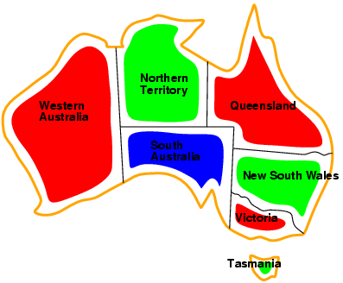
Example: Map-Coloring
Models / Solutions are complete and consistent assignments, e.g., WA = red, NT = green, Q = red, NSW = green, V = red,SA = blue, T = green

Slide 27
Constraint Satisfaction Problem: Variants
We may want to solve the following problems using a CSP
determine whether or not a model exists
find a model
find all of the models
count the number of the models
find the best model given some model quality
  this is now an optimization problem
determine whether some properties of the variables hold in all models
Notes:
Get a “quick answer” then spend more time to find the model
Typical
To assess the difficulty of the problem
Same as above
If you want the largest regions to be red (can be encoded as additional constraints)
In all models do two variables have the same value? (even if it was not required by the constraints)

Slide 28
Constraint Satisfaction Problems: Game Plan
Even the simplest problem of determining whether or not a model exists in a general CSP with finite domains is NP-hard
  There is no known algorithm with worst case polynomial runtime
  We can't hope to find an algorithm that is efficient for all CSPs
However, we can try to:
  identify special cases for which algorithms are efficient (polynomial)
  work on approximation algorithms that can find good solutions quickly, even though they may offer no theoretical guarantees
  find algorithms that are fast on typical cases

Slide 29
Constraint Satisfaction Problems: definitions
Definition (Constraint Satisfaction Problem)
A constraint satisfaction problem consists of
  a set of variables
  a domain for each variable
  a set of constraints
Definition (model / solution)
A model of a CSP is an assignment of values to variables that satisfies all of the constraints.
Notes:
A possible world satisfies a set of constraints if the set of variables involved in each constraint take
values that are consistent with that constraint

Slide 30
Modules we'll cover in this course: R&Rsys
Environment
Deterministic
Stochastic
Problem
Arc Consistency
Constraint Satisfaction
Vars +
Constraints
Search
Static
Belief Nets
Query
Logics
Var. Elimination
Search
Sequential
Decision Nets
STRIPS
Var. Elimination
Planning
Search
Markov Processes
Representation
Value Iteration
Reasoning
Technique
Notes:
R&R Sys Representation and reasoning Systems
Each cell is a R&R system
STRIPS actions preconditions and effects

Slide 31
Standard Search vs. Specific R&R systems
Constraint Satisfaction (Problems):
  State (and start state)
  Successor function
  Goal test
  Solution
  Heuristic function
Planning :
  State
  Successor function
  Goal test
  Solution
  Heuristic function
Answering Queries
  State
  Successor function
  Goal test
  Solution
  Heuristic function
Notes:
Allows useful general-purpose algorithms with more power than standard search algorithms

Slide 32
Today Sept 15
Finish Search
Constraint Satisfaction Problems
  Variables/Features
  Constraints
  CSPs
  Generate-and-Test
  Search
  Consistency
  Arc Consistency
….

Slide 33
Generate-and-Test Algorithm
Algorithm:
  Generate possible worlds one at a time
  Test them to see if they violate any constraints
For a in domA
For b in domB
For c in domC
if
return
return
This procedure is able to solve any CSP
However, the running time is proportional to the number of possible worlds
  always exponential in the number of variables
  far too long for many CSPs ☹
Notes:
The assignment space of a CSP is the space of possible worlds

Slide 34
CSPs as search problems
  states: assignments of values to a subset of the variables
  start state: the empty assignment (no variables assigned values)
  neighbours of a state: nodes in which values are assigned to one additional variable
  goal state: a state which assigns a value to each variable, and satisfies all of the constraints
Note: the path to a goal node is not important
Notes:
CSPs can be mapped into search problems:

Slide 35
CSPs as Search Problems
What search strategy will work well for a CSP?
  If there are n variables every solution is at depth…….
  Is there a role for a heuristic function?
  the tree is always finite and has no cycles, so which one is better BFS or IDS or DFS?
Notes:
??the
DFS is one way of implementing generate-and-test
re are no costs, so there's no role for a heuristic function??

Slide 36
CSPs as search problems
Simplified notation
Notes:
CSPs can be mapped into search problems:

Slide 37
CSPs as Search Problems
  How can we avoid exploring some sub-trees i.e.,
  prune the DFS Search tree?
  once we consider a path whose end node violates one or more constraints, we know that a solution cannot exist below that point
  thus we should remove that path rather than continuing to search
Notes:
We consider a path whose end node violates…..
this can yield us exponential savings over generate-and-test, though it's still exponential

Slide 38
Solving CSPs by DFS: Example
Problem:
  Variables: A,B,C
  Domains: {1, 2, 3, 4}
  Constraints: A < B, B < C
Notes:
Generate and test is equivalent to not checking the constraints until the leaves
Remaining values heuristics : variable with fewest legal values (variable that generates less viable neighbors)
Degree Heuristic: variable involved in more constraints

Slide 39
Solving CSPs by DFS: Example Efficiency
Problem:
  Variables: A,B,C
  Domains: {1, 2, 3, 4}
  Constraints: A < B, B < C
Note: the algorithm's efficiency depends on the order in which variables are expanded
Degree “Heuristics”
A=1
A=4
A=2
A=3
C=1
C=2
C=3
C=4
C=1
C=2
C=3
C=4
C=1
C=2
C=3
C=4
C=1
C=2
C=3
C=4
Notes:
MAYBE DO NOT MENTION
Minimum remaining Vallues heuristics: chose the var with less legal values. Also called fail first heuristic because it picks the var that is most likely to cause a failure soon, thereby pruning the tree. In the extreme case if the var X has zero values, the MRV heuristic will select X and failure will be detected immediately – avoiding pointless search through other vars which always will fail when X is finally tested

Slide 40
Standard Search vs. Specific R&R systems
Constraint Satisfaction (Problems):
  State: assignments of values to a subset of the variables
  Successor function: assign values to a “free” variable
  Goal test: set of constraints
  Solution: possible world that satisfies the constraints
  Heuristic function: none (all solutions at the same distance from start)
Planning :
  State
  Successor function
  Goal test
  Solution
  Heuristic function
Inference
  State
  Successor function
  Goal test
  Solution
  Heuristic function
Notes:
Allows useful general-purpose algorithms with more power than standard search algorithms

Slide 41
Can we do better than Search?
  Key ideas:
  prune the domains as much as possible before “searching” for a solution.
  Simple when using constraints involving single variables (technically enforcing domain consistency)
  Example: D_{B} = {1, 2, 3, 4} with constraint B ≠ 3.
Notes:
prune the domains as much as possible before selecting values from them.

Slide 42
How do we deal with constraints involving multiple variables?
Definition (constraint network)
A constraint network is defined by a graph, with
  one node for every variable
  one node for every constraint
and undirected edges running between variable nodes and constraint nodes whenever a given variable is involved in a given constraint.
Notes:
When all of the constraints are binary, constraint nodes are not necessary: we can drop constraint nodes and use edges to indicate that a constraint holds between a pair of variables.

Slide 43
Example Constraint Network
Recall Example:
  Variables: A,B,C
  Domains: {1, 2, 3, 4}
  Constraints: A < B, B < C

Slide 44
Example: Constraint Network for Map-Coloring
Variables WA, NT, Q, NSW, V, SA, T
Domains D_{i} = {red,green,blue}
Constraints: adjacent regions must have different colors

Slide 45
Arc Consistency
Definition (arc consistency)
An arc is arc consistent if for each value in there is some value in such that is satisfied.
A
B
A< B
1,2
2,3
A
B
A< B
1,2,3
2,3

Slide 46
How can we enforce Arc Consistency?
  If an arc is not arc consistent, all values in for which there is no corresponding value in may be deleted from to make the arc consistent.
    This removal can never rule out any models/solutions
X
Y
X< Y
2,3,4
1,2,3
  A network is arc consistent if all its arcs are arc consistent.

Slide 47
Arc Consistency Algorithm: high level strategy
Consider the arcs in turn, making each arc consistent.
BUT, arcs may need to be revisited whenever….
NOTE - Regardless of the order in which arcs are considered, we will terminate with the same result
Notes:
the domains of other variables are reduced.
AIspace simple1withUnary problem

Slide 48
Which arcs need to be reconsidered?
When we reduce the domain of a variable X to make an arc ⟨X,c⟩ arc consistent, which arcs do we need to reconsider?
You do not need to reconsider other arcs
  If an arc ⟨X,c'⟩ was arc consistent before, it will still be arc consistent
  Nothing changes for arcs of constraints not involving X
every arc ⟨Z,c'⟩ where c’ ≠ c involves Z and X:
Z₁
T
H
E
S
E
c₁
Z₂
X
c
Y
c₂
Z₃
c₃
c₄
A

Slide 49
What arcs need to be revisited?
When we reduce the domain of a variable X to make an arc ⟨X,c⟩ arc consistent, we add……
every arc ⟨Z,c'⟩ where c' involves Z and X:
You do not need to add other arcs ⟨X,c'⟩ , c ≠ c‘
  If an arc ⟨X,c'⟩ was arc consistent before, it will still be arc consistent (in the ``for all'' we'll just check fewer values)

Slide 50
Arc Consistency Algorithm (for binary C)
1: Procedure GAC(V,dom,C)
2: Inputs
3: V: a set of variables
4: dom: a function such that dom(X) is the domain of variable X
5: C: set of constraints to be satisfied
6: Output
7: arc-consistent domains for each variable
8: Local
9: D_{X} is a set of values for each variable X
10: TDA is a set of arcs
11: for each variable X do
12: D_{X} ←dom(X)
13: TDA ←{〈X,c〉| c∈C and X∈scope(c)}
14:
15: while (TDA ≠{})
16: select 〈X,c〉 ∈TDA;
17: TDA ←TDA \ {〈X,c〉};
18: ND_{X} ←{x| x ∈D_{X} and there is y_{i} ∈D_{Yi} {X=x,Y=y}∈c };
19: if (ND_{X} ≠D_{X}) then
20: TDA ←TDA ∪{〈Z,c'〉|X ∈scope(c'), c' is not c, Z∈scope(c') \ {X} }
21: D_{X} ←ND_{X}
22:
23:
24: return {D_{X}| X is a variable}
Notes:
ND = New D
Non binary ND_{X} ←{x| x ∈D_{X} and some {X=x,Y₁=y₁,...,Y_{k}=y_{k}}∈c where y_{i} ∈D_{Yi} for all i} omain

Slide 51
Arc Consistency Algorithm: Complexity
Let’s determine Worst-case complexity of this procedure (compare with DFS )
  let the max size of a variable domain be d
  let the number of variables be n
  The max number of binary constraints is…….
How many times the same arc can be inserted in the ToDoArc list?
How many steps are involved in checking the consistency of an arc?
Notes:
Every time a domain value of its “left var” is removed
Some special cases are faster
e.g., if the constraint graph is a tree, arc consistency is O(ed)
I DO NOT THINK SO
It is linear in the number of variables n (not quadratic as the general case) check with David and Kevin

Slide 52
Arc Consistency Algorithm: Interpreting Outcomes
Three possible outcomes (when all arcs are arc consistent):
  One domain is empty →
  Each domain has a single value →
  Some domains have more than one value → may or may not be a solution
    in this case, arc consistency isn't enough to solve the problem: we need to perform search
Notes:
Otherwise, split a domain & apply arc consistency to each case.
Spiltting in half the variable with the smallest domain usually works best (who know why)
ACC: Show with Cispace, first “scheduling problem”, and then crossword 1 for splitting. What makes sense is to split the node with 6 vars to the right, show that it gets to an empty solution, backtrack, and do more s0plitting on the var with 2 values on the top-left. Done. WENT WELL

Slide 53
Domain splitting (or case analysis)
Arc consistency ends: Some domains have more than one value → may or may not be a solution
  Apply Depth-First Search with Pruning
  Split the problem in a number of disjoint cases
Set of all solution equals to….
Notes:
Otherwise, split a domain & apply arc consistency to each case.
Spiltting in half the variable with the smallest domain usually works best (who know why)
ACC: Show with Cispace, first “scheduling problem”, and then crossword 1 for splitting. What makes sense is to split the node with 6 vars to the right, show that it gets to an empty solution, backtrack, and do more s0plitting on the var with 2 values on the top-left. Done. WENT WELL

Slide 54
But what is the advantage?
By reducing dom(X) we may be able to run AC again
Complete Process
Simplify the problem using arc consistency
No unique solution i.e., for at least one var, |dom(X)|>1
Split X
For all the splits
  Restart arc consistency on arcs <Z, r(Z,X)>
these are the ones that are possibly inconsistent
Disadvantage ☹: you need to keep all these CSPs around (vs. lean states of DFS)
Notes:
Combining Arc Consistency and
Domain Splitting
Otherwise, split a domain & apply arc consistency to each case.
Spiltting in half the variable with the smallest domain usually works best (who know why)
ACC: Show with Cispace, first “scheduling problem”, and then crossword 1 for splitting. What makes sense is to split the node with 6 vars to the right, show that it gets to an empty solution, backtrack, and do more s0plitting on the var with 2 values on the top-left. Done. WENT WELL

Slide 55
Searching by domain splitting
Disadvantage ☹: you need to keep all these CSPs around (vs. lean states of DFS)
Notes:
Combining Arc Consistency and
Domain Splitting
Otherwise, split a domain & apply arc consistency to each case.
Spiltting in half the variable with the smallest domain usually works best (who know why)
ACC: Show with Cispace, first “scheduling problem”, and then crossword 1 for splitting. What makes sense is to split the node with 6 vars to the right, show that it gets to an empty solution, backtrack, and do more s0plitting on the var with 2 values on the top-left. Done. WENT WELL

Slide 56
Systematically solving CSPs: Summary
Build Constraint Network
Apply Arc Consistency
  One domain is empty →
  Each domain has a single value →
  Some domains have more than one value →
Apply Depth-First Search with Pruning
Split the problem in a number of disjoint cases
  Apply Arc Consistency to each case
Notes:
Otherwise, split a domain & apply arc consistency to each case.
Spiltting in half the variable with the smallest domain usually works best (who know why)
ACC: Show with Cispace, first “scheduling problem”, and then crossword 1 for splitting. What makes sense is to split the node with 6 vars to the right, show that it gets to an empty solution, backtrack, and do more s0plitting on the var with 2 values on the top-left. Done. WENT WELL

Slide 57
Local Search motivation: Scale
Many CSPs (scheduling, DNA computing, more later) are simply too big for systematic approaches
If you have 10⁵ vars with dom(var_{i}) = 10⁴
Systematic Search
Constraint Network
but if solutions are densely distributed…….

Slide 58
Do exercises 4.A , 4.B available at http://www.aispace.org/exercises.shtml
Please, look at solutions only after you have tried hard to solve them!
TODO for this Thue
Read Chp 4 of textbook (especially from 4.8 to end)
Join piazza (the class discussion forum)

Slide 59
Which arcs need to reconsidered?
When we reduce the domain of a variable X to make an arc ⟨X,c⟩ arc consistent, which arcs do we need to reconsider?
You do not need to reconsider other arcs
  If an arc ⟨X,c'⟩ was arc consistent before, it will still be arc consistent
  Nothing changes for arcs of constraints not involving X
every arc ⟨Z,c'⟩ where c’ ≠ c involves Z and X:
Z₁
T
H
E
S
E
c₁
Z₂
X
c
Y
c₂
Z₃
c₃
c₄
A

Slide 60
Arc consistency algorithm (for binary constraints)
Procedure GAC(V,dom,C)
Inputs
V: a set of variables
dom: a function such that dom(X) is the domain of variable X
C: set of constraints to be satisfied
Output
arc-consistent domains for each variable
Local
D_{X} is a set of values for each variable X
TDA is a set of arcs
1: for each variable X do
2: D_{X} ←dom(X)
3: TDA ←{〈X,c〉| c ∈ C and X ∈ scope(c)}
4: while (TDA ≠ {})
5: select 〈X,c〉 ∈TDA
6: TDA ←TDA \ {〈X,c〉}
7: ND_{X} ←{x| x ∈ D_{X} and ∃ y ∈ D_{Y} s.t. (x, y) satisfies c}
8: if (ND_{X} ≠ D_{X}) then
9: TDA ←TDA ∪ { 〈Z,c'〉 | X ∈ scope(c'), c' ≠ c, Z ∈ scope(c') \ {X} }
10: D_{X} ←ND_{X}
11: return {D_{X}| X is a variable}
Scope of constraint c is the set of variables involved in that constraint
TDA:
ToDoArcs,
blue arcs
in AIspace
X’s domain changed:
⇒ arcs (Z,c’) for variables Z sharing a
constraint c’ with X could become inconsistent
ND_{X}: values x for X for which there a value for y supporting x

Slide 61
Clarification: state space graph vs search tree
k
d
a
kb
kc
b
z
kbz
kch
4
5
k
c
h
kchfy
f
6
7
8
kbza
kbzd
State space
graph.
If there are no cycles, the two look the same
Search tree.
Nodes in this tree correspond to paths in the state space graph

Slide 62
Clarification: state space graph vs search tree
k
d
a
kb
kc
b
z
kbz
kch
4
5
k
c
h
kchf
f
6
7
8
kbza
kbzd
State space
graph.
Search tree.
What do I mean by the numbers in the search tree’s nodes?
Node’s name
Order in which a search algo. (here: BFS) expands nodes
62

Slide 63
Clarification: state space graph vs search tree
k
d
a
kb
kc
b
z
kbk
kbz
kch
kck
k
c
h
kchf
kbkb
kbkc
f
kbza
kbzd
kckb
kckc
State space
graph.
Search tree.
(only first 3 levels, of BFS)
If there are cycles, the two look very different

Slide 64
Clarification: state space graph vs search tree
k
d
a
kb
kc
b
z
kbk
kbz
kch
kck
k
c
h
kchf
kbkb
kbkc
f
kbza
kbzd
kckb
kckc
State space
graph.
Search tree.
(only first 3 levels, of BFS)
What do nodes in the search tree represent in the state space?
nodes
edges
paths
states

Slide 65
Clarification: state space graph vs search tree
k
d
a
kb
kc
b
z
kbk
kbz
kch
kck
k
c
h
kchf
kbkb
kbkc
f
kbza
kbzd
kckb
kckc
State space
graph.
Search tree.
(only first 3 levels, of BFS)
What do edges in the search tree represent in the state space?
nodes
edges
paths
states

Slide 66
Clarification: state space graph vs search tree
k
d
a
kb
kc
b
z
kbk
kbz
kch
kck
k
c
h
kchz
kbkb
kbkc
z
kbza
kbzd
kckb
kckc
State space
graph.
May contain cycles!
Search tree.
Nodes in this tree correspond to paths in the state space graph
(if multiple start nodes: forest)
Cannot contain cycles!

Slide 67
Clarification: state space graph vs search tree
k
d
a
kb
kc
b
z
kbk
kbz
kch
kck
k
c
h
kchz
kbkb
kbkc
z
State space
graph.
Why don’t we just eliminate cycles?
Sometimes (but not always) we want multiple solution paths
kbza
kbzd
kckb
kckc
Search tree.
Nodes in this tree correspond to paths in the state space graph

Slide 68
Cycle Checking: if we only want optimal solutions
You can prune a node n that is on the path from the start node to n.
This pruning cannot remove an optimal solution ⇒ cycle check
Using depth-first methods, with the graph explicitly stored, this can be done in constant time
  Only one path being explored at a time
Other methods: cost is linear in path length
  (check each node in the path)

Slide 69
Size of search space vs search tree
With cycles, search tree can be exponential in the state space
  E.g. state space with 2 actions from each state to next
  With d + 1 states, search tree has depth d
A
A
B
B
B
C
C
C
C
C
D
2^{d} possible paths through the search space
=> exponentially larger search tree!

Slide 70
Multiple Path Pruning
n
If we only want one path to the solution
Can prune path to a node n that has already been reached via a previous path
  Store S := {all nodes n that have been expanded}
  For newly expanded path p = (n₁,…,n_{k},n)
    Check whether n ∈ S
    Subsumes cycle check
Can implement by storing the path to each expanded node

Slide 71
Multiple-Path Pruning & Optimal Solutions
Problem: what if a subsequent path to n is shorter than the first path to n, and we want an optimal solution ?
Can remove all paths from the frontier that use the longer path. (these can’t be optimal)
2
2
1
1
1

Slide 72
Multiple-Path Pruning & Optimal Solutions
Problem: what if a subsequent path to n is shorter than the first path to n, and we want just the optimal solution ?
Can change the initial segment of the paths on the frontier to use the shorter path
2
2
1
1
1

Slide 73
Multiple-Path Pruning & Optimal Solutions
Problem: what if a subsequent path to n is shorter than the first path to n, and we want just the optimal solution ?
Can prove that this can’t happen for an algorithm
2
2
1
1
1

Slide 74
Which of the following algorithms always find the shortest path to nodes on the frontier first?
Least Cost Search First
A*
Both of the above
None of the above

Slide 75
Which of the following algorithms always find the shortest path to nodes on the frontier first?
  Only Least Cost First Search (like Dijkstra’s algorithm)
  For A* this is only guaranteed for nodes on the optimal solution path
  Example: A* expands the upper path first
    Special conditions on the heuristic can recover the guarantee of LCFS
h=0
2
2
h=1
Start state
goal state
1
1
1
20
h=10
Notes:
Can recover LCFS’s guarantee with monotone heuristic:
|h(m) – h(n)| <= cost(m,n)

Slide 76
Summary: pruning
Sometimes we don’t want pruning
  Actually want multiple solutions (including non-optimal ones)
Search tree can be exponentially larger than search space
  So pruning is often important
In DFS-type search algorithms
  We can do cheap cycle checks: O(1)
BFS-type search algorithms are memory-heavy already
  We can store the path to each expanded node and do multiple path pruning

