Slide 1
Introduction to
Artificial Intelligence (AI)
Computer Science cpsc502, Lecture 17
Nov, 8, 2011
Slide credit : C. Conati, S. Thrun, P. Norvig, Wikipedia
Notes:
Lecture 17

Slide 2
Today Nov 8
Unsupervised Machine Learning
K-means
Intro to EM
Brief Intro to Reinforcement Learning (RL)
Q-learning

Slide 3
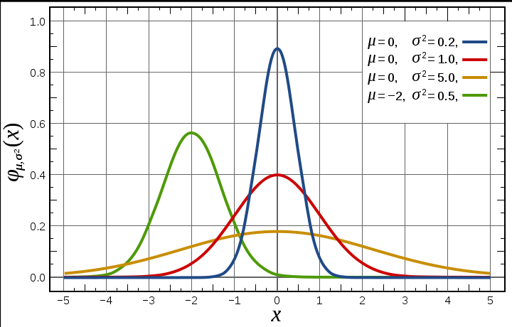
Gaussian Distribution
Models a large number of phenomena encountered in practice
Under mild conditions the sum of a large number of random variables is distributed approximately normally
Notes:
The normal distribution is considered the most prominent probability distribution in statistics. There are several reasons for this:^{[1]} First, the normal distribution is very tractable analytically, that is, a large number of results involving this distribution can be derived in explicit form. Second, the normal distribution arises as the outcome of the central limit theorem, which states that under mild conditions the sum of a large number of random variables is distributed approximately normally. Finally, the "bell" shape of the normal distribution makes it a convenient choice for modelling a large variety of random variables encountered in practice.

Slide 4
Gaussian Learning: Parameters
n data points

Slide 5
Expectation Maximization for Clustering: Idea
Lets assume: that our Data were generated from several Gaussians (a mixture, technically)
For simplicity – one dimensional data – only two Gaussians (with same variance, but possibly different ………..)
Generation Process
Gaussian/Cluster is selected
Data point is sampled from that cluster

Slide 6
But this is what we start from
n data points without labels! And we have to cluster them into two (soft) clusters.
“Identify the two Gaussians that best explain the data”
Since we assume they have the same variance, we “just” need to find their priors and their means
In K-means we assume we know the center of the clusters and iterate…..
Notes:
If we had the labels we could find the means and prior for cluster
If we had the means and prior for cluster we could find “soft” labels..

Slide 7
Here we assume that we know
Prior for clusters and the two means
We can compute the probability that data point x_{i} corresponds to the cluster N_{j}

Slide 8
We can now recompute
Prior for clusters
The means

Slide 9
Intuition for EM in two dim. (as a generalization of k-means)

Slide 10
Expectation Maximization
Converges! ☺
Proof [Neal/Hinton, McLachlan/Krishnan]:
E/M step does not decrease data likelihood
But does not assure optimal solution ☹

Slide 11
Practical EM
Number of Clusters unknown
Algorithm:
Guess initial # of clusters
Run EM
Kill cluster center that doesn’t contribute (two clusters with the same data)
Start new cluster center if many points “unexplained” (uniform cluster distribution for lots of data points)

Slide 12
EM is a very general method!
Baum-Welch Algorithm (also known as forward-backward): Learn HMMs from unlabeled data
Inside-Outside Algorithm: unsupervised induction of probabilistic context-free grammars.
More generally, learn parameters for hidden variables in any Bnets (see textbook example 11.1.3 to learn parameters of Naïve-Bayes classifier)

Slide 13
Today Nov 8
Unsupervised Machine Learning
K-means
Intro to EM
Brief Intro to Reinforcement Learning (RL)
Q-learning

Slide 14
MDP and RL
Markov decision process
Set of states S, set of actions A
Transition probabilities to next states P(s’| s, a′)
Reward functions R(s, s’, a)
RL is based on MDPs, but
Transition model is not known
Reward model is not known
While for MDPs we can compute an optimal policy
RL learns an optimal policy

Slide 15
Search-Based Approaches to RL
Policy Search (evolutionary algorithm)
Start with an arbitrary policy
Try it out in the world (evaluate it)
Improve it (stochastic local search)
Repeat from (b) until happy
Problems with evolutionary algorithms
Policy space can be huge: with n states and m actions there are m^{n} policies
Policies are evaluated as a whole: cannot directly take into account locally good/bad behaviors
Notes:
Here the agent is evaluated as a whole, based on how it survives
use of experiences is wasteful: cannot directly take into account locally good/bad behavior, since policies are evaluated as a whole

Slide 16
Q-learning
Contrary to search-based approaches, Q-learning learns after every action
Learns components of a policy, rather than the policy itself
Q(a,s) = expected value of doing action a in state s and then following the optimal policy
Discounted reward we have seen in MDPs
expected value of following optimal policy л in s’
reward in s
states reachable
from s by doing a
Probability of getting to s’ from s via a

Slide 17
Q values
Q(s,a) are known as Q-values, and are related to the utility of state s as follows
From (1) and (2) we obtain a constraint between the Q value in state s and the Q value of the states reachable from a

Slide 18
Q values
 | s₀ | s₁ | … | s_{k}
a₀ | Q[s₀,a₀] | Q[s₁,a₀] | …. | Q[s_{k},a₀]
a₁ | Q[s₀,a₁] | Q[s₁,a₁] | … | Q[s_{k},a₁]
… | … | … | …. | …
a_{n} | Q[s₀,a_{n}] | Q[s₁,a_{n}] | …. | Q[s_{k},a_{n}]
Once the agent has a complete Q-function, it knows how to act in every state
By learning what to do in each state, rather then the complete policy as in search based methods, learning becomes linear rather than exponential in the number of states
But how to learn the Q-values?
Notes:
Selects one of the actions that maximiae Q[s,a]

Slide 19
Learning the Q values
Can we exploit the relation between Q values in “adjacent” states?
No, because we don’t know the transition probabilities P(s’|s,a)
We’ll use a different approach, that relies on the notion on Temporal Difference (TD)

Slide 20
Average Through Time
Suppose we have a sequence of values (your sample data):
v₁, v₂, .., v_{k}
And want a running approximation of their expected value
e.g., given sequence of grades, estimate expected value of next grade
A reasonable estimate is the average of the first k values:
Notes:
One of the main elements of Q-learning

Slide 21
Average Through Time

Slide 22
Estimate by Temporal Differences
(v_{k} - A_{k-1}) is called a temporal difference error or TD-error
it specifies how different the new value v_{k} is from the prediction given by the previous running average A_{k-1}
The new estimate (average) is obtained by updating the previous average by α_{k} times the TD error
Notes:
It intuitively makes sense
If the new value v_{k} is higher than the average at k-1, than the old average was too small
the new average is generated by increasing the old average by a measure proportional to the error
Do the opposite if the new v_{k} is smaller than the average at k-1

Slide 23
Q-learning: General Idea
Learn from the history of interaction with the environment, i.e., a sequence of state-action-rewards
<s₀, a₀, r₁, s₁, a₁, r₂, s₂, a₂, r₃,.....>
History is seen as sequence of experiences, i.e., tuples
<s, a, r, s’>
agent doing action a in state s,
receiving reward r and ending up in s’
These experiences are used to estimate the value of Q (s,a) expressed as

Slide 24
Q-learning: General Idea
But remember
Is an approximation. The real link between Q(s,a) and Q(s’,a’) is

Slide 25
Q-learning: Main steps
Store Q[S, A], for every state S and action A in the world
Start with arbitrary estimates in Q ⁽⁰⁾[S, A],
Update them by using experiences
Each experience <s, a, r, s’> provides one new data point on the actual value of Q[s, a]
current estimated value of Q[s’,a’], where s’ is the state the agent arrives to in the current experience
New value of Q[s,a],
Notes:
How do you merge it with the previous estimate

Slide 26
Q-learning: Update step
TD formula applied to Q[s,a]
New value for Q[s,a] from <s,a,r,s’>
updated estimated value of Q[s,a]
Previous estimated value of Q[s,a]

Slide 27
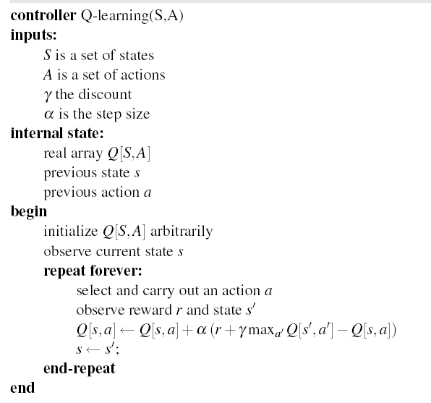
Q-learning: algorithm

Slide 28
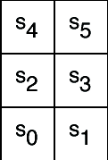
Example
Six possible states <s₀,..,s₅>
4 actions:
UpCareful: moves one tile up unless there is wall, in which case stays in same tile. Always generates a penalty of -1
Left: moves one tile left unless there is wall, in which case
stays in same tile if in s₀ or s₂
Is sent to s₀ if in s₄
Right: moves one tile right unless there is wall, in which case stays in same tile
Up: 0.8 goes up unless there is a wall, 0.1 like Left, 0.1 like Right
-1
-1
+ 10
-1
-100
-1
-1
-1
Reward Model:
-1 for doing UpCareful
Negative reward when hitting a wall, as marked on the picture

Slide 29
Example
-1
-1
+ 10
-1
The agent knows about the 6 states and 4 actions
Can perform an action, fully observe its state and the reward it gets
Does not know how the states are configured, nor what the actions do
no transition model, nor reward model
-100
-1
-1
-1

Slide 30
Example (variable α_{k})
Suppose that in the simple world described earlier, the agent has the following sequence of experiences
<s₀, right, 0, s₁, upCareful, -1, s₃, upCareful, -1, s₅, left, 0, s₄, left, 10, s₀>
And repeats it k times (not a good behavior for a Q-learning agent, but good for didactic purposes)
Table shows the first 3 iterations of Q-learning when
Q[s,a] is initialized to 0 for every a and s
α_{k}= 1/k, γ= 0.9
For full demo, see http://www.cs.ubc.ca/~poole/demos/rl/tGame.html

Slide 31
-1
-1
+ 10
-1
Q[s,a] | s₀ | s₁ | s₂ | s₃ | s₄ | s₅
upCareful | 0 | 0 | 0 | 0 | 0 | 0
Left | 0 | 0 | 0 | 0 | 0 | 0
Right | 0 | 0 | 0 | 0 | 0 | 0
Up | 0 | 0 | 0 | 0 | 0 | 0
-100
-1
k=1
k=1
-1
-1
Only immediate rewards
are included in the update
in this first pass

Slide 32
-1
-1
+ 10
-1
Q[s,a] | s₀ | s₁ | s₂ | s₃ | s₄ | s₅
upCareful | 0 | -1 | 0 | -1 | 0 | 0
Left | 0 | 0 | 0 | 0 | 10 | 0
Right | 0 | 0 | 0 | 0 | 0 | 0
Up | 0 | 0 | 0 | 0 | 0 | 0
-100
-1
k=1
k=2
-1
-1
1 step backup from previous positive reward in s4

Slide 33
-1
-1
+ 10
-1
Q[s,a] | s₀ | s₁ | s₂ | s₃ | s₄ | s₅
upCareful | 0 | -1 | 0 | -1 | 0 | 0
Left | 0 | 0 | 0 | 0 | 10 | 4.5
Right | 0 | 0 | 0 | 0 | 0 | 0
Up | 0 | 0 | 0 | 0 | 0 | 0
-100
-1
k=1
k=3
-1
-1
The effect of the positive reward in s4 is felt two steps earlier at the 3rd iteration

Slide 34
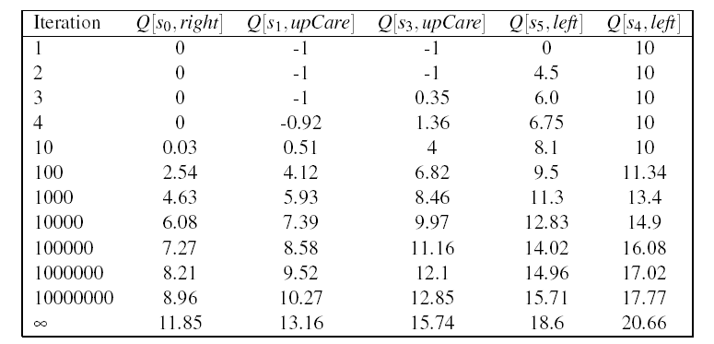
Example (variable α_{k})
As the number of iteration increases, the effect of the positive reward achieved by moving left in s₄ trickles further back in the sequence of steps
Q[s₄,left] starts changing only after the effect of the reward has reached s₀ (i.e. after iteration 10 in the table)
Why 10 and not 6?
Notes:
Because before s0 feels a positive effect, the Q value in s1 need to become positive, otherwise the actions that bring to states with Q = 0 get picked first

Slide 35
Example (Fixed α=1)
First iteration same as before, let’s look at the second
-1
-1
+ 10
-1
Q[s,a] | s₀ | s₁ | s₂ | s₃ | s₄ | s₅
upCareful | 0 | -1 | 0 | -1 | 0 | 0
Left | 0 | 0 | 0 | 0 | 10 | 0
Right | 0 | 0 | 0 | 0 | 0 | 0
Up | 0 | 0 | 0 | 0 | 0 | 0
-100
-1
k=2
-1
-1
New evidence is given much more weight than original estimate
Notes:
Note that each Q(s,a) corresponds to a different TD equation. Thus the value of k in each update depends upon how many times that specific (s,a) pair has been visited. Need a separate K counter for each (s,a) pair

Slide 36
-1
-1
+ 10
-1
Q[s,a] | s₀ | s₁ | s₂ | s₃ | s₄ | s₅
upCareful | 0 | -1 | 0 | -1 | 0 | 0
Left | 0 | 0 | 0 | 0 | 10 | 9
Right | 0 | 0 | 0 | 0 | 0 | 0
Up | 0 | 0 | 0 | 0 | 0 | 0
-100
-1
k=1
k=3
-1
-1
Same here
No change from previous iteration, as all the reward from the step ahead was included there

Slide 37
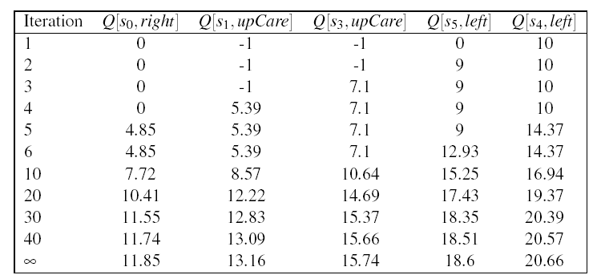
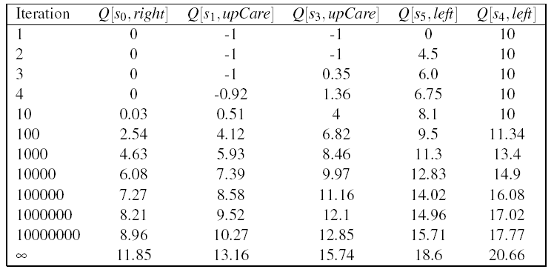
Comparing fixed α (top) and variable α (bottom)
Fixed α generates faster update:
all states see some effect of the
positive reward from <s4, left> by
the 5th iteration
Each update is much larger
Gets very close to final numbers by
iteration 40, while with variable α
still not there by iteration 10⁷
However, remember:
Q-learning with fixed α is not guaranteed to converge

Slide 38
Why approximations work… (1)
In Q-learning,
Updates involve only s and a that appear in experiences
The computation of Q(s,a) relies on an approximation of its true link with Q(s’, a’)
The Q-learning update only considers the s’ observed in the experience
WHY?

Slide 39
Why approximations work…
True relation between Q(s.a) and Q(s’a’)
Q-learning approximation based on each individual experience <s, a, s’>
Way to get around the missing transition model and reward model
Aren’t we in danger of using data coming from unlikely transition to make incorrect adjustments?
No, as long as Q-learning tries each action an unbounded number of times
Frequency of updates reflects transition model, P(s’|a,s)
Notes:
Unlikely transitions will be observed much less frequently than likely ones, so their related updates will have limited impact in the long term

Slide 40
Course summary R&R + ML
Deterministic
Environment
(not in this picture)
Stochastic Environment
Belief Nets
Var. Elimination
Approx. Inference
Query
Markov Chains and HMMs
Temporal. Inference
Decision Nets
Var. Elimination
Planning
Markov Decision Processes
Value Iteration
POMDPs
Approx. Inference
Notes:
R&R Sys Representation and reasoning Systems
Each cell is a R&R system
STRIPS actions preconditions and effects

Slide 41
502: what is next
Midterm exam @5:30-7pm this room DMP 201
Readings / Your Presentations will start Nov 17
We will have a make-up class later

