Slide 1
Introduction to
Artificial Intelligence (AI)
Computer Science cpsc502, Lecture 16
Nov, 3, 2011
Slide credit: C. Conati, S. Thrun, P. Norvig, Wikipedia Peter Mark Pollefeys, Dan Klein, Chris Manning
Notes:
Lecture 15

Slide 2
Supervised ML: Formal Specification

Slide 3
Today Nov 3
Supervised Machine Learning
  Naïve Bayes
  Markov-Chains
  Decision Trees
  Regression
  Logistic Regression
Unsupervised Machine Learning
  K-means
  Intro to EM

Slide 4
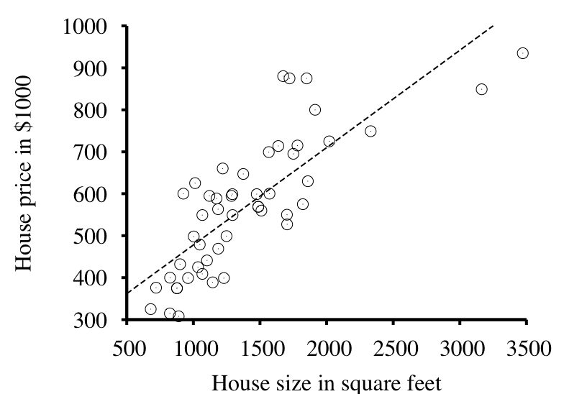
Regression: Example

Slide 5
Regression
Only very simple examples
  Linear regression
Linear model
  y = m x + b
  h_{w}(x) = y = w₁ x + w₀
Find best values for parameters
  “maximize goodness of fit”
  “maximize probability” or “minimize loss”

Slide 6
Regression: Minimizing Loss
  Assume true function f is given by
  y = f (x) = m x + b + noise
  where noise is normally distributed
  Then most probable values of parameters
  found by minimizing squared-error loss:
  Loss(h_{w} ) = Σ_{j} (y_{j} – h_{w}(x_{j}))²

Slide 7
Regression: Minimizing Loss
Choose weights to minimize
sum of squared errors

Slide 8
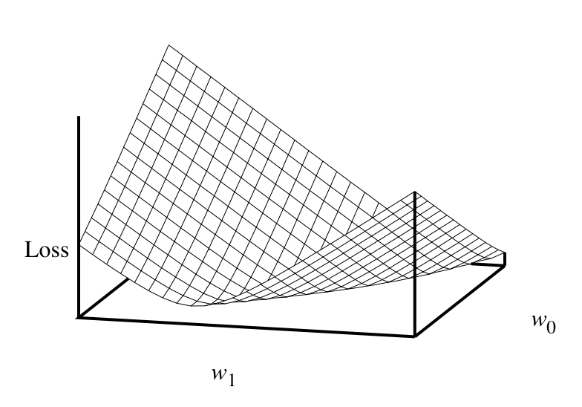
Regression: Minimizing Loss
y = w₁ x + w₀
  Loss(h_{w} ) = Σ_{j} (y_{j} – h_{w}(x_{j}))²
Algebra gives
an exact solution to
the minimization
problem

Slide 11
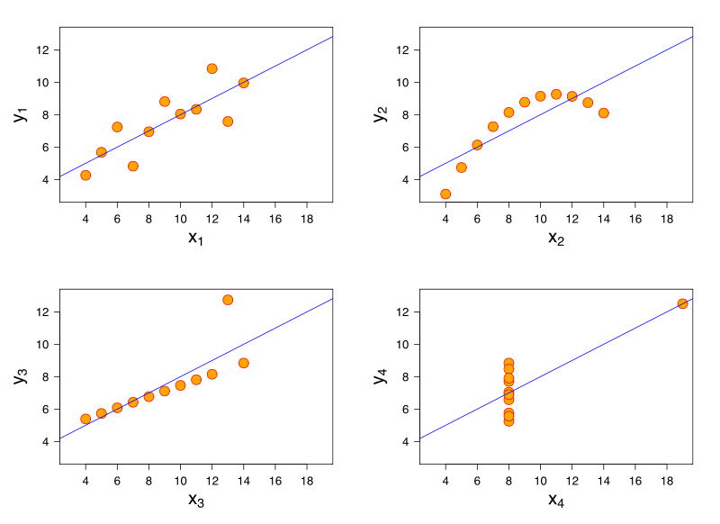
Don’t Always Trust Linear Models
Anscombe's quartet
Four datasets with “identical”
statistical properties
Notes:
Anscombe's quartet comprises four datasets that have identical simple statistical properties, yet appear very different when graphed. Each dataset consists of eleven (x,y) points. They were constructed in 1973 by the statistician F.J. Anscombe to demonstrate both the importance of graphing data before analysing it and the effect of outliers on statistical properties.
The first one (top left) seems to be distributed normally, and corresponds to what one would expect when considering two variables correlated and following the assumption of normality. The second one (top right) is not distributed normally; while an obvious relationship between the two variables can be observed, it is not linear, and the Pearson correlation coefficient is not relevant. In the third case (bottom left), the distribution is linear, but with a different regression line, which is offset by the one outlier which exerts enough influence to alter the regression line and lower the correlation coefficient from 1 to 0.81. Finally, the fourth example (bottom right) shows another example when one outlier is enough to produce a high correlation coefficient, even though the relationship between the two variables is not linear.

Slide 12
Multivariate Regression
x =
  h_{w}(x) = w ∙ x = w x^{T} = Σ_{i} w_{i} x_{i}
The most probable set of weights, w*
(minimizing squared error):
  (y – Xw) ^{T} (y – Xw)
  w* = (X^{T} X)⁻¹ X^{T} y
Derivative of the
Squared error

Slide 13
Overfitting
To avoid overfitting, don’t just minimize loss
Also minimize complexity of the model
Can be stated as minimization:
  Cost(h) = EmpiricalLoss(h) + λ Complexity(h)
For linear models, consider
  Complexity(h_{w}) = L_{q}(w) = ∑_{i} | w_{i} |^{q}
  L₁ regularization minimizes sum of abs. values
  L₂ regularization minimizes sum of squares

Slide 14
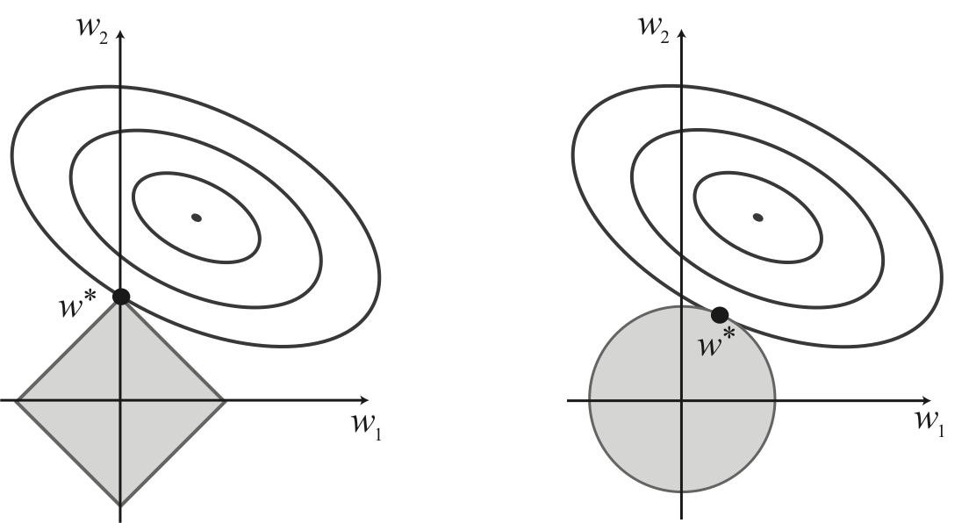
Regularization and Sparsity
  Cost(h) = EmpiricalLoss(h) + λ Complexity(h)
L₁ regularization
L₂ regularization

Slide 15
Regression by Gradient Descent
  No closed-form solution for complex loss functions
w = any point
loop until convergence do:
for each w_{i} in w do:
w_{i}^{m}= w_{i}^{m-1} – α ∂ Loss(w_{i}^{m-1})
∂ w_{i}

Slide 16
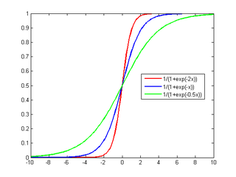
Logistic Regression
Predicts prob. of y given z
Fitting data to a logistic function
Learning: iterative optimization (gradient)
Used in one of the NLP papers we will read
Notes:
The function f(x) represents the exposure to some set of independent variables, while z represents the probability of a particular outcome, given that set of explanatory variables.
``Advanced`` Logisitic Regression
https://alliance.seas.upenn.edu/~cis520/wiki/index.php?n=Lectures.Logistic
Unfortunately, solving for the parameters is not “closed form”, like it is Naive Bayes or (arguably) for least squares regression. To find MLE we will resort to iterative optimization. Luckily, the function we’re trying to optimize is concave, which means it has one global optimum (caveat: it may be at infinity). The simplest form of optimization is gradient ascent:

Slide 17
Today Nov 3
Supervised Machine Learning
  Naïve Bayes
  Markov-Chains
  Decision Trees
  Regression
  Logistic Regression
Unsupervised Machine Learning
  K-means
  Intro to EM (very general technique!)

Slide 18
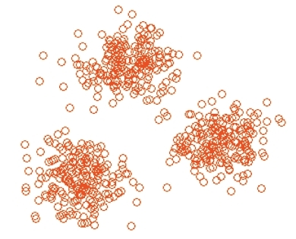
The unsupervised learning problem
Many data points, no labels

Slide 19
K-Means
Choose a fixed number of clusters
Ideally…
Choose cluster centers and point-cluster allocations to minimize error
can’t do this by exhaustive search, because there are too many possible allocations.
Algorithm
  Fix cluster centers;
  Allocate points to closest cluster
  With fixed allocation; compute best cluster centers
  Until nothing changes
* From Marc Pollefeys COMP 256 2003
Notes:
x could be any set of features for which we can compute a distance (careful about scaling)

Slide 20
K-Means

Slide 21
Problems with K-means
  Need to know k
  Local minima
  High dimensionality
  Lack of mathematical basis
Notes:
The common theme of these problems is that when the dimensionality increases, the volume of the space increases so fast that the available data becomes sparse. This sparsity is problematic for any method that requires statistic significance. In order to obtain a statistically sound and reliable result, the amount of data you need to support the result often grows exponentially with the dimensionality. Also organizing and searching data often relies on detecting areas where objects form groups with similar properties; in high dimensional data however all objects appear to be sparse and dissimilar in many ways which prevents common data organization strategies from being efficient.
For high-dimensional data, many of the existing methods fail due to the curse of dimensionality, which renders in particular distance functions problematic in high-dimensional spaces. This led to new clustering algorithms for high-dimensional data that focus on subspace clustering (where only some attributes are used, and cluster models include the relevant attributes for the cluster) and correlation clustering that also looks for arbitrary rotated ("correlated") subspace clusters that can be modeled by giving a correlation of their attributes. Examples for such clustering algorithms are CLIQUE^{[11]} and SUBCLU.^{[12]}

Slide 22
Today Nov 3
Supervised Machine Learning
  Naïve Bayes
  Markov-Chains
  Decision Trees
  Regression
  Logistic Regression
Unsupervised Machine Learning
  K-means
  Intro to EM (very general technique!)

Slide 23
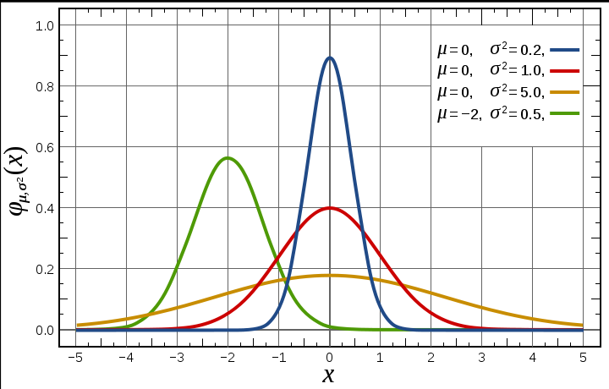
Gaussian Distribution
Models a large number of phenomena encountered in practice
Under mild conditions the sum of a large number of random variables is distributed approximately normally
Notes:
The normal distribution is considered the most prominent probability distribution in statistics. There are several reasons for this:^{[1]} First, the normal distribution is very tractable analytically, that is, a large number of results involving this distribution can be derived in explicit form. Second, the normal distribution arises as the outcome of the central limit theorem, which states that under mild conditions the sum of a large number of random variables is distributed approximately normally. Finally, the "bell" shape of the normal distribution makes it a convenient choice for modelling a large variety of random variables encountered in practice.

Slide 24
Gaussian Learning: Parameters
n data points

Slide 25
Expectation Maximzation for Clustering: Idea
Lets assume: that our Data were generated from several Gaussians (a mixture, technically)
For simplicity – one dimensional data – only two Gaussians (with same variance, but possibly different ………..)
Generation Process
  Gaussian/Cluster is selected
  Data point is sampled from that cluster

Slide 26
But this is what we start from
n data points without labels! And we have to cluster them into two (soft) clusters.
“Identify the two Gaussians that best explain the data”
Since we assume they have the same variance, we “just” need to find their priors and their means
In K-means we assume we know the center of the clusters and iterate…..
Notes:
If we had the labels we could find the means and prior for cluster
If we had the means and prior for cluster we could find “soft” labels..

Slide 27
Here we assume that we know
Prior for clusters and the two means
We can compute the probability that data point x_{i} corresponds to the cluster N_{j}

Slide 28
We can now recompute
Prior for clusters
The means

Slide 29
Intuition for EM in two dim.
(as a generalization of k-means)

Slide 30
Expectation Maximization
Converges! ☺
Proof [Neal/Hinton, McLachlan/Krishnan]:
  E/M step does not decrease data likelihood
But does not assure optimal solution ☹

Slide 31
Practical EM
Number of Clusters unknown
Algorithm:
  Guess initial # of clusters
  Run EM
    Kill cluster center that doesn’t contribute (two clusters with the same data)
    Start new cluster center if many points “unexplained” (uniform cluster distribution for lots of data points)

Slide 32
EM is a very general method!
Baum-Welch algorithm (also known as forward-backward): Learn HMMs from unlabeled data
Inside-Outside algorithm: unsupervised induction of probabilistic context-free grammars.
More generally, learn parameters for hidden variables in any Bnets (see textbook example 11.1.3 to learn parameters of NB classifier)

Slide 33
Machine Learning: Where are we?
Supervised Learning
Examples of correct answers are given
  Discrete answers: Classification
  Continuous answers: Regression
Unsupervised Learning
  No feedback from teacher; detect patterns
Next Week: Reinforcement Learning
  Feedback consists of rewards/punishment (Robotics, Interactive Systems)

Slide 34
TODO for next Tue
Read 11.3: Reinforcement Learning
Assignment 3-Part2 out soon

