Slide 1
Introduction to
Artificial Intelligence (AI)
Computer Science cpsc502, Lecture 15
Nov, 1, 2011
Slide credit: C. Conati, S. Thrun, P. Norvig, Wikipedia
Notes:
Lecture 15

Slide 2
Supervised ML: Formal Specification

Slide 3
Example Classification Data

Slide 4
Today Nov 1
Supervised Machine Learning
Naïve Bayes
Markov-Chains
Decision Trees
Regression
Logistic Regression
Key Concepts
Over-fitting
Evaluation

Slide 5
Example Classification Data
We want to classify new examples on property Action based
on the examples’ Author, Thread, Length, and Where.

Slide 6
Learning task
Inductive inference
Given a set of examples of
f(author,thread, length, where) = {reads,skips}
Find a function h(author,thread, length, where) that approximates f

Slide 7
Example Decision Tree
The non-leaf nodes are labeled with attributes.
author
unknown
known
length
thread
short
long
new
old
reads
skips
Arcs out of a node labeled with attribute A are labeled with each of the possible values of the attribute
length
skips
long
short
skips
reads
The leaves of the tree are labeled with classifications.

Slide 8
DT as classifiers
To classify an example, filter in down the tree
For each attribute of the example, follow the branch corresponding to that attribute’s value.
When a leaf is reached, the example is classified as the label for that leaf.

Slide 9
DT as classifiers
author
unknown
known
length
thread
long
short
skips
new
reads
old
e3
e2
length
skips
e4
e6
long
short
skips
reads
e1
e5

Slide 10
DT Applications
DT are often the first method tried in many areas of industry and commerce, when task involves learning from a data set of examples
Main reason: the output is easy to interpret by humans

Slide 11
Learning Decision Trees
Method for supervised classification (we will assume
attributes with finite discrete values)
Representation is a decision tree.
Bias is towards simple decision trees.
Search through the space of decision trees, from simple decision trees to more complex ones.

Slide 12
Trivially Correct Decision Tree
PROBLEMS?
author
unknown
known
thread
thread
new
old
new
old
length
length
length
length
long
short
long
short
long
where
where
where
where
where
home
work
work
work
home
home
skips
reads
skips
reads
skips
skips
e1
e5
e6
e2
e3
e4

Slide 13
Example Decision Tree (2)
length
long
short
e1, e3, e4, e6
e2, e5
read
skips
But this tree also classifies my examples correctly.

Slide 14
Searching for a Good Decision Tree
The input is
a target attribute for which we want to build a classifier,
a set of examples
a set of attributes.
Stop if all examples have the same classification (good ending).
Plus some other stopping conditions for not so good endings
Otherwise, choose an attribute to split on (greedy, or myopic step)
for each value of this attribute, build a sub-tree for those examples with this attribute value

Slide 15
Building a Decision Tree (Newsgroup Read Domain)
e1-s, e2-r, e3-s, e5-r, e4-s, e6-s author, thread, length, where
author
known
unknown
e1-s, e5-r, e4-s, e6-s
thread, length, where
e2-r, e3-s
thread
thread
new
old
new
old
e4-s, e6-s
e1-s, e5-r
length,
where
length
reads
skips
skips
e2-r
e3-s
long
short
skips
e1-s
reads
e5-r

Slide 16
Choosing a good split
Goal: try to minimize the depth of the tree
Split on attributes that move as much as possible toward an exact classification of the examples
Ideal split divides examples into sets, with the same classification
Bad split leaves about the same proportion of examples in the different classes
Notes:
Given some data, which decision tree should be generated?
The space of decision trees is too big for systematic search for the smallest decision tree.

Slide 17
Choosing a Good Attribute (binary case)
Good
Not So Good

Slide 18
Information Gain (1)

Slide 19
Information Gain (2): Expected Reduction in Entropy
Chose the attribute with the highest Gain

Slide 20
Example: possible splits
For the initial training set B(4/6) = 0.92 bit
Skips 4
author
Read 2
known
unknown
e2, e3
e1, e5, e4, e6
Skips 3
Skips 1
Read 1
Read 1
Reminder(author) = 4/6 * B(1/4) + 2/6 * B(1/2)
= 2/3*0.811+1/3 =
Gain(author ) = 0.92 – 0.875 = 0.054

Slide 21
Example: possible splits
For the initial training set I(4/6, 2/6) = 0.92 bit
Skips 4
Read 2
length
long
short
e2, e5
e1, e3, e4, e6
Read 0
Skip 2
Skips 4
Read 0
Reminder (length) = 4/6 * B(1) + 2/6 * B(1)=0
Gain(length)=0.92

Slide 22
Drawback of Information Gain
Tends to favor attributes with many different values
Can fit the data better than spitting on attributes with fewer values
Imagine extreme case of using “message id-number” in the newsgroup reading example
Every example may have a different value on this attribute
Splitting on it would give highest information gain, even if it is unlikely that this attribute is relevant for the user’s reading decision
Alternative measures (e.g. gain ratio)

Slide 23
Expressiveness of Decision Trees
They can represent any discrete function, an
consequently any Boolean function
How many

Slide 24
Handling Overfitting
This occurs with noise and correlations in the available examplesthat are not reflected in the data as a whole.
One technique to handle overfitting: decision tree pruning
Statistical techniques to evaluate when the gain on the attribute selected by the splitting technique is large enough to be relevant
Generic techniques to test ML algorithms
Notes:
This algorithm gets into trouble over fitting the data.

Slide 25
How to Learn
Data: labeled instances, e.g. emails marked spam/ham
Training set
Held out (validation) set
Test set
Experimentation cycle
Learn model on training set
Tune it on held-out set
Compute accuracy on test set
Very important: never “peek” at the test set!
Evaluation
Accuracy: fraction of instances predicted correctly
Overfitting and generalization
Want a classifier which does well on test data
Overfitting: fitting the training data very closely, but not generalizing well to test data
Training
Data
Held-Out
Data
Test
Data

Slide 26
Assessing Performance of Learning Algorithm
Collect a large set of examples
Divide into two sets: training set and test set
Use the learning algorithm on the training set to generate an hypothesis h
Measure the percentage of examples in the test set that are correctly classified by h
Repeat with training sets of different size and different randomly selected training sets.

Slide 27
Cross-Validation
Partition the training set into k sets
Run the algorithm k times, each time (fold) using one of the k sets as the test test, and the rest as training set
Report algorithm performance as the average performance (e.g. accuracy) over the k different folds
Useful to select different candidate algorithms/models
E.g. a DT built using information gain vs. some other measure for splitting
Once the algorithm/model type is selected via cross-validation, return the model trained on all available data

Slide 28
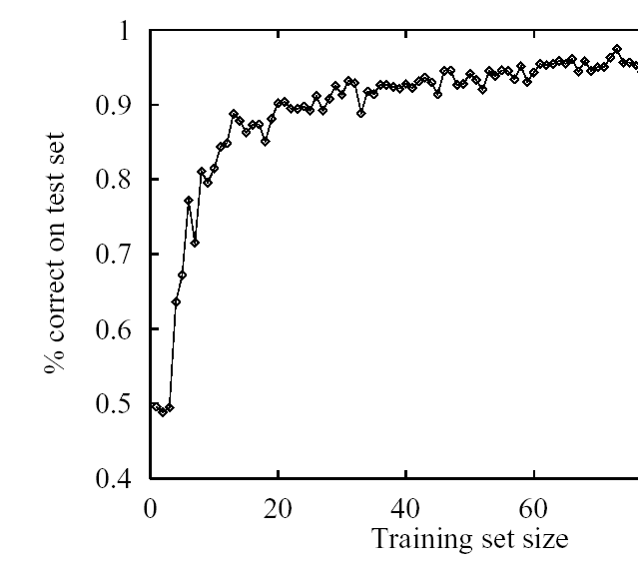
Interesting thing to try
Repeat cross-validation with training sets of different size
Report algorithm performance as a function of training set size: learning curve

Slide 29
Other Issues in DT Learning
Attributes with continuous and integer values (e.g. Cost in $)
Important because many real world applications deal with continuous values
Methods for finding the split point that gives the highest information gain (e.g. Cost > 50$)
Still the most expensive part of using DT in real-world applications
Continue-valued output attribute (e.g. predicted cost in $): Regression Tree
Splitting may stop before classifying all examples
Leaves with unclassified examples use a linear function of a subset of the attributes to classify them via linear regression
Tricky part: decide when to stop splitting and start linear regression

Slide 30
TODO for this Thurs
Read 7.5, 7.6 and 11.1, 11.2
Assignment 3-Part1 due

