Slide 1
Introduction to
Artificial Intelligence (AI)
Computer Science cpsc502, Lecture 14
Oct, 27, 2011
Slide credit: C. Conati, S. Thrun, P. Norvig, WEKA book
Notes:
Lecture 14

Slide 2
Today Oct 27
Machine Learning
Introduction
Supervised Machine Learning
Naïve Bayes
Markov-Chains (learning the parameters of the model)
Decision Trees

Slide 3
Machine Learning
Up until now: how to reason in a model and how to make optimal decisions
Machine learning: how to acquire a model on the basis of data / experience
Learning parameters (e.g. probabilities)
Learning structure (e.g. BN graphs)
Learning hidden concepts (e.g. clustering)

Slide 4
Why is Machine Learning So Popular?
We have lots of data!
Web
User Behavior on the Web
Human Genome
Huge medical, financial …. databases
Need for autonomous Agents (robots and soft-bots) that cannot be pre-programmed

Slide 5
Fielded applications
The result of learning—or the learning method itself—is deployed in practical applications
Processing loan applications
Screening images for oil slicks
Electricity supply forecasting
Diagnosis of machine faults
Marketing and sales
Separating crude oil and natural gas
Reducing banding in rotogravure printing
Finding appropriate technicians for telephone faults
Scientific applications: biology, astronomy, chemistry
Automatic selection of TV programs
Monitoring intensive care patients
More details on some of these apps at the end

Slide 6
Machine Learning
Supervised Learning
Examples of correct answers are given
Discrete answers: Classification
Category of a document, User Type, ….
Continuous answers: Regression
Stock Price, Time of next Earthquake
Unsupervised Learning
No feedback from teacher; detect patterns
Reinforcement Learning
Feedback consists of rewards/punishment (Robotics, Interactive Systems)

Slide 7
Example Classification Data
We want to classify new examples on property Action based
on the examples’ Author, Thread, Length, and Where.

Slide 8
The contact lenses data
Age
Spectacle prescription
Astigmatism
Tear production rate
Recommended lenses
Young
Myope
No
Reduced
None
Young
Myope
No
Normal
Soft
Young
Myope
Yes
Reduced
None
Young
Myope
Yes
Normal
Hard
Young
Hypermetrope
No
Reduced
None
Young
Hypermetrope
No
Normal
Soft
Young
Hypermetrope
Yes
Reduced
None
Young
Hypermetrope
Yes
Normal
hard
Pre-presbyopic
Myope
No
Reduced
None
Pre-presbyopic
Myope
No
Normal
Soft
Pre-presbyopic
Myope
Yes
Reduced
None
Pre-presbyopic
Myope
Yes
Normal
Hard
Pre-presbyopic
Hypermetrope
No
Reduced
None
Pre-presbyopic
Hypermetrope
No
Normal
Soft
Pre-presbyopic
Hypermetrope
Yes
Reduced
None
Pre-presbyopic
Hypermetrope
Yes
Normal
None
Presbyopic
Myope
No
Reduced
None
Presbyopic
Myope
No
Normal
None
Presbyopic
Myope
Yes
Reduced
None
Presbyopic
Myope
Yes
Normal
Hard
Presbyopic
Hypermetrope
No
Reduced
None
Presbyopic
Hypermetrope
No
Normal
Soft
Presbyopic
Hypermetrope
Yes
Reduced
None
Presbyopic
Hypermetrope
Yes
Normal
None

Slide 9
Supervised ML: Formal Specification

Slide 10
The ML critical question
Occam’s Razor: Everything else being equal choose the less complex Hypothesis

Slide 11
Key trade-off between FIT and COMPLEXITY

Slide 13
Today Oct 27
Machine Learning Intro
Definitions
Supervised Machine Learning
Naïve Bayes
Markov-Chains
Decision Trees

Slide 14
Naïve Bayesian Classifier
A very simple and successful Bnets that allow to classify entities in a set of classes C, given a set of attributes
Example:
Determine whether an email is spam (only two classes spam=T and spam=F)
Useful attributes of an email ?
Assumptions
The value of each attribute depends on the classification
(Naïve) The attributes are independent of each other given the classification
P(“bank” | “account” , spam=T) = P(“bank” | spam=T)
Notes:
Bnets do not need to be complex to be useful!

Slide 15
Naïve Bayesian Classifier for Email Spam
Assumptions
The value of each attribute depends on the classification
(Naïve) The attributes are independent of each other given the classification
Email Spam
What is the structure?
words
Email contains
“free”
Email contains
“money”
Email contains
“ubc”
Email contains
“midterm”
Number of parameters?
Easy to acquire?
If you have a large collection of emails for which you know if they are spam or not……
Notes:
Bnets do not need to be complex to be useful!

Slide 16
Learn the Probabilities
You have 100,000 emails of which 10,000 are spam
2,000 of you non-spam emails contain the word “money”. In contrast, “money” appears in 2,500 of your spam emails

Slide 17
Most likely class given set of observations
NB Classifier for Email Spam: Usage
Is a given Email E spam?
“free money for you now”
Email Spam
Email contains
“free”
Email contains
“money”
Email contains
“ubc”
Email contains
“midterm”
Email is a spam if…….

Slide 18
How to improve this model?
Need more features– words aren’t enough!
Have you emailed the sender before?
Have 1K other people just gotten the same email?
Is the sending information consistent?
Is the email in ALL CAPS?
Do inline URLs point where they say they point?
Does the email address you by (your) name?
Can add these information sources as new variables in the Naïve Bayes model

Slide 19
For another example of naïve Bayesian Classifier
See textbook ex. 6.16 (Section 6.3.1)
help system to determine what help page a user is interested in based on the keywords they give in a query to a help system.

Slide 20
Today Oct 27
Machine Learning
Introduction
Supervised Machine Learning
Naïve Bayes
Markov-Chains
(learning the parameters of the model)
Decision Trees

Slide 21
Key problems in NLP
“Book me a room near UBC”
Assign a probability to a sentence
Part-of-speech tagging
Word-sense disambiguation,
Probabilistic Parsing
Predict the next word
Speech recognition
Hand-writing recognition
Augmentative communication for the disabled
Summarization, Machine Translation….....
Impossible to estimate ☹
Notes:
Room in a bldg.
Room space
Room scope / opportunity
He is rooming with my friend

Slide 22
Prob of a sentence: N-Grams
Chain-rule
simplifications
unigram
bigram
trigram

Slide 23
Bigram <s>The big red dog barks
P(The big red dog barks)=
P(The|<S>) x

Slide 24
Estimates for Bigrams
Notes:
N-pairs in a corpus is equal to the N-words in the corpus

Slide 25
Estimates for Bigrams
Silly language repositories with only two sentences:
“<S>The big red dog barks against the big pink dog”
“<S>The big pink dog is much smaller”
Notes:
N-pairs in a corpus is equal to the N-words in the corpus

Slide 26
Berkeley Restaurant Project (1994) Table: Counts
Dialog System
Corpus: ~10,000 sentences, 1616 word types
Excerpt of a
1616x1616 table
Notes:
Berkley Restaurant Project 1994
~10000 sentences
Notice that majority of values is 0
But the full matrix would be even more sparse

Slide 27
BERP Table:

Slide 28
BERP Table Comparison
Counts
Prob.
1?
Notes:
To also train for out of the vocabulary (unknown) words. Substitute in your corpus the first occurrence of every word type with the <UKN> symbol and train to get estimated for that symbol

Slide 29
Two problems with applying:
to
General Problems for ML !
Notes:
0 for unseen
This is qualitatively wrong as a prior model because it would never allow n-gram,
While clearly some of the unseen ngrams will appear in other texts

Slide 30
Problem (1)
We may need to multiply many very small numbers (underflows!)
Easy Solution:
Convert probabilities to logs and then sum
To get the real probability (if you need it) go back to the antilog.

Slide 31
Problem (2)
The probability matrix for n-grams is sparse
How can we assign a probability to a sequence where one of the component n-grams has a value of zero?
Solutions:
Add-one smoothing (Laplace Smoothing)
Good-Turing
Back off and Deleted Interpolation
Notes:
Let’s assume we’re using N-grams
How can we assign a probability to a sequence where one of the component n-grams has a value of zero
Assume all the words are known and have been seen
Go to a lower order n-gram
Back off from bigrams to unigrams
Replace the zero with something else
SOME USEFUL OBSERVATIONS
A small number of events occur with high frequency
You can collect reliable statistics on these events with relatively small samples
A large number of events occur with small frequency
You might have to wait a long time to gather statistics on the low frequency events
Some zeroes are really zeroes
Meaning that they represent events that can’t or shouldn’t occur
On the other hand, some zeroes aren’t really zeroes
They represent low frequency events that simply didn’t occur in the corpus

Slide 32
Add-One
Make the zero counts 1.
Rationale: If you had seen these “rare” events chances are you would only have seen them once.
Corpus: ~10,000 sentences, 1616 word types
unigram
Pseudo-counts
Notes:
They’re just events you haven’t seen yet.
What would have been the count that would have generated P*?
A related way to view smoothing is as discounting (lowering) some non-zero counts in order to
get the probability mass that will be assigned to the zero counts.
Thus instead of referring to the discounted counts c* we may describe a smoothing algorithm in
Terms of a relative discount dc the ratio of the discounted counts to the original ones

Slide 34
Add-One: Bigram
Counts
……
Notes:
Sum up for all the wN and it must add to 1

Slide 35
BERP Original vs. Add-one smoothed Counts
6
5
2
2
19
15
Notes:
0.18
Factor of 8 for Chinese food

Slide 36
Biggest Language Model…
Google language model
Update (22 Sept. 2006): The LDC has the data available in their catalog. The counts are as follows: File sizes: approx. 24 GB compressed (gzip'ed) text files Number of tokens: 1,024,908,267,229 Number of sentences: 95,119,665,584 Number of unigrams: 13,588,391 Number of bigrams: 314,843,401 Number of trigrams: 977,069,902 Number of fourgrams: 1,313,818,354
Notes:
Google language model
Update (22 Sept. 2006): The LDC now has the data available in their catalog. The counts are as follows: File sizes: approx. 24 GB compressed (gzip'ed) text files Number of tokens: 1,024,908,267,229 Number of sentences: 95,119,665,584 Number of unigrams: 13,588,391 Number of bigrams: 314,843,401 Number of trigrams: 977,069,902 Number of fourgrams: 1,313,818,354

Slide 37
Today Oct 27
Machine Learning
Introduction
Supervised Machine Learning
Naïve Bayes
Markov Chains
Decision Trees

Slide 38
Example Classification Data
We want to classify new examples on property Action based
on the examples’ Author, Thread, Length, and Where.

Slide 39
Learning task
Inductive inference
Given a set of examples of
f(author,thread, length, where) = {reads,skips}
Find a function h(author,thread, length, where) that approximates f

Slide 40
Example Decision Tree
The non-leaf nodes are labeled with attributes.
author
unknown
known
length
thread
short
long
new
old
reads
skips
Arcs out of a node labeled with attribute A are labeled with each of the possible values of the attribute
length
skips
long
short
skips
reads
The leaves of the tree are labeled with classifications.

Slide 41
DT as classifiers
To classify an example, filter in down the tree
For each attribute of the example, follow the branch corresponding to that attribute’s value.
When a leaf is reached, the example is classified as the label for that leaf.

Slide 42
DT as classifiers
author
unknown
known
length
thread
long
short
skips
new
reads
old
e3
e2
length
skips
e4
e6
long
short
skips
reads
e1
e5

Slide 43
Learning Decision Trees
Method for supervised classification (we will assume
attributes with finite discrete values)
Representation is a decision tree.
Bias is towards simple decision trees.
Search through the space of decision trees, from simple decision trees to more complex ones.

Slide 44
DT Applications
DT are often the first method tried in many areas of industry and commerce, when task involves learning from a data set of examples
Main reason: the output is easy to interpret by humans

Slide 45
Equivalent Rule Based Representation
If author is unknown and length is short
then user-action is reads
If author is unknown and length is long
then user-action is skips
If author is known and thread is new and length is short
then user-action is reads
If author is known and thread is new and length is long
then user-action is skips
If author is known and thread is old
then user-action is skips
Suppose this is the true criteria that my user is employing

Slide 46
TODO for next Tue
Read textbook 7.3
Also Do exercise 7.A http://www.aispace.org/exercises.shtml

Slide 47
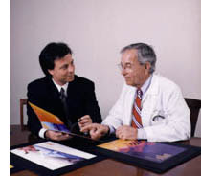
Processing loan applications (American Express)
Given: questionnaire with financial and personal information
Question: should money be lent?
Simple statistical method covers 90% of cases
Borderline cases referred to loan officers
But: 50% of accepted borderline cases defaulted!
Solution: reject all borderline cases?
No! Borderline cases are most active customers

Slide 48
Enter machine learning
1000 training examples of borderline cases
20 attributes:
age
years with current employer
years at current address
years with the bank
other credit cards possessed,…
Learned rules: correct on 70% of cases
human experts only 50%
Rules could be used to explain decisions to customers

Slide 49
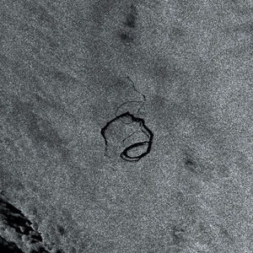
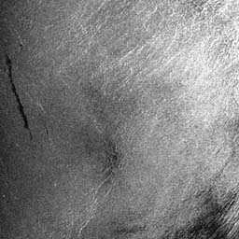
Screening images
Given: radar satellite images of coastal waters
Problem: detect oil slicks in those images
Oil slicks appear as dark regions with changing size and shape
Not easy: lookalike dark regions can be caused by weather conditions (e.g. high wind)
Expensive process requiring highly trained personnel

Slide 50
Enter machine learning
Extract dark regions from normalized image
Attributes:
size of region
shape, area
intensity
sharpness and jaggedness of boundaries
proximity of other regions
info about background
Constraints:
Few training examples—oil slicks are rare!
Unbalanced data: most dark regions aren’t slicks
Regions from same image form a batch
Requirement: adjustable false-alarm rate

Slide 51
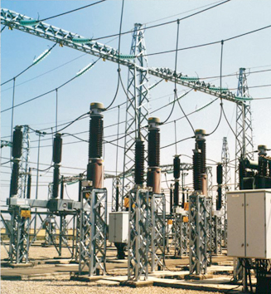
Load forecasting
Electricity supply companies need forecast of future demand for power
Forecasts of min/max load for each hour ⇒ significant savings
Given: manually constructed load model that assumes “normal” climatic conditions
Problem: adjust for weather conditions
Static model consist of:
base load for the year
load periodicity over the year
effect of holidays

Slide 52
Enter machine learning
Prediction corrected using “most similar” days
Attributes:
temperature
humidity
wind speed
cloud cover readings
plus difference between actual load and predicted load
Average difference among three “most similar” days added to static model
Linear regression coefficients form attribute weights in similarity function

Slide 53
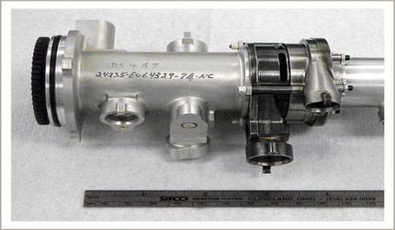
Diagnosis of machine faults
Diagnosis: classical domain of expert systems
Given: Fourier analysis of vibrations measured at various points of a device’s mounting
Question: which fault is present?
Preventative maintenance of electromechanical motors and generators
Information very noisy
So far: diagnosis by expert/hand-crafted rules
Notes:
53
10/26/2011

Slide 54
Enter machine learning
Available: 600 faults with expert’s diagnosis
~300 unsatisfactory, rest used for training
Attributes augmented by intermediate concepts that embodied causal domain knowledge
Expert not satisfied with initial rules because they did not relate to his domain knowledge
Further background knowledge resulted in more complex rules that were satisfactory
Learned rules outperformed hand-crafted ones

Slide 55
Marketing and sales I
Companies precisely record massive amounts of marketing and sales data
Applications:
Customer loyalty: identifying customers that are likely to defect by detecting changes in their behavior (e.g. banks/phone companies)
Special offers: identifying profitable customers (e.g. reliable owners of credit cards that need extra money during the holiday season)

Slide 56
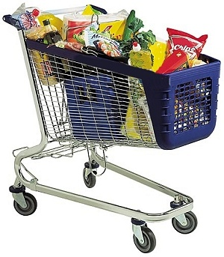
Marketing and sales II
Market basket analysis
Association techniques find groups of items that tend to occur together in a transaction (used to analyze checkout data)
Historical analysis of purchasing patterns
Identifying prospective customers
Focusing promotional mailouts (targeted campaigns are cheaper than mass-marketed ones)

Slide 57
Machine learning and statistics
Historical difference (grossly oversimplified):
Statistics: testing hypotheses
Machine learning: finding the right hypothesis
But: huge overlap
Decision trees (C4.5 and CART)
Nearest-neighbor methods
Today: perspectives have converged
Most ML algorithms employ statistical techniques

