Slide 1
Introduction to
Artificial Intelligence (AI)
Computer Science cpsc502, Lecture 13
Oct, 25, 2011
Slide credit POMDP: C. Conati and P. Viswanathan
Notes:
Lecture 13

Slide 2
Markov Models
Markov Chains
Hidden Markov Model
Partially Observable Markov Decision Processes (POMDPs)
Markov Decision Processes (MDPs)

Slide 3
Today Oct 25
Partially Observable Markov Decision Processes
Formal Specification and example
  Belief State
  Belief State Update
Policies and Optimal Policy
  Three Methods
Notes:
POMDPs were initially formalized by the control theory and operations research communities
to optimally control stochastic dynamical systems.
More recently, the articial intelligence community also considered POMDPs for planning
under uncertainty. To date, a wide range of sequential decision problems
such as robot navigation, preference elicitation, stochastic resource
allocation, maintenance scheduling, spoken-dialog systems
and many others have been modeled using POMDPs.

Slide 4
POMDP: Intro
The MDPs we looked at so far were fully observable
  The agent always knows which state it is in
  This, combined with the Markov assumption for P(s’|a,s) implies that the optimal policy л* depends only on ….
What if the environment is only partially observable?
Notes:
Current state

Slide 5
POMDP: Intro
What if the environment is only partially observable?
  The agent cannot simply follow what a policy л(s) would recommend, since it does not know whether it is in s
  The agent decision should be affected by how much it knows about its “position” in the state space
Additional complexity: Partially Observable MDPs are much more difficult than MDPs
  But cannot be avoided as the world is a POMDP most of the time!

Slide 6
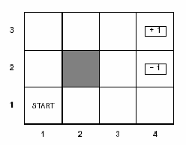
Belief States
In POMDPs, the agent cannot tell for sure where it is in the space state, all it can have are beliefs on that
  probability distribution over states
  This is usually called belief state b
  b(s) is the probability assigned by b to the agent being in state s
Example: Suppose we are in our usual grid world, but
  the agent has no information at all about its position in non-terminal states
  It knows only when it is in a terminal state (because the game ends)
What is the initial belief state, if the agent knows that it is not in a terminal state?

Slide 7
Belief States
Initial belief state:
  <1/9,1/9, 1/9,1/9,1/9,1/9, 1/9,1/9,1/9,0,0>

Slide 8
Observation Model
As in HMM, the agent can learn something about its actual state by sensing the environment:
  Sensor Model P(e|s): probability of observing the evidence e in state s
A POMDP is fully specified by
  Reward function: R(s) (we’ll forget about a and s’ for simplicity)
  Transition Model: P(s’|a,s)
  Observation model: P(e|s)
Agent’s belief state is updated by computing the conditional probability distribution over all the states given the sequence of observations and actions so far
  Does it remind you of anything that we have seen before?

Slide 9
State Belief Update
Remember filtering in temporal models?
  Compute conditional probability distribution over states at time t given all observation so far
  P(X_{t},| e_{0:t}) = α P(e_{t} | X_{t}) ∑_{xt-1} P(X_{t} | x_{t-1} ) P( x_{t-1} | e_{0:t-1} )
Filtering at time t-1
Inclusion of new evidence (sensor model)‏
Propagation to time t
State belief update is similar but includes actions
  If the agent has current belief state b(s), performs action a and then perceives evidence e, the new belief state b’(s’) is
Inclusion of new evidence:
Probability of perceiving e in s’
Filtering at time t-1:
State belief based on all observations and actions up to t-1
Sum over all the states that can take to s’ after performing \a
Propagation at time t: Probability of transition to s’ given s and a

Slide 10
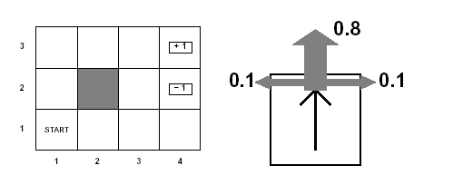
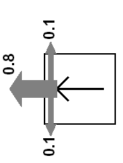
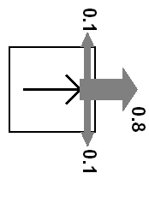
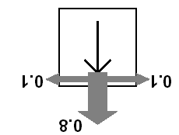
Grid World Actions Reminder
Agent moves in the above grid via actions Up, Down, Left, Right
Each action has:
  0.8 probability to reach its intended effect
  0.1 probability to move at right angles of the intended direction
  If the agents bumps into a wall, it says there

Slide 11
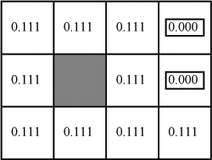
Example
Back to the grid world, what is the belief state after agent performs action left in the initial situation?
The agent has no information about its position
  Only one fictitious observation: no observation
  P(no observation|s) = 1 for every s
Let’s instantiate
Do the above for every state to get the new belief state

Slide 12
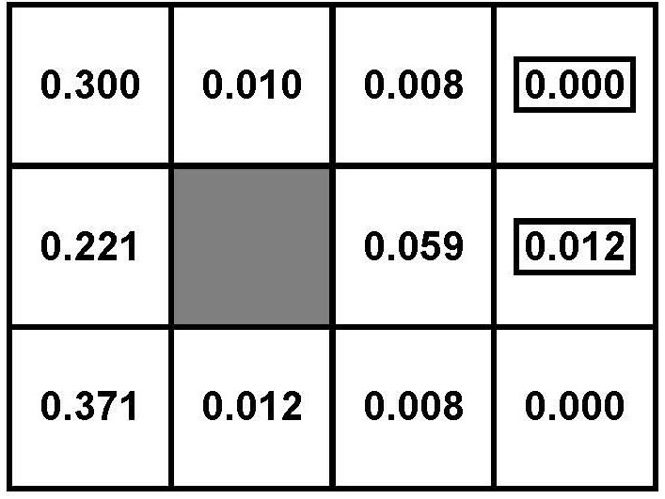
After five Left actions

Slide 13
Example
Let’s introduce a sensor that perceives the number of adjacent walls in a location with a 0.1 probability of error
  P(2|s) = 0.9 if s is non-terminal and not in third column
  P(1|s) = 0.9 if s is non-terminal and in third column
Try to compute the new belief state if agent moves left and then perceives 1 adjacent wall
?

Slide 14
State Belief Update
We abbreviate
To summarize: when the agent performs action a in belief state b, and then receives observation e, filtering gives a unique new probability distribution over state
  deterministic transition from one belief state to another

Slide 15
Optimal Policies in POMDs
Theorem (Astrom, 1965):
  The optimal policy in a POMDP is a function π*(b) where b is the belief state (probability distribution over states)
That is, π*(b) is a function from belief states (probability distributions) to actions
  It does not depend on the actual state the agent is in
  Good, because the agent does not know that, all it knows are its beliefs
Decision Cycle for a POMDP agent
  Given current belief state b, execute a = π*(b)
  Receive observation e
  Repeat

Slide 16
How to Find an Optimal Policy?
?
Turn a POMDP into a corresponding MDP and then apply VI
Generalize VI to work on POMDPs
Develop Approx. Methods (Factored)
  Look Ahead
  Point-Based VI

Slide 17
POMDP as MPD
But how does one find the optimal policy π*(b)?
  One way is to restate the POMDP as an MPD in belief state space
State space :
  space of probability distributions over original states
  For our grid world the belief state space is?
  initial distribution <1/9,1/9, 1/9,1/9,1/9,1/9, 1/9,1/9,1/9,0,0> is a point in this space
What does the transition model need to specify?
?

Slide 18
POMDP as MPD
Transition model P(b’|a,b) defines the probability of reaching belief state b’ if the agent performs a when in belief state b
Marginalization over all possible observations
Product Rule
Product Rule
Probability of observing e after performing action a when in belief state b
Sum over all the states s’
reachable by performing a
P(e|s’,a,b) = P(e|s’) = P(e|s’) Sensor Model
P(s’|a,b) = ∑ _{s} P(s’,s|a,b) = ∑ _{s} P(s’|s, a, b) P(s|a,b) = ∑ _{s} P(s’|s, a) b(s)
Probability of getting to s’ by performing a in s does not depend on b:
It is the POMDP transition model
belief state for s
Summing over possible states that can take to s’

Slide 19
POMDP as MPD
Putting it all together: Transition model P(b’|a,b)
When the agent perfoms a given action a in belief state b, and then receives observation e, filtering gives a unique new probability distribution over state
  deterministic transition from one belief state to the next
We can also define a reward function for belief states

Slide 20
POMDP as MPD
By applying simple rules of probability we can derive a: Transition model P(b’|a,b)
When the agent performs a given action a in belief state b, and then receives observation e, filtering gives a unique new probability distribution over state
  deterministic transition from one belief state to the next
We can also define a reward function for belief states
?

Slide 21
Solving POMDP as MPD
So we have defined a POMD as an MDP over the belief states
  Why bother?
Because it can be shown that an optimal policy л*(b) for this MDP is also an optimal policy for the original POMDP
  i.e., solving a POMDP in its physical space is equivalent to solving the corresponding MDP in the belief state
Great, we are done!

Slide 22
Not Really
The MDP over belief states has a continuous multi-dimensional state space
  e.g. 11-dimentional in our simple grid world
None of the algorithms we have seen can deal with that
There are variations for continuous, multidimensional MDPs, but finding approximately optimal policies is PSPACE-hard
  Problems with a few dozen states are often unfeasible
Alternative approaches….

Slide 23
How to Find an Optimal Policy?
Turn a POMDP into a corresponding MDP and then apply VI
Generalize VI to work on POMDPs (also ☹)
Develop Approx. Methods (Factored)
  Look Ahead
  Point-Based VI

Slide 24
Dynamic Decision Networks (DDN)
Comprehensive approach to agent design in partially observable, stochastic environments
Basic elements of the approach
  Transition and observation models are represented via a Dynamic Bayesian Network (DBN)
  The network is extended with decision and utility nodes, as done in decision networks
  The resulting model is a Dynamic Decision Network (DDN)
  A filtering algorithm is used to incorporate each new percept and action, and to update the belief state
    i.e. the posterior probability of the chance nodes in the DDN
  Decisions are made by projecting forward possible action sequences and choosing the best one: look ahead search

Slide 25
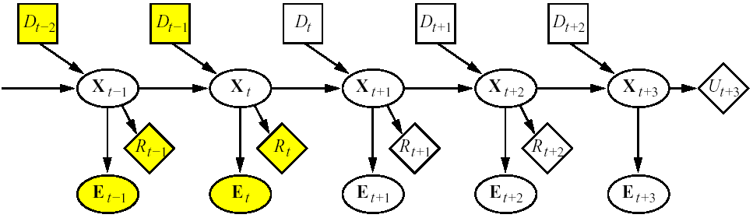
Dynamic Decision Networks (DDN)
A_{t-2}
A_{t-1}
A_{t}
A_{t+1}
A_{t+2}
A_{t+1}
Filtering
Projection (3-step look-ahead here)
Nodes in yellow are known (evidence collected, decisions made, local rewards)
Here X_{t} represents a collection of variables, as in DBNs
Agent needs to make a decision at time t (A_{t} node)
Network unrolled into the future for 3 steps
Node U_{t+3} represents the utility (or expected optimal reward V*) in state X_{t+3}
  i.e., the reward in that state and all subsequent rewards
  Available only in approximate form

Slide 26
Look Ahead Search for Optimal Policy
General Idea:
Expand the decision process for n steps into the future, that is
  “Try” all actions at every decision point
  Assume receiving all possible observations at observation points
Result: tree of depth 2n+1 where
  every branch represents one of the possible sequences of n actions and n observations available to the agent, and the corresponding belief states
  The leaf at the end of each branch corresponds to the belief state reachable via that sequence of actions and observations – use filtering to compute it
“Back Up” the utility values of the leaf nodes along their corresponding branches, combining it with the rewards along that path
Pick the branch with the highest expected value

Slide 27
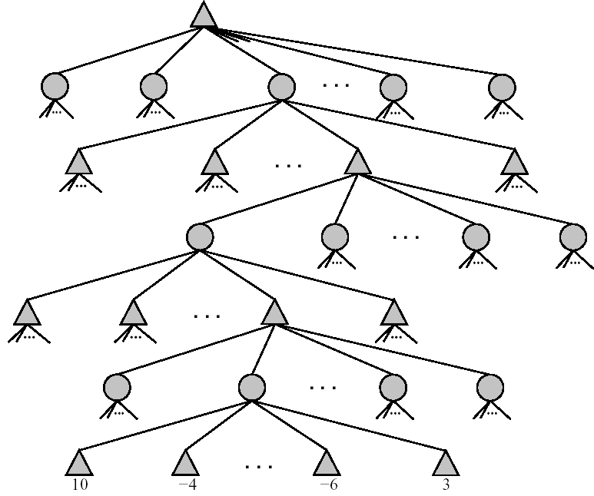
Look Ahead Search for Optimal Policy
Decision A_{t} in P(X_{t}|E_{1:t})
These are chance nodes, describing the probability of each observation
ak_{t}
a1_{t}
a2_{t}
Observation E_{t+1}
e1_{t+1}
A_{t+1} in P(X_{t+1}|E_{1:t+1})
e2_{t+1}
ek_{t+k}
Belief states are computed via any filtering algorithm, given the sequence of actions and observations up to that point
|E_{t+2}
A_{t+2} in P(X_{t+1}|E_{1:t+2})
To back up the utilities
take average at chance points
Take max at decision points
|E_{t+3}
P(X_{t+3}|E_{1:t+3})
|U(X_{t+3})

Slide 29
Look Ahead Search for Optimal Policy
Time complexity for exhaustive search at depth d, with |A| available actions and |E| possible observations
  O(|A|^{d}*|E|^{d})
There are problems in which a shallow depth works
There are ways to find good approximate solutions

Slide 30
How to Find an Optimal Policy?
Turn a POMDP into a corresponding MDP and then apply Value Iteration ( ☹ )
Generalize VI to work on POMDPs (also ☹)
Develop Approx. Methods (Factored)
  Look Ahead
  Point-Based Value Iteration

Slide 31
Recent Method: Point-based Value Iteration
Find a solution for a sub-set of all states
Not all states are necessarily reachable
Generalize the solution to all states
Methods include: PERSEUS, PBVI, and HSVI and other similar approaches (FSVI, PEGASUS)‏
Notes:
Building on this insight, we present Point-Based Value Iteration
(PBVI), a new approximate POMDP planning algorithm.
PBVI selects a small set of representative belief
points and iteratively applies value updates to those
points. The point-based update is significantly more efficient
than an exact update (quadratic vs exponential), and
because it updates both value and value gradient, it generalizes
better to unexplored beliefs than grid-based approximations
which only update the value [Lovejoy, 1991;
Brafman, 1997; Hauskrecht, 2000; Zhou and Hansen, 2001;
Bonet, 2002]). PBVI is also guaranteed to have bounded error.
Finally, exploiting an insight from policy search methods
and MDP exploration [Ng and Jordan, 2000; Thrun, 1992],
PBVI uses explorative stochastic trajectories to select belief
points, thus reducing the number of belief points necessary to
find a good solution.

Slide 32
Finding the Optimal Policy: State of the Art
Turn a POMDP into a corresponding MDP and then apply VI: only small models
Generalize VI to work on POMDPs
  10 states in1998
  200,000 states in 2008
Develop Approx. Methods (Factored)
  Look Ahead and Point-Based VI
  Even 50,000,000 states http://www.cs.uwaterloo.ca/~ppoupart/software.html

Slide 33
R&R systems BIG PICTURE
Environment
Deterministic
Stochastic
Problem
Arc Consistency
Search
Constraint Satisfaction
Vars +
Constraints
SLS
Static
Belief Nets
Var. Elimination
Query
Logics
Approx. Inference
Search
Markov Chains and HMMs
Temporal. Inference
Sequential
Decision Nets
STRIPS
Var. Elimination
Planning
Markov Decision Processes
Search
Value Iteration
Representation
POMDPs
Approx. Inference
Reasoning
Technique
Notes:
R&R Sys Representation and reasoning Systems
Each cell is a R&R system
STRIPS actions preconditions and effects

Slide 34
Agents acting in an environment
abilities
Representation
& Reasoning
Notes:
Environment World
State / Possible Worlds
What do we need to represent?
Different problems
Different domains
For each of those possibly different reasoning techniques

Slide 35
TODO for next Tue
Read textbook 7.1-7.3 (intro ML)
Also Do exercise 9.C
http://www.aispace.org/exercises.shtml
Assignment 3-part1 will be posted today

Slide 36
In practice, the hardness of POMDPs arises from the complexity of policy spaces and the potentially large number of states.
Nervertheless, real-world POMDPs tend to exhibit a signicant amount of structure, which can often be exploited to improve the scalability of solution algorithms.
  Many POMDPs have simple policies of high quality. Hence, it is often possible to quickly find those policies by restricting the search to some class of compactly representable policies.
  When states correspond to the joint instantiation of some random variables (features), it is often possible to exploit various forms of probabilistic independence (e.g., conditional independence and context-specic independence), decomposability (e.g., additive separability) and sparsity in the POMDP dynamics to mitigate the impact of large state spaces.
Notes:
From

Slide 37
Symbolic Perseus
Symbolic Perseus - point-based value iteration algorithm that uses Algebraic Decision Diagrams (ADDs) as the underlying data structure to tackle large factored POMDPs
Flat methods: 10 states at 1998, 200,000 states at 2008
Factored methods: 50,000,000 states
http://www.cs.uwaterloo.ca/~ppoupart/software.html
Notes:
To date, these
techniques have only been implemented with the classical solution algorithms. Although
they can eectively overcome the complexity of large state spaces, none of them address
the exponential complexity of policy and value function space. As a result, they cannot
solve much larger/dicult POMDPs.
Scalable POMDP algorithms can only be realized when both sources of intractability
are tackled simultaneously.

