Slide 1
Introduction to
Artificial Intelligence (AI)
Computer Science cpsc502, Lecture 1
Sep, 8, 2011
Notes:
Lecture 1

Slide 2
People
Instructor
Giuseppe Carenini ( carenini@cs.ubc.ca; office CICSR 129)
Teaching Assistant
Shafiq Joty rjoty@cs.ubc.ca
This course is designed as a "breadth" introduction to AI.
It is suitable for those with
no AI background ,
or with only one undergraduate course in AI (or Machine Learning)
Notes:
If you have done your ugrad at UBC we will cover 322 422 340 in 2/3 of the course
And 1/3 on reading/discussing research papers

Slide 3
Today Sept 8
Overview of the field – Key definitions
Overview of course
Background knowledge
Topics
Activities and Grading
Administrative Stuff
Assignment-0
Notes:
Introductions?

Slide 4
What is Intelligence?
Notes:
Ability to solve complex problems
To plan actions to achieve goals
Perform Inference (generate new knowledge)
Communicate (Language!)
Learn from past experience
FROM textbook
An agent acts intelligently when:
what it does is appropriate for its circumstances and its goals,
it is flexible to changing environments and changing goals,
it learns from experience,
it makes appropriate choices given its perceptual and computational
limitations. An agent typically cannot observe the state of the world
directly, it has only a finite memory and it doesn’t have unlimited
time to act.

Slide 5
Thinking and Acting Humanly
Model the cognitive functions of human beings
Humans are our only example of intelligence: we should use that example!
Problems:
But... humans often think/act in ways that we don't consider intelligent (why?)
And... detailed model of how people's minds operate not yet available

Slide 6
Thinking Rationally
Rationality: an abstract “ideal'' of intelligence, rather than ``whatever humans think/do'‘
Ancient Greeks invented syllogisms: argument structures that always yield correct conclusions given correct premises
This led to logic, and probabilistic reasoning which we'll discuss in this course
But correct sound reasoning is not always enough “to survive” “to be useful”…

Slide 7
Acting (&thinking) Rationally
This course will emphasize a view of AI as building agents: artifacts that are able to think and act rationally in their environments
Rationality is more cleanly defined than human behavior, so it's a better design objective
(Eg: “intelligent” vacuum cleaner: maximize area cleaned, minimize noise and electricity consumption)
Agents that can answer queries, plan actions and solve complex problems
And when you have a rational agent you can always tweak it to make it irrational!

Slide 8
Why do we need intelligent agents?
Notes:
Help people making better decision
Help people to learn
Help people to work more effectively
Help experts to be even more effective
Doctors Lawyers Scientist
Robots replacing humans in dangerous repetitive tasks
… Making any piece of software more intelligent / adaptive

Slide 9
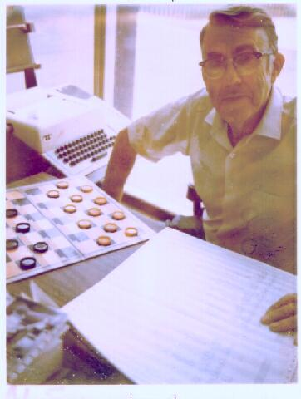
(Adversarial) Search: Checkers
Game playing was one of the first tasks undertaken in AI
Arthur Samuel at IBM wrote programs to play checkers (1950s)
initially, they played at a strong amateur level
however, they used some (simple) machine learning techniques, and soon outperformed Samuel
Source: IBM Research
Chinook’s program was declared the Man-Machine World Champion in checkers in 1994!
…and completely solved by a program in 2007!
Notes:
Chinook's program algorithm includes an opening book, a library of opening moves from games played by grandmasters; a deep search algorithm; a good move evaluation function; and an end-game database for all positions with eight pieces or fewer. The linear handcrafted evaluation function considers several features of the game board, including piece count, kings count, trapped kings, turn, runaway checkers (unimpeded path to be kinged) and other minor factors. All of Chinook's "knowledge" was programmed by its creators, rather than "learned"
Checkers was completely solved in 2007 by a computer which explored all reachable positions

Slide 10
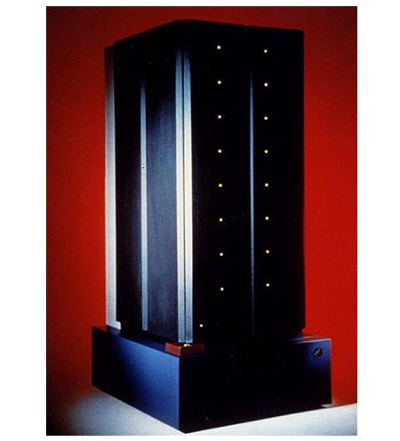
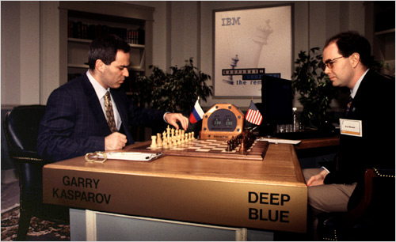
(Adversarial) Search: Chess
In 1996 and 1997, Gary Kasparov, the world chess grandmaster played two tournaments against Deep Blue, a program written by researchers at IBM
Source: IBM Research

Slide 11
(Adversarial) Search: Chess
Deep Blue’s Results in the first tournament:
won 1 game, lost 3 and tied 1
first time a reigning world champion lost to a computer
Source: CNN

Slide 12
(Adversarial) Search: Chess
Deep Blue’s Results in the second tournament:
second tournament: won 3 games, lost 2, tied 1
30 CPUs + 480 chess processors
Searched 126.000.000 nodes per sec
Generated 30 billion positions per move reaching depth 14 routinely
Notes:
Winning machine was a parallel computer (30 CPUs) + 480 VLSI chess processors
Searched 126.000.000 nodes per sec
Generated 30 billion positions per move, reaching depth 14 routinely
Standard iterative deepening alpha beta search (with transposition table)
But key to success seems to be its ability to go deeper for sufficiently interesting lines of forced/forcing moves
Evaluation functions had over 8000 features
+ opening book with 4000 positions
+ solved positions with 5 pieces and many with 6 (to extend the effective depth of the search)

Slide 13
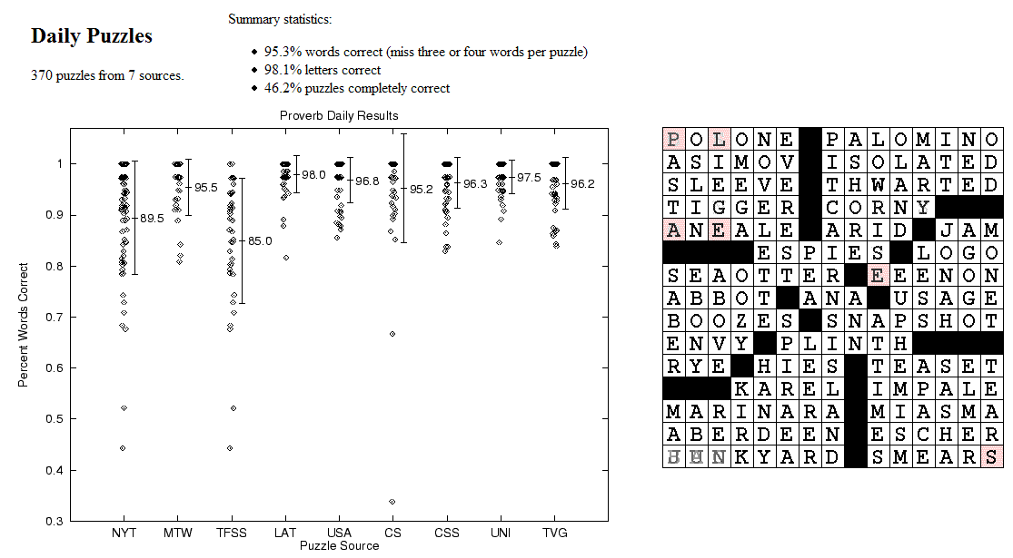
CSPs: Crossword Puzzles
Source: Michael Littman
Notes:
Variables are the places where word can go e.g. (1 across, 3 down)
Domains are words of the appropriate length (for 1 across in this example – length equals 6)
Constraints letter should be the same at the intersection
www.cs.rutgers.edu/~mlittman/papers/aaai99-solver.ps

Slide 14
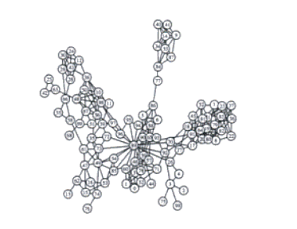
CSPs: Radio link frequency assignment
Assigning frequencies to a set of radio links defined between pairs of sites in order to avoid interferences.
Constraints on frequency depend on position of the links and on physical environment .
Source: INRIA
Sample Constraint network

Slide 15
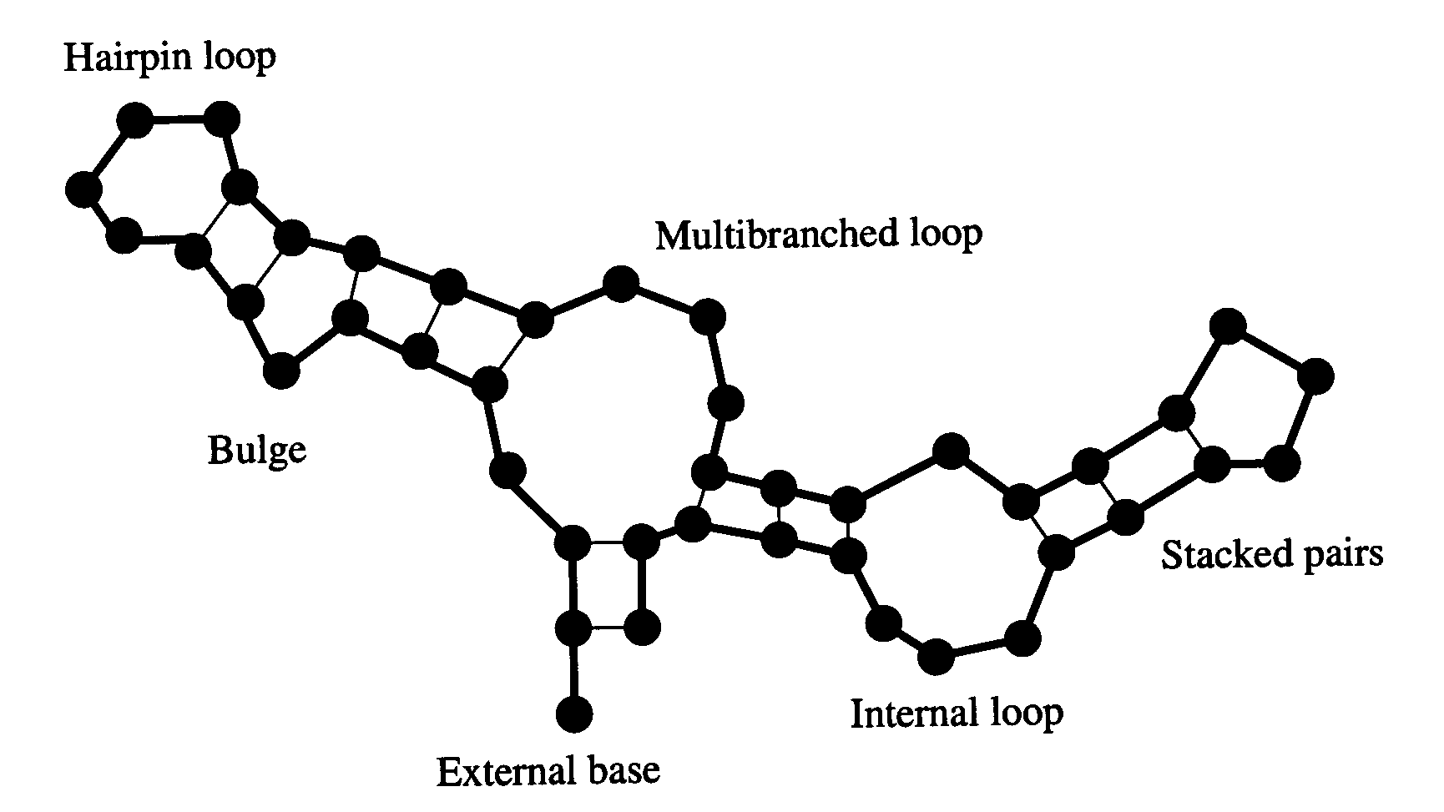
Example: SLS for RNA secondary structure design
RNA strand made up of four bases: cytosine (C), guanine (G), adenine (A), and uracil (U)
2D/3D structure RNA strand folds into is important for its function
Predicting structure for a strand is “easy”: O(n³)
But what if we want a strand that folds into a certain structure?
Local search over strands
Search for one that folds into the right structure
Evaluation function for a strand
Run O(n³) prediction algorithm
Evaluate how different the result is from our target structure
Only defined implicitly, but can be evaluated by running the prediction algorithm
RNA strand GUCCCAUAGGAUGUCCCAUAGGA
Easy
Hard
Secondary structure
Best algorithm to date: Local search algorithm RNA-SSD developed at UBC [Andronescu, Fejes, Hutter, Condon, and Hoos, Journal of Molecular Biology, 2004]

Slide 16
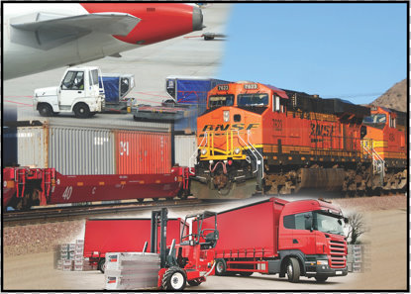
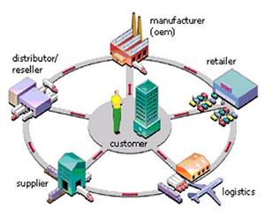
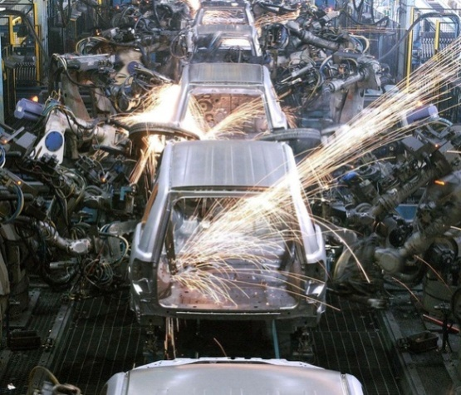
Constraint optimization problems
Optimization under side constraints (similar to CSP)
E.g. mixed integer programming (software: IBM CPLEX)
Linear program: max c^{T}x such that Ax ≤ b
Mixed integer program: additional constraints, x_{i} ∈ Z (integers)
NP-hard, widely used in operations research and in industry
Transportation/Logistics: Supply chain Production planning
SNCF, United Airlines management and optimization: UPS, United States software: Airbus, Dell, Porsche, Postal Service, … Oracle, Thyssen Krupp, SAP,… Toyota, Nissan, ...

Slide 17
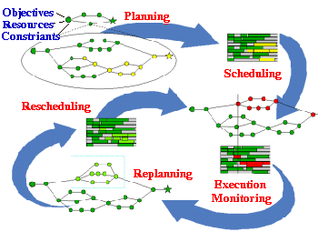
Planning & Scheduling: Logistics
Dynamic Analysis and Replanning Tool (Cross & Walker)
logistics planning and scheduling for military transport
used in the 1991 Gulf War by the US
problems had 50,000 entities (e.g., vehicles); different starting points and destinations
Same techniques can be used for non-military applications:
e.g., Emergency Evacuation
Source: DARPA
Notes:
(Re)Planning done in hours instead of in weeks
ARPA stated that this single application paid back its 30years investments in AI

Slide 18
CSP/logic: formal verification
Hardware verification Software verification
(e.g., IBM) (small to medium programs)
Most progress in the last 10 years based on:
Encodings into propositional satisfiability (SAT)

Slide 19
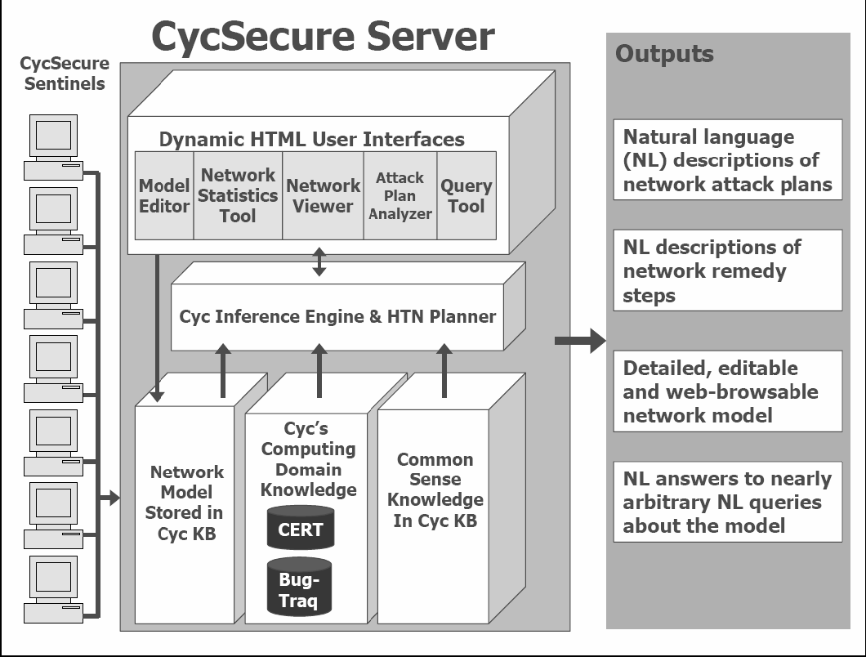
Logic: CycSecure
“scans a computer network to build a formal representation of the network, based on Cyc’s pre-existing ontology of networking, security, and computing concepts:
Excerpted from: Shepard et al., 2005
This formal representation also allows users to interact directly with the model of the network, allowing testing of proposed changes.”
Knowledge Representation
Semantic Web !
Notes:
information about what computers are on the network, what programs are installed or running on those computers, what privileges the running programs have, what users are logged into the computers, etc.

Slide 20
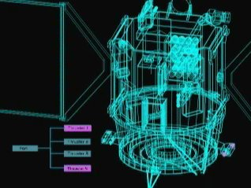
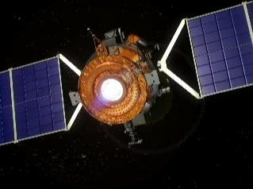
Planning: Spacecraft Control
NASA: Deep Space One spacecraft
operated autonomously for two days in May, 1999:
determined its precise position using stars and asteriods
despite a malfunctioning ultraviolet detector
planned the necessary course adjustment
fired the ion propulsion system to make this adjustment
For another space application see the Spike system for the Hubble
telescope
Source: NASA
Notes:
The Spike scheduling system, developed for scheduling astronomical observations for NASA's Hubble Space Telescope (HST), AI techniques reduced to a few hours what used to take weeks

Slide 21
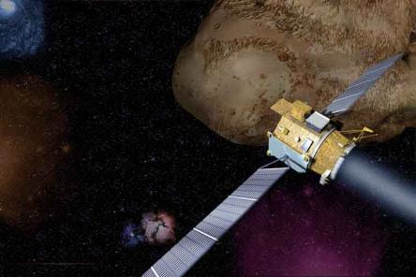
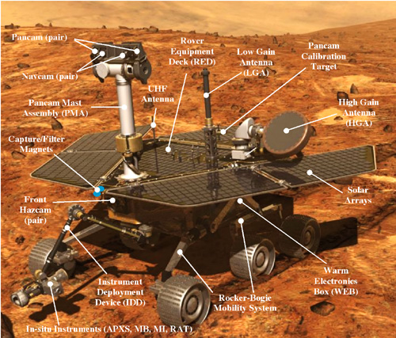
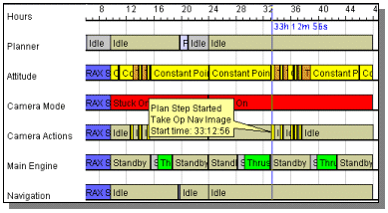
Source: cs221 stanford

Slide 22
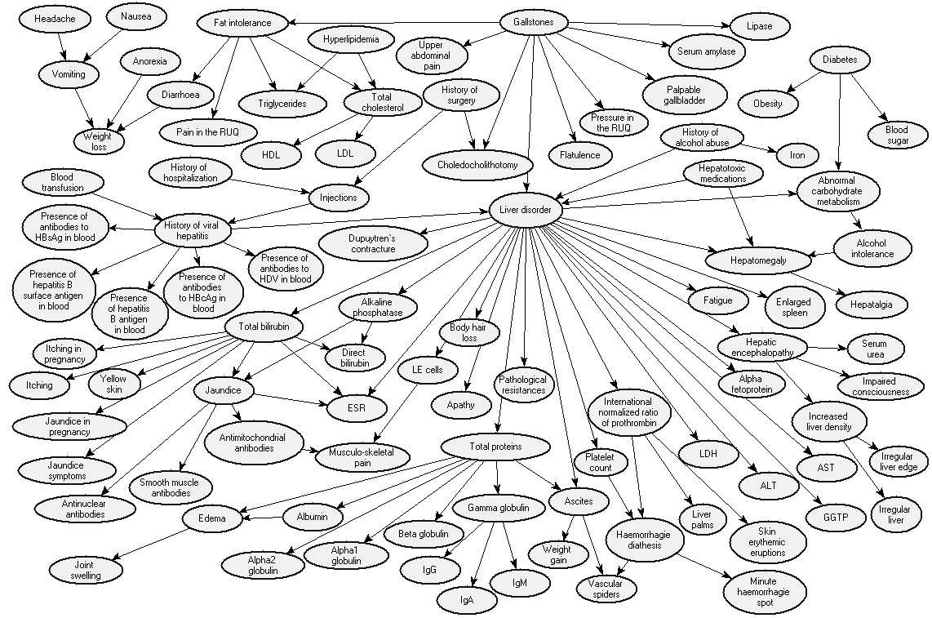
Reasoning under Uncertainty: Diagnosis
Bayes Net: to diagnose liver diseases
Source: Onisko et al., 99

Slide 23
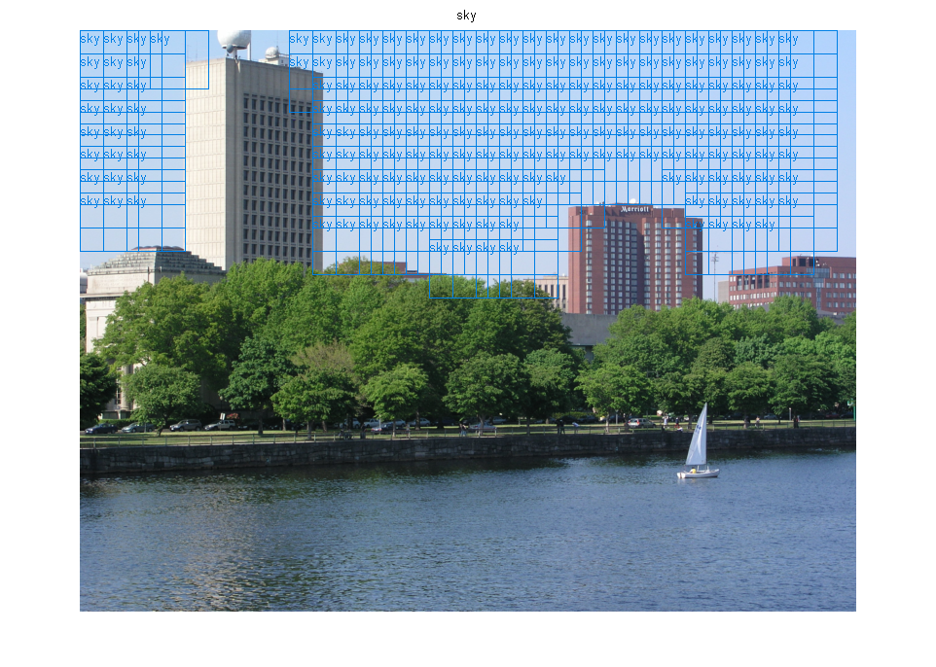
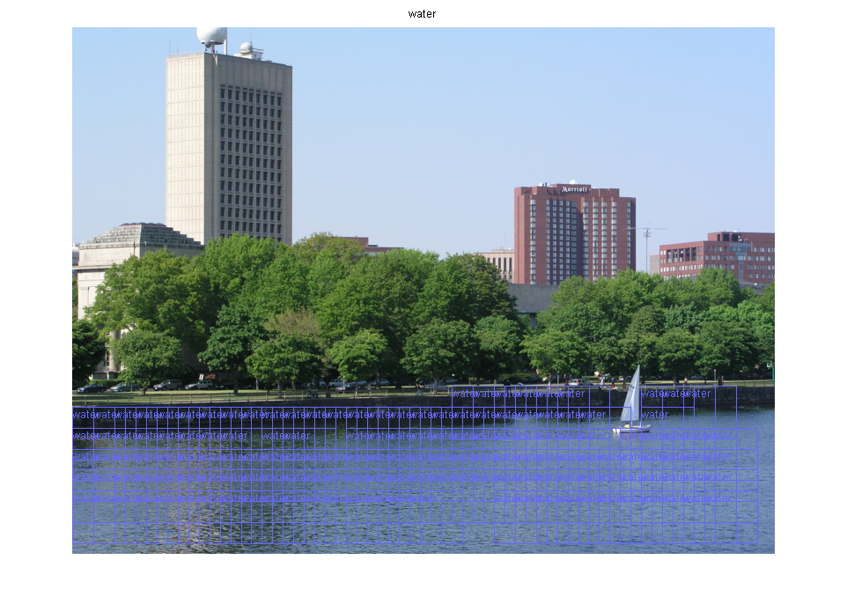
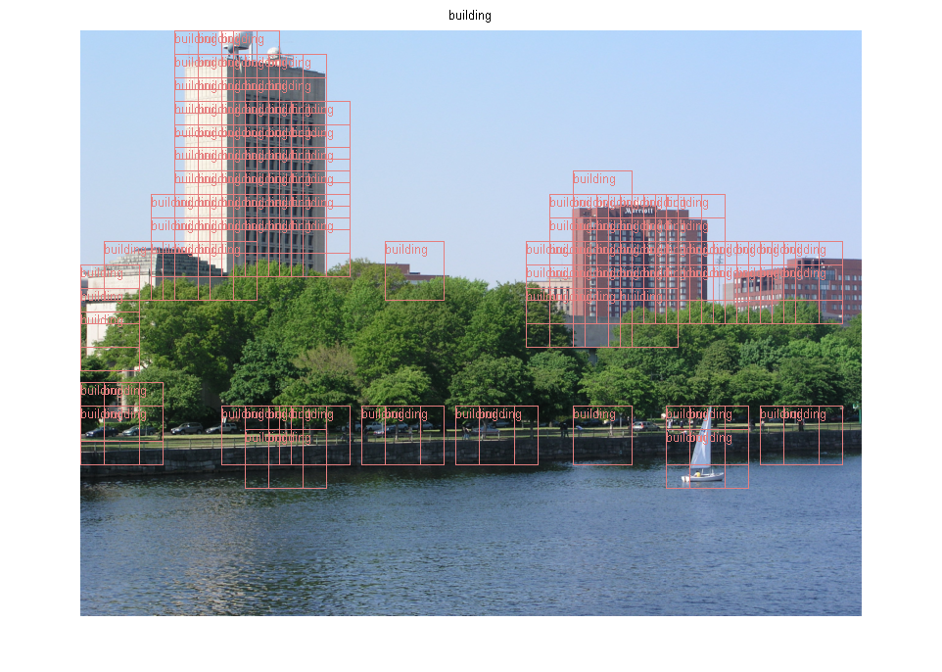
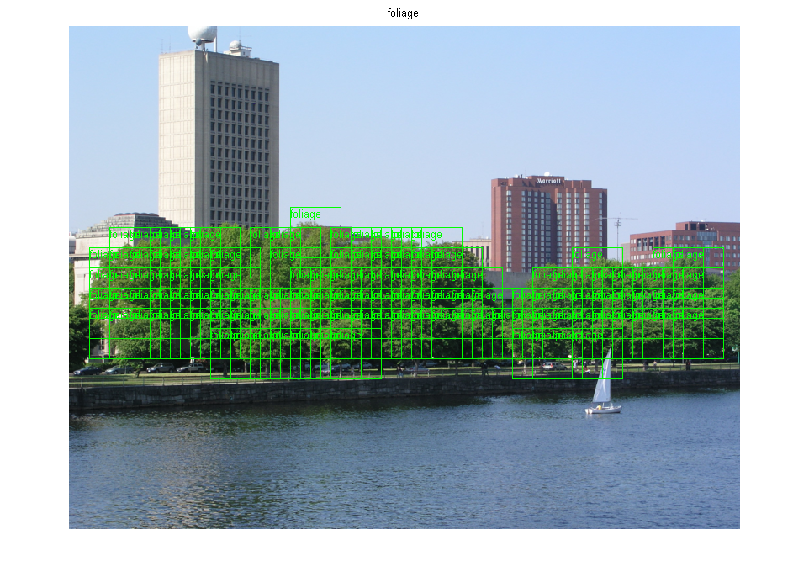
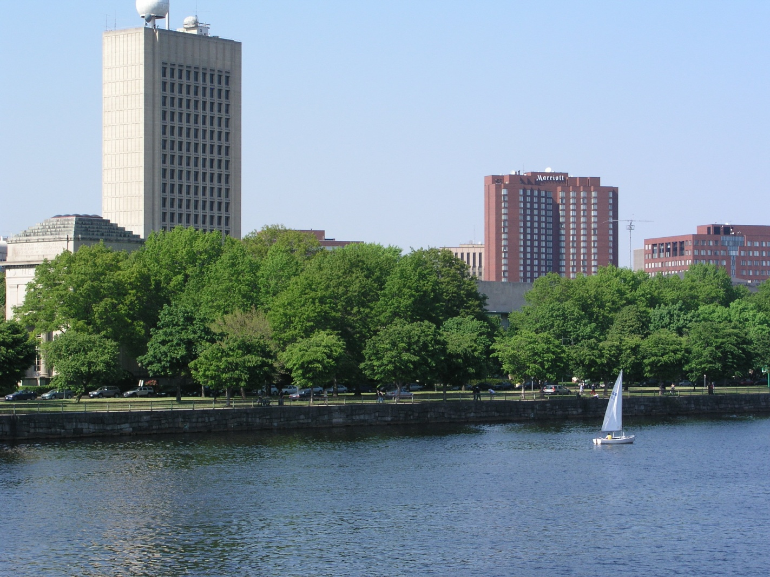
Reasoning Under Uncertainty
Texture classification using Support Vector Machines
foliage, building, sky, water
Source: Mike Cora, UBC

Slide 24
Reasoning Under Uncertainty
E.g. motion tracking: track a hand and estimate activity:
drawing, erasing/shading, other
Source: Kevin Murphy, UBC

Slide 25
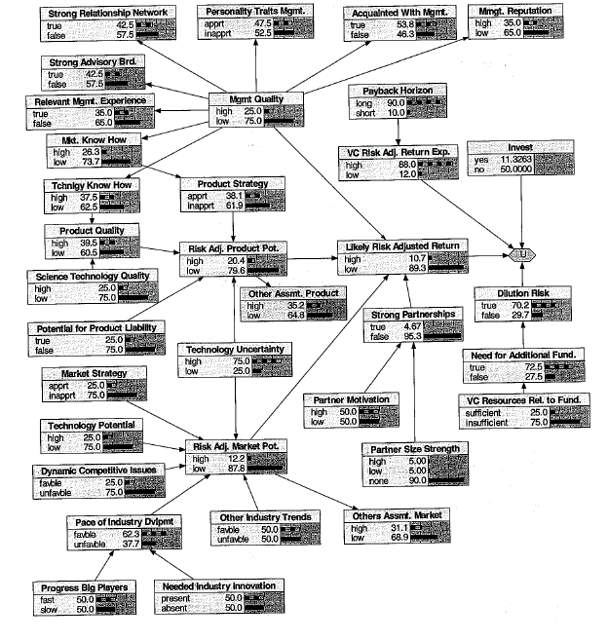
Decision Network in Finance for venture capital decision
Source: R.E. Neapolitan, 2007
Notes:
More on http://www.aaai.org/AITopics/html/applications.html (this is true in general)

Slide 26
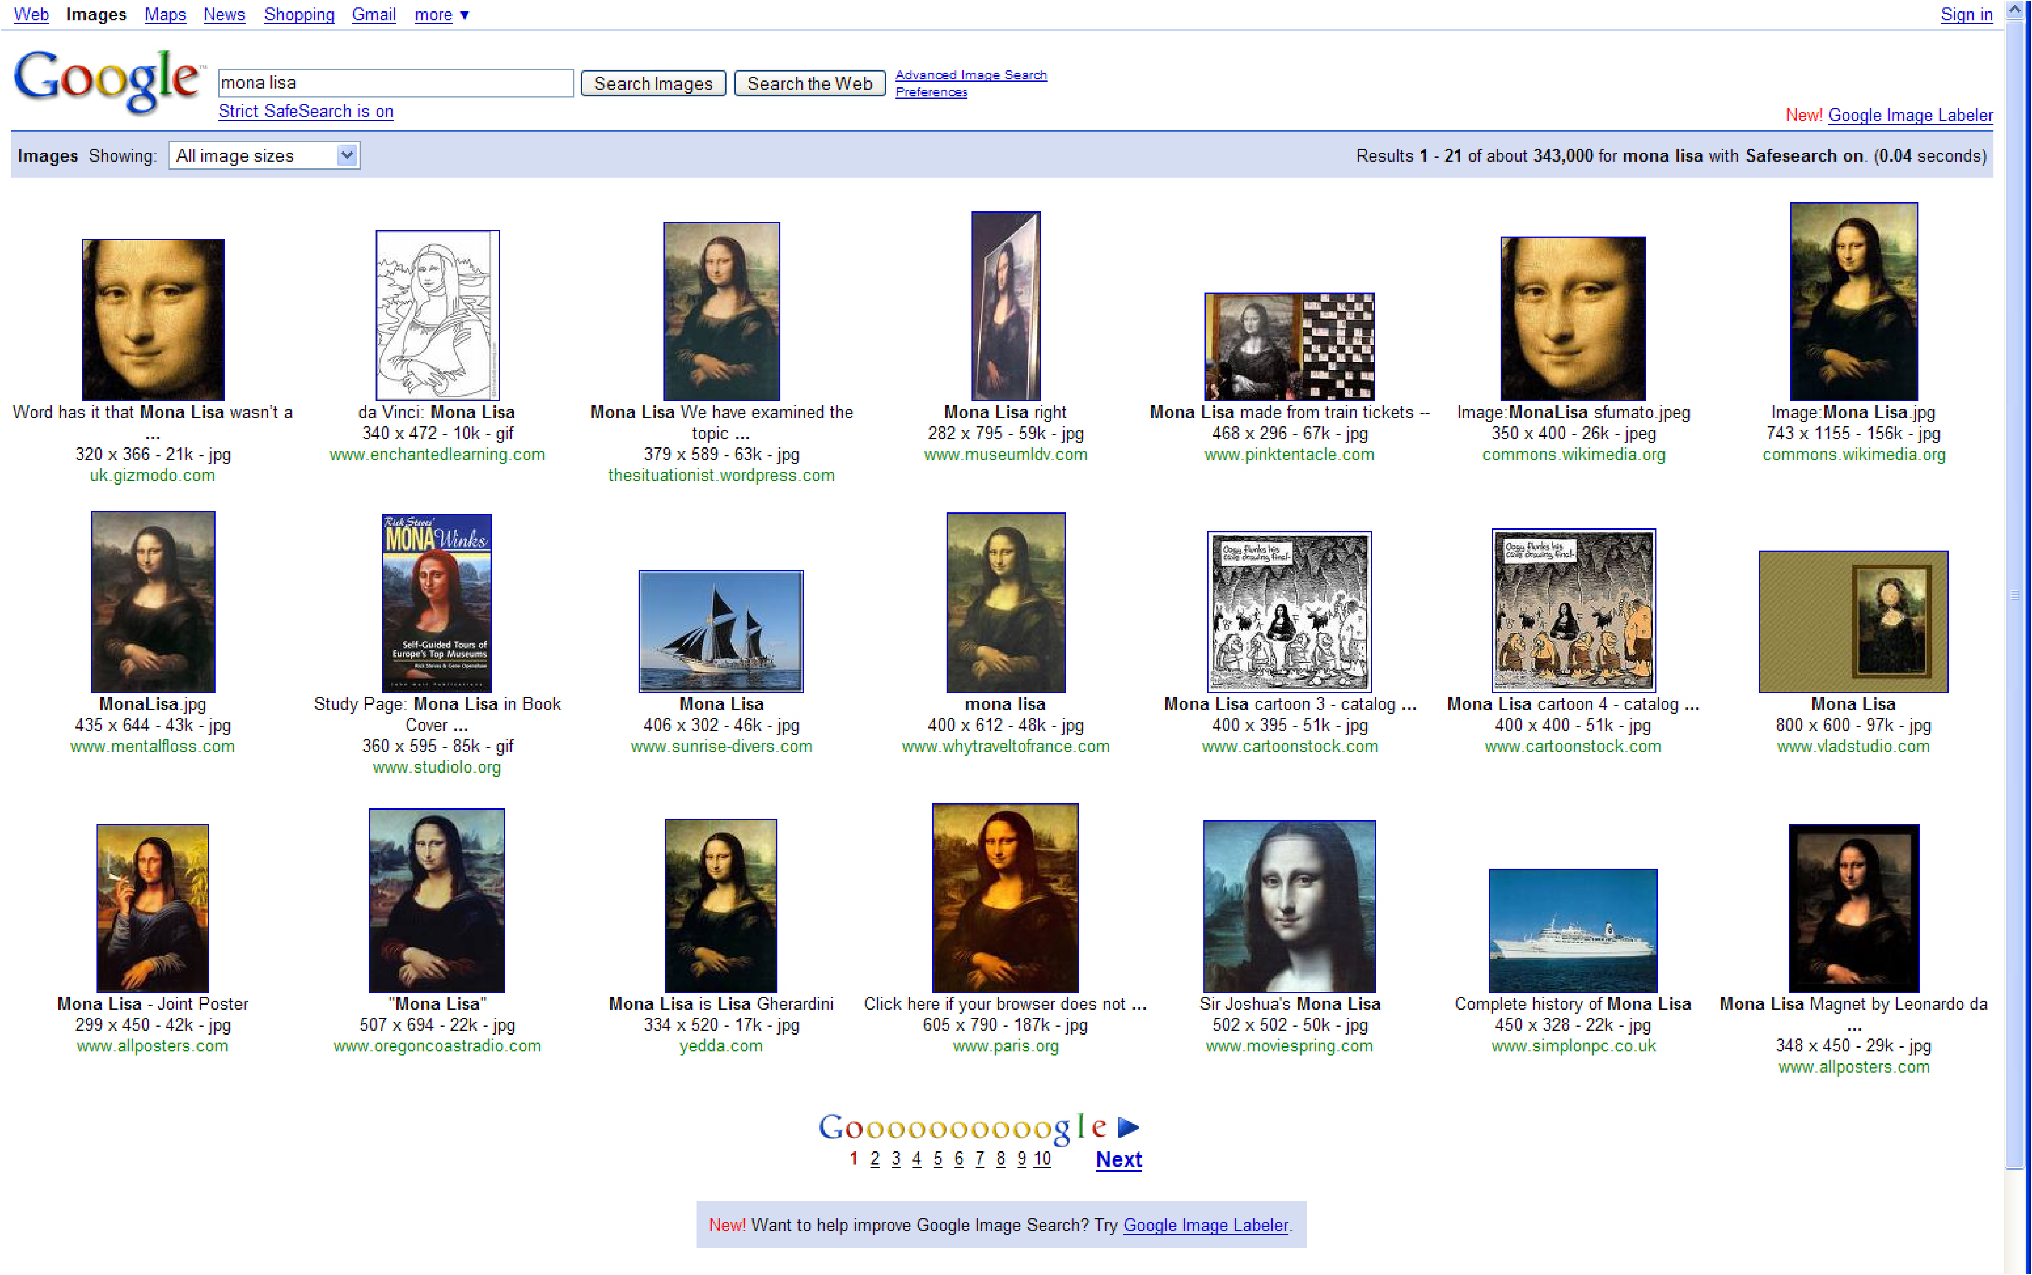
Computer Vision (not just for robots!) Jing, Baluja, Rowley, Google: Finding Canonical Images
Source: cs221 stanford

Slide 27
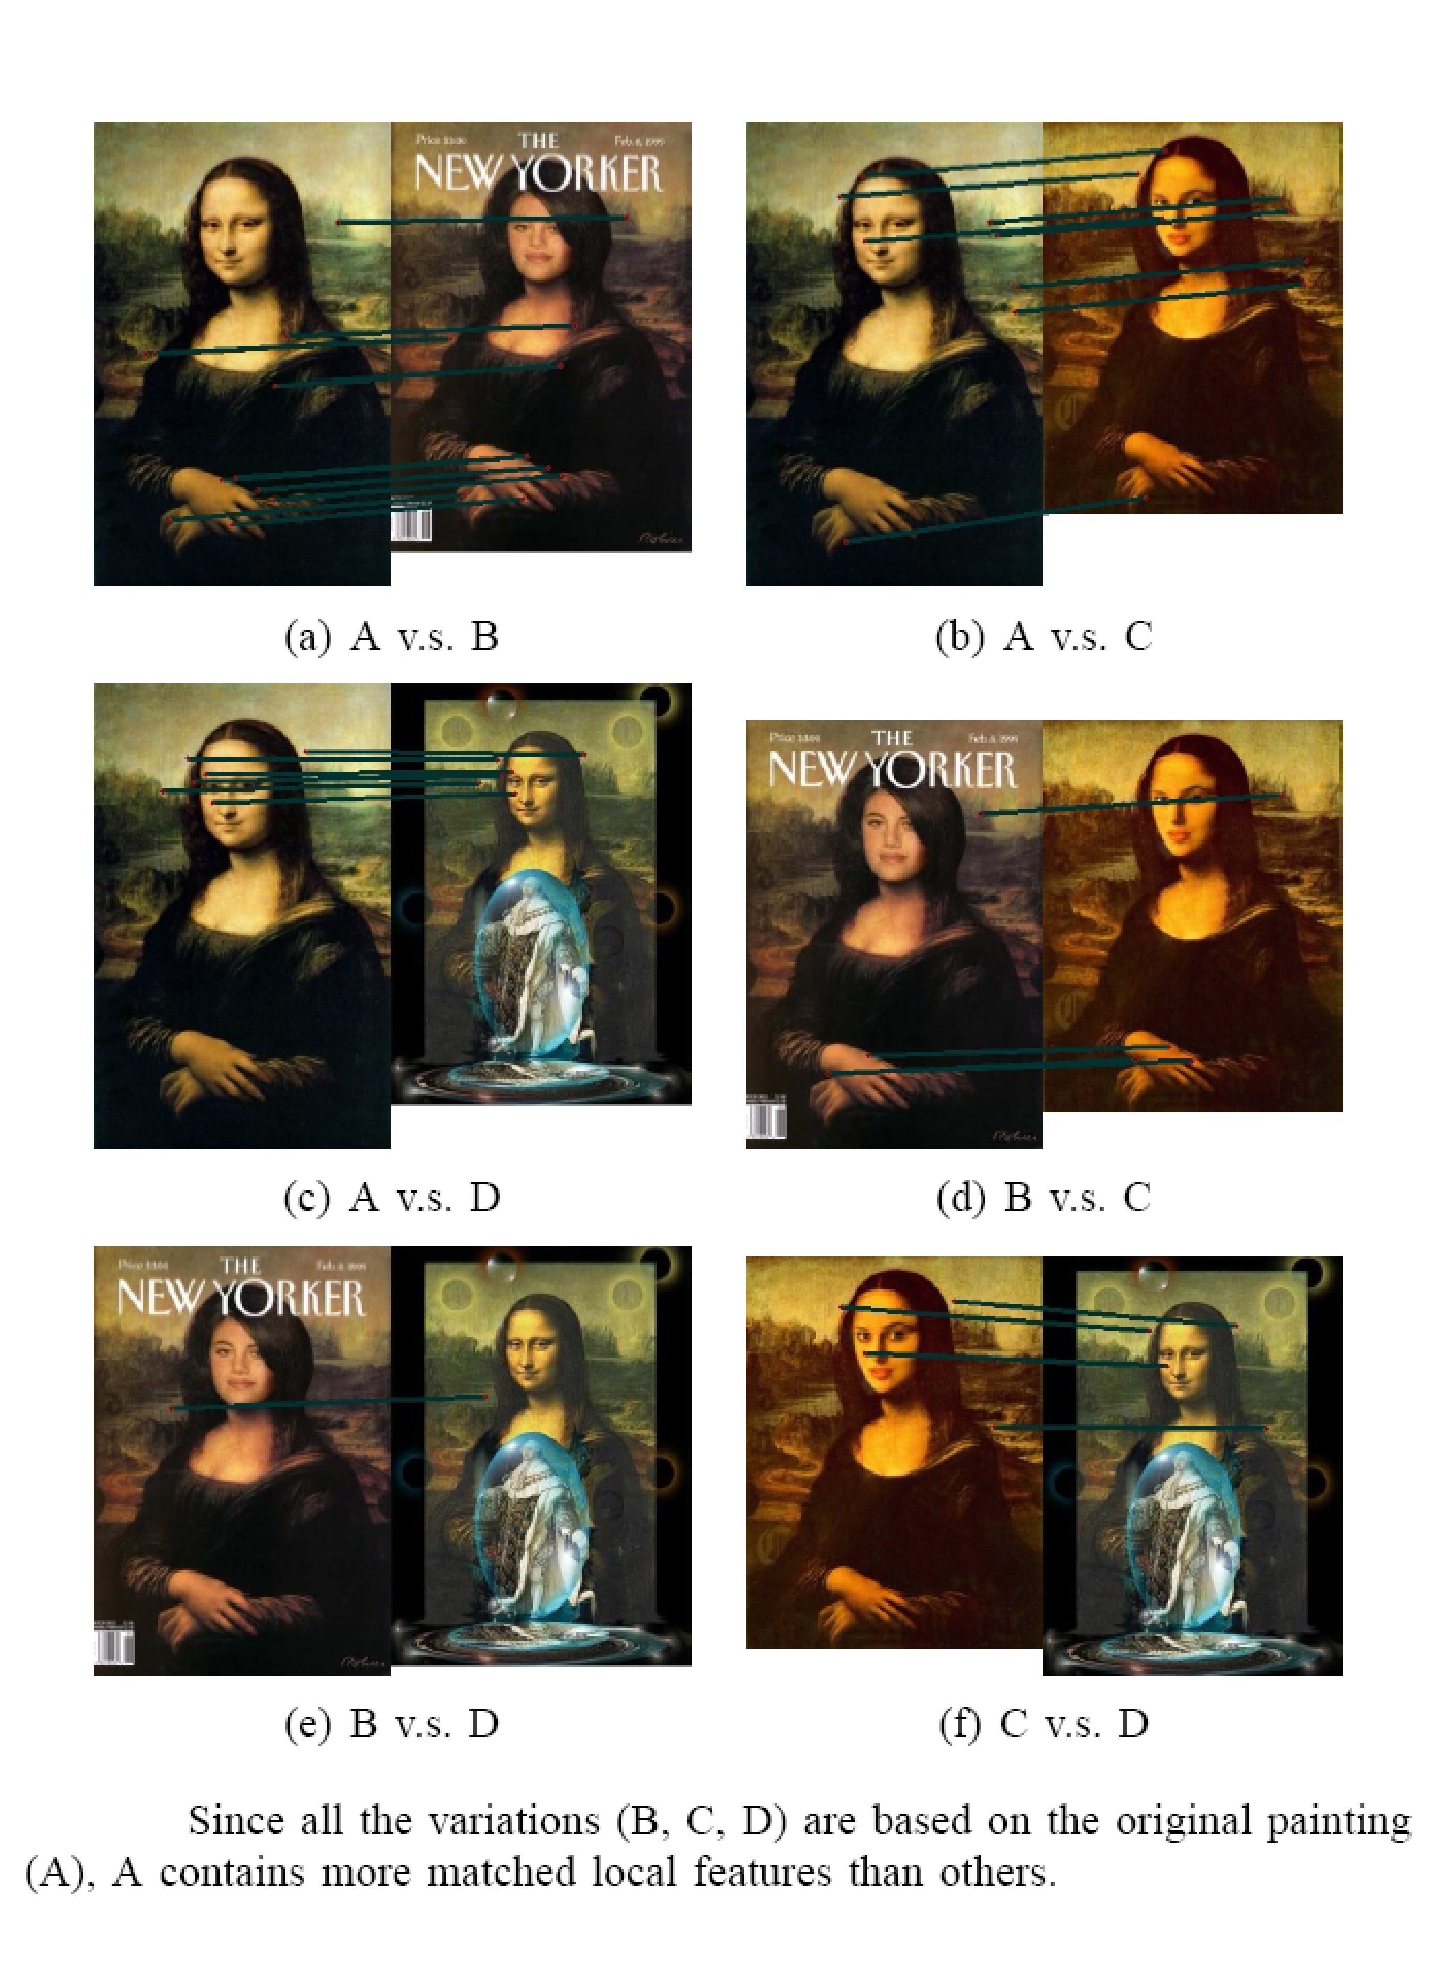
Compare low-level features
Source: cs221 stanford

Slide 28
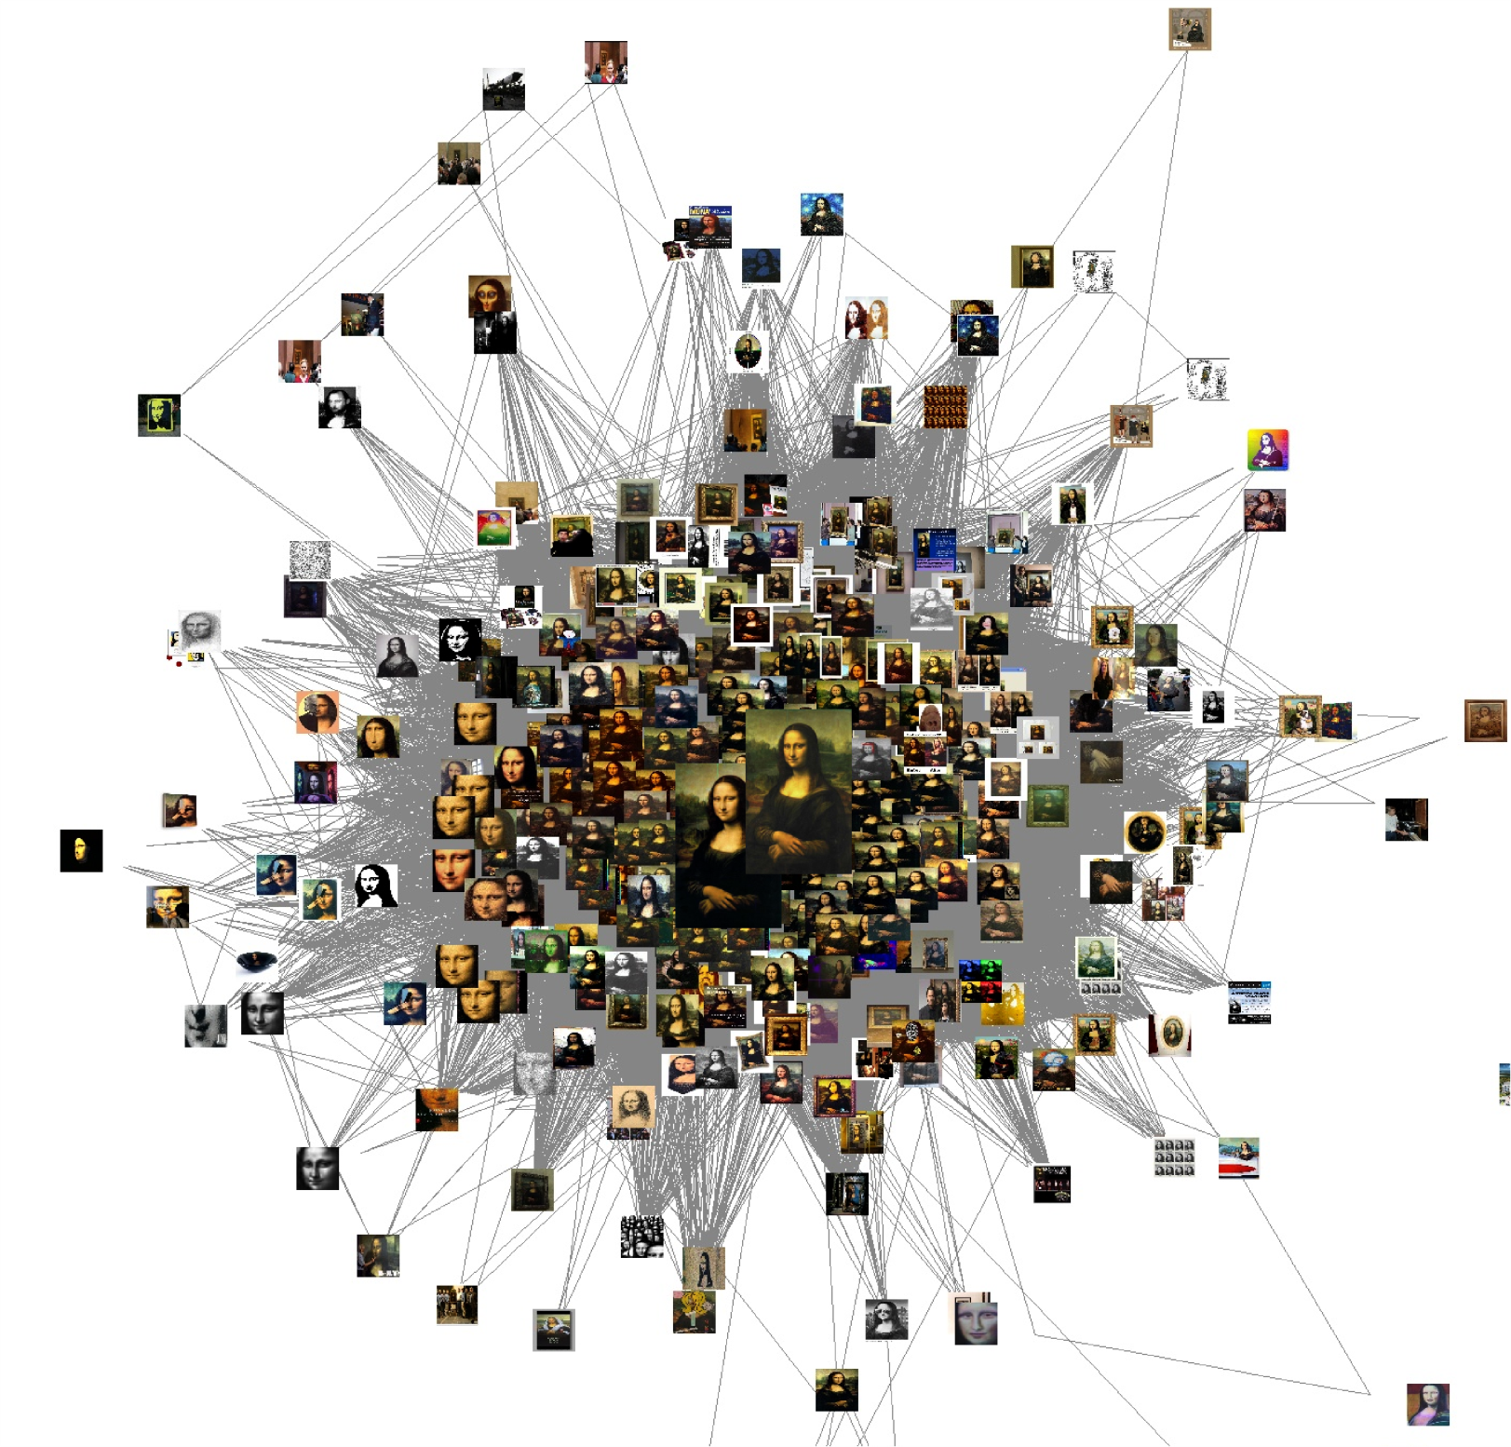
Induced Graph
Source: cs221 stanford

Slide 29
AI - Machine Learning @google
Spam/Porn Detection
Which ad to place given a query
Train Speech to search on mobile
Machine Translation
…..
Highly Parallelizable EM + Map Reduce (simple code to write)
Stochastic Gradient Descent
Notes:
Machine learning research has often concentrated on more and more complex algorithms to extract the best models out of a limited number of training examples. In recent years, though, with the availability of cheaper computing resources, industries have started collecting very large databases (millions or even billions of examples, thousands or even millions of features, thousands or more classes, etc). Trying to apply classical machine learning algorithms on these large datasets is often a challenge. In this talk, I'll describe a few examples and challenges we recently faced at Google in order to adapt or develop machine learning algorithms for our ever larger datasets and problems. This includes examples such as speech recognition, machine translation, image and video annotation, natural language processing and more.

Slide 30
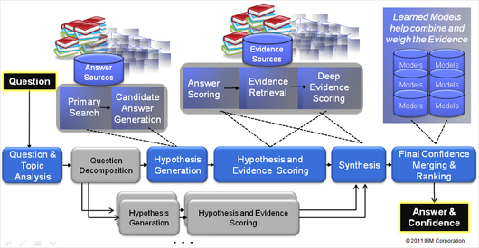
Watson : analyzes natural language questions and content well enough and fast enough to compete and win against champion players at Jeopardy!
“This Drug has been shown to relieve the symptoms of ADD with relatively few side effects."
3 secs
1000s of algorithms and KBs,
Source: IBM
Notes:
The correct Jeopardy! response would be "What is Ritalin?“
This is no easy task for a computer, given the need to perform over an enormously broad domain,
with consistently high precision and amazingly accurate confidence estimations in the correctness of its answers.
Watson’s performance on Jeopardy! is just the opening salvo for a research mission built on decades of
experience in deep Content Analysis, Natural Language Processing, Information Retrieval, Machine Learning and Artificial Intelligence.
Rich natural language questions covering a broad range of general knowledge. It is widely recognized as an entertaining game requiring smart, knowledgeable and quick players.
Computer systems that can directly and accurately answer questions over a broad domain of human knowledge have been envisioned by scientists and writers since the advent of computers themselves. Open domain question answering holds tremendous promise for facilitating informed decision making over vast volumes of natural language content. Applications in business intelligence, healthcare, customer support, enterprise knowledge management, social computing, science and government would all benefit from deep language processing. The DeepQA project is aimed at exploring how advancing and integrating Natural Language Processing (NLP), Information Retrieval (IR), Machine Learning (ML), massively parallel computation and Knowledge Representation and Reasoning (KR&R) can advance open-domain automatic Question Answering. One proof-point in this challenge is to develop a computer system that can successfully compete against top human players at the Jeopardy! quiz show (www.jeopardy.com). Attaining champion-level performance in Jeopardy! requires a computer system to rapidly and accurately answer rich open-domain questions, and to assess its own confidence in a category or question. The system must deliver high degrees of precision and confidence over a very broad range of knowledge and natural language content within a very short 3-second response time. The need for speed and high precision demands a massively parallel computing platform capable of generating, evaluating and combing thousands of hypotheses and their associated evidence. In this talk I will introduce the audience to the Jeopardy! Challenge and the techniques used to tackle it.

Slide 31
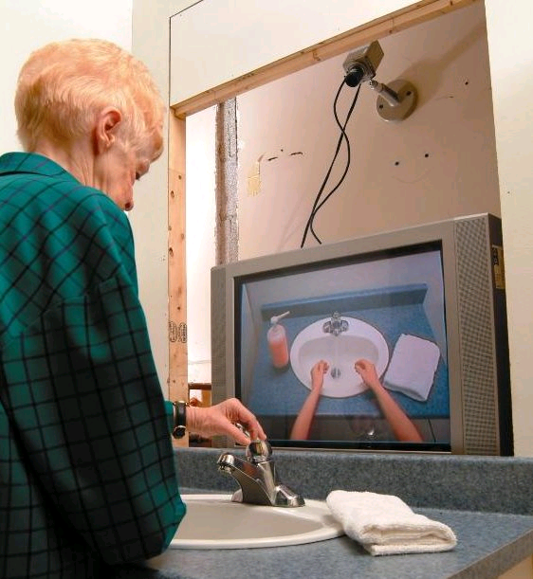
Planning Under Uncertainty
Learning and Using POMDP
models of Patient-Caregiver
Interactions During Activities
of Daily Living
Goal: Help Older adults living with
cognitive disabilities (such as Alzheimer's) when they:
forget the proper sequence of tasks that need to be completed
they lose track of the steps that they have already completed.
Source: Jesse Hoey UofT 2007
Notes:
Older adults living with cognitive disabilities (such as Alzheimer's disease or other forms of dementia) have
difficulty completing activities of daily living (ADLs). They forget the proper sequence of tasks that need
to be completed, or they lose track of the steps that they have already completed

Slide 32
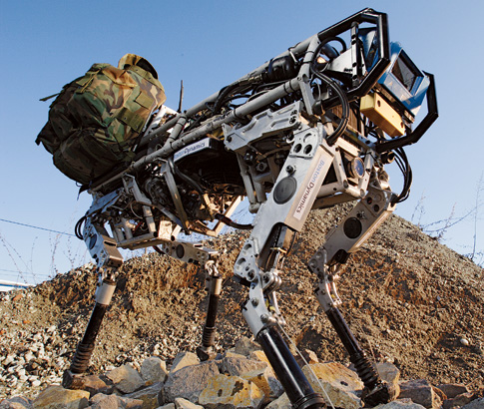
Military applications: ethical issues
Robot soldiers
Existing: robot dog carrying heavy materials for soldiers in the field
The technology is there
Unmanned airplanes
Missile tracking
Surveillance
…

Slide 33
Planning Under Uncertainty
Helicopter control: MDP, reinforcement learning
States: all possible positions, orientations, velocities and angular velocities
Final solution involves
Deterministic search!
Source: Andrew Ng 2004
Notes:
To our knowledge, this is the first helicopter capable of sustained
inverted flight under computer control. A video of the helicopter in inverted
autonomous flight is also at
In our problem, S is the set of states (expressed in
world coordinates) comprising all possible helicopter positions, orientations,
velocities and angular velocities;
But using the Pegasus method (Ng and
Jordan, 2000), we can turn this stochastic optimization problem into an or-
dinary deterministic problem, so that any standard search algorithm can now
be applied.

Slide 34
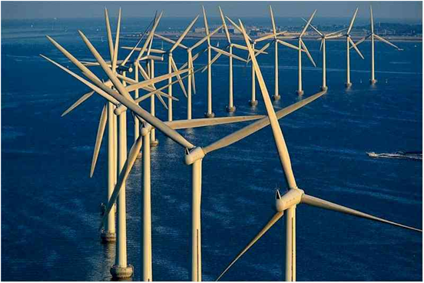
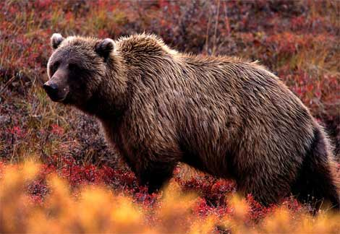
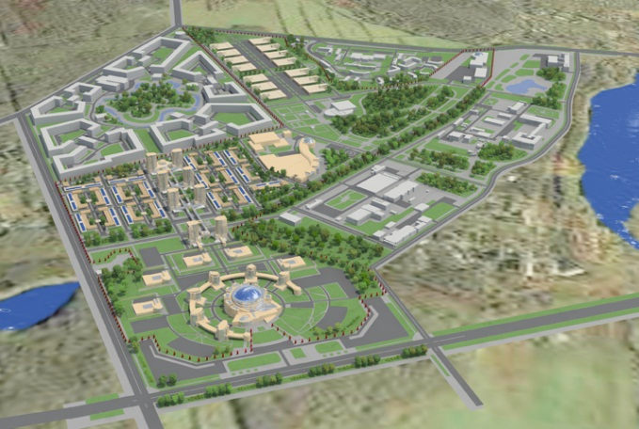
Decision Theory: Decision Support Systems
E.g., Computational Sustainability
New interdisciplinary field, AI is a key component
Models and methods for decision making concerning the management and allocation of resources
to solve most challenging problems related to sustainability
Often constraint optimization problems. E.g.
Energy: when are where to produce green energy most economically?
Which parcels of land to purchase to protect endangered species?
Urban planning: how to use budget for best development in 30 years?
Source: http://www.computational-sustainability.org/

Slide 35
Multiagent Systems: Poker
Search Space: 1.2 quintillion nodes
“In full 10-player games Poki is better than a typical low-limit casino player and wins consistently; however, not as good as most experts
New programs being developed for the 2-player game are quite a bit better, and we believe they will very soon surpass all human players”
Source: The University of Alberta GAMES Group
Notes:
Q: How large is the search space for 2-player Texas Hold'em?
A: Short answer: about 1.2 quintillion nodes. Exact answer: the imperfect information game tree for limit Hold'em (with a maximum of four bets each per round) has 1,179,000,604,565,715,751 nodes in total, including dominated sequences (ie. folding to no bet). Almost all of these (1,176,023,515,434,768,000) involve all four betting rounds. The breakdown by type of node is: 406,551,932,608,867,500 terminal (fold) nodes, 364,972,815,134,928,000 showdown nodes, 203,275,966,304,433,750 decision nodes for each player, and 923,924,213,052,751 chance nodes. Eliminating dominated sequences reduces the tree to a mere 1,097,690,218,045,566,601 nodes. (Thanks for asking! :)

Slide 36
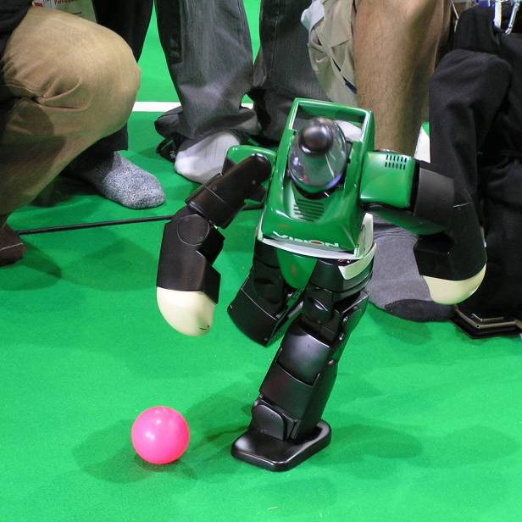
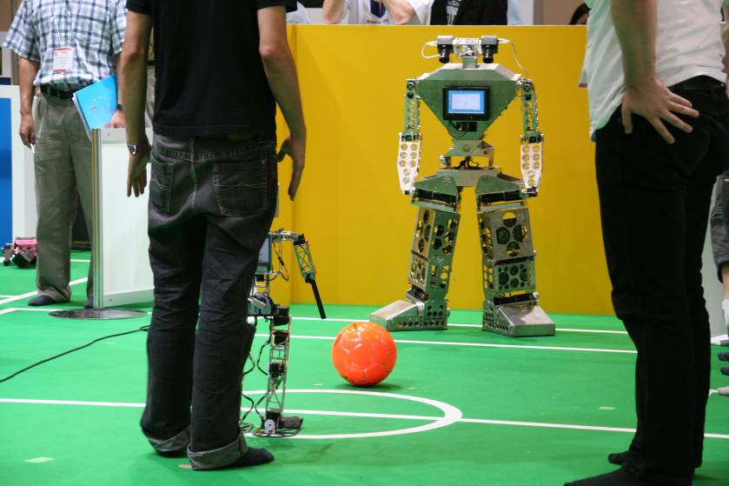
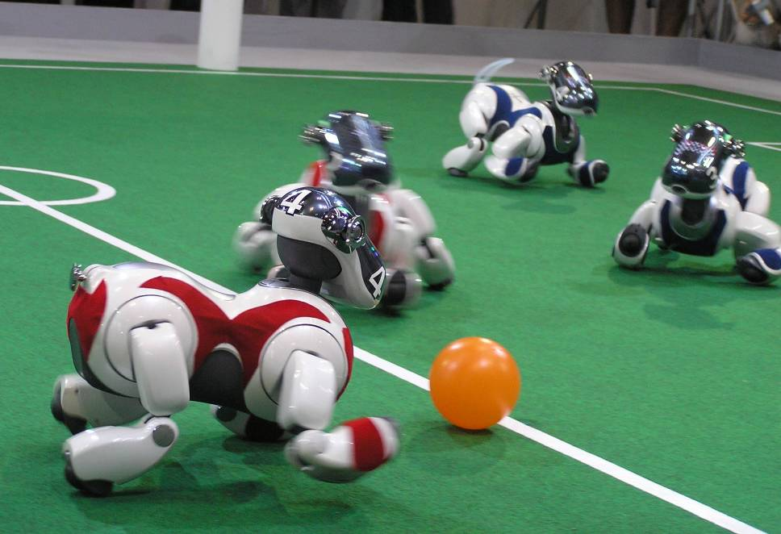
Multiagent Systems: Robot Soccer
Extremely complex
Stochastic
Sequence of actions
Multiagent
robotic soccer competition was proposed by LCI (UBC) in 1992 (which became Robocup in 1997).
Source: RoboCup web site

Slide 37
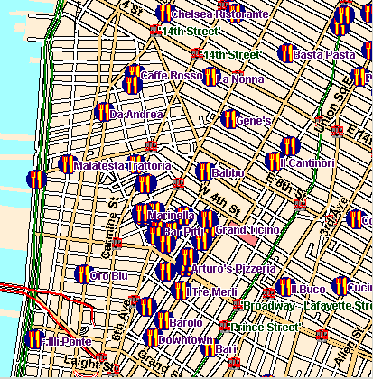
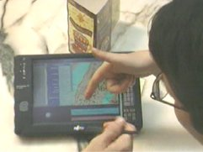
Natural Language Processing
Multimodal Access to City Help (MATCH)
Multimodal interface
Portable Fujitsu tablet
Input: Pen for deictic gestures and Speech input
Output: Text, Speech and graphics
Source: M. Walker (ex. AT&T) 2002

Slide 38
Statistical Machine Translation
SEHR GEEHRTER GAST! KUNST, KULTUR UND
KOMFORT IM HERZEN
BERLIN.
DEAR GUESTS,
ART, CULTURE AND
LUXURY IN THE HEART
OF BERLIN.
DIE ÖRTLICHE
NETZSPANNUNG BETRÄGT 220/240 VOLT BEI 50 HERTZ.
THE LOCAL VOLTAGE
IS 220/240 VOLTS 50 HZ.
EN
Source: cs221 stanford
DE

Slide 39
他 信 也 说 自己 仍 然 是 总理 , 拒 绝 辞 职 .
仍 然 是
continues to be
are still the main
would still be
continued to be
remains one of
remains one
continues to be the
still is
remains an area
still viewed by
are always one of
总理 , 拒绝
……
他
he
He
other
his
him
other
that he
he was
him to
he is
he has
of his
信
letter
trust
letters
believe
signal
a letter
believe that
letter of
confidence
是 总理
Prime Minister
the Prime Minister
is the Prime Minister
他 信
Thaksin
Thaksin Chinnawat
and Joint Communique
Dr Thaksin
Joint Communique
, Mr Thaksin
in his letter
his letter
others
说 自己
themselves
said that
say they
said he
say that
said they themselves
saying that he
would say that
said that she had
saying that he has
他 信 也
Thaksin also
辞 职 .
resign .
leaving their service .
of leaving their service .
resigned as counsel .
Source: cs221 stanford

Slide 40
Zite: a personalized magazine
… that gets smarter as you use it

Slide 41
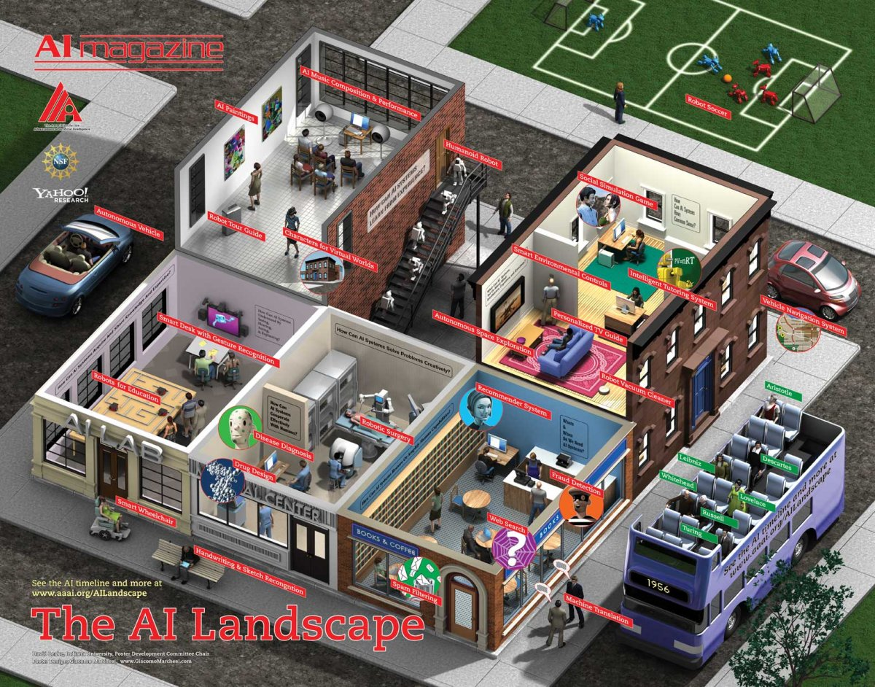

Slide 42
Agents acting in an environment
abilities
Representation
& Reasoning
Notes:
Environment World
State / Possible Worlds
What do we need to represent?
Different problems
Different domains
For each of those possibly different reasoning techniques

Slide 43
What is an agent?
It has the following characteristics:
It is situated in some environment
does not have to be the real world---can be an abstracted electronic environment
It can make observations (perhaps imperfectly)
It is able to act (provide an answer, buy a ticket)
It has goals or preferences (possibly of its user)
It may have prior knowledge or beliefs, and some way of updating beliefs based on new experiences (to reason, to make inferences)
Notes:
AI is about practical reasoning: reasoning in order to do something. A coupling
of perception, reasoning, and acting comprises an agent. An agent
acts in an environment. An agent could be, for example, a coupling of a
computational engine with physical sensors and actuators, called a robot.
It could be the coupling of an advice-giving computer—an expert system—
with a human who provides the perceptual information and carries out the
task.
Can be just the user, tutoring system
Medical diagnostic system

Slide 44
Intelligent Agents in the World
Knowledge Representation
Machine Learning
abilities
Reasoning +
Decision Theory
Natural Language
Generation
Natural Language
Understanding
+
Computer Vision
Speech Recognition
+
Physiological Sensing
Mining of Interaction Logs
+
Robotics
+
Human Computer
/Robot
Interaction
Notes:
abilities, which are the primitive actions it is capable of carrying out.

Slide 45
Today Sept 9
Overview of the field – Key definitions
Overview of course
Background knowledge
Topics
Activities and Grading
Administrative Stuff
Assignment 0
Notes:
Introductions?

Slide 46
What do we need to represent ?
The environment /world : What different configurations (states / possible worlds) can the world be in, and how do we denote them?
Chessboard, Info about a patient, Robot Location
How the world works (we will focus on)
Constraints: sum of current into a node = 0
Causal: what are the causes and the effects of brain disorders?
Actions preconditions and effects: when can I press this button? What happens if I press it?
Notes:
2*6+1 to the 64
Causal is restrictive but I think pedagogically adequate:
should add definitional? A dog is a mammal
How would the world be changed if we were to take some given action:
what are the system dynamics?

Slide 47
Corresponding Reasoning Tasks / Problems
STATIC
Constraint Satisfaction – Find state that satisfies set of constraints. E.g., What is a feasible schedule for final exams?
Answering Query – Is a given proposition true/likely given what is known? E.g., Does this patient suffers from viral hepatitis?
SEQUENTIAL
Planning – Find sequence of actions to reach a goal state / maximize utility. E.g., Navigate through and environment to reach a particular location
Notes:
Furthermore, the course will consider two main representational dimensions:
Does this person has a PhD?
How to get a PhD
How many actions does the agent need to select?
The agent needs to take a single action
Solve a problem (e.g., Sudoku)
Provide diagnosis for a patient with a disease
The agent needs to take a sequence of actions
Planning
navigate through an environment to reach a goal state (particular location)
Assemble/fix a complex machinery/system
Bid in online auctions to purchase a desired good

Slide 48
Representation and Reasoning System
A (representation) language in which the environment and how it works can be described
Computational (reasoning) procedures to compute a solution to a problem in that environment (an answer, a sequence of actions)
But the choice of an appropriate R&R system depends on a key property of the environment and of the agent’s knowledge
Notes:
Problem => representation => computation
A representation and reasoning system (RRS) consists of:
flesh out the task and determine what constitutes a solution
represent the problem in a language that a computer can reason with
use the computer to compute an output, which is an answer presented
to a user or a sequence of actions to be carried out in the environment
interpret the output as a solution to the problem.
(``syntax'')
A way to assign meaning to the symbols (``semantics'')

Slide 49
Deterministic vs. Stochastic (Uncertain) Domains
Sensing Uncertainty: Can the agent fully observe the current state of the world?
Effect Uncertainty: Does the agent knows for sure what the effects of its actions are?
Doctor Diagnosis
Poker
Factory Floor
Chess
Doctor Treatment
Notes:
Is the environment deterministic or stochastic?
Is the agent's knowledge certain or uncertain?
AI is What to do when you don’t know what to do
Uncertainty due to
Ignorance
Laziness
Adversaries
State uncertainty
Action uncertanty
Future uncertainty
Utility uncertainty

Slide 50
Deterministic vs. Stochastic Domains
Historically, AI has been divided into two camps:
those who prefer representations based on logic
those who prefer probability.
Note: Some of the most exciting current research in AI is actually building bridges between these camps.
Notes:
AI 2 grad course

Slide 51
R&Rsys we'll cover in this course
Environment
Deterministic
Stochastic
Problem
Arc Consistency
Constraint Satisfaction
Vars +
Constraints
Search
Static
Belief Nets
Var. Elimination
Query
Logics
Approx. Inference
Search
Temporal. Inference
Sequential
Decision Nets
STRIPS
Var. Elimination
Planning
Search
Markov Processes
Representation
Value Iteration
Reasoning
Technique
Notes:
R&R Sys Representation and reasoning Systems
Each cell is a R&R system
STRIPS actions prec
The SCSP extends the classical CSP by
including both decision variables, that an agent can set, and stochastic
variables that follow a probability distribution and can model uncer-
tain events beyond the agent’s control. So far, two approaches to solving
SCSPs have been proposed; backtracking-based procedures that extend
standard methods from CSPs, and scenario-based methods that solve
SCSPs by reducing them to a sequence of CSPs.onditions and effects Stanford Research Institute Problem Solver

Slide 52
Knowledge given vs. knowledge learned from experience
The agent is provided with a model of the world once and for all
The agent can learn how the world works based on experience
in this case, the agent often still does start out with some prior knowledge
Supervised Machine Learning
Unsupervised Machine Learning
Reinforcement Learning

Slide 53
Dimensions of Representational Complexity
We've already discussed:
Reasoning tasks (Static vs. Sequential )
Deterministic versus stochastic domains
Knowledge given versus knowledge learned from experience (Machine Learning)
Some other important dimensions of complexity:
Explicit state or propositions or relations
Flat or hierarchical
Goals versus complex preferences
Single-agent vs. multi-agent
Notes:
begin{itemize}
% \item \alert{Key point}: ``stochastic world'' can mean that the world itself has stochastic dynamics, that the world is deterministic but imperfectly observed, or that the world has stochastic dynamics \emph{and} is imperfectly observed.
%\end{itemize}

Slide 54
Explicit State or propositions
How do we model the environment?
You can enumerate the states of the world.
A state can be described in terms of features
Often it is more natural to describe states in terms of assignments of values to features (variables).
30 binary features (also called propositions) can represent 2³⁰= 1,073,741,824 states.
Mars Explorer Example
Weather
Temperature
Long Lati

Slide 55
Explicit State or propositions or relations
States can be described in terms of objects and relationships.
There is a proposition for each relationship on each “possible” tuple of individuals.
University Example
Registred(S,C)
Students (S) = { }
Courses (C) = { }
Textbook example: One binary relation and 10 individuals can represents 10²=100 propositions and 2¹⁰⁰ states!
Notes:
One binary rel and 2 individual
4 propositions
16 states

Slide 56
Flat or hierarchical
Is it useful to model the whole world at the same level of abstraction?
You can model the world at one level of abstraction: flat
You can model the world at multiple levels of abstraction: hierarchical
Example: Planning a trip from here to a resort in Cancun, Mexico

Slide 57
Goals versus (complex) preferences
An agent may have a goal that it wants to achieve
e.g., there is some state or set of states of the world that the agent wants to be in
e.g., there is some proposition or set of propositions that the agent wants to make true
An agent may have preferences
e.g., there is some preference/utility function that describes how happy the agent is in each state of the world; the agent's task is to reach a state which makes it as happy as possible
Preferences can be complex…
What beverage to order?
The sooner I get one the better
Cappuccino better than Espresso
Notes:
How do we represent an agent's desire(s)?
If an agent doesn't want to achieve anything, it has no reason to act.
Think about preferences for Mars explorer

Slide 58
Single-agent vs. Multiagent domains
Does the environment include other agents?
Everything we've said so far presumes that there is only one agent in the environment.
If there are other agents whose actions affect us, it can be useful to explicitly model their goals and beliefs rather than considering them to be part of the environment
Other Agents can be: cooperative, competitive, or a bit of both
Notes:
How do we represent an agent's desire(s)?
If an agent doesn't want to achieve anything, it has no reason to act.
Think about preferences for Mars explorer

Slide 59
Dimensions of Representational Complexity
Reasoning tasks (Constraint Satisfaction / Logic&Probabilistic Inference / Planning)
Deterministic versus stochastic domains
Knowledge given versus knowledge learned from experience
Some other important dimensions of complexity:
Explicit state or features or relations
Flat or hierarchical
Goals vs. (complex) preferences
Single-agent vs. multi-agent
Notes:
begin{itemize}
% \item \alert{Key point}: ``stochastic world'' can mean that the world itself has stochastic dynamics, that the world is deterministic but imperfectly observed, or that the world has stochastic dynamics \emph{and} is imperfectly observed.
%\end{itemize}

Slide 60
Today Sept 8
Overview of the field – Key definitions
Overview of course
Background knowledge
Topics
Activities and Grading
Administrative Stuff
Assignment 0
Notes:
Introductions?

Slide 61
Activities
For the first 9 or 10 weeks we will cover an overview of the material in lectures and assignments
There will be a midterm on the material covered in class
The last few weeks will cover current research topics presented by students
Students will write a review paper based on the lecture they gave (+ additional relevant papers), and peer review the papers of other students

Slide 62
Tentative Grading Scheme
5% Class Participation
25% Assignments
30% Midterm exam
10% Your Presentation
30% Your Essay

Slide 63
Textbook - Readings
Required
Selected Chapters of Artificial Intelligence: foundations of computational agents by D. Poole and A. Mackworth, Cambridge University Press, 2010
Between 15 and 20 research papers from recent conferences/journals in Artificial Intelligence
Reference
Artificial Intelligence : A Modern Approach, by Russell and Norvig, 3rd Edition (Prentice-Hall, 2010)
Synthesis Lectures in Artificial Intelligence webpage

Slide 64
Class Forum: Piazza
Join the class asap via the signup link below.
http://www.piazza.com/ubc.ca/fall2011/cpsc502
You need a ubc.ca or cs.ubc.ca email address to sign up. If you do not have one, please send an email to rjoty@cs.ubc.ca

Slide 65
Assignment 0: available from the course web page
TODO for next Tue
Read Chp 1 and 3 of textbook
Join piazza (the class discussion forum)
Read Course web-pages:
www.cs.ubc.ca/~carenini/TEACHING/CPSC502-11/502-11.html
WebSearch: Giuseppe Carenini
This is where most information about the course will be posted, most handouts (e.g., slides) will be distributed, etc.
CHECK IT OFTEN!
Notes:
I'll show some pictures of cool applications in that class, and will give you an opportunity to discuss the applications that you discovered

