Slide 1
Intelligent Systems (AI-2)
Computer Science cpsc422, Lecture 9
Jan, 29, 2021

Slide 2
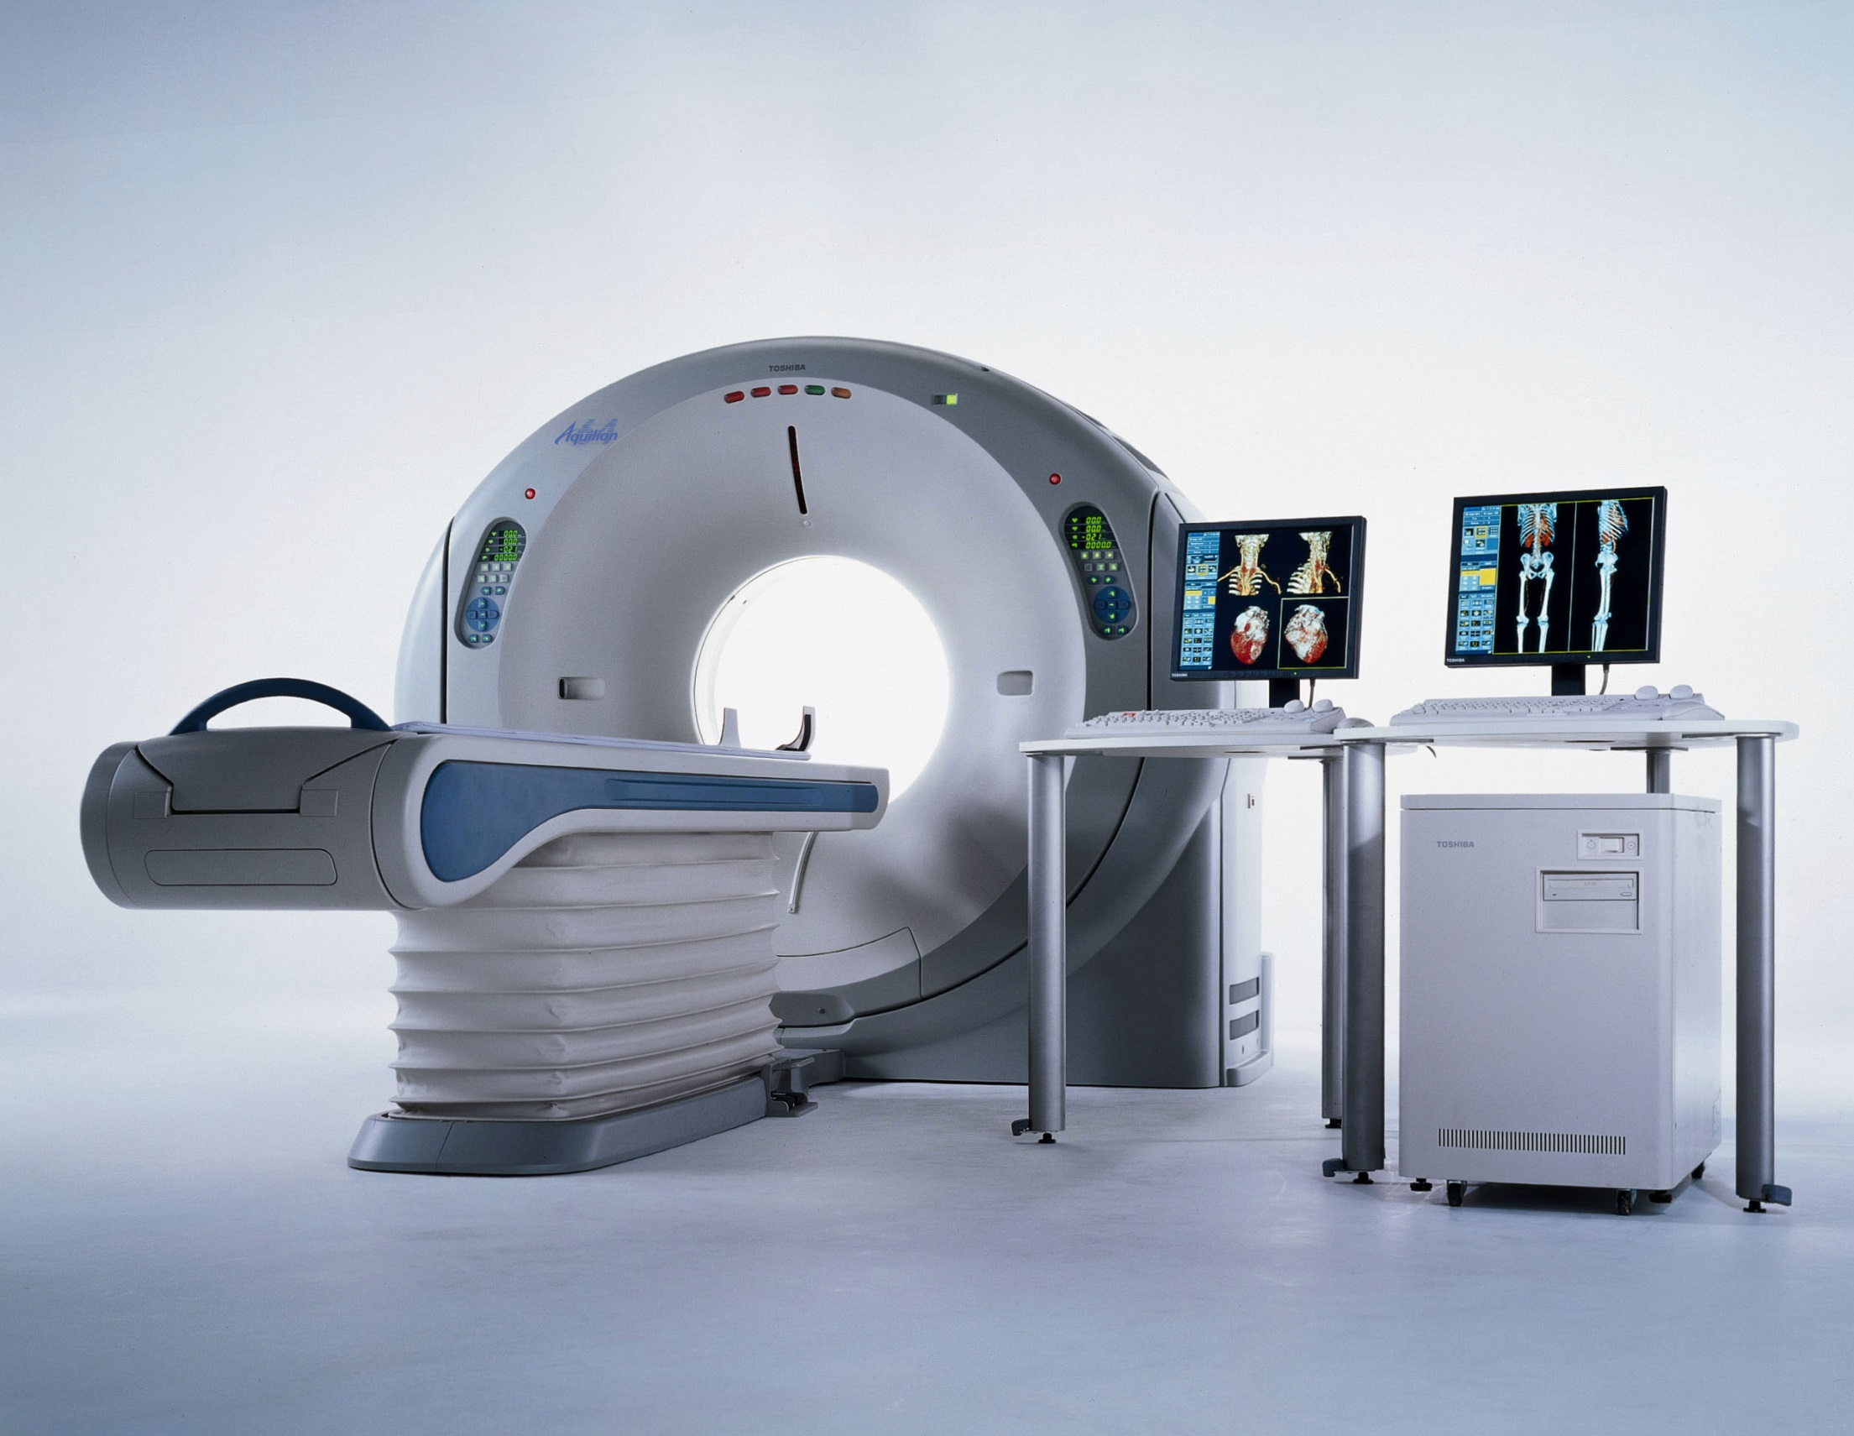
An MDP Approach to Multi-Category Patient Scheduling in a Diagnostic Facility
Adapted from: Matthew Dirks

Slide 3
Goal / Motivation
To develop a mathematical model for multi-category patient scheduling decisions in computed tomography (CT), and to investigate associated trade-offs from economic and operational perspectives.
Contributions to AI, OR and radiology

Slide 4
Types of patients:
Emergency Patients (EP)
  Critical (CEP)
  Non-critical (NCEP)
Inpatients (IP)
Outpatients
  Scheduled OP
  Add-on OP: Semi-urgent (OP)
(Green = Types used in this model)
Notes:
In facilities that perform CT scans there are varying degrees of urgency.
Assumptions:
Arriving CEPs scanned immediately (so no decision can be made here)
Scheduled OPs are scanned by a dedicated scanner (so, a 3rd scanner we don’t have access to)
Question: What if more than 2 CEPs? ?This model is not realistic, and is good only for theoretical/statistical analysis?
Scanning an OP first might lead to extra hospitalization for IP.
And IP staying overnight incurs cost penalty. Preferring IP over OP may lead to perceived loss of service-quality for the OP.

Slide 5
Proposed Solution
Finite-horizon MDP
Non-stationary arrival probabilities for IPs and EPs
Performance objective: Max $
Notes:
FINITE
Finite-Horizon MDPs are often used to model quantitative decision-making problems. Because guaranteed to find optimal policy whereas infinite can only approach optimality
Policies for infinite-horizon cases are actually simpler than those for finite-horizon cases because with no time-limit there is no reason to behave differently in the same state at different times, so the optimal policy is stationary.
So in this case, I think Finite-Horizon better suits since the day does have a finite length, and optimal policy may be different an hour before closing than at 9am
(b/c patients come in a varying probabilities)
THEY USE
Non-stationary arrival probabilities used for IP and EP
PERFORMANCE OBJECTIVE
Maximize expected net revenue over a work-day

Slide 6

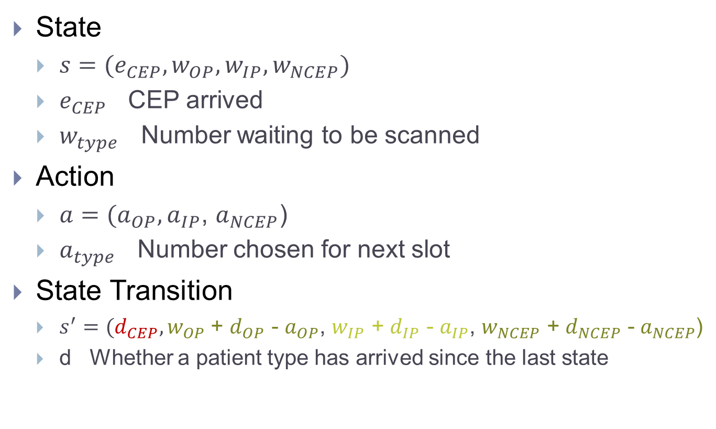
MDP Representation
State
  $s=(e_{CEP}, w_{OP}, w_{IP}, w_{NCEP})$
  $e_{CEP}$ CEP arrived
  $w_{type}$ Number waiting to be scanned
Action
  $a=(a_{OP},a_{IP}$, $a_{NCEP}$)
  $a_{type}$ Number chosen for next slot
State Transition
  $s^{′}=(d_{CEP},w_{OP}$ + $d_{OP}$ - $a_{OP}$, $w_{IP}$ + $d_{IP}$ - $a_{IP}$, $w_{NCEP}$ + $d_{NCEP}$ - $a_{NCEP}$)
  d Whether a patient type has arrived since the last state
Notes:
//Q: Would the optimal policy calculation change at all if critical emergency patients (CEP’s) were removed from the patient type domain?
Regarding CEPs. I don’t think the policy would change if they were removed, since the rule for CEPs is set in stone.
But it WOULD change # of slots available, and thus affect the results.
So, we don’t have to make a choice about whether to scan a CEP, but we do lose slots to those CEPs.

Slide 7
MDP Representation (cont’)
Transition Probabilities
Notes:
They also considered these in their analysis

Slide 8
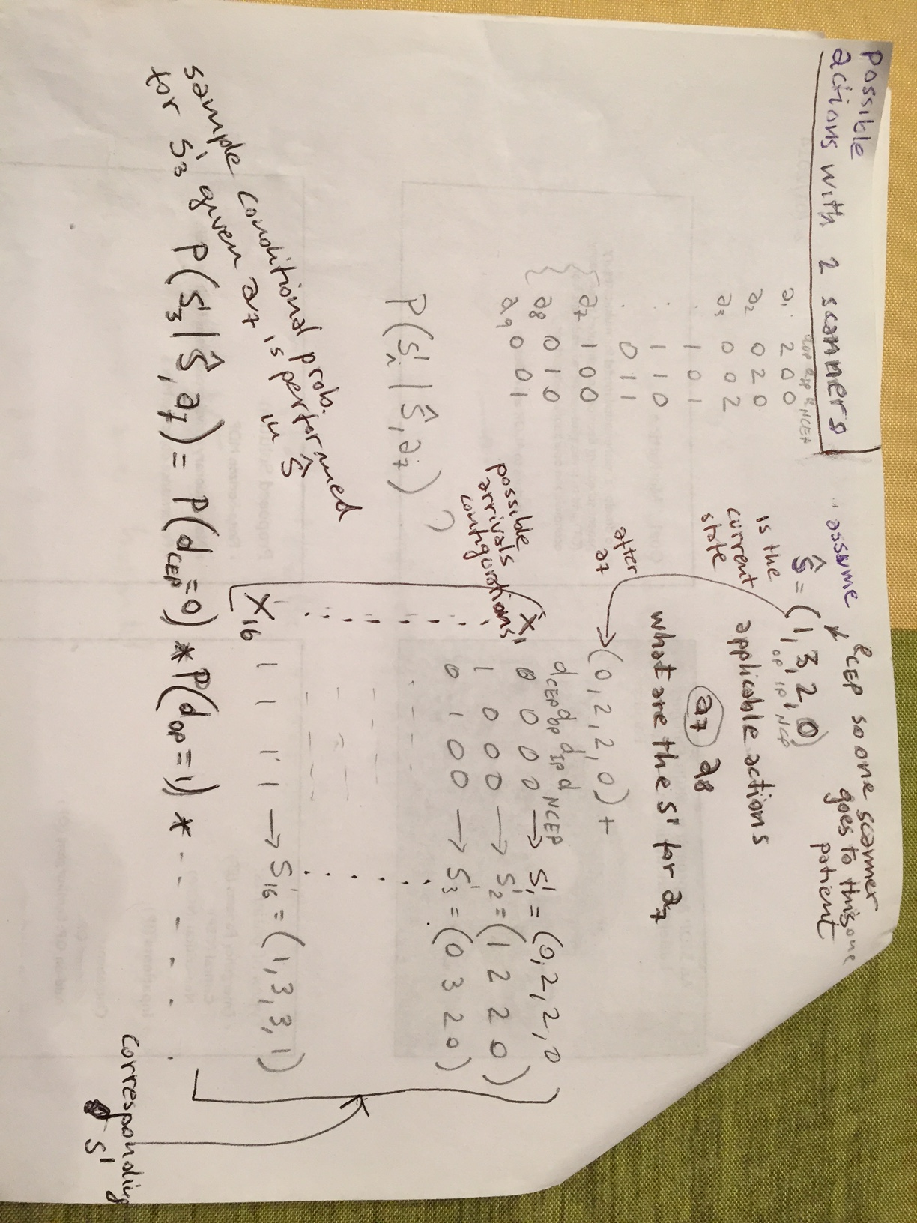
Example: action

Slide 9
example

Slide 10
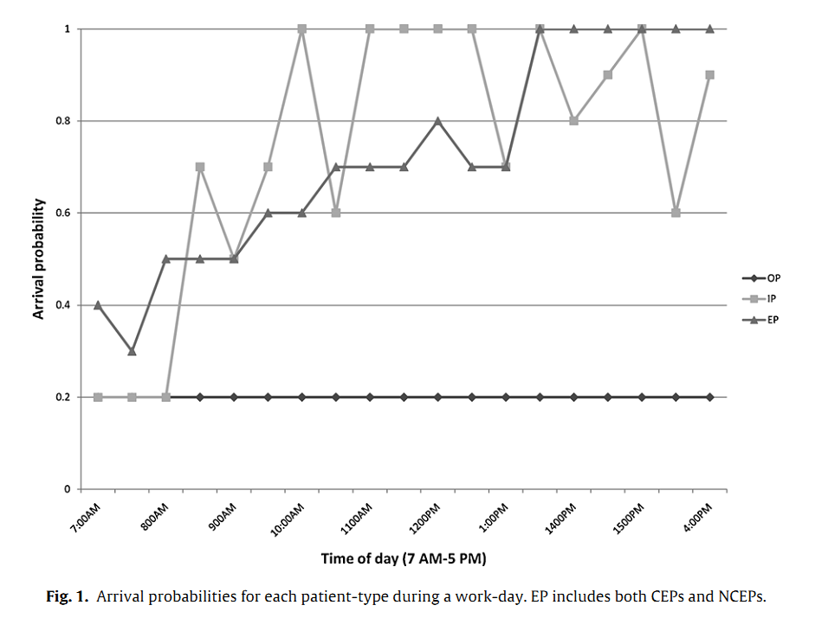
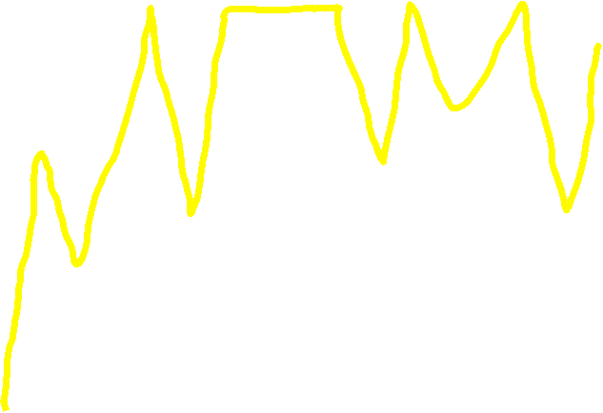
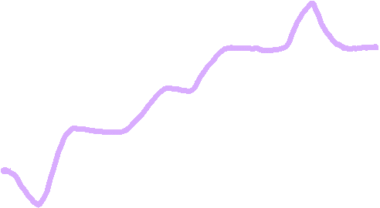
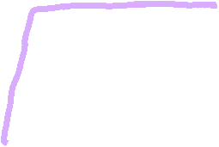
Notes:
Arrival probabilities
As you can see, it varies over the time of day

Slide 11
Notes:
Arrival probabilities
As you can see, it varies over the time of day

Slide 12

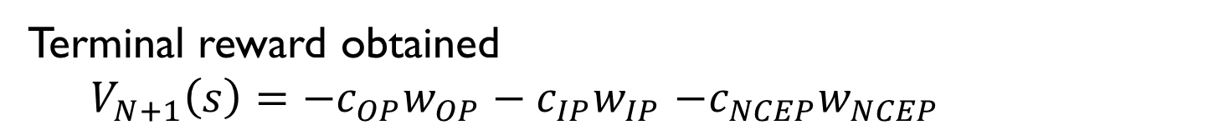
Performance Metrics (over 1 work-day)
Expected net CT revenue
Average waiting-time
Average # patients not scanned by day’s end
Rewards
Terminal reward obtained
  $V_{N+1}\left(s\right)=−c_{OP}w_{OP}−c_{IP}w_{IP}$ $−c_{NCEP}w_{NCEP}$
Discount factor? 1
Notes:
They also considered these in their analysis

Slide 13
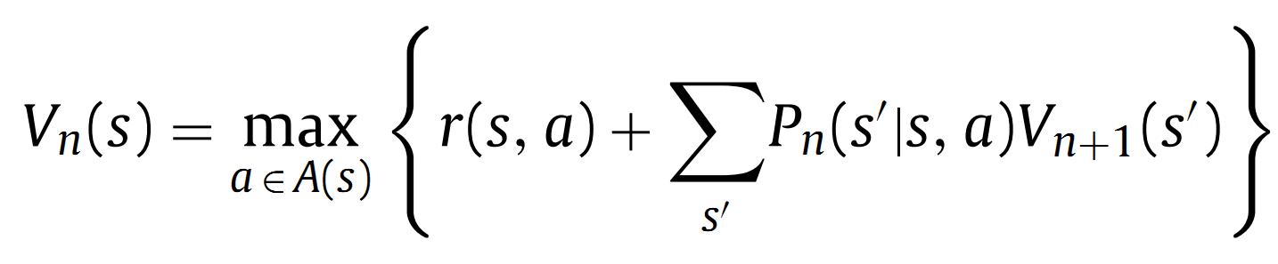
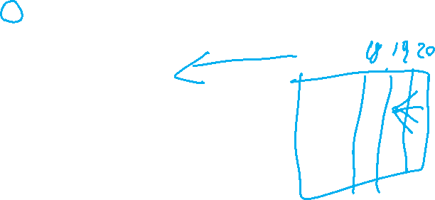
Maximize total expected revenue
Optimal Policy
  Solving this gives the policy for each state, n, in the day
Finite Horizon MDP
The recursive equation (3) has value of current state Vn calculated based on future state Vn+1, this contradicts with the equation given during class, where Vn+1 depends on Vn?
The one in class was Value Iteration (the n index was for the iteration) here we have a finite horizon. We know the Vs at the end so we can compute all the Vs backward. n is an index for the time slice
Notes:
Expected Revenue is the “Total penalty cost incurred for arriving patients who are not scanned by the end of the day”
This is BAD – so we incur the cost at the end of the day, but then these patients just disappear and we start fresh the next day?

Slide 14
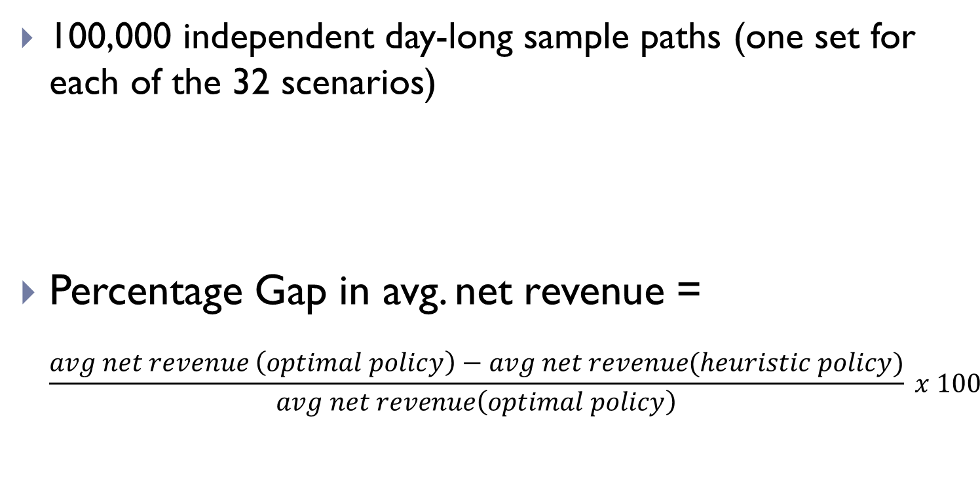

Evaluation: Comparison of MDP with Heuristic Policies
100,000 independent day-long sample paths (one set for each of the 32 scenarios)
Percentage Gap in avg. net revenue =
$\frac{avg net revenue \left(optimal policy\right)−avg net revenue(heuristic policy)}{avg net revenue\left(optimal policy\right)} x 100$
Result Metric

Slide 15
Heuristics
FCFS: First come first serve
R-1: One patient from randomly chosen type is scanned
R-2: One patient randomly chosen from all waiting patients (favors types with more people waiting)
O-1: Priority
  OP
  NCEP
  IP
O-2: Priority:
  OP
  IP
  NCEP
Notes:
These are the heuristics used to compare their optimal policy against
…
O-2: Intuition here is that Ips have higher penalty, so prioritizing them may be beneficial

Slide 16
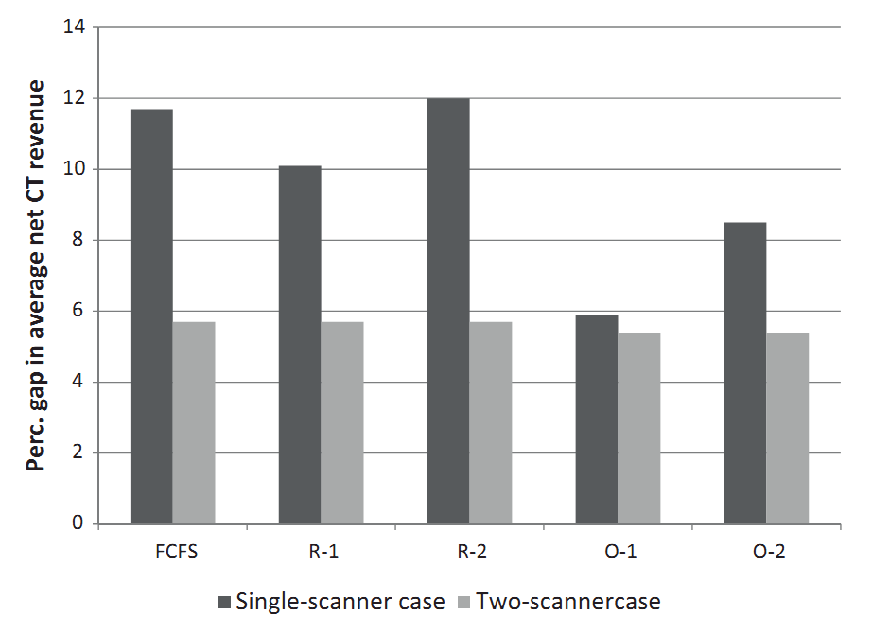
Notes:
This just says that their method did better than the heuristics in every case.
But by varying amounts, most notably for the single-scanner cases

Slide 17
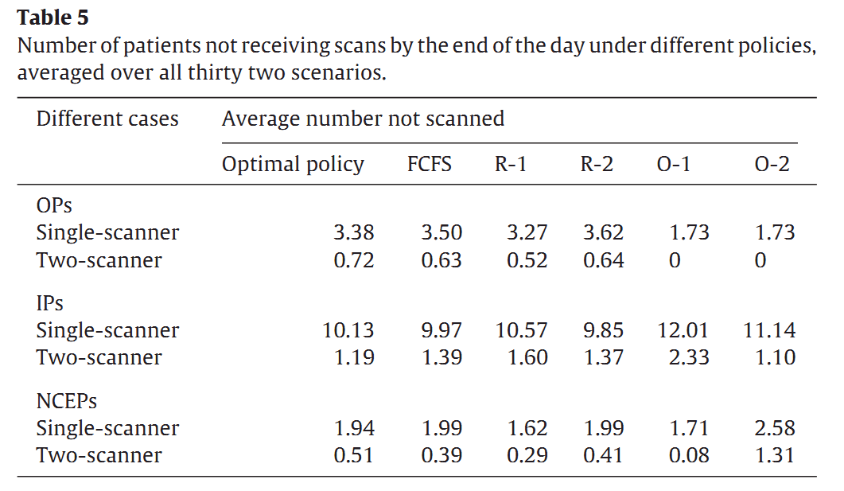
Number of patients not scanned
Notes:
Theirs performed better in some cases, but not by much in some cases
Ok, so # patients not receiving scans wasn’t improved very much. (In fact, in no case did Optimal perform the BEST)
The average number of patients not scanned by the end of the day, and the average waiting time of
a patient before service under the optimal policy are both nearly
80% smaller in the two-scanner case.

Slide 18
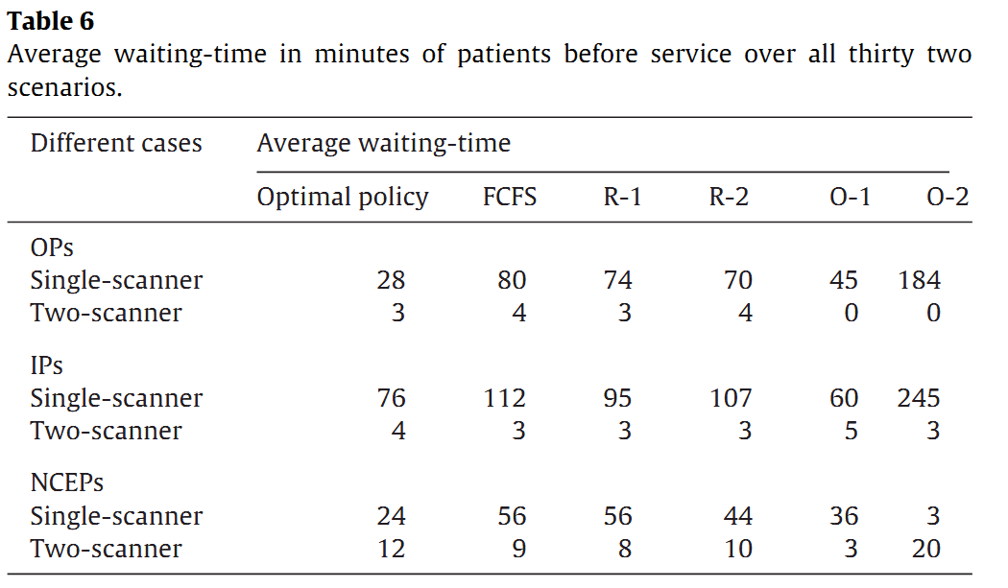
Waiting-time
Notes:
While optimal outperforms all heuristic rules in terms of net revenues, it is sometimes inferior in other performance metrics

Slide 19
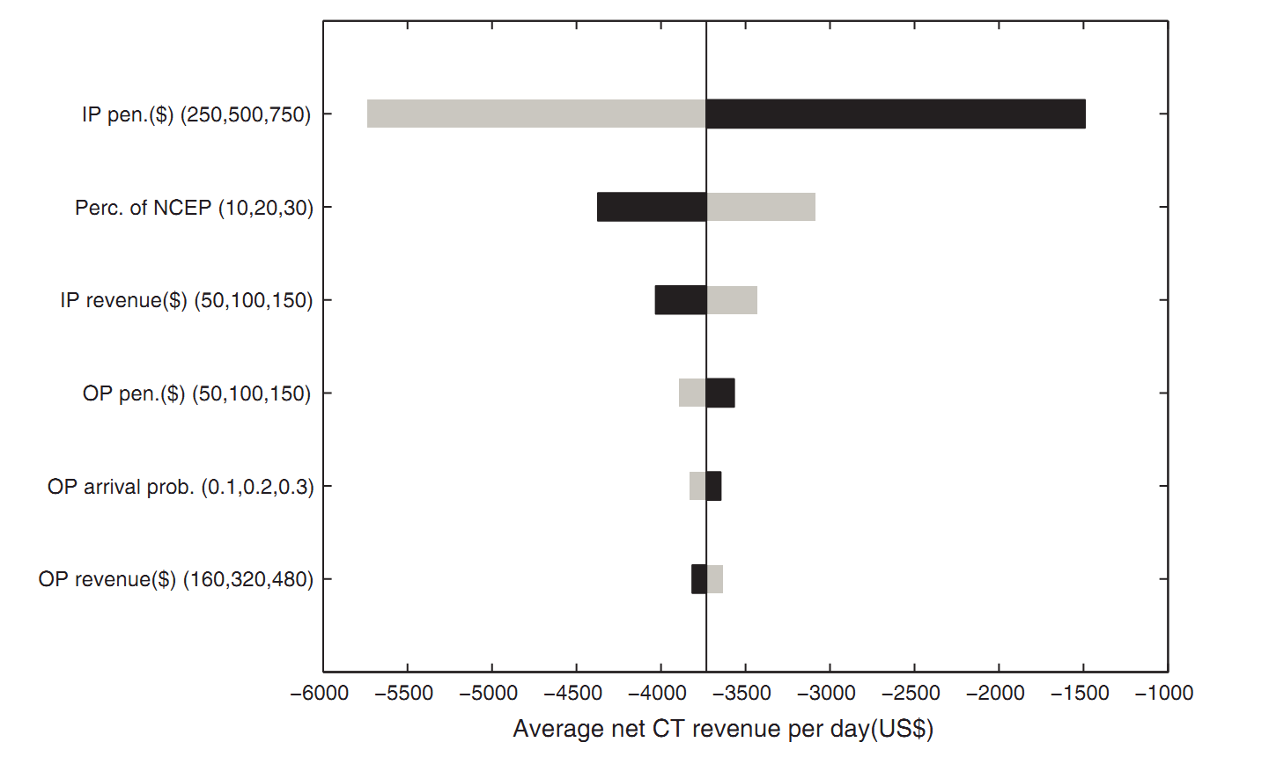
Single-scanner
Notes:
The avg net revenue is most sensitive to changes in IP penalty cost in the single scanner case. It is more sensitive to IP revenue and OP revenue when a second scanner is available
Here the IP penalty is most significant, because with 1 scanner you just can’t scan enough people in a given day.
This means that with 1 scanner, you’re best off favoring IPs

Slide 20
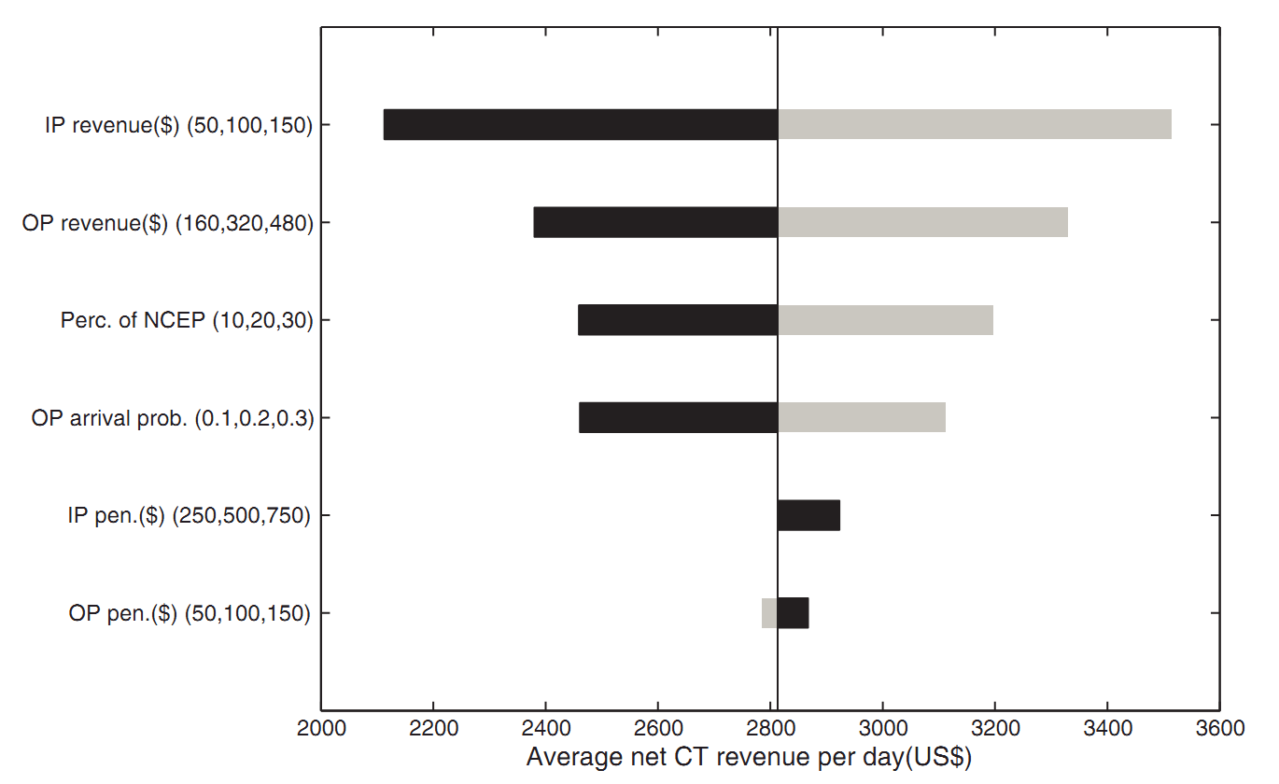
Two-scanner
Notes:
The avg net revenue is most sensitive to changes in IP penalty cost in the single scanner case. It is more sensitive to IP revenue and OP revenue when a second scanner is available
Why do we need a sensitivity analysis?
The answer to QUESTION is: shows how much each part of the expected cost will vary based on the param value.
It could be used to simplify the problem by removing things that don’t vary much, and could be used to raise awareness about which things you need to be sure are precise and accurate.
e.g. If we change the IP revenue by just a little bit (+- 50), the result is drastic revenue differences. So, this tells us that this value is important to get right, and perhaps should be modeled to reflect the differences per patient.

Slide 21
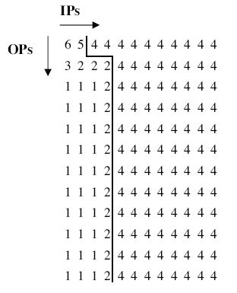
Sample Policy n=12, NCEP=5

Slide 22
Student selected questions 2021

Slide 23
Students’ (selected) questions
Assumptions
- why only 1 or 2 scanners. how does result change for more machines?
- In reality, due to possible equipment failure or operator leave, the situation of numbers of CT machine can vary. If we take this into consideration, how will this effect the output optimal policy?
- what if there are fewer or more than 20 timeslots?
- why only 4 types of patients? Too generic.
- Is using a fixed time for all CT scans realistic? Is there a distribution that could be used to represent this instead?
- How did they determine that a four-month period is sufficient for deriving the arrival probabilities of IPs and Eps?
Notes:
ASSUMPTIONS
- why only 1 or 2 scanners. how does result change for more machines?
- what if there are fewer or more than 20 timeslots?
- why only one request from each patient type arriving at each timeslot?
- identical time slot length for different patient. why?
- arrival probabilities -- request shouldn't be constant during the day. how can we change to consider this?
- Where was the data for the transitional probabilities obtained from?
- What if patient arrival probability is NOT independent, e.g. in the case of a large accident or epidemic?
- is there a variable that accounts for the peak in patients due to summer tourism?
- why only 4 type of patients?
- The authors deduced 32 possible scenarios (states) in this study to build a simplified model. I wonder how this number is chosen;
- In reality, due to possible equipment failure or operator leave, the situation of numbers of CT machine can vary. If we take this into consideration,how will this effect the output optimal policy?
****************************************************************************************************
DATA
- only one hospital. is it general enough?
- data is old. still valid?
****************************************************************************************************
MODEL
- why finite horizon MDP and not infinite horizon? in general how to choose between the two types?
- other approaches proposed:
- neural network (advantages of MDP with respect to NN?)
- reinforcement learning
- evolutionary algorithms
- dynamic programming (as it resembles jobs cheduling/load balancing problem)
- how to model more variables:
- night shifts
- over-time shifts
- waiting cost for NCEPs, IPs and OPs waiting for service
- human shortcomings such as people arriving late for the scan or being short staffed
- Can the model take into account human suffering?
- patient no-shows or cancellation?
- patient that starts as non critical but turns to be critical
- patient that is non critical but the longer it waits it becomes critical
- why did they not use value iteration here?
- What if instead of having 0 or 1 “additional patients waiting” for each patient type and for each time slot, we have “additional patients waiting” as a random variable that can be more than 1? This more accurately reflects reality. Would this have made the methodology more complicated?
****************************************************************************************************
METRICS / EXPERIMENTS / RESULTs
- why not against optimal policy?
- evaluation metrics make sense?
- In this paper, the metrics seem to be considered separately. Why not design a general metric that takes all those separate metrics into account by some weightings? In addition, the reward is designed only to maximize revenue; thus, there is no reason that the optimal policy will perform well according to other metrics.
****************************************************************************************************
IMPLEMENTATION - USE IN REAL LIFE
- why did they test it only in simulation? Are the assumptions simplifying too much to implement it in real hospitals?
- Is this method used in practice nowadays?
- How is the optimal policy to be implemented in practice?
- Is there evidence that such a theoretical analysis would work in practice?
- Since it breaks the queue rule, it is unfair to OPs who come to hospital earlier.
- Will computation costs ever be an issue with an MDP solution?
- How do these scientists plan on approaching such companies with this research to implement it in hospitals?
****************************************************************************************************
DOUBTS
- Markov Decision Process makes two assumptions: Markov assumption and stationary assumption. How do these two assumptions hold up for real life situations like this?
- What is the difference between Random selection-1 (R-1) and Random selection-2 (R-2)?
- Since they already have the optimal policy, why do they develop other decision rules?
- In section 4.1, there is a paired t-test together with standard significance level. What do those terms mean? What can they tell us in this case?
- What is the point of doing sensitivity analysis when the optimal policy already implicitly tells us which patients are more costly and therefore their relative importance?
- optimizing for net revenue is NOT ETHICAL. Probably optimizing for patient care? Is it possible to measure ethics in a model? Is maximizing the net revenue really going to help patients’ experience?
- So is the finite model in the paper not capable of scheduling patients on the waiting list across multiple days efficiently?
- Why include a parameter for the waiting cost only to set it to 0?
- Critical emergency patients (CEPs) are assumed to be medically unstable enough to necessitate scanning in the next slot. Why? /Would it make a difference to the MDP model and results if instead we incorporated this assumption by making the reward for scanning CEPs very high (or alternatively the action penalty incurred very heavy)?
- Why does the penalty costs for IPs are assumed to be higher than other patiend-types? In my opinion, OPs have higher probability to go to other hospital. In order to generate more profit, OPs should have priority.
- Problems understanding the tornado charts. what do they tell?
- How does the model handle appointments made in advance?
- paper is 8 years old. What is the state of the art for this problem?
- can this research be applied to other types of scheduling like interval scheduling?
- how does this model generalise to other imaging services provided medical facilities?
- How did the authors decide on the base-case penalty for IPs staying an extra day? The $500 price tag without any basis seems to be a pretty big flaw.
- setting cost parameter h to unity - what does this mean and what is its significance?
- how is p-values computed actually? (from table 3 and table 4)

Slide 24
Students’ (selected) questions
Models
why finite horizon MDP and not infinite horizon? in general how to choose between the two types?
neural network (advantages of MDP with respect to NN?) - reinforcement learning?
- dynamic programming (as it resembles jobs scheduling/load balancing problem)
- Can the model take into account human suffering?
- Patient that starts as non critical but turns to be critical
- why did they not use value iteration here?
- What if instead of having 0 or 1 “additional patients waiting” for each patient type and for each time slot, we have “additional patients waiting” as a random variable that can be more than 1? This more accurately reflects reality. Would this have made the methodology more complicated
Notes:
****************************************************************************************************
DATA
- only one hospital. is it general enough?
- data is old. still valid?
****************************************************************************************************
MODEL
- why finite horizon MDP and not infinite horizon? in general how to choose between the two types?
- other approaches proposed:
- neural network (advantages of MDP with respect to NN?)
- reinforcement learning
- evolutionary algorithms
- dynamic programming (as it resembles jobs cheduling/load balancing problem)
- how to model more variables:
- night shifts
- over-time shifts
- waiting cost for NCEPs, IPs and OPs waiting for service
- human shortcomings such as people arriving late for the scan or being short staffed
- Can the model take into account human suffering?
- patient no-shows or cancellation?
- patient that starts as non critical but turns to be critical
- patient that is non critical but the longer it waits it becomes critical
- why did they not use value iteration here?
- What if instead of having 0 or 1 “additional patients waiting” for each patient type and for each time slot, we have “additional patients waiting” as a random variable that can be more than 1? This more accurately reflects reality. Would this have made the methodology more complicated?
****************************************************************************************************
METRICS / EXPERIMENTS / RESULTs
- why not against optimal policy?
- evaluation metrics make sense?
- In this paper, the metrics seem to be considered separately. Why not design a general metric that takes all those separate metrics into account by some weightings? In addition, the reward is designed only to maximize revenue; thus, there is no reason that the optimal policy will perform well according to other metrics.
****************************************************************************************************
IMPLEMENTATION - USE IN REAL LIFE
- why did they test it only in simulation? Are the assumptions simplifying too much to implement it in real hospitals?
- Is this method used in practice nowadays?
- How is the optimal policy to be implemented in practice?
- Is there evidence that such a theoretical analysis would work in practice?
- Since it breaks the queue rule, it is unfair to OPs who come to hospital earlier.
- Will computation costs ever be an issue with an MDP solution?
- How do these scientists plan on approaching such companies with this research to implement it in hospitals?
****************************************************************************************************
DOUBTS
- Markov Decision Process makes two assumptions: Markov assumption and stationary assumption. How do these two assumptions hold up for real life situations like this?
- What is the difference between Random selection-1 (R-1) and Random selection-2 (R-2)?
- Since they already have the optimal policy, why do they develop other decision rules?
- In section 4.1, there is a paired t-test together with standard significance level. What do those terms mean? What can they tell us in this case?
- What is the point of doing sensitivity analysis when the optimal policy already implicitly tells us which patients are more costly and therefore their relative importance?
- optimizing for net revenue is NOT ETHICAL. Probably optimizing for patient care? Is it possible to measure ethics in a model? Is maximizing the net revenue really going to help patients’ experience?
- So is the finite model in the paper not capable of scheduling patients on the waiting list across multiple days efficiently?
- Why include a parameter for the waiting cost only to set it to 0?
- Critical emergency patients (CEPs) are assumed to be medically unstable enough to necessitate scanning in the next slot. Why? /Would it make a difference to the MDP model and results if instead we incorporated this assumption by making the reward for scanning CEPs very high (or alternatively the action penalty incurred very heavy)?
- Why does the penalty costs for IPs are assumed to be higher than other patiend-types? In my opinion, OPs have higher probability to go to other hospital. In order to generate more profit, OPs should have priority.
- Problems understanding the tornado charts. what do they tell?
- How does the model handle appointments made in advance?
- paper is 8 years old. What is the state of the art for this problem?
- can this research be applied to other types of scheduling like interval scheduling?
- how does this model generalise to other imaging services provided medical facilities?
- How did the authors decide on the base-case penalty for IPs staying an extra day? The $500 price tag without any basis seems to be a pretty big flaw.
- setting cost parameter h to unity - what does this mean and what is its significance?
- how is p-values computed actually? (from table 3 and table 4)

Slide 25
Students’ (selected) questions
METRICS / EXPERIMENTS / RESULTs… IMPLEMENTATION - USE IN REAL LIFE
evaluation metrics make sense? is the reward designed only to maximize revenue? Probably optimizing for patient care? Is it possible to measure ethics in a model?
- Will computation costs ever be an issue with an MDP solution?
- Is there evidence that such a theoretical analysis would work in practice?
- Is this method used in practice nowadays?
Notes:
****************************************************************************************************
METRICS / EXPERIMENTS / RESULTs
- why not against optimal policy?
- evaluation metrics make sense?
- In this paper, the metrics seem to be considered separately. Why not design a general metric that takes all those separate metrics into account by some weightings? In addition, the reward is designed only to maximize revenue; thus, there is no reason that the optimal policy will perform well according to other metrics.
****************************************************************************************************
IMPLEMENTATION - USE IN REAL LIFE
- why did they test it only in simulation? Are the assumptions simplifying too much to implement it in real hospitals?
- Is this method used in practice nowadays?
- How is the optimal policy to be implemented in practice?
- Is there evidence that such a theoretical analysis would work in practice?
- Since it breaks the queue rule, it is unfair to OPs who come to hospital earlier.
- Will computation costs ever be an issue with an MDP solution?
- How do these scientists plan on approaching such companies with this research to implement it in hospitals?
****************************************************************************************************
DOUBTS
- Markov Decision Process makes two assumptions: Markov assumption and stationary assumption. How do these two assumptions hold up for real life situations like this?
- What is the difference between Random selection-1 (R-1) and Random selection-2 (R-2)?
- Since they already have the optimal policy, why do they develop other decision rules?
- In section 4.1, there is a paired t-test together with standard significance level. What do those terms mean? What can they tell us in this case?
- What is the point of doing sensitivity analysis when the optimal policy already implicitly tells us which patients are more costly and therefore their relative importance?
- optimizing for net revenue is NOT ETHICAL. Probably optimizing for patient care? Is it possible to measure ethics in a model? Is maximizing the net revenue really going to help patients’ experience?
- So is the finite model in the paper not capable of scheduling patients on the waiting list across multiple days efficiently?
- Why include a parameter for the waiting cost only to set it to 0?
- Critical emergency patients (CEPs) are assumed to be medically unstable enough to necessitate scanning in the next slot. Why? /Would it make a difference to the MDP model and results if instead we incorporated this assumption by making the reward for scanning CEPs very high (or alternatively the action penalty incurred very heavy)?
- Why does the penalty costs for IPs are assumed to be higher than other patiend-types? In my opinion, OPs have higher probability to go to other hospital. In order to generate more profit, OPs should have priority.
- Problems understanding the tornado charts. what do they tell?
- How does the model handle appointments made in advance?
- paper is 8 years old. What is the state of the art for this problem?
- can this research be applied to other types of scheduling like interval scheduling?
- how does this model generalise to other imaging services provided medical facilities?
- How did the authors decide on the base-case penalty for IPs staying an extra day? The $500 price tag without any basis seems to be a pretty big flaw.
- setting cost parameter h to unity - what does this mean and what is its significance?
- how is p-values computed actually? (from table 3 and table 4)

Slide 26
Students’ (selected) questions
Others
Since they already have the optimal policy, why do they develop other decision rules?
In section 4.1, there is a paired t-test together with standard significance level. What do those terms mean? What can they tell us in this case?
- paper is 10 years old. What is the state of the art for this problem?
Notes:
****************************************************************************************************
DOUBTS
- Markov Decision Process makes two assumptions: Markov assumption and stationary assumption. How do these two assumptions hold up for real life situations like this?
- What is the difference between Random selection-1 (R-1) and Random selection-2 (R-2)?
- Since they already have the optimal policy, why do they develop other decision rules?
- In section 4.1, there is a paired t-test together with standard significance level. What do those terms mean? What can they tell us in this case?
- What is the point of doing sensitivity analysis when the optimal policy already implicitly tells us which patients are more costly and therefore their relative importance?
- optimizing for net revenue is NOT ETHICAL. Probably optimizing for patient care? Is it possible to measure ethics in a model? Is maximizing the net revenue really going to help patients’ experience?
- So is the finite model in the paper not capable of scheduling patients on the waiting list across multiple days efficiently?
- Why include a parameter for the waiting cost only to set it to 0?
- Critical emergency patients (CEPs) are assumed to be medically unstable enough to necessitate scanning in the next slot. Why? /Would it make a difference to the MDP model and results if instead we incorporated this assumption by making the reward for scanning CEPs very high (or alternatively the action penalty incurred very heavy)?
- Why does the penalty costs for IPs are assumed to be higher than other patiend-types? In my opinion, OPs have higher probability to go to other hospital. In order to generate more profit, OPs should have priority.
- Problems understanding the tornado charts. what do they tell?
- How does the model handle appointments made in advance?
- paper is 8 years old. What is the state of the art for this problem?
- can this research be applied to other types of scheduling like interval scheduling?
- how does this model generalise to other imaging services provided medical facilities?
- How did the authors decide on the base-case penalty for IPs staying an extra day? The $500 price tag without any basis seems to be a pretty big flaw.
- setting cost parameter h to unity - what does this mean and what is its significance?
- how is p-values computed actually? (from table 3 and table 4)

Slide 27
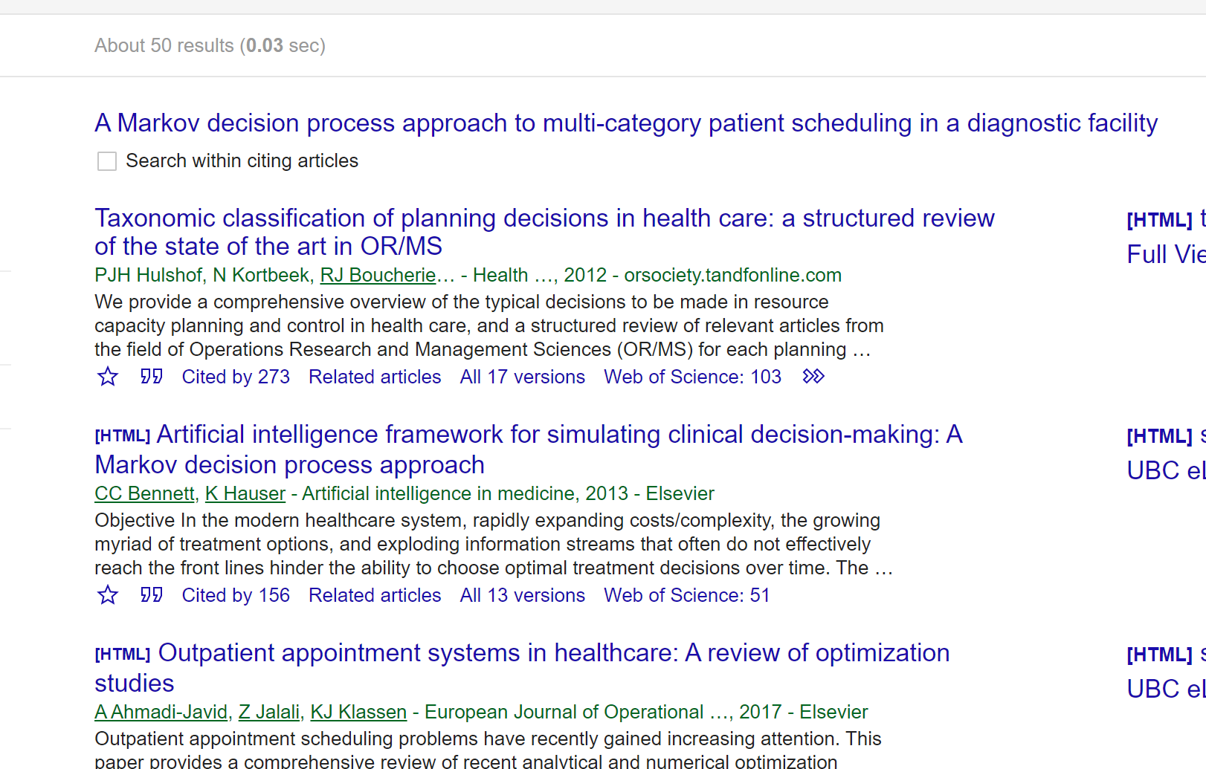
More than 50 citations

Slide 28
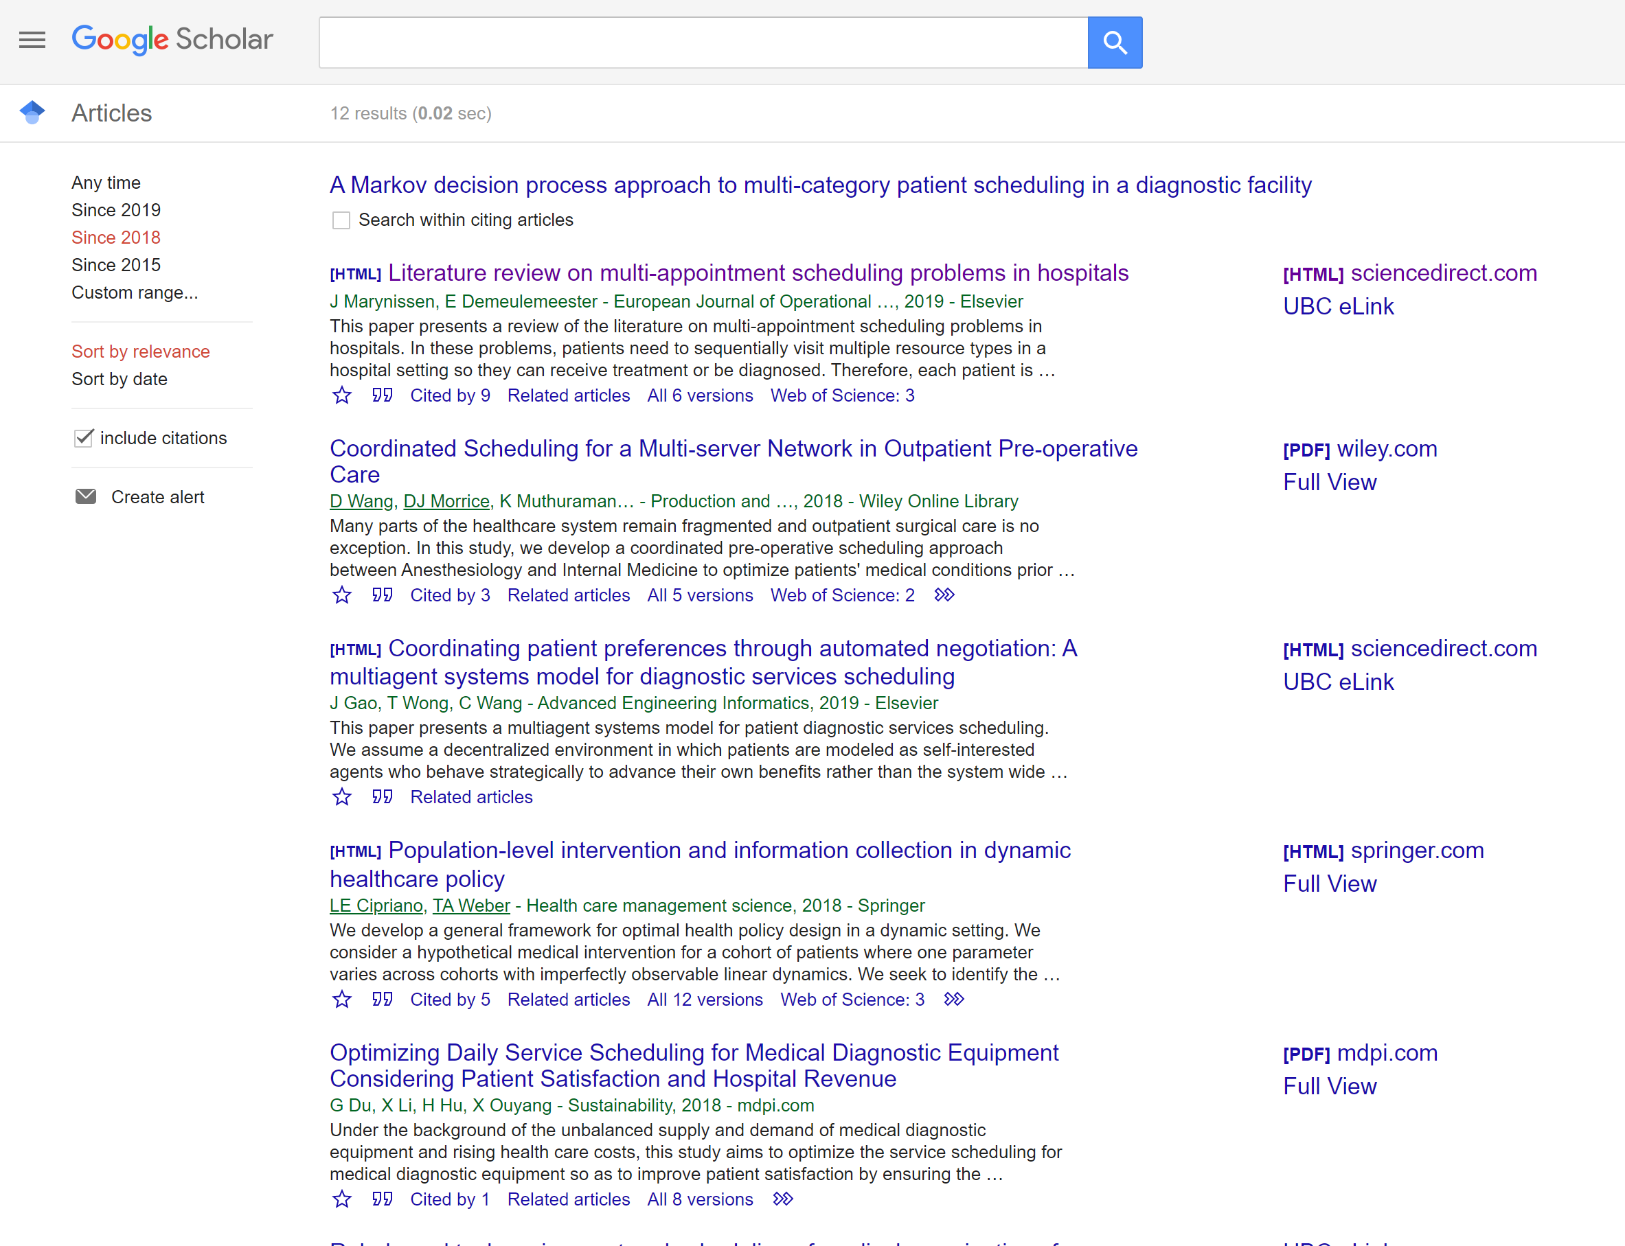
12 from 2018….

Slide 29
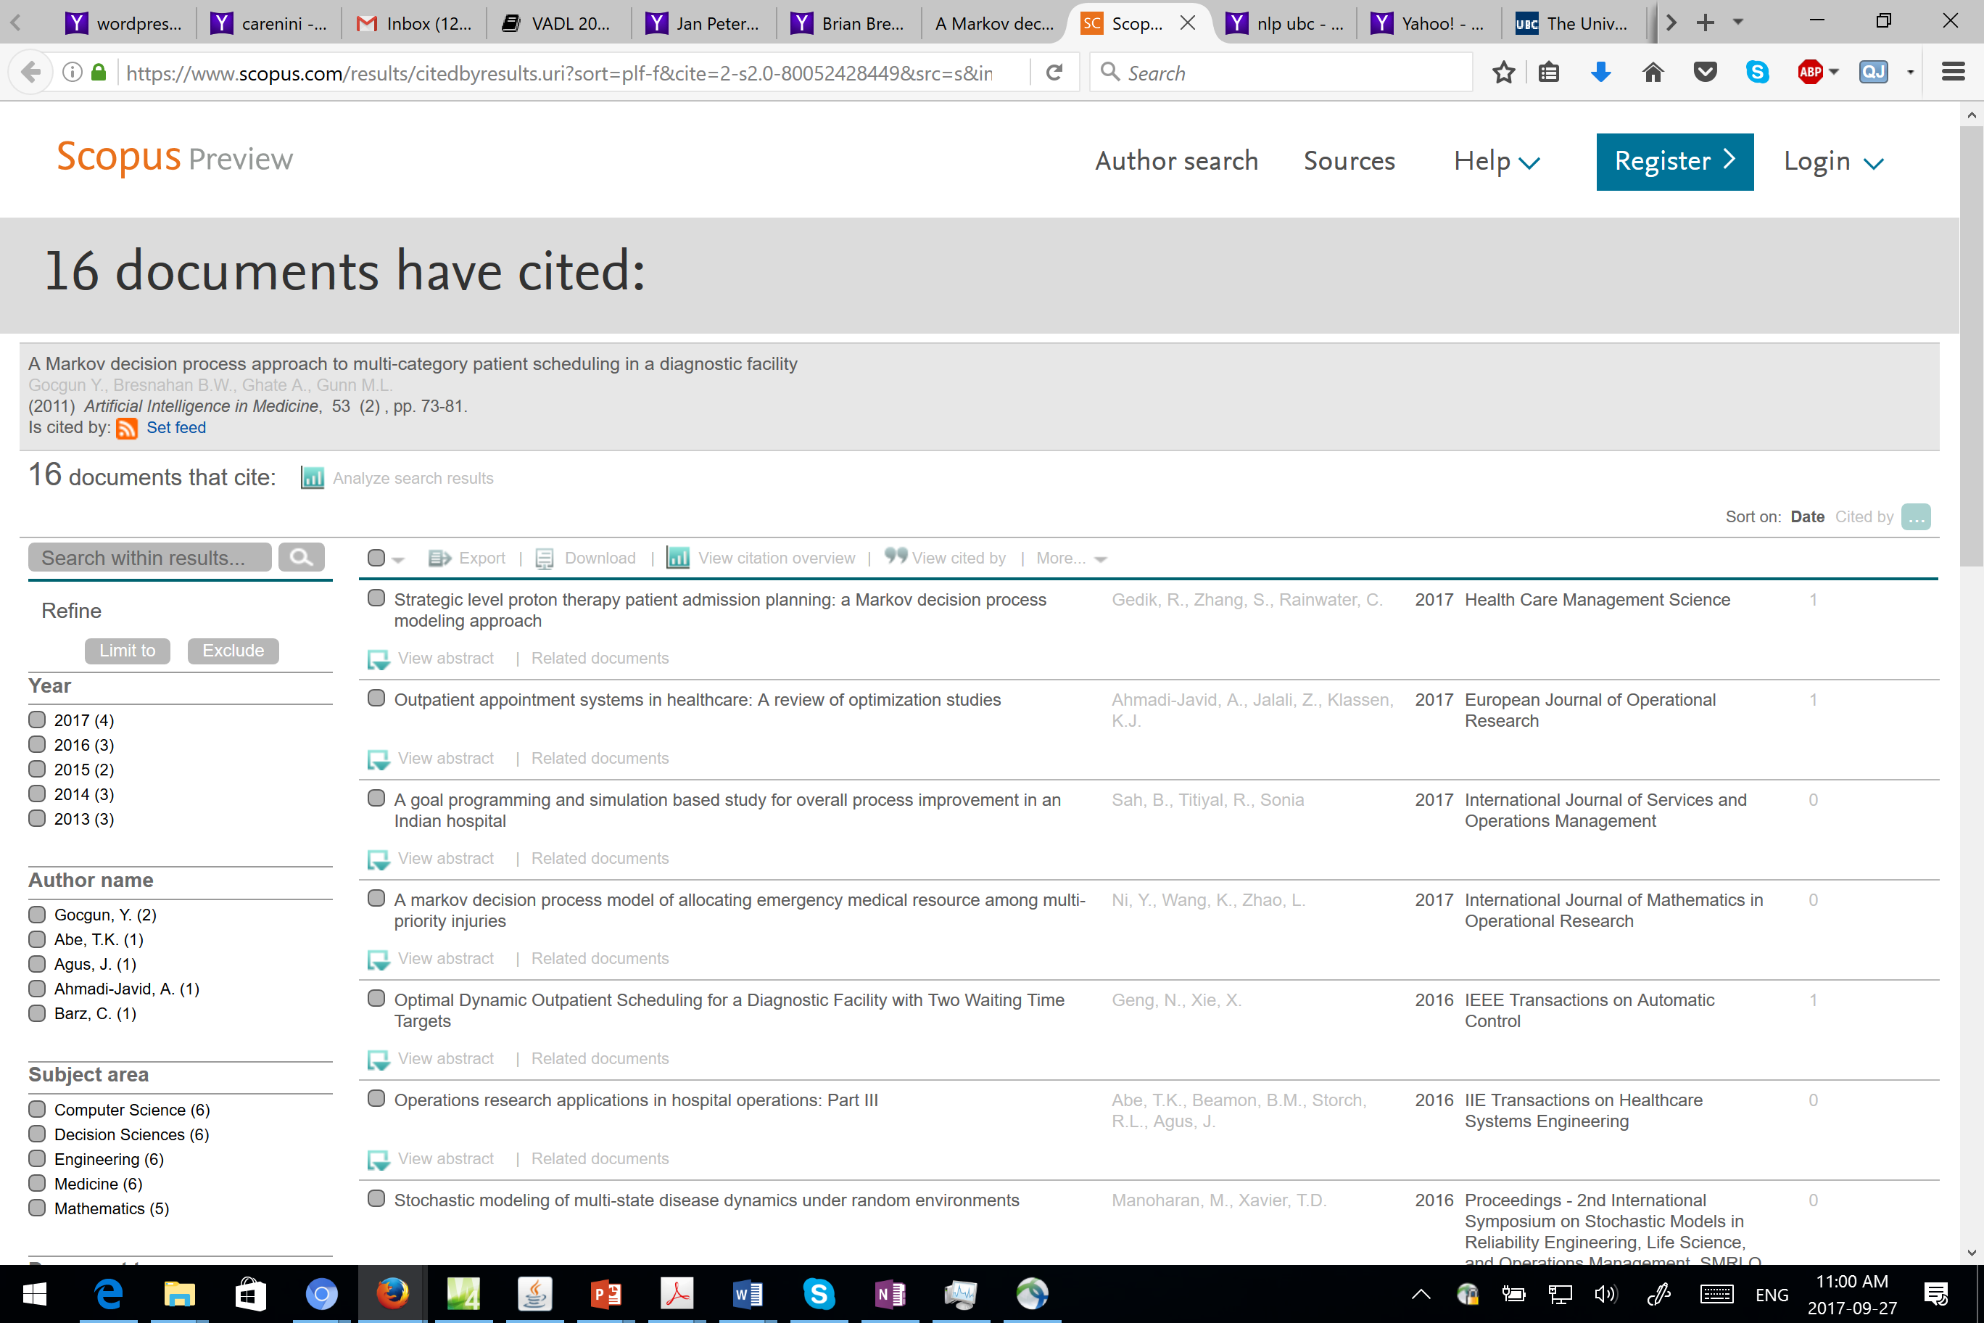

Slide 30
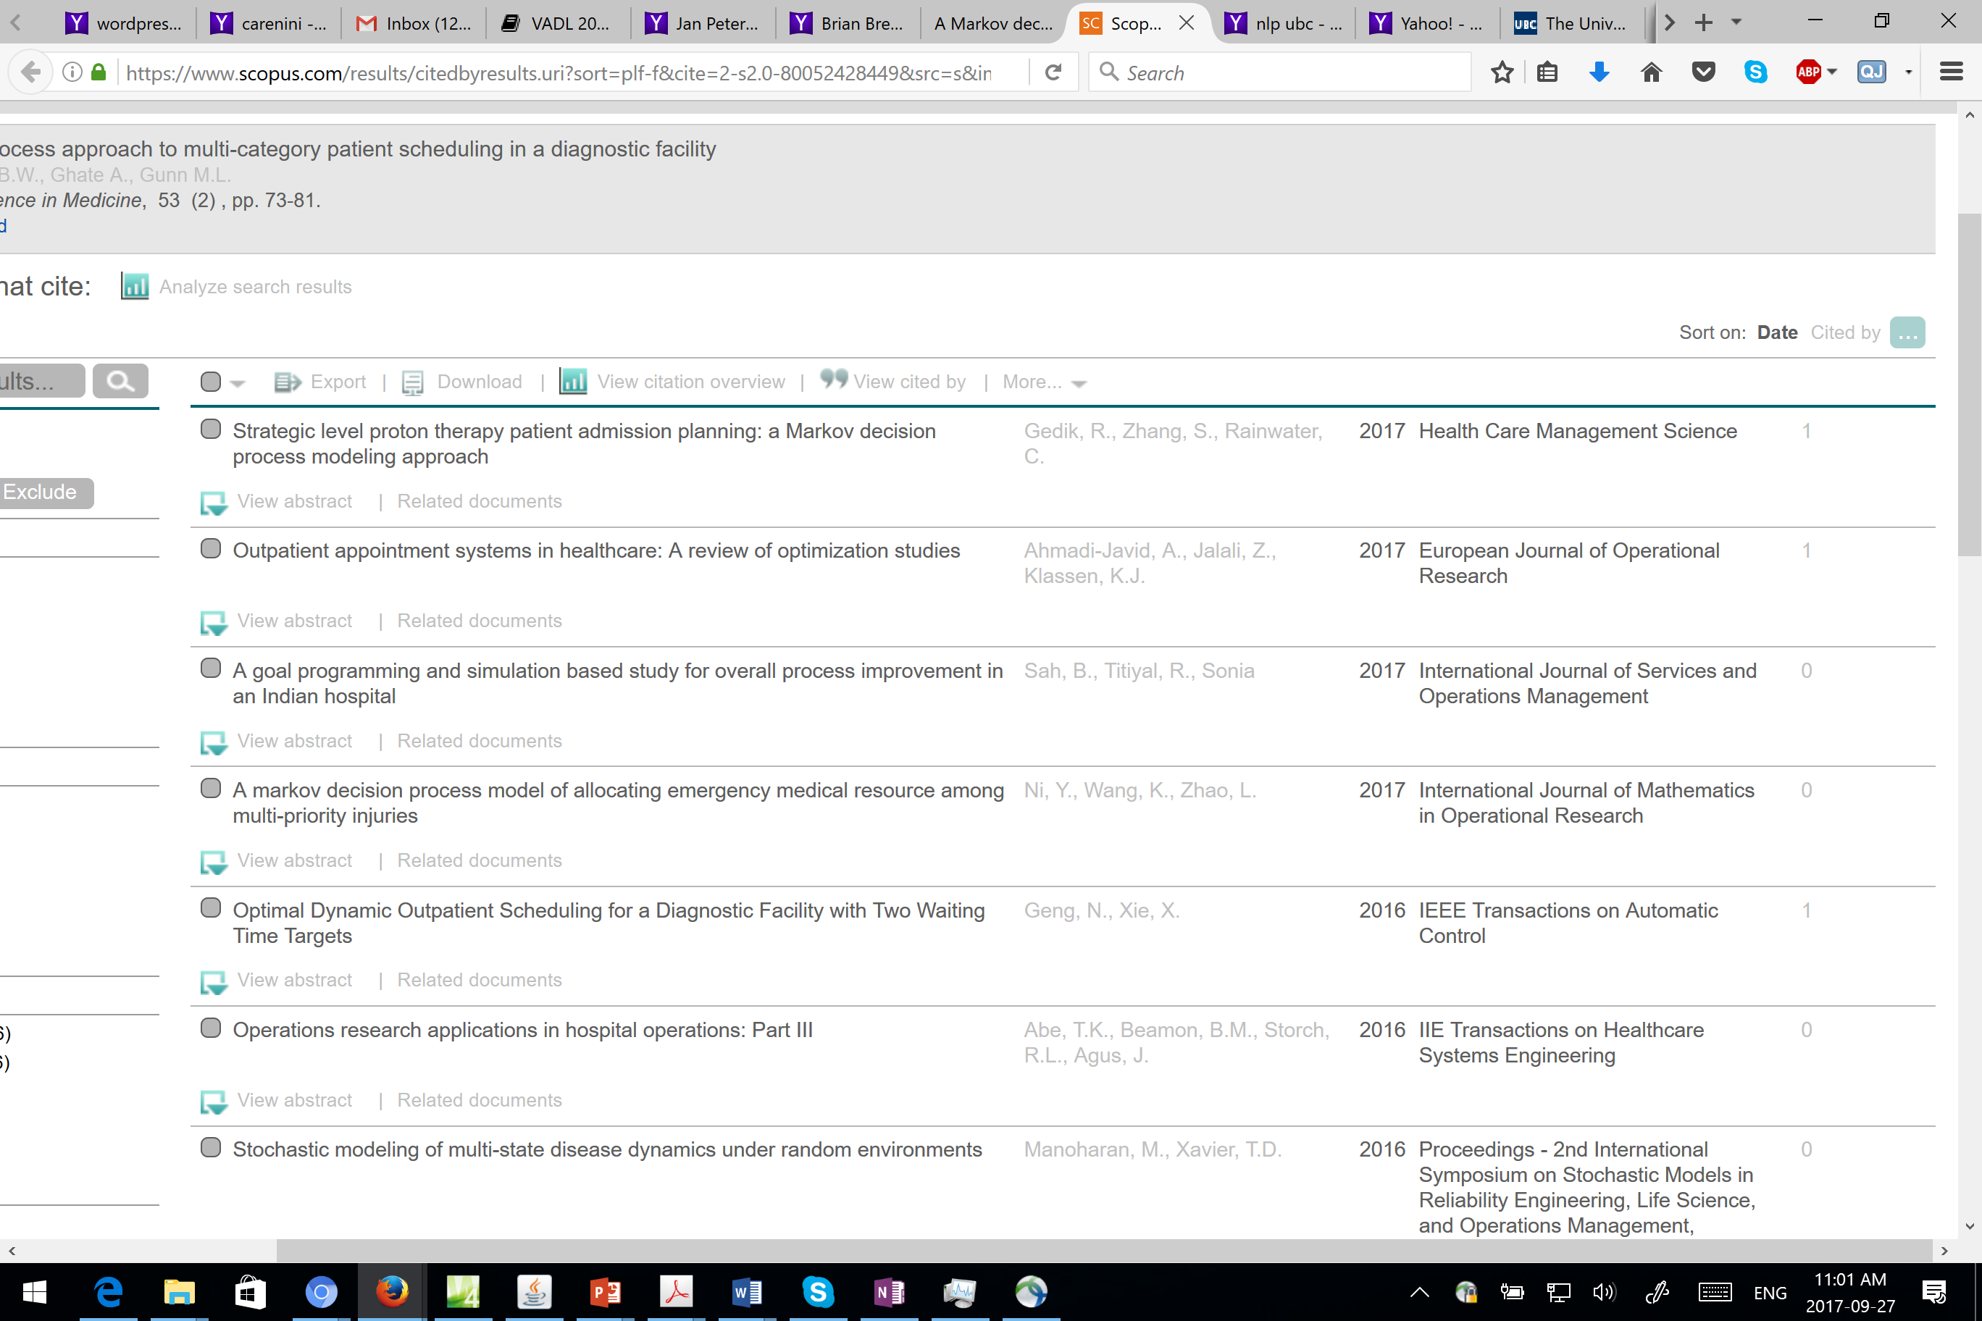

Slide 31
Question from students (2017)
Would the model cause ethical problems in hospitals? Is revenue a good metric of performance if we put life and death situations into consideration?
Finite vs. infinite
  Simplicity. Lots of uncertainty about what can happen overnight
  Non stationary process – best action depends on time
Use machine learning / reinforcement learning?
Arrival Probabilities (seasonal trends? More than one patient of each type?)
Only comparison with simple heuristics
More scanners Why only 1 and 2 scanners?
Modeling more patient types (urgency) / different hospital….. can easily extend the model
Only data from one Hospital (general?)
Uniform slot length (realistic?) Finer granularity of the time slots
Modeling even more uncertainty “Accidents happen randomly without any pattern.” “Scanner not working”
What is a potential adjustment you can do to the MDP that will account for the variability in time taken to perform a scan, or multiple scans for a particular type of patient?
Notes:
the probability distribution of the time for CT scans to be completed rather than to make the assumption that they are all of fixed duration?
Can we also determine how many more CT scanner will increase revenue before having diminishing revenue.
Accidents happen randomly without any pattern. Different patients have different health situation. Would Q-learning be a more suitable tool for patient scheduling as the model improves over unbounded learning over time? Why or why not?
You can always envision more and more sophisticated models but do you have the data to learn their params?
Rewards Would it be
a better policy if we also incorporate the "longest waiting time" in
each patient group? Is this idea easy to implement?
for facilities that are open 24/7, wouldn't an infinite MDP be better? If the goal is economic optimality, would the discount factor need to be related to current interest rates? How would the economic benefit projections change with variations in those interest rates?

Slide 32
Benefits classifying more patient types? Could same solution be applied to scheduling other functions of the hospital?
How would this model handle two CEPs that came in at the same time? Randomly Push one to the next slot ☹
What happens if you add a sudden influx of patients? Example, due to a nearby accident. Will it still perform better than the heuristics?
Transfer model to other facilities? Yes…
Discount factor 1? Yes
This work failed to take into account human suffering, or the urgency of scans for in and out patients. Could the reward function to tailored to include such concepts or is it beyond the capabilities of the model?
This model is specific to the target hospital
Operational Cost of Implementing the policy (take into account): compute the policy vs. apply the policy

Slide 33
Question Types from students
Finite vs. infinite
  Simplicity. Lots of uncertainty about what can happen overnight
  Non stationary process – best action depends on time
Arrival Probabilities
More scanners
Modeling more patient types (urgency) / different hospital….. can easily extend the model, Only data from one Hospital (general?)
Uniform slot length (realistic?)
the probability distribution of the time for CT scans to be completed rather than to make the assumption that they are all of fixed duration? Finer granularity of the time slots
Operational Cost of Implementing the policy (take into account): compute the policy vs. apply the policy
Modeling even more uncertainty “Accidents happen randomly without any pattern.” “Scanner not working”
2 patients at once (need to collect all the prob and consider those in the transition prob)
P-value
Why no VI?
Used in practice ?
Notes:
the probability distribution of the time for CT scans to be completed rather than to make the assumption that they are all of fixed duration?
Can we also determine how many more CT scanner will increase revenue before having diminishing revenue.
Accidents happen randomly without any pattern. Different patients have different health situation. Would Q-learning be a more suitable tool for patient scheduling as the model improves over unbounded learning over time? Why or why not?
You can always envision more and more sophisticated models but do you have the data to learn their params?
Rewards Would it be
a better policy if we also incorporate the "longest waiting time" in
each patient group? Is this idea easy to implement?
for facilities that are open 24/7, wouldn't an infinite MDP be better? If the goal is economic optimality, would the discount factor need to be related to current interest rates? How would the economic benefit projections change with variations in those interest rates?

Slide 34
Other models: Is it better to use continuous Markov Chain and queuing theory in analyzing this scheduling problem?
How would this model handle two CEPs that came in at the same time? Randomly Push one to the next slot ☹
How does approximate dynamic programming compare to value iteration? (approximate method, can deal with bigger models but not optimal)
Transfer model to other facilities? Yes…
Discount factor 1? Yes
This work failed to take into account human suffering, or the urgency of of scans for in and out patients. Could the reward function to tailored to include such nebulous concepts or is it beyond the capabilities of the model?
This model is specific to the target hospital
I think outperforming other MDP-based models can better illustrate the effectiveness of this model's features, so are the choices of comparison methods good in this paper?
First step showing that sound probabilistic models can be build and outperform heuristics then you can do the above

