Slide 1
Intelligent Systems (AI-2)
Computer Science cpsc422, Lecture 7
Jan, 25, 2021

Slide 2
Course Announcements
Assignment 1 has been posted (due Sep 27)
ValueOfInfo and ValueOfControl
MDPs: Value Iteration
POMDPs: Belief State Update
Notes:
POMDPs were initially formalized by the control theory and operations research communities
to optimally control stochastic dynamical systems.
More recently, the articial intelligence community also considered POMDPs for planning
under uncertainty. To date, a wide range of sequential decision problems
such as robot navigation, preference elicitation, stochastic resource
allocation, maintenance scheduling, spoken-dialog systems
and many others have been modeled using POMDPs.

Slide 3
StarAI (statistical relational AI)
Hybrid: Det +Sto
422 big picture
Parsing
Prob CFG
Prob Relational Models
Markov Logics
Deterministic
Stochastic
Belief Nets
Logics
Approx. : Gibbs
First Order Logics
Markov Chains and HMMs
Ontologies
Forward, Viterbi….
Approx. : Particle Filtering
Query
Full Resolution
SAT
Undirected Graphical Models
Markov Networks
Conditional Random Fields
Markov Decision Processes and
Partially Observable MDP
Planning
Value Iteration
Approx. Inference
Reinforcement Learning
Representation
Applications of AI
Reasoning
Technique
Notes:
Breadth and Depth

Slide 4
Lecture Overview
Start Reinforcement Learning
  Start Q-learning
  Estimate by Temporal Differences

Slide 5
MDP and Reinforcement Learning (RL)
Markov decision process
  Set of states S, set of actions A
  Transition probabilities to next states P(s’| s, a′)
  Reward function R(s) or R(s, a) or R(s, a, s’)
RL is based on MDPs, but
  Transition model is not known
  Reward model is not known
While for MDPs we can compute an optimal policy
RL learns an optimal policy
Notes:
R(s, s’, a)

Slide 6
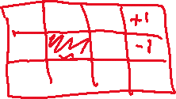
Search-Based Approaches to RL
Policy Search (stochastic local search)
  Start with an arbitrary policy
  To evaluate a policy, try it out in the world
  Generate some neighbours…..
Problems with evolutionary algorithms
  Policy space can be huge: with n states and m actions there are m^{n} policies
  Policies are evaluated as a whole: cannot directly take into account locally good/bad behaviours
Notes:
Here the agent is evaluated as a whole, based on how it survives
use of experiences is wasteful: cannot directly take into account locally good/bad behavior, since policies are evaluated as a whole

Slide 7
Q-learning
Contrary to search-based approaches, Q-learning learns after every action
Learns components of a policy, rather than the policy itself
Q(s,a) = expected value of doing action a in state s and then following the optimal policy

Slide 8
Q-learning
Contrary to search-based approaches, Q-learning learns after every action
Learns components of a policy, rather than the policy itself
Q(s,a) = expected value of doing action a in state s and then following the optimal policy
Discounted reward we have seen in MDPs
expected value of following optimal policy л in s’
reward in s
states reachable
from s by doing a
Probability of getting to s’ from s via a

Slide 9

Q values
 | s₀ | s₁ | … | s_{k}
a₀ | Q[s₀,a₀] | Q[s₁,a₀] | …. | Q[s_{k},a₀]
a₁ | Q[s₀,a₁] | Q[s₁,a₁] | … | Q[s_{k},a₁]
… | … | … | …. | …
a_{n} | Q[s₀,a_{n}] | Q[s₁,a_{n}] | …. | Q[s_{k},a_{n}]
If the agent had the complete Q-function, would it know how to act in every state?
  A. Yes
  B. No
But how to learn the Q-values?
Notes:
If more than one max pick one of the max actions randomly

Slide 10
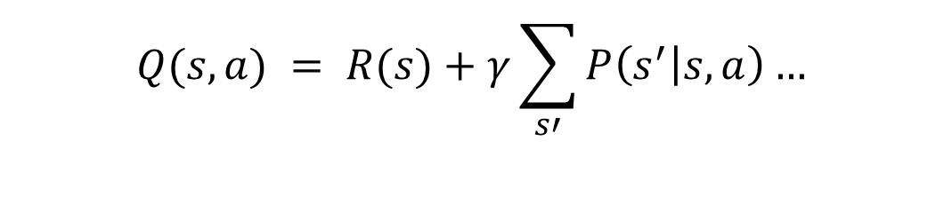
Q values
Q(s,a) are known as Q-values, and are related to the utility of state s as follows
From (1) and (2) we obtain a constraint between the Q value in state s and the Q value of the states reachable from a
$$Q(s,a) = R(s)+γ\sum_{s′}{P\left(s^{′} | s,a\right)… }$$

Slide 11
Learning the Q values
Can we exploit the relation between Q values in “adjacent” states?
  A. Yes
  B. No
Notes:
Clickers yes No ?

Slide 12
Average Through Time
Suppose we have a sequence of values (your sample data):
  v₁, v₂, .., v_{k}
And want a running approximation of their expected value
  e.g., given sequence of grades, estimate expected value of next grade
A reasonable estimate is the average of the first k values:
Notes:
One of the main elements of Q-learning

Slide 13
Average Through Time

Slide 14
Estimate by Temporal Differences
(v_{k} - A_{k-1}) is called a temporal difference error or TD-error
  it specifies how different the new value v_{k} is from the prediction given by the previous running average A_{k-1}
The new estimate (average) is obtained by updating the previous average by α_{k} times the TD error
Notes:
It intuitively makes sense
If the new value v_{k} is higher than the average at k-1, than the old average was too small
the new average is generated by increasing the old average by a measure proportional to the error
Do the opposite if the new v_{k} is smaller than the average at k-1

Slide 15
Q-learning: General Idea
Learn from the history of interaction with the environment, i.e., a sequence of state-action-rewards
  <s₀, a₀, r₁, s₁, a₁, r₂, s₂, a₂, r₃,.....>
History is seen as sequence of experiences, i.e., tuples
  <s, a, r, s’>
  agent doing action a in state s,
  receiving reward r and ending up in s’
These experiences are used to estimate the value of Q (s,a) expressed as

Slide 16
Q-learning: General Idea
But …..
Is an approximation.
The real link between Q(s,a) and Q(s’,a’) is

Slide 17
Q-learning: Main steps
Store Q[S, A], for every state S and action A in the world
Start with arbitrary estimates in Q ⁽⁰⁾[S, A],
Update them by using experiences
  Each experience <s, a, r, s’> provides one new data point on the actual value of Q[s, a]
current estimated value of Q[s’,a’], where s’ is the state the agent arrives to in the current experience
New value of Q[s,a],
Notes:
How do you merge it with the previous estimate?

Slide 18
Q-learning: Update step
TD formula applied to Q[s,a]
New value for Q[s,a] from <s,a,r,s’>
updated estimated value of Q[s,a]
Previous estimated value of Q[s,a]
Notes:
Alpha-k can actually be a constant but then you do not have assurance of convergence

Slide 19
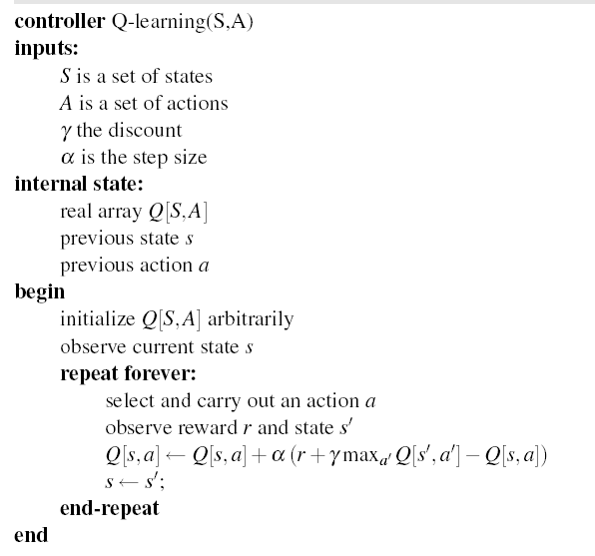
Q-learning: algorithm

Slide 20
Learning Goals for today’s class
You can:
Describe and criticize search-based approaches to RL
Motivate Q-learning
Justify Estimate by Temporal Differences
Explain, trace and implement Q-learning

Slide 21
TODO for Wed
Do Practice Ex. On Reinforcement Learning:
Exercise 11.A: Q-learning
http://www.aispace.org/exercises.shtml
Keep working on assignment 1 !

