Slide 1
Intelligent Systems (AI-2)
Computer Science cpsc422, Lecture 6
Jan, 22, 2021
Slide credit POMDP: C. Conati and P. Viswanathan
Notes:
Lecture 6

Slide 2
Lecture Overview
Partially Observable Markov Decision Processes
Summary
  Belief State
  Belief State Update
Policies and Optimal Policy
Notes:
POMDPs were initially formalized by the control theory and operations research communities
to optimally control stochastic dynamical systems.
More recently, the articial intelligence community also considered POMDPs for planning
under uncertainty. To date, a wide range of sequential decision problems
such as robot navigation, preference elicitation, stochastic resource
allocation, maintenance scheduling, spoken-dialog systems
and many others have been modeled using POMDPs.

Slide 3
Markov Models
Markov Chains
Hidden Markov Model
Partially Observable Markov Decision Processes (POMDPs)
Markov Decision Processes (MDPs)

Slide 4
Observation Model
As in HMM, the agent can learn something about its actual state by sensing the environment:
  Sensor Model P(e|s): probability of observing the evidence e in state s
A POMDP is fully specified by
  Reward function: R(s) (we’ll forget about a and s’ for simplicity)
  Transition Model: P(s’ |a,s)
  Observation model: P(e|s)
Agent’s belief state is updated by computing the conditional probability distribution over all the states given the sequence of observations and actions so far
Notes:
Does it remind you of anything that we have seen before?

Slide 5
State Belief Update
We just saw filtering for HMM?
  Compute conditional probability distribution over states at time t given all observations so far
  P(X_{t} | e_{0:t}) = α P(e_{t} | X_{t}) ∑_{xt-1} P(X_{t} | x_{t-1} ) P( x_{t-1} | e_{0:t-1} )
Filtering at time t-1
Inclusion of new evidence (sensor model)‏
Propagation to time t
State belief update is similar but includes actions
  If the agent has current belief state b(s), performs action a and then perceives evidence e, the new belief state b’(s’) is
Inclusion of new evidence:
Probability of perceiving e in s’
Filtering at time t-1:
State belief based on all observations and actions up to t-1
Sum over all the states that can take to s’ after performing a
Propagation at time t: Probability of transition to s’ given s and a

Slide 6
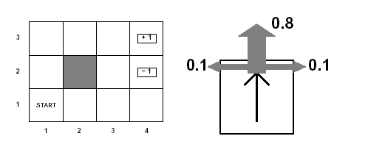
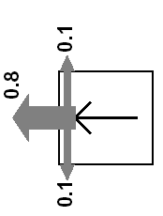
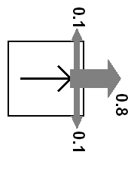
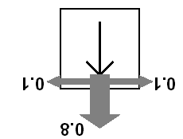
Grid World Actions Reminder
Agent moves in the above grid via actions Up, Down, Left, Right
Each action has:
  0.8 probability to reach its intended effect
  0.1 probability to move at right angles of the intended direction
  If the agents bumps into a wall, it says there

Slide 7


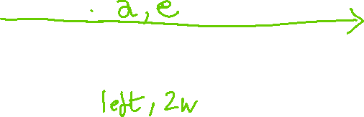
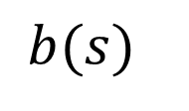




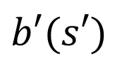

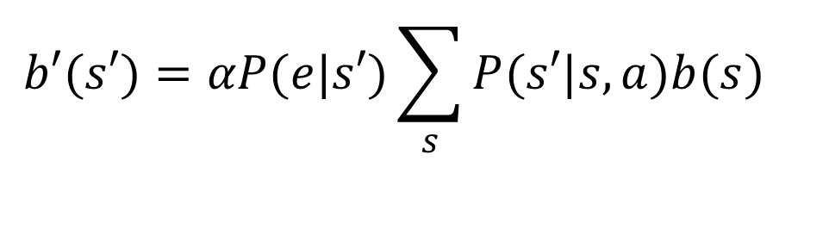
Belief Update
When the agent performs action a in belief state b, and then receives observation e, it can compute the new belief state b’
$$b(s)$$
$$b′(s′)$$
E = # of walls {1w, 2w}
A = {Up, Down, Left, Right}
7
$$b′(s′)=αP(e|s′)\sum_{s}{P(s′|s,a)b(s)}$$

Slide 8
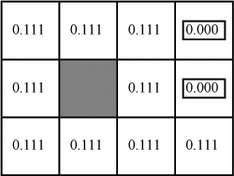


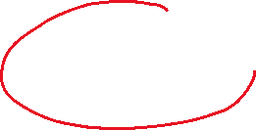
Example (no observation)
What is the belief state after agent performs action left in the initial situation?
The agent has no information about its position
  Only one fictitious observation: no observation
  P(no observation | s) = 1 for every s
Let’s instantiate
For state (1,1) (action a = left)
What is missing to get the correct answer?
A.
B.
C.

Slide 9
Example (no observation)
Back to the grid world, what is the belief state after agent performs action left in the initial situation?
The agent has no information about its position
  Only one fictitious observation: no observation
  P(no observation | s) = 1 for every s
Let’s instantiate
For state (1,1) (action a = left)
What is missing to get the correct answer?
A.
B.
C.

Slide 10

Example
Back to the grid world, what is the belief state after agent performs action left in the initial situation?
The agent has no information about its position
  Only one fictitious observation: no observation
  P(no observation | s) = 1 for every s
Let’s instantiate
Do the above for every state to get the new belief state

Slide 11
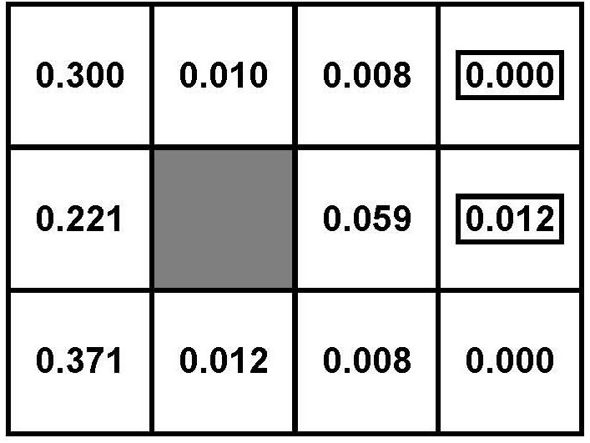
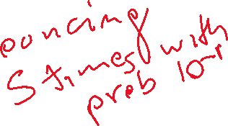



After five Left actions

Slide 12



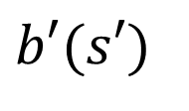






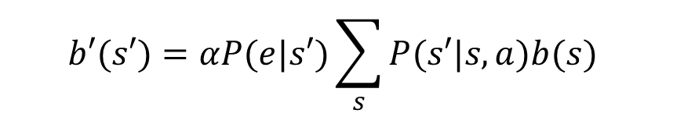


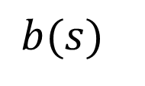

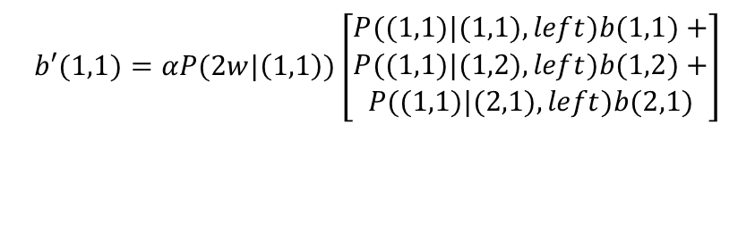


Belief State and its Update
$$b′(s′)=αP(e|s′)\sum_{s}{P(s′|s,a)b(s)}$$
$$b(s)$$
$$b′(s′)$$
$$b′(1,1)=αP(2w|\left(1,1\right))\left[\begin{aligned}P((1,1)|(1,1),left)b(1,1)+ \\ P((1,1)|(1,2),left)b(1,2)+ \\ P((1,1)|(2,1),left)b(2,1)\end{aligned}\right]$$
$$b′(1,2)=αP(2w|\left(1,2\right))\left[\begin{aligned}P((1,2)|(1,1),left)b(1,1)+ \\ P((1,2)|(1,2),left)b(1,2)+ \\ P((1,2)|(1,3),left)b(1,3)\end{aligned}\right]$$
$$b′(2,1)=αP(2w|\left(2,1\right))\left[…..\right]$$
$$b′(4,3)=αP(2w|\left(4,3\right))\left[…..\right]$$

Slide 13










Belief Update: Example1
The sensor that perceives the number of adjacent walls in a location has a 0.1 probability of error
  P(2w|s) = 0.9 ; P(1w|s) = 0.1 if s is non-terminal and not in third column
  P(1w|s) = 0.9 ; P(2w|s) = 0.1 if s is non-terminal and in third column
Try to compute the new belief state if agent moves left and then perceives 1 adjacent wall
X should be equal to ?
A. 0.1
B. 0.2
C. 0.9

Slide 14














Belief Update: Example 2
Let’s introduce a sensor that perceives the number of adjacent walls in a location with a 0.1 probability of error
  P(2w|s) = 0.9 ; P(1w|s) = 0.1 if s is non-terminal and not in third column
  P(1w|s) = 0.9 ; P(2w|s) = 0.1 if s is non-terminal and in third column
Try to compute the new belief state if agent moves right and then perceives 2 adjacent wall

Slide 15
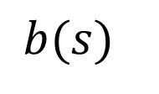
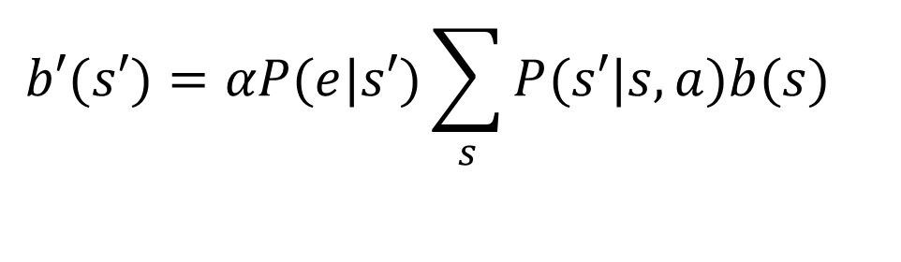
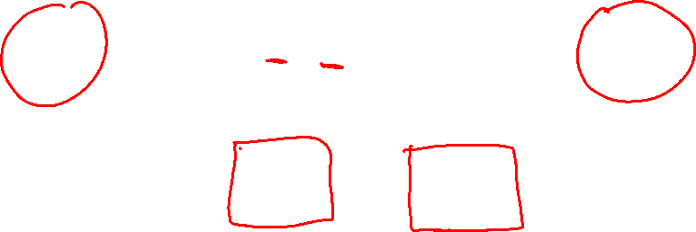
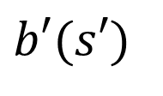
Belief State and Belief Update: Summary
When the agent performs action a in belief state b, and then receives observation e, it can compute the new belief state b’
$$b(s)$$
$$b′(s′)$$
$$b′(s′)=αP(e|s′)\sum_{s}{P(s′|s,a)b(s)}$$
  deterministic transition from one belief state to another

Slide 16
Optimal Policies in POMDs ?
Theorem (Astrom, 1965):
  The optimal policy in a POMDP is a function π*(b) where b is the belief state (probability distribution over states)
That is, π*(b) is a function from belief states (probability distributions) to actions
  It does not depend on the actual state the agent is in
  Good, because the agent does not know that, all it knows are its beliefs!
Decision Cycle for a POMDP agent
  Given current belief state b, execute a = π*(b)
  Receive observation e
  Repeat

Slide 17
How to Find an Optimal Policy?
?
Turn a POMDP into a corresponding MDP and then solve that MDP
Generalize VI to work on POMDPs
Develop Approx. Methods
  Point-Based VI
  Look Ahead

Slide 18
Finding the Optimal Policy: State of the Art
Turn a POMDP into a corresponding MDP and then apply VI: only small models
Generalize VI to work on POMDPs
  10 states in1998
  200,000 states in 2008-09 (now: always behind approx. methods)
Develop Approx. Methods 2009 - now
  Point-Based VI and Look Ahead
  Even 50,000,000 states http://www.cs.uwaterloo.ca/~ppoupart/software.html
Notes:
Turn POMDP into MDP: For finite-horizon POMDPs, the optimal value function is piecewise-linear and convex.^{[2]} It can be represented as a finite set of vectors. In the infinite-horizon formulation, a finite vector set can approximate V ∗ {\displaystyle V^{*}} arbitrarily closely, whose shape remains convex. Value iteration applies dynamic programming update to gradually improve on the value until convergence to an ϵ {\displaystyle \epsilon } -optimal value function, and preserves its piecewise linearity and convexity.^{[3]} By improving the value, the policy is implicitly improved.

Slide 19
Recent Method: Point-based Value Iteration
(not required)
Find a solution for a sub-set of all states
Not all states are necessarily reachable
Generalize the solution to all states
Methods include: PERSEUS, PBVI, and HSVI and other similar approaches (FSVI, PEGASUS)‏
Notes:
Building on this insight, we present Point-Based Value Iteration
(PBVI), a new approximate POMDP planning algorithm.
PBVI selects a small set of representative belief
points and iteratively applies value updates to those
points. The point-based update is significantly more efficient
than an exact update (quadratic vs exponential), and
because it updates both value and value gradient, it generalizes
better to unexplored beliefs than grid-based approximations
which only update the value [Lovejoy, 1991;
Brafman, 1997; Hauskrecht, 2000; Zhou and Hansen, 2001;
Bonet, 2002]). PBVI is also guaranteed to have bounded error.
Finally, exploiting an insight from policy search methods
and MDP exploration [Ng and Jordan, 2000; Thrun, 1992],
PBVI uses explorative stochastic trajectories to select belief
points, thus reducing the number of belief points necessary to
find a good solution.

Slide 20
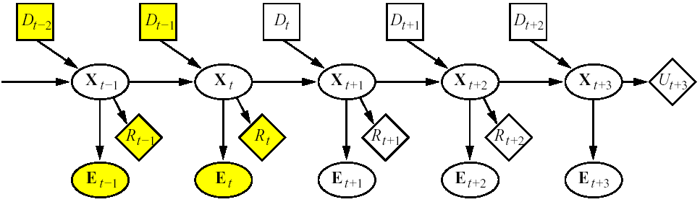
Dynamic Decision Networks (DDN)
Comprehensive approach to agent design in partially observable, stochastic environments
Basic elements of the approach
  Transition and observation models are represented via a Dynamic Bayesian Network (DBN).
  The network is extended with decision and utility nodes, as done in decision networks
A_{t-2}
A_{t-1}
A_{t}
A_{t+1}
A_{t+2}
R_{t-1}
R_{t}
E_{t-1}
E_{t}
Notes:
In a MDP you have a direct link from state to action and you do not need the observation
In a POMDP your decision should depend on ?
How can this be computed

Slide 21
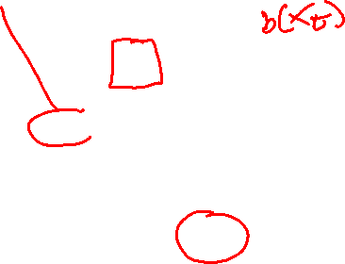


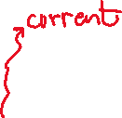

Dynamic Decision Networks (DDN)
  The Belief Update algorithm is used to incorporate each new percept and the action to update the belief state X_{t}
  Decisions are made by projecting forward possible action sequences and choosing the best one: look ahead search
A_{t-2}
A_{t-1}
A_{t}
A_{t+1}
A_{t+2}
R_{t-1}
R_{t}
E_{t-1}
E_{t}

Slide 22
Dynamic Decision Networks (DDN)
A_{t-2}
A_{t-1}
A_{t}
A_{t+1}
A_{t+2}
A_{t+1}
Filtering / Belief Update
Projection (3-step look-ahead here)
Nodes in yellow are known (evidence collected, decisions made, local rewards)
Agent needs to make a decision at time t (A_{t} node)
Network unrolled into the future for 3 steps
Node U_{t+3} represents the utility (or expected optimal reward V*) in state X_{t+3}
  i.e., the reward in that state and all subsequent rewards
  Available only in approximate form (from another approx. method)
Notes:
Here X_{t} may represent a collection of variables, as in DBNs

Slide 23
Look Ahead Search for Optimal Policy
General Idea:
Expand the decision process for n steps into the future, that is
  “Try” all actions at every decision point
  Assume receiving all possible observations at observation points
Result: tree of depth 2n+1 where
  every branch represents one of the possible sequences of n actions and n observations available to the agent, and the corresponding belief states
  The leaf at the end of each branch corresponds to the belief state reachable via that sequence of actions and observations – use filtering/belief-update to compute it
“Back Up” the utility values of the leaf nodes along their corresponding branches, combining it with the rewards along that path
Pick the branch with the highest expected value

Slide 24
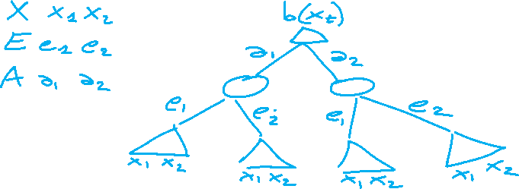
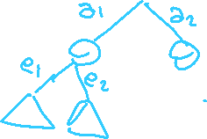

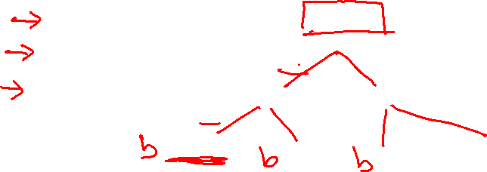


Look Ahead Search for Optimal Policy
General Idea:
Expand the decision process for n steps into the future, that is
  “Try” all actions at every decision point
  Assume receiving all possible observations at observation points

Slide 25
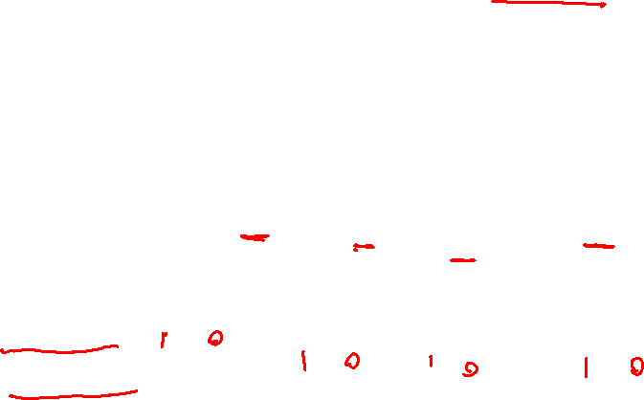
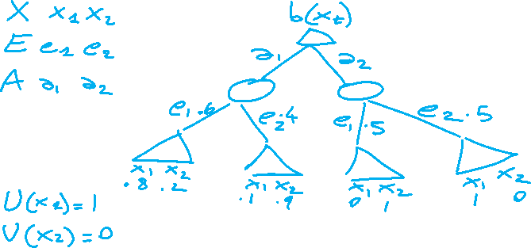
Look Ahead Search for Optimal Policy
Result: tree of depth 2n+1 where
  every branch represents one of the possible sequences of n actions and n observations available to the agent, and the corresponding belief states
  The leaf at the end of each branch corresponds to the belief state reachable via that sequence of actions and observations – use belief-update to compute it

Slide 26


Look Ahead Search for Optimal Policy
“Back Up” the utility values of the leaf nodes along their corresponding branches, combining it with the rewards along that path
Pick the branch with the highest expected value

Slide 27
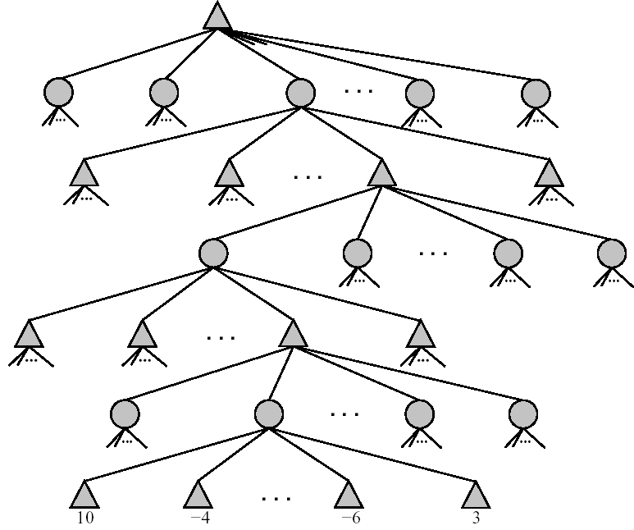
Look Ahead Search for Optimal Policy
Decision A_{t} in P(X_{t}|E_{1:t}A_{1:t-1} )
These are chance nodes, describing the probability of each observation
ak_{t}
a1_{t}
a2_{t}
Observation E_{t+1}
e1_{t+1}
e2_{t+1}
ek_{t+k}
A_{t+1} in P(X_{t+1}|E_{1:t+1} A_{1:t})
Belief states are computed via any filtering algorithm, given the sequence of actions and observations up to that point
|E_{t+2}
A_{t+2} in P(X_{t+1}|E_{1:t+2}A_{1:t+1})
To back up the utilities
take average at chance points
Take max at decision points
|E_{t+3}
P(X_{t+3}|E_{1:t+3} A_{1:t+2})
|U(X_{t+3})
Notes:
After the action you can compute a new belief state P(X|a)
There you can compute P(E) = sum(X) P(E,X)=sum(X) P(E|X).P(X)

Slide 28
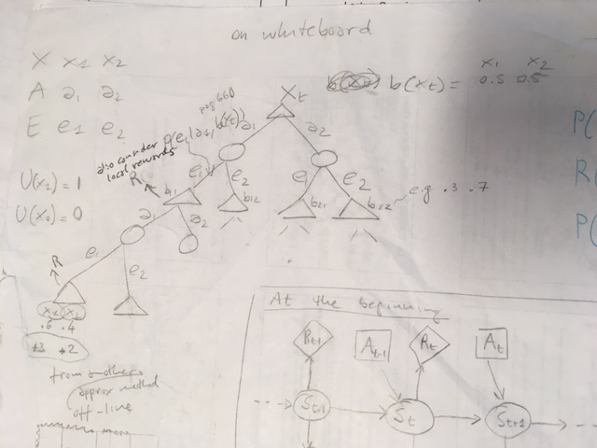

Slide 29
Best action at time t?
  A. a₁
  B. a₂
  C. indifferent
Notes:
Should also include the expected CURRENT reward (not considered for the sake of simplicity)

Slide 31
Look Ahead Search for Optimal Policy
What is the time complexity for exhaustive search at depth d, with |A| available actions and |E| possible observations?
  A. O(d *|A| * |E|)
  B. O(|A|^{d} * |E|^{d})
  C. O(|A|^{d} * |E|)
  Would Look ahead work better when the discount
factor is?
  A. Close to 1
  B. Not too close to 1
Notes:
There are problems in which a shallow depth works (e.g., when the discount factor is not too close to 1)

Slide 32
Some Applications of POMDPs……
Jesse Hoey, Tobias Schröder, Areej Alhothali (2015), Affect control processes: Intelligent affective interaction using a POMDP, AI Journal
S Young, M Gasic, B Thomson, J Williams (2013) POMDP-based Statistical Spoken Dialogue Systems: a Review, Proc IEEE,
J. D. Williams and S. Young. Partially observable Markov decision processes for spoken dialog systems. Computer Speech & Language, 21(2):393–422, 2007.
S. Thrun, et al. Probabilistic algorithms and the interactive museum tour-guide robot Minerva. International Journal of Robotic Research, 19(11):972–999, 2000.
A. N.Rafferty,E. Brunskill,Ts L. Griffiths, and Patrick Shafto. Faster teaching by POMDP planning. In Proc. of Ai in Education, pages 280–287, 2011
P. Dai, Mausam, and D. S.Weld. Artificial intelligence for artificial artificial intelligence. In Proc. of the 25th AAAI Conference on AI , 2011. [intelligent control of workflows]

Slide 33
Nan Ye, Adhiraj Somani, David Hsu and Wee Sun Lee (2017) "DESPOT: Online POMDP Planning with Regularization", Volume 58, pages 231-266PDF | PostScript | doi:10.1613/jair.5328
Appendix - Errata
The partially observable Markov decision process (POMDP) provides a principled general framework for planning under uncertainty, but solving POMDPs optimally is computationally intractable, due to the "curse of dimensionality" and the "curse of history". To overcome these challenges, we introduce the Determinized Sparse Partially Observable Tree (DESPOT), a sparse approximation of the standard belief tree, for online planning under uncertainty. A DESPOT focuses online planning on a set of randomly sampled scenarios and compactly captures the "execution" of all policies under these scenarios. We show that the best policy obtained from a DESPOT is near-optimal, with a regret bound that depends on the representation size of the optimal policy. Leveraging this result, we give an anytime online planning algorithm, which searches a DESPOT for a policy that optimizes a regularized objective function. Regularization balances the estimated value of a policy under the sampled scenarios and the policy size, thus avoiding overfitting. The algorithm demonstrates strong experimental results, compared with some of the best online POMDP algorithms available. It has also been incorporated into an autonomous driving system for real-time vehicle control. The source code for the algorithm is available online
Notes:
Nan Ye, Adhiraj Somani, David Hsu and Wee Sun Lee (2017) "DESPOT: Online POMDP Planning with Regularization", Volume 58, pages 231-266PDF | PostScript | doi:10.1613/jair.5328
Appendix - Errata
The partially observable Markov decision process (POMDP) provides a principled general framework for planning under uncertainty, but solving POMDPs optimally is computationally intractable, due to the "curse of dimensionality" and the "curse of history". To overcome these challenges, we introduce the Determinized Sparse Partially Observable Tree (DESPOT), a sparse approximation of the standard belief tree, for online planning under uncertainty. A DESPOT focuses online planning on a set of randomly sampled scenarios and compactly captures the "execution" of all policies under these scenarios. We show that the best policy obtained from a DESPOT is near-optimal, with a regret bound that depends on the representation size of the optimal policy. Leveraging this result, we give an anytime online planning algorithm, which searches a DESPOT for a policy that optimizes a regularized objective function. Regularization balances the estimated value of a policy under the sampled scenarios and the policy size, thus avoiding overfitting. The algorithm demonstrates strong experimental results, compared with some of the best online POMDP algorithms available. It has also been incorporated into an autonomous driving system for real-time vehicle control. The source code for the algorithm is available online

Slide 34
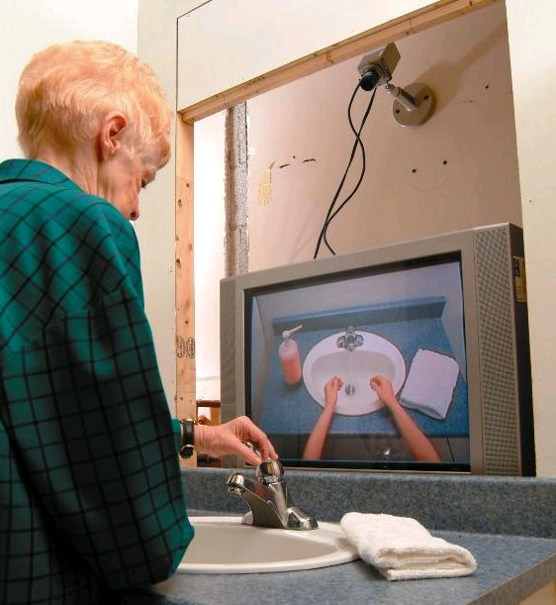
Another “famous” Application
Learning and Using POMDP
models of Patient-Caregiver
Interactions During Activities
of Daily Living
Goal: Help Older adults living with
cognitive disabilities (such as Alzheimer's) when they:
forget the proper sequence of tasks that need to be completed
they lose track of the steps that they have already completed.
Source: Jesse Hoey UofT 2007
Notes:
Older adults living with cognitive disabilities (such as Alzheimer's disease or other forms of dementia) have
difficulty completing activities of daily living (ADLs). They forget the proper sequence of tasks that need
to be completed, or they lose track of the steps that they have already completed
Another one
Kochenderfer, Mykel J. (2015). "Optimized Airborne Collision Avoidance". Decision Making Under Uncertainty. The MIT Press

Slide 35
StarAI (statistical relational AI)
Hybrid: Det +Sto
422 big picture
Parsing
Prob CFG
Prob Relational Models
Markov Logics
Deterministic
Stochastic
Belief Nets
Logics
Approx. : Gibbs
First Order Logics
Markov Chains and HMMs
Ontologies
Forward, Viterbi….
Approx. : Particle Filtering
Query
Full Resolution
SAT
Undirected Graphical Models
Markov Networks
Conditional Random Fields
Markov Decision Processes and
Partially Observable MDP
Planning
Value Iteration
Approx. Inference
Reinforcement Learning
Representation
Applications of AI
Reasoning
Technique
Notes:
Breadth and Depth

Slide 36
Learning Goals for today’s class
You can:
  Define a Policy for a POMDP
  Define and trace Belief Update
  Define and trace Look Ahead Search for finding an (approximate) Optimal Policy
  Compute Complexity of Look Ahead Search

Slide 37
TODO for Mon
Read textbook chpt 12
  12.1 Reinforcement Learning
  12.3 Temporal Differences
  12.4 Q-learning
Assignment 1 has been posted on Canvas today (due Wed Feb 3 3:30PM)
  VInfo and VControl
  MDPs (Value Iteration)
  POMDPs (Belief Update)

