Slide 1
Intelligent Systems (AI-2)
Computer Science cpsc422, Lecture 5
Jan, 20, 2021
Slide credit POMDP: C. Conati and P. Viswanathan
Notes:
Lecture 5

Slide 2
Lecture Overview
Markov Decision Processes
……
Finding the Optimal Policy
  Value Iteration
From Values to the Policy
Rewards and Optimal Policy
Filtering for HMM (more when we will do temporal models)
Partially Observable Markov Decision Processes
Formal Specification and example
  Belief State
  Belief State Update

Slide 3
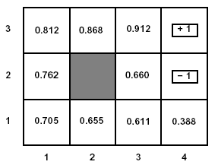





Value iteration: Visual Summary
Iteration 0
3
2
1
0 | 0 | 0
0 |  | 0
0 | 0 | 0 | 0
+1
-1
1 2 3 4
Apply the 9 Bellman Equations
Iteration 1
3
2
1
-.04 | -.04 | 0.76
-.04 |  | -.04
-.04 | -.04 | -.04 | -.04
+1
-1
1 2 3 4
$$V^{π∗}(s)=\underset{ }{R(s)+γ\max_{a}}\sum_{s′}{P(s′|s,a)×V^{π∗}(s′)})$$

Slide 4

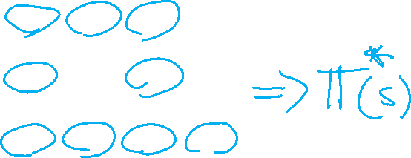

Value Iteration: from state values V to
Now the agent can chose the action that maximizes its expected utility

Slide 5
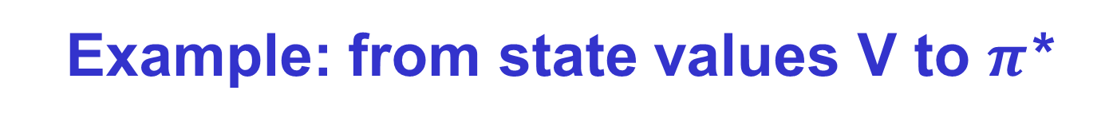
Example: from state values V to $π$*
To find the best action in (1,1)
I should consider all the actions
For each action see
  in which states I can end up in
  with what probability
  And their value
The expected value/utility of an action is the sum across all the states of value of each state times its probability
So for state (1,1) the expected utility of RIGHT is
0.8 V(2,1) + 0.1 V(1,2) + 0.1 V(1,1) =
(0.8 * 0.655) + (0.1 * 0.762) + (0.1 * 0.705)

Slide 6

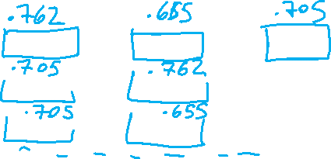
Example: from state values V to $π$*
The action of the optimal policy is the one that maximizes the expected utility
For state (1,1)
In general:

Slide 7
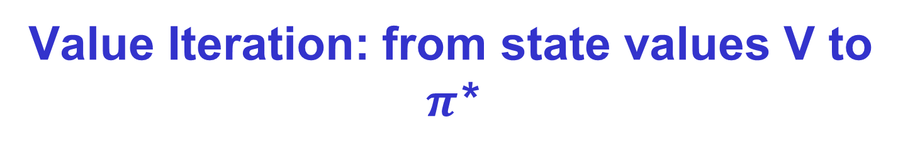
Value Iteration: from state values V to $π$*
Now the agent can chose the action that implements the MEU principle: maximize expected utility
expected value of following policy л* in s’
states reachable
from s by doing a
Probability of getting to s’ from s via a

Slide 8
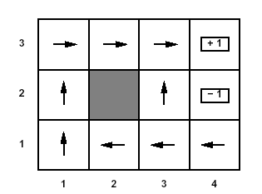
Optimal policy
This is the policy that we obtain….

Slide 9
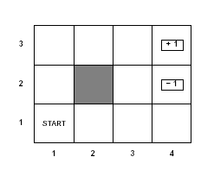
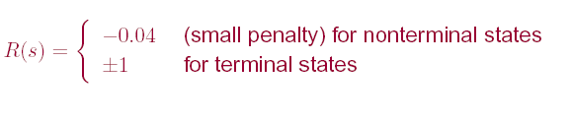
Optimal policy
Reward structure for our example
This is the policy that we obtain by applying Value Iteration to our example

Slide 10

Rewards and Optimal Policy
Optimal Policy when reward in non-terminal states is -0.04
Is it possible that the optimal policy changes if the reward in the non-terminal states changes?
B. No
A. Yes

Slide 11
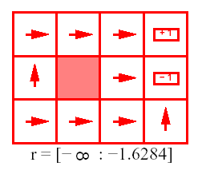
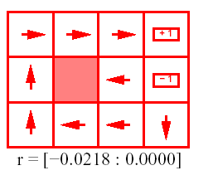
Rewards and Optimal Policy
If r = -2, what would be a reasonable policy?
1 2 3 4
1 2 3 4
3
2
1
3
2
1
A.
B.
Notes:
The cost of taking a step is so high that the agent heads straight
into the nearest terminal state, even if this is (2,4) (reward -1)

Slide 12
Rewards and Optimal Policy
Optimal Policy when penalty in non-terminal states is -0.04
Note that here the cost of taking steps is small compared to the cost of ending into (2,4)
  Thus, the optimal policy for state (1,3) is to take the long way around the obstacle rather then risking to fall into (2,4) by taking the shorter way that passes next to it
May the optimal policy change if the reward in the non-terminal states (let’s call it r) changes?

Slide 13


Rewards and Optimal Policy
Optimal Policy when r < -1.6284
1 2 3 4
3
2
1
Why is the agent heading straight into (4,2) from its surrounding states?
Notes:
The cost of taking a step is so high that the agent heads straight
into the nearest terminal state, even if this is (2,4) (reward -1)

Slide 14
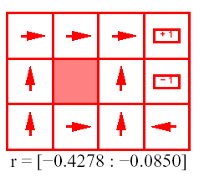
Rewards and Optimal Policy
Optimal Policy when -0.427 < r < -0.085
1 2 3 4
3
2
1
The cost of taking a step is high enough to make the agent take the shortcut to (4,3) from (3,1)

Slide 15
Rewards and Optimal Policy
Optimal Policy when -0.0218 < r < 0
1 2 3 4
3
2
1
Why is the agent heading straight into the obstacle from (3,2)? And into the wall in (4,1)?

Slide 16
Rewards and Optimal Policy
Optimal Policy when -0.0218 < r < 0
1 2 3 4
3
2
1
Stay longer in the grid is not penalized as much as before. The agent is willing to take longer routes to avoid (4,2)
  This is true even when it means banging against the obstacle a few times when moving from (3,2)

Slide 17
Rewards and Optimal Policy
Optimal Policy when r > 0 ?
Which means the agent is rewarded for every step it takes
Notes:
it is basically rewarded for sticking around
The only actions that need to be specified are the ones in states that are adjacent to the terminal states: take the agent away from them

Slide 18

Rewards and Optimal Policy
Optimal Policy when r > 0
Which means the agent is rewarded for every step it takes
1 2 3 4
3
2
1
state where every action belong to an optimal policy
r > 0
Notes:
it is basically rewarded for sticking around
The only actions that need to be specified are the ones in states that are adjacent to the terminal states: take the agent away from them

Slide 19

MDPs scalability (not required)
Modern optimal algorithms draw from a vast repertoire of techniques, like graph algorithms, heuristic search, compact value function representations, and simulation-based approaches. E.g.,
  Only compute V for states “reachable” from S₀
  Do not compute V for really bad states (based on heuristics)
An enormous number of approximation algorithms have been suggested that exploit several intuitions, such as inadmissible heuristics, interleaving planning and execution, special processing for dead-end states, domain determinization ideas, hybridizing multiple algorithms, and hierarchical problem decompositions.
explore the vast space of optimality-efficiency tradeoffs
Planning with Markov Decision Processes: An AI Perspective Mausam (UW), Andrey Kolobov (MSResearch) Synthesis Lectures on Artificial Intelligence and Machine Learning Jun 2012
Free online through UBC
Notes:
Although they are a simple and expressive model, the basic set of solution techniques do
not quite scale to many real world problems, and the key challenge for the researchers has been
algorithm scalability. In this book, we have surveyed the multitude of ideas that go into making
MDP algorithms efficient. The fundamental solution algorithms are based on iterative dynamic
programming, although a linear programming approach is also possible. Modern optimal algorithms
draw from a vast repertoire of techniques, like graph algorithms, heuristic search, compact value
function representations, and simulation-based approaches.
Of course, optimal solutions for such an expressive model are a luxury. An enormous number
of approximation algorithms have been suggested that exploit several intuitions, such as inadmissible
heuristics, interleaving planning and execution, special processing for dead-end states, domain
determinization ideas, hybridizing multiple algorithms, hierarchical problem decompositions, and
so on. These algorithms explore the vast space of optimality-efficiency tradeoffs.
Chp.4
The first of these pieces of information is the MDP’s initial state, denoted as s0. In the Mars
rover example, s0 may be the configuration of the rover’s systems (the amount of energy, the positions
of its manipulators, etc.) and its location at the start of the mission. While computing a policy that
reaches the goal from states other than s0 may be useful, for many of the states doing so is unnecessary
since they are not reachable from the initial state. In other words, if the initial state is known, it
makes sense to compute only a partial policy πs0 closed w.r.t. s0.
The second piece of information often available when modeling a problem as an MDP, and
one that will help us find π∗s0 efficiently, is a heuristic function, or heuristic, for short. From an intuitive
point of view, a heuristic is just some prior knowledge about the problem that lets us assess the
quality of different states in the MDP. For
…..Throughout the analysis, we will view the connectivity structure of an MDP M’s state space as
a directed hypergraph GS which we call the connectivity graph of M. A directed hypergraph generalizes
the notion of a regular graph by allowing each hyperedge, or k-connector, to have one source but several
destinations. In the case of an MDP, the corresponding hypergraph GS has S as the set of vertices,
and for each state s and action a pair has a k-connector whose source is s and whose destinations
are all states s s.t. T (s, a, s) > 0. In other words, it has a k-connector for linking each state via an
action to the state’s possible successors under that action. We will need several notions based on the
hypergraph concept.
Definition 3.25 Dead-End State. A dead-end state, or dead end, is a state s ∈ S such that no
policy can reach the goal from s in any number of time steps, i.e., for all policies π and any number
of time steps t , Pπ
t (s, G) = 0.
Chp5
The key idea of symbolic algorithms is to compactly store the MDP tables (value functions,
transition functions, costs, etc.) using decision diagrams. These representations naturally cluster
those states that behave similarly, e.g., have the same values. If a subset of states behaves similarly,
then instead of redundant backups for each state, it is sufficient to consider the whole subset at once
and update all values by just a single backup. This speeds up all the VI-based algorithms. Moreover,
the compact representation saves valuable space. Thus, symbolic algorithms often scale far better
than their flat counterparts (i.e., where the functions are stored as tables).
The main requirement for applying symbolic techniques is that we have access to a factored
MDP (see Definition 2.22), i.e., the state space S is factored into a set of d state variables X =
{X1,X2, . . . , Xd }. Moreover, as in the previous chapter, we assume that all variables Xi are Boolean.
This is not a severe restriction, since a variable with finite domains could be converted into multiple
Boolean variables.
It is important to note that a symbolic representation, such as using ADDs, is an instance of
a factored representation. A factored representation exploits the knowledge of the factored MDP to
represent a function (often, more compactly).Other factored representations have also been studied
within MDPs, for instance the sum of basis function representation. We discuss that in Section
6.4.2.
Last but not least, we will turn to hybridized planning (Section 6.6). The objective of these
kinds of offline solvers is to come up with a “reasonable” policy as quickly as possible and then, as
time and memory allow, to patch it up in order to endow it with some quality guarantees. Thus, their
focus is more on achieving a good anytime performance than on saving memory. More specifically,
these planners start by using an optimal heuristic search algorithm. This algorithm rapidly produces
a decent policy, but may take a long time to arrive at an optimal solution. Therefore, at some point
hybridized planners switch to a suboptimal algorithm that can nonetheless turn the current “halfbaked”
solution into one with some guarantees, and can do so quickly.

Slide 20
Markov Models
Markov Chains
Hidden Markov Model
Partially Observable Markov Decision Processes (POMDPs)
Markov Decision Processes (MDPs)

Slide 21
Lecture Overview
Filtering for HMM (more when we will do temporal models)
Partially Observable Markov Decision Processes
Formal Specification and example
  Belief State
  Belief State Update
Notes:
POMDPs were initially formalized by the control theory and operations research communities
to optimally control stochastic dynamical systems.
More recently, the articial intelligence community also considered POMDPs for planning
under uncertainty. To date, a wide range of sequential decision problems
such as robot navigation, preference elicitation, stochastic resource
allocation, maintenance scheduling, spoken-dialog systems
and many others have been modeled using POMDPs.

Slide 22






Hidden Markov Model
A Hidden Markov Model (HMM) starts with a Markov chain, and adds a noisy observation/evidence about the state at each time step:
|domain(X)| = k
|domain(E)| = h
P (X₀) specifies initial conditions
(probability distrib. for start state)
P (X_{t+1}|X_{t}) specifies the dynamics
P (E_{t} |S_{t}) specifies the sensor model

Slide 23
Hidden Markov Model
(our example with no actions)
E = # of walls {1w, 2w}
|domain(X)| = 11
|domain(E)| =
P (X₀) specifies initial conditions
P (X_{t+1}|X_{t}) specifies the dynamics
P (E_{t} |S_{t}) specifies the sensor model

Slide 24
Useful inference in HMMs
In general (Filtering): compute the posterior distribution over the current state given all evidence to date
P(X_{t} | e_{0:t} )
Notes:
24

Slide 25
Intuitive Explanation for filtering recursive formula
P(X_{t} | e_{0:t} )
Notes:
25
We will examine this more formally when we discuss temporal models
WRITE FORMULA ON WHITEBOARD

Slide 26
Intuitive Explanation for filtering recursive formula
P(X_{t} | e_{0:t} )
Notes:
26
We will examine this more formally when we discuss temporal models

Slide 27
Lecture Overview
Filtering for HMM (more when we will do temporal models)
Partially Observable MDPs
Formal Specification and example
  Belief State
  Belief State Update
Notes:
POMDPs were initially formalized by the control theory and operations research communities
to optimally control stochastic dynamical systems.
More recently, the articial intelligence community also considered POMDPs for planning
under uncertainty. To date, a wide range of sequential decision problems
such as robot navigation, preference elicitation, stochastic resource
allocation, maintenance scheduling, spoken-dialog systems
and many others have been modeled using POMDPs.

Slide 28
POMDP: Intro (hidden)
The MDPs we looked at so far were fully observable
  The agent always knows which state it is in
  This, combined with the Markov assumption for P(s’ |a,s) implies that the optimal policy л* depends only on ….
What if the environment is only partially observable?
Notes:
Current state

Slide 29





POMDP: Intro
The MDPs we looked at so far were fully observable
  The agent always knows which state it is in
  The uncertainty is in …………..?
  Policy only depends on………….?
Notes:
Current state

Slide 30
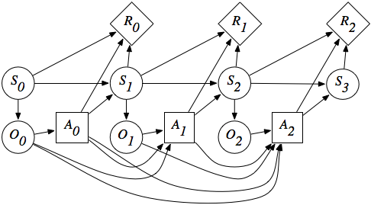
hidden

Slide 31
POMDP: Intro (hidden)
What if the environment is only partially observable?
  The agent cannot simply follow what a policy л(s) would recommend, since it does not know whether it is in s
  The agent decision should be affected by how much it knows about its “position” in the state space
Additional complexity: Partially Observable MDPs are much more difficult than MDPs
  But cannot be avoided as the world is a POMDP most of the time! i.e., for many applications the agent has no access to the current state

Slide 32
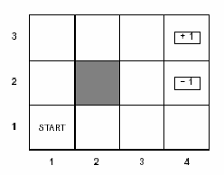
Belief States
In POMDPs, the agent cannot tell for sure where it is in the space state, all it can have are beliefs on that
  probability distribution over states
  This is usually called belief state b
  b(s) is the probability assigned by b to the agent being in state s
Example: Suppose we are in our usual grid world, but
  the agent has no information at all about its position in non-terminal states
  It knows only when it is in a terminal state (because the game ends)
What is the initial belief state, if the agent knows that it is not in a terminal state?

Slide 33
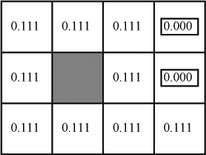
Belief States
Initial belief state:
  <1/9,1/9, 1/9,1/9,1/9,1/9, 1/9,1/9,1/9,0,0>

Slide 34
Observation Model
As in HMM, the agent can learn something about its actual state by sensing the environment:
  Sensor Model P(e|s): probability of observing the evidence e in state s
A POMDP is fully specified by
  Reward function: R(s) (we’ll forget about a and s’ for simplicity)
  Transition Model: P(s’ |a,s)
  Observation model: P(e|s)
Agent’s belief state is updated by computing the conditional probability distribution over all the states given the sequence of observations and actions so far
Notes:
Does it remind you of anything that we have seen before?

Slide 35
State Belief Update
We just saw filtering for HMM?
  Compute conditional probability distribution over states at time t given all observations so far
  P(X_{t} | e_{0:t}) = α P(e_{t} | X_{t}) ∑_{xt-1} P(X_{t} | x_{t-1} ) P( x_{t-1} | e_{0:t-1} )
Filtering at time t-1
Inclusion of new evidence (sensor model)‏
Propagation to time t
State belief update is similar but includes actions
  If the agent has current belief state b(s), performs action a and then perceives evidence e, the new belief state b’(s’) is
Inclusion of new evidence:
Probability of perceiving e in s’
Filtering at time t-1:
State belief based on all observations and actions up to t-1
Sum over all the states that can take to s’ after performing a
Propagation at time t: Probability of transition to s’ given s and a

Slide 36
Learning Goals for today’s class
You can:
  Compute optimal policy from output of Value Iteration
  Define and compute filtering on an HMM (intuitively)
  Define a POMDP
  Define and compute a state belief update for a POMDP
  Define a Policy for a POMDP

Slide 37
TODO for Fri
Read Textbook 9.5.6 Partially Observable MDPs
Check what to do with readings (details on course webpage)
Carefully read the paper before class
Send by email
  (at least 3) questions on the assigned paper
  a brief summary of the paper (no more than half a page)
  First Fri 29
Assignment 1 will be out on Fri

Slide 38
Not required
Partially Observable Markov Decision Process (POMDP): As the name suggests, POMDPs model scenarios where the agent cannot observe the world state fully [123]. A POMDP agent needs to execute actions for two reasons: for changing the world state (as in an MDP) and for obtaining additional information about the current world state. As Section 7.1.1 explains, a POMDP is a large Continuous MDP, in which a state-variable is the world state, and its value denotes the agent’s belief (probability) that it is in that state. Straightforward implementations of MDP algorithms do not scale up to POMDPs and, over the years, a large number of specialized POMDP techniques have been developed, with successes in scaling the algorithms to millions of states [214]. POMDPs have also seen several applications, e.g., dialog management [241], intelligent control of workflows [65], intelligent tutoring [200], and several robotic planning applications [233].

