Slide 1
Intelligent Systems (AI-2)
Computer Science cpsc422, Lecture 4
Jan, 18, 2021

Slide 2
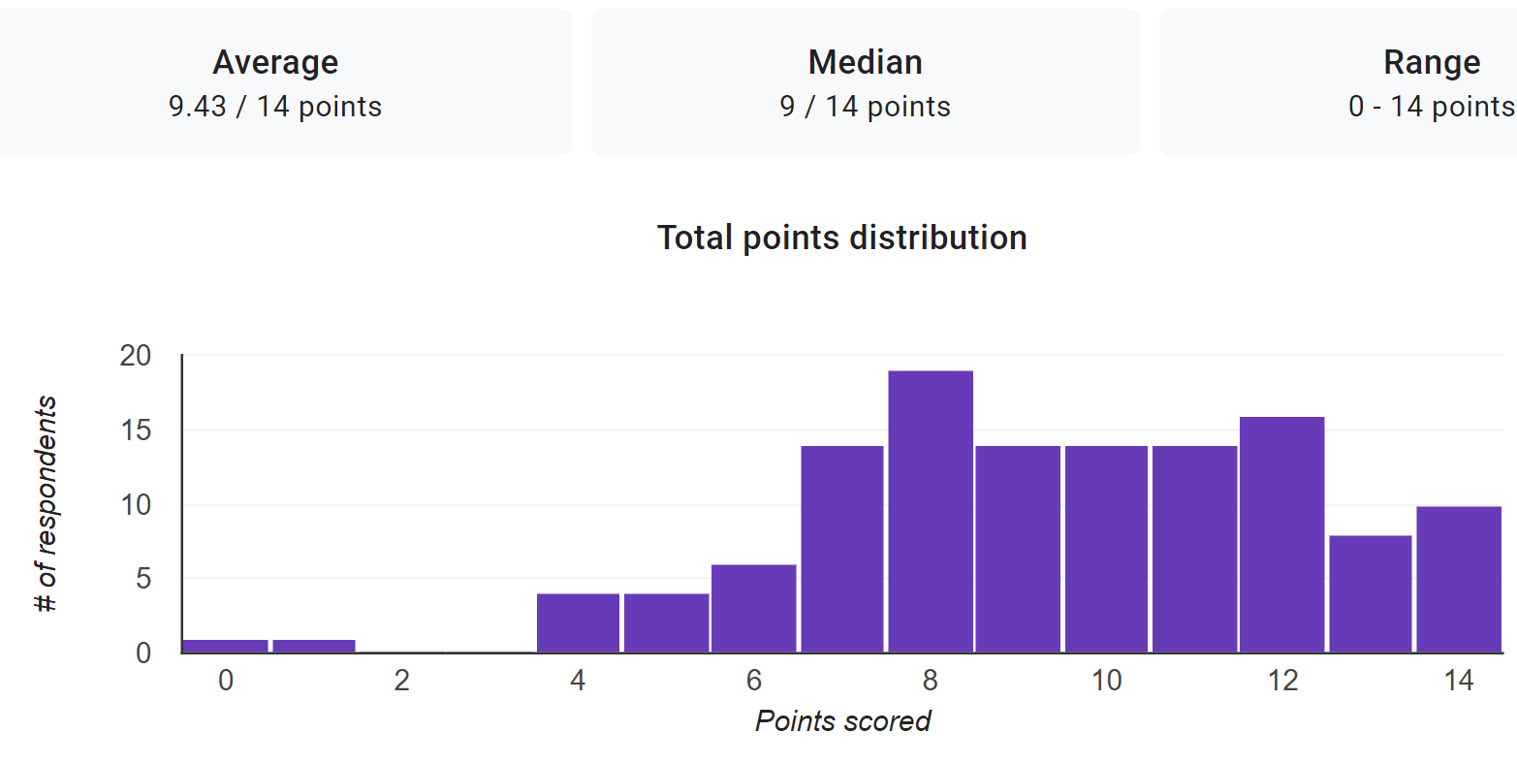



Announcements
322 Review Exam (125 submissions!)
Office Hours have been posted: all on zoom (see on Canvas)
Giuseppe Carenini carenini@cs.ubc.ca Wed 11-12
Deka Namrata dnamrata@cs.ubc.ca Mon 10am
Ivanova Inna inna.ivanova@alumni.ubc.ca Tue 1pm
Tootooni Mofrad Amirhossein tootooni@cs.ubc.ca Fri 11:30-1
What to do with readings? In a few lectures we will discuss the first research paper. Instructions on what to do are available on the course webpage.
Notes:
Thursday, 2:00pm to 3:00pm | Grigorii | Room ICCSX237
Monday, 5:00pm to 6:00pm | Matthew Wilson | Room ICCSX237
Tuesday, 4:00pm to 5:00pm | Daniele Reda | Room ICCSX237
I am especially interested in applications of artificial intelligence that support human-driven decision making, either by automatically generating and evaluating potential solutions, or providing betters tools for humans to evaluate solutions themselves. I am also curious about the potential for machine learning to contribute to human decision making instead of its traditional application to computer decision making, such as in game playing.
Driver-less cars
Finding ways to solve NP-Complete problems
none
Game theory.
Not sure about what things can be applied from this course.
-
Video games development is my area of specialty, so I'm very interested in applications in that field!
Computer Graphics, Computer Vision
Object identification in images
To be honest I am interested in ANY application examples. It doesn't matter what the topic is, as long as it's kind of cool/interesting (such as humorous situations or perhaps software failure examples that caused issues for the creators.) Also, pictures or videos will make it feel more engaging. Pure text isn't quite as effective.
A.I. and Quantum Computing.
I would be very interested in doing a fintech applicable ai such as your last example of online commerce and trading, or the natural language processing.
AI in computer vision for pattern recognition in self-driving cars.
scenarios where there's multiple agents - ie: security (computer or physical) intelligent agents for moderating online communities/discussions
Psychiatric Support, learning/socializing systems targeted for those with Autism Spectrum Disorder or other behavioral/developmental problems.
Music performance
Voice/image recognition, applications to human kinetics
None
N/A
Motion Tracking
-
Neural networks and deep learning

Slide 3
StarAI (statistical relational AI)
Hybrid: Det +Sto
422 big picture
Prob CFG
Prob Relational Models
Markov Logics
Deterministic
Stochastic
Belief Nets
Logics
Approx. : Gibbs
First Order Logics
Markov Chains and HMMs
Ontologies
Forward, Viterbi….
Approx. : Particle Filtering
Query
Full Resolution
SAT
Undirected Graphical Models
Markov Networks
Conditional Random Fields
Markov Decision Processes and
Partially Observable MDP
Planning
Value Iteration
Approx. Inference
Reinforcement Learning
Representation
Applications of AI
Reasoning
Technique
Notes:
Breadth and Depth

Slide 4


Just a few datapoints (from NLP, same trends in other areas of AI)
When the popularity of these R&R methods started to explode
Four papers in 2016 using
(PO)MDP & Reinforcement Learning!
Four papers in 2017 as well……
Now e.g., EMNLP 2020: seven papers with reinforcement learning in the title and many more using it !

Slide 5
Lecture Overview
Markov Decision Processes
Some ideas and notation
Finding the Optimal Policy
  Value Iteration
From Values to the Policy (if there is time)
Rewards and Optimal Policy

Slide 6
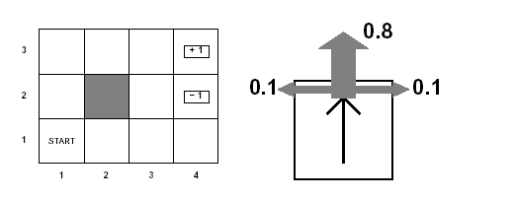
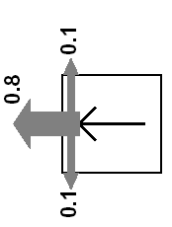
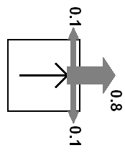
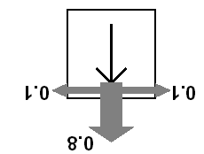
Example MDP: Scenario and Actions
Agent moves in the above grid via actions Up, Down, Left, Right
Each action has:
  0.8 probability to reach its intended effect
  0.1 probability to move at right angles of the intended direction
  If the agents bumps into a wall, it says there
Eleven states
Two terminal states (4,3) and (4,2)

Slide 7
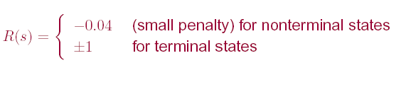
Example MDP: Rewards
Notes:
Example of Stochastic Shortest-PathMDP
Where (3,4) is the goal state? (see MDP book Chp2)

Slide 8
Discounted Reward Function
Suppose the agent goes through states s₁, s₂,...,s_{k} and receives rewards r₁, r₂,...,r_{k}
We will look at discounted reward to define the reward for this sequence, i.e. its utility for the agent

Slide 9
MDPs: Policy
The robot needs to know what to do as the decision process unfolds…
It starts in a state, selects an action, ends up in another state selects another action….
Needs to make the same decision over and over: Given the current state what should I do?
So a policy for an MDP is a single decision function π(s) that specifies what the agent should do for each state s
Notes:
So what is the best sequence of actions for our Robot?
There is no best sequence of actions!
Minimizes cost
(you do not know how the world will be when you’ll need to make the decision)

Slide 10














Sketch of ideas to find the optimal policy for a MDP (Value Iteration)
We first need a couple of definitions
  V^{π}(s): the expected value of following policy π in state s
  Q^{π} (s, a), where a is an action: expected value of performing a in s, and then following policy π.

Slide 11
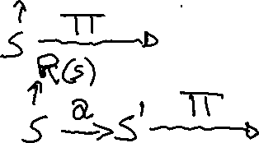

Sketch of ideas to find the optimal policy for a MDP (Value Iteration)
  V ^{п}(s):
  Q ^{п}(s, a)
  We have, by definition
  Q ^{п}(s, a)=
reward obtained in s
states reachable
from s by doing a
Probability of getting to s’ from s via a
expected value of following policy π in s’
Discount factor

Slide 12
Sketch of ideas to find the optimal policy for a MDP (Value Iteration)
We first need a couple of definitions
  V ^{п}(s): the expected value of following policy π in state s
  Q ^{п}(s, a), where a is an action: expected value of performing a in s, and then following policy π.
We have, by definition
  Q ^{п}(s, a)=
reward obtained in s
states reachable
from s by doing a
Probability of getting to s’ from s via a
expected value of following policy π in s’
Discount factor

Slide 13
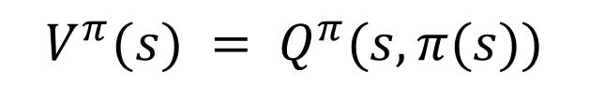
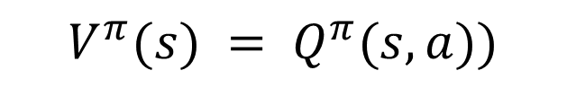

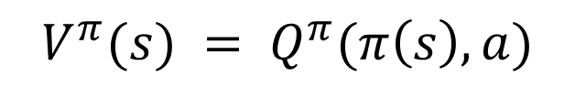
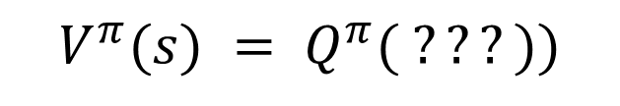

Value of a policy and Optimal policy
  V ^{п}(s):
  Q ^{п}(s, a)
We can also compute V ^{п}(s) in terms of Q ^{п}(s, a)
$$V^{π}(s) = Q^{π}( ???))$$
A.
$$V^{π}(s) = Q^{π}(s,a))$$
B.
$$V^{π}(s) = Q^{π}(π\left(s\right), a)$$
C.
$$V^{π}(s) = Q^{π}(s,π(s))$$
Notes:
This is true for any policy, so it is also true for the optimal one

Slide 14


Value of a policy and Optimal policy
We can also compute V ^{п}(s) in terms of Q ^{п}(s, a)
  V ^{п}(s):
  Q ^{п}(s, a)
For the optimal policy π * we also have
Notes:
This is true for any policy, so it is also true for the optimal one

Slide 15
Value of a policy and Optimal policy
We can also compute V ^{п}(s) in terms of Q ^{п}(s, a)
action indicated by π in s
Expected value of following π in s
Expected value of performing the action indicated by π in s and following π after that
For the optimal policy π * we also have
Notes:
This is true for any policy, so it is also true for the optimal one

Slide 16

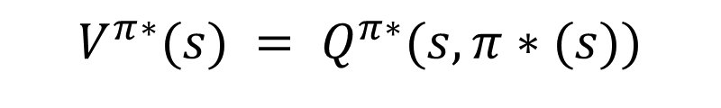
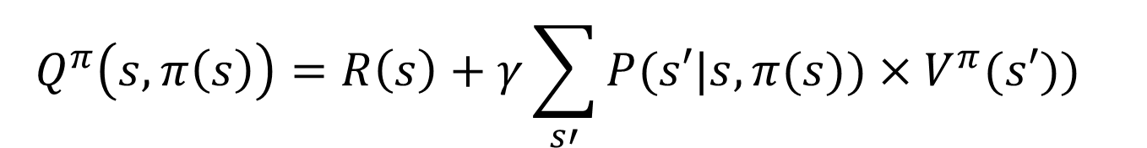

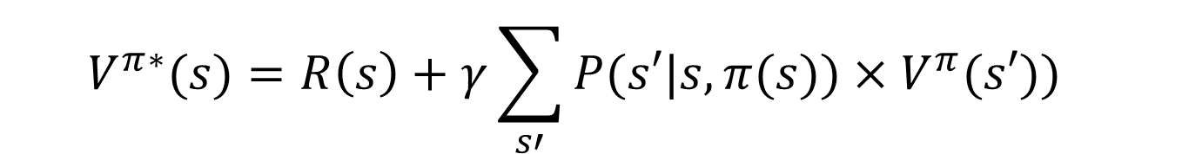
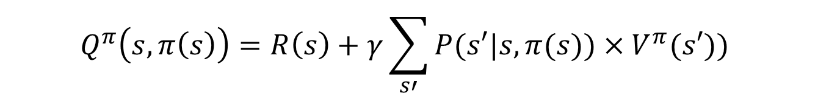
Value of Optimal policy
$$V^{π∗}(s) = Q^{π∗}(s,π∗(s))$$
Remember for any policy π and any action a
$$Q^{π}\left(s,a\right)=R\left(s\right)+γ\sum_{s′}{P(s′|s,aV^{π}(s′)})$$
So for a = π(s)
$$Q^{π}\left(s,π\left(s\right)\right)=R\left(s\right)+γ\sum_{s′}{P(s′|s,π(s))×V^{π}(s′)})$$
Which is true also for the optimal policy
$$Q^{π}\left(s,π\left(s\right)\right)=R\left(s\right)+γ\sum_{s′}{P(s′|s,π(s))×V^{π}(s′)})$$
So from (1) and (2)
$$V^{π∗}(s)=R\left(s\right)+γ\sum_{s′}{P(s′|s,π(s))×V^{π}(s′)})$$

Slide 17
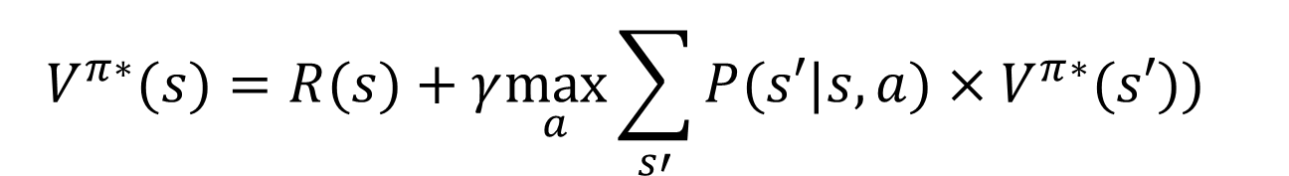
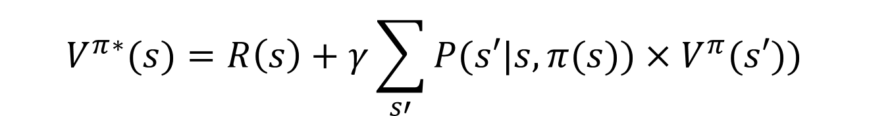
Value of Optimal policy
$$V^{π∗}(s)=R\left(s\right)+γ\sum_{s′}{P(s′|s,π(s))×V^{π}(s′)})$$
But the Optimal policy π* is the one that gives the action that maximizes the future reward for each state
$$V^{π∗}(s)=\underset{ }{R(s)+γ\max_{a}}\sum_{s′}{P(s′|s,a)×V^{π∗}(s′)})$$

Slide 18
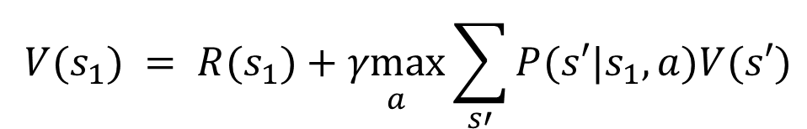
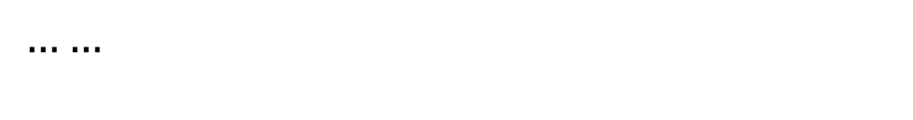
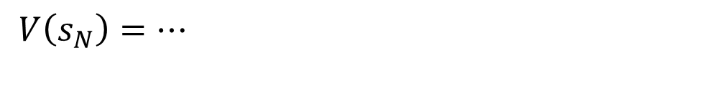
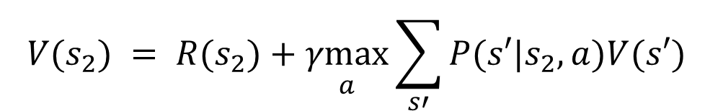
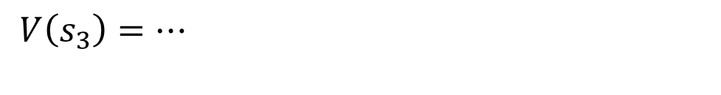
Value Iteration Rationale
Given N states, we can write an equation like the one below for each of them
$$V(s_{1}) = R(s_{1})+\underset{a}{γmax}\sum_{s′}^{ }{P(s′|s_{1},a)V(s′)}$$
$$V(s_{2}) = R(s_{2})+\underset{a}{γmax}\sum_{s′}^{ }{P(s′|s_{2},a)V(s′)}$$
$$V\left(s_{3}\right)=…$$
$$……$$
$$V\left(s_{N}\right)=…$$

Slide 19






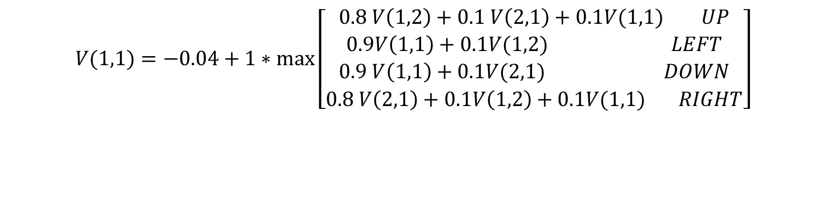
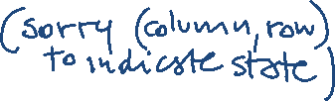
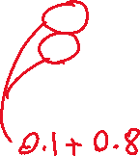
Example for state (1,1)
Example for state (1,1)
$$V(1,1)=−0.04+1∗\max\left[\begin{aligned}0.8 V\left(1,2\right)+0.1 V\left(2,1\right)+0.1V(1,1) UP \\ 0.9V\left(1,1\right)+0.1V(1,2) LEFT \\ 0.9 V\left(1,1\right)+0.1V(2,1) DOWN \\ 0.8 V\left(2,1\right)+0.1V\left(1,2\right)+0.1V(1,1) RIGHT\end{aligned}\right]$$

Slide 20
Value Iteration Rationale
Given N states, we can write an equation like the one below for each of them
Each equation contains N unknowns – the V values for the N states
N equations in N variables (Bellman equations): It can be shown that they have a unique solution: the values for the optimal policy
Unfortunately the N equations are non-linear, because of the max operator: Cannot be easily solved by using techniques from linear algebra
Value Iteration Algorithm: Iterative approach to find the V values and the corresponding
optimal policy

Slide 21
Value Iteration in Practice
Let V^{(i)}(s) be the utility of state s at the i^{th} iteration of the algorithm
Start with arbitrary utilities on each state s: V⁽⁰⁾(s)
Repeat simultaneously for every s until there is “no change”
True “no change” in the values of V(s) from one iteration to the next are guaranteed only if run for infinitely long.
  In the limit, this process converges to a unique set of solutions for the Bellman equations
  They are the total expected rewards (utilities) for the optimal policy

Slide 22
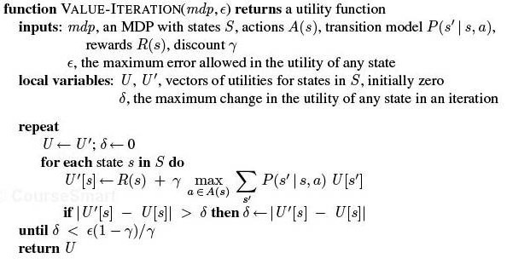
VI algorithm

Slide 23
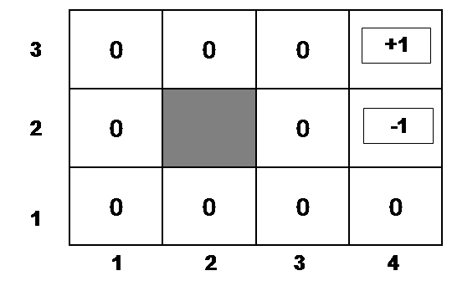
Example
Suppose, for instance, that we start with values V⁽⁰⁾(s) that are all 0
Iteration 0
Iteration 1
3
2
1
0 | 0 | 0
0 |  | 0
0 | 0 | 0 | 0
+1
-1
-0.04
1 2 3 4

Slide 24
Example (cont’d)
Let’s compute V⁽¹⁾(3,3)
Iteration 0
Iteration 1
3
2
1
0 | 0 | 0
0 |  | 0
0 | 0 | 0 | 0
0.76
+1
-1
-0.04
-0.4
1 2 3 4

Slide 25
Example (cont’d)
Let’s compute V⁽¹⁾(4,1)
Iteration 0
Iteration 1
3
2
1
0 | 0 | 0
0 |  | 0
0 | 0 | 0 | 0
.76
+1
-1
-0.04
-0.04
1 2 3 4

Slide 26
After a Full Iteration
Iteration 1
3
2
1
-.04 | -.04 | 0.76
-.04 |  | -.04
-.04 | -.04 | -.04 | -.04
+1
-1
1 2 3 4
Only the state one step away from a positive reward (3,3) has gained value, all the others are losing value
Notes:
?because of the cost of moving?
Because at best they are all one step from states with 0 value

Slide 27
Some steps in the second iteration
Iteration 1
Iteration 2
3
2
1
-.04 | -.04 | 0.76
-.04 |  | -.04
-.04 | -.04 | -.04 | -.04
3
2
1
-.04 | -.04 | 0.76
-.04 |  | -.04
-.04 | -.04 | -.04 | -.04
+1
+1
-1
-1
-0.08
1 2 3 4
1 2 3 4

Slide 28
Example (cont’d)
Let’s compute V⁽²⁾(2,3)
Steps two moves away from positive rewards start increasing their value
Iteration 2
Iteration 1
-.04 | -.04 | 0.76
-.04 |  | -.04
-.04 | -.04 | -.04 | -.04
0.56
+1
3
2
1
-.04 | -.04 | 0.76
-.04 |  | -.04
-.04 | -.04 | -.04 | -.04
+1
-1
-1
-0.08
1 2 3 4
1 2 3 4

Slide 29
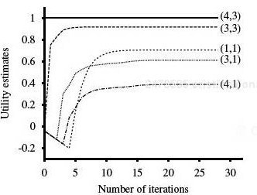
State Utilities as Function of Iteration #
 |  | (3,3) | (4,3)
 |  |  | (4,2)
(1,1) |  | (3,1) | (4,1)
Note that values of states at different distances from (4,3) accumulate negative rewards until a path to (4,3) is found

Slide 30

Value Iteration: Computational Complexity
Value iteration works by producing successive approximations of the optimal value function.
What is the complexity of each iteration?
…or faster if there is sparsity in the transition function.
A. O(|A|²|S|)
B. O(|A||S|²)
C. O(|A|²|S|²)
Notes:
Computational Complexity
Value iteration works by producing successive approximations of the optimal value function. Each iteration can be performed in O(|A||S|²) steps, or faster if there is sparsity in the transition function. However, the number of iterations required can grow exponentially in the discount factor [27]; as the discount factor approaches 1, the decisions must be based on results that happen farther and farther into the future. In practice, policy iteration converges in fewer iterations than value iteration, although the per-iteration costs of O(|A||S|² ⁺ |S|³ ) can be prohibitive. There is no known tight worst-case bound available for policy iteration [66]. Modified policy iteration [91] seeks a trade-off between cheap and effective iterations and is preferred by some practictioners [96].

Slide 31
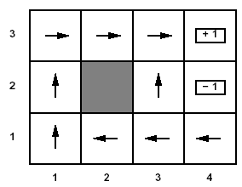
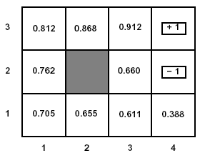
U(s) and R(s)
Note that U(s) and R(s) are quite different quantities
  R(s) is the short term reward related to s
  U(s) is the expected long term total reward from s onward if following л*
Example: U(s) for the optimal policy we found for the grid problem with R(s non-terminal) = -0.04 and γ =1

Slide 32

Relevance to state of the art MDPs
FROM : Planning with Markov Decision Processes: An AI Perspective Mausam (UW), Andrey Kolobov (MSResearch) Synthesis Lectures on Artificial Intelligence and Machine Learning Jun 2012
Free online through UBC
“ Value Iteration (VI) forms the basis of most of the advanced MDP algorithms that we discuss in the rest of the book. ……..”

Slide 33
Lecture Overview
Markov Decision Processes
……
Finding the Optimal Policy
  Value Iteration
From Values to the Policy
Rewards and Optimal Policy

Slide 34
Value Iteration: from state values V to л*
Now the agent can chose the action that implements the MEU principle: maximize the expected utility of the subsequent state

Slide 35
Value Iteration: from state values V to л*
Now the agent can chose the action that implements the MEU principle: maximize the expected utility of the subsequent state
expected value of following policy л* in s’
states reachable
from s by doing a
Probability of getting to s’ from s via a

Slide 36
Example: from state values V to л*
To find the best action in (1,1)

Slide 37
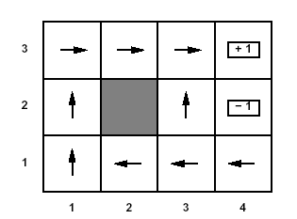
Optimal policy
This is the policy that we obtain….

Slide 38
Learning Goals for today’s class
You can:
Define/read/write/trace/debug the Value Iteration (VI) algorithm. Compute its complexity.
Compute the Optimal Policy given the output of VI
Explain influence of rewards on optimal policy

Slide 39
TODO for Mon
Read Textbook 9.5.6 Partially Observable MDPs
Also Do Practice Ex. 9.C
http://www.aispace.org/exercises.shtml

