Slide 1
Intelligent Systems (AI-2)
Computer Science cpsc422, Lecture 33
Apr, 27, 2021
Slide source: from David Page (MIT) (which were from From Lise Getoor, Nir Friedman,
Daphne Koller, and Avi Pfeffer) and from Lise Getoor
Notes:
Lecture 34

Slide 2

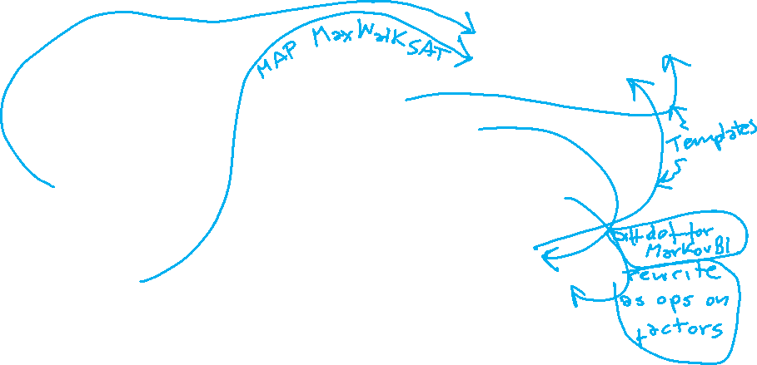

422 big picture: where are we?
StarAI (statistical relational AI)
Hybrid: Det +Sto
Prob CFG
Prob Relational Models
Markov Logics
Deterministic
Stochastic
Belief Nets
Logics
Approx. : Gibbs
First Order Logics
Markov Chains and HMMs
Ontologies
Forward, Viterbi….
Approx. : Particle Filtering
Query
Full Resolution
SAT
Undirected Graphical Models
Markov Networks
Conditional Random Fields
Markov Decision Processes and
Partially Observable MDP
Planning
Value Iteration
Approx. Inference
Reinforcement Learning
Representation
Applications of AI
Reasoning
Technique
Notes:
Breadth and Depth

Slide 3
Lecture Overview
Recap Motivation and Representation for Probabilistic Relational Models (PRMs)
  Full Relational Schema and its Instances
  Relational Skeleton and its Completion Instances
Probabilistic Model of PRMs
  Dependency Structure
  Parameters

Slide 4
How PRMs extend BNs?
Registration
PRMs conceptually extend BNs to allow the specification of a probability model for classes of objects rather than a fixed set of simple attributes
RegID
Course
Student
Grade
Satisfaction
Registration
Satisfaction
Grade
Notes:
HAVE CLASSES and attribute + ref slots on the whiteboard
The starting point of this work is the structured representation of probabilistic models of Bayesian networks (BNs). BNs for a given domain involves a pre-specified set of attributes whose relationship to each other is fixed in advance
PRMs conceptually extend BNs to allow the specification of a probability model for classes of objects rather than a fixed set of simple attributes
PRMs also allow properties of an entity to depend probabilistically on properties of other related entities

Slide 5
How PRMs extend BNs?
PRMs conceptually extend BNs to allow the specification of a probability model for classes of objects rather than a fixed set of simple attributes
Professor
Teaching-Ability
Popularity
2. PRMs also allow properties of an entity to depend probabilistically on properties of other related entities
Registration
Satisfaction
Grade
Notes:
HAVE CLASSES and attribute + ref slots on the whiteboard
The starting point of this work is the structured representation of probabilistic models of Bayesian networks (BNs). BNs for a given domain involves a pre-specified set of attributes whose relationship to each other is fixed in advance
PRMs conceptually extend BNs to allow the specification of a probability model for classes of objects rather than a fixed set of simple attributes
PRMs also allow properties of an entity to depend probabilistically on properties of other related entities

Slide 6
Mapping PRMs from Relational Models
The representation of PRMs is a direct mapping from that of relational databases
A relational model consists of a set of classes X₁,…,X_{n} and a set of relations R₁,…,R_{m}, where each relation R_{i} is typed

Slide 7
University Domain Example – Full Relational Schema
Primary
keys are
indicated
by a blue rectangle
M
1
Professor
Student
Name
Name
Indicates
many-to-many
relationship
Popularity
Intelligence
Indicates
one-to-many
relationship
Teaching-Ability
Ranking
1
Registration
Course
Underlined
attributes are
reference
slots of the class
Dashed lines
indicate the types of objects referenced
Name
RegID
Course
Instructor
M
M
Student
Rating
M
Grade
Difficulty
Satisfaction

Slide 8
University Domain Example – An Instance of the Schema
Professor
Name
Prof. Gump
Popularity
high
Teaching-Ability
medium
Student
Name
Jane Doe
Intelligence
high
Ranking
average
Student
Name
Jane Doe
Intelligence
high
Ranking
average
One
professor
is the instructor for both courses
Registration
RegID
#5639
Grade
A
Satisfaction
3
Jane Doe is registered for only one course, Phil101, while the other student is registered for both courses
Course
Name
Phil101
Difficulty
low
Rating
high
Registration
RegID
#5639
Grade
A
Satisfaction
3
Course
Name
Phil101
Difficulty
low
Rating
high
Registration
RegID
#5639
Grade
A
Satisfaction
3

Slide 9
University Domain Example – Another Instance of the Schema
Professor
Name
Prof. Vincent
Popularity
high
Teaching-Ability
high
Student
Name
Jane Doe
Intelligence
high
Ranking
average
Professor
Name
Prof. Gump
Popularity
high
Teaching-Ability
medium
Student
Name
Jane Doe
Intelligence
high
Ranking
average
Student
Name
John Doe
Intelligence
high
Ranking
average
There are two
professors
instructing a course
Registration
RegID
#5639
Grade
A
Satisfaction
3
Registration
RegID
#5639
Grade
A
Satisfaction
3
There are three students in the Phil201 course
Course
Name
Phil201
Difficulty
low
Rating
high
Registration
RegID
#5723
Grade
A
Satisfaction
3

Slide 10
University Domain Example – fixed vs. probabilistic attributes
M
1
Professor
Student
Name
Name
Popularity
Intelligence
Teaching-Ability
Ranking
1
Registration
Course
Probabilistic attributes are shown in italic
Name
RegID
Fixed attributes are shown in regular font
Probabilistic
attributes
are shown in italic
Fixed
attributes
are shown in regular font
Course
Instructor
M
M
Student
Rating
M
Grade
Difficulty
Satisfaction

Slide 11
PRM Semantics: Skeleton Structure
A skeleton structure σ of a relational schema is a partial specification of an instance of the schema. It specifies
  set of objects for each class,
  values of the fixed attributes of these objects,
  relations that hold between the objects
The values of probabilistic attributes are left unspecified
A completion I of the skeleton structure σ extends the skeleton by also specifying the values of the probabilistic attributes
Notes:
A skeleton structure σ of a relational schema is a partial specification of an instance of the schema. It specifies the set of objects O^{σ}(X_{i}) for each class, the values of the fixed attributes of these objects, and the relations that hold between the objects
The values of probabilistic attributes are left unspecified
A completion I of the skeleton structure σ extends the skeleton by also specifying the values of the probabilistic attributes

Slide 12
University Domain Example –Relational Skeleton
Professor
Name
Prof. Vincent
Popularity
???
Teaching-Ability
???
Student
Name
Jane Doe
Intelligence
high
Ranking
average
Professor
Name
Prof. Gump
Popularity
high
Teaching-Ability
???
Student
Name
Jane Doe
Intelligence
high
Ranking
average
Student
Name
John Doe
Intelligence
???
Ranking
???
Registration
RegID
#5639
Grade
A
Satisfaction
3
Registration
RegID
#5639
Grade
A
Satisfaction
3
Course
Name
Phil201
Difficulty
???
Rating
???
Registration
RegID
#5723
Grade
???
Satisfaction
???

Slide 13
University Domain Example – The Completion Instance I
Professor
Name
Prof. Vincent
Popularity
high
Teaching-Ability
high
Student
Name
Jane Doe
Intelligence
high
Ranking
average
Professor
Name
Prof. Gump
Popularity
high
Teaching-Ability
medium
Student
Name
Jane Doe
Intelligence
high
Ranking
average
Student
Name
John Doe
Intelligence
high
Ranking
average
Registration
RegID
#5639
Grade
A
Satisfaction
3
Registration
RegID
#5639
Grade
A
Satisfaction
3
Course
Name
Phil201
Difficulty
low
Rating
high
PRMs also allow multiple possible instances and values
Registration
RegID
#5723
Grade
A
Satisfaction
3

Slide 14
Lecture Overview
Recap Motivation and Representation for Probabilistic Relational Models (PRMs)
  Full Relational Schema and its Instances
  Relational Skeleton and its Completion Instances
Probabilistic Model of PRMs
  Dependency Structure
  Parameters

Slide 15
PRMs: Probabilistic Model
The probabilistic model consists of two components:
  the qualitative dependency structure, S
  the parameters associated with it, θ_{S}
The dependency structure is defined by associating with each attribute X.A a set of parents Pa(X.A); parents are attributes that are “direct influences” on X.A. This dependency holds for any object of class X

Slide 16
Dependencies within a class
The prob. attribute X.A can depend on another probabilistic attribute B of X. This induces a corresponding dependency for individual objects
Registration
Registration
RegID
#5723
Grade
….
Satisfaction
…..
RegID
Course
Student
Grade
Satisfaction
Registration
Satisfaction
Grade

Slide 17
Dependencies across classes
The attribute X.A can also depend on attributes of related objects X.τ.B, where τ is a slot chain
Professor
M
Professor
Teaching-Ability
Name
Popularity
Teaching-Ability
Popularity
Course
1
Registration
Name
RegID
Instructor
Course
Registration
M
M
Student
Rating
M
Difficulty
Grade
Satisfaction
Satisfaction
Grade
Notes:
For example, given any Registration object r and the corresponding Professor object p for that instance, r.Satisfaction will depend probabilistically on r.Grade as well as p.Teaching-Ability

Slide 18
Possible PRM Dependency Structure for the University Domain
M
Edges correspond
to probabilistic
dependency for
objects in that class
Professor
Teaching-Ability
Popularity
M
Student
1
Course
Intelligence
1
Rating
Ranking
M
M
Registration
Difficulty
Satisfaction
Edges from
one class to
another are routed
through slot-chains
Grade

Slide 19
Let’s derive the Corresponding “grounded” Dependency Structure for this Skeleton
Student
Name
Jane Doe
Intelligence
high
Ranking
average
Professor
Name
Prof. Gump
Popularity
???
Teaching-Ability
???
Professor
Name
Prof. Vincent
Popularity
???
Teaching-Ability
???
Student
Name
Sue Chu
Intelligence
???
Ranking
???
Course
Name
CS101
Difficulty
??????
Rating
??
Registration
RegID
#3
Grade
???
Satisfaction
???
Registration
RegID
#5
Grade
???
Satisfaction
???
Course
Name
Phil101
Difficulty
???
Rating
???
Registration
RegID
#6
Grade
???
Satisfaction
???

Slide 20
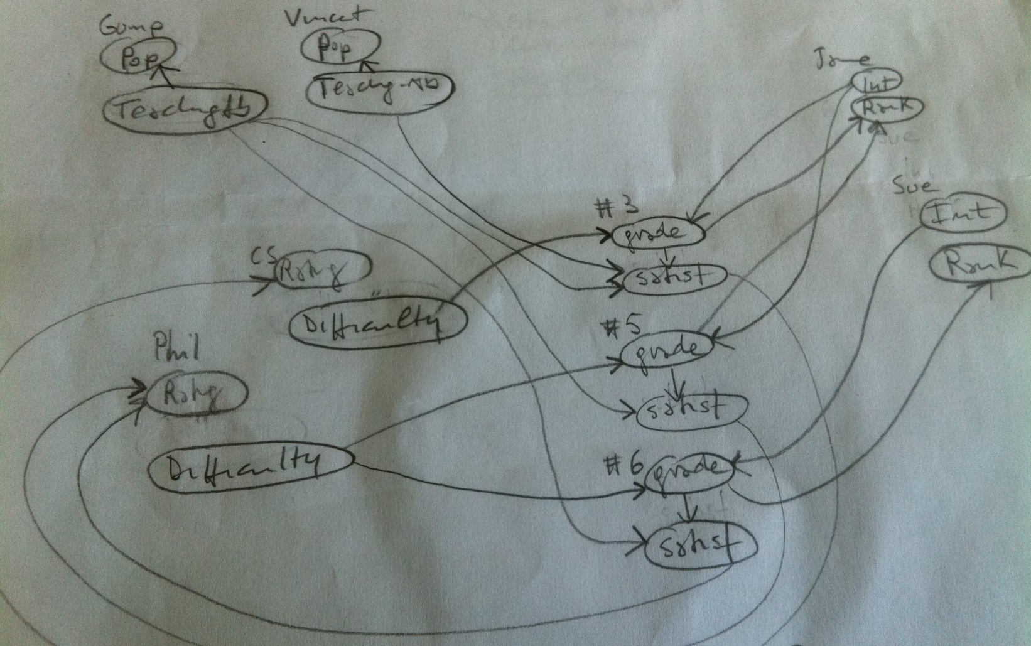















M
Professor
Name
Prof. Gump
Popularity
???
Teaching-Ability
???
Professor
Name
Prof. Vincent
Popularity
???
Teaching-Ability
???
Student
Name
Jane Doe
Intelligence
high
Ranking
average
Professor
Teaching-Ability
Student
Name
Sue Chu
Intelligence
???
Ranking
???
Popularity
Student
M
1
Course
1
Intelligence
Rating
Ranking
Course
Name
CS101
Difficulty
??????
Rating
??
Registration
RegID
#3
Grade
???
Satisfaction
???
M
Registration
M
Difficulty
Satisfaction
Course
Name
Phil101
Difficulty
???
Rating
???
Registration
RegID
#5
Grade
???
Satisfaction
???
Registration
RegID
#6
Grade
???
Satisfaction
???
Grade

Slide 21






M
Professor
Name
Prof. Gump
Popularity
???
Teaching-Ability
???
Professor
Name
Prof. Vincent
Popularity
???
Teaching-Ability
???
Student
Name
Jane Doe
Intelligence
high
Ranking
average
Professor
Teaching-Ability
Student
Name
Sue Chu
Intelligence
???
Ranking
???
Popularity
Student
M
1
Course
1
Intelligence
Rating
Ranking
Course
Name
CS101
Difficulty
??????
Rating
??
Registration
RegID
#3
Grade
???
Satisfaction
???
M
Registration
M
Difficulty
Satisfaction
Course
Name
Phil101
Difficulty
???
Rating
???
Registration
RegID
#5
Grade
???
Satisfaction
???
Registration
RegID
#6
Grade
???
Satisfaction
???
Grade

Slide 22
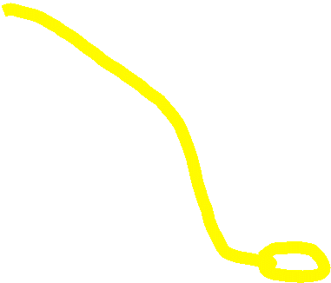







M
Professor
Name
Prof. Gump
Popularity
???
Teaching-Ability
???
Professor
Name
Prof. Vincent
Popularity
???
Teaching-Ability
???
Student
Name
Jane Doe
Intelligence
high
Ranking
average
Professor
Teaching-Ability
Student
Name
Sue Chu
Intelligence
???
Ranking
???
Popularity
Student
M
1
Course
1
Intelligence
Rating
Ranking
Course
Name
CS101
Difficulty
??????
Rating
??
Registration
RegID
#3
Grade
???
Satisfaction
???
M
Registration
M
Difficulty
Satisfaction
Course
Name
Phil101
Difficulty
???
Rating
???
Registration
RegID
#5
Grade
???
Satisfaction
???
Registration
RegID
#6
Grade
???
Satisfaction
???
Grade

Slide 23
Now, what are the parameters θ_{S}
M
Professor
Teaching-Ability
Popularity
M
Student
1
Course
Intelligence
1
Rating
M
Ranking
M
Registration
Difficulty
Satisfaction
D.I A B C
h,h 0.5 0.4 0.1
h,l 0.1 0.5 0.4
l,h 0.8 0.1 0.1
l,l 0.3 0.6 0.1
Grade

Slide 24
Parameters of PRMs
A PRM contains a conditional probability distribution (CPD) P(X.A|Pa(X.A)) for each attribute X.A of each class e.g.,
P(Registration.Grade | Course.Difficulty, Student.Intelligence)
More precisely, let U be the set of parents of X.A. For each tuple of values u ∈ V(U), the CPD specifies a distribution P(X.A|u) over V(X.A).
D.I A B C
h,h 0.5 0.4 0.1
h,l 0.1 0.5 0.4
l,h 0.8 0.1 0.1
l,l 0.3 0.6 0.1
The parameters in all of these CPDs comprise θ_{S}

Slide 25

Problem with some parameters θ_{S}
M
Professor
Teaching-Ability
Popularity
M
Student
1
Course
Intelligence
1
Rating
M
Ranking
M
Registration
???
Difficulty
Satisfaction
Grade

Slide 26
Problem with some parameters θ_{S}
M
Professor
Teaching-Ability
M
Popularity
Student
Course
1
Intelligence
Rating
1
M
M
Ranking
Difficulty
Registration
Satisfaction
Grade
When the slot chain τ
is not guaranteed to be single-valued, we must specify the probabilistic dependence of
x.A
on the set {y.B: y ∈ x.τ}
Notes:
In general it should be a multiset (set with repetitions) but for the sake of simplicity let’s only consider sets

Slide 27
How to specify cond. Prob. When # of parents can vary?
The notion of aggregation from database theory gives us the tool to address this issue; i.e., x.A will depend probabilistically on some aggregate property of this set
Notes:
As mentioned earlier, x.τ represents the set of objects that are τ-relatives of x.

Slide 28
Aggregation in PRMs
Examples of aggregation are:
the mode of the set (most frequently occurring value);
mean value of the set (if values are numerical);
median, maximum, or minimum (if values are ordered);
cardinality of the set; etc.
Notes:
An aggregate essentially takes a set of values of some ground type and returns a summary of it
The type of the aggregate can be the same as that of its arguments, or any type returned by an aggregate. X.A can have γ(X.τ.B) as a parent; the semantics is that for any x ∈ X, x.a will depend on the value of γ(x.τ.b), V(γ(x.τ.b))

Slide 29
PRM Dependency Structure with aggregations
The same course can be taught by multiple profs
A course satisfaction depends on the teaching abilities of its instructors
M
Professor
Teaching-Ability
A student may take multiple courses
Popularity
M
Student
1
Course
AGG
Intelligence
1
Rating
Ranking
M
M
Registration
Difficulty
AGG
Satisfaction
The student’s ranking depends on the average of his grades
A course rating depends on the average satisfaction of students in the course
AGG
Grade

Slide 30
CPDs in PRMs
M
Professor
Teaching-Ability
Popularity
M
Student
1
Course
Intelligence
1
Rating
M
Ranking
M
Registration
Difficulty
AGG
Satisfaction
AGG
D.I A B C
h,h 0.5 0.4 0.1
h,l 0.1 0.5 0.4
l,h 0.8 0.1 0.1
l,l 0.3 0.6 0.1
Grade
agg l m h
A 0.1 0.2 0.7
B 0.2 0.4 0.4
C 0.6 0.3 0.1

Slide 31
JPD in PRMs
Given a skeleton structure σ for our schema, we can apply these local conditional probabilities to define a JPD (joint probability distribution) over all completions of the skeleton
Note that the objects and relations between objects in a skeleton are always specified by σ, hence we are disallowing uncertainty over the relational structure of the model

Slide 32




M
Professor
Name
Prof. Gump
Popularity
???
Teaching-Ability
???
Professor
Name
Prof. Vincent
Popularity
???
Teaching-Ability
???
Student
Name
Jane Doe
Intelligence
high
Ranking
average
Professor
Teaching-Ability
Student
Name
Sue Chu
Intelligence
???
Ranking
???
Popularity
Student
M
1
Course
1
Intelligence
Rating
Ranking
Course
Name
CS101
Difficulty
??????
Rating
??
Registration
RegID
#3
Grade
???
Satisfaction
???
M
Registration
M
Difficulty
Satisfaction
Course
Name
Phil101
Difficulty
???
Rating
???
Registration
RegID
#5
Grade
???
Satisfaction
???
Registration
RegID
#6
Grade
???
Satisfaction
???
Grade

Slide 33
Parameter Sharing / CPTs reuse, where else?
Temporal Models
Because of the stationary assumption!

Slide 34
Final Issue: Cycles
To define a coherent probabilistic model, we must ensure that our probabilistic dependencies are acyclic
A dependency structure S is acyclic relative to a skeleton σ if the directed graph over all the parents of the variables x.A is acyclic
If S is acyclic relative to σ, then the following defines a distribution over completions I of σ:
P(I|σ,S,θ_{S}) =
Notes:
To define a coherent probabilistic model, we must ensure that our probabilistic dependencies are acyclic, so that a random variable does not depend, directly or indirectly, on its own value
A dependency structure S is acyclic relative to a skeleton σ if the directed graph over all the parents of the variables x.A is acyclic
If S is acyclic relative to σ, then the following defines a distribution over completions I of σ: P(I|σ,S,θ_{S}) =

Slide 35
Final Issue….
To define a coherent probabilistic model as a Bayesian network, we must ensure that our probabilistic dependencies are…..
Polynomial
Acyclic
Cyclic
Recursive
Notes:
To define a coherent probabilistic model, we must ensure that our probabilistic dependencies are acyclic, so that a random variable does not depend, directly or indirectly, on its own value
A dependency structure S is acyclic relative to a skeleton σ if the directed graph over all the parents of the variables x.A is acyclic
If S is acyclic relative to σ, then the following defines a distribution over completions I of σ: P(I|σ,S,θ_{S}) =

Slide 36
Class Dependency Graph for the University Domain
Course.Difficulty
Student.Intelligence
Professor.Teaching-Ability
Registration.Grade
Professor.Popularity
Registration.Satisfaction
Student.Ranking
Course.Rating

Slide 37
Ensuring Acyclic Dependencies
In general, however, a cycle in the class dependency graph does not imply that all skeletons induce cyclic dependencies
A model may appear to be cyclic at the class level, however, this cyclicity is always resolved at the level of individual objects
The ability to guarantee that the cyclicity is resolved relies on some prior knowledge about the domain. The user can specify that certain slots are guaranteed acyclic

Slide 38
Relational Schema for the Genetics Domain
Person
1
Blood Test
BT-ID
Name
Patient
Blood-Type
M
P-Chromosome
Results
M-Chromosome
Contaminated
M = Maternal
P = Paternal
Notes:
M maternal
P paternal

Slide 39
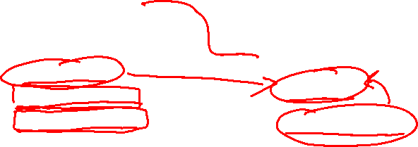
Relational Schema for the Genetics Domain
Person
1
Blood Test
BT-ID
Name
Patient
Blood-Type
M
P-Chromosome
Results
M-Chromosome
Contaminated
Notes:
M maternal
P paternal
a P-chromosome depends on another P-chromosom

Slide 40

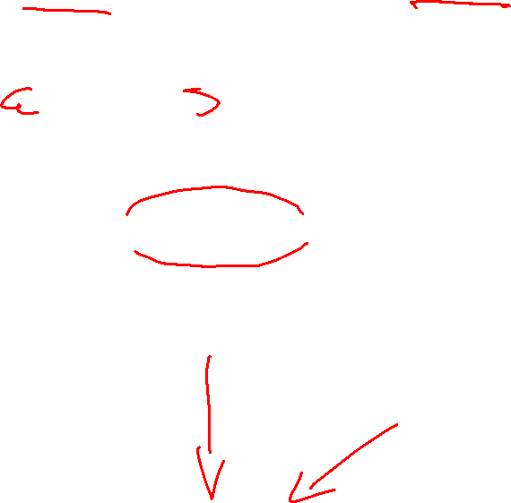
Dependency Graph: Genetics Domain
Person
1
Blood Test
Name
BT-ID
Patient
Blood-Type
M
P-Chromosome
Results
M-Chromosome
Contaminated
Person.M-chromosome
Person.P-chromosome
Person.BloodType
BloodTest.Contaminated
BloodTest.Result

Slide 41
PRM for the Genetics Domain
(Father)
(Mother)
Person
BloodType
Person
BloodType
P-chromosome
P-chromosome
M-chromosome
M-chromosome
Person
P-chromosome
M-chromosome
BloodType
Contaminated
Result
BloodTest
Notes:
M maternal
P paternal
If you were your own mother/father there would be cycles! But that’s impossible “in this domain”

Slide 42
Dependency Graph for Genetics Domain
Person.M-chromosome
Person.P-chromosome
Person.BloodType
Dashed edges correspond to “guaranteed acyclic” dependencies
BloodTest.Contaminated
BloodTest.Result

Slide 43
Learning Goals for today’s class
You can:
Build the grounded Bnet, given a Relational Skeleton, a dependency structure, and the corresponding parameters
Define and apply guaranteed acyclicity

Slide 44
MONDAY: Third and final research paper reading
EMNLP 2020 paper MEGA RST Discourse Treebanks with Structure and Nuclearity from Scalable Distant Sentiment Supervision
Patrick Huber, Giuseppe Carenini
(guest speaker: first author of the paper PhD student Patrick Huber !
Material to review before reading:
  CKY,
  Exploration/Exploitation trade-off in RL,
  Beam Search (from 322),
  Recurrent Neural Networks (if you have seen them in 340 or other courses)

Slide 45
Relatively Recent Book + VideoTutorial on Star-AI
Book: Logic, Probability, and Computation 2016
Luc De Raedt, KU Leuven, Belgium,
Kristian Kersting, Technical University of Dortmund, Germany,
Sriraam Natarajan, Indiana University,
David Poole, University of British Columbia
An intelligent agent interacting with the real world will encounter individual people, courses, test results, drugs prescriptions, chairs, boxes, etc., and needs to reason about properties of these individuals and relations among them as well as cope with uncertainty.
Uncertainty has been studied in probability theory and graphical models, and relations have been studied in logic, in particular in the predicate calculus and its extensions. This book examines the foundations of combining logic and probability into what are called relational probabilistic models. It introduces representations, inference, and learning techniques for probability, logic, and their combinations.
The book focuses on two representations in detail: Markov logic networks, a relational extension of undirected graphical models and weighted first-order predicate calculus formula, and Problog, a probabilistic extension of logic programs that can also be viewed as a Turing-complete relational extension of Bayesian networks.
Statistical Relational AI tutorial at NIPS (now NEURIPS) 2017. https://www.facebook.com/watch/live/?v=1552222671535633&ref=watch_permalink
Notes:
Logic, Probability, and Computation
Luc De Raedt, KU Leuven, Belgium,
Kristian Kersting, Technical University of Dortmund, Germany,
Sriraam Natarajan, Indiana University,
David Poole, University of British Columbia
An intelligent agent interacting with the real world will encounter individual people, courses, test results, drugs prescriptions, chairs, boxes, etc., and needs to reason about properties of these individuals and relations among them as well as cope with uncertainty.
Uncertainty has been studied in probability theory and graphical models, and relations have been studied in logic, in particular in the predicate calculus and its extensions. This book examines the foundations of combining logic and probability into what are called relational probabilistic models. It introduces representations, inference, and learning techniques for probability, logic, and their combinations.
The book focuses on two representations in detail: Markov logic networks, a relational extension of undirected graphical models and weighted first-order predicate calculus formula, and Problog, a probabilistic extension of logic programs that can also be viewed as a Turing-complete relational extension of Bayesian networks.

Slide 46
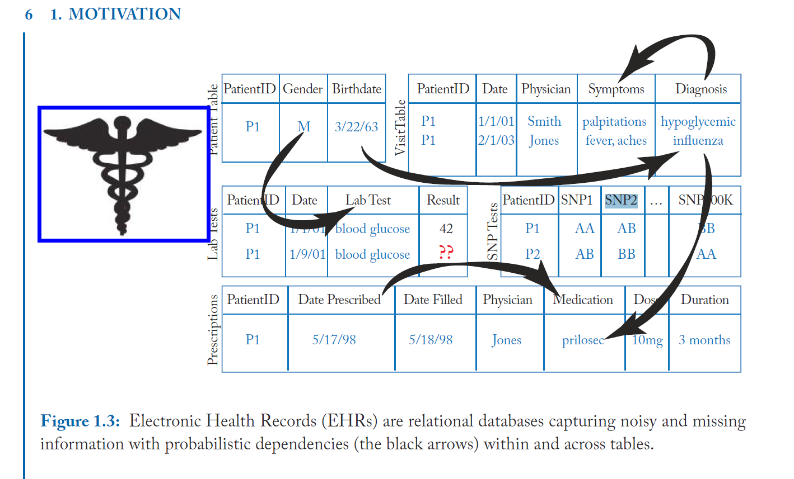

Slide 47
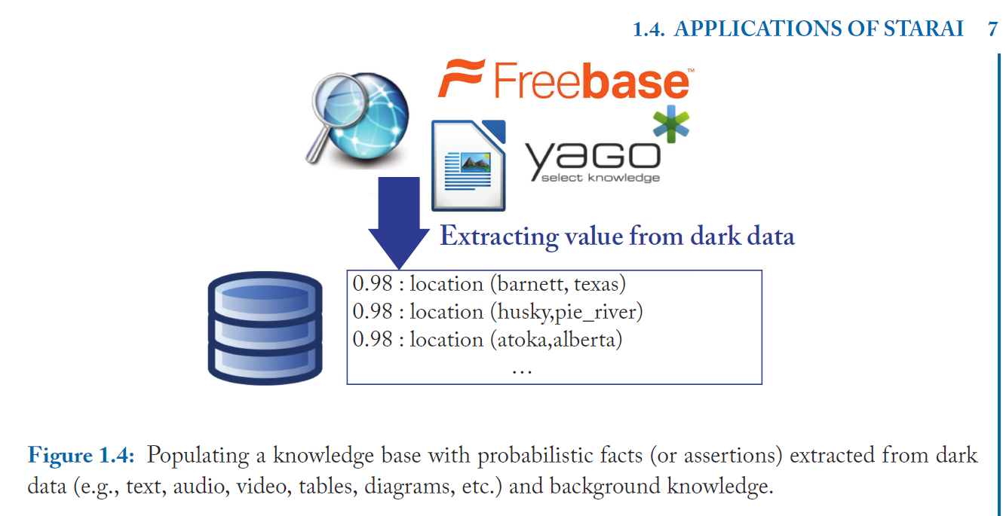

Slide 48
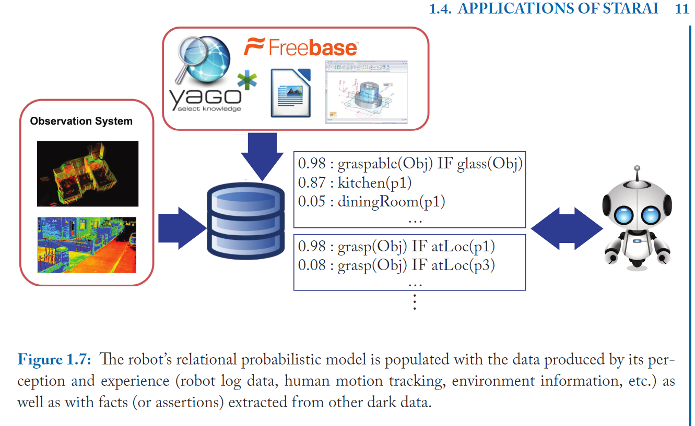

Slide 49
Last class on Wed
Beyond 322/422 (ML + grad courses)
Watson....
Final Exam
Assignment-4 Due !
Fill out on-line Teaching Evaluation

