Slide 1
Intelligent Systems (AI-2)
Computer Science cpsc422, Lecture 32
Apr, 5, 2021
Slide source: from David Page (MIT) (which were from From Lise Getoor, Nir Friedman,
Daphne Koller, and Avi Pfeffer) and from Lise Getoor
Notes:
Lecture 33

Slide 2

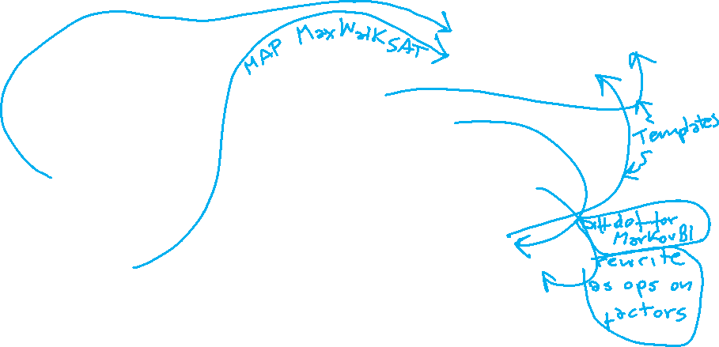

422 big picture: where are we?
StarAI (statistical relational AI)
Hybrid: Det +Sto
Prob CFG
Prob Relational Models
Markov Logics
Deterministic
Stochastic
Belief Nets
Logics
Approx. : Gibbs
First Order Logics
Markov Chains and HMMs
Ontologies
Forward, Viterbi….
Approx. : Particle Filtering
Query
Full Resolution
SAT
Undirected Graphical Models
Markov Networks
Conditional Random Fields
Markov Decision Processes and
Partially Observable MDP
Planning
Value Iteration
Approx. Inference
Reinforcement Learning
Representation
Applications of AI
Reasoning
Technique
Notes:
Breadth and Depth

Slide 3
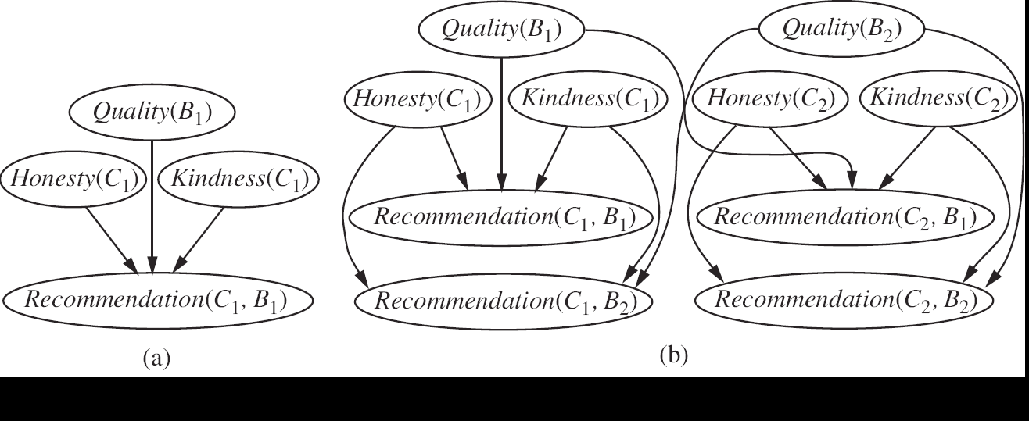
Combining Symbolic and Probabilistic R&R systems
(a) Probabilistic Context-Free Grammars
  Weights are conditional prob. on rewriting rules
  Applications: NLP parsing & Hierarchical Planning
(b) Markov Logics: weighted FOL
(c) Probabilistic Relational models
  Probs specified on relations
Notes:
A probabilistic relational model (PRM) or a relational probability model is a model in which the probabilities are specified on the relations, independently of the actual individuals. Different individuals share the probability parameters.
On R&N at pag 539
Markov Logics
Syntax: Weighted first-order formulas Semantics: Feature templates for Markov networks
Intuition: Soften logical constraints Give each formula a weight (Higher weight ⇒ Stronger constraint)
PCFG in Planning
Recent example 2012:
Learning Probabilistic Hierarchical Task Networks as Probabilistic Context-Free Grammars to Capture
User Preferences
NAN LI
Computer Science Department
Carnegie Mellon University, Pittsburgh, PA 15213 USA
and
WILLIAM CUSHING, SUBBARAO KAMBHAMPATI, SUNGWOOK YOON
Department of Computer Science
Arizona State University, Tempe, AZ 85281 USA

Slide 4
Intuition for Prob. Relational models
A customer C1 will / will not recommend a book B1 depending on the book quality, and the customer honesty and kindness
When you have two customers and two books…..
Notes:
(a) A Bnet for a single customer and a single book
Honesty is boolean while the other vars have integer values from 1 to 5
(b) Bnet for two customers and two books
Both a and b when instantiated on many individuals can generate large models (Bnets and Mnetworks respectively) where inference is tractable only for aprrox. algorithms
A probabilistic relational model (PRM) or a relational probability model is a model in which the probabilities are specified on the relations, independently of the actual individuals. Different individuals share the probability parameters.
On R&N at pag 539
PRMs conceptually extend BNs to allow the specification of a probability model for classes of objects rather than a fixed set of simple attributes
PRMs also allow properties of an entity to depend probabilistically on properties of other related entities

Slide 5
Lecture Overview
Motivation and Representation
Semantics of Probabilistic Relational Models (PRMs)
  Classes and Relations
  Attributes and Reference Slots
  Full Relational Schema and its Instances
  Fixed vs. Probabilistic Attributes
  Relational Skeleton and its Completion Instance
  Inverse Slot and Slot chain

Slide 6
Motivation for PRMs
Most real-world data are stored in relational DBMS
Combine advantages of relational logic & Bayesian networks:
  natural domain modeling: objects, properties, relations;
  generalization over a variety of situations;
  compact, natural probability models.
Integrate uncertainty with relational model:
  properties of domain entities can depend on properties of related entities;
  uncertainty over relational structure of domain.
Notes:
How these are different from BNs
Most real-world data are stored in relational DBMS
Few learning algorithms are capable of handling data in its relational form; thus we have to resort to “flattening” the data in order to do analysis
As a result, we lose relational information which might be crucial to understanding the data

Slide 7
Limitations of Bayesian Networks
A Bayesian networks (BNs) represents a pre-specified set of attributes/variables whose relationship to each other is fixed in advance.
Course.502.Difficulty
Student.Joe.Ability
Professor.Mary-Ability
Student.Joe.502.Grade
Student.Joe.502.Satisfaction
Notes:
The starting point of this work is the structured representation of probabilistic models of Bayesian networks (BNs). BNs for a given domain involves a pre-specified set of attributes whose relationship to each other is fixed in advance
PRMs conceptually extend BNs to allow the specification of a probability model for classes of objects rather than a fixed set of simple attributes
PRMs also allow properties of an entity to depend probabilistically on properties of other related entities

Slide 8
How PRMs extend BNs?
PRMs conceptually extend BNs to allow the specification of a probability model for classes of objects rather than a fixed set of simple attributes
PRMs also allow properties of an entity to depend probabilistically on properties of other related entities
Notes:
The starting point of this work is the structured representation of probabilistic models of Bayesian networks (BNs). BNs for a given domain involves a pre-specified set of attributes whose relationship to each other is fixed in advance
PRMs conceptually extend BNs to allow the specification of a probability model for classes of objects rather than a fixed set of simple attributes
PRMs also allow properties of an entity to depend probabilistically on properties of other related entities

Slide 9
Lecture Overview
Motivation and Representation
Semantics of Probabilistic Relational Models (PRMs)
  Classes and Relations
  Attributes and Reference Slots
  Full Relational Schema and its Instances
  Fixed vs. Probabilistic Attributes
  Relational Skeleton and its Completion Instance
  Inverse Slot and Slot chain

Slide 10
Mapping PRMs from Relational Models
The representation of PRMs is a direct mapping from that of relational databases
A relational model consists of a set of classes X₁,…,X_{n} and a set of relations R₁,…,R_{m}, where each relation R_{i} is typed

Slide 11
University Domain Example – Classes and relations
M
1
Professor
Student
Indicates
many-to-many
relationship
Indicates
one-to-many
relationship
1
Registration
Course
M
M
M
Notes:
For each student you can have many registrations
for each professor you can have many courses for each course you can have many professors

Slide 12
Mapping PRMs from Relational Models: attributes
Each class or entity type (corresponding to a single relational table) is associated with a set of attributes A(X_{i}) (at least one of which is a primary key)
Course
Name
Rating
Difficulty

Slide 13
Mapping PRMs from Relational Models: reference slot
Each class or entity type is also associated with a set of reference slots R (X)
correspond to attributes that are foreign keys (key attributes of another table)
X.ρ, is used to denote reference slot ρ of X.
Course
Professor
Name
Instructor
Name
Rating
Popularity
Difficulty
Teaching-Ability
Notes:
Each reference slot ρ is typed according to the relation that it references

Slide 14
University Domain Example – Full Relational Schema
Primary
keys are
indicated
by a blue rectangle
M
1
Professor
Student
Name
Name
Indicates
many-to-many
relationship
Popularity
Intelligence
Indicates
one-to-many
relationship
Teaching-Ability
Ranking
1
Registration
Course
Underlined
attributes are
reference
slots of the class
Dashed lines
indicate the types of objects referenced
Name
RegID
Course
Instructor
M
M
Student
Rating
M
Grade
Difficulty
Satisfaction

Slide 15

Book Recommendation Domain – Full Relational Schema
Customer
Book
Name
Honesty
Title
Kindness
Quality
Recommendation
Name
Book
Customer
Rating
Notes:
If you do not have multiple customers writing a recommendation together and you do not have a recommendation written for multiple books

Slide 16
Book Recommendation Domain – Full Relational Schema
Customer
Book
Name
Honesty
Title
Kindness
Quality
Recommendation
Name
Book
Customer
Rating

Slide 17
PRM Semantics: Attribute values
Each attribute A_{j} ∈ A(X_{i}) takes on values in some fixed domain of possible values denoted V(A_{j}). We assume that value spaces are finite
Attribute A of class X is denoted X.A
E.g., V(Student.Intelligence) might be { high, low }
Notes:
For example, the Student class has an Intelligence attribute and the value space or domain for Student.Intelligence might be { high, low }

Slide 18
PRM Semantics: Instance of Schema
An instance I of a schema/model specifies a set of objects x, partitioned into classes; such that there is
  a value for each attribute x.A
  and a value for each reference slot x.ρ
Notes:
A(x) is used as a shorthand for A(X), where x is of class X.
For each object x in the instance and each of its attributes A, we use I_{x.A} to denote the value of x.A in I

Slide 19
University Domain Example – An Instance of the Schema
Professor
Name
Prof. Gump
Popularity
high
Teaching-Ability
medium
Student
Name
Jane Doe
Intelligence
high
Ranking
average
Student
Name
Jane Doe
Intelligence
high
Ranking
average
One
professor
is the instructor for both courses
Registration
RegID
#5639
Grade
A
Satisfaction
3
Jane Doe is registered for only one course, Phil101, while the other student is registered for both courses
Course
Name
Phil101
Difficulty
low
Rating
high
Registration
RegID
#5639
Grade
A
Satisfaction
3
Course
Name
Phil101
Difficulty
low
Rating
high
Registration
RegID
#5639
Grade
A
Satisfaction
3

Slide 20
University Domain Example – Another Instance of the Schema
Professor
Name
Prof. Vincent
Popularity
high
Teaching-Ability
high
Student
Name
Jane Doe
Intelligence
high
Ranking
average
Professor
Name
Prof. Gump
Popularity
high
Teaching-Ability
medium
Student
Name
Jane Doe
Intelligence
high
Ranking
average
Student
Name
John Doe
Intelligence
high
Ranking
average
There are two
professors
instructing a course
Registration
RegID
#5639
Grade
A
Satisfaction
3
Registration
RegID
#5639
Grade
A
Satisfaction
3
There are three students in the Phil201 course
Course
Name
Phil201
Difficulty
low
Rating
high
Registration
RegID
#5723
Grade
A
Satisfaction
3

Slide 21
PRM Semantics: fixed vs. prob. attributes
Some attributes, such as Name or Social Security Number, are fully determined. Such attributes are labeled as fixed. Assume that they are known in any instantiation of the schema
The other attributes are called probabilistic. We may be uncertain about their value

Slide 22
University Domain Example – fixed vs. probabilistic attributes
M
1
Professor
Student
Name
Name
Popularity
Intelligence
Teaching-Ability
Ranking
1
Registration
Course
Name
RegID
Course
Instructor
M
M
Student
Rating
M
Grade
Difficulty
Satisfaction
Which ones are fixed? Which are probabilistic?

Slide 23
University Domain Example – fixed vs. probabilistic attributes
M
1
Professor
Student
Name
Name
Popularity
Intelligence
Teaching-Ability
Ranking
1
Registration
Course
Probabilistic attributes are shown in italic
Name
RegID
Fixed attributes are shown in regular font
Probabilistic
attributes
are shown in italic
Fixed
attributes
are shown in regular font
Course
Instructor
M
M
Student
Rating
M
Grade
Difficulty
Satisfaction

Slide 24
PRM Semantics: Skeleton Structure
A skeleton structure σ of a relational schema is a partial specification of an instance of the schema. It specifies
  set of objects for each class,
  values of the fixed attributes of these objects,
  relations that hold between the objects
The values of probabilistic attributes are left unspecified
A completion I of the skeleton structure σ extends the skeleton by also specifying the values of the probabilistic attributes
Notes:
A skeleton structure σ of a relational schema is a partial specification of an instance of the schema. It specifies the set of objects O^{σ}(X_{i}) for each class, the values of the fixed attributes of these objects, and the relations that hold between the objects
The values of probabilistic attributes are left unspecified
A completion I of the skeleton structure σ extends the skeleton by also specifying the values of the probabilistic attributes

Slide 25
University Domain Example – Relational Skeleton
Professor
Name
Prof. Gump
Popularity
???
Teaching-Ability
???
Student
Name
Jane Doe
Intelligence
high
Ranking
average
Student
Name
Jane Doe
Intelligence
???
Ranking
???
Registration
RegID
#5639
Grade
A
Satisfaction
3
Course
Name
Phil101
Difficulty
low
Rating
high
Registration
RegID
#5639
Grade
A
Satisfaction
3
Course
Name
Phil101
Difficulty
???
Rating
???
Registration
RegID
#5639
Grade
???
Satisfaction
???

Slide 26
University Domain Example – The Completion Instance I
Professor
Name
Prof. Gump
Popularity
high
Teaching-Ability
medium
Student
Name
Jane Doe
Intelligence
high
Ranking
average
Student
Name
Jane Doe
Intelligence
high
Ranking
average
Registration
Name
#5639
Grade
A
Satisfaction
3
Course
Name
Phil101
Difficulty
low
Rating
high
Registration
Name
#5639
Grade
A
Satisfaction
3
Course
Name
Phil101
Difficulty
low
Rating
high
Registration
Name
#5639
Grade
A
Satisfaction
3

Slide 27
University Domain Example – Another Relational Skeleton
Professor
Name
Prof. Vincent
Popularity
???
Teaching-Ability
???
Student
Name
Jane Doe
Intelligence
high
Ranking
average
Professor
Name
Prof. Gump
Popularity
high
Teaching-Ability
???
Student
Name
Jane Doe
Intelligence
high
Ranking
average
Student
Name
John Doe
Intelligence
???
Ranking
???
Registration
RegID
#5639
Grade
A
Satisfaction
3
Registration
RegID
#5639
Grade
A
Satisfaction
3
Course
Name
Phil201
Difficulty
???
Rating
???
PRMs allow multiple possible skeletons
Registration
RegID
#5723
Grade
???
Satisfaction
???

Slide 28
University Domain Example – The Completion Instance I
Professor
Name
Prof. Vincent
Popularity
high
Teaching-Ability
high
Student
Name
Jane Doe
Intelligence
high
Ranking
average
Professor
Name
Prof. Gump
Popularity
high
Teaching-Ability
medium
Student
Name
Jane Doe
Intelligence
high
Ranking
average
Student
Name
John Doe
Intelligence
high
Ranking
average
Registration
RegID
#5639
Grade
A
Satisfaction
3
Registration
RegID
#5639
Grade
A
Satisfaction
3
Course
Name
Phil201
Difficulty
low
Rating
high
PRMs also allow multiple possible instances and values
Registration
RegID
#5723
Grade
A
Satisfaction
3

Slide 29
PRM Semantics: inverse slot
For each reference slot ρ, we define an inverse slot, ρ⁻¹, which is the inverse function of ρ
M
Professor
Student
1
Name
Name
Popularity
Intelligence
Teaching-Ability
Ranking
Course
1
Registration
Name
RegID
Instructor
Course
M
M
Student
Rating
M
Grade
Difficulty
Satisfaction
Notes:
For example, we can define an inverse slot for the Student slot of Registration and call it Registered-In. Since the original relation is a one-to-many relation, it returns a set of Registration objects

Slide 30


PRM Semantics: slot chain
A slot chain τ=ρ₁..ρ_{m} is a sequence of reference slots that defines functions from objects to other objects to which they are indirectly related.
M
Professor
Student
1
Name
Name
Popularity
Intelligence
Teaching-Ability
Ranking
A. the instructors of a course a student is taking
B. a student’s set of instructors?
C. An instructor’s set of students
D. cpsc422
Course
1
Registration
Name
RegID
Instructor
Course
M
M
Student
Rating
M
Difficulty
Grade
Satisfaction
Student.Registered-In.Course.Instructor denotes?
Notes:
A final definition is the notion of a slot chain τ=ρ₁..ρ_{m}, which is a sequence of reference slots that defines functions from objects to other objects to which they are indirectly related. For example, Student.Registered-In.Course.Instructor can be used to denote a student’s set of instructors

Slide 31
PRM Semantics: slot chain
A slot chain τ=ρ₁..ρ_{m} is a sequence of reference slots that defines functions from objects to other objects to which they are indirectly related.
M
Professor
Student
1
Name
Name
Popularity
Intelligence
Teaching-Ability
Ranking
Course
1
Registration
Name
RegID
Instructor
Course
M
M
Student
Rating
M
Difficulty
Grade
Satisfaction
Student.Registered-In.Course.Instructor can be used to denote……
Notes:
A final definition is the notion of a slot chain τ=ρ₁..ρ_{m}, which is a sequence of reference slots that defines functions from objects to other objects to which they are indirectly related. For example, Student.Registered-In.Course.Instructor can be used to denote a student’s set of instructors

Slide 32
Slot chains will allow us…
To specify probabilistic dependencies between attributes of related entities
M
Professor
Name
Popularity
Teaching-Ability
Course
1
Registration
Name
RegID
Instructor
Course
M
M
Student
Rating
M
Difficulty
Grade
Satisfaction

Slide 33
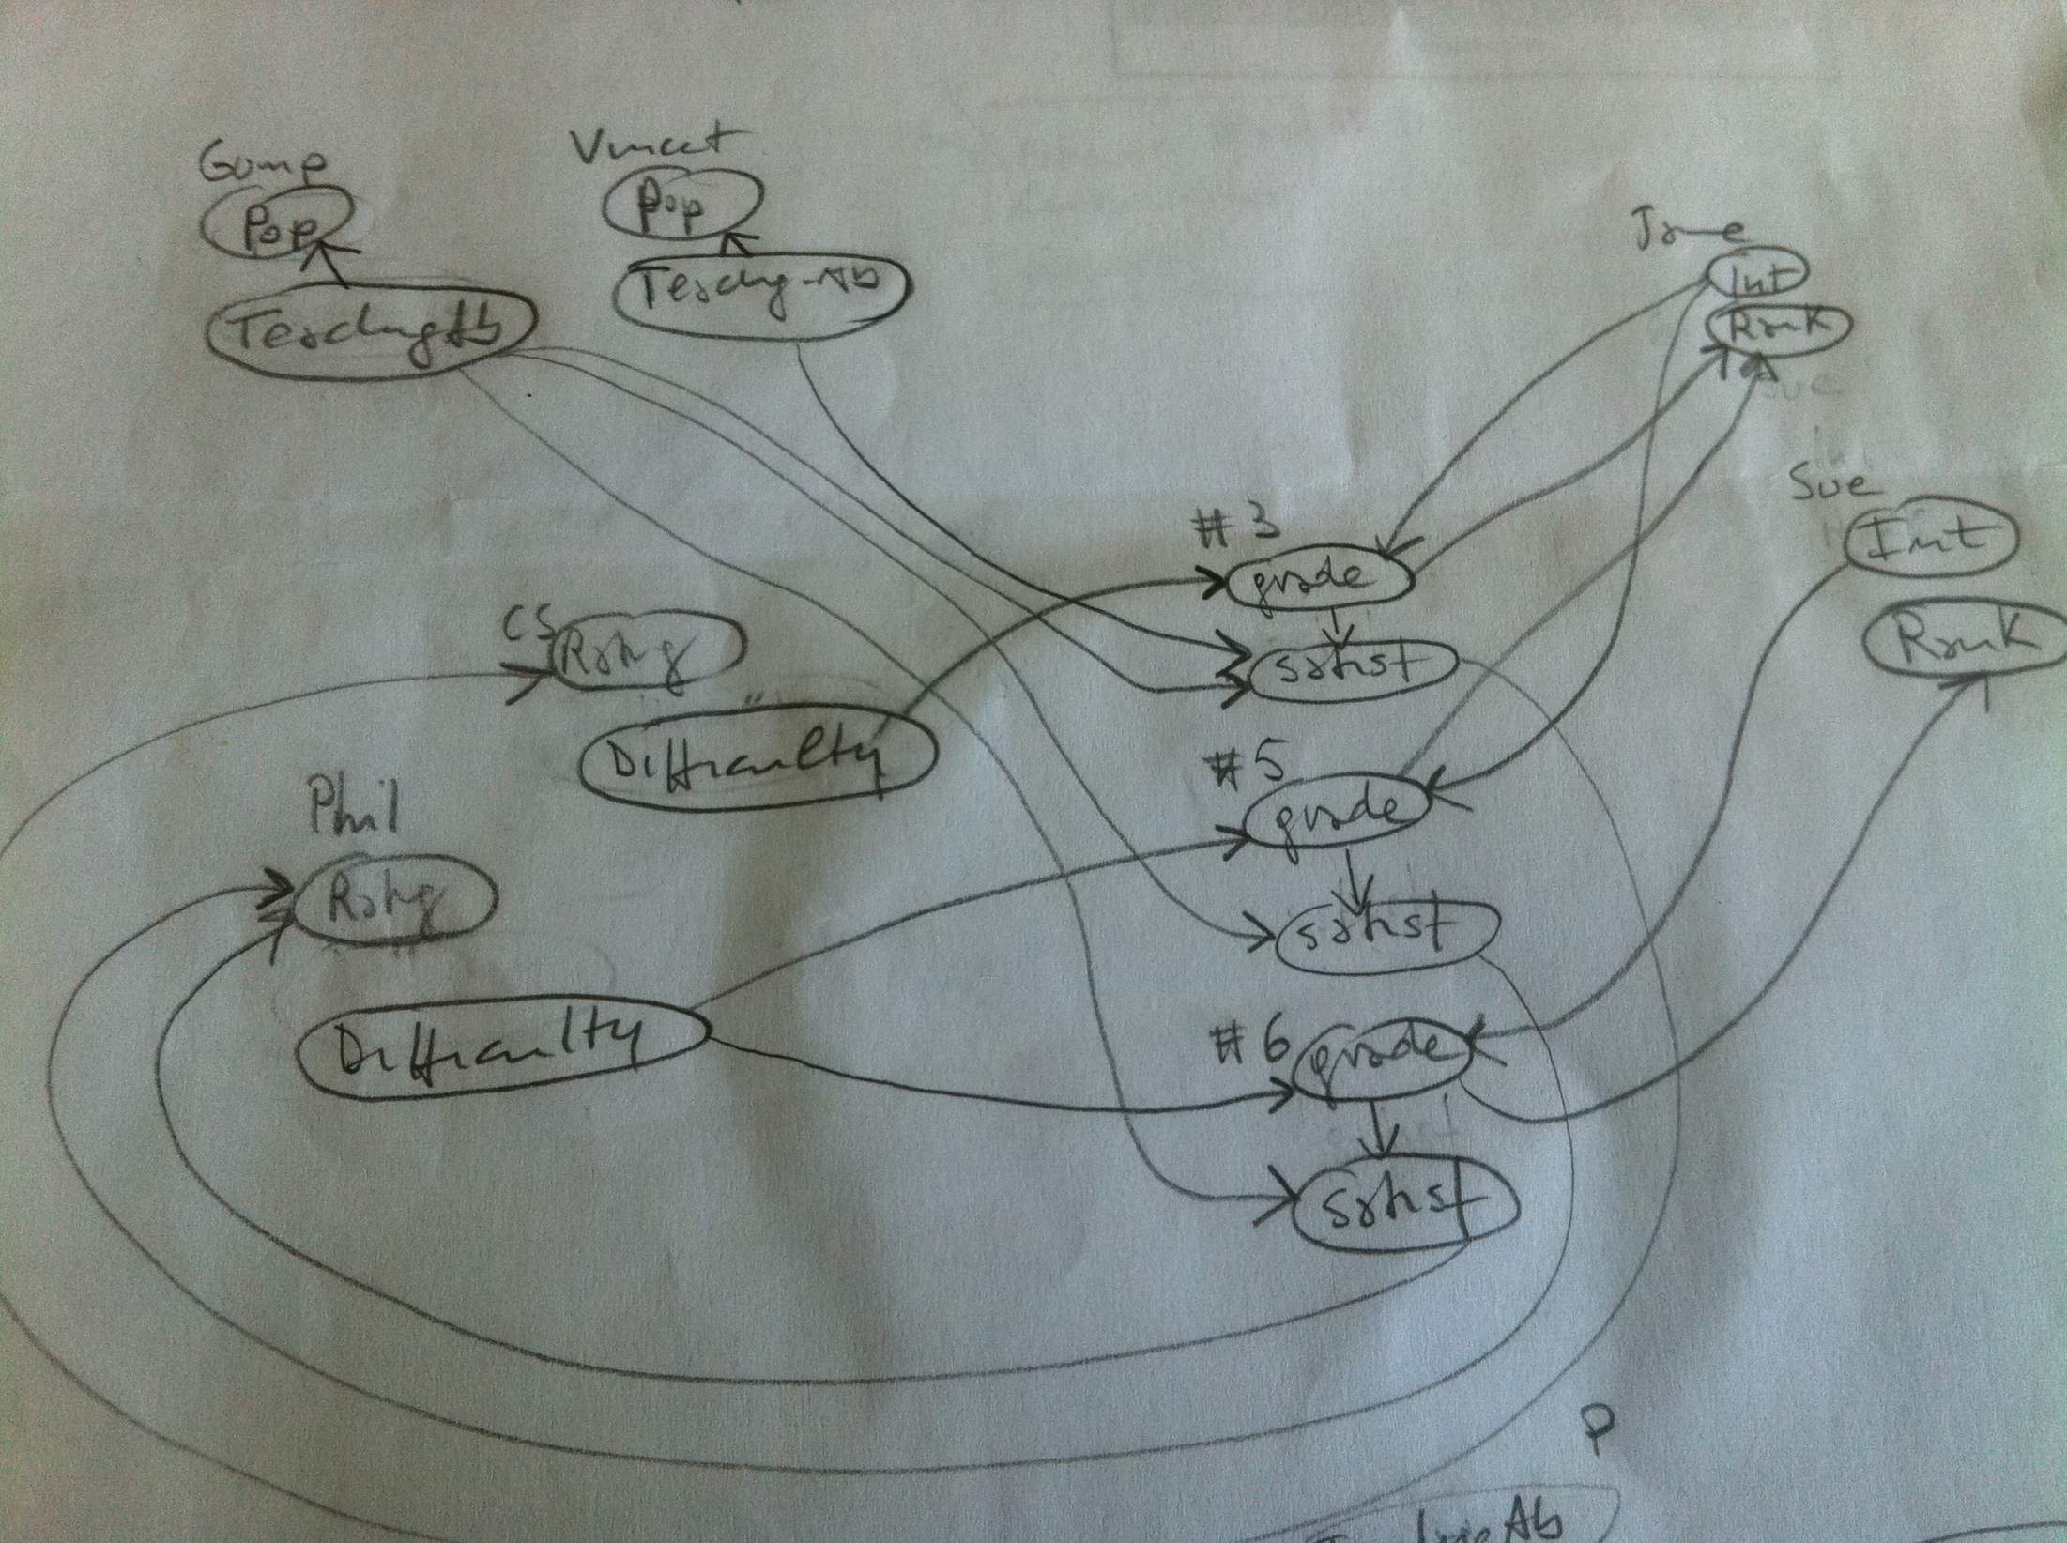
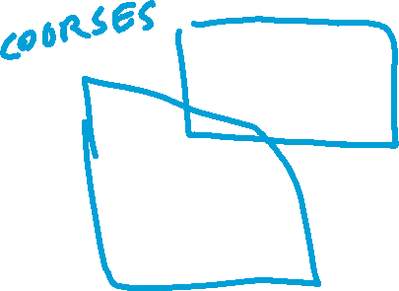
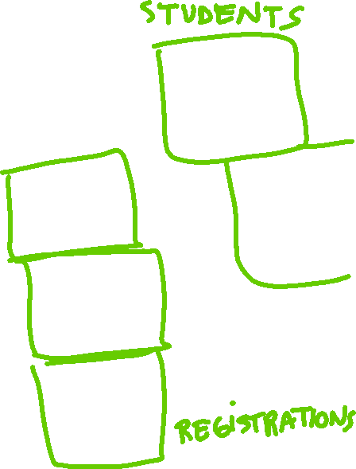

Slot chains will allow us…
To specify probabilistic dependencies between attributes of related entities
M
Professor
Name
Popularity
Teaching-Ability
Course
1
Registration
Name
RegID
Instructor
Course
M
M
Student
Rating
M
Difficulty
Grade
Satisfaction

Slide 34
Learning Goals for today’s class
You can:
Explain the need for Probabilistic relational model
Explain how PRMs generalize BNs
Define a Full Relational Schema and its instances
Define a Relational Skeleton and its completion Instances
Define an inverse slot and an slot chain

Slide 35
MONDAY: Third and final research paper reading
EMNLP 2020 paper MEGA RST Discourse Treebanks with Structure and Nuclearity from Scalable Distant Sentiment Supervision
Patrick Huber, Giuseppe Carenini
(guest speaker: first author of the paper PhD student Patrick Huber !
Material to review before reading:
  CKY,
  Exploration/Exploitation trade-off in RL,
  Beam Search (from 322),
  Recurrent Neural Networks (if you have seen them in 340 or other courses)

Slide 36
Relatively Recent Book + VideoTutorial on Star-AI
Book: Logic, Probability, and Computation 2016
Luc De Raedt, KU Leuven, Belgium,
Kristian Kersting, Technical University of Dortmund, Germany,
Sriraam Natarajan, Indiana University,
David Poole, University of British Columbia
An intelligent agent interacting with the real world will encounter individual people, courses, test results, drugs prescriptions, chairs, boxes, etc., and needs to reason about properties of these individuals and relations among them as well as cope with uncertainty.
Uncertainty has been studied in probability theory and graphical models, and relations have been studied in logic, in particular in the predicate calculus and its extensions. This book examines the foundations of combining logic and probability into what are called relational probabilistic models. It introduces representations, inference, and learning techniques for probability, logic, and their combinations.
The book focuses on two representations in detail: Markov logic networks, a relational extension of undirected graphical models and weighted first-order predicate calculus formula, and Problog, a probabilistic extension of logic programs that can also be viewed as a Turing-complete relational extension of Bayesian networks.
Statistical Relational AI tutorial at NIPS (now NEURIPS) 2017. https://www.facebook.com/watch/live/?v=1552222671535633&ref=watch_permalink
Notes:
Logic, Probability, and Computation
Luc De Raedt, KU Leuven, Belgium,
Kristian Kersting, Technical University of Dortmund, Germany,
Sriraam Natarajan, Indiana University,
David Poole, University of British Columbia
An intelligent agent interacting with the real world will encounter individual people, courses, test results, drugs prescriptions, chairs, boxes, etc., and needs to reason about properties of these individuals and relations among them as well as cope with uncertainty.
Uncertainty has been studied in probability theory and graphical models, and relations have been studied in logic, in particular in the predicate calculus and its extensions. This book examines the foundations of combining logic and probability into what are called relational probabilistic models. It introduces representations, inference, and learning techniques for probability, logic, and their combinations.
The book focuses on two representations in detail: Markov logic networks, a relational extension of undirected graphical models and weighted first-order predicate calculus formula, and Problog, a probabilistic extension of logic programs that can also be viewed as a Turing-complete relational extension of Bayesian networks.

Slide 37
Next class on Fri
Finish Probabilistic Relational Models
  Probabilistic Model
  Dependency Structure
  Aggregation
  Parameters
  Class dependency Graph
  Inference
Keep working on Assignment-4
Due Apr 14

