Slide 1
Intelligent Systems (AI-2)
Computer Science cpsc422, Lecture 3
Jan, 15 2019

Slide 2
Lecture Overview
Markov Decision Processes
Formal Specification and example
Policies and Optimal Policy
Intro to Value Iteration

Slide 3
Decision Processes
Often an agent needs to go beyond a fixed set of decisions – Examples?
Infinite horizon problems: process does not stop
Indefinite horizon problem: the agent does not know when the process may stop
Finite horizon: the process must end at a give time N
Notes:
Helper of a senior
Monitoring system (of a plant)
Treatment of a chronic disease

Slide 4

Goal: represent (and optimize) an indefinite sequence of decisions
Decision networks
Markov models
Represent (and optimize) a fixed number of decisions
The network can extend indefinitely

Slide 5
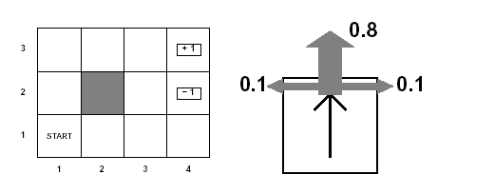
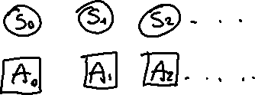
How can we deal with indefinite/infinite Decision processes?
Like in a Markov Chain one random variable S_{t} for each time slice represents the state at time t.
And A_{t} be the action/decision at time t
Example
Agent moves in the above grid :
States are the cells of the grid
Actions Up, Down, Left, Right

Slide 6
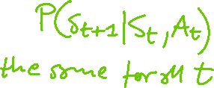
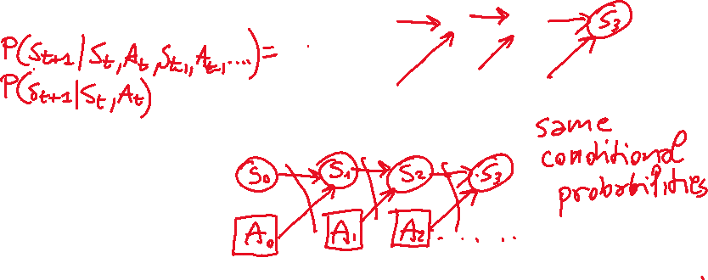
How can we deal with indefinite/infinite Decision processes?
Like in a Markov Chain one random variable S_{t} for each time slice represents the state at time t.
And A_{t} be the action/decision at time t
Make the same two assumptions we made for Markov Chains
(a) The action outcome (the state S_{t+1} at time t+1) only depends on S_{t} and A_{t}
(b) The process is stationary…
Notes:
depends on the sequence of states involved in a decision process (environment history), rather than a single final state
P(S_{t+1}|S₀, A₀,...,S_{t}, A_{t}) = P(S_{t+1}|S_{t}, A_{t})
if P(s’|s , a) is the same at each point in time, where P(s’|s , a) the probability that the agent will be in state s’ after doing action a in state s

Slide 7

Agent knows in which state it is at time t when it selects the action at time t
The robot always knows in which cell it is…
So what will be a policy ?
Notes:
depends on the sequence of states involved in a decision process (environment history), rather than a single final state
P(S_{t+1}|S₀, A₀,...,S_{t}, A_{t}) = P(S_{t+1}|S_{t}, A_{t})
if P(s’|s , a) is the same at each point in time, where P(s’|s , a) the probability that the agent will be in state s’ after doing action a in state s

Slide 8
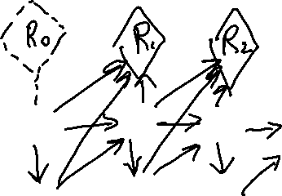
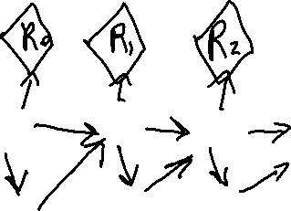
How can we deal with indefinite/infinite Decision processes?
We also need a more flexible specification for the utility. How?
  Defined based on a reward/punishment that the agent receives in each time slice
  Typically summing them up
Notes:
depends on the sequence of states involved in a decision process (environment history), rather than a single final state
P(S_{t+1}|S₀, A₀,...,S_{t}, A_{t}) = P(S_{t+1}|S_{t}, A_{t})
if P(s’|s , a) is the same at each point in time, where P(s’|s , a) the probability that the agent will be in state s’ after doing action a in state s

Slide 9
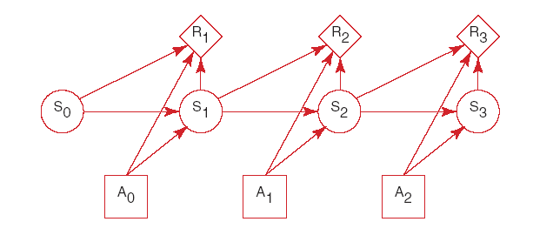


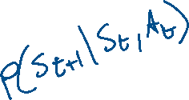




MDP graphical specification
Basically a MDP is a Markov Chain augmented with actions and rewards/values

Slide 10
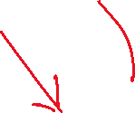
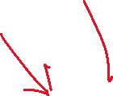
When Rewards only depend on the state

Slide 11
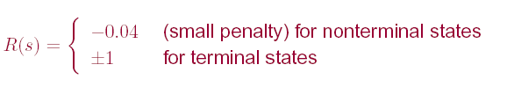
Example MDP: Rewards

Slide 12
Summary Decision Processes: MDPs
To manage an ongoing (indefinite… infinite) decision process, we combine….
Markovian
Stationary
Utility not just at the end
Sequence of rewards
Fully Observable
Notes:
forget the proper sequence of tasks that need to be completed
they lose track of the steps that they have already completed.
At any stage of the process
The agent decides which action to perform
The new state of the world depends on the previous state(s) as well as the action(s) performed
The agent receives rewards or punishments at various points in the process
Aim: maximize the reward received

Slide 13
MDP: formal specification
For an MDP you specify:
  set S of states and set A of actions
  the process’ dynamics (or transition model)
    P(S_{t+1}|S_{t}, A_{t})
  The reward function
      R(s) is used when the reward depends only on the state s and not on how the agent got there
      More complex R(s, a,, s’) describing the reward that the agent receives when it performs action a in state s and ends up in state s’
  Absorbing/stopping/terminal state

Slide 14
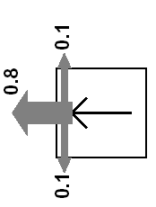
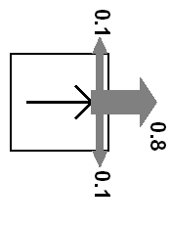
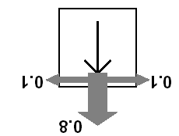
Example MDP: Scenario and Actions
Agent moves in the above grid via actions Up, Down, Left, Right
Each action has:
  0.8 probability to reach its intended effect
  0.1 probability to move at right angles of the intended direction
  If the agents bumps into a wall, it says there
How many states?
There are two terminal states (3,4) and (2,4)

Slide 15
Example MDP: Rewards
Notes:
Example of Stochastic Shortest-PathMDP
Where (3,4) is the goal state? (see MDP book Chp2)

Slide 16
Example MDP: Underlying info structures
Four actions Up, Down, Left, Right
Eleven States: {(1,1), (1,2)…… (3,4)}
2,1

Slide 17




Example MDP: Underlying info structures
Four actions Up, Down, Left, Right
Eleven States: {(1,1), (1,2)…… (3,4)}
A. 0.1
2,1
B. 0.8
C. 0.2

Slide 18

Example MDP: Sequence of actions
The sequence of actions [Up, Up, Right, Right, Right ] will take the agent in terminal state (3,4)…
A. always
B. never
C. Only sometimes
With what probability?
A. (0.8)⁵
B. (0.8)⁵+ ((0.1)⁴ x 0.8)
C. ((0.1)⁴ x 0.8)
Notes:
Yes, with probability 0.8⁵=0.3278
yes, going the other way around with prob. 0.1⁴ x 0.8

Slide 19
Example MDP: Sequence of actions
Can the sequence [Up, Up, Right, Right, Right ] take the agent in terminal state (3,4)?
Can the sequence reach the goal in any other way?
Notes:
Yes, with probability 0.8⁵=0.3278
yes, going the other way around with prob. 0.1⁴ x 0.8

Slide 20
MDPs: Policy
The robot needs to know what to do as the decision process unfolds…
It starts in a state, selects an action, ends up in another state selects another action….
Needs to make the same decision over and over: Given the current state what should I do?
So a policy for an MDP is a single decision function π(s) that specifies what the agent should do for each state s
Notes:
So what is the best sequence of actions for our Robot?
There is no best sequence of actions!
Minimizes cost
(you do not know how the world will be when you’ll need to make the decision)

Slide 21
How to evaluate a policy
(in essence how to compute V^{π}(s) brute force)
A policy can generate a set of state sequences with different probabilities
Each state sequence has a corresponding reward. Typically the (discounted) sum of the rewards for each state in the sequence
Notes:
Because of the stochastic nature of the environment,

Slide 22
MDPs: expected value/total reward of a policy and optimal policy
  Each sequence of states (environment history) associated with a policy has
  a certain probability of occurring
  a given amount of total reward as a function of the rewards of its individual states
Expected value /total reward
For all the sequences of states generated by the policy
Optimal policy is the policy that maximizes expected total reward
Notes:
Because of the stochastic nature of the environment,
Minimizes cost
(you do not know how the world will be when you’ll need to make the decision)

Slide 23
Lecture Overview
Markov Decision Processes
Formal Specification and example
Policies and Optimal Policy
Intro to Value Iteration

Slide 24










Sketch of ideas to find the optimal policy for a MDP (Value Iteration)
We first need a couple of definitions
  V^{π}(s): the expected value of following policy π in state s
  Q^{π} (s, a), where a is an action: expected value of performing a in s, and then following policy π.

Slide 25
Sketch of ideas to find the optimal policy for a MDP (Value Iteration)
We first need a couple of definitions
  V^{π}(s): the expected value of following policy π in state s
  Q^{π} (s, a), where a is an action: expected value of performing a in s, and then following policy π.
Can we express Q^{π} (s, a) in terms of V^{π} (s) ?
  Q^{π} (s, a)=
A.
B.
  Q^{π} (s, a)=
  Q ^{п}(s, a)=
C.
X: set of states reachable from s by doing a
D. None of the above

Slide 26
Discounted Reward Function
Suppose the agent goes through states s₁, s₂,...,s_{k} and receives rewards r₁, r₂,...,r_{k}
We will look at discounted reward to define the reward for this sequence, i.e. its utility for the agent

Slide 27
Sketch of ideas to find the optimal policy for a MDP (Value Iteration)
We first need a couple of definitions
  V^{π}(s): the expected value of following policy π in state s
  Q ^{π} (s, a), where a is an action: expected value of performing a in s, and then following policy π.
We have, by definition
  Q ^{π} (s, a)=
reward obtained in s
states reachable
from s by doing a
Probability of getting to s’ from s via a
expected value of following policy π in s’
Discount factor

Slide 28
Learning Goals for today’s class
You can:
Compute the probability distribution on states given a sequence of actions in an MDP
Define a policy for an MDP
Define and Justify a discounted reward function
Derive the Bellman equations on which Value Iteration is based (we will likely finish this in the next lecture)

Slide 29
For Fro:
TODO for Mon
Read textbook
  9.5.3 Value Iteration
Notes:
I'll show some pictures of cool applications in that class, and will give you an opportunity to discuss the applications that you discovered

Slide 30
CPSC 322 Review “Exam”
https://forms.gle/SpQwrXfonTZrVf4P7
Based on CPSC 322 material
  Logic
  Uncertainty
  Decision Theory
Review material (e.g., 322 slides from 2017):
https://www.cs.ubc.ca/~carenini/TEACHING/CPSC322-17S/index.html

