Slide 1
Intelligent Systems (AI-2)
Computer Science cpsc422, Lecture 27
March, 24, 2021
Notes:
Lecture 28

Slide 2
Lecture Overview
Recap Probabilistic Context Free Grammars (PCFG)
CKY parsing for PCFG (only key steps)
PCFG in practice: Modeling Structural and Lexical Dependencies

Slide 3
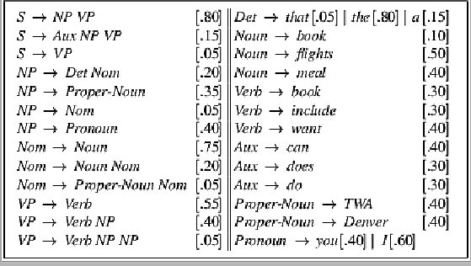
Sample PCFG

Slide 4
PCFGs are used to….
Estimate Prob. of parse tree
Estimate Prob. to sentences
Notes:
The probability of a derivation (tree) is just the product of the probabilities of the rules in the derivation.
Product because rule applications are independent (because CFG)
integrate them with n-grams
The probability of a word sequence (sentence) is the probability of its tree in the unambiguous case.
It’s the sum of the probabilities of the trees in the ambiguous case.

Slide 5
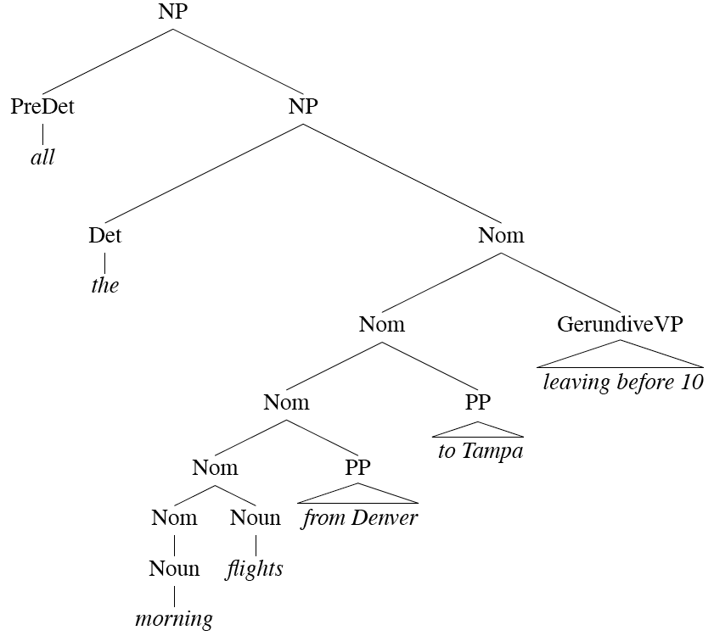
Head of a Phrase
Notes:
For each phrase type Simple set of hand-written rules to find the head of such a phrase.
This rules are often called head percolation

Slide 6
Acquiring Grammars and Probabilities
Manually parsed text corpora (e.g., PennTreebank)
Grammar: read it off the parse trees
Ex: if an NP contains an ART, ADJ, and NOUN then we create the rule NP -> ART ADJ NOUN.
Probabilities:
Notes:
We can create a PCFG automatically by exploiting manually parsed text corpora, such as the Penn Treebank. We can read off them grammar found in the treebank.
Probabilities: can be assigned by counting how often each item is found in the treebank
Ex: if the NP -> ART ADJ NOUN rule is used 50 times and all NP rules are used 5000 times, then the rule’s probability is 50/5000 = .01

Slide 7
Lecture Overview
Recap Probabilistic Context Free Grammars (PCFG)
CKY parsing for PCFG (only key steps)
PCFG in practice: Modeling Structural and Lexical Dependencies

Slide 8
Probabilistic Parsing:
  (Restricted) Task is to find the max probability tree for an input
Notes:
We will look at a solution to a restricted version of the general problem of finding all
possible parses of a sentence and their corresponding probabilities

Slide 9
Probabilistic CKY Algorithm
Ney, 1991 Collins, 1999
CYK (Cocke-Kasami-Younger) algorithm
  A bottom-up parser using dynamic programming
  Assume the PCFG is in Chomsky normal form (CNF)
    Non-terminal can be rewritten either as two Non-terminals or as a Terminal
Notes:
First described by Ney, but the version we are seeing here is adapted from Collins

Slide 10
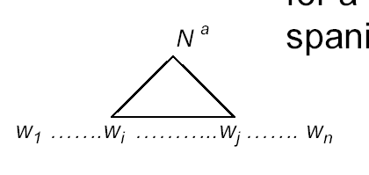
Probabilistic CKY Algorithm
Definitions
  w₁… w_{n} an input string composed of n words
  w_{ij} a string of words from word i to word j
  µ[i, j, A] : a table entry holds the maximum probability for a constituent with non-terminal A spanning words w_{i}…w_{j}
A
Notes:
First described by Ney, but the version we are seeing here is adapted from Collins

Slide 11
Probabilistic CKY Algorithm
Definitions
  w₁… w_{n} an input string composed of n words
  w_{ij} a string of words from word i to word j
  µ[i, j, A] : a table entry holds the maximum probability for a constituent with non-terminal A spanning words w_{i}…w_{j}
A
Notes:
First described by Ney, but the version we are seeing here is adapted from Collins

Slide 12
CKY: Base Case
Fill out the table entries by induction: Base case
  Consider the input strings of length one (i.e., each individual word w_{i})
  Since the grammar is in CNF: A *⇒ w_{i} iff A → w_{i}
  So µ[i, i, A] = P(A → w_{i})
“Can₁ you₂ book₃ TWA₄ flights₅ ?”
Aux
Noun
1
.4
……
.5
5
1
5

Slide 13
Sample PCFG

Slide 14




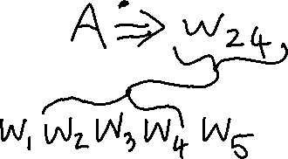



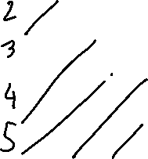
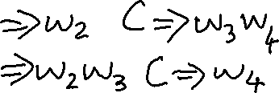

















Slide 16













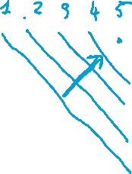
















Key idea: to compute the value of a cell ? I can find the needed values in lower diagonals
So CKY just fills the diagonals one at the time, with each diagonal representing subsequences of increasing length

Slide 17

CKY: Recursive Case
Recursive case
  For strings of words of length = 2,
  A *⇒ w_{ij} iff there is at least one rule A → BC
  where B derives the first k words (between i and i+k-1 ) and C derives the remaining ones (between i+k and j)
A
  µ[i, j, A] = µ [i, i+k-1, B] *
  µ [i+k, j, C ] *
  P(A → BC)
B
C
i
i+k-1
i+k
j
  (for each non-terminal) Choose the max among all possibilities
Notes:
Compute the probability by multiplying together the probabilities of these two pieces (note that they have been calculated in the recursion)
2<= k <= j – i - 1

Slide 18
CKY: Termination
  The max prob parse will be µ [ ]
“Can₁ you₂ book₃ TWA₄ flight₅ ?”
5
S
1
1.7x10⁻⁶
5
Notes:
Any other filler for this matrix?
1,3 and 1,4 and 3,5 !

Slide 19

CKY: Termination
  Any other entry in this matrix for S?
A. Yes
C. Cannot Tell
B. No
“Can₁ you₂ book₃ TWA₄ flight₅ ?”
5
S
1
1.7x10⁻⁶
1,3 and 1,4 and 3,5 …. !
5
Notes:
Any other filler for this matrix?
1,3 and 1,4 and 3,5 !

Slide 20
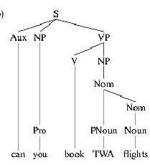
CKY: anything missing?
  The max prob parse will be µ [ ]
“Can₁ you₂ book₃ TWA₄ flight₅ ?”
5
S
1
1.7x10⁻⁶
5

Slide 21
Lecture Overview
Recap Probabilistic Context Free Grammars (PCFG)
CKY parsing for PCFG (only key steps)
PCFG in practice: Modeling Structural and Lexical Dependencies

Slide 22
Problems with PCFGs
Most current PCFG models are not vanilla PCFGs
  Usually augmented in some way
Vanilla PCFGs assume independence of non-terminal expansions
But statistical analysis shows this is not a valid assumption
  Structural and lexical dependencies
Notes:
Probabilities for NP expansions do not depend on context.

Slide 23
Structural Dependencies: Problem
E.g. Syntactic subject (vs. object) of a sentence tends to be a pronoun because
  Subject tends to realize the topic of a sentence
  Topic is usually old information (expressed in previous sentences)
  Pronouns are usually used to refer to old information
  Mary bought a new book for her trip. She didn’t like the first chapter. So she decided to watch a movie.
  In Switchboard corpus:
Notes:
I do not get good estimates for the pro
Parent annotation technique
91% of subjects in declarative sentences are pronouns
66% of direct objects are lexical (nonpronominal)
(i.e., only 34% are pronouns)
Subject tends to realize the topic of a sentence
Topic is usually old information
Pronouns are usually used to refer to old information
So subject tends to be a pronoun

Slide 24
How would you address this problem?

Slide 25
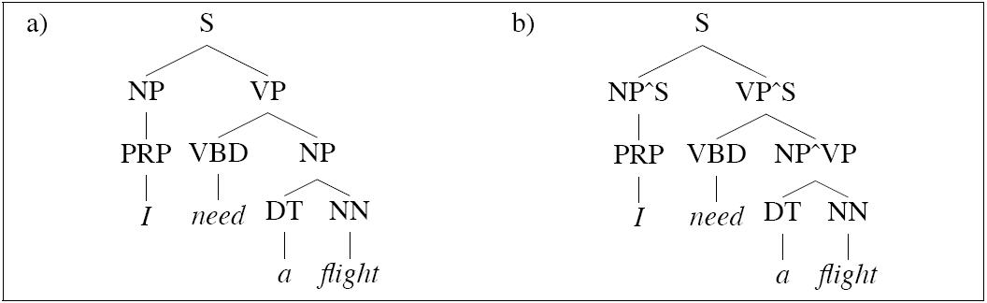
Structural Dependencies: Solution
Split non-terminal. E.g., NPsubject and NPobject
Parent Annotation:
Hand-write rules for more complex struct. dependencies
Splitting problems?
  Automatic/Optimal split – Split and Merge algorithm [Petrov et al. 2006- COLING/ACL]
Notes:
I do not get good estimates for the pro
Parent annotation technique
Splitting problems
- Increase size of the grammar -> reduces amount of training data for each rule -> leads to overfitting

Slide 26
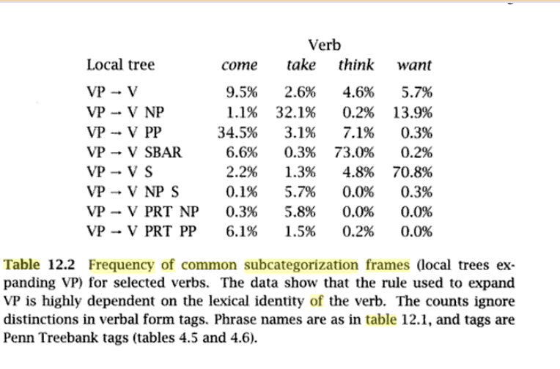
Lexical Dependencies: Problem
SBAR = subordinate clause
Notes:
The verb send subcategorises for a destination, which could be a PP headed by “into”
SBAR stands for Subordinate Clause

Slide 27
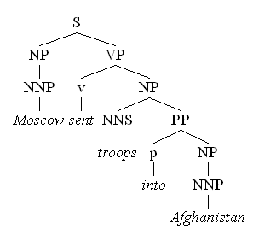
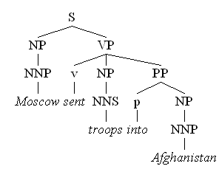
Lexical Dependencies: Problem
Two parse trees for the sentence
“Moscow sent troops into Afghanistan”
(a)
(b)
VP-attachment
NP-attachment
Typically NP-attachment more frequent than VP-attachment
Notes:
The verb send subcategorises for a destination, which could be a PP headed by “into”

Slide 28
Attribute grammar for Lexicalized PCFG : each non-terminal is annotated with its lexical head… many more rules!
(Collins 1999)
We used to have rules like
  VP -> V NP PP
Now we have much more specific rules like
  VP(dumped)-> V(dumped) NP(sacks) PP(into)
Notes:
Each non-terminal is annotated with a single word which is its lexical head
A CFG with a lot more rules!
We used to have rule r
VP -> V NP PP P(r|VP)
That’s the count of this rule divided by the number of VPs in a treebank

Slide 29
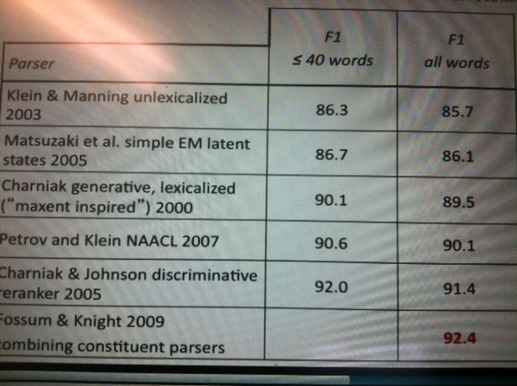
PCFG Parsing State of the art(~2010)
  From C. Manning (Stanford NLP)
Notes:
Most effective: Combining lexicalized and unlexicalized

Slide 30
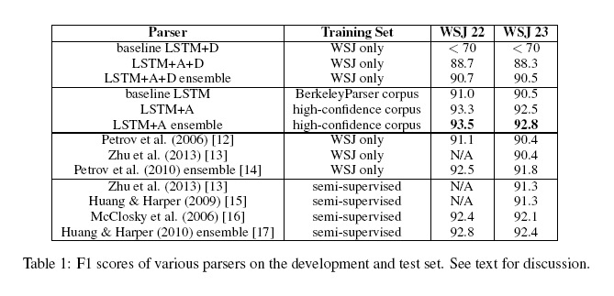
Grammar as a Foreign Language
Computation and Language [cs.CL] Published 24 Dec 2014
Updated 9 Jun 2015
O. Vinyals, L. Kaiser, T. Koo, S. Petrov, I. Sutskever, G. Hinton Google
Fast and Accurate Shift-Reduce Constituent Parsing by Muhua Zhu, Yue Zhang, Wenliang Chen, Min Zhang and Jingbo Zhu (ACL - 2013)

Slide 31
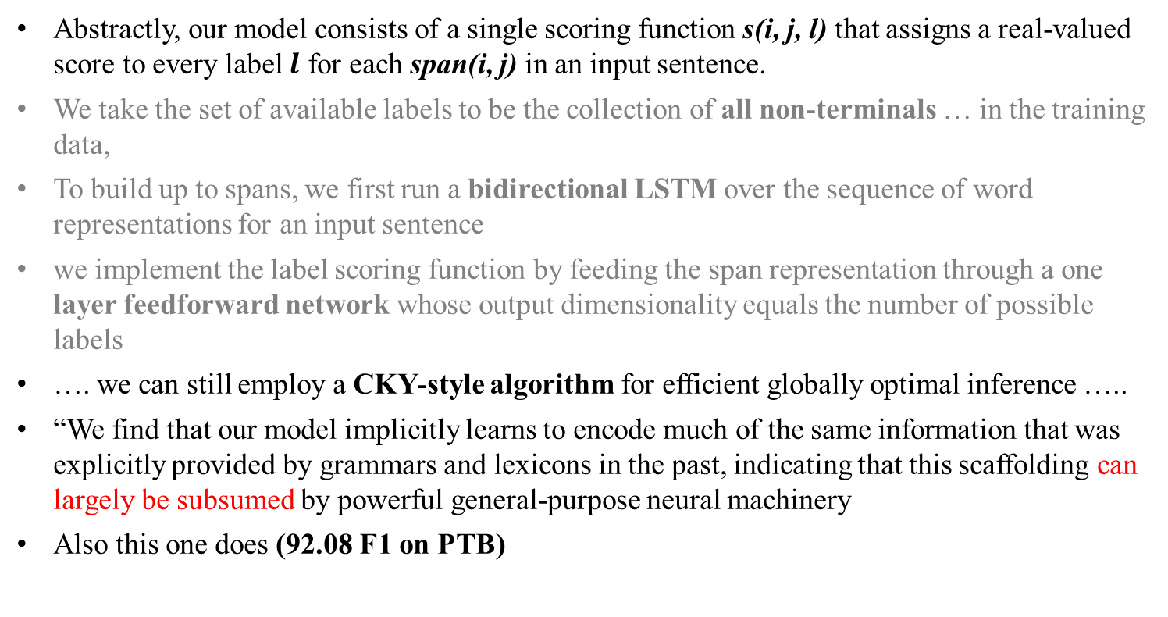
Very recent paper (NAACL 2018) (not required for 422)
What’s Going On in Neural Constituency Parsers? An Analysis,
D.Gaddy, M. Stern, D. Klein, Computer Science ., Univ. of California, Berkeley
Abstractly, our model consists of a single scoring function s(i, j, l) that assigns a real-valued score to every label $l$ for each span(i, j) in an input sentence.
We take the set of available labels to be the collection of all non-terminals … in the training data,
To build up to spans, we first run a bidirectional LSTM over the sequence of word representations for an input sentence
we implement the label scoring function by feeding the span representation through a one layer feedforward network whose output dimensionality equals the number of possible labels
…. we can still employ a CKY-style algorithm for efficient globally optimal inference …..
“We find that our model implicitly learns to encode much of the same information that was explicitly provided by grammars and lexicons in the past, indicating that this scaffolding can largely be subsumed by powerful general-purpose neural machinery
Also this one does (92.08 F1 on PTB)
Notes:
A number of differences have emerged between modern and classic approaches to constituency parsing in recent years, with structural
components like grammars and feature rich lexicons becoming less central while recurrent neural network representations rise in
popularity. The goal of this work is to analyze the extent to which information provided directly by the model structure in classical systems
is still being captured by neural methods. To this end, we propose a high-performance neural model (92.08 F1 on PTB) that is representative
of recent work and perform a series of investigative experiments. We find that our model implicitly learns to encode much of
the same information that was explicitly provided by grammars and lexicons in the past, indicating that this scaffolding can largely be
subsumed by powerful general-purpose neural machinery.
“Abstractly, our model consists of a single scoring function s(i, j, l) that assigns a real-valued score to every label $l$ for each span(i, j) in an input sentence.
We take the set of available labels to be the collection of all non-terminals and unary chains observed in the training data,
To build up to spans, we first run a bidirectional LSTM over the sequence of word representations for an input sentence
we implement the label scoring function by feeding the span representation through a one layer feedforward network whose output dimensionality equals the number of possible labels
…. Even though our model operates on n-ary trees, we can still employ a CKY-style algorithm for efficient globally optimal inference by introducing an auxiliary empty label
“We find that our model implicitly learns to encode much of the same information that was explicitly provided by grammars and lexicons in the past, indicating that this scaffolding can largely be subsumed by powerful general-purpose neural machinery”

Slide 32
Beyond NLP……. Planning…..
CKY/PCFG Beyond syntax……. Discourse Parsing….. And Dialog
CKY Probabilistic parsing Paper in Reading
Conversation Trees: A Grammar Model for Topic Structure in Forums, Annie Louis and Shay B. Cohen, EMNLP 2015. [corpus]
Li, N., Cushing, W., Kambhampati, S., & Yoon, S. (2012). Learning probabilistic hierarchical task networks as probabilistic context-free grammars to capture user preferences. ACM Transactions on Intelligent Systems and Technology. (CMU+Arizona State)
Notes:
Probabilistic Context-Free Grammars (PCFG) and Probabilistic Linear Context-Free Rewriting Systems (PLCFRS). In the PCFG model, a non-terminal spans a contiguous sequence of posts. In the PLCFRS model, non-terminals are allowed to span discontinuous segments of posts.

Slide 33
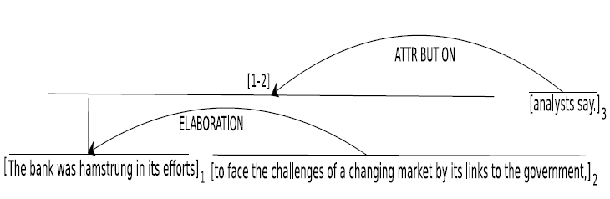
Discovering Discourse Structure: Computational Tasks
The bank was hamstrung in its efforts to face the challenges of a changing market by its links to the government, analysts say.
Discourse Segmentation
The bank was hamstrung in its efforts
to face the challenges of a changing
market by its links to the government,
analysts say.
1
2
3
Discourse Parsing
Notes:
Discourse analysis in RST involves two subtasks. 1. breaking the text into EDUs, known as discourse segmentation, 2. linking the EDUs into a labeled hierarchical tree structure, known as discourse parsing.

Slide 34
StarAI (statistical relational AI)
Hybrid: Det +Sto
422 big picture
Prob CFG
Prob Relational Models
Markov Logics
Deterministic
Stochastic
Belief Nets
Logics
Approx. : Gibbs
First Order Logics
Markov Chains and HMMs
Ontologies
Forward, Viterbi….
Approx. : Particle Filtering
Query
Full Resolution
SAT
Undirected Graphical Models
Markov Networks
Conditional Random Fields
Markov Decision Processes and
Partially Observable MDP
Planning
Value Iteration
Approx. Inference
Reinforcement Learning
Representation
Applications of AI
Reasoning
Technique
Notes:
Breadth and Depth

Slide 35
Learning Goals for today’s class
You can:
Describe the key steps of CKY probabilistic parsing
Motivate introduction of structural and lexical dependencies
Describe how to deal with these dependencies within the PCFG framework

Slide 36
Next class on Fri
We will start Markov Logics
Assignment-3 due on Mon 29th
Assignment-4 will be out on the same day

Slide 37
NOT REQUIRED !

Slide 38


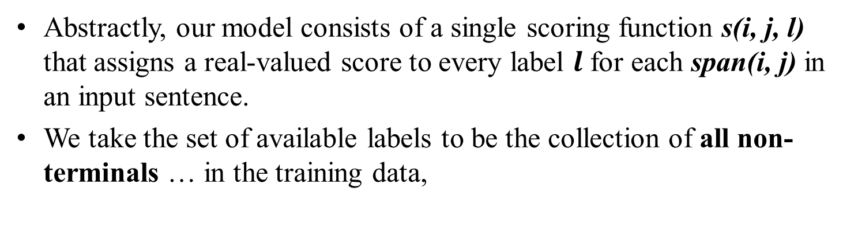


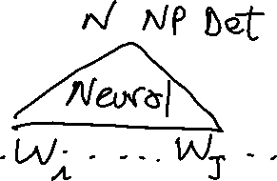

Very recent paper (NAACL 2018)
What’s Going On in Neural Constituency Parsers? An Analysis,
D.Gaddy, M. Stern, D. Klein, Computer Science ., Univ. of California, Berkeley
Abstractly, our model consists of a single scoring function s(i, j, l) that assigns a real-valued score to every label $l$ for each span(i, j) in an input sentence.
We take the set of available labels to be the collection of all non-terminals … in the training data,
You know the terminology and the methods !
You should be able to understand most of this !
Notes:
A number of differences have emerged between modern and classic approaches to constituency parsing in recent years, with structural
components like grammars and feature rich lexicons becoming less central while recurrent neural network representations rise in
popularity. The goal of this work is to analyze the extent to which information provided directly by the model structure in classical systems
is still being captured by neural methods. To this end, we propose a high-performance neural model (92.08 F1 on PTB) that is representative
of recent work and perform a series of investigative experiments. We find that our model implicitly learns to encode much of
the same information that was explicitly provided by grammars and lexicons in the past, indicating that this scaffolding can largely be
subsumed by powerful general-purpose neural machinery.
“Abstractly, our model consists of a single scoring function s(i, j, l) that assigns a real-valued score to every label $l$ for each span(i, j) in an input sentence.
We take the set of available labels to be the collection of all non-terminals and unary chains observed in the training data,
To build up to spans, we first run a bidirectional LSTM over the sequence of word representations for an input sentence
we implement the label scoring function by feeding the span representation through a one layer feedforward network whose output dimensionality equals the number of possible labels
…. Even though our model operates on n-ary trees, we can still employ a CKY-style algorithm for efficient globally optimal inference by introducing an auxiliary empty label
“We find that our model implicitly learns to encode much of the same information that was explicitly provided by grammars and lexicons in the past, indicating that this scaffolding can largely be subsumed by powerful general-purpose neural machinery”

Slide 39



Very recent paper (NAACL 2018)
To build up to spans, we first run a bidirectional LSTM over the sequence of word representations for an input sentence
You know the terminology and the methods !
You should be able to understand most of this !
Notes:
A number of differences have emerged between modern and classic approaches to constituency parsing in recent years, with structural
components like grammars and feature rich lexicons becoming less central while recurrent neural network representations rise in
popularity. The goal of this work is to analyze the extent to which information provided directly by the model structure in classical systems
is still being captured by neural methods. To this end, we propose a high-performance neural model (92.08 F1 on PTB) that is representative
of recent work and perform a series of investigative experiments. We find that our model implicitly learns to encode much of
the same information that was explicitly provided by grammars and lexicons in the past, indicating that this scaffolding can largely be
subsumed by powerful general-purpose neural machinery.
“Abstractly, our model consists of a single scoring function s(i, j, l) that assigns a real-valued score to every label $l$ for each span(i, j) in an input sentence.
We take the set of available labels to be the collection of all non-terminals and unary chains observed in the training data,
To build up to spans, we first run a bidirectional LSTM over the sequence of word representations for an input sentence
we implement the label scoring function by feeding the span representation through a one layer feedforward network whose output dimensionality equals the number of possible labels
…. Even though our model operates on n-ary trees, we can still employ a CKY-style algorithm for efficient globally optimal inference by introducing an auxiliary empty label
“We find that our model implicitly learns to encode much of the same information that was explicitly provided by grammars and lexicons in the past, indicating that this scaffolding can largely be subsumed by powerful general-purpose neural machinery”

Slide 40

Very recent paper (NAACL 2018)
we implement the label scoring function by feeding the span representation through a one layer feedforward network whose output dimensionality equals the number of possible labels
…. we can still employ a CKY-style algorithm for efficient globally optimal inference …..
“We find that our model implicitly learns to encode much of the same information that was explicitly provided by grammars and lexicons in the past, indicating that this scaffolding can largely be subsumed by powerful general-purpose neural machinery
Also this one does (92.08 F1 on PTB)
You know the terminology and the methods !
You should be able to understand most of this !
Notes:
A number of differences have emerged between modern and classic approaches to constituency parsing in recent years, with structural
components like grammars and feature rich lexicons becoming less central while recurrent neural network representations rise in
popularity. The goal of this work is to analyze the extent to which information provided directly by the model structure in classical systems
is still being captured by neural methods. To this end, we propose a high-performance neural model (92.08 F1 on PTB) that is representative
of recent work and perform a series of investigative experiments. We find that our model implicitly learns to encode much of
the same information that was explicitly provided by grammars and lexicons in the past, indicating that this scaffolding can largely be
subsumed by powerful general-purpose neural machinery.
“Abstractly, our model consists of a single scoring function s(i, j, l) that assigns a real-valued score to every label $l$ for each span(i, j) in an input sentence.
We take the set of available labels to be the collection of all non-terminals and unary chains observed in the training data,
To build up to spans, we first run a bidirectional LSTM over the sequence of word representations for an input sentence
we implement the label scoring function by feeding the span representation through a one layer feedforward network whose output dimensionality equals the number of possible labels
…. Even though our model operates on n-ary trees, we can still employ a CKY-style algorithm for efficient globally optimal inference by introducing an auxiliary empty label
“We find that our model implicitly learns to encode much of the same information that was explicitly provided by grammars and lexicons in the past, indicating that this scaffolding can largely be subsumed by powerful general-purpose neural machinery”

Slide 41
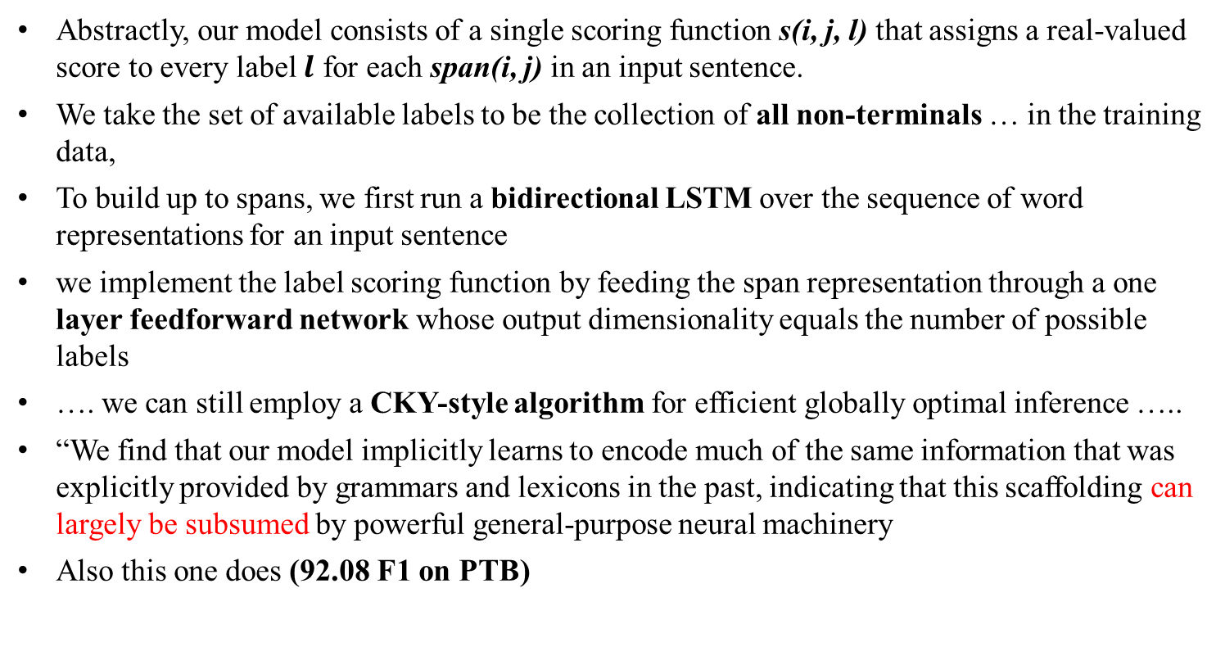
Very recent paper (NAACL 2018)
What’s Going On in Neural Constituency Parsers? An Analysis,
D.Gaddy, M. Stern, D. Klein, Computer Science ., Univ. of California, Berkeley
Abstractly, our model consists of a single scoring function s(i, j, l) that assigns a real-valued score to every label $l$ for each span(i, j) in an input sentence.
We take the set of available labels to be the collection of all non-terminals … in the training data,
To build up to spans, we first run a bidirectional LSTM over the sequence of word representations for an input sentence
we implement the label scoring function by feeding the span representation through a one layer feedforward network whose output dimensionality equals the number of possible labels
…. we can still employ a CKY-style algorithm for efficient globally optimal inference …..
“We find that our model implicitly learns to encode much of the same information that was explicitly provided by grammars and lexicons in the past, indicating that this scaffolding can largely be subsumed by powerful general-purpose neural machinery
Also this one does (92.08 F1 on PTB)
You know the terminology and the methods !
You should be able to understand most of this !
Notes:
A number of differences have emerged between modern and classic approaches to constituency parsing in recent years, with structural
components like grammars and feature rich lexicons becoming less central while recurrent neural network representations rise in
popularity. The goal of this work is to analyze the extent to which information provided directly by the model structure in classical systems
is still being captured by neural methods. To this end, we propose a high-performance neural model (92.08 F1 on PTB) that is representative
of recent work and perform a series of investigative experiments. We find that our model implicitly learns to encode much of
the same information that was explicitly provided by grammars and lexicons in the past, indicating that this scaffolding can largely be
subsumed by powerful general-purpose neural machinery.
“Abstractly, our model consists of a single scoring function s(i, j, l) that assigns a real-valued score to every label $l$ for each span(i, j) in an input sentence.
We take the set of available labels to be the collection of all non-terminals and unary chains observed in the training data,
To build up to spans, we first run a bidirectional LSTM over the sequence of word representations for an input sentence
we implement the label scoring function by feeding the span representation through a one layer feedforward network whose output dimensionality equals the number of possible labels
…. Even though our model operates on n-ary trees, we can still employ a CKY-style algorithm for efficient globally optimal inference by introducing an auxiliary empty label
“We find that our model implicitly learns to encode much of the same information that was explicitly provided by grammars and lexicons in the past, indicating that this scaffolding can largely be subsumed by powerful general-purpose neural machinery”

Slide 42
Very recent paper (NAACL 2018)
What’s Going On in Neural Constituency Parsers? An Analysis,
D.Gaddy, M. Stern, D. Klein, Computer Science ., Univ. of California, Berkeley
Notes:
A number of differences have emerged between modern and classic approaches to constituency parsing in recent years, with structural
components like grammars and feature rich lexicons becoming less central while recurrent neural network representations rise in
popularity. The goal of this work is to analyze the extent to which information provided directly by the model structure in classical systems
is still being captured by neural methods. To this end, we propose a high-performance neural model (92.08 F1 on PTB) that is representative
of recent work and perform a series of investigative experiments. We find that our model implicitly learns to encode much of
the same information that was explicitly provided by grammars and lexicons in the past, indicating that this scaffolding can largely be
subsumed by powerful general-purpose neural machinery.
“Abstractly, our model consists of a single scoring function s(i, j, l) that assigns a real-valued score to every label $l$ for each span(i, j) in an input sentence.
We take the set of available labels to be the collection of all non-terminals and unary chains observed in the training data,
To build up to spans, we first run a bidirectional LSTM over the sequence of word representations for an input sentence
we implement the label scoring function by feeding the span representation through a one layer feedforward network whose output dimensionality equals the number of possible labels
…. Even though our model operates on n-ary trees, we can still employ a CKY-style algorithm for efficient globally optimal inference by introducing an auxiliary empty label
“We find that our model implicitly learns to encode much of the same information that was explicitly provided by grammars and lexicons in the past, indicating that this scaffolding can largely be subsumed by powerful general-purpose neural machinery”

Slide 43
Very recent ?AACL-20? paper
Parallel CKY paper:
https://arxiv.org/pdf/2008.03736.pdf
This work proposes a fast and accurate CRF constituency parser by substantially extending the graph-based parser of Stern et al. [2017]. The key contribution is that we batchify the inside (forward) algorithm for direct loss and gradient computation on GPU. Meanwhile, we find that the outside algorithm can be efficiently fulfilled by automatic backpropagation, which is shown to be equally efficient with the inside (forward) procedure, naturally verifying the great theoretical work of Eisner [2016]. Similarly, we batchify the Cocke–Kasami–Younger (CKY) algorithm for fast decoding…..

