Slide 1
Intelligent Systems (AI-2)
Computer Science cpsc422, Lecture 23
Mar 12, 2021
Slide credit: Probase Microsoft Research Asia, YAGO Max Planck Institute, National Lib. Of Medicine, NIH
Notes:
Lecture 23

Slide 2
NLP Practical Goal for FOL: the ultimate Web question-answering system?
  Map NL queries into FOPC so that answers can be effectively computed
What African countries are not on the Mediterranean Sea?
Was 2007 the first El Nino year after 2001?
Notes:
We didn’t assume much about the meaning of words when we talked about sentence meanings
Verbs provided a template-like predicate argument structure
Nouns were practically meaningless constants
There has be more to it than that
View assuming that words by themselves do not refer to the world, cannot be
Judged to be true or false…

Slide 3
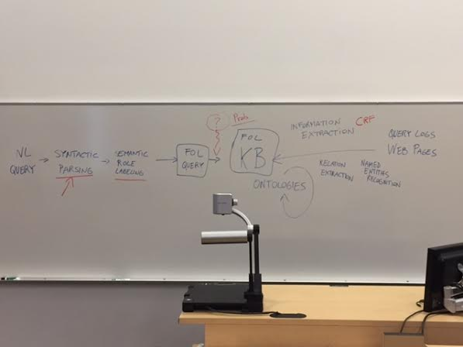

Just a sketch: to provide some context for some concepts / techniques covered in 422

Slide 4
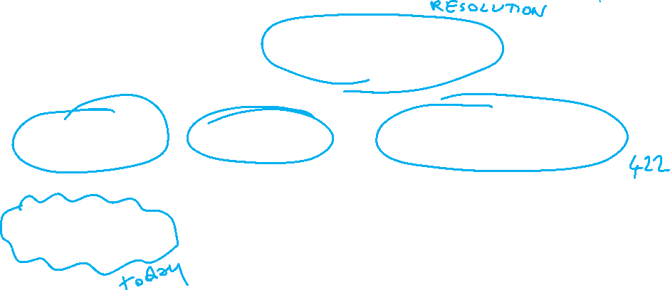
Logics in AI: Similar slide to the one for planning
Propositional Definite Clause Logics
Semantics and Proof Theory
Propositional Logics
First-Order Logics
Satisfiability Testing (SAT)
Hardware Verification
Production Systems
Ontologies
Product Configuration
Cognitive Architectures
Semantic Web
Video Games
Summarization
Tutoring Systems
Information Extraction

Slide 5
Lecture Overview
Ontologies – what objects/individuals should we represent? what relations (unary, binary,..)?
Inspiration from Natural Language: WordNet and FrameNet
Extensions based on Wikipedia and mining the Web (YAGO, ProBase, Freebase)
Domain Specific Ontologies (e.g., Medicine: MeSH, UMLS)

Slide 6
Ontologies
Given a logical representation (e.g., FOL)
What individuals and relations are there and we need to model?
In AI an Ontology is a specification of what individuals and relationships are assumed to exist and what terminology is used for them
What types of individuals
What properties of the individuals
Notes:
13.2.1 Choosing Individuals and Relations
Given a logical representation language, such as the one developed in the previous chapter, and a world to reason about, the people designing knowledge bases have to choose what, in the world, to refer to. That is, they have to choose what individuals and relations there are. It may seem that they can just refer to the individuals and relations that exist in the world. However, the world does not determine what individuals there are. How the world is divided into individuals is invented by whomever is modeling the world. The modeler divides up the world up into things so that the agent can refer to parts of the world that make sense for the task at hand.
To share and communicate knowledge, it is important to be able to come up with a common vocabulary and an agreed-on meaning for that vocabulary.
A conceptualization is a mapping between symbols used in the computer (i.e., the vocabulary) and the individuals and relations in the world. It provides a particular abstraction of the world and notation for that abstraction. A conceptualization for small knowledge bases can be in the head of the designer or specified in natural language in the documentation. This informal specification of a conceptualization does not scale to larger systems where the conceptualization must be shared.
In philosophy, ontology is the study of what exists. In AI, an ontology is a specification of the meanings of the symbols in an information system. That is, it is a specification of a conceptualization. It is a specification of what individuals and relationships are assumed to exist and what terminology is used for them. Typically, it specifies what types of individuals will be modeled, specifies what properties will be used, and gives some axioms that restrict the use of that vocabulary.
13.3 Ontologies and Knowledge Sharing
Building large knowledge-based systems is complex because
Knowledge often comes from multiple sources and must be integrated. Moreover, these sources may not have the same division of the world. Often knowledge comes from different fields that have their own distinctive terminology and divide the world according to their own needs.
Systems evolve over time and it is difficult to anticipate all future distinctions that should be made.
The people involved in designing a knowledge base must choose what individuals and relationships to represent. The world is not divided into individuals; that is something done by intelligent agents to understand the world. Different people involved in a knowledge-based system should agree on this division of the world.
It is difficult to remember what your own notation means, let alone to discover what someone else's notation means. This has two aspects:
given a symbol used in the computer, determining what it means;
given a concept in someone's mind, determining what symbol they should use; that is, determining whether the concept has been used before and, if it has, discovering what notation has been used for it.
n

Slide 7
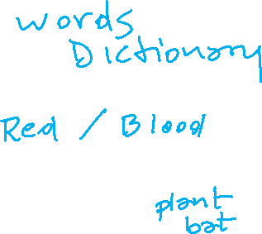
Ontologies: inspiration from Natural Language
:
How do we refer to individuals and relationship in the world in Natural Languages e.g., English?
Where do we find definitions for words?
  Most of the definitions are circular? They are descriptions.
  Fortunately, there is still some useful semantic info (Lexical Relations):
  w₁ w₂ same Form and Sound, different Meaning
  w₁ w₂ same Meaning, different Form
  w₁ w₂ “opposite” Meaning
  w₁ w₂ Meaning₁ subclass of Meaning₂
Homonymy
Synonymy
Antonymy
Hyponymy
Notes:
Meaning of words
Relations among words and their meanings (Paradigmatic)
Internal structure of individual words (Syntagmatic)
Repositories of information about the meaning of words, but…..
We can use them because some lexemes are grounded in the external word (perception (visual systems), ….)
Red blood
The list of relations presented here is by no means exhaustive

Slide 8
Polysemy
Def. The case where we have a set of words with the same form and multiple related meanings.
Consider the homonym:
bank → commercial bank₁ vs. river bank₂
Now consider: “VGH is the hospital with the largest blood bank in BC” or
“A PCFG can be trained using derivation trees from a tree bank annotated by human experts”
Are these a new independent senses of bank?
Notes:
meanings associated with it
Most non-rare words have multiple meanings
The number of meanings is related to its frequency
Verbs tend more to polysemy
Distinguishing polysemy from homonymy isn’t always easy (or necessary)

Slide 9
Synonyms
Def. Different words with the same meaning.
Substitutability- if they can be substituted for one another in some environment without changing meaning or acceptability.
Would I be flying on a large/big plane?
?… became kind of a large/big sister to…
? You made a large/big mistake
Notes:
Synonyms clash with polysemous meanings (one sense of big is older)
Collocation: big mistake sounds more natural
There aren’t any…
Maybe not, but people think and act like there are so maybe there are…
PURCHASE / BUY
One test…
Two lexemes are synonyms if they can be successfully substituted for each other in all situations
Too strong!

Slide 10
Hyponymy/Hypernym
Def. Pairings where one word denotes a sub/super class of the other
  Since dogs are canids
    Dog is a hyponym of canid and
    Canid is a hypernym of dog
  car/vehicle
  doctor/human
  ……
Notes:
A hyponymy relation can be asserted between two lexemes when the meanings of the lexemes entail a subset relation

Slide 11
Lexical Resources
Databases containing all lexical relations among all words
Development:
  Mining info from dictionaries and thesauri
  Handcrafting it from scratch
WordNet: first developed with reasonable coverage and widely used, started with [Fellbaum… 1998]
  for English (versions for other languages have been developed – see MultiWordNet)

Slide 12
WordNet 3.0
Part Of Speech | Unique Strings | Word-Sense Pairs | Synsets
Noun | 117798 | 146312 | 82115
Verb | 11529 | 25047 | 13767
Adjective | 21479 | 30002 | 18156
Adverb | 4481 | 5580 | 3621
Totals | 155287 | 206941 | 117659
For each word: all possible senses (no distinction between homonymy and polysemy)
For each sense: a set of synonyms (synset) and a gloss
Notes:
So bass includes fish-sense instrument-sense musical-range-sense
The noun "bass" has 8 senses in WordNet.
1. bass -- (the lowest part of the musical range)
2. bass, bass part -- (the lowest part in polyphonic music)
3. bass, basso -- (an adult male singer with the lowest voice)
4. sea bass, bass -- (the lean flesh of a saltwater fish of the family Serranidae)
5. freshwater bass, bass -- (any of various North American freshwater fish with lean flesh (especially of the genus Micropterus))
6. bass, bass voice, basso -- (the lowest adult male singing voice)
7. bass -- (the member with the lowest range of a family of musical instruments)
8. bass -- (nontechnical name for any of numerous edible marine and freshwater spiny-finned fishes)

Slide 13
WordNet: entry for “table”
The noun "table" has 6 senses in WordNet.
1. table, tabular array -- (a set of data …)
2. table -- (a piece of furniture …)
3. table -- (a piece of furniture with tableware…)
4. mesa, table -- (flat tableland …)
5. table -- (a company of people …)
6. board, table -- (food or meals …)
The verb "table" has 1 sense in WordNet.
1. postpone, prorogue, hold over, put over,
table, shelve, set back, defer, remit, put off –
(hold back to a later time; "let's postpone the exam")
Notes:
Each blue list is a synset

Slide 14

WordNet Relations (between synsets!)
fi
Notes:
Key point: synsets are related not specific words
Adjectives (synonyms, antonyms)

Slide 15
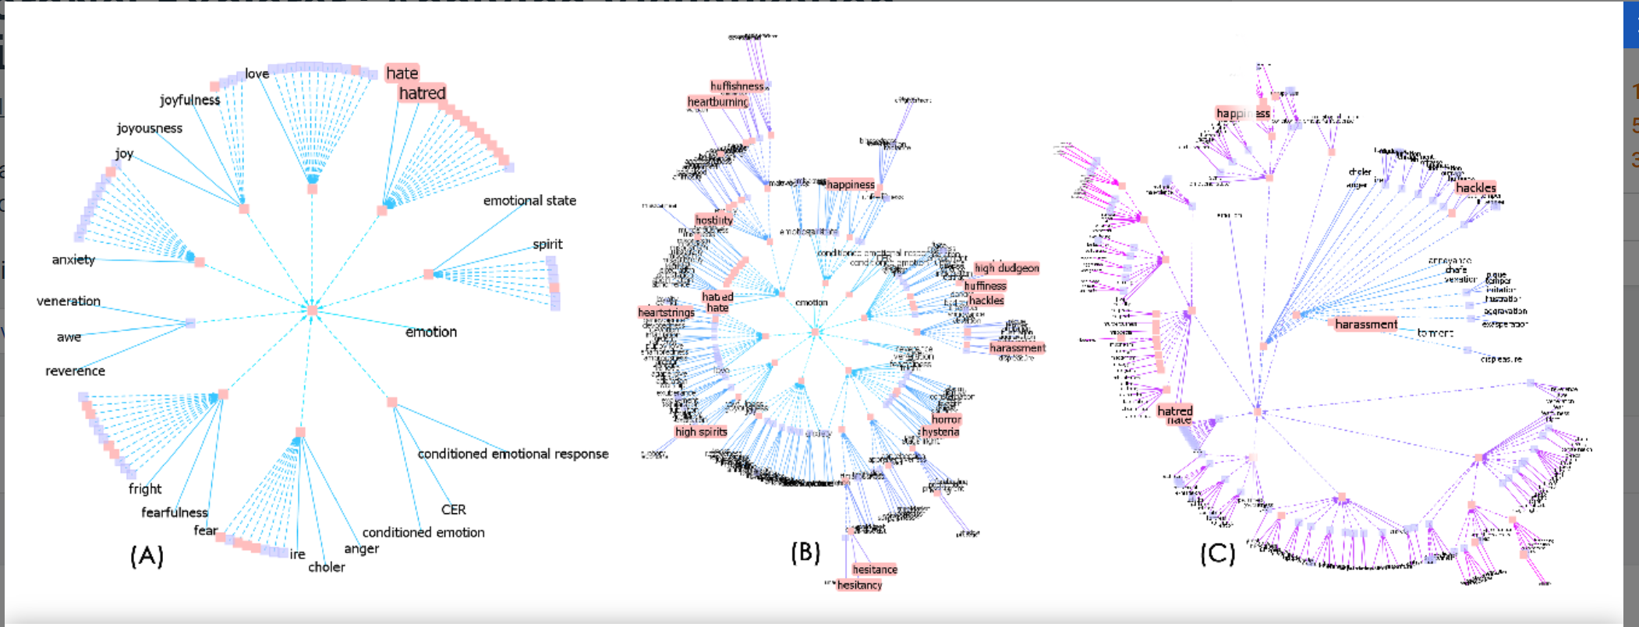
Visualizing Wordnet Relations
C. Collins, “WordNet Explorer: Applying visualization principles to lexical semantics,” University of Toronto, Technical Report kmdi 2007-2, 2007.
Notes:
(A)
Hyponymy of “emotion” filtered at depth
2
. Words starting with “h” and collapsed nodes containing search results
are highlighted in pink.
(B)
Graph from (A) changed so that subtree rooted at the synset containing “love” is the central focus node,
expanding its radial extent.
(C)
All highlighted search results from (A) expanded

Slide 16
WordNet Hierarchies: “Vancouver”
WordNet: example from ver1.7.1
For the three senses of “Vancouver”
⇒(city, metropolis, urban center)
⇒ (municipality)
⇒ (urban area)
⇒ (geographical area)
⇒ (region)
⇒ (location)
⇒ (entity, physical thing)
⇒ (administrative district, territorial division)
⇒ (district, territory)
⇒ (region)
⇒ (location ⇒ (entity, physical thing)
⇒ (port)
⇒ (geographic point)
⇒ (point)
⇒ (location)
⇒ (entity, physical thing)
Notes:
Now 3.0

Slide 17
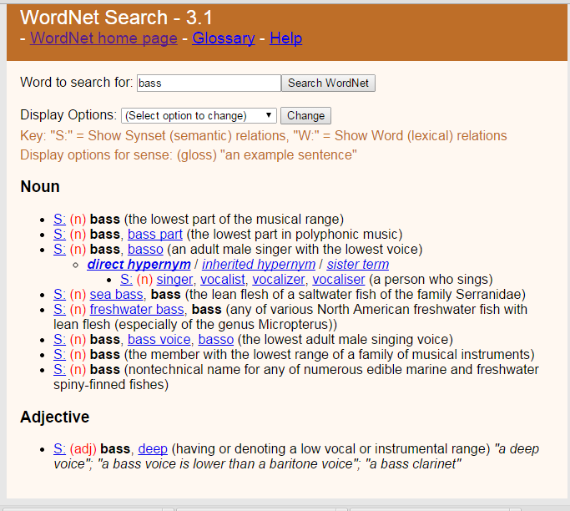
Web interface & API

Slide 18
Wordnet: NLP Tasks
First success in “obscure” task for Probabilistic Parsing (PP-attachments): words + word-classes extracted from the hypernym hierarchy increase accuracy from 84% to 88% [Stetina and Nagao, 1997]
Word sense disambiguation
Lexical Chains (summarization)
…… and many others !
More importantly starting point for larger Ontologies!
Notes:
If you know the right attachment for “acquire a company for money”,
“purchase a car for money”
Can help you to decide the attachment for “buy books for money”
John assassinated the senator

Slide 19
More ideas from NLP….
Relations among words and their meanings (paradigmatic)
Internal structure of individual words (syntagmatic)

Slide 20
Predicate-Argument Structure
Represent relationships among concepts, events and their participants
“I ate a turkey sandwich for lunch”
∃ w: Isa(w,Eating) ∧ Eater(w,Speaker) ∧ Eaten(w,TurkeySandwich) ∧ MealEaten(w,Lunch)
“Nam does not serve meat”
∃ w: Isa(w,Serving) ∧ Server(w, Nam) ∧ ¬Served(w,Meat)
Notes:
All human languages
a specific relation holds between the concepts expressed by the words or the phrases
Events, actions and relationships can be captured with representations that consist of predicates and arguments.
Languages display a division of labor where some words and constituents function as predicates and some as arguments.
One of the most important roles of the grammar is to help organize this pred-args structure

Slide 21
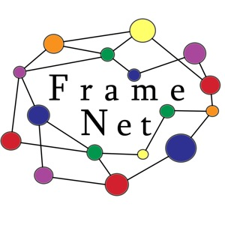
Semantic Roles: Resources
Move beyond inferences about single verbs
“ IBM hired John as a CEO ”
“ John is the new IBM hire ”
“ IBM signed John for 2M$”
FrameNet: Databases containing frames and their syntactic and semantic argument structures
book online Version 1.5-update (revised in 2016)
  for English (versions for other languages are under development)
FrameNet Tutorial at NAACL/HLT 2015!
Notes:
10,000 lexical units (defined below), more than 6,100 of which are fully annotated, in more than 825 hierarchically structured semantic frames, exemplified in more than 135,000 annotated sentences
John was HIRED to clean up the file system.
IBM HIRED Gates as chief janitor.
I was RETAINED at $500 an hour.
The A's SIGNED a new third baseman for $30M.

Slide 22
FrameNet Entry
Hiring
Definition: An Employer hires an Employee, promising the Employee a certain Compensation in exchange for the performance of a job. The job may be described either in terms of a Task or a Position in a Field.
Inherits From: Intentionally affect
Lexical Units: commission.n, commission.v, give job.v, hire.n, hire.v, retain.v, sign.v, take on.v
Notes:
Very specific thematic roles!

Slide 23
FrameNet : Semantic Role Labeling
Some roles..
Employer
Employee
Task
Position
np-vpto
  In 1979 , singer Nancy Wilson HIRED him to open her nightclub act .
  ….
np-ppas
  Castro has swallowed his doubts and HIRED Valenzuela as a cook in his small restaurant .
Notes:
Shallow semantic parsing is labeling phrases of a sentence with semantic roles with respect to a target word.
For example, the sentence
“Shaw Publishing offered Mr. Smith a reimbursement last March.”
Is labeled as:
[AGENTShaw Publishing] offered [RECEPIENTMr. Smith] [THEMEa reimbursement] [TIMElast March] .
We work with a number of collaborators, beginning with Dan Gildea in his dissertation work, on automatic semantic parsing. Much of Dan Gildeas's dissertation work was written up here: Daniel Gildea and Daniel Jurafsky. 2002. Automatic Labeling of Semantic Roles. Computational Linguistics 28:3, 245-288. This work also involves close collaboration with the FrameNet and PropBank projects.
Currently, we focus on building joint probabilistic models for simultaneous assignment of labels to all nodes in a syntactic parse tree. These models are able to capture the strong correlations among decisions at different nodes.
CompensationPeripheral
EmployeeCore
EmployerCore
FieldCore
InstrumentPeripheral
MannerPeripheral
MeansPeripheral
PlacePeripheral
PositionCore
PurposeExtra-Thematic
TaskCore
TimePeripheral

Slide 24
Lecture Overview
Ontologies – what objects/individuals should we represent? what relations (unary, binary,..)?
Inspiration from Natural Language: WordNet and FrameNet
Extensions based on Wikipedia and mining the Web & Web search logs (YAGO, ProBase, Freebase,……)
Domain Specific Ontologies (e.g., Medicine: MeSH, UMLS)

Slide 25
YAGO2: huge semantic knowledge base
Derived from Wikipedia, WordNet and GeoNames. (started in 2007, paper in www conference)
10⁶ entities (persons, organizations, cities, etc.)
>120* 10⁶ facts about these entities.
YAGO accuracy of 95%. has been manually evaluated.
Anchored in time and space. YAGO attaches a temporal dimension and a spatial dimension to many of its facts and entities.
Notes:
YAGO2s is a huge semantic knowledge base, derived from Wikipedia WordNet and GeoNames. Currently, YAGO2s has knowledge of more than 10 million entities (like persons, organizations, cities, etc.) and contains more than 120 million facts about these entities.
YAGO is special in several ways:
The accuracy of YAGO has been manually evaluated, proving a confirmed accuracy of 95%. Every relation is annotated with its confidence value.
YAGO is an ontology that is anchored in time and space. YAGO attaches a temporal dimension and a spatial dimension to many of its facts and entities.
In addition to a taxonomy, YAGO has thematic domains such as "music" or "science" from WordNet Domains.

Slide 26
Freebase
“Collaboratively constructed database.”
Freebase contains tens of millions of topics, thousands of types, and tens of thousands of properties and over a billion of facts
Automatically extracted from a number of resources including Wikipedia, MusicBrainz, and NNDB
as well as the knowledge contributed by the human volunteers.
All was available for free through the APIs or to download from weekly data dumps
Notes:
https://en.wikipedia.org/wiki/Freebase_(database)
Notable Names Database (NNDB) is an online database of biographical details of over 40,000 people of note.
What is Freebase?
Freebase contains tens of millions of topics, thousands of types, and tens of thousands of properties. By comparison, English Wikipedia has over 4 million articles. Each of the topics in Freebase is linked to other related topics and annotated with important properties like movie genres and people's dates of birth. There are over a billion such facts or relations that make up the graph and they're all available for free through the APIs or to download from our weekly data dumps.
Notable Names Database (NNDB) is an online database of biographical details of over 40,000 people of note
MusicBrainz is an open music encyclopedia that collects music metadata and makes it available to the public.
Each Freebase entity is assigned a set of human-readable unique keys, which are assembled of a value and a namespace.

Slide 27
Fast Changing Landscape.....
On 16 December 2015, Google officially announced the Knowledge Graph API, which is meant to be a replacement to the Freebase API.
Freebase.com was officially shut down on 2 May 2016.^{[6]}
Notes:
Freebase was a large collaborative knowledge base consisting of data composed mainly by its community members. It was an online collection of structured data harvested from many sources, including individual, user-submitted wiki contributions.^{[2]} Freebase aimed to create a global resource that allowed people (and machines) to access common information more effectively. It was developed by the American software company Metaweb and ran publicly since March 2007. Metaweb was acquired by Google in a private sale announced 16 July 2010.^{[3]} Google's Knowledge Graph was powered in part by Freebase.^{[4]}
Freebase data was available for commercial and non-commercial use under a Creative Commons Attribution License, and an open API, RDF endpoint, and a database dump was provided for programmers.
On 16 December 2014, Knowledge Graph announced that it would shut down Freebase over the succeeding six months and help with the move of the data from Freebase to Wikidata.^{[5]}
On 16 December 2015, Google officially announced the Knowledge Graph API, which is meant to be a replacement to the Freebase API. Freebase.com was officially shut down on 2 May 2016.^{[6]}

Slide 28
Probase (MS Research) < Sept 2016
Harnessed from billions of web pages and years worth of search logs
Extremely large concept/category space (2.7 million categories).
Probabilistic model for correctness, typicality (e.g., between concept and instance)
Notes:
Knowledge in Probase is harnessed from billions of web pages and years worth of search logs -- these are nothing more than the digitized footprints of human communication.
Probase is unique in two aspects. First, Probase has an extremely large concept/category space (2.7 million categories). As these concepts are automatically acquired from web pages authored by millions of users, it is probably true that they cover most concepts in our mental world (about worldly facts). Second, data in Probase, as knowledge in our mind, is not black or white. Probase quantifies the uncertainty. These serve as the priors and likelihoods that become the foundations of probabilistic reasoning in Probase.
Our mental world contains many concepts about worldly facts, and Probase tries to duplicate them. The core taxonomy of Probase alone contains above 2.7 million concepts. Figure 2 shows their distribution. The Y axis is the number of instances each concept contains(logarithmic scale), and on the X axis are the 2.7 million concepts ordered by their size. In contrast, existing knowledge bases have far fewer concepts (Freebase [3] contains no more than 2,000 concepts, and Cyc [7] has about 120,000 concepts), which fall short of modeling our mental world. As we can see in Figure 2, besides popular concepts such as “cities” and “musicians”, which are included by almost every general purpose taxonomy, Probase has millions of long tail concepts such as “anti-parkinson treatments”, "celebrity wedding dress designers” and “basic watercolor techniques”, which cannot be found in Freebase or Cyc. Besides concepts, Probase also has a large data space (each concept contains a set of instances or sub-concepts), a large attribute space (each concept is described by a set of attributes), and a large relationship space (e.g.,“locatedIn”, "friendOf”, "mayorOf”, as well as relationships that are not easily named, such as the relationship between apple and Newton.)
Another feature of Probase is that it is probabilistic, which means every claim in Probase is associated with some probabilities that model the claim’s correctness, typicality, ambiguity, and other characteristics. The probabilities are derived from evidences found in web data, search log data, and other existing taxonomies. For example, for typicality (between concepts and instances), Probase contains the following probabilities:
P(C=company|I=apple): How likely people will think of the concept “company” when they see the word “apple”.
P(I=steve jobs|C=ceo): How likely “steve jobs” will come into mind when people think about the concept “ceo”.
Probase also has typicality scores for concepts and attributes. Another important score in Probase is the similarity between any
two concepts y1 and y2 (e.g., celebrity and famous politicians). Thus Probase can tell that natural disasters and politicians are very different concepts,endangered species and tropical rainforest plants have certain relationships, while countries and nations are almost the same concepts.
These probabilities serve as priors and likelihoods for Bayesian reasoning on top of Probase. In addition, the probabilistic nature of Probase also enables it to incorporate data of varied quality from heterogeneous sources. Probase regards external data as evthese probabilities serve as priors and likelihoods for Bayesian reasoning on top of Probase.

Slide 29
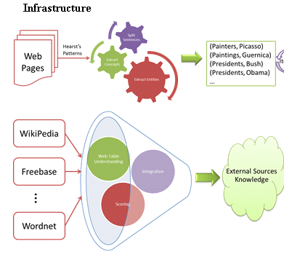

Slide 30
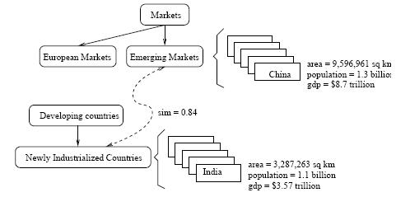
A snippet of Probase's core taxonomy
Notes:
shows what is inside Probase. The knowledgebase consists of concepts (e.g. emerging markets), instances (e.g., China), attributes and values (e.g., China's population is 1.3 billion), and relationships (e.g., emerging markets, as a concept, is closely related to newly industrialized countries), all of which are automatically derived in an unsupervised manner.

Slide 31
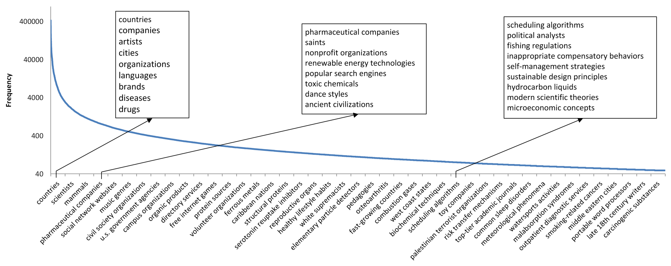
Frequency distribution of the 2.7 million concepts
The Y axis is the number of instances each concept contains(logarithmic scale), and on the X axis are the 2.7 million concepts ordered by their size.
besides popular concepts such as “cities” and “musicians”, which are included by almost every general purpose taxonomy, Probase has millions of long tail concepts such as “anti-parkinson treatments”, "celebrity wedding dress designers” and “basic watercolor techniques”,
Notes:
Figure 2 shows their distribution. The Y axis is the number of instances each concept contains(logarithmic scale), and on the X axis are the 2.7 million concepts ordered by their size. In contrast, existing knowledge bases have far fewer concepts (Freebase [3] contains no more than 2,000 concepts, and Cyc [7] has about 120,000 concepts), which fall short of modeling our mental world. As we can see in Figure 2, besides popular concepts such as “cities” and “musicians”, which are included by almost every general purpose taxonomy, Probase has millions of long tail concepts such as “anti-parkinson treatments”, "celebrity wedding dress designers” and “basic watercolor techniques”, which cannot be found in Freebase or Cyc.

Slide 32
Fast Changing Landscape….
From Probase page......
[Sept. 2016] Please visit our Microsoft Concept Graph release for up-to-date information of this project!

Slide 33
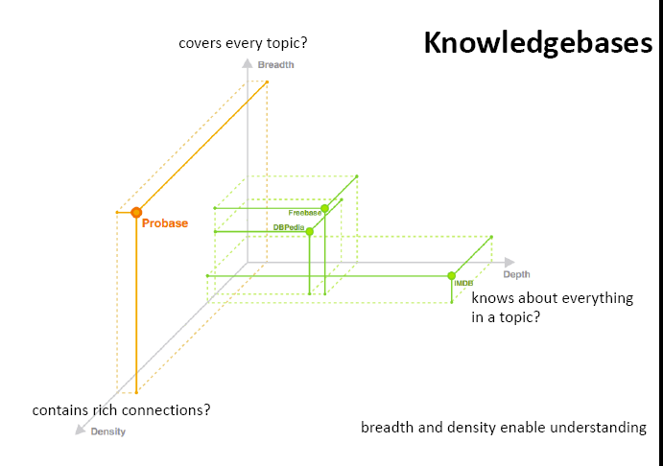
Interesting dimensions to compare Ontologies
(but form Probase so possibly biased)
Notes:
DBpedia is a crowd-sourced community effort to extract structured information from Wikipedia and make this information available on the Web. DBpedia allows you to ask sophisticated queries against Wikipedia, and to link the different data sets on the Web to Wikipedia data. We hope that this work will make it easier for the huge amount of information in Wikipedia to be used in some new interesting ways. Furthermore, it might inspire new mechanisms for navigating, linking, and improving the encyclopedia itself.

Slide 34
Lecture Overview
Ontologies – what objects/individuals should we represent? what relations (unary, binary,..)?
Inspiration from Natural Language: WordNet and FrameNet
Extensions based on Wikipedia and mining the Web (YAGO, ProBase, Freebase)
Domain Specific Ontologies (e.g., Medicine: MeSH, UMLS)

Slide 35
Domain Specific Ontologies: UMLS, MeSH
Unified Medical Language System: brings together many health and biomedical vocabularies
Enable interoperability (linking medical terms, drug names)
Develop electronic health records, classification tools
Search engines, data mining
My group has used it in text classification and topic modeling..
Notes:
What is the UMLS?
The UMLS, or Unified Medical Language System, is a set of files and software that brings together many health and biomedical vocabularies and standards to enable interoperability between computer systems.
You can use the UMLS to enhance or develop applications, such as electronic health records, classification tools, dictionaries and language translators.
More About the UMLS
Presentations and Publications
UMLS Reference Manual
UMLS Basics Tutorial
Source Vocabulary Information
UMLS Video Learning Resources
UMLS in Use
One powerful use of the UMLS is linking health information, medical terms, drug names, and billing codes across different computer systems. Some examples of this are:
Linking terms and codes between your doctor, your pharmacy, and your insurance company
Patient care coordination among several departments within a hospital
The UMLS has many other uses, including search engine retrieval, data mining, public health statistics reporting, and terminology research.
More Uses of the UMLS
NLM Applications
UMLS Community
Health Information Technology
Supporting Interoperability
The Three UMLS Tools
The UMLS has three tools, which we call the Knowledge Sources:
Metathesaurus: Terms and codes from many vocabularies, including CPT®, ICD-10-CM, LOINC®, MeSH®, RxNorm, and SNOMED CT®
Semantic Network: Broad categories (semantic types) and their relationships (semantic relations)
SPECIALIST Lexicon and Lexical Tools: Natural language processing tools
We use the Semantic Network and Lexical Tools to produce the Metathesaurus. Metathesaurus production involves:
Processing the terms and codes using the Lexical Tools
Grouping synonymous terms into concepts
Categorizing concepts by semantic types from the Semantic Network
Incorporating relationships and attributes provided by vocabularies
Releasing the data in a common format
Although we integrate these tools for Metathesaurus production, you can access them separately or in any combination according to your needs.

Slide 36
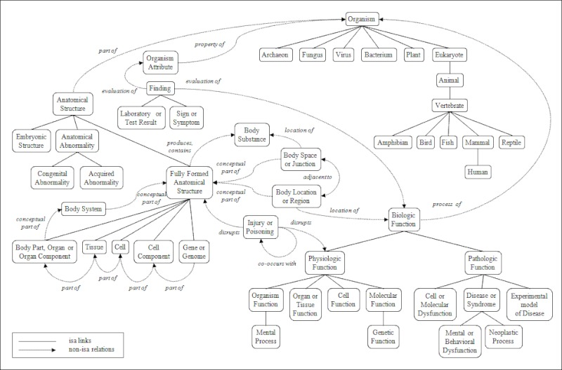
Portion of the UMLS Semantic Net
Notes:
igure 3. A Portion of the UMLS Semantic Network: Relations
The Semantic Network contains 133 semantic types and 54 relationships.

Slide 38
Learning Goals for today’s class
You can:
Define an Ontology
Describe and Justify the information represented in Wordnet and Framenet
Describe and Justify the three dimensions for comparing ontologies

Slide 39
Next class Mon
Assignment-3 out – due Mar 30
(8-18 hours – working in pairs on programming parts is strongly advised)
Similarity measures in ontologies (e.g., Wordnet)

Slide 40
DBpedia is a structured twin ofWikipedia. Currently it describes more than 3.4 million entities. DBpedia resources bear the names of the Wikipedia pages, from which they have been extracted.
YAGO is an automatically created ontology, with taxonomy structure derived from WordNet, and knowledge about individuals extracted from Wikipedia. Therefore, the identifiers of resources describing individuals in YAGO are named as the corresponding Wikipedia pages. YAGO contains knowledge about more than 2 million entities and 20 million facts about them.
Freebase is a collaboratively constructed database. It contains knowledge automatically extracted from a number of resources including Wikipedia, MusicBrainz,2 and NNDB,3 as well as the knowledge contributed by the human volunteers. Freebase describes more than 12 million interconnected entities. Each Freebase entity is assigned a set of human-readable unique keys, which are assembled of a value and a namespace. One of the namespaces is the Wikipedia namespace, in which a value is the name of the Wikipedia page describing an entity.
Notes:
What is Freebase?
Freebase contains tens of millions of topics, thousands of types, and tens of thousands of properties. By comparison, English Wikipedia has over 4 million articles. Each of the topics in Freebase is linked to other related topics and annotated with important properties like movie genres and people's dates of birth. There are over a billion such facts or relations that make up the graph and they're all available for free through the APIs or to download from our weekly data dumps.

Slide 41
2017 OLD Announcements: Midterm
Avg 66 Max 103! Min 14
If score below 70 need to very seriously revise all the material covered so far
You can pick up a printout of the solutions along with your midterm
BUT
Before you look at the solutions try to answer the questions by yourself now that you have all the time you want and access to your notes

Slide 42
New Re-weighting to help you
Original breakdown
Assignments -- 15%
Readings: Questions and Summaries -- 10%
Midterm -- 30%
Final -- 45%
BUT If your grade improves 10% from the midterm to the final
Assignments -- 15%
Readings: Questions and Summaries -- 10%
Midterm -- 15%
Final -- 60%
Notes:
On course web site
If your grade improves substantially from the midterm to the final, defined as a final exam grade that is at least 20% higher than the midterm grade, then the following grade breakdown will be used instead.
Assignments -- 15%
Readings: Questions and Summaries -- 10%
Midterm -- 15%
Final -- 60%

