Slide 1
Intelligent Systems (AI-2)
Computer Science cpsc422, Lecture 22
Mar, 10, 2021
Slide credit: some from Prof. Carla P. Gomes (Cornell)
some slides adapted from Stuart Russell (Berkeley), some from Prof. Jim Martin (Univ. of Colorado)
Notes:
Lecture 22

Slide 2

Relationships between different Logics (better with colors)

Slide 3
Lecture Overview
SAT : example
First Order Logics
  Language and Semantics
  Inference

Slide 4
Satisfiability problems (SAT)
Consider a CNF sentence, e.g.,
(¬D ∨ ¬B ∨ C) ∧ (B ∨ ¬A ∨ ¬C) ∧ (¬C ∨ ¬B ∨ E) ∧ (E ∨ ¬D ∨ B) ∧ (B ∨ E ∨ ¬C)
  Is there an interpretation in which this sentence is true (i.e., that is a model of this sentence )?
Many combinatorial problems can be reduced to checking the satisfiability of propositional sentences ……and returning a model
Notes:
Any improvement in Sat algorithms has huge impact on our ability to solve these complex problems

Slide 5
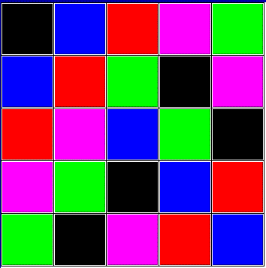
Encoding the Latin Square Problem in
Propositional Logic
In combinatorics and in experimental design, a Latin square is
an n × n array
filled with n different symbols,
each occurring exactly once in each row and exactly once in each column.
Here is an example:
A | B | C
C | A | B
B | C | A
Here is another one:

Slide 6



Encoding Latin Square in Propositional Logic: Propositions
Variables must be binary! (They must be propositions)
Each variables represents a color assigned to a cell i j.
Assume colors are encoded as an integer k
Assuming colors are encoded as follows
(black, 1) (red, 2) (blue, 3) (green, 4) (purple, 5)
True or false, ie. 1 or 0 with respect to the interpretation represented by the picture?
How many vars/propositions overall?

Slide 7


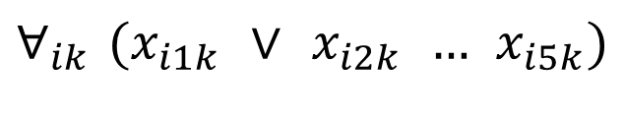






Encoding Latin Square in Propositional Logic: Clauses
Some color must be assigned to each cell (clause of length 5);
$$∀_{ij} (x_{ij1} ∨ x_{ij2} … x_{ij5})$$
$$∀_{ik} (x_{i1k} ∨ x_{i2k} … x_{i5k})$$
How many clauses?
Notes:
B would be true if we were just assigning all colours to only the elements of the first colum
X111 X211

Slide 8
Encoding Latin Square in Propositional Logic: Clauses
Some color must be assigned to each cell (clause of length n);
No color is repeated in the same row (sets of negative binary clauses);
How many clauses?
Notes:
B would be true if we were just assigning all colours to only the elements of the first colum
X111 X211

Slide 9
Encoding Latin Square in Propositional Logic: Clauses
Some color must be assigned to each cell (clause of length n);
No color repeated in the same row (sets of negative binary clauses);
How many clauses?

Slide 10
Encoding Latin Square Problems in
Propositional Logic: FULL MODEL
Variables:
Each variables represents a color assigned to a cell.
Clauses:
Some color must be assigned to each cell (clause of length n);
No color repeated in the same row (sets of negative binary clauses);
No color repeated in the same column (sets of negative binary clauses);

Slide 11
Logics in AI: Similar slide to the one for planning
Propositional Definite Clause Logics
Semantics and Proof Theory
Propositional Logics
First-Order Logics
Satisfiability Testing (SAT)
Description Logics
Hardware Verification
Production Systems
Product Configuration
Ontologies
Cognitive Architectures
Semantic Web
Video Games
Summarization
Tutoring Systems
Information Extraction

Slide 12
Relationships between different Logics (better with colors)

Slide 13
Lecture Overview
Finish SAT (example)
First Order Logics
  Language and Semantics
  Inference

Slide 14
Representation and Reasoning in Complex domains (from 322)
In complex domains expressing knowledge with propositions can be quite limiting
It is often natural to consider individuals and their properties
up_s₂
up_s₃
ok_cb₁
ok_cb₂
live_w₁
connected_w₁_w₂
up( s₂ )
up( s₃ )
ok( cb₁ )
ok( cb₂ )
live( w₁)
connected( w₁ , w₂ )
There is no notion that
up_s₂
up_s₃
live_w₁
connected_w₁_w₂
Notes:
the propositions up s2, up s3,
ok s2 have no internal structure. There is no notion that the proposition
up s2 and up s3 are about the same relation, but with different individuals,
or that up s2 and ok s2 are about the same switch. There is no notion
of individuals and relations.
An alternative is to explicitly represent the individual switches s1,
s2, s3, and the properties or relations, up and ok. Using this representation,
“switch s2 is up” is represented as up(s2). A binary relation, like
connected to, can be used to relate two individuals, such as connected to(w1, s1)

Slide 15

(from 322) What do we gain….
By breaking propositions into relations applied to individuals?
Express knowledge that holds for set of individuals (by introducing )
live(W) <- connected_to(W,W1) ∧ live(W1) ∧ wire(W) ∧ wire(W1).
We can ask generic queries (i.e., containing )
? connected_to(W, w₁)
Notes:
Economy of symbols: 10 individuals and 1 binary relation can express….
connected_to(X,Y)
1000 wires

Slide 16
“Full” First Order Logics (FOL)
LIKE DATALOG: Whereas propositional logic assumes the world contains facts, FOL (like natural language) assumes the world contains
  Objects: people, houses, numbers, colors, baseball games, wars, …
  Relations: red, round, prime, brother of, bigger than, part of, comes between, …
  Functions: father of, best friend, one more than, plus, …
FURTHERMORE WE HAVE
  More Logical Operators:….
  Equality: coreference (two terms refer to the same object)
  Quantifiers
    Statements about unknown objects
    Statements about classes of objects

Slide 17
Syntax of FOL
Constants KingJohn, 2, ,...
Predicates Brother, >,...
Functions Sqrt, LeftLegOf,...
Variables x, y, a, b,...
Connectives ¬, ⇒, ∧, ∨, ⇔
Equality =
Quantifiers ∀, ∃

Slide 18
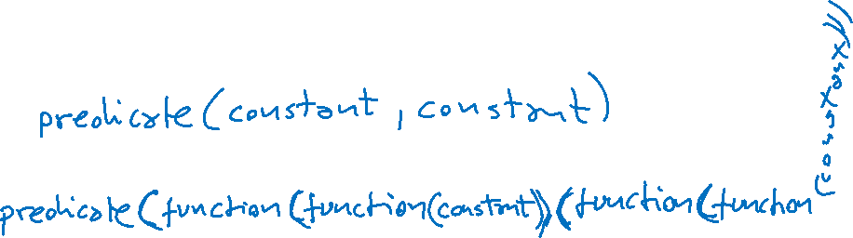
Atomic sentences
Term is a function (term₁,...,term_{n}) or constant or variable
Atomic sentence is predicate (term₁,...,term_{n}) or term₁ = term₂
E.g.,
Brother(KingJohn, RichardTheLionheart)
> (Length( LeftLegOf(Richard)), Length(LeftLegOf(KingJohn)))

Slide 19
Complex sentences
Complex sentences are made from atomic sentences using connectives
¬S, S₁ ∧ S₂, S₁ ∨ S₂, S₁ ⇒ S₂, S₁ ⇔ S₂,
E.g.
Sibling(KingJohn, Richard) ⇒ Sibling(Richard, KingJohn)
∀x P(x) is true in an interpretation I iff P is true with x being each possible object in I
∃x P(x) is true in an interpretation I iff P is true with x being some possible object in I

Slide 20
Truth in first-order logic
Like in Prop. Logic a sentences is true with respect to an interpretation
¬A∧ (B ⇒ C),
In FOL interpretations are much more complex but still same idea:
possible configuration of the world
A. yes
B. no
Notes:
Model contains objects (domain elements) and relations among them
Interpretation specifies referents for
constant symbols → objects
predicate symbols → relations
function symbols → functional relations
An atomic sentence predicate(term₁,...,term_{n}) is true
iff the objects referred to by term₁,...,term_{n}
are in the relation referred to by predicate.

Slide 21
Truth in first-order logic
Like in Prop. Logic a sentences is true with respect to an interpretation
¬A∧ B ⇒ C,
In FOL interpretations are much more complex but still same idea:
possible configuration of the world
Notes:
Model contains objects (domain elements) and relations among them
Interpretation specifies referents for
constant symbols → objects
predicate symbols → relations
function symbols → functional relations
An atomic sentence predicate(term₁,...,term_{n}) is true
iff the objects referred to by term₁,...,term_{n}
are in the relation referred to by predicate.

Slide 22
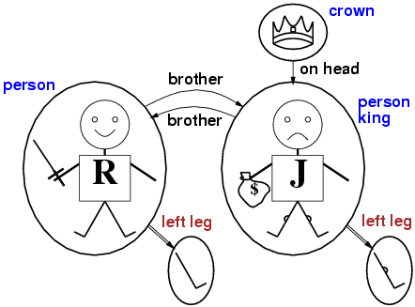
Interpretations for FOL: Example
C
JLL
RLL

Slide 23
Same interpretation with sets
C
Since we have a one to one mapping between symbols and object we can use symbols to refer to objects
  {R, J, RLL, JLL, C}
Property Predicates
  Person = {R, J}
  Crown = {C}
  King = {J}
Relational Predicates
  Brother = { <R,J>, <J,R>}
  OnHead = {<C,J>}
Functions
  LeftLeg = {<R, RLL>, <J, JLL>}
RLL
JLL

Slide 24
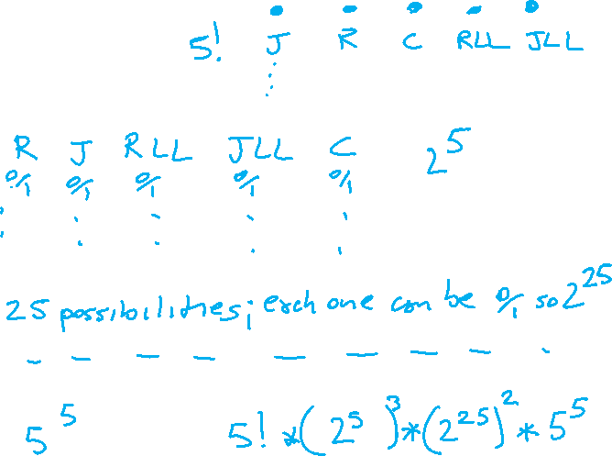
How many Interpretations with….
5 Objects and 5 symbols
  {R, J, RLL, JLL, C}
3 Property Predicates (Unary Relations)
  Person
  Crown
  King
2 Relational Predicates
  Brother
  OnHead
1 Function
  LeftLeg
A. 2⁵
B. 2²⁵
C. 25²

Slide 25
To summarize: Truth in first-order logic
Sentences are true with respect to an interpretation
World contains objects (domain elements)
Interpretation specifies referents for
  constant symbols → objects
  predicate symbols → relations
  function symbols → functional relations
An atomic sentence predicate(term₁,...,term_{n}) is true
iff the objects referred to by term₁,...,term_{n}
are in the relation referred to by predicate
C
RLL
JLL

Slide 26
Quantifiers
Allows us to express
Properties of collections of objects instead of enumerating objects by name
Properties of an unspecified object
Universal: “for all” ∀
Existential: “there exists” ∃

Slide 27
Universal quantification
∀<variables> <sentence>
Everyone at UBC is smart:
∀x At(x, UBC) ⇒ Smart(x)
∀x P is true in an interpretation I iff P is true with x being each possible object in I
Equivalent to the conjunction of instantiations of P
  At(KingJohn, UBC) ⇒ Smart(KingJohn)
  ∧ At(Richard, UBC) ⇒ Smart(Richard)
  ∧ At(Ralphie, UBC) ⇒ Smart(Ralphie)
  ∧ ...
Notes:
Roughly speaking….

Slide 28
Existential quantification
∃<variables> <sentence>
Someone at UBC is smart:
∃x At(x, UBC) ∧ Smart(x)
∃x P is true in an interpretation I iff P is true with x being some possible object in I
Equivalent to the disjunction of instantiations of P
  At(KingJohn, UBC) ∧ Smart(KingJohn)
  ∨ At(Richard, UBC) ∧ Smart(Richard)
  ∨ At(Ralphie, UBC) ∧ Smart(Ralphie)
  ∨ ...

Slide 29
Properties of quantifiers
∃x ∀y is not the same as ∀y ∃x
∃x ∀y Loves(x,y)
  “There is a person who loves everyone in the world”
∀y ∃x Loves(x,y)
  “Everyone in the world is loved by at least one person”
Quantifier duality: each can be expressed using the other
∀x Likes(x,IceCream) ¬∃x ¬Likes(x,IceCream)
∃x Likes(x,Broccoli) ¬∀x ¬Likes(x,Broccoli)

Slide 30
Lecture Overview
Finish SAT (example)
First Order Logics
  Language and Semantics
  Inference

Slide 31
FOL: Inference
Resolution Procedure can be generalized to FOL
Every formula can be rewritten in logically equivalent CNF
  Additional rewriting rules for quantifiers
Similar Resolution step, but variables need to be unified (like in DATALOG)
Notes:
KB entails
Semidecidable: algorithms exists that says yes for every entailed formulas, but no algorithm exists that also says no for every non-entailed sentence
alpha iff KB and (not alpha) is unsatisfiable

Slide 32
NLP Practical Goal for FOL: the ultimate Web question-answering system?
  Map NL queries into FOPC so that answers can be effectively computed
What African countries are not on the Mediterranean Sea?
Was 2007 the first El Nino year after 2001?
Notes:
We didn’t assume much about the meaning of words when we talked about sentence meanings
Verbs provided a template-like predicate argument structure
Nouns were practically meaningless constants
There has be more to it than that
View assuming that words by themselves do not refer to the world, cannot be
Judged to be true or false…

Slide 33
Learning Goals for today’s class
You can:
Explain differences between Proposition Logic and First Order Logic
Compute number of interpretations for FOL
Explain the meaning of quantifiers
Describe application of FOL to NLP: Web question answering

Slide 34
Next class Fri
Ontologies (e.g., Wordnet, Probase), Description Logics…
Midterm will be likely returned next week
Assignment-3 will be out soon (tonight or tomorrow at the latest)

