Slide 1
Intelligent Systems (AI-2)
Computer Science cpsc422, Lecture 21
March, 5, 2019
Slide credit: some slides adapted from Stuart Russell (Berkeley), some from Prof. Carla P. Gomes (Cornell)
Notes:
Lecture 21
Some slides Prof. Carla P. Gomes
gomes@cs.cornell.edu

Slide 2
Lecture Overview
Finish Resolution in Propositional logics
Satisfiability problems
WalkSAT
Start Encoding Example

Slide 3
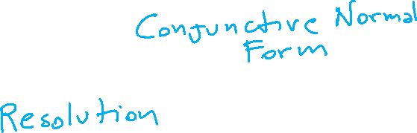
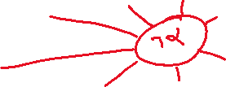
Proof by resolution
Key ideas
Simple Representation for
Simple Rule of Derivation

Slide 4
Full Propositional Logics: Summary
DEFs.
Literal: an atom or a negation of an atom
Complementary Literals: an atom and its negation
Clause: is a disjunction of literals
Conjunctive Normal Form (CNF): a conjunction of clauses
INFERENCE:
Convert all formulas in KB and in CNF
Apply Resolution Procedure
Notes:
KB entails alpha iff KB and (not alpha) is unsatisfiable

Slide 5
Conjunctive Normal Form (CNF)
Rewrite into conjunction of disjunctions
literals
(A ∨ ¬B) ∧ (B ∨ ¬C ∨ ¬D)
Clause
Clause
Any KB can be converted into CNF !
Notes:
In fact, any KB can be converted into CNF-3 using clauses
with at most 3 literals.

Slide 6
Example: Conversion to CNF
A ⇔ (B ∨ C)
Eliminate ⇔, replacing α ⇔ β with (α ⇒ β)∧(β ⇒ α).
  (A ⇒ (B ∨ C)) ∧ ((B ∨ C) ⇒ A)
2. Eliminate ⇒, replacing α ⇒ β with ¬α∨ β.
  (¬A ∨ B ∨ C) ∧ (¬(B ∨ C) ∨ A)
3. Using de Morgan's rule replace ¬(α∨ β) with (¬α ∧ ¬ β) :
  (¬A ∨ B ∨ C) ∧ ( (¬ B ∧ ¬ C) ∨ A)
4. Apply distributive law (∨ over ∧) and flatten:
  (¬A ∨ B ∨ C) ∧ (¬B ∨ A) ∧ (¬C ∨ A)

Slide 7
Example: Conversion to CNF
A ⇔ (B ∨ C)
5. KB is the conjunction of all of its sentences (all are true),
so write each clause (disjunct) as a sentence in KB:
…
  (¬A ∨ B ∨ C)
  (¬B ∨ A)
  (¬C ∨ A)
  …

Slide 8
Full Propositional Logics: Summary
DEFs.
Literal: an atom or a negation of an atom
Complementary Literals: an atom and its negation
Clause: is a disjunction of literals
Conjunctive Normal Form (CNF): a conjunction of clauses
INFERENCE:
Convert all formulas in KB and in CNF
Apply Resolution Procedure
Notes:
KB entails alpha iff KB and (not alpha) is unsatisfiable

Slide 9
Resolution Deduction step
Resolution: inference rule for CNF: sound and complete! *
“If A or B or C is true, but not A, then B or C must be true.”
“If A is false then B or C must be true, or if A is true
then D or E must be true, hence since A is either true or
false, B or C or D or E must be true.”
Simplification
Notes:
* Resolution is “refutation complete”
in that it can prove the truth of any entailed sentence by refutation.

Slide 10
Resolution Algorithm
The resolution algorithm tries to prove:
is converted in CNF
Resolution is applied to each pair of clauses with complementary literals
Resulting clauses are added to the set (if not already there)
Process continues until one of two things can happen:
Two clauses resolve in the empty clause. i.e. query is entailed
No new clauses can be added: We find no contradiction, there is a model that satisfies the sentence and hence we cannot entail the query.
Notes:
We find no contradiction: there is a model that satisfies the sentence
(non-trivial) and hence we cannot entail the query.

Slide 11
Resolution example
KB = (A ⇔ (B∨ C)) ∧¬ A
α = ¬B
True!
False in
all worlds
Notes:
Any clause in which two complementary literals appear can be discarded

Slide 12
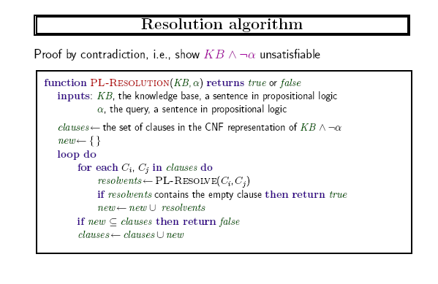

Slide 13
Lecture Overview
Finish Resolution in Propositional logics
Satisfiability problems
WalkSAT
Hardness of SAT
Start Encoding Example

Slide 14
Satisfiability problems
Consider a CNF sentence, e.g.,
(¬D ∨ ¬B ∨ C) ∧ (B ∨ ¬A ∨ ¬C) ∧ (¬C ∨ ¬B ∨ E) ∧ (E ∨ ¬D ∨ B) ∧ (B ∨ E ∨ ¬C)
  Is there an interpretation in which this sentence is true (i.e., that is a model of this sentence )?
Many combinatorial problems can be reduced to checking the satisfiability of propositional sentences (example later)… and returning the model
Notes:
Any improvement in Sat algorithms has huge impact on our ability to solve these complex problems

Slide 15
How can we solve a SAT problem?
Consider a CNF sentence, e.g.,
(¬D ∨ ¬B ∨ C) ∧ (A ∨ C) ∧ (¬C ∨ ¬B ∨ E) ∧ (E ∨ ¬D ∨ B) ∧ (B ∨ E ∨ ¬C)
  Each clause can be seen as a constraint that reduces the number of interpretations that can be models
  Eg (A ∨ C) eliminates interpretations in which A=F and C=F
So SAT is a Constraint Satisfaction Problem: Find a possible world that is satisfying all the constraints (here all the clauses)

Slide 16


WalkSAT algorithm
(Stochastic) Local Search Algorithms can be used for this task!
Evaluation Function: number of unsatisfied clauses
WalkSat: One of the simplest and most effective algorithms:
Start from a randomly generated interpretation
Pick randomly an unsatisfied clause
Pick a proposition/atom to flip (randomly 1 or 2)
  Randomly
  To minimize # of unsatisfied clauses

Slide 17
WalkSAT: Example
(¬D ∨ B ∨ C) ∧ (A ∨ C) ∧ (¬C ∨ ¬B ) ∧ (E ∨ ¬D ∨ B) ∧ (B ∨ C )
Look at algo on previous slide
Because by flipping
B we are left with only 1 unsatisfied clause, while by flipping E with 3 and by flipping D with 2 (see above)

Slide 18
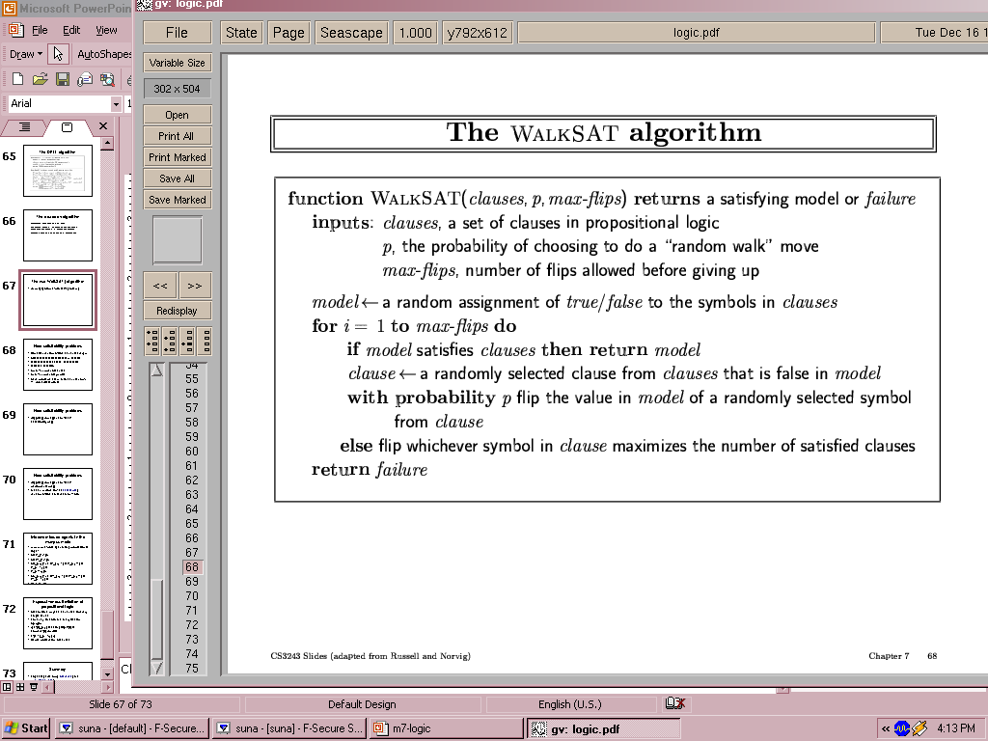
Pseudocode for WalkSAT
pw
pw
pw
pw
1
pw
2
pw = possible world / interpretation

Slide 19

The WalkSAT algorithm
If it returns failure after it tries max-flips times, what can we say?
A. The sentence is unsatisfiable
B. Nothing
C. The sentence is satisfiable
Typically most useful when we expect a solution to exist
Notes:
If it returns failure (after some number of tries) we cannot tell whether the sentence is unsatisfiable or whether we have not searched long enough
If max-flips = infinity, and sentence is unsatisfiable, algorithm never terminates!

Slide 20
Hard satisfiability problems
Consider random 3-CNF sentences. e.g.,
(¬D ∨ ¬B ∨ C) ∧ (B ∨ ¬A ∨ ¬C) ∧ (¬C ∨ ¬B ∨ E) ∧ (E ∨ ¬D ∨ B) ∧ (B ∨ E ∨ ¬C)
  m = number of clauses (5)
  n = number of symbols (5)
  Under constrained problems:
    Relatively few clauses constraining the variables
    Tend to be easy
    E.g. For the above problem16 of 32 possible assignments are solutions
      (so 2 random guesses will work on average)

Slide 21
Hard satisfiability problems
What makes a problem hard?
  Increase the number of clauses while keeping the number of symbols fixed
  Problem is more constrained, fewer solutions
  You can investigate this experimentally….

Slide 22
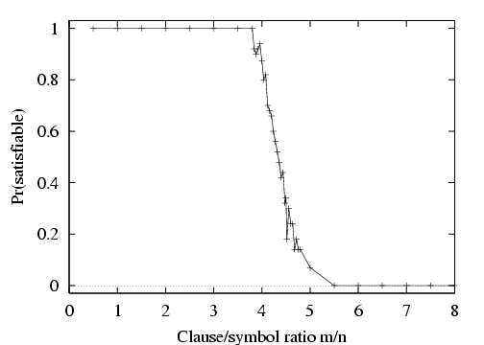

P(satisfiable) for random 3-CNF sentences, n = 50 symbols
  m = number of clauses
  n = number of symbols
  Hard problems seem to cluster near m/n = 4.3 (critical point)
Notes:
m number of clauses, n number of symbols/variables
Empirically we find that the cliff stays roughly the same place (for k=3) and gets sharper and sharper as n increases

Slide 23
Lecture Overview
Finish Resolution in Propositional logics
Satisfiability problems
WalkSAT
Start Encoding Example

Slide 24
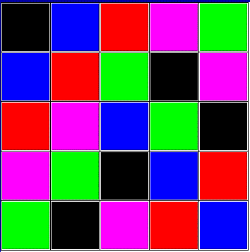
Encoding the Latin Square Problem in
Propositional Logic
In combinatorics and in experimental design, a Latin square is
an n × n array
filled with n different symbols,
each occurring exactly once in each row and exactly once in each column.
A | B | C
C | A | B
B | C | A
Here is an example:
Here is another one:

Slide 25
Encoding Latin Square in Propositional Logic: Propositions
Variables must be binary! (They must be propositions)
Each variables represents a color assigned to a cell.
Assume colors are encoded as integers
Assuming colors are encoded as follows
(black, 1) (red, 2) (blue, 3) (green, 4) (purple, 5)
True or false, ie. 1 or 0 with respect to the interpretation represented by the picture?
How many vars/propositions overall?

Slide 26

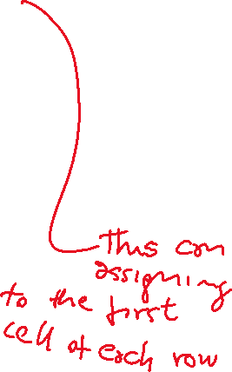


Encoding Latin Square in Propositional Logic: Clauses
Some color must be assigned to each cell (clause of length n);
No color is repeated in the same row (sets of negative binary clauses);
How many clauses?
Notes:
‘A correct

Slide 27

Logics in AI: Similar slide to the one for planning
Propositional Definite Clause Logics
Semantics and Proof Theory
Propositional Logics
First-Order Logics
Satisfiability Testing (SAT)
Description Logics
Hardware Verification
Production Systems
Product Configuration
Ontologies
Cognitive Architectures
Semantic Web
Video Games
Summarization
Tutoring Systems
Information Extraction

Slide 28
Relationships between different Logics (better with colors)

Slide 29
Learning Goals for today’s class
You can:
Specify, Trace and Debug the resolution proof procedure for propositional logics
Specify, Trace and Debug WalkSat
Encode the Latin square problem in propositional logics (basic ideas)

Slide 30
Next class Wed (Midterm on Mon)
Finish SAT example
First Order Logic
Extensions of FOL
Assignment-3 will be posted on Fri!

Slide 31
Midterm, Mon, March 8,
Will be a Canvas Quiz
We will start at 4pm sharp
55 minutes
Add stuff from piazza: alternative offer etc.
CPSC 422, Lecture 19
31

Slide 32
Midterm, Mon, March 8,
Will be a Canvas Quiz
We will start at 4pm sharp
55 minutes
How to prepare…
Go to Office Hours
Learning Goals (look at the end of the slides for each lecture – complete list has been posted)
Revise all the clicker questions and practice exercises
Practice material has been posted
Check questions and answers on Piazza
CPSC 422, Lecture 19
32

Slide 33
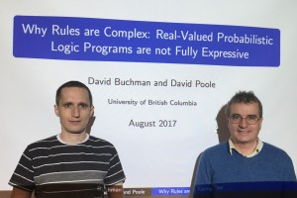
David Buchman and Professor David Poole are the recipients of the UAI 2017
Best Student Paper Award, “Why Rules are Complex: Real-Valued Probabilistic Logic Programs are not Fully Expressive”.
This paper proves some surprising results about what can and what cannot be represented by a popular method that combines logic and probability. Such models are important as they let us go beyond features in machine learning to reason about objects and relationships with uncertainty.

